Slide 1
Preparing a New Generation of Illinois Fruit and Vegetable Farmers a USDA NIFA Beginning Farmer and Rancher Development Program Project Grant # 2012-49400-19565
Rick Weinzierl
University of Illinois
weinzier@illinois.edu
Notes:
Hello, I’m Rick Weinzierl, from the University of Illinois. This is a brief description of our beginning farmer course that was titled “Preparing a New Generation of Illinois Fruit and Vegetable Farmers.” This course was supported by a grant from the United States Department of Agriculture’s National Institute for Food and Agriculture, and specifically NIFA’s Beginning Farmer and Rancher Development Program. From 2012 through 2015 we provided online, in-person, and hands-on training for over 300 new and aspiring farmers. We did so by providing online resources and holding classes one Saturday per month at each of three University of Illinois Research and Education Centers (farms) in southern, central, and northern Illinois. Separately, we delivered classes in Spanish to Hispanic participants in the same regions each year for three years. More than 25 University of Illinois faculty and Extension staff contributed to this training program, as did multiple farmers, staff from USDA’s Natural Resources Conservation Service and Farm Service Agency, and staff from the Illinois Migrant Council.

Slide 2
Why a new farmer training program
The average age of farmers is >55; for fruit growers it is ~58. To meet future demands, new farmers are needed. This need extends to traditionally underserved groups, including Hispanic workers.
There is increased demand for locally produced foods in IL, but only 1.1 percent of all crop sales recorded in IL in the 2007 Ag Census were fruits and vegetables.
Starting a new fruit and vegetable enterprise – with lower acreage and equipment needs – is more realistic financially than starting a new commodity crop enterprise. Our focus on training new fruit and vegetable producers made best use of our skills and resources and offered the greatest likelihood of success for new small farmers.
Notes:
There were several reasons for our decision to develop and deliver this course. First, farmers in the US are older on average than workers and professionals in most other jobs and careers. To keep farms operating and producing food well into the future, we as a nation need new farmers. New farmers will come from traditional farming communities and also from groups and cultures that have been underrepresented in farm ownership and management in the past, including Hispanic workers with valuable farming skills. We focused this program on fruit and vegetable production because demand for fresh, locally grown produce has grown tremendously in recent years, but fruits and vegetables represent only a very small portion of all crop sales in Illinois … there is need and opportunity for major expansion of farms that can supply this demand. We also focused this program on fruit and vegetable production because the investment in land and equipment to start a viable small produce farm is much smaller than the investment required to begin farming commodity crops at a scale sufficient to provide a meaningful income.

Slide 3
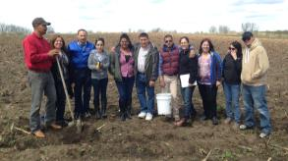
Our goals
Increase the number of new farmers producing fruits and vegetables throughout Illinois and enhance the viability, profitability, and sustainability of new and beginning enterprises to meet increasing demand for local produce and contribute to local economies.
Assist a specific target audience – seasonal Hispanic farm workers – in beginning viable, profitable, and sustainable small produce farms.
Increase the expertise of extension educators, high school and community college teachers, and educators in allied organizations so they can better aid new farmers.
Notes:
Our goals were very straightforward. We provided instruction and training to (1) increase the overall number of new farmers producing fruits and vegetables throughout Illinois and enhance the viability, profitability, and sustainability of new and beginning enterprises; (2) assist a specific target audience – Hispanic farm workers – in beginning viable, profitable, and sustainable small produce farms; and (3) increase the expertise of university extension educators, high school and community college teachers, and educators in community organizations so they can better aid new farmers.

Slide 4
What we covered:
Basics of vegetable production, fruit production, and business planning, cultivar selection, FSA and NRCS programs, transplant production, succession plantings, high tunnel construction and operation, greenhouse production, pruning and training, soils, fertilizers, soil quality, record-keeping and taxes, irrigation, equipment, farm safety, business structures, IPM, pesticides, OMRI-approved pesticides; organic certification, weeds, diseases, composting, contracts, wildlife management, insects, pollination, beekeeping, harvesting and postharvest handling, food safety and GAPs, labor, insurance, cover crops, multi-year planning, hydroponics, cottage food regulations, Farm to School, management and marketing analyses, aggregation and food hubs, wholesale marketing … and more. With farmer presentations and visits to established farms.
Notes:
What did we “cover” in this course? … a wide range of production, business planning, and marketing topics that are important for commercial fruit and vegetable growers in Illinois. The topics listed here were taken from the course syllabus, pretty much in the order we presented them. We also encouraged students to participate in the many additional educational programs offered by Extension and other organizations that cover the topics that we did not include. Keep in mind that beginning farmer training programs do not provide a mastery of these subjects. We introduced important issues, delivered information on the basics of those topics, and provided direction, references, resources, and networks to use in learning more.

Slide 5
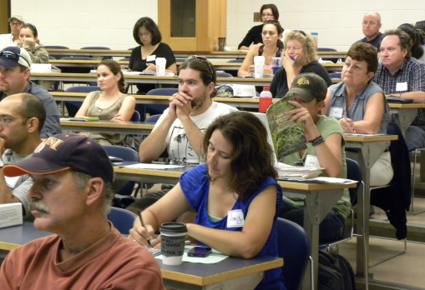
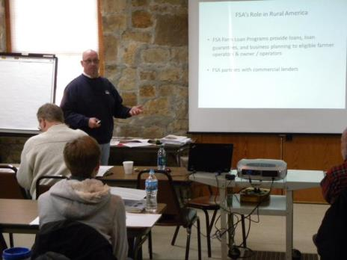
John Gehrke, USDA Farm Service Agency, discussing FSA‘s loan programs, particularly the new microloan program, in January, 2013, at Dixon Springs. Several of our students have applied for and received USDA microloans and NRCS cost-sharing funds through their EQIP program.
Notes:
We unapologetically relied on lots of classroom instruction in addition to hands-on experiences. There are countless topics and details that beginners need to know – or at least be aware of – about production, marketing, and business planning, … and organized indoor discussions were the most practical way for us to address many of these topics. We provided recorded lectures and references in advance of each class, and we discussed additional details and answered questions when we were together. University of Illinois faculty, research specialists, and Extension educators served as instructors, and representatives from other agencies and organizations also came to our locations to provide valuable information … for example, representatives of USDA’s Natural Resources Conservation Service (NRCS) and Farm Service Agency (FSA) and local Small Business Development Center (SBDC) staff addressed all of our classes each year.

Slide 6
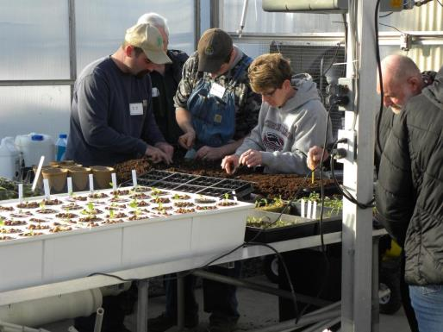
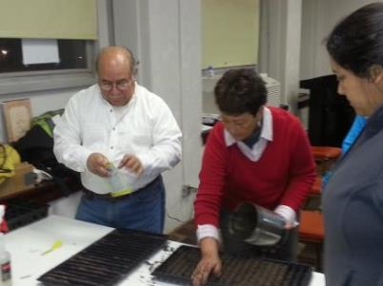
Vegetable transplant production: Seeding flats and transferring seedlings to larger pots.
Notes:
We did, however, provide lots of hands-on and eyes-on practical experiences. We covered transplant production well ahead of the season, and our coverage of this topic included students seeding flats and transferring seedlings from trays to larger pots.

Slide 7
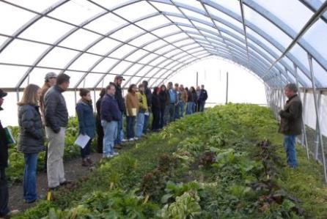
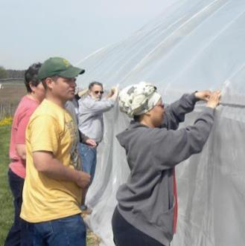
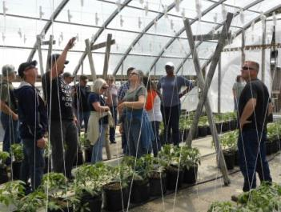
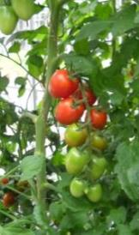
Growing in high tunnels – unheated greenhouses -- is an important part of season extension and income generation, and we demonstrated high-tunnel growing practices in different seasons as the course progressed.
Notes:
We used the high tunnels at Dixon Springs, Urbana, and St. Charles to demonstrate production practices for vegetables, brambles, strawberries, and mushrooms, and regular observations of crops in the high tunnels were part of many Saturday afternoon sessions. In the high tunnel in the photo at the upper left, winter greens crops were growing and awaiting harvest in December of 2012. In the spring of 2014, students in the St. Charles class gained some experience re-skinning the same tunnel (putting on the new plastic). Crops in high tunnels may be grown in soil or hydroponically … as shown in the lower right photo taken as the Dixon Springs class toured a nearby farm in southern Illinois … and our discussions covered both approaches (and a few modifications of each).

Slide 8
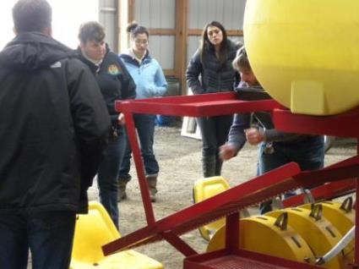
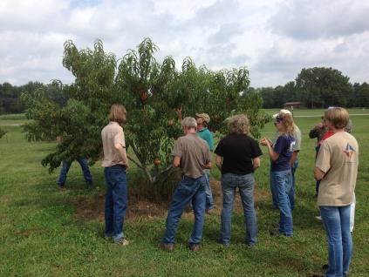
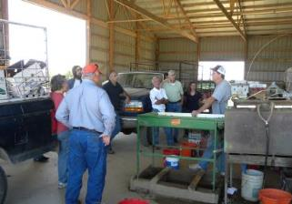
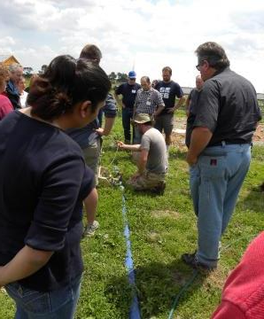
Equipment
Pruning,
Irrigation
Post-harvest handling
Notes:
We also used our Saturday afternoons to demonstrate equipment, pruning, irrigation, post-harvest handling, and a wide variety of additional topics … at University of Illinois research farms and at growers’ farms nearby. These trips also provided opportunities to see and identify insects, weeds, and plant diseases that limit production and to discuss their prevention and control.
Students in our classes included some who plan to grow organically and some who plan to use synthetic inputs as needed. We stressed sustainable and responsible approaches to soil fertility, integrated pest management, and overall production practices, but we did not advocate for or against organic versus conventional production.

Slide 9
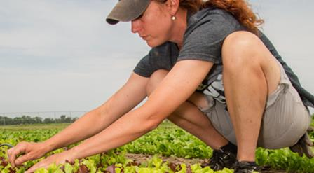
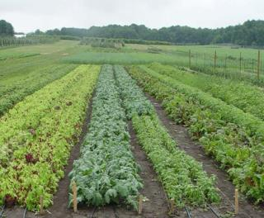
Incubator plots
Up to ½ acre per individual; applicants are evaluated to determine likely success
Regular on-site work is required
Primary tillage and access to irrigation provided, along with some simple equipment
All labor and management supplied by the participant
Participants allowed to sell produce grown on the plots
Notes:
A limited number of students also used incubator plots of up to ½ acre at our research farms to try out and improve their production skills and methods. We provided primary tillage and access to irrigation and some basic equipment, but participants did all the work to manage their plots, and they sold the produce that they grew.

Slide 10
Resources
Many specific online and printed resources for individual topics
See http://newillinoisfarmers.org/ for categorized listings
Illinois SARE (Sustainable Agriculture Research and Education) calendar
http://illinoissare.org/calendar.php
Illinois Fruit and Vegetable News
http://ipm.illinois.edu/ifvn/
University of Illinois Extension’s Local Food Systems and Small Farms team home page
http://web.extension.illinois.edu/smallfarm/
USDA’s Start2Farm site
http://www.start2farm.gov/
Notes:
Although our new farmer training program has ended, recorded presentations on most of the topics we covered in our course are available as YouTube videos on the NewIllinoisFarmers website. The Illinois SARE calendar lists lots of educational program and grant opportunities, the Illinois Fruit and Vegetable News lists upcoming programs and provides a variety of updates on production, pest management, and marketing issues, and Extension’s Local Food Systems and Small Farms educators also maintain a web site with lots of information and a calendar of events. Other beginning farmer training programs and resources are available on the United States Department of Agriculture’s Start2Farm website.

