Slide 1
Preparing a New Generation of Illinois Fruit and Vegetable Farmers a USDA NIFA Beginning Farmer and Rancher Development Program Project Grant # 2012-49400-19565 http://www.newillinoisfarmers.org
Notes:
The following presentation was part of a beginning farmer course, “Preparing a New Generation of Illinois Fruit and Vegetable Farmers,” offered by the University of Illinois and the Illinois Migrant Council from 2012 through 2015. This course was funded by the United States Department of Agriculture’s National Institute of Food and Agriculture, and specifically by the Beginning Farmer and Rancher Development Program. For more information about the program and for links to presentations and resources on many other topics, see the website newillinoisfarmers.org.

Slide 2
Preparing a New Generation of Illinois Fruit and Vegetable Farmers a USDA NIFA Beginning Farmer and Rancher Development Program Project Grant # 2012-49400-19565 Pesticides and Pesticide Application
Rick Weinzierl
May, 2015
Notes:
Hello. My name is Rick Weinzierl, and I am a Professor and Extension Specialist in Entomology in the Department of Crop Sciences at the University of Illinois. This session in our Beginning Farmer program, “Preparing a New Generation of Illinois Fruit and Vegetable Farmers,” provides an introduction to pesticides and pesticide application.

Slide 3
Today’s objectives
Know the different categories of pesticides
by a few different ways of classifying them
Understand how pesticides are applied
Understand key aspects of pesticide use and stewardship for reducing negative side effects
Understand the regulation of pesticide sale and use in Illinois
This lecture is not a substitute for Pesticide Applicator Training programs. See
http://web.extension.illinois.edu/psep/ for information on the Illinois Pesticide Safety Education Program
Notes:
My objectives for this discussion are to help you learn or better understand (1) the different categories of pesticides … and different ways to classify or understand them; (2) how pesticides are applied; (3) ways to minimize the adverse effects of pesticide use; and (4) the regulation of pesticide use. This introduction to pesticides is NOT a substitute for attending a Pesticide Applicator Training program offered by the Illinois Pesticide Safety Education Program. Later in this presentation I’ll provide more information about training and licensing for pesticide applicators.

Slide 4
What I will cover
Insecticides, fungicides, herbicides, __icides
Formulations
Modes of actions and resistance management codes
Residual activity or not
Systemic or not
Selective or broad-spectrum (non-selective)
References for recommended uses
Sprayers and other application equipment
Pesticide placement
Coverage
Notes:
I am going to provide an overview of the major categories of pesticides – from several perspectives, discuss formulations, modes of action, resistance management, residual versus “knockdown” pesticides, systemic pesticides, and selective versus non-selective pesticides. I’ll provide links to some references that provide recommendations for the use of pesticides in fruits and vegetables and talk a little about pesticide application.

Slide 5
Pesticide stewardship
IPM – agricultural practices, scouting, models, and more
Resistance management
Environmental protection – to prevent drift, run-off, leaching, pollinator losses, and more
Human health – pesticide registration, protective equipment, label restrictions, REIs, PHIs, and tolerances
US and Illinois regulation of pesticides
US EPA and IL registrations
Restricted-Use versus General Use pesticides
Applicators and Operators
Private Pesticide Applicator licensing
Notes:
I’ll also provide some basics on ways to minimize the use of and adverse effects of pesticides – practicing integrated pest management and pesticide resistance management, avoiding environmental contamination and nontarget impacts, and protecting human health by following label directions and restrictions, including REIs – re-entry intervals before working without protective clothing in treated fields – and PHIs – preharvest intervals that must elapse between the last application of a pesticide and the harvest of the treated crop. The United States Environmental Protection Agency and the Illinois Department of Agriculture both have important roles in the regulation of pesticide use in Illinois. Recognizing the distinction between General Use and Restricted Use pesticides is very important, and that will lead into the explanation of the licensing of pesticide applicators. Although certain details of pesticide applicator training differ among states, the general ideas will be relevant to all fruit and vegetable growers.

Slide 6
Types of pesticides … by what they kill
Insecticides, fungicides, herbicides, bactericides, rodenticides, antimicrobials, …
All are regulated as pesticides under FIFRA, the Federal Insecticides, Fungicides, and Rodenticides Act of 1947 (amended in 1972 and 1996)
Remember that we categorize a chemical according to what we have manufactured it to kill … acute and chronic toxicity may extend to other kinds of organisms.
Notes:
We name pesticides according to what we intend to kill or control with them. Insecticides for insect control, fungicides for control of plant-pathogenic fungi, herbicides for weed control, and several other –icides are all pesticides, and all are regulated under the Federal Insecticides, Fungicides, and Rodenticides Act and its amendments. It’s important to realize that we use MANY substances to kill unwanted organisms – not just insects and weeds in crops, but bacteria in swimming pools, in bathrooms, and on kitchen counters. We name them for their intended purpose, but many may be toxic at some level to other organisms, either immediately or over the course of repeated chronic exposures at low doses. Developing and using pesticides with minimal adverse effects on nontarget organisms is an ongoing goal for manufacturers, users, and consumers.

Slide 7
Formulations
Active ingredients – the stuff that does the killing – are not usually applied in pure form
They are mixed with “carriers” to reduce risk during mixing and loading, allow uniform dispersal in water, and provide a formulation that is convenient to handle
Notes:
The active ingredients in pesticides, either synthetic or naturally derived, are almost never sold in pure form. They are mixed with carriers that make them more easy to mix with water in a spray tank or spread more evenly as a dust. The pesticide product you purchase is called the formulated product or pesticide formulation.

Slide 8
Dusts
Sevin 5D
Granules
Lorsban 15G
Wettable Powders
Brigade 10WP
Water-dispersable and water-soluble granules
Water soluble powders
Dusts and some granules are applied dry; the other formulations s are mixed with water. Constant agitation is required for products that do not dissolve. Numbers represent percent active ingredient by weight in the formulated product.
Emulsifiable concentrates
Brigade 2EC
Soluble concentrates
Belay 2.13SC
Liquid formulations that are diluted in water either become suspended or dissolve in water. Numbers that are part of the label name represent the number of pounds of active ingredient per gallon of formulated liquid product.
(And there are additional formulation types.)
Notes:
The formulations on the left dry products – dusts, powders, and granules. Dusts and some granules are applied dry; the other formulations are mixed with water. Constant agitation is required for products that do not dissolve. Numbers represent percent active ingredient by weight in the formulated product. Sevin 5D is a 5 percent dust for application in dry form. Brigade 10WP is a 10 percent wettable powder that is mixed with water to form a suspension that is applied through a sprayer. The formulations on the right are sold in liquid form – emulsifiable or soluble concentrates – that are also diluted in water before application. In general, for liquid products, the numbers that are part of the label name represent the number of pounds of active ingredient per gallon of formulated liquid product. Brigade 2 EC contains 2 pounds of the active ingredient bifenthrin per gallon of product.

Slide 9
Chemical names, common names, and trade names
Chemical name
1-naphthyl methylcarbamate
Common name
carbaryl
Trade name
Sevin 80WP, Sevin 4EC, etc.
Chemical name
dimethyl (2aR,3S,4S,R,S,7aS, 8S,10R,10aS,10bR)- 10-(acetyloxy)- 3,5-dihydroxy- 4-(1S,2S,6S,8S,9R,11S) - 2-hydroxy- 11-methyl- 5,7,10-trioxatetracyclo [6.3.1.0^{2,6}.0^{9,11}]dodec- 3-en- 9-yl]- 4-methyl- 8-{[(2E)- 2-methylbut- 2-enoyl]oxy}octahydro- 1H-furo [3',4':4,4a]naphtho[1,8-bc]furan- 5,10a(8H)-dicarboxylate
Common name
azadirachtin
Trade name
Neemix 4.5
Notes:
Pesticides are identified by three types of names – the chemical name that describes the molecular structure of the active ingredient, the common name used to identify that active ingredient, and the trade name used on the formulated product. 1-napthyl carbamate is carbaryl, and Sevin is the original trade name given to products that contain this active ingredient. You can see the chemical name of azadirachtin, and one of the common formulations of azadirachtin (or neem) is Neemix. The reason to point out these technicalities is that a single active ingredient may be sold under many trade names … the identity of the active ingredient in a pesticide product may not be apparent based just on the trade name on the label.

Slide 10
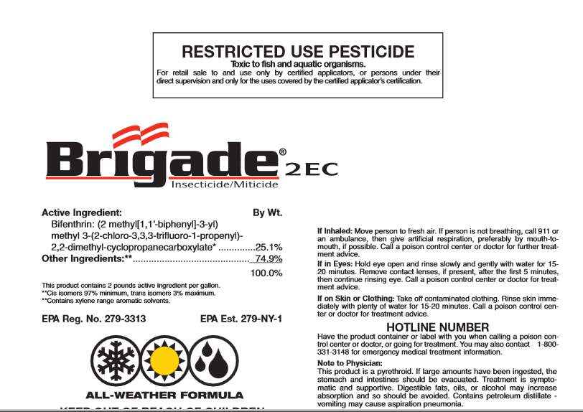
Notes:
The label for this formulation of bifenthrin, a pyrethroid insecticide, lists the common and chemical name of the active ingredient. Brigade 2 EC contains 2 pounds of bifenthrin per gallon. It is a Restricted-Use pesticide – something we’ll discuss in more detail shortly. Other parts of the label also show that this is a Group 3 insecticide (for resistance management) and provide specific instructions on the crops that can be treated, allowable rates, restrictions, and so on.

Slide 11
Modes of action, insecticides
Most are nerve poisons
Interfere with acetylcholinesterase or with sodium channel ion exchange to trigger tremors and death
Are poisonous to humans but our exposure is less and our detoxification systems are different
Others are insect-specific pathogens or pathogen products, synthetic versions of arthropod growth or molting hormones, or compounds that interfere in a different way with insect physiology.
IRAC numbers
Insecticide Resistance Action Committee (IRAC) numbers on insecticide container labels indicate the “mode of action group” for the active ingredient. To slow development of insecticide resistance in insects, do not use insecticides with the same IRAC number repeatedly
See http://www.irac-online.org/content/uploads/MoA-classification.pdf
Notes:
Let’s very briefly summarize some general characteristics of insecticides, fungicides, and herbicides. For each group, “modes of action” describe in general terms the main way that the pesticide interferes with normal biological functions in target (and sometimes nontarget) organisms. Most insecticides interfere with nerve impulse transmission in animals. Several interfere with the action of neurotransmitters such as acetylcholinesterase or with sodium channel ion exchange along nerve axons. They are used with relative safety to humans and other mammals because (1) our exposures are very low in comparison with those encountered by insects, and (2) our ability to detoxify the doses we encounter prevents the primary toxic effects from occurring. Over the last few decades, several insecticides have been developed that rely on modes of action other than inhibition of nerve impulse transmission. Some are microbial insecticides that contain pathogens that infect and kill only certain groups of insects, some interfere with growth or molting hormones, and others disrupt insect mating behavior. All labels now present IRAC numbers that describe the mode of action of the insecticide. Where alternating or rotating among different insecticides over time is recommended to slow the development of resistance in insect populations, it is important to use insecticides in different mode of action groups, not just products with different names or active ingredients that act in the same way.

Slide 12
Modes of action, fungicides
12 mode of action groups of fungicides (with several subcategories in most) are recognized by the Fungicide Resistance Action Committee
See http://www.frac.info/publication/anhang/FRAC%20Code%20List%202013-update%20April-2013.pdf
Fungicide Resistance Action Committee (FRAC) numbers on fungicide container labels indicate the “mode of action group” for the active ingredient. To slow development of fungicide resistance in pathogenic fungi, do not use fungicides with the same FRAC number repeatedly
Many older protectant fungicides (Captan, for example) act in multiple ways to prevent fungal infections, and pathogenic fungi have not developed resistance to them
Practically, fungicides are often viewed as either “protectants” or “eradicants”
Notes:
For fungicides, FRAC codes (mode of action codes identified and assigned by the Fungicide Resistance Action Committee) recognize 12 broad modes of action. Where multiple applications of a fungicide are needed over time, rotating among products with different FRAC codes is recommended. A few older fungicides – such as Captan – have multiple modes of action, and even after decades of use, resistance remains rare for most fungal pathogens. Fungicides are also described as “protectants” versus “eradicants”. Protectant fungicides must be on the surface of the plant to prevent fungal entry and infection … they do not “cure” even in very early stages of infection. A few fungicides are able to kill fungi after very early stages of plant infection have already occurred. These are called eradicants, and they may be described as having some “kickback” activity. Be aware, however, that their eradicant or curative value is only for very early stages of infection in most cases.

Slide 13
Modes of action, herbicides
Over a dozen mode of action groups of herbicides (with several subcategories in most) are recognized by the Herbicide Resistance Action Committee
See http://www.hracglobal.com/Portals/5/moaposter.pdf
HRAC numbers
Herbicide Resistance Action Committee (HRAC) numbers on herbicide container labels indicate the “mode of action group” for the active ingredient. To slow development of herbicide resistance in weeds, do not use herbicides with the same HRAC number repeatedly
Notes:
Similarly, herbicides used to kill weeds are grouped according to their modes of action and assigned HRAC codes by the Herbicide Resistance Action Committee. Over a dozen different modes of action are recognized, and using herbicides with different modes of action is recommended to slow the development of herbicide resistance in weeds. Widespread use of Roundup (glyphosate) in corn and soybean production without rotations involving other weed control practices is widely cited as the reason for the evolution of glyphosate-resistant weeds. Many herbicides that are effective for weed control in in specific vegetable crops may be difficult to incorporate into small-scale, mixed-crop vegetable production systems because they persist in or on the soil and can injure subsequent crops … or because different crops are planted in close proximity to one another and drift may be an issue. We will return to more detailed discussions of the use of pesticides and other practices for insect, weed, and disease control over the next few months, but the basics on insecticides, fungicides, and herbicides should make those discussions more relevant and understandable.

Slide 14
How long and where?
Residual activity
May range from hours to years
Differs with temperature, moisture, and light
Systemic or not
Is the pesticide taken into the vascular system of the plant and transported to other plant organs (roots to leaves or leaves to roots)
Admire (imidacloprid)
Roundup (glyphosate)
Notes:
For most pesticides, in addition to knowing the mode of action of the ingredients, how long the product lasts and whether or not it moves within a plant or animal is key in understanding how to (and NOT to) use it effectively. Although there are exceptions, in most cases, we want a pesticide residue to persist on a plant for at least a few days. And in fact, residues of many insecticides are effective on plant surfaces for 5-7 days. We also do NOT want excessive residues to remain on harvested produce, persist in the soil, or move into water, so rates and timing of applications are regulated accordingly. Systemic pesticides move in the vascular system of plants (and in the circulatory system of animals for some pet and livestock insecticides). Most common is movement from the roots to stems and leaves, as is the case with the insecticide imidacloprid. The herbicide Roundup or glyphosate moves from leaves to roots. Labels and instructions for the use of a pesticides note whether or not it is systemic.

Slide 15
Selective versus broad-spectrum
Selective within a group of target organisms
Kills some kinds of insects but not others
Bacillus thuringiensis (BT) kills Lepidopteran larvae, not other insects
Many other examples; several are considered “Reduced-Risk” pesticides
Kills some plants but not others
2,4-D kills broadleaf plants, not grasses
Some pesticides are acutely toxic to a wide range of organisms
Methyl bromide (a fumigant) – kills insects, fungi, weed seeds, and people at commonly applied doses
Notes:
Some pesticides are broadly toxic to many organisms and others are more selective or specific. This is evident when one reads the label on a pesticide – it often states specifically which insects or weeds it kills or which fungal diseases it prevents. Most Bt insecticides kill only caterpillars that eat them; many new reduced-risk insecticides are effective against only certain orders or groups of insects; some microbial insecticides that contain insect-pathogenic viruses kill only larval stages of a single genus or species. These examples of selectivity differ phenomenally from the broad-spectrum nature of the old organochlorine, organophosphate, and carbamate insecticides. For herbicides, many preplant, pre-emergence, and postemergence herbicides are selective – they may kill grasses but not broadleaf weeds or vice-versa. Other herbicides such as paraquat or glyphosate are non selective and kill most plants. A very few pesticides – primarily fumigants – are highly toxic to a very broad range of organism at their common rates of use. Methyl bromide and other space or commodity fumigants are in this category.

Slide 16
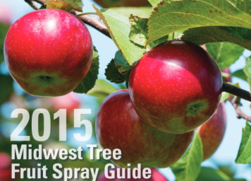
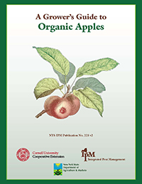
How do you know what to spray against what pest in a given crop?
Midwest Tree Fruit Spray Guide
http://www2.ca.uky.edu/agcollege/plantpathology/ext_files/PPFShtml/MwTreeFruitSprayGuideID92.pdf
Cornell Production Guide for Organic Apples
http://nysipm.cornell.edu/nysipm/organic_guide/fruit_org_guide.asp
Notes:
So how do you identify what pesticides can be used in what crops to control or prevent specific pest problems. For tree fruits, the annually updated Midwest Tree Fruit Spray Guide and the Cornell guide for organic apple production list “spray recommendations” for insect, plant disease, weed, and vertebrate pest control.

Slide 17
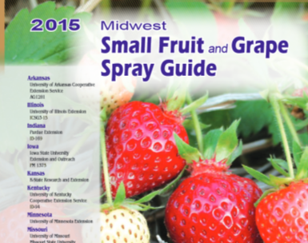
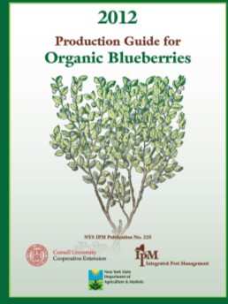
Spray Guides for Small Fruits
Midwest Small Fruit and Grape Spray Guide:
https://ag.purdue.edu/hla/Hort/Documents/ID-169.pdf
Cornell Organic Production Guides (blueberries, grapes, strawberries)
http://nysipm.cornell.edu/organic_guide/
Notes:
For grapes and small fruits such as brambles, blueberries, and strawberries, the annually revised Midwest Small Fruit and Grape Spray Guide and the Cornell organic production guides for certain small fruits provide spray recommendations for specific pests.

Slide 18
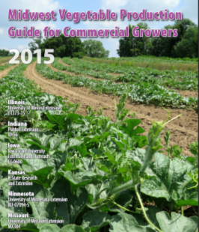
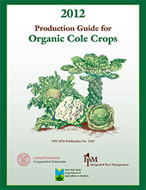
For Vegetables … Midwest Vegetable Production Guide
Midwest Vegetable Production Guide
http://mwveguide.org/
Cornell’s Organic Production Guides for Vegetables
http://nysipm.cornell.edu/nysipm/organic_guide/veg_org_guide.asp
Notes:
For vegetable crops, the Midwest Vegetable Production Guide and Cornell’s organic vegetable production guides for specific crops provide pesticide recommendations and other production and pest management guidelines. We cover integrated pest management in an upcoming lecture and discussion, but it’s important to note now as well that spray guides list a wide range of pest problems, not all of which occur in any given field. They provide extensive listings of approved pesticides for crop and pest combinations. They do not cover all the production practices that might limit or avoid pest problems … that is not their purpose. Other references DO cover cropping system design, monitoring or scouting, and other aspects of crop and pest management … use the spray guides to understand what pesticides can be used effectively where they are needed.

Slide 19
Production guides and spray guides are great, but … Read the label and follow directions …
Target pests – sometimes too inclusive
Rates – Never exceed maximum rates
Environmental cautions
Blooming crops or weeds, pollinators, water quality, wind speed and drift … and more
PHI – preharvest interval
REI – re-entry interval
Worker Protection – training, signage, personal protective equipment
Notes:
Production guides and spray guides provide very useful summaries, but the pesticide label is the ultimate legal document for how a pesticide can be used. Labels list target pests that the product controls … these are sometimes too inclusive, and checking recommendation in spray guides may lead to the most effective products for specific pests. Labels list the rate (per acre) that can be used and the maximum number of applications that can be made – never exceed these limits. Labels may instruct against application to blooming crops or weeds to prevent bee poisoning, they may restrict applications in areas where water contamination may be especially likely, and they always caution against application if winds exceed speeds likely to cause drift. Labels specify the preharvest interval – the number of days that must elapse between a pesticide application and harvest – and the re-entry interval – the time period that must elapse between application and the return of workers to the treated field or crop. Pesticide users also must comply with Worker Protection regulations regarding signage at treated fields, training employees, and provision of personal protective equipment.

Slide 20
How are pesticides applied in fruit and vegetable production?
To soil or seed for residual or systemic action
To soil as fumigants
To stems, leaves, and fruits for knockdown, residual, or systemic activity
To closed spaces as fumigants to disinfest produce after harvest
Notes:
Let’s look at how pesticides are actually used in fruit and vegetable production.

Slide 21
Soil-applied & seed-treatment insecticides and fungicides
Soil-applied for residual control:
Applied to kill insects or inhibit fungi in treated soil at time of application and for a period up to several weeks later; incorporated (at least lightly) or injected to mix with soil
Insecticides sometimes applied at planting for control of rootworms, cutworms, wireworms, grubs, seed and root maggots, etc. in field crops, vegetables, small fruits, gardens
Examples:
Organophosphates: Lorsban/Dursban, Counter, Diazinon
Pyrethroids: Force, Fortress
Band applications instead of broadcast applications are most common in crops
Notes:
Pesticides may be applied to the soil with the intent that they persist for several days at the location they were applied so that they prevent crop damage from insects or prevent weed growth. Soil-applied pesticides are usually incorporated or mixed at least lightly with the soil; some are applied in “bands” – for example, a width of 7 inches or so that covers the row as corn is planted, but the area between rows is not.

Slide 22
Soil-applied & seed-treatment insecticides
Soil-applied residual insecticides
Typically have (or should have) half-lives of (very roughly) 30 to 90 days
Typically are low to very low in water solubility (so that they do not leach out of the treatment zone in spring rainfall)
Are not bound too tightly to soil particles as to be unavailable in contact with insects
Historic problems have included too-great persistence (aldrin, dieldrin, heptachlor, chlordane, and other organochlorines) and too-great solubility (Temik)
Notes:
Insecticides applied to the soil for residual control of insect pests in the soil typically have soil “half-lives” of 30 – 90 days … much shorter than the old residual organochlorine insecticides of the 1960s and 1970s. Typically they are very low in water solubility so that they do leach into ground water. Not every insecticide that is effective when applied to foliage is effective when used in the soil because many break down very rapidly in soil or are bound very tightly to soil particles and therefore unavailable to enter and kill soil insect pests.

Slide 23
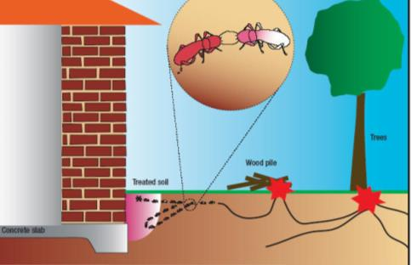
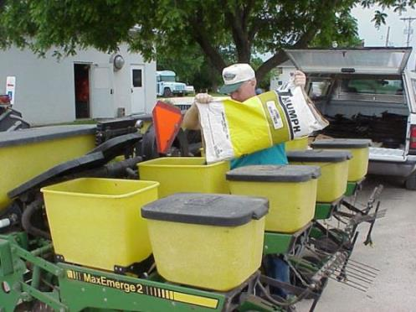
Notes:
Examples of the use of soil residual insecticides include applications around the foundations of homes to prevent infestations of subterranean termites and the use of soil insecticides applied in a band over the row to control corn rootworm larvae in corn fields. Soil applications of insecticides are sometimes used for seed and root maggot, grub, and wireworm control in vegetables.

Slide 24
Seed-applied residual insecticides and fungicides
Insecticides and fungicides applied to seed at seed company facility or as a planter-box mixture
Kill insects that feed directly on seeds and below-ground portions of seedlings
Common seed protectants have included diazinon, Lorsban, lindane, and permethrin
Targets: seedcorn maggot, other seed and root maggots, wireworms, white grubs, seedcorn beetles
Prevent infection of seeds and seedlings by soil-borne fungal pathogens (damping off)
Captan and several newer fungicides
IF effective, seed treatments are appealing because they use a lot less pesticide than band or broadcast applications
Notes:
Where protecting seeds from insects or fungal pathogens is necessary, growers may buy treated seed or, in a few instances, apply treatments onto seeds after purchase. Most residual insecticides and fungicides used in this way are not systemic … they do not move upwards via the vascular system to above-ground portions of plants. In comparison with band or broadcast applications of insecticides, seed treatments use far less insecticide on a per-acre basis. Consequently, seed treatments are preferred over band or broadcast applications if seed treatments effectively control the target pests.

Slide 25
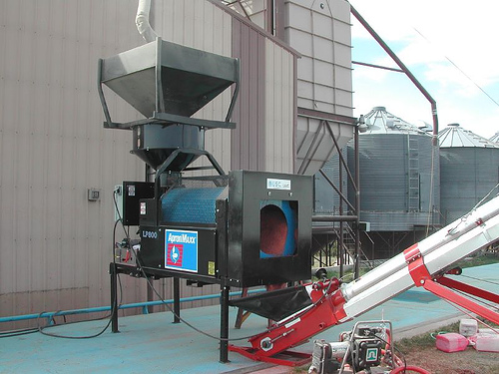
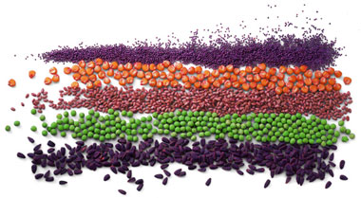
Treated seeds are also coated with dyes … do not feed treated seed to animals.
Notes:
Seeds that have been treated commercially with an insecticide or a fungicide are always coated with a dye as well … to indicate that the seed should not be used as feed. Never feed “colored” seed to animals.

Slide 26
Soil-applied for systemic uptake
Applied at planting or transplanting or later as a drench or in irrigation water
Insecticides … Admire, Platinum, other neonicotinoids
Fungicides … Ridomil Gold
Control usually begins a few days after application and persists 2 to 4 weeks; somewhat dependent on precipitation; neonicotinoids used around trees and shrubs may remain active for a year or more
Seed-applied for systemic uptake
Systemic insecticidal seed treatments are sold under the trade names Cruiser, Gaucho, and Poncho – all are neonicotinoids
On sweet corn and cucurbit seed (as well as corn and soybean seeds) … targets include corn flea beetle, cucumber beetles, leafhoppers, and aphids for 1 – 3 weeks after seedling emergence
Persistence and off-target movement may pose risks to pollinators, especially for vast acreages planted to corn and soybeans
Apron ® fungicidal seed treatment on sweet corn to reduce damping off
Notes:
Pesticides may also be applied to soil or seed not primarily to protect the seed but to allow for the movement of the pesticide in the vascular system to protect above-ground parts of plants. Applications to soil can be made prior to planting, at planting, or postemergence as a drench or via irrigation water (depending on specific product labels). For soil- or seed-applied systemic insecticides, above-ground control of insects usually begins a few days after application and lasts 2-3 weeks. Many of the insecticides used in this way are neonicotinoids that are highly toxic to bees. This presents a serious hazard where high rates of very long-lasting insecticides are used around landscape trees and shrubs for several months of control of leaf-feeding insects and where treated seeds are used on vast acreages of corn and soybeans.

Slide 27
Soil fumigants
Primary fumigant against insects, pathogens, and weeds in the soil has been methyl bromide
Applications usually made to raised beds tarped with plastic (for specialty crops)
Fumigant gas kills organisms present at the time of fumigation; dissipates in a few days
Cost = several hundred dollars to >$2,000 per acre
In IL, crops are “plasticulture” strawberries; some peppers and tomatoes
Soil fumigation is rare in IL, but in FL, TX, and CA (and a few other areas), fumigating before planting high-value fruits and vegetables is common.
Phase-out of methyl bromide because of its ozone-depleting effects presents a major challenge
Notes:
Another group of soil pesticide are fumigants, and methyl bromide has been the most common of the soil fumigants. It is injected into the soil, and the surface is immediately covered with plastic to slow its escape. It moves in the gaseous form in the soil and kills a wide range of soil organisms. It dissipates slowly over a few days, then crops are planted through the tarp or mulch. Soil fumigation is very expensive and not used commonly in Illinois. Methyl bromide has been identified as a gas that contributes to ozone depletion in the atmosphere, and alternatives to it are under development as plans to phase out its use are eventually carried out.

Slide 28
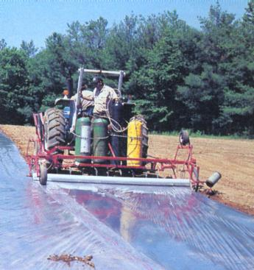
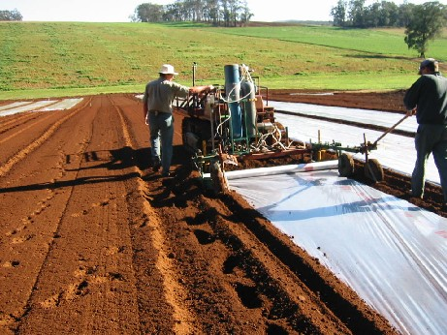
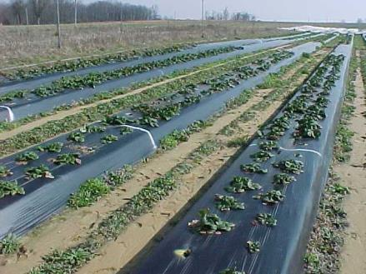
Notes:
These are examples of soil fumigation and crops grown on fumigated beds.

Slide 29
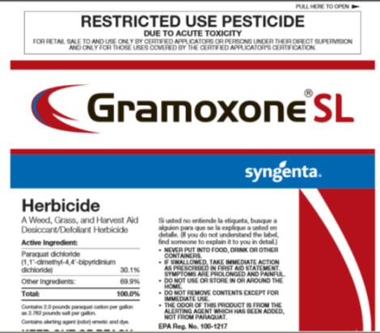
Preplant burn-down (nonselective) herbicides
Gramoxone and Roundup
Notes:
Herbicides applied prior to planting some fruits and vegetable crops include the non-selective herbicides paraquat (Gramoxone) and glyphosate (Roundup). Roundup is systemic and moves in the vascular system to the roots and kills most plants to which it is applied. Gramoxone or paraquat kills the tissue it contacts, often killing the above-ground portion of plants. It is not systemic, however, and plants that can re-grow from roots or crowns will grow back after treatment.

Slide 30
Preplant and pre-emergence selective herbicides applied to soil
Preplant, incorporated
Atrazine in sweet corn
Pre-emergence, applied to the soil surface after the crop is planted but before it emerges (may also kill small, emerged weeds)
Lexar or Lumax in sweet corn (pre-mixes that contain metolachlor, atrazine, and mesotrione)
Notes:
Some selective herbicides – that kill some kinds of plants but not others – are applied to the soil surface prior to planting or after vegetable seeds are planted but before they have emerged to kill germinating weed seeds or small emerged weeds. Atrazine is among the herbicides use in this way in corn. For many small growers with diverse cropping systems, drift to nearby areas with different (susceptible) crops and the residual activity of these kinds of herbicides in future rotation crops present challenges for their safe use.

Slide 31
Post-emergence herbicides
Selective
Callisto, 2,4-D, and Aim in sweet corn
Nonselective except to GMO crops …
Roundup on Roundup-Ready sweet corn
Nonselective but applied in a selective manner
Roundup or paraquat (or other products) applied with shielded sprayers between crop rows or beds or in sprays to tree rows but without contact on green tissue
Notes:
Postemergence herbicides – applied within crop fields after the crop is standing – may be selective, for example killing broadleaf weeds in a grass crop such as sweet corn, or they may be nonselective but applied to a resistant crop – such as with Roundup use in Roundup-ready corn and soybeans. Roundup and paraquat – both nonselective herbicides – also are used in perennial fruit crops, but they applied at a time and in a manner where they do not contact green tissue or damage the crop.

Slide 32
III. Foliar-applied insecticides
Foliar “knock-down” insecticides (with little or no residual control intended)
Very few insecticides are applied with the intent that they NOT last at least a few days, but insecticides that kill only the insects that are present at the time of application or persist for only a short time include: dormant oils, soaps, pyrethrins, and malathion.
Most insecticides that break down rapidly have short preharvest intervals; this can be especially important in fruits and vegetables where control may be necessary right up to the time the crop is picked.
PHIs are related to rate of breakdown and residues on crops … NOT safety to applicator
Notes:
Among the most common pesticides applied to fruits and vegetables are sprays of insecticides and fungicides to the above ground portions of the plant to protect foliage or fruit from insect feeding or pathogen infection. Most of these sprays are intended to provide lasting control for a few days. Some, however, have little or no residual value after application. These include “knock-down” insecticides. Either they work only while still in the liquid form or their chemical residues – though effective – break down so rapidly that they do not continue to kill insects for very long. Natural pyrethrins are very short-lived; malathion also breaks down rapidly enough that its pest control value doe not last more than a couple of days in most outdoor uses. Short-lived products are usually the ones that can be used very close to harvest in fruits and vegetables. In some instances, short PHIs are granted for products that are very low in toxicity to humans (who will eat those fruits and vegetables), but in general a short preharvest interval does NOT mean that a pesticide poses a low risk to the applicator … so always be careful.

Slide 33
Foliar-applied insecticides
Foliar residual insecticides … Most applications of insecticides to plant foliage, by aerial or ground sprayers, are intended to last for a few to several days as residues on plant foliage
Most last from 3 to 10 days as effective residues
Treatments remain effective if sprays dry before rainfall of up to 1 inch (generally)
In general, most foliar residual sprays are effective as contact poisons … insects that crawl across treated surfaces are killed when insecticides are absorbed through the insect’s cuticle
Notes:
Most insecticides and fungicides applied to crops last from 3 to 10 days as effective residues on treated parts of plants. Rainfall of over an inch removes residues and activity; time and sunlight also allow degradation. Most insecticides used on plants are “contact” poisons to insects … the chemical residues rub onto the insect’s cuticle, move through the waxy layers, and enter the insect via this path … they do not need to be eaten to enter the insect.

Slide 34
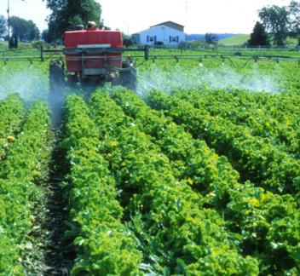
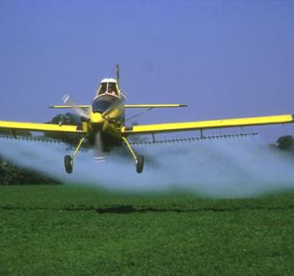
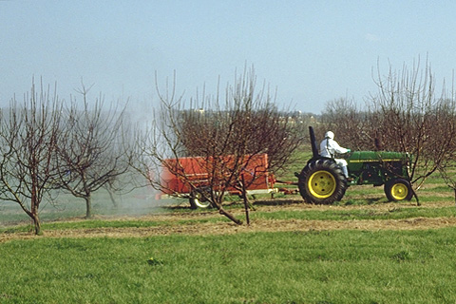
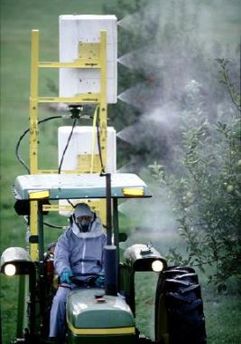
Notes:
Pesticides may be applied by boom sprayers, airplane mounted sprayers, air-blast sprayers, and platform mounted sprayers (and by other types). Where plant foliage presents a dense canopy and makes it difficult to push a pesticide into the center of the plant with just spray-tank pressure, fans that move air with the pesticide provide improved coverage.

Slide 35
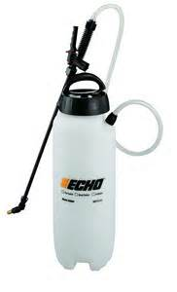
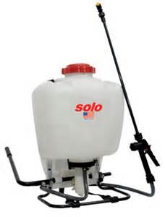
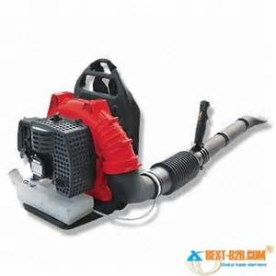
Pesticide sprayers
At the smallest scale, pump-up canister sprayers, hand-pump backpack sprayers, and gas-powered backpack mist blowers are low-cost options.
Notes:
Both conventional farms and organic farms will have the need for sprayers on a variety of scales. Back pack hand pump, electric, and gas powered sprayers are the entry level set ups for many growers. Though low cost, they are not effective are applying products evenly over larger areas.

Slide 36
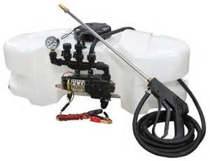
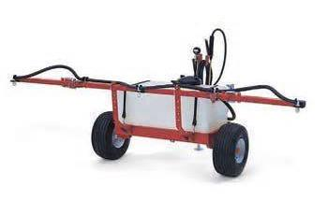
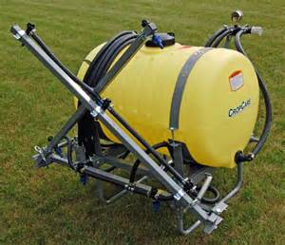
15- to 30-gallon small tank sprayers powered by a 12-volt battery can be mounted on 4-wheelers or utility vehicles. Small pull-behind or 3-point hitch-mounted boom sprayers may be appropriate for larger acreages of low-growing vegetable crops.
Notes:
15- to 30-gallon small tank sprayers powered by a 12-volt battery can be mounted on 4-wheelers or utility vehicles. Small pull-behind or 3-point hitch-mounted boom sprayers may be appropriate for larger acreages of low-growing vegetable crops.

Slide 37
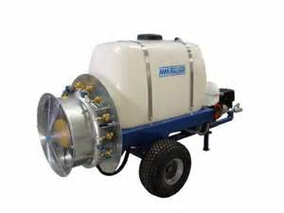
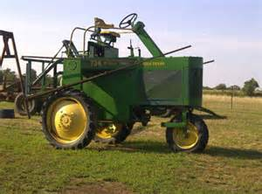
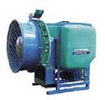
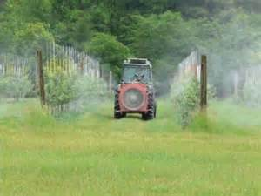
For growers with a few acres of sweet corn, a high-boy sprayer that can pass through rows even when corn is 4 to 6 feet tall is usually a necessary investment. For orchards and vineyards, an airblast sprayer – either a pull-behind or 3-point hitch-mounted model – becomes a necessity as plants become large enough that spray penetration into the plant canopy requires air as an additional carrier. It’s difficult and time-consuming to treat lots of trees effectively with a hand-sprayer, and applicator exposure is also a concern.
Notes:
For growers with a few acres of sweet corn, a high-boy sprayer that can pass through rows even when corn is 4 to 6 feet tall is usually a necessary investment. For orchards and vineyards, an airblast sprayer – either a pull-behind or 3-point hitch-mounted model – becomes a necessity as plants become large enough that spray penetration into the plant canopy requires air as an additional carrier. It’s difficult and time-consuming to treat lots of trees effectively with a hand-sprayer, and applicator exposure is also a concern.

Slide 38
Foliar (and fruit) applied fungicides
Many! See the tree fruit and small fruit spray guides and the vegetable production guide
“Protectant” versus “eradicants”
Coverage is extremely important
Notes:
Many fungicides are labeled for use fruits and vegetables, and other disease-prevention chemicals such as copper and sulfur compounds may be used primarily as “bactericides”. Some have limited curative or kickback activity and may be called eradicants; most are protectants that prevent infections but to not stop or kill out existing infections. Even more than for insecticides very thorough coverage of plant tissues is necessary for protectant fungicides to be effective … fungal spores do not crawl around on leaves and encounter spotty residues as insects may do.

Slide 39
Systemic insecticides and fungicides applied to foliage
Movento in apples for woolly apple aphid control
Fontelis in apples for apple scab control
Notes:
Some insecticides and fungicides applied to foliage are at least somewhat systemic – Movento applied to apples will move down the vascular system to trunks and roots and kill woolly apple aphid; Fontelis is locally systemic in apples and some additional crops.

Slide 40
Aerosol space sprays
Examples include “bombs” for fly and fruit fly control in packing houses or cider rooms … usually pyrethrins or pyrethroids with short residual and low toxicity
These are not fumigants … the active ingredient is dispersed in very small droplets of liquid that float through the air and deposit on exposed surfaces (including insects’ cuticles). They do not move as a gas into closed spaces such as cabinets, drawers, etc.
Notes:
Finally, it’s important to distinguish between pesticides that move as tiny liquid particles in the air – aerosols – and pesticides that move as gases in the air – fumigants. Fine aerosol sprays – like those produced by pressurized “bug bombs” float through the air and land on exposed surfaces – including the cuticles of insects. They may be used for fly control in packing houses or cider rooms. They are not fumigants … they do not penetrate closed spaces such as kitchen cabinets, drawers, and so on.

Slide 41
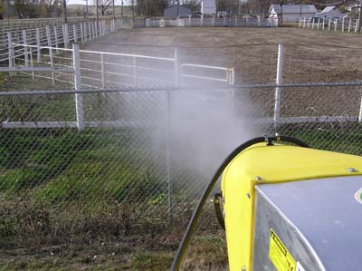
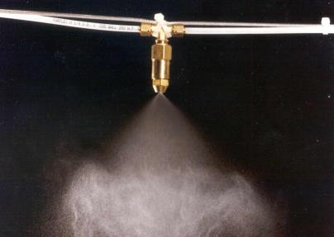
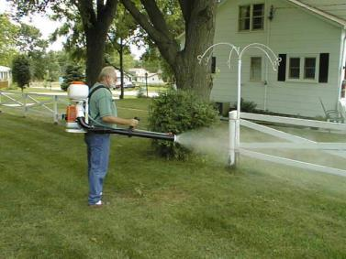
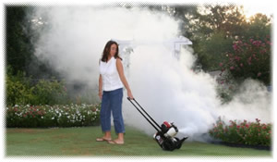
Notes:
These are all examples of aerosol applications of fine droplets that contain pesticides. The aerosol “floats through air to reach many exposed surfaces. I hope the X through the illustration in the lower right is for obvious reasons … no protective clothing or equipment to keep the pesticide off her skin, out of her eyes, and prevent her from inhaling it.

Slide 42
Space and commodity fumigants
Examples: methyl bromide, phosphine, chloropicrin, sulfuryl fluoride, and even carbon dioxide.
In agriculture, used to disinfest stored grains, flour, flour mills and other food processing plants, and ripe fruits and vegetables (Mediterranean fruit fly and similar pests).
In general, fumigants are EXTREMELY toxic and require special training and equipment for safe handling
Notes:
Fumigants – in addition to those used in soil fumigation – may be used to disinfest stored grains, flour mills, and ripe fruits and vegetables. Common fumigants include methyl bromide, phosphine, chloropicrin, sulfuryl fluoride, and even carbon dioxide.

Slide 43
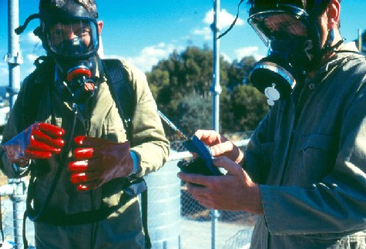
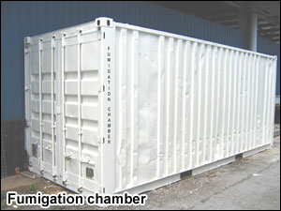
Notes:
Fumigants are highly toxic, and applicators must be specifically licensed to use them. Gas detection and measuring devices and self-contained breathing units are commonly required.

Slide 44
Pesticide stewardship
Because
Pesticides are toxic to nontarget organisms
Pollinators, natural enemies of pests, wildlife, fish, humans, other crops and plants
Pesticides may reach nontarget organisms through direct application, drift, run-off, leachate, and residues on foods
Pest species develop resistance when pesticides are overused
So … how to minimize the negatives?
Notes:
So … pesticides, be they synthetic or “natural” products can be toxic to a range of nontarget organisms, and they have to be handled appropriately if adverse effects are to be minimized. Protecting pollinators, natural enemies, fish, wildlife, and humans is always a concern. Nontarget effects can result from direct application, drift, run-off, leaching, and residues on foods. Too-frequent applications favor evolution of resistance in pest species. What are logical steps to reduce risks while still preventing excessive losses to pests?

Slide 45
Use integrated pest management (IPM)
Use integrated pest management
Design farming systems to reduce pest problems
Crop rotations, cover crops, diversity
Use optimal cultural practices
Pruning, thinning, plant densities, planting and harvesting dates, resistant varieties
Monitor (“scout”) crops and spray when needed
Use least disruptive pesticides
Notes:
The most common approach to minimizing risks from pest management activities is to use “integrated pest management” or IPM methods. IPM is based on the use of a range of practices that limit losses to pests while minimizing the environmental damage, human health risks, and dollar costs associated with pest suppression. Tactics include biological control, cultural controls, pest-resistant varieties, regulatory programs … and pesticides where needed and in ways that minimize their adverse effects. I urge you plan and design farming systems that minimize the likelihood of severe pest problems – steps will include crop rotations, cover crops, plant diversity, tillage, pruning, thinning, ideal planting and harvesting dates, using resistant varieties, managing irrigation well, and several other steps. IPM then involves monitoring crops to assess the densities of pest and beneficial organisms – scouting – and using pesticides if needed. The least disruptive pesticides may be synthetic or they may be of natural origin – though synthetic products cannot be used in certified organic production.

Slide 46
Use resistance management practices
Spray only when needed
Spray only the areas where control is needed
Rotate among modes of action of pesticides based on IRAC, FRAC, and HRAC code numbers
Notes:
Simple rules govern pesticide use … after designing a farm plan that reduces the likelihood of pest problems, spray only when needed – based on results of scouting efforts. Spray only the areas where pest pressure requires it. Rotate within types of pesticides according to modes of action to slow the evolution of resistance. And never apply a pesticide in ways prohibited by the labels … especially, do not use more than the label instructs.

Slide 47
Prevent off-site contamination
Prevent drift
Environmental conditions
Application methods
Prevent run-off
Waterways, field borders
Prevent leaching
Obey labels regarding sensitive sites
Do not use pesticides that are highly toxic to bees on blooming crops or weeds (or allow their drift onto blooming crops or weeds)
Notes:
Do not apply pesticides in excessive winds or too close to neighboring property or sensitive crops. Manage soil erosion and do not apply pesticides to waterways or field borders. Where labels restrict use to protect shallow water supplies, always obey the label. And do not apply pesticides in ways that will poison bees or other pollinators. We will discuss these recommendations in more detail when we cover insect, disease, and weed management.

Slide 48
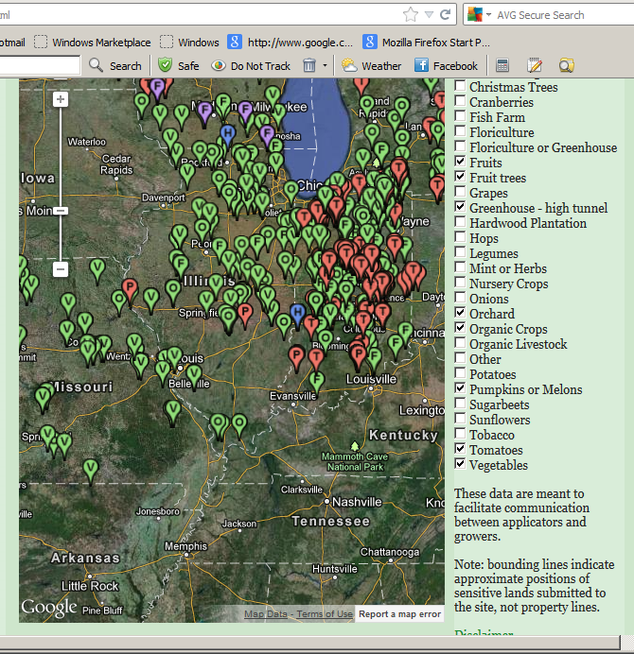
Register on DriftWatch, http://il.driftwatch.org/
Notes:
One thing that owners of sensitive crops and livestock can do to notify pesticide applicators of their vulnerability to drift is to register their locations on Drift Watch. The DriftWatch Specialty Crop Site Registry is a voluntary communication tool that enables crop producers, beekeepers, and pesticide applicators to work together to protect specialty crops and apiaries. It is not a substitute for any state regulatory requirements. Applicators can get advanced integration capabilities to help avoid spraying specialty sites and receive notifications when sites are moved or added to the DriftWatch database. Producers have an additional layer of protection against accidental pesticide drift. The locations indicated on this slide are orchards, greenhouses and high tunnels, cucurbit fields, tomatoes, other vegetables. Clearly there were more such properties than were registered at the time this screen shot was taken.

Slide 49
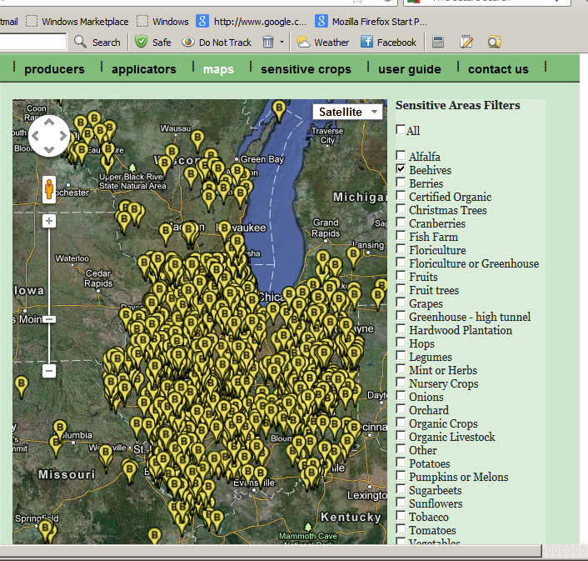
Notes:
The symbols on this map indicated the locations of apiaries / bee hives … again, although many are shown, there are probably more that need to be registered. Registering on Drift Watch is one more way to let pesticide users know that you are vulnerable to their actions and that they should take all possible precautions.

Slide 50
Human health
Pesticide registrations consider
Toxicity (acute and chronic) to nontarget species, including humans
Persistence of residues on crops and in the environment
Pesticide solubility and likelihood of movement in water
Product labels require practices that reduce risk
Notes:
Pesticide users – of products that are approved for organic use and those that are not – should all be aware that pesticides can harm humans – applicators, consumers of treated foods, and everyone who lives in the environment … using pesticides strictly according to label instructions minimizes risks where pesticides must be used.

Slide 51
Use only on specified crops … do not exceed listed rates or apply closer to harvest than specified (PHI) so that residues do not exceed allowable tolerances
Use personal protective equipment and obey specified re-entry intervals (REIs) and Worker Protection requirements
Obey restrictions regarding blooming weeds, pollinators, wildlife, and water supplies
A pesticide label is the law … you may be punished severely for off-label uses
Notes:
Labels indicate what crops may be treated, how much can be used, when a crop may be treated, and what precautions should be taken to protect applicators and workers who enter treated fields. Pesticide labels are not like brownie recipes … the details are not optional. If a little works well, using a lot is NOT a better choice. Not spraying and NOT using the maximum allowed rate are available choices … spraying too often or using too much are not. Failure to follow label instructions that protect the environment, workers, and consumers is punishable by law.

Slide 52
Pesticide registration (approval)
Responsibility of the US Environmental Protection Agency
Requires data on environmental fate of ingredients and toxicity to test animals. Tolerances (allowed amount of residue on food) reflect these data.
States can be more restrictive. (IL is not.) Illinois charges a fee per company and product to fund pesticide safety education programs and testing.
Notes:
Pesticides are regulated by the US Environmental Protection Agency and – in Illinois – by the Illinois Department of Agriculture. The US EPA requires data on the environmental fate of pesticides and their toxicity to test animals. It uses these data to construct the details on the pesticide label. Some states require additional data (primarily New York and California), though usually they use existing data but may develop more restrictive labels. The Illinois Department of Agriculture does charge a fee for each company that registers pesticides for sale in the state and for each pesticide they register. That fee pays for regulatory expenses and pesticide safety education programs and the state’s applicator licensing program.

Slide 53
General versus restricted use
General use pesticides can be purchased by anyone, with no proof of training
Restricted use pesticides (because of greater risks) may be sold only to licensed applicators
Labels on pesticides sold to homeowners may state “Not for Commercial Use.” Do not sell produce treated with these pesticides.
Notes:
All registered pesticides are classified as General Use or Restricted Use products. General Use products may be purchased by anyone without proof of knowledge or training … but their labels are still the law in terms of how they can be used. Restricted Use pesticides may be sold only to licensed pesticide applicators who have passed a licensing exam. Products available to homeowners and others at garden centers and hardware stores are exclusively General Use products … but labels on these products often state “Not for Commercial Use” … this means that produce treated with these pesticides should not be sold. Commercial growers should purchase and use products intended for on-farm use.

Slide 54
Private versus commercial licenses
Private applicator
(= farmer)
Commercial
Applicator (responsible)
Operator (worker)
Several categories
Field crops
Right-of-way
Turf
Ornamental
Fruit & vegetable
Notes:
Illinois classifies pesticide applicators as “private” versus “commercial”. For fruit and vegetable and small-scale livestock producers, the term private applicator can generally be translated to mean farmer applicator … someone who uses the pesticide on his or her own property for the production of their crops and livestock (or as exchange labor with another farmer). Commercial applicators apply pesticides for hire … and their licenses must match the type of “for hire” application they are going to do … in field crops, rights-of-way, turf, landscape plants, etc. Operators are workers employed by a company where an applicator with greater training supervises their work. Again, for students in this Beginning Farmers class, a private applicator’s license is the category needed to purchase Restricted-Use pesticides.

Slide 55
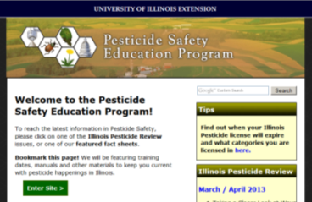
The Illinois PSEP program
Training by U of I Extension
Testing by the Illinois Department of Agriculture
http://web.extension.illinois.edu/psep/
Notes:
For information on educational programs and testing required to obtain a pesticide applicator’s license, check the Illinois Pesticide Safety Education Program. Dates for training and testing are listed on their website. Even if you do not plan to obtain a pesticide applicator’s license, taking the training offered by this program is a good idea for all growers. Training sessions include information on safe handling, calibration, application methods, and much more.

Slide 56
Contacts | Contact information
Rick Weinzierl | weinzier@illinois.edu
Notes:
We will cover many more details about pest management in fruits and vegetables, but this summary was designed to provide an overview of pesticide use and regulations. Please contact me or others who have provided instruction on these topics if you have more questions. Pesticides are often necessary in fruit and vegetable production. Using them responsibly and effectively can protect crops from losses and protect your profits. Using them incorrectly or irresponsibly can cost money, fail to protect crops, and present risks to others. Be sure to use accurate resources to make decisions on pesticide use and crop protection.

Slide 57
If you have questions …
University of Illinois Extension Local Food Systems and Small Farms team
http://web.extension.illinois.edu/smallfarm/
USDA’s Start2Farm site
http://www.start2farm.gov/
Notes:
Our beginning farmer training program ended in the fall of 2015. The best way to pursue answers to questions about fruit and vegetable production in Illinois is to contact educators on the University of Illinois Extension Local Food Systems and Small Farms team. Extension programs in other states are operated by the land-grant university in each state. Additionally, USDA’s Start2Farm site provides listings of farmer training programs in specific states and localities.

