Slide 1
Preparing a New Generation of Illinois Fruit and Vegetable Farmers a USDA NIFA Beginning Farmer and Rancher Development Program Project Grant # 2012-49400-19565 http://www.newillinoisfarmers.org
Notes:
The following presentation was part of a beginning farmer course, “Preparing a New Generation of Illinois Fruit and Vegetable Farmers,” offered by the University of Illinois and the Illinois Migrant Council from 2012 through 2015. This course was funded by the United States Department of Agriculture’s National Institute of Food and Agriculture, and specifically by the Beginning Farmer and Rancher Development Program. For more information about the program and for links to presentations and resources on many other topics, see the website newillinoisfarmers.org.

Slide 2
Preparing a New Generation of Illinois Fruit and Vegetable Farmers Integrated Pest Management focusing on plant diseases, insects, and weeds
Rick Weinzierl
May, 2014
Notes:
Hello, my name is Rick Weinzierl. I am a professor and extension specialist in entomology with the Department of Crop Sciences at the University of Illinois. This presentation in our Beginning Farmers program for fruit and vegetable producers focuses on integrated pest management.

Slide 3
Integrated Pest Management (IPM)
An approach that uses a range of practices that limit losses to pests (insects, pathogens, weeds, vertebrates) while minimizing the environmental damage, human health risks, and dollar costs associated with pest suppression.
Tactics include biological control, cultural controls, pest-resistant varieties, regulatory programs … and pesticides where needed and in ways that minimize their adverse effects
Notes:
Let’s start with a general definition of integrated pest management, or IPM. (Read definition above.) Note that for IPM, just as for pesticides, “pests” are broadly defined to include insects, mites, plant pathogens, weeds, and even wildlife. Today’s discussion will not cover wildlife damage prevention, but wildlife management will be included in an upcoming class.

Slide 4
Objectives
Today …
Consider farm plans that minimize the likelihood of severe pest outbreaks … a theme that’s repeated for all kinds of “pests”
Understand the basics of disease cycles, monitoring, and management
Understand the basics of insect life cycles, monitoring, and management
Understand the basics of weed life cycles, monitoring, and management
Know how to identify key references on identification, monitoring, and management so that you can build a library of resources
Examples for sweet corn, tomatoes, and apples
Your longer-term goals …
Develop plans for integrated pest management in your crops
Notes:
In this presentation I want to encourage you to develop farm plans that minimize the likelihood of severe pest outbreaks, and I’ll discuss that idea for various kinds of pests. I’ll introduce and stress the importance of understanding life cycles, monitoring methods, and management practices for plant pathogens, insects, and weeds. And I’ll provide examples of the types of references you will want to gather so that you can build a library of resources. My intent is to help you work on a longer-term goal – the development and implementation of an overall integrated pest management plan for your farm.

Slide 5
More on IPM …
Previous presentations and discussions on …
Basics of fruit and vegetable production
Variety selection
Transplant production
Pruning
Soils and soil fertility
Irrigation
Pesticides
… all of these included components related to integrated pest management, and future presentations and discussions will do so as well.
Notes:
While this presentation discusses IPM very broadly, several other classes and discussions have included aspects of IPM. Pest management was a concern in our discussions of the basics of fruit and vegetable production, variety selection, transplant production, pruning (to allow air movement and spray penetration), soils and soil management, irrigation, and pesticides. We will also cover insect, disease, weed, and wildlife management in individual sessions in later classes.

Slide 6
IPM is part of a farm plan that minimizes the likelihood of severe losses to pests and optimizes yields and profits…
Crop rotation
Cover crops
Appropriate tillage and soil management
Diversification of plantings
Well suited and disease-resistant cultivars
Irrigation management
Exclusion / avoidance
Monitoring / record-keeping
Direct control practices, including pesticides
Notes:
During the production season, IPM practices often focus on monitoring crops for pest problems and responding appropriately. However, integrated pest management involves much more than just scouting fields and dealing with pests. Instead, it is part of whole-farm planning. As you design, plan, and revise your crop production system, minimizing pest problems to optimize yield and profits should be a key component. Crop rotations, cover crops, tillage practices, crop and landscape diversity, disease-resistant cultivars, irrigation management, pest exclusion and avoidance, pest monitoring and record-keeping, and direct control practices are all involved in crop and pest management.

Slide 7
Basic Concepts in Plant Pathology, by J.R. Hartman. http://www.hort.purdue.edu/mg/pubs/DiagnosisBasicConcepts.pdf
Types of plant diseases
Abiotic noninfectious diseases
Infectious diseases
The disease triangle
Susceptible host plant, infective pathogen, and conducive environment
Diseases caused by fungi, bacteria, viruses, and nematodes
Disease symptoms and signs
Controlling diseases
Avoidance, exclusion, eradication, protection, resistance, and “therapy”
Notes:
Let’s start with a discussion of plant disease management. “Basic Concepts in Plant Pathology,” by John Hartman, is a good general summary to start with … it will be provided as a handout during our class on IPM. Dr. Hartman starts this summary by pointing out that some diseases are infectious … caused by living pathogens that infect plants … but other diseases result from non-living – abiotic – causes. Ozone injury, salt injury, and nutrient deficiencies are just a few examples of noninfectious, abiotic diseases. For infectious diseases, a very important concept in plant pathology is the plant disease triangle … the basic idea that infectious plant diseases develop only when three things are present simultaneously – (1) a susceptible host plant, (2) a pathogen that can infect that plant, and (3) environmental conditions that allow the infection to occur. Disease management practices always attempt to alter of one these parts of the disease triangle to prevent infections. The pathogens that infect plants include fungi, bacteria, nematodes, and viruses, and management practices for specific crops and diseases differ for different types of pathogens. Dr. Hartman points out that for disease diagnosis, the terms symptom and sign have specific meaning ... symptoms are plant reactions to infection – wilt, yellowing, blight, and so on; signs are the observable presence of the pathogen itself – fungal spores, fungal mycelia or fibers, bacterial ooze, and so on. He summarizes disease management practices under the headings avoidance, exclusion, eradication, protection, resistance, and therapy.

Slide 8
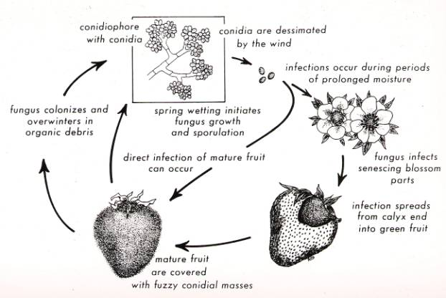
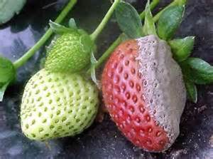
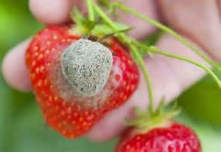
Disease cycle: Gray mold (Botrytis) on strawberries
Notes:
For major diseases of the crops you grow, a key step in disease management is to understand the disease cycle for each … in advance of growing the crop. For gray mold of strawberries (and several other crops), the causal pathogen is a fungus in the genus Botrytis. It causes the most damage when rainfall or irrigation during bloom and fruit development allow the pathogen to grow. It infects senescing blossoms first, and infections spread from blossoms to fruit. Spores are produced on infected tissue and on plant debris, and direct infection of mature fruit can occur a few days later. Knowing that senescing blossoms are an initial infection site can guide decisions on the use of fungicides at bloom during periods of rainy weather, and understanding that infected tissues produce spores that can start new infections guides additional decisions about disease management

Slide 9
Monocyclic versus polycyclic diseases
Polycyclic = Compound interest … several infection cycles per season – gray mold, powdery mildew, brown rot in stone fruits
Monocyclic = Simple interest … one infection cycle per season – soil-borne pathogen infections such as those caused by Fusarium, also peach leaf curl in peaches
Notes:
Gray mold of strawberries and other crops is called a polycyclic disease … production of new inoculum (spores, in this case called conidia) on infected tissues can initiate additional infection cycles as the season progresses. Polycyclic diseases – also called compound interest diseases – include gray mold, powdery mildew, brown rot in stone fruits, and many other examples. In contrast, monocyclic diseases cause only one infection cycle per crop season (although multiple cycles can occur in one year if succession plantings of vegetables provide a new crop for infection later in the summer or fall on the same ground or plot). Examples of monocyclic diseases – or simple interest diseases – include root or crown infections caused by fungi in the genus Fusarium or other soil-borne pathogens and peach leaf curl of peaches.

Slide 10
Controlling plant diseases …
Avoidance
By geographic area (climate), planting date, topography and drainage, disease-free planting stock, crop rotations
Exclusion
By disease-free planting stock, quarantines, exclusion of insect vectors
Eradication
(Or at least reduction in inoculum) By crop destruction, crop rotation, fumigation or other soil treatments
Protection
By application of fungicides or bactericides, habitat modification (high tunnels), control of insect vectors
Resistance
Usually not immunity, slowing disease progress can be adequate
Therapy
Removal of diseased plant parts
Notes:
Examples of Dr. Hartman’s summary of disease management practices are listed in this slide. To avoid pathogens, crops may be grown in regions where certain pathogens do not occur or are rare (for example, several vegetable seed crops are grown in the arid West where key bacterial diseases do not occur, and that produces disease-free seeds), crops susceptible to aphid-borne viruses are grown early in the season when aphid populations are usually lighter, crops susceptible to root rots are not grown on low, wet, poorly drained soils, and rotations are designed to place susceptible crops in fields where specific pathogen levels have declined in the absence of crops in that plant family. Seed and plant certification programs, quarantines on the movement of infected plant materials, and the use of row covers to exclude insect vectors of viruses are all examples of exclusion of plant pathogens from fields. Eradication of pathogens – or more accurately the reduction of inoculum to low levels – is the goal of destroying or burying or effectively composting crop residues and of crop rotations so that soil-borne pathogens die off or are attacked by other soil microorganisms during the years when susceptible crops are not grown in those fields. Fungicides and bactericides may be applied to plants to protect them from infection, and high tunnels and greenhouses protect plants from rainfall that may be necessary for infections. Using disease-resistant varieties is often a key step in disease management for fruits and vegetables. Therapy – killing off an infection within a plant – is usually not an option, though hot-water treatment of some vegetable seeds is an example of this approach.

Slide 11
Using resistant varieties slows disease progression
Late blight disease progress curve showing the proportion of leaf area infected across 45 days post infection (dpi) of the four groups of pyramiding population RH03-424; without R _{pi} -genes, with R _{Pi-mcd1} present, with R _{Pi-ber} present, and containing both R _{pi} -genes R _{Pi-mcd1} + R _{Pi-ber} . Error bars indicate the standard error of the mean. a Uncorrected disease progress using values as observed in the field. b Disease progress values using maturity corrected resistance (MCR) values. From: The effect of pyramiding Phytophthora infestans resistance genes R Pi-mcd1 and R Pi-ber in potato , by Tan, M. Y. Adillah; Hutten, Ronald C. B.; Visser, Richard G. F.; Eck, Herman J. Theoretical and Applied Genetics Vol. 121 Issue 1.
Notes:
Often the realistic goal of plant disease management is to slow the progress of disease development in a crop or field. (Plant pathologists often describe disease development by measuring the “area under the disease progress curve.” If disease development can be delayed, especially for diseases that do not alter the appearance of fruits and vegetables, profitable yields can be harvested even if many plants are infected by the end of the season. The graphs in this slide illustrate the value of using resistance in potatoes to reduce losses to late blight. The details are not the point of showing the slide, but the idea that resistance, habitat modification, fungicides, and other management practices can slow disease development and protect yields is very important … and the basis for disease management in general.

Slide 12
Examples of plant disease resources
Cornell’s Vegetable MD online site focusing on plant diseases http://vegetablemdonline.ppath.cornell.edu/
Midwest Small Fruit Pest Management Handbook
http://pested.osu.edu/documents/CommStudy/2b%20Midwest%20Small%20Fruit%20Pest%20Mgmt..pdf
Midwest Tree Fruit Pest Management Handbook
http://www2.ca.uky.edu/agc/pubs/id/id93/id93.htm
Tomato diseases
http://www.extension.iastate.edu/publications/pm1266.pdf
http://aggie-horticulture.tamu.edu/vegetable/tomato-problem-solver/
Notes:
We grow a great number of vegetable and fruit crops in Illinois, and each is susceptible to several common and damaging diseases. We’ll cover some specific disease management practices later this gourse and see several during our field and farm visits as well, but the breadth of the topic of plant disease management in vegetables and fruits is much greater than we can cover in our presentations. Cornell’s Vegetable MD site provides many useful fact sheets, illustrations, and management recommendations for a wide variety of vegetable crops. Similarly, the Midwest Small Fruit Pest Management Handbook and the Midwest Tree Fruit Pest Management Handbook are available online and in print … they provide background information on disease cycles and cultural control practices for many common diseases. In many instances, you will want to use google or a similar search engine to look for disease identification and disease management guides for specific crops. The two tomato disease publications listed here are examples of the kind of information available online. In many instances, the online references that will be most valuable are those from .edu and .gov domains … publications produced by university research and extension personnel and by USDA researchers. Good references can be found from private sources (.com and .org domains), but some of these also advocate for certain commercial products or contain inaccurate or unsubstantiated claims … be a little careful as an information consumer.

Slide 13
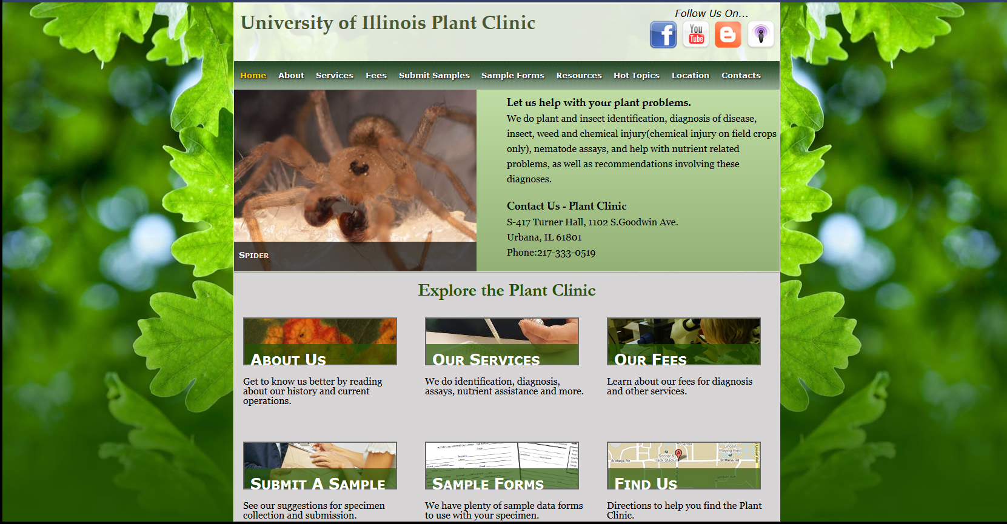
The University of Illinois Plant Clinic
http://web.extension.illinois.edu/plantclinic/
Notes:
Although online and printed disease identification guides can be very helpful, it’s often necessary to send samples of diseased plants to a lab where a definitive diagnosis can be done. The University of Illinois Plant Clinic provides such a service for a small fee. The Plant Clinic web site provides information on its services and fees and on how to prepare and send samples. Planning and carrying out disease management practices that can resolve a problem or avoid it in the future depend on correct diagnosis … practices that reduce losses to one disease may not be at all effective for another whose symptoms may look quite similar. Paying a small fee for an accurate identification and diagnosis is almost always a good investment.

Slide 14
Background information on insect pest management
Introduction to Applied Entomology
http://cpsc270.cropsci.illinois.edu/syllabus/ … early topics cover biology / identification; later topics cover insect pest management; lab 10 (http://cpsc270.cropsci.illinois.edu/syllabus/lab10.pdf) covers fruit and vegetable insect management
Garden Insects of North America. W. Cranshaw. ISBN: 9780691095615. 672 pp. 1,400+ color photos.
An excellent general reference with lots of illustrations.
Notes:
Let’s turn to insect pest management considerations. Two general sources of information on insects and pest management for fruits and vegetables in the Midwest are the website for the University of Illinois Introduction to Applied Entomology course and the book, Garden Insects of North America. The early portion of the introductory entomology course covers insect biology and broad categories of classification and identification; the later portion of the course focuses on pest management. The guide to the lab on fruit and vegetable insects is available at the link on this slide. This is the class that I have taught from the mid-1990s and will continue to teach through 2016 or 2017. An excellent reference on common insects in gardens, crops, and landscapes is Garden Insects of North America by Whitney Cranshaw. It contains over 1400 illustrations and sells for $29.95 (or less sometimes on Amazon).

Slide 15
Things to know about insect pests and their natural enemies
Insect life cycles
Univoltine (1 generation per year) versus multivoltine (2 or more generations per year)
Complete versus gradual metamorphosis
Chewing versus piercing/sucking mouthparts
Structure of legs and wings
Phenology
Relationship between development and degree-days
Direct versus indirect pests
Direct pests feed on the part of the crop we harvest – especially important for fruits and vegetables because of cosmetic standards. Indirect pests feed on “supporting” plant tissues (often but not always roots and stems)
Secondary pests
Insects or mites that are usually controlled by natural enemies, they build up to become pests after control actions kill their natural enemies
Notes:
Some key things to consider in insect pest management – in addition to accurate identification of the insects that occur in crops – include
their life cycles … some develop through just one generation each year, others have multiple generations per year (and a few take more than one year to develop from egg to adult); this characteristic influences management practices;
their metamorphosis – those with gradual metamorphosis – or change in form -- look pretty much the same in immature and adult stages and live in the same habitat, while those with complete metamorphosis change form from the immature to adult stage – caterpillars to moths, grubs to beetles, and maggots to flies;
their mouthparts or feeding structures … those with a piercing, needle-like stylet suck plant fluids from host plants and cannot eat holes in leaves … if an insect feeds on leaves and results in holes or missing tissue, it’s one that instead has chewing mandibles – beetles, caterpillars, grasshoppers, and so on;
and whenever you describe an insect to someone in hopes of learning what it is, be sure to be able to describe the wings (how many and what shape) and the legs (are they “special” in any way … modified for jumping, digging, and so on?).
Insects develop faster at warmer temperatures, so the timing of their occurrence is sometimes predicted using phenology models and degree-days. They may be direct or indirect pests … direct pests fed on the parts of crops that we intend to harvest – for example the fruits of apples and tomatoes; indirect pests feed on supporting parts – often roots, stems, and leaves, though in some cases those parts are what we harvest … think beets, carrots, and spinach. And some pest populations “explode” in numbers after insecticides are used to control other pests and kill natural enemies as well. These are called secondary pests, and aphids and mites often fall into this description.

Slide 16
References and resources on vegetable insects
Fact sheets on vegetable insects
http://ento.psu.edu/extension/vegetables/fact-sheets
http://www.vegedge.umn.edu/vegpest/pests.htm
Vegetable Insect Management
http://store.meistermedia.com/vegetable-insect-management-w-bonus-cd-rom/
Notes:
For identification of pest insects in specific crops, fact sheets and specialized publications are useful. The Penn State University and University of Minnesota fact sheets cited in this slide are very useful; so is the Vegetable Insect Management book published by Meister Press.

Slide 17
References and resources for fruit insects
Field Guide for Identification of Pest Insects, Diseases, and Beneficial Organisms in Minnesota Apple Orchards
http://www.mda.state.mn.us/plants/pestmanagement/ipm/apple-guide.aspx
Tree Fruit Field Guide to Insect, Mite, and Disease Pests and Natural Enemies of Eastern North America. ISBN: 1-933395-02-8. Order at:
http://palspublishing.cals.cornell.edu/nra_order.taf?_function=detail&pr_id=158&_UserReference=4983462C15D28A6C4A201F4B
Epstein et al. Pocket Guides for IPM scouting in Apples and in Stone Fruits.
Order at http://msue.anr.msu.edu/resources/scouting_guides_for_fruit or view online at http://web2.msue.msu.edu/Bulletins/Bulletin/PDF/Historical/finished_pubs/e2720/e2720-2004.PDF and at http://www.oakgov.com/msu/Documents/publications/e2840_ipm_scoutingin_stonefruits.pdf
Midwest Small Fruit Pest Management Handbook
http://pested.osu.edu/documents/CommStudy/2b%20Midwest%20Small%20Fruit%20Pest%20Mgmt..pdf
Midwest Tree Fruit Pest Management Handbook
http://www.ca.uky.edu/agc/pubs/id/id93/id93.htm
Notes:
For fruit insects, the first reference listed on this slide is from the University of Minnesota. The second is more extensive but less focused on the Midwest. The pocket guides for apples and stone fruits (peaches, nectarines, apricots, plums, and cherries) focus on how to look for and assess densities of pest problems in common tree fruits. The Midwest Pest Management handbooks for small fruits and tree fruits were recommended earlier in conjunction with plant disease management as well.

Slide 18
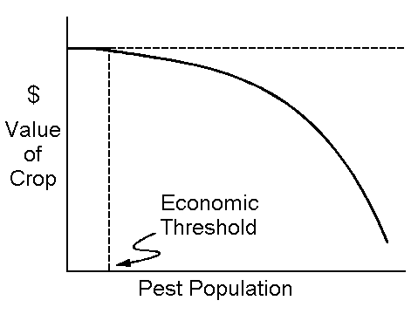
Economic thresholds and insect pest management
Thresholds: Pest density at which control actions should be taken to prevent crop losses that exceed the cost of control
Can be complicated by environmental consequences and the ability to monitor pest densities before control steps need to begin
Notes:
An underlying idea for insect pest management – and for management of diseases, weeds, and wildlife – is that low densities of pests may cost more to control than the value of the loss that they will cause. If the cost of controlling a pest is greater than the losses the pest will cause, then the control action is not profitable. Where control actions –often pesticide applications -- can be effective if they are initiated after scouting or monitoring indicates that the problem is “worth” treating, research on the relationship between pest density and profit loss can be used to set “ thresholds” – how many insects, weeds, nematodes, or infected plants per standard sample warrants some sort of control. The idea can become quite complicated when the value of the crop, standards for cosmetic appearance, and the costs of control steps differ within or over seasons, but a valuable take-home message is that pest management practices do not need to aim for total elimination pests to be adequately effective. “Thresholds” are guidelines for pest densities that should trigger direct control actions.

Slide 19
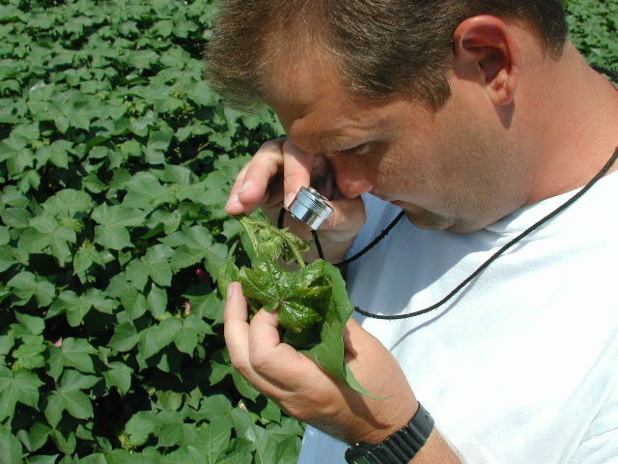
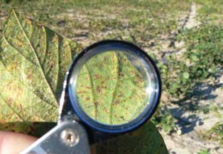
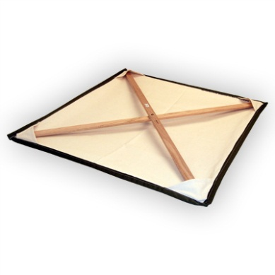
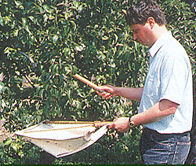
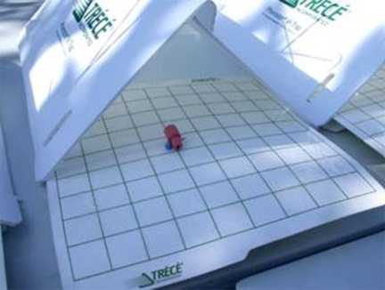
Monitoring Insects and Mites
Primary tools
Hand lens
Beating tray
Pheromone traps
Sweep net
Sources of Equipment and Supplies
Great Lakes IPM, 10220 E Church Rd., Vestaburg, MI 48891
989-268-5693 or 800-235-0285 ... http://www.greatlakesipm.com/
Notes:
So if estimates of pest density allow decisions on whether or not controls are warranted, what kind of monitoring or scouting tools are needed? The most common tools and devices are (1) a hand lens … not a big magnifying glass, the distortion associated with lenses of that diameter limit their effective magnification … buy a small lens and learn how to use it; (2) a beating tray or ground cloth … any kind of light-colored surface that can be held or placed under plants so that when the plants are struck or shaken, the insects that drop from the plants end up on the tray or cloth; (3) pheromone traps … traps that are baited with lures that attract a certain pest species; and (4) a sweep net. You’ll see examples of all of these devices in class and in our farm visits this season. A reliable supplier of monitoring tools in the Midwest is Great Lakes IPM.

Slide 20
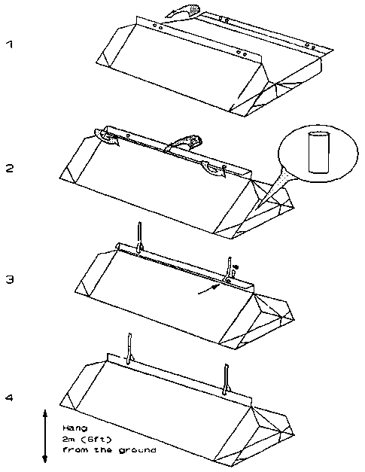
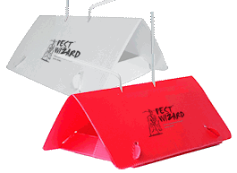
Pheromone traps
Using pheromone traps (and other insect traps)
A summary of insect trapping guidelines for tree fruit insects (for monitoring populations to determine the need for and timing of sprays) is provided at http://ipm.illinois.edu/ifvn/contents.php?id=40#fruit
Color … orange or white for most moths (red sphere for apple maggot)
Type … large delta trap for most moths
Lures … differ for each species; do not combine in a single trap
Record keeping
Notes:
Pheromones are chemicals that insects use for within-species communication. In pest management, pheromones that female moths use to attract males are used most commonly for monitoring the time of occurrence and the relative density of pest populations. They do NOT attract females or lead to an increase in damage in the areas around the traps. Although pheromones for many species have been identified, pheromone traps (and similar traps that do not use pheromones as lures) are used for a relatively small number of insect pests. For new growers, start with using traps to monitor flights of codling moth, apple maggot, and oriental fruit moth in apples; oriental fruit moth and lesser and greater peachtree borers in peaches, spotted wing Drosophila in several fruit crops, and corn earworm around sweet corn and tomatoes. Keeping records of counts is essential for later decision-making. Remember that these traps are used to monitor populations, not reduce them. We almost never recommend the use of any kind of traps to reduce populations of insects outdoors. And we definitely do not recommend the use of Japanese beetle traps to reduce populations of that insect … they do not work as adverstised.

Slide 21
Beneficial insects
See:
Natural Enemy Field Guide … http://www.ncipmc.org/glvwg/pdfs/NaturalEnemiesFlyer-FINAL.pdf
Identifying and Enhancing Natural Enemies in Vegetable Crops … http://www.youtube.com/watch?v=r1EYCevAgnY
Alternatives in Insect Management: Biological and Biorational Approaches … http://www.aces.uiuc.edu/vista/abstracts/aaltinsec.html
An IPM Scouting Guide for Natural Enemies of Vegetable Pests … http://www2.ca.uky.edu/agc/pubs/ent/ent67/ent67.pdf
Plants that Attract Beneficial Insects … http://nac.unl.edu/bufferguidelines/guidelines/5_protection/2.html
Attracting Beneficial Insects with Native Flowering Plants … http://migarden.msu.edu/uploads/files/e2973.pdf
Notes:
The vast majority of insects are not pests, and many are directly beneficial as pollinators and as natural enemies – predators and parasites – of pests. The first 4 references in this slide include general information on identifying natural enemies and encouraging their populations. The fifth and sixth listings provide recommendations of specific plants that attract and support various predaceous and parasitic insects. Realize that many predaceous and parasitic insects feed on pollen and nectar from small flowers as well as on other insects. In outdoor production, the purchase and release of natural enemies from insectaries rarely provides meaningful benefits. Buying and releasing predators and/or parasites of aphids, whiteflies, thrips, and mites in greenhouses or high tunnels can be effective in some cases.

Slide 22
Controlling insects… (using the same categories of practices listed for plant disease control)
Avoidance
By geographic area (climate), planting date, insect-free planting stock, crop rotations
Exclusion
By insect-free planting stock, quarantines, row covers, screening
Population reduction
By crop destruction, crop rotation, fumigation or other soil treatments
Protection
By application of insecticides and miticides
Resistance
Usually not immunity, slowing population growth can be adequate; fewer examples of insect resistance than plant disease resistance in fruit and vegetable crops … thrips resistance in cabbage and onions; Bt sweet corn
Therapy
Systemic insecticides (emerald ash borer)
Notes:
In many ways, the approaches used to limit crop losses to insects are very similar to those used in disease management. Early plantings of several vegetable crops may be used to avoid late-season pests such as earworms, fall armyworms, and aphids; later plantings may avoid early-season seed and root maggots; rotations are less effective against insects that are highly mobile at the relevant stage of their life cycle, but they are valuable against several important pests such as Colorado potato beetle and squash bug. Planting insect-free transplants is important … and using infested transplants occasionally result in diamondback moth infestations in cabbage family crops. Screening in greenhouses and row covers in fields can provide effective exclusion of many pests. Crop destruction after harvest prevents further survival and reproduction for host-specific insects such as squash bug and squash vine borer. Insecticides and miticides “protect” plants by killing the pests in treated fields. There are fewer examples of insect-resistant cultivars than disease-resistant cultivars, but thrips-resistant onion and cabbage cultivars are available, and Bt sweet corn cultivars kill caterpillars that otherwise infest stalks and ears.

Slide 23
Weed Management
Important considerations
Broad taxonomic categories
Life cycles and time of control
Identification
Cultural control practices
Mechanical control practices
Herbicides … chemical control
Notes:
Weed management is also part of IPM. At an overview level, important considerations are the types of weeds, their life cycles, specific identification, and cultural, mechanical, and chemical control. Remember that the reasons for weed management include reducing their impact as competitors for water, light, and nutrients; limiting the buildup of the weed seed bank in the soil; and reducing their contributions to the survival and impacts of crop pathogens and insects.

Slide 24
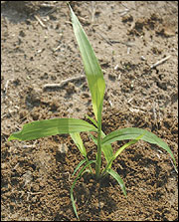
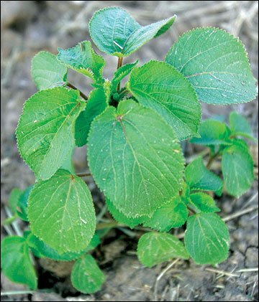
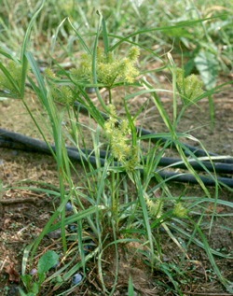
Weed classification: by broad taxonomic groupings
Grass
Broadleaf
Sedge
MU Extension
MU Extension
Michigan State University
Notes:
Weeds are broadly classified as grasses (monocots), broadleaf weeds (dicots), and sedges. These groups of plants respond differently to physical practices and herbicides that might be used in attempts to control them.

Slide 25
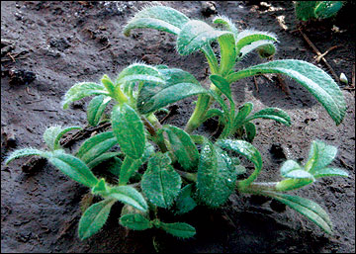
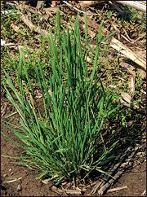
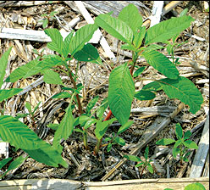
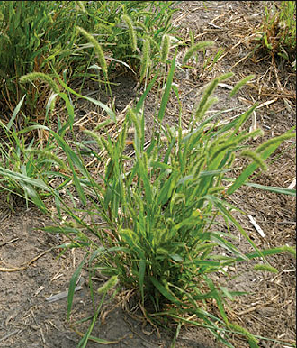
Weed classification by life cycle
Annuals – complete life cycle in one “season”
Summer annuals (waterhemp, giant foxtail)
Winter annuals (henbit, chickweed)
Notes:
Weeds are described by the seasonality of their life cycles and the duration of their life cycles. Annual weeds complete their life cycle – from seed germination through vegetative growth, flowering, and seed production – in one year. Summer annuals such as waterhemp and giant foxtail germinate from seed in the spring or summer, then grow and produce seed later in the summer or fall of the same year. Henbit and chickweed are examples of winter annuals that germinate from seed in the later summer or fall, grow vegetatively before cold temperatures prevent further growth, then resume growth and produce seed in the spring or early summer of the next year.

Slide 26
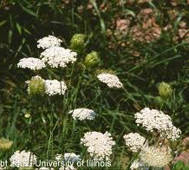
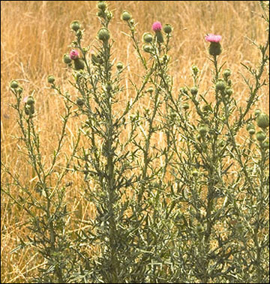
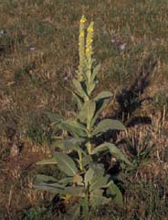
Biennial – complete life cycle in two growing seasons
Wild carrot, bull thistle, common mullein
Notes:
Biennial weeds such as wild carrot, bull thistle, and common mullein require two growing seasons to complete their life cycles. They emerge from seeds in the spring or summer, grow vegetatively the first season, survive the winter, and flower and produce seeds the next growing season

Slide 27
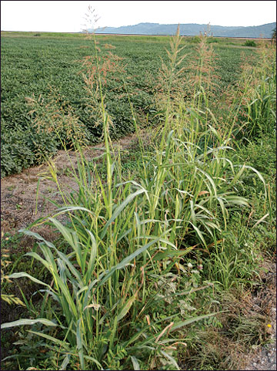
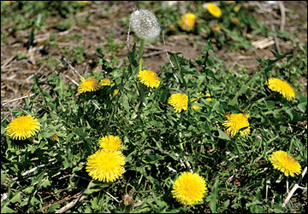
Perennial – live for two or more years
Dandelion, pokeweed, johnsongrass, wild garlic
Notes:
And as the name implies, perennial weeds live for 2 years or more … many for several years, regrowing from roots each year. Dandelions, johnsongrass, and wild garlic are perennials. Different weeds with different life cycles are favored in different cropping systems. Those that are very similar to the crop may be most difficult to control.

Slide 28
Weed identification
The key to a successful weed management program.
Many herbicides only control certain weeds
Also important in mechanical or cultural methods
The more similar the crop and weed the more difficult it is to control
It is much easier to control a grass weed in a broadleaf crop than a grass crop
Notes:
As with disease management and insect management, identifying the weeds that infest different portions of your farm is a key step in planning management practices. Herbicides that are effective against a certain weed may not be effective against another, and even the cultural and mechanical practices you might use may differ in their value against different weed species. Weeds that are more closely related to the crop in a given field are often hardest to control; weeds with life cycles similar to the crop can also present added challenges.

Slide 29
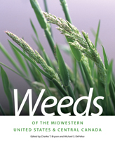
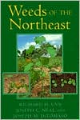
Weed identification resources
University of Missouri Weed ID
http://weedid.missouri.edu/
USDA Plants Database
http://plants.usda.gov/java/
Practical Weed Science for the Field Scout
http://extension.missouri.edu/p/ipm1007
Weeds of the Northeast (book)
Uva, Neil, and DiTomaso
Weeds of the Midwestern United States and Central Canada (book)
Bryson and DeFelice
Notes:
The references listed here are among many good resources on weed identification. References that include keys and photos for identification of weed seedlings can be especially valuable where selection of an herbicide may depend on the weed species that you intend to control.

Slide 30
Cultural control practices for weeds
Planting date
Seeding rate/row spacing
Cover crops
Fertility
Irrigation management
Crop rotation
Plant vigorously growing cultivars
Mulching (Organic or Inorganic)
Notes:
Weed management involves lots of different factors. Delaying planting may allow removal of an early flush of weeds with light tillage or a burn-down herbicide before planting; planting early may allow crop establishment and growth before summer annual weeds germinate and compete for resources. Higher seeding rates and close row spacings can lead to quick development of a crop canopy that shades out weed seedlings. Cover crops may produce allelopathic chemicals that inhibit weed growth or out-compete weeds during periods between crops … and prevent weeds from producing seeds that would add to the soil weed seed bank. Fertilizing and watering only within rows on raised beds covered with plastic mulch support the crop but not the weeds between rows. Crop rotations allow for different weed control practices at different times in different crops on the same plot of land. And mulches – of many different types – are used in many vegetable and fruit production systems.

Slide 31
Mechanical control practices for weeds
Cultivation/Tillage
Preplant tillage
Row cultivation after planting and emergence
Hoeing/hand pulling
Mowing
Fallow
Flaming/Burning
Heat (steaming, solarization) – good for controlling / reducing weed seed bank population
Notes:
We always advise against over-tillage because of the negative effects of tillage on soil structure, but tillage is often a key step in weed management in vegetable crops. Preplant tillage removes weed seedlings and prepares a seedbed that allows rapid germination of new crops. Row cultivation also is a standard practice in some crops. Everyone is very familiar with hoeing, pulling, and mowing. Flaming, burning, steaming, and solarizing all can play roles in certain circumstances.

Slide 32
Herbicides for chemical control
Many herbicides on the market but only a limited number are labeled for many specialty crops
Why???
Due to the diversity of specialty crops
Specialty crops are a smaller market share compared with agronomic crops.
Notes:
Recommendations for herbicide use for weed control in fruits and vegetables are presented in publications that I’ll list in a few minutes, and in fact herbicides can be used effectively and safely as part of weed control program on small farms. However, herbicides are not as dominant a part of weed control in specialty crops as they are in large-scale agronomic crops. One reason is that herbicide development and registration is a very expensive process, and the potential sales that would allow companies to recoup investment costs are much lower in specialty crops. Additionally, drift of some products across even a short distance and persistence in soil for other chemicals complicate the use of herbicides in the diverse plantings and complex crop rotations that characterize many small farms.

Slide 33
Models and forecasting systems
Degree-day (phenology) models for insects
http://ipm.illinois.edu/degreedays/
Disease forecasting models for …
Stewart’s wilt of sweet corn
Potato late blight
Apple scab, fireblight, and sooty blotch and flyspeck of apples
Early blight, Septoria, and Anthracnose of tomato (TOMcast)
Especially important if sprays must be applied before any signs of infection or infestation are present
Notes:
Although we all know that insects develop faster in warmer weather and that most plant diseases progress more rapidly in warm, wet weather, predictive models based on temperature, leaf wetness, and other factors are available to guide monitoring and control programs for insects and diseases. Some are available at no charge online, others require purchase of weather monitoring equipment and computer software. Even if you’re not ready for such investments, it’s never too soon to read about and learn about these programs that can help to refine decisions on pesticide application.

Slide 34
Newsletters
Illinois Fruit and Vegetable News
http://ipm.illinois.edu/ifvn/
Facts for Fancy Fruit (Indiana)
http://www.hort.purdue.edu/fff/fff.shtml
Vegetable Crops Hotline (Indiana)
http://www.btny.purdue.edu/pubs/vegcrop/index2013.html
VegNet (Ohio)
http://vegnet.osu.edu/newsletter
Notes:
A common recommendation for all aspects of integrated pest management … read the relevant newsletters that cover fruit and vegetable production. These newsletters from Illinois, Purdue (Indiana), and Ohio are especially useful for Illinois growers.

Slide 35
Archived webinars
University of Illinois Small Farms webinars …
http://web.extension.illinois.edu/hkmw/cat88_3926.html
Topics include …
3 webinars on insect, disease, and weed management in organic vegetable production
3 webinars on small orchard management … overall management, insect management, disease management
2 webinars on the basics of fruit insect management and common vegetable insects
Many more topics of interest for small- to medium-scale farmers
Notes:
The University of Illinois Extension’s Local Food Systems and Small Farms team has organized and delivered numerous webinars that are especially useful for new growers, and these discussions are archived and available. Three cover insect, disease, and weed management in organic vegetable production; three focus on small orchard pest management and crop management; two others cover insect management in fruits and vegetables in general. Use the link presented in this slide to access these archived webinars.

Slide 36
Examples of IPM Guides
An IPM Scouting Guide for Common Problems of Sweet Corn in Kentucky
http://www2.ca.uky.edu/agc/pubs/id/id184/id184.pdf
For tomatoes and peppers … An IPM Scouting Guide for Common Pests of Solanaceous Crops in Kentucky
http://www2.ca.uky.edu/agc/pubs/id/id172/id172.pdf
University of Kentucky Apple IPM
http://www.uky.edu/Ag/IPM/appleipm/appleipm/ap-man.php
Identifying and Managing Cucurbit Pests
Order for $11.00 from https://pubsplus.illinois.edu/C1392.html
Notes:
For the main crops you plan to grow, it’s always good to locate and read one or two good references on pest management before you start growing the crop. These are a few examples that cover sweet corn, tomatoes and peppers, apples, and cucurbits.

Slide 37
Examples of scouting forms
Pumpkins
http://www.pestmanagement.rutgers.edu/ipm/Vegetable/Scoutforms/PumpkinScoutingForm.pdf
Tomatoes
http://www.pestmanagement.rutgers.edu/ipm/vegetable/Scoutforms/Tomato%20form.pdf
Cole crops
http://www.pestmanagement.rutgers.edu/ipm/Vegetable/Scoutforms/Cole%20Crop%20Scouting%20Form.pdf
Peppers
http://www.pestmanagement.rutgers.edu/ipm/Vegetable/Scoutforms/Pepper%20form.pdf
Notes:
It’s also really important to monitor fields or plots regularly – at least once weekly. The monitoring process is called scouting, and it requires specific approaches to looking for and assessing different insects, diseases, and weeds. The links listed in this slide provide forms to use when scouting specific crops. These are just examples, and in fact we use a single form for scouting multiple crops at the Sustainable Student Farm at campus at Urbana. The most important things are to (1) observe crops closely and (2) record what you see … with numbers that indicate how many or how much.

Slide 38
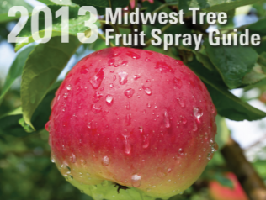
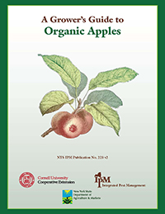
How do you know what to spray against what pest in a given crop?
Midwest Tree Fruit Spray Guide
http://www.extension.iastate.edu/Publications/PM1282.pdf
Cornell Production Guide for Organic Apples
http://nysipm.cornell.edu/nysipm/organic_guide/fruit_org_guide.asp
Notes:
AFTER you design your farm plan to minimize pest risks, you scout to determine what problems still arise, and you need to do something to reduce the losses that insects, diseases, or weeds will cause, THEN the same references I mentioned in the discussion about pesticides provide summaries of what works against what problems … the Midwest Tree Fruit Spray Guide and the Cornnell Production Guide for Organic Apples.

Slide 39
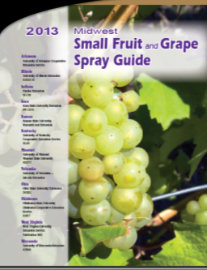
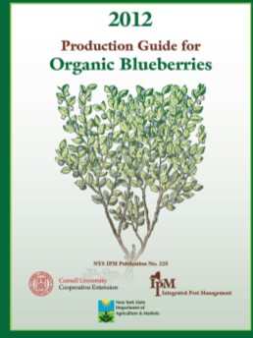
Spray Guides for Small Fruits
Midwest Small Fruit and Grape Spray Guide:
https://ag.purdue.edu/hla/Hort/documents/ID-169-2013.pdf
Cornell Organic Production Guides (blueberries, grapes, strawberries)
http://nysipm.cornell.edu/organic_guide/
Notes:
For small fruits, use the Midwest Small Fruit and Grape Spray Guide or the organic production guides from Cornell.

Slide 40
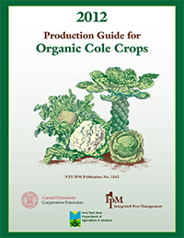
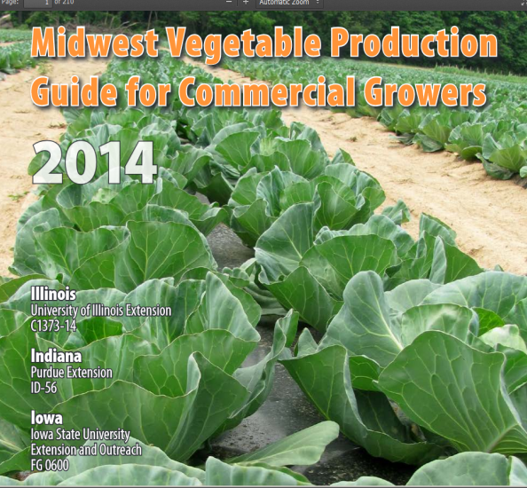
For Vegetables …
Midwest Vegetable Production Guide
http://www.btny.purdue.edu/pubs/id/id-56/ID-56.pdf
Cornell’s Organic Production Guides for Vegetables
http://nysipm.cornell.edu/nysipm/organic_guide/veg_org_guide.asp
Notes:
And for vegetables, the Midwest Vegetable Production Guide and Cornell’s organic production guides.

Slide 41
To summarize …
This presentation has provided some general information to help you …
Consider farm plans that minimize the likelihood of severe pest outbreaks … a theme that’s repeated for all kinds of “pests”
Understand the basics of disease cycles, monitoring, and management
Understand the basics of insect life cycles, monitoring, and management
Understand the basics of weed life cycles, monitoring, and management
Identify key references on identification, monitoring, and management so that you can build a library of resources
Examples for sweet corn, tomatoes, and apples
Upcoming presentations and discussions will address specifics of weed, plant disease, insect, and wildlife management in fruit and vegetable production so that you can begin to develop plans for integrated pest management in your crops

Slide 42
To reach us …
Contacts | Contact information
Rick Weinzierl | weinzier@illinois.edu
Nathan Johanning | njohann@illinois.edu

Slide 43
If you have questions …
University of Illinois Extension Local Food Systems and Small Farms team
http://web.extension.illinois.edu/smallfarm/
USDA’s Start2Farm site
http://www.start2farm.gov/
Notes:
Our beginning farmer training program ended in the fall of 2015. The best way to pursue answers to questions about fruit and vegetable production in Illinois is to contact educators on the University of Illinois Extension Local Food Systems and Small Farms team. Extension programs in other states are operated by the land-grant university in each state. Additionally, USDA’s Start2Farm site provides listings of farmer training programs in specific states and localities.

