Slide 1
Preparing a New Generation of Illinois Fruit and Vegetable Farmers a USDA NIFA Beginning Farmer and Rancher Development Program Project Grant # 2012-49400-19565 http://www.newillinoisfarmers.org
Notes:
The following presentation was part of a beginning farmer course, “Preparing a New Generation of Illinois Fruit and Vegetable Farmers,” offered by the University of Illinois and the Illinois Migrant Council from 2012 through 2015. This course was funded by the United States Department of Agriculture’s National Institute of Food and Agriculture, and specifically by the Beginning Farmer and Rancher Development Program. For more information about the program and for links to presentations and resources on many other topics, see the website newillinoisfarmers.org.

Slide 2
Preparing a New Generation of Illinois Fruit and Vegetable Farmers Transplant Success!
Jeff Kindhart, Chris Konieczka¹, Zack Grant,
William Davison, Shelby Henning and Jeremy Shafer
January 2014
¹Some slides developed by Chris Konieczka

Slide 3
Why use transplants?
Higher germination rate for expensive seeds
Extends growing season – 4 to 6 week old plants are ready to set out soon as danger of frost has passed
Earlier yields which allow for easier crop marketing
Notes:
Transplants are commonly used in temperate climate areas like Illinois for several reasons. First they allow growers to achieve a higher percent germination for expensive seeds. Some hybrid seeds can cost as much as one dollar per seed. Additionally, by using transplants we can gain about 4 to six weeks of growing season. For example, by setting a 4 week old tomato transplant, instead of direct seeding a tomato seed in the field, after the frost free date we can harvest tomatoes 4 weeks or more earlier. Early harvested vegetable are generally both easier to market and worth a higher price.

Slide 4
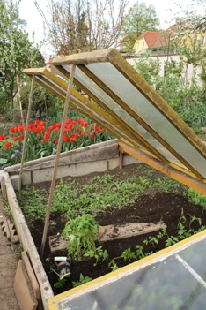
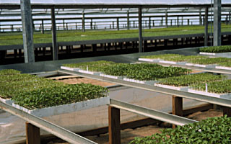
Hotbeds & Greenhouses
Notes:
Transplants can be produced in either hotbeds or greenhouses. A hotbed like seen on the left is typically a low profile box with a slanted top that is skinned with glass, polycarbonate or other light transmitting material. Thermostatically controlled heat cables are the most common heat source for hotbeds although composting manure and/or plant debris can also provide heat. Greenhouses are by far the most common for transplant production. New growers will sometimes try raising transplants in their house by using grow lights to provide additional light. With very rare exception, this option normally ends poorly.

Slide 5
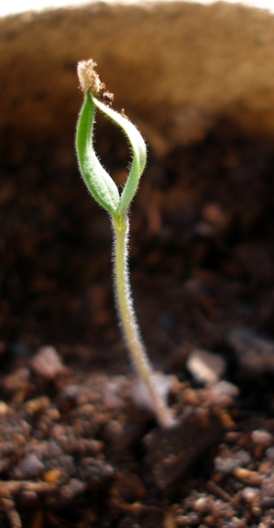
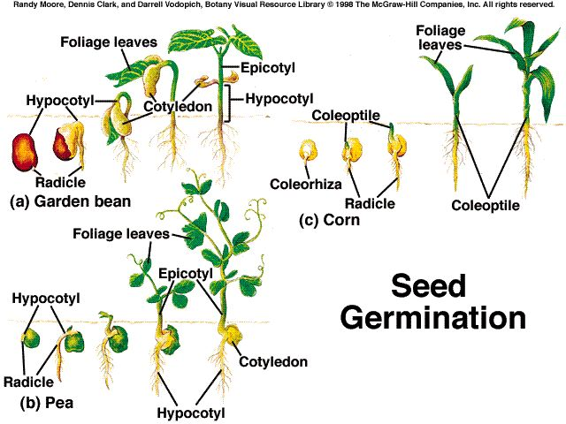
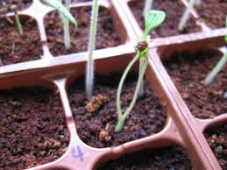
Seed Germination
Notes:
The first step to transplant production in generally to germinate a seed.

Slide 6
Factors for seed germination
1. Viable seed: Seed must be alive (embryo)
2. Correct environmental conditions including:
a. Water
b. Temperature
c. Oxygen
d. Light
3. Lack of dormancy or dormancy released
Notes:
Seed germination requires several factors. The seed be used must be viable with a living embryo. The seed must be placed in an environment that with proper water, temperature, oxygen and light levels for the species being grown. The seed must also be free from dormancy. While dormancy is not an issue for growers using purchased seed it can be a problem for some species if growers are saving their own seed.

Slide 7
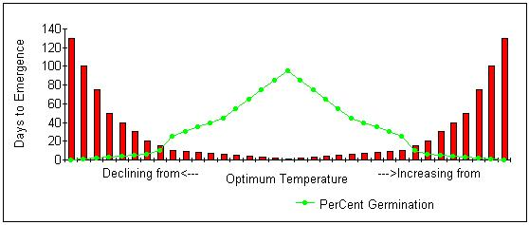
Impact of Temperature
Notes:
The graph above shows the impact of temperature on seed germination. At optimal temperature the percent seed germination is maximized and the days to emergence is minimized. As it gets warmer or colder than optimal temperature, the number of days required for emergence of all the seedling that are going to germinate is lengthened and the percent germination declines.

Slide 8
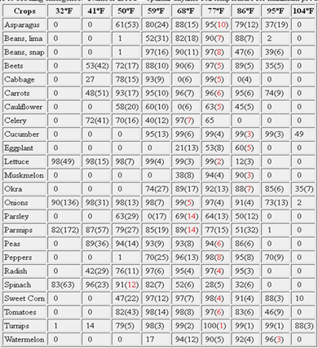
Notes:
This chart shows the optimum temperature for several vegetable crops. There are many similar charts available in reference books or on the internet. The chart shows the percent germination at various temperatures the number in parenthesis is the number of days to seed emergence.

Slide 9
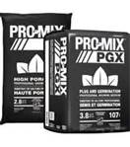
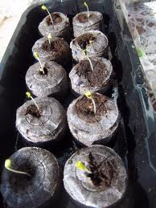
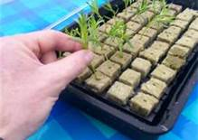
Water and Oxygen
Notes:
Proper water and oxygen levels are important for successful seed germination. These will largely be determined by the choice of media the grower is using. Plug mix is most commonly used for seed germination. Plug mix (or seed starter) is a media that is finer in texture than the growing media that will be used later. This helps ensure good seed soil contact. For some crops like cucurbits, jiffy pellets seen in the upper right can be used. Hydroponic growers may opt for rock wool cubes like seen in the bottom center.

Slide 10
Dormancy Types and Remedies
Hard seed coat(many gourds)
Scarify seed coat
Immature embryo
Allow for after ripening period
Internal physiological dormancy
Stratification
Notes:
Growers using purchased seed will not need to worry about seed dormancy. Growers that are saving their own seed need to make sure the species they are saving either does not have dormancy problems or take steps to alleviate seed dormancy. Common types of seed dormancy and the remedies are listed.

Slide 11
Seeding Methods
Broadcast
Sown in rows
Direct seeded into plug tray, jiffy pellet, grodan block etc.
Notes:
Growers vary in the seeding methods they use and in some cased the seeding method varies also with the species being raised. Small growers and also small seeded species may rely heavily on simply broadcasting seed on top of plug mix. This system works but the biggest problem associated with it is that disease like damping off can proceed from plant to plant and result in mortality of the entire seeded flat. Seeding in rows reduces the likelihood that the entire flat will be lost to disease. Growers that use plug trays jiffy pellets or rock wool blocks direct seed single seeds into the growing container/receptacle.

Slide 12
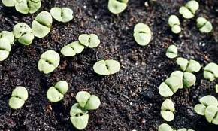
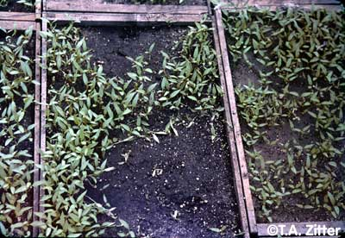
Broadcast
Broadcast onto surface randomly
Used for fine seeds
Damping off can be real problem
Notes:
Broadcasting works for small seeded species. The picture on the right show the danger of broadcast seeding. Damping off is spreading rapidly across the entire flat.

Slide 13
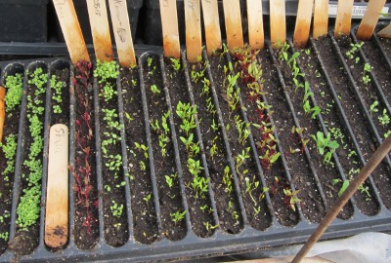
In Rows
Notes:
Seeding in rows reduced chances of losing an entire flat to disease. In this picture a seeding flat is being used so that the plastic septums between rows further reduce likelihood of disease spread.

Slide 14
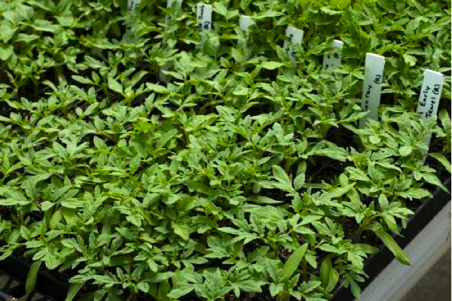
Notes:
A plug tray where single seeds have been placed in each individual hole.

Slide 15
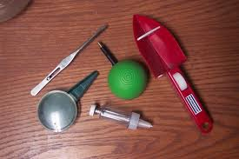
Notes:
There are a variety of seeding aids/tools that small growers can purchase and use.

Slide 16
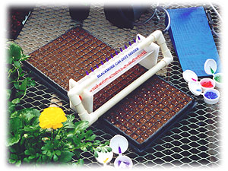
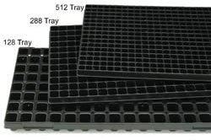
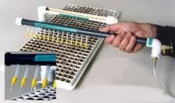
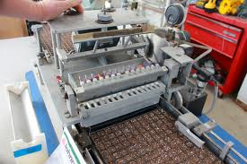
Direct
Notes:
Direct seeding into plug trays is more common in larger operations. The upper left picture shows some of the various sizes of plug trays available. Tools for direct seeding are also available for purchase and use. The seeding tool best suited for an individual operation is largely a function of the number of transplants it raises.

Slide 17
Germinating
Notes:
Once the seed has been sown it is time to begin the germination process.

Slide 18
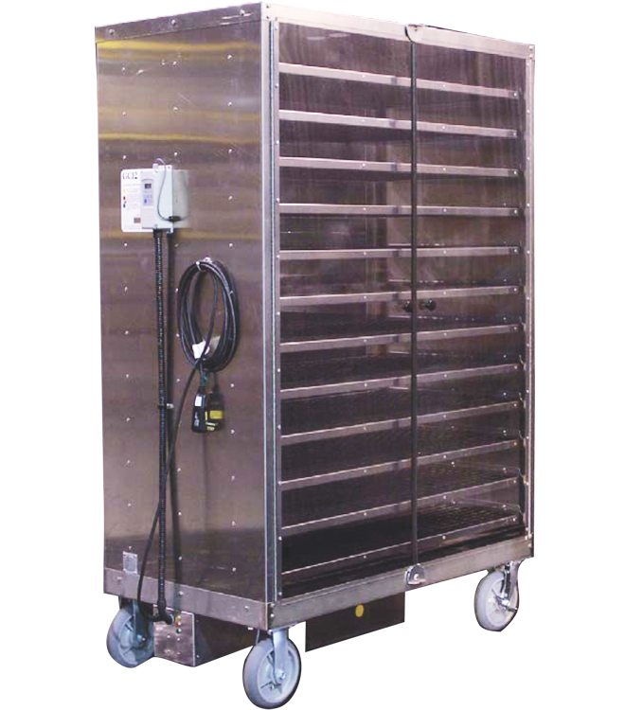
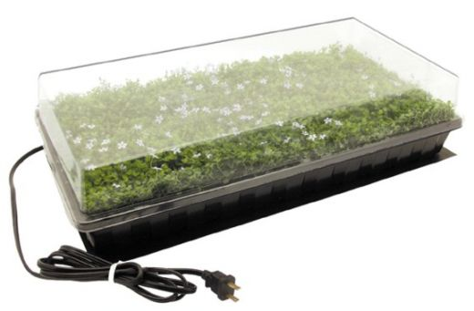
Notes:
As discussed earlier proper temperature and moisture are critical for good seed germination. Larger operation commonly have a room (or modified walk in cooler) where higher than average temperatures and relative humidity can be maintained. Medium size growers may utilize purchased germinators like seen on the left. Smaller growers may utilize thermostatically controlled heat mats and cover flats with domes to maintain humidity like seen on the right.

Slide 19
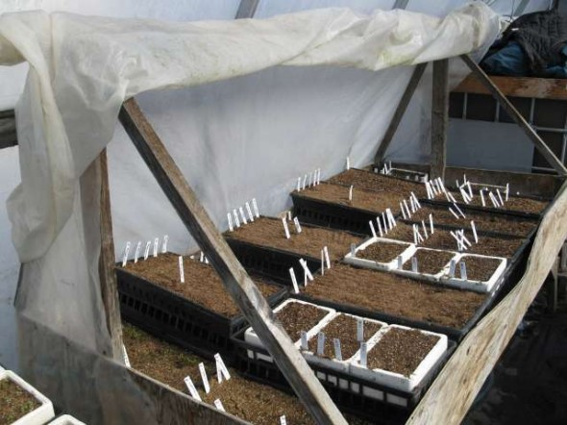
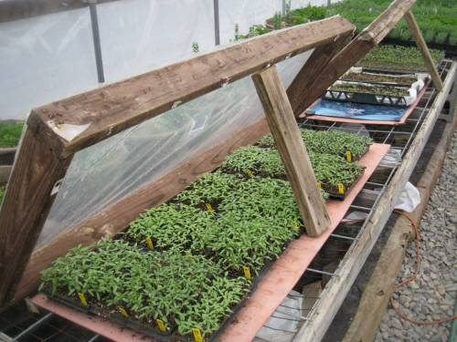
Notes:
A couple of photos of how growers germinate seeds. The lower left show the use of heating mats. The germination bench in the upper right is heated with electric heating cables that are not visible. Note how both operation can cover the area with plastic to keep humidity high until seeds germinate.

Slide 20
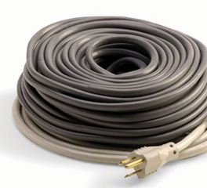
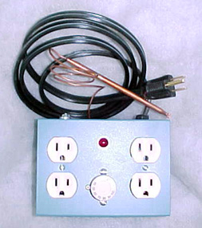
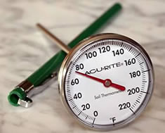
Notes:
The upper left shows an electric heating cable. They are available in a wide variety of lengths and wattages The right hand picture in an example of a thermostat that is used to control heat mats or cables. The copper probe is inserted into an empty flat or section of flat that is filled with the same media that is at the same wetness as is being used to germinate the seed. Another tool that is critical is an accurate thermometer that can be inserted into the germination media.

Slide 21
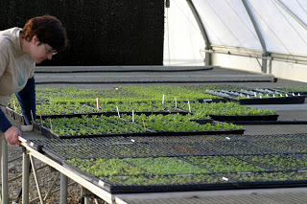
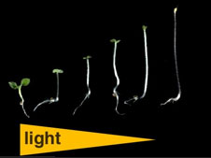
Notes:
Very soon after germination, the flat containing the seedlings should be moved out of the germination area and into the greenhouse. Failure to remove the seedlings from the germination area, which is higher in temperature and relative humidity and lower in light intensity, will result in stretched (etiolated) seedlings which are of inferior quality.

Slide 22
Potting
Notes:
Usually around a week after seedling emergence it is time to pot the seedlings.

Slide 23
Container Selection
Material
Plastic
Clay
Peat
Size
Tomato: larger transplant=earlier fruit + higher yield
Must be large enough to support size of finished transplant
Notes:
There is a wide variety of containers used for growing on transplants. The type(s) of containers used will vary by growers and species being raised. The size of the container must be large enough to support the finished transplant size. Growers should note that in a vast number of studies there has been a correlation established between tomato transplant size and both early and overall yield.

Slide 24
Notes:
A study that shows the impact of tomato transplant size on early and total marketable yield. Larger transplant size equals greater yield.

Slide 25
Container Material
Plastic
Economical
Light weight
May be reusable
Nearly infinite selection of sizes
Tends to stay wet
Notes:
Plastic is the most commonly used material for growing transplants. It is economical, light weight, reusable and available in many shapes and sizes. The biggest problem with plastic, especially for new growers, is that plastic tends to stay very wet which can dramatically reduce transplant quality.

Slide 26
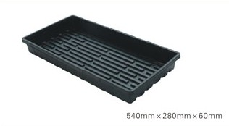
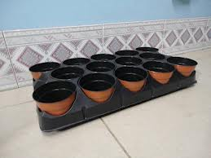
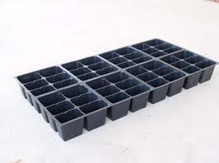

Slide 27
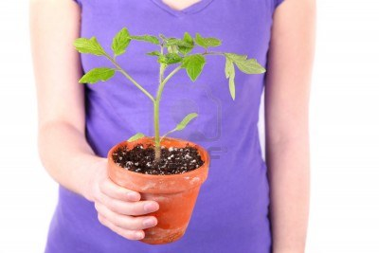
Clay
Heavy
Reusable
Easier to keep dry
Notes:
Clay is seldom used anymore by commercial growers. It is very grower friendly, reusable, and easy to keep the media dry. However, the expense and weight associated with clay has largely removed its use by commercial producers.

Slide 28
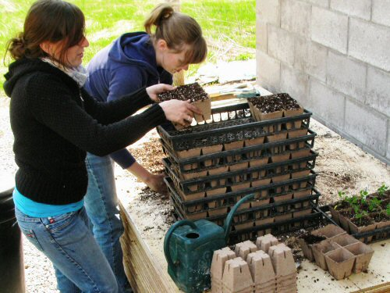
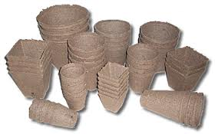
Peat
Light weight
Easy to keep dry
Not reusable
Notes:
The use of peat containers is increasing among growers. The peat containers are not reusable but are relatively cheap, grower friendly (easy to keep media dry) and available in a wide variety of shapes and sizes.

Slide 29
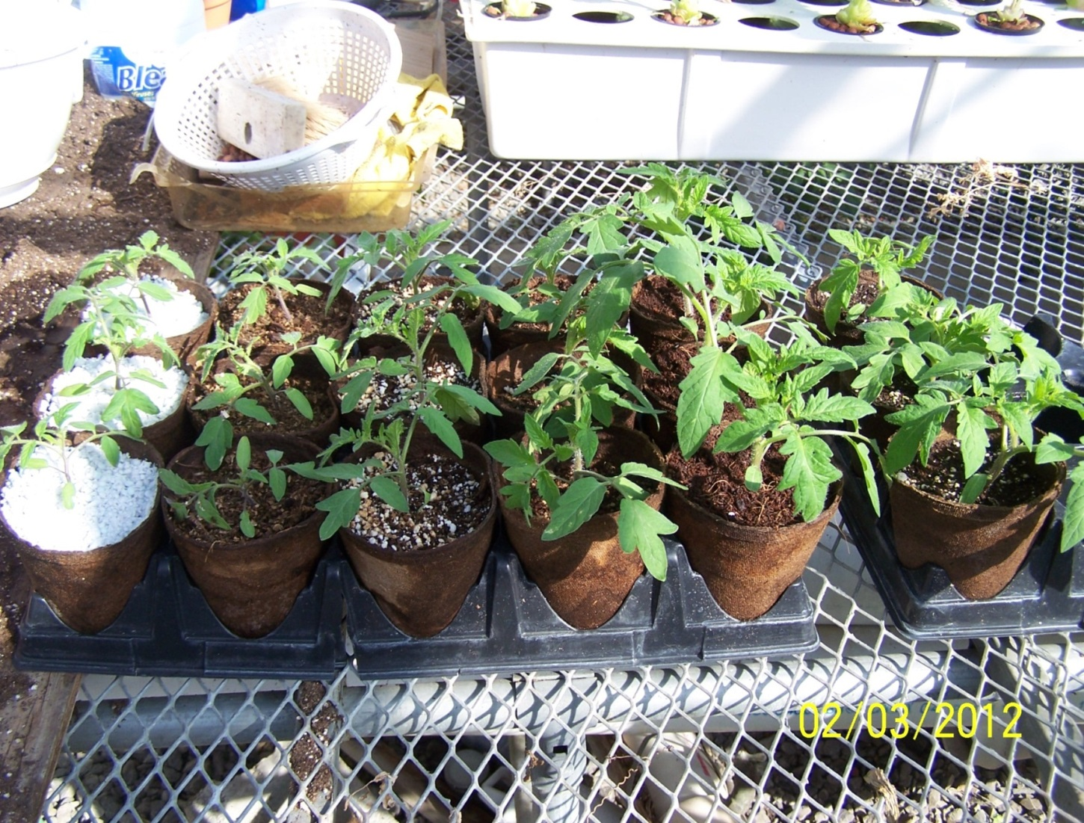
Media
Notes:
A variety of materials can be used for growing on transplants. These plants were all transplanted on the same date but you can see that they vary greatly in size. The medias are from left to right: perlite, sawdust, vermiculite and perlite 50:50, metro mix, coconut coir, and coconut coir and perlite 50:50

Slide 30
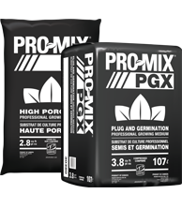
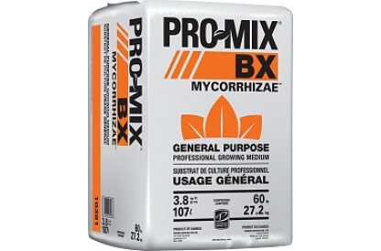
Common soilless media
Plug Mix
Growing Media
Notes:
Typically growers will purchase plug or general purpose growing media in compressed bales that need to be broken apart and wetted prior to use.

Slide 31
Pro Mix BX
Traditional peat-based growing medium with perlite and vermiculite
Is pH-adjusted
General‑purpose growing mix for transplanting a wide variety of plant species
Ideal for the production of vegetable transplants in large cell trays
Contains MYCORRHIZAE™ mycorrhizal inoculum (Glomus intraradices)
Contains BIOFUNGICIDE™ - (Bacillus pumilus – strain GHA-180)
Notes:
This is a description of what is in Pro Mix BX.

Slide 32
Canadian Sphagnum Peat Moss (75-85% by volume)
Perlite - horticultural grade
Vermiculite-horticultural grade
Dolomitic and Calcitic limestone (pH adjuster)
Wetting Agent
Mycorrhizae – endomycorrhizal innoculum (Glomus intraradices)
BIOFUNGICIDE™ - (Bacillus pumilus – strain GHA-180)
Notes:
These are the ingredients for Pro Mix BX

Slide 33
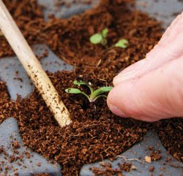
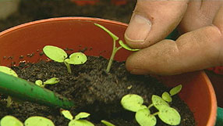
Notes:
After filling the growing container with media it is time to transplant. For broadcast seed or seed sown in rows, the seedlings will have to be pricked out typically using a pencil. Note how the grower is handling the transplant by the cotyledons.

Slide 34
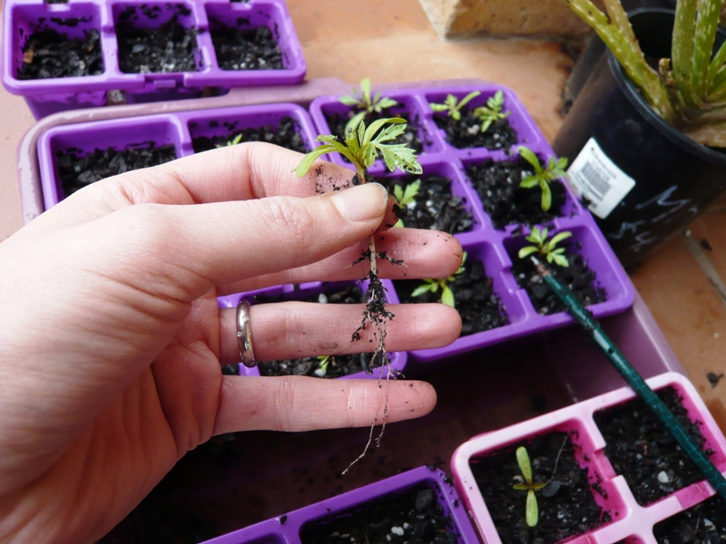
Notes:
Do NOT handle the seedling by the stem. This can easily result in damage to the stem or growing point, either of which will result in a damaged transplant that will likely not be useable.

Slide 35
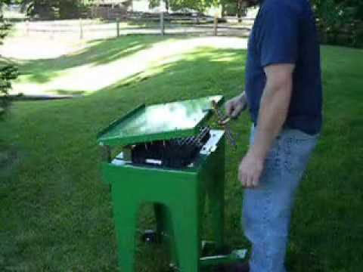
Notes:
Growers using that have direct seeded into plug tray also often move the plants up to a larger container. To avoid damaging the plug plant the plugs must be dislodged. This is a foot operated plug dislodger that loosens all the plugs in the tray at one time. Smaller growers can accomplish the same task by using a bolt of appropriate diameter to fit up through the holes in the bottom of the plug tray.

Slide 36
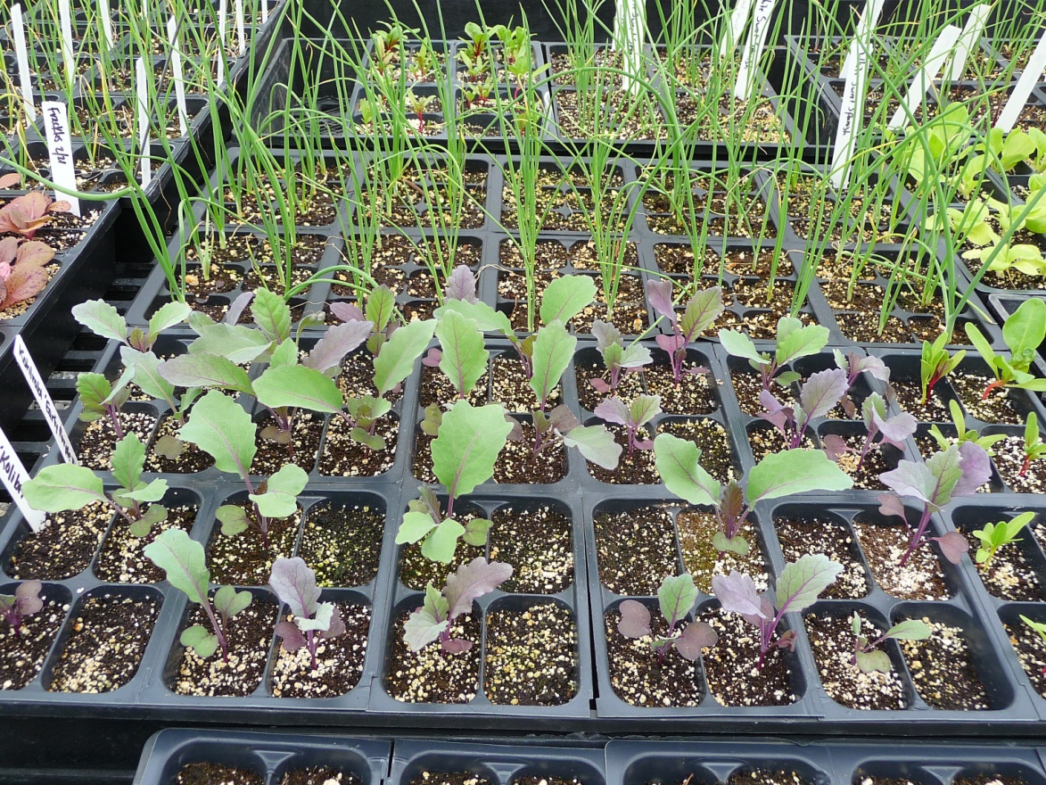
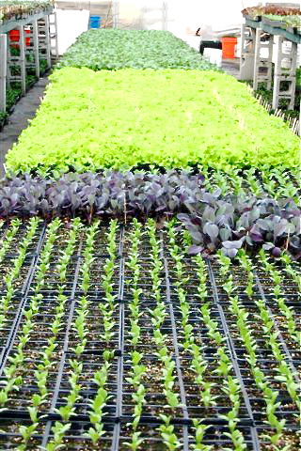
Notes:
Once the transplants have been potted they are grown on in the greenhouse. The left hand picture shows a well planned greenhouse that can be watered so that all plants are receiving the amount of water they need. The picture on the right shows too many types of plants in a small area. It will be difficult to not over or under water some of the plants.

Slide 37
Transplant Growing
Water only when needed
Apply fertilizer
Maintain good light
Maintain proper temperatures
Have good air circulation
Maintain proper plant spacing
Notes:
Successful transplant growing requires several factors. First and foremost, water plants only when needed. Far more plants are killed or delayed from over watering. Most growers use soilless media which have little or no micronutrient content. Growers should start applying fertilizer on a weekly basis on the second or third week of growing. It is important to maintain proper temperature and good air circulation. This may help reduce disease and will result in production of a higher quality transplant. Good light quality is important to avoid stretching and to hasten plant growth and development. Proper plant spacing is also required. If plants are in too close proximity they will stretch resulting in a poor quality transplant.

Slide 38
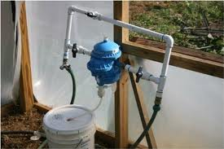
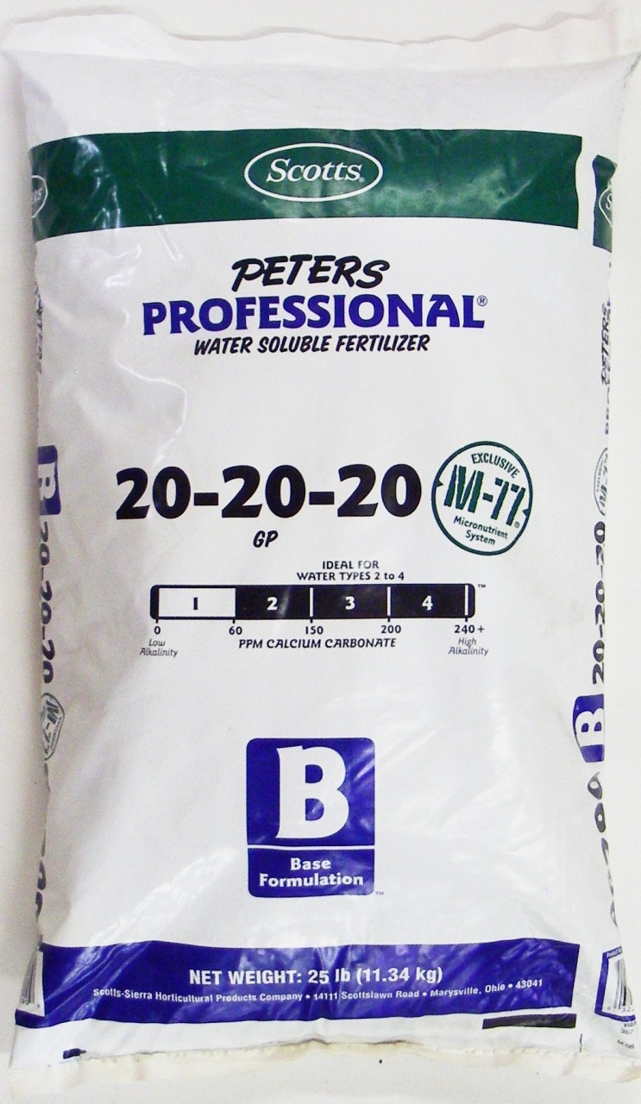
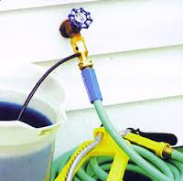
Fertilizer
Notes:
Most growers use water soluble fertilizer for greenhouse transplant production. Organic producers may use fish emulsion or other suitable fertilizer forms. The water soluble fertilizer is typically injected into the irrigation water. The picture in the upper right shows a proportional injector that typically costs between $250 and $400. They are very precise and may be adjustable or fixed. They normally operate in the vicinity of 100:1. The bottom right shows a cheaper less accurate method of using water soluble fertilizer and costs around $30. This Siph-O-Mix device will operate around 20:1 and may be useful for growers that are just getting started that can not justify the expense of a proportional injector.

Slide 39
GUARANTEED ANALYSIS
For Continuous Liquid Feed Programs
Total Nitrogen (N) ......................................................................................................... 20%
3.94% ammoniacal nitrogen
6.05% nitrate nitrogen
10.01% urea nitrogen
Available phosphate (P2O5) ........................................................................................... 20%
Soluble potash (K2O)..................................................................................................... 20%
Magnesium (Mg) (Total) ............................................................................................ 0.05%
0.05% water soluble magnesium (Mg)
Boron (B)................................................................................................................ 0.0068%
Copper (Cu) ............................................................................................................ 0.0036%
0.0036% chelated copper (Cu)
Iron (Fe) ...................................................................................................................... 0.05%
0.05% chelated iron (Fe)
Manganese (Mn)....................................................................................................... 0.025%
0.025% chelated manganese (Mn)
Molybdenum (Mo) ................................................................................................. 0.0009%
Zinc (Zn)................................................................................................................. 0.0025%
0.0025% chelated zinc (Zn)
Derived from: ammonium phosphate, potassium nitrate, urea, magnesium sulfate,
boric acid, copper EDTA, iron EDTA, manganese EDTA, ammonium
molybdate, zinc EDTA.
Potential Acidity: 565 lb. calcium carbonate equivalent per ton
Notes:
This is the label from the Scotts 20-20-20 pictured in the previous slide. Notice that in addition to nitrogen, phosphorous, and potassium it also contain micro nutrient. This is critical for successful transplant production if the grower is using soil less media.

Slide 40
Crop | Day Temperature | Night Temperature | Weeks from seed
Broccoli, Cabbage, Cauliflower | 65 | 55-60 | 4-6
Celery | 65 | 60 | 8-12
Eggplant | 70-80 | 60 | 6-8
Lettuce | 60-65 | 50 | 3-5
Melons | 70-75 | 60 | 2-3
Onions | 65-70 | 55-60 | 6-8
Peppers | 70-75 | 60 | 6-8
Tomatoes | 65-70 | 60 | 5-8
Notes:
Maintaining proper temperature is also mandatory for the production of high quality transplants. This table, and many other like it that can be found from numerous sources, lists the optimal day and night time temperatures. Running daytime temperature far in excess of those listed or night time temperature below those listed will result in lower quality transplants.

Slide 41
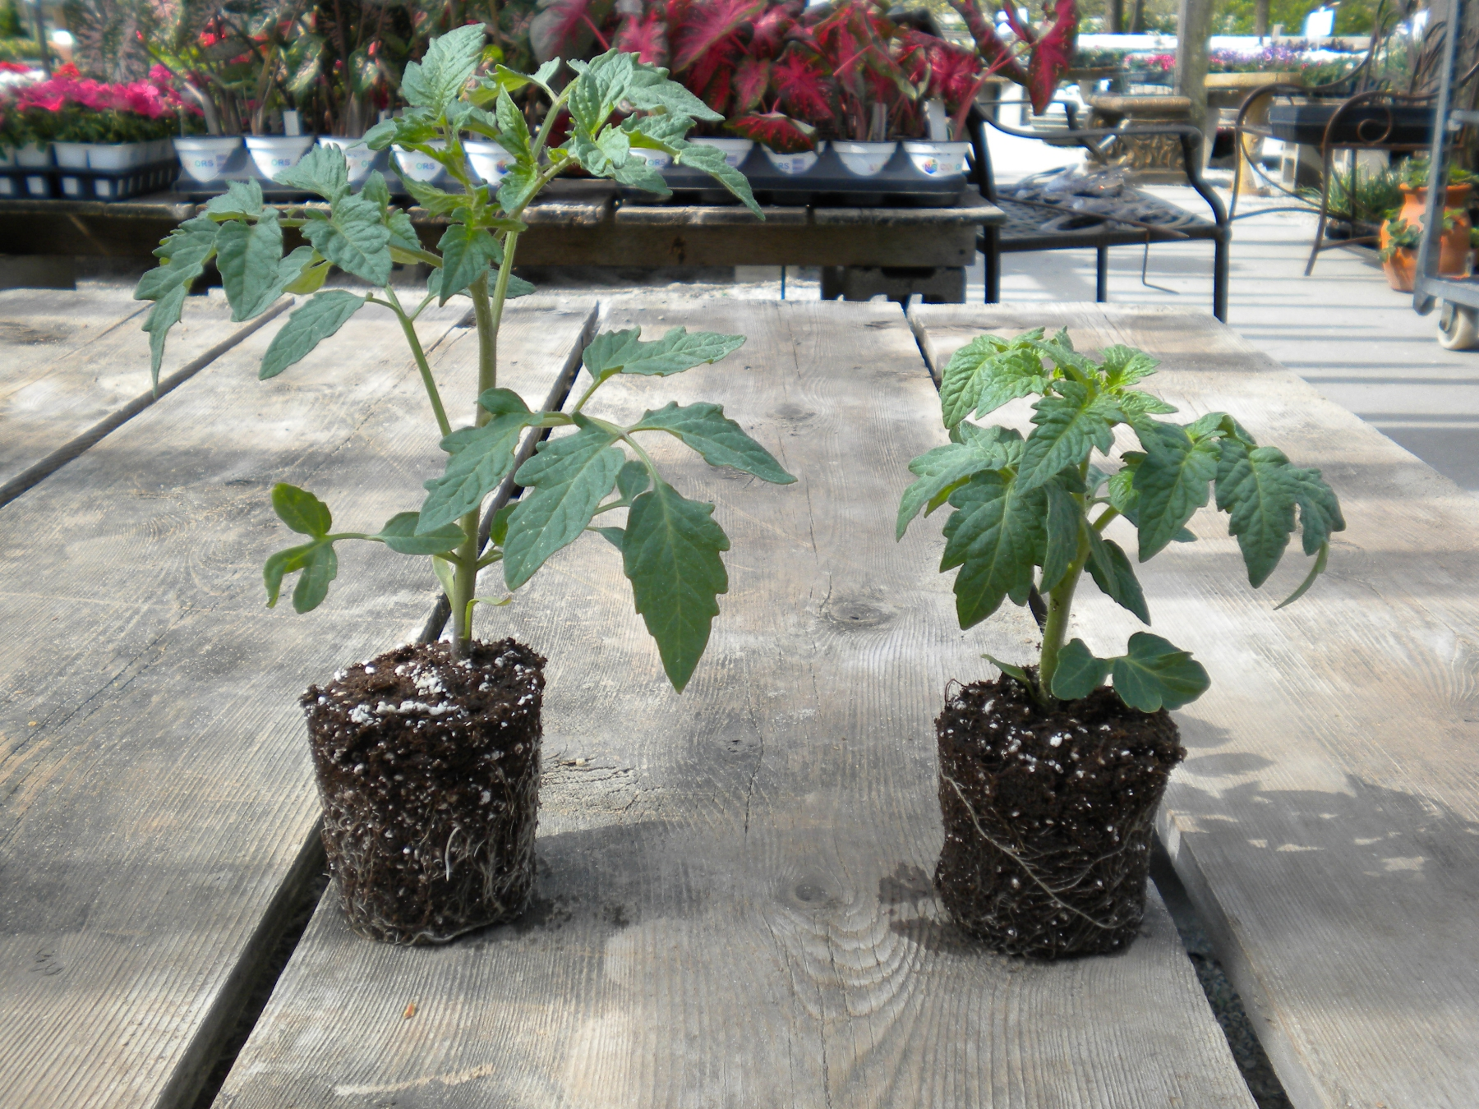
Notes:
Here are two tomato transplants. The transplant on the right while shorter is actually the better quality transplant. The lack of stretching in the transplant on the right will likely have higher survivability and suffer less transplant shock.

Slide 42
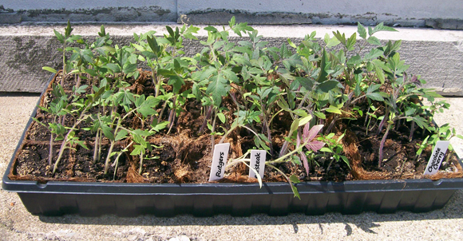
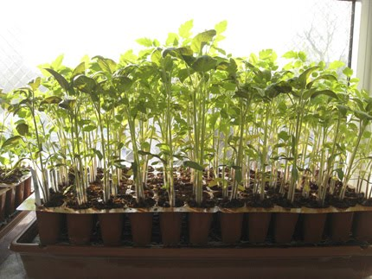
Notes:
Here are two examples of poor quality transplants. The upper picture is showing plants that have weak stems and poor color. They are obviously lacking phosphorus and one would suspect the plants have likely been grown too cold. The bottom flat shows stretched (etiolated) plants. They were likely grown too warm and too wet.

Slide 43
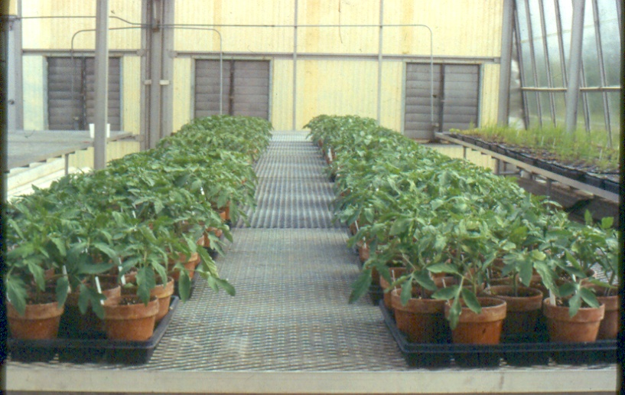
Notes:
A good quality tomato transplant is nearly a cube being similar in both height and width.

Slide 44
Keys to Success
Good sanitation
Good light quality and quantity
Proper Temperature Regimes
Notes:
So again successful transplant production is the product of many factors including good santitation, good light quality and quantity, and maintaining proper temperatures.

Slide 45
Sanitation
Clean seed (or other propagule)
Sterilized Containers, Tools, Benches
No Wand/Breaker on Ground
Lids on Garbage Cans
No Weeds in Greenhouse
Wash Hands especially if Tobacco user
Soilless media
Notes:
Sanitation can not be overlooked. Use clean certified seed. Disinfest all tools, containers that are being reused and the greenhouse benches. Keep water wands and breakers off the ground. Any garbage can in the greenhouse should have a lid on it. Keep weeds out of the greenhouse. They can harbor insect pests and diseases. If growers are using soil based rather than soilless media it is best if the soil is stream pasteurized prior to use.

Slide 46
Soil Blocking
Why use soil blocks?
Better root environment – more air circulation, less pruning/binding in cells
Improved water holding capacity
Reduce incidence of transplant shock
Usually can remain in flats longer than plug cells
Less waste (fewer plastic trays)
Notes:
Although not commonplace there are growers that use soil blocking for transplant production. Reasons for using soil blocking are cited above.

Slide 47
Soil Blocking
Notes:
Here are some example of tools use to make soil block and tomato transplants being grown in soil blocks.

Slide 48
Soil Blocking
Notes:
Soil block that are pre dibbled ready to be direct seeded.

Slide 49
Soil Blocking
Notes:
By using various sizes of soil blockers you can move up soil blocks just like you might move up plug plants.

Slide 50
Soil Block Mix
3 buckets brown peat
½ cup lime
2 buckets perlite
3 cups fertilizer mix
1 bucket soil
2 buckets compost
10 quart bucket
Makes 2 bushels
Existing soilless mix can be amended with fertilizer, soil, and compost
Mix not sterilized, can sterilize soil before mixing if needed
Notes:
A good soil block mix must be capable of sticking together to make the soil block but also be well drained enough for good plant growth. Here is one recipe for making mix that is good for blocking.

Slide 51
Other Organic Transplant Mixes
Material is mixed in a small manure spreader with water
Brought to 140F and mixed again with alfalfa meal to help reheat
Allowed to mature over summer
Perlite added along with slowly available organic fertilizer or fertilized with water soluble fertilizer
MSU-SOF Compost based mix
1 bale straw
1 bale hay or alfalfa mix
1 bale wood shavings
1 bale peat moss
6 cubic ft (wheel barrow) each soil and grass clippings
6 cubic ft green plants
Notes:
Organic growers must use growing media that is allowed under OMRI. There are several manufactured sources of organic growing media or growers may make their own. The above is a recipe for organic growing media.

Slide 52
Seed Storage
The sum of temperature in °F and relative humidity (RH) should be near 80
-40°-45°F
-35%-40% RH
Viability declines with time
Notes:
Many growers find themselves with leftover seed. How long seed can be saved varies from species to species. Seed that is saved for use the following year should be stored in an area that is relatively cool and dry. May growers use a refrigerator. The length of time seed can be stored and optimal storage conditions can be found in several sources such as Knott’s Vegetable Growers Handbook.

Slide 53
Disease/Pest Management
Pests and Treatments
Aphids
Thrips
Slugs
Virus resistant seed
Notes:
It is common for growers to face pest and diseases that will need to be managed. Common insect pests include aphids and thrips. Slugs can also occasionally be a problem. While insects and slugs can be addressed with pesticides, both conventional and organic, viral diseases are best address by using virus free seed stock of varieties that are virus resistant.

Slide 54
Thrip
Notes:
Thrips are a major greenhouse pest that not only cause damage by their feeding but also can transmit diseases. Their management requires great vigilance and often requires more than a single pest control method for successful management of this pest.

Slide 55
Disease/Pest Management
Damping Off
Group of soil borne pathogens including-
Rhizoctonia, Phytophtora, Botrytis, Fusarium, Pythium, Sclerotinia spp.
Affects seeds and germinating seedlings
Signs – white mold at soil surface
Symptoms – dark stem spots, rotten roots and stems, ‘wiry stem’
Notes:
Although there are many diseases that can be problematic for growers raising transplant the more common ones are listed above. Damping off or water molds and botrytis can be common problems in greenhouses. Occasionally phytophthora can also be a problem. The first line of defense a grower should rely on is maintaining an environment that is less favorable for the development of these diseases and practicing good sanitation. The greenhouse should be kept at proper temperature and not have excessive moisture and humidity. These good cultural practices will go far in controlling disease problems. Additionally, there are both organic and synthetic pesticides that can be utilized to aid in the control of greenhouse diseases.

Slide 56
Disease/Pest Management
Damping Off
Look for patterns among your flats to detect damping off.
Notes:
When disease does occur growers should consider rouging affected plants and moving adjacent plants to a quarantine area to observe for further disease development. This can help stop outbreaks.

Slide 57
Disease/Pest Management
Damping Off
Prevention
Sanitation
Soilless media
Air circulation
Timely planting
Even watering
Treatment
Fungicide (as spray or drench)
Quarantine and dispose
Notes:
Good disease control requires growers maintain good cultural practices and may also require treatment with organic or synthetic pesticides.

Slide 58
Field Planting
Avoid Transplant Shock
Harden off plants
Handle with care
Pay attention to roots
Planting depth
Water
Notes:
Prior to field planting, transplant should be allowed to harden off. While historically this involved placing plants on wagons that could be rolled in and out of machine sheds or other buildings this often occurs inside the greenhouse now if the sides of the greenhouse can be opened and closed. The process should begin by reducing the frequency of watering and allowing plant some exposure to light winds. Hardening off periods vary from a couple of days to a week or more depending on the grower. Plants that are hardened off may have better survivability and be less subject to transplant shock.

Slide 59
Field Planting
Considerations
Select healthiest transplants
Timing of planting
Rain/Irrigation
Root/soil contact
Transplant Shock
Notes:
Other consideration at field planting time include selecting only the healthiest transplants and set them at an appropriate time. Care should be taken to make sure the newly set transplant has good root soil contact and normally plants are watered in after setting. For many crops it is also common that the water used for watering in the transplants contains a water soluble plant starter fertilizer. Following these steps may also help improve transplant survival and reduce transplant shock.

Slide 60
Field Planting
Adjustments to your system may be necessary if switching from hand transplanting to mechanical transplanting.
Notes:
There are many types of machines that can be used for transplanting such as the water wheel setter pictured above.

Slide 61
Field Planting
Mechanical Transplanting
Water with transplant
Faster for large plantings
Bed must be passable with equipment
Requires minimum of 2 people
Notes:
A water wheel setter and most other types of mechanical transplanting equipment allow for the application of water and plant starter fertilizer immediately and time of transplanting. There are devices for both bare ground and plasticulture growing systems. The use of tractor drawn mechanical equipment does require that beds be layed out so that a tractor can be driven over the bed and also that field conditions at planting time are dry enough to allow for tractor operation in the field.

Slide 62
Field Planting
Hand Planting
Smaller acreages
Wet conditions OK
Rows can be uneven
Irrigate after
Notes:
Smaller growers that are going to plant may also use some equipment such a the hole marking aperati shown above. This equipment mark where plants are to be set allowing for uniform plant spacing without the need for a tape measure. Hand planting is more suitable for smaller plantings and does not require that the field be dry enough for tractor operation. Uneven rows and oddly shaped fields are not a problem for growers planting by hand.

Slide 63
Field Planting
Notes:
Some additional aids for hand planting.

Slide 64
Field Planting Considerations
Straight rows
Spacing
Planting depth
Nutrition
Row covers
Adapt to system
Notes:
Field planting works best with straight rows and the row spacing (both in and between) should be appropriate for the crop being raised. Transplants should be set at proper depth and field should be soil sampled and amended as needed prior to planting. Some growers may use row covers on plantings. Row covers can be used to provide a slight degree of frost protection and can also be useful to reduce insect problems for some crops.

Slide 65
Planning
Crop Selection
Sufficient variety of crops
Early and late maturing cultivars
Crops that are successful in your area
Check out this link for varietal ratings - http://vegvariety.cce.cornell.edu/index.php
Notes:
Like in most endeavor success occurs when preparation meets opportunity. That mean planning is a critical part of a successful venture. We must be sure we have a sufficient variety of crops across the time period are customers are wanting to purchase them. To spread the harvest of any one crop growers use two strategies. First select early, mid and late season varieties of the crop you are raising. Additionally, growers can also make successive plantings to spread out the harvest.

Slide 66
Crop Planning
Frost free period (~April 15-Oct. 15)
Days til plantout?
How much to plant?
How many plantouts?
Keep good records for future planning
http://clydesvegetableplantingchart.com/Vegetable-Garden-Planner.aspx
Notes:
Planning considerations include when do I want to plant, how long does it take to make a transplant, how much do I need to plant, and how many plantings. The first year this will be largely a guess on the part of a new grower. It is critical that growers keep good notes in a journal so that the following year they can capitalize on the successes and avoid their mistakes.

Slide 67
Planning - Determine harvest outcomes for each crop
Example: per 100 CSA shares (24 total weeks June 4 – November 12)
Need 1 head x 100 shares per week = 100 harvestable heads per week
Add 25% cull rate for poor quality transplants, crop loss, etc. 100 x 1.25 = 125 plants per week
Want to provide a head of lettuce in 16 of 24 weeks of CSA. 125 x 16 = 2,000 total lettuce plants needed
How much per harvest? (lbs., heads, bunches)
Frequency of harvests?
Over what time period?
Add 25% cull rate
Notes:
In some cases such as a CSA, the grower may have a fairly certain idea of the amount of produce that they need to have available for market across the growing season. In those cases, planning can be done to make sure that market demands are met and excess production is avoided.

Slide 68
Planning
You can create your own plan using excel, access, or other database software
Not only for transplants, but for all field production
Better records mean better planning
Notes:
Tools for crop planning can be created by the grower or they may wish to use existing software programs or apps. The use of planning tools does not alleviate the need for good record keeping.

Slide 69
Resources
http://extension.umass.edu/floriculture/fact-sheets/damping-bedding-plants-and-vegetables
https://www.morgancountyseeds.com/store/
http://www.veggiecompass.com/
http://clydesvegetableplantingchart.com/Vegetable-Garden-Planner.aspx
http://bse.wisc.edu/HFHP/tipsheets_pdf/dibble4web.pdf
http://www.nevegetable.org/index.php/management

Slide 70
Resources
http://www.gpnmag.com/height-control-vegetable-transplants-0
http://www.uky.edu/Ag/Horticulture/anderson/orgfert1.pdf
http://www.uky.edu/Ag/Horticulture/anderson/orgfert3.pdf
http://www.hoophouse.msu.edu/assets/custom/files/Develop%20A%20Transplant%20Action%20Plan.pdf

Slide 71
Resources
http://www.msuorganicfarm.com/Transplants.pdf
http://extension.psu.edu/start-farming/courses/files/select-seeding
https://attra.ncat.org/attra-pub/summaries/summary.php?pub=55
http://www.agsquared.com

Slide 72
Happy Transplanting!
Questions?
Visit our websites to find out about other programs and events:
Illinois SARE – www.illinoissare.org
Illinois Small Farms - http://web.extension.illinois.edu/smallfarm/

Slide 73
To reach us
Contacts | Contact information
Jeff Kindhart Zack Grant William Davison Shelby Henning Jeremy Shafer | jkindhar@illinois.edu Zgrant2@illinois.edu wdavison@illinois.edu shenning@illinois.edu jshafer@illinois.edu

Slide 74
If you have questions …
University of Illinois Extension Local Food Systems and Small Farms team
http://web.extension.illinois.edu/smallfarm/
USDA’s Start2Farm site
http://www.start2farm.gov/
Notes:
Our beginning farmer training program ended in the fall of 2015. The best way to pursue answers to questions about fruit and vegetable production in Illinois is to contact educators on the University of Illinois Extension Local Food Systems and Small Farms team. Extension programs in other states are operated by the land-grant university in each state. Additionally, USDA’s Start2Farm site provides listings of farmer training programs in specific states and localities.

