Slide 1



Preparing a New Generation of Illinois Fruit and Vegetable Farmers a USDA NIFA Beginning Farmer and Rancher
Development Program Project
Grant # 2012-49400-19565 http://www.newillinoisfarmers.org
Notes:
The following presentation was part of a beginning farmer course, “Preparing a New Generation of Illinois Fruit and Vegetable Farmers,” offered by the University of Illinois and the Illinois Migrant Council from 2012 through 2015. This course was funded by the United States Department of Agriculture’s National Institute of Food and Agriculture, and specifically by the Beginning Farmer and Rancher Development Program. For more information about the program and for links to presentations and resources on many other topics, see the website newillinoisfarmers.org.

Slide 2
Growing a New Generation of Illinois Fruit and Vegetable Farmers
Training and Pruning Fruit Plants
Elizabeth Wahle
(with contributions from Sonja Lallemand)
February 2015
Notes:
Welcome to Training and Pruning Fruit Plants. Basic pruning was first introduced in the “Basic Fruit Production Module” and is here further explored in more detail.

Slide 3
Today’s Objectives
Understand the basic principles of
  Pruning
  How to prune tree fruits, including pome and stone fruits
  How to prune small fruit, including blueberries, brambles and grapes
Notes:
As previously discussed, training a fruit plant involves selecting strong shoots or branches to become the main bearing framework of the plant, and positioning these shoots or branches so that they’ll receive enough sunlight. Training begins at planting time and includes pruning branches, pinching new growth, and branch spreading or typing. The aim is to develop a branch structure that’s strong enough to support heavy crops of fruit and open enough to maximize light intake and minimize disease problems. Well-trained fruit plants bear heavier crops at an early age. Most training is accomplished during the first two years after planting, which was covered in the “Basic Fruit Production” module. Once fruit plants are trained, they need yearly pruning to remain healthy and keep producing good crops of high quality fruit. Unpruned fruit trees grow too tall and dense, bearing fruit only around the outside of the tree where sunlight is adequate. Unpruned brambles and grapes become choked with dead canes, while unrenovated strawberry patches suffer from too many competing strawberry plants. With all fruits, getting rid of dead, diseased, and unproductive growth will prevent disease spread and channel the plants energies toward better fruit production. In this module you will learn the basic principles of annual pruning using tree fruit as the main example but specific pruning techniques for apple, peach and brambles will also be presented.

Slide 4
Goals of Annual Pruning
Develop good framework in young plants
Remove poor, unproductive wood
  And broken and pest damaged wood
Increase light penetration
Increase air flow
Maintain the tree height and spread
Notes:
Without training and pruning, fruit plants will not develop proper shape and form. Properly trained and pruned plants will yield high quality fruit much earlier in their lives and live significantly longer. For example, a primary objective of training and pruning for fruit trees is to develop a strong tree framework that will support fruit production. Improperly trained fruit trees generally have very upright branch angles, which result in serious limb breakage under a heavy fruit load. This significantly reduces the productivity of the tree and may greatly reduce tree life. Another goal of annual training and pruning of fruit plants is to remove dead, diseased, or broken limbs. Proper training and pruning opens up the canopy to maximize light penetration. For most deciduous fruit plants, flower buds for the current season's crop are formed the previous summer. Light penetration is essential for flower bud development and optimal fruit set, flavor, and quality. Although a mature plant may be growing in full sun, a very dense canopy may not allow enough light to reach 12 to 18 inches inside the canopy. Opening the plant canopy also permits adequate air movement through the plant, which promotes rapid drying to minimize disease infection and allows thorough pesticide penetration.

Slide 5
Goals of Pruning cont.
To maintain the proper balance between vegetative growth and fruit production to obtain high yields of quality fruit each year
Maintain fruiting wood throughout the tree canopy
  Positioning of fruit zone
  Positively affect fruit size
Notes:
Though not included in this module, grapes are a very good example of the need for balanced pruning. The primary purpose in pruning mature grapevines is to balance the amount of crop produced to the vine’s capacity to ripen the crop. The mature grapevine will have several hundred buds before pruning, and more than half are capable of producing fruiting shoots. If all buds remain, the vine will over-crop, resulting in delayed fruit maturity, small berries, and small clusters. More important, the vine will not produce enough good fruiting wood for the next year’s crop. On the other hand, if the vine is over-pruned, the current season’s crop will be reduced, and the new growth will be overly vigorous. Excessively vigorous growth produces poor fruiting wood for the following season.

Slide 6

Dormant Pruning vs. Summer Pruning
Dormant pruning
  Invigorating process
    “Heavy” dormant pruning promotes excessive vigor and reduced fruit growth and development
Summer Pruning
  Devigorating
Notes:
Trees respond very differently to dormant and summer pruning. Dormant pruning is an invigorating process. During the fall, energy is stored primarily in the trunk and root system to support the top portion of the tree. If a large portion of the tree is removed during the winter, while the tree is dormant, the tree's energy reserve is unchanged. In the spring, the tree responds by producing many new vigorous, upright shoots, called water sprouts, which shade the tree and inhibit proper development. Heavy dormant pruning also promotes excessive vegetative vigor, which uses much of the tree's energy, leaving little for fruit growth and development.
Timing of dormant pruning is critical. Pruning should begin as late in the winter as possible to avoid winter injury. Apple and pecan trees should be pruned first, followed by cherry, peach, and plum trees. A good rule to follow is to prune the latest blooming trees first and the earliest blooming last. Another factor to consider is tree age. Within a particular fruit type, the oldest trees should be pruned first. Younger trees are more prone to winter injury from early pruning.
Summer pruning eliminates an energy or food producing portion of the tree and results in reduced tree growth. Pruning can begin as soon as the buds start to grow, but it is generally started after vegetative growth is several inches long. For most purposes, summer pruning should be limited to removing the upright and vigorous current season's growth; only thinning cuts should be used. To minimize the potential for winter injury, summer pruning should not be done after the end of July.

Slide 7
Equipment
Pruner
Lopper
Saw
Scale (Grapes)
Notes:
Match pruning tools to the size wood being removed: Use hand shears for small twigs; lopping shears for medium branches; and a saw for larger limbs. Both hand pruners and loppers are available as anvil or bypass style cutting blades. Anvil style has a tendency to crush living tissue, and is generally not recommended. Bypass style cuts like a pair of scissors and makes a clean cut which minimizes damage to the live tissue. Hand pruners are useful for cutting branches up to ¾” in diameter. Loppers will cut branches 2” to 3” in diameter and larger if the lopper has a compound action cutting mechanism.

Slide 8
Pruning technique
Flush cut
NEVER
Collar cut
The collar
Stub cut
Notes:
Every branch has internal tissues that separate it from the trunk. These tissues are instrumental in the process of wound closure and self-defense and must be protected and maintained during pruning. The branch collar should never be injured, cut into or compromised in any way.
Stub cuts are pruning cuts that are made too far outside the branch collar. These cuts leave branch tissue attached to the stem. Disease organisms “incubate” on the dying stub that remains. Eventually the stub becomes a pathway for decay organisms to enter the tree trunk and cause serious wood decay.
Flush Cuts are pruning cuts that originate inside the branch bark ridge or the branch collar, causing unnecessary injury to stem tissues. Flush cuts can, and usually do, lead to a myriad of defects, including radial cracks, circumferential cracks, discolored wood and wood decay. Flush cuts are improper and may break the protective chemical barrier and allow decay organisms to colonize stem tissue. The spread of this decay will eventually end in the demise of the tree.

Slide 9

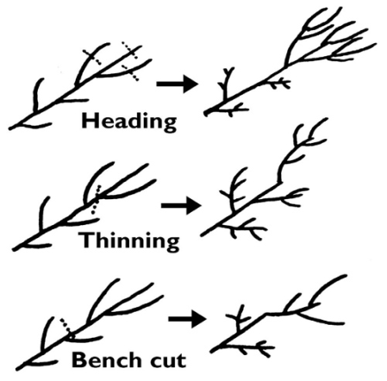
Pruning Cuts
Encourage growth
Encourage fruiting
Produce strong vertical growth at the cut
Notes:
Regardless of the kind of fruit plant, only two types of pruning cuts are made: heading back cuts and thinning out cuts. Every other cut you may hear discussed is a variation of these two.
A heading back cut is the partial removal of a shoot, limb, or branch. This may range from the tipping of leaders or branches to the use of mechanical hedging machines. This type of cut promotes the growth of lower buds as well as several terminal buds below the cut. When lateral branches are headed into one-year-old wood, the area near the cut is invigorated. The headed branch is much stronger and rigid, resulting in lateral secondary branching.
A thinning out cut is the removal of an entire shoot, limb, or branch at its point of origin. This can include the removal of a primary or secondary scaffold limb, removal of a spur system, or desuckering interior water sprouts arising from horizontal limbs. Thinning cuts do not invigorate the tree in comparison to some of the other pruning cuts.
A bench cut removes vigorous, upright shoots back to side branches that are relatively flat and outward growing. Bench cuts are used to open up the center of the tree and spread the branches outward.
When making pruning cuts, it is important to use techniques that will allow the cut surface to heal quickly. Rapid healing minimizes the incidence of disease and insect infection. Pruning cuts should be flush with the adjacent branch without leaving stubs. Also, when large horizontal cuts are made, they should be slightly angled so that water does not set on the cut surface, allowing the growth of rot and disease organisms.
Many compounds are available as wound dressing or pruning paints. But the best treatment is to make proper pruning cuts and allow the tree to heal naturally.

Slide 10
Pruning cuts
Thinning cut to direct new growth
Heading cut to produce new growth
Notes:
The growing point or terminal bud is the site of manufacture of the class of plant hormones known as auxins. Removing either the shoot tip or the young growing leaves stimulates the
growth of lateral buds into side shoots because of the removal of that site of auxin manufacture. The lateral buds are inhibited in growth by auxins produced in the young meristematic tissues contained in the shoot tip and transported back downward. This effect must occur when the leaves are very young because removing young, developing leaves can stimulate lateral bud break; but removing fully expanded leaves cannot stimulate growth.
There are two ways to overcome this apical dominance effect from shoot tips. One is to remove the shoot tip as in a heading cut and the other is to bend a shoot tip to a more horizontal
position. The latter works because auxins generally move in response to gravity.
The result of a heading cut is the loss of apical dominance as mentioned above, with the removal of the inhibiting effect on the lateral buds. The net result is an increase in total shoot growth. Both shoot number and length are affected, but the impact is affected by shoot age, severity of cut, growth habit, and shoot orientation.
Thinning cuts primarily are used for two purposes: (1) to increase light penetration and (2) to remove competing or crowding shoots or limbs. Vigorous shoot growth may develop in the immediate vicinity of the pruning cut, but the effect on adjacent parts of the tree is minimal. Thinning cuts do not change the relationship of various parts of the shoot or branch to each other as heading cuts do, because either the entire shoot or the branch is removed or left intact. The ratio of terminal to lateral buds is largely undisturbed, and as a result, thinning cuts do not increase shoot growth as much as heading cuts. Thinning cuts also reduce flower formation less and can increase flowering when better light penetration is achieved. Yield is reduced only to the extent that the bearing surface is removed and is not reduced because of invigorating buds to form shoots rather than flowers.

Slide 11
Pruning cuts
“Bench cuts”
Notes:
A bench cut is actually a special type of heading cut and involves removal of the terminal portion of a branch at a point just above a side branch. Bench cuts on young trees during the tree training and early fruiting years will tend to stiffen the portion of the branch below the cut and reduce the natural limb spreading caused by the weight of fruit. Bench cuts are often used to encourage outward growth of branches. However, limb spreading is preferable to bench cuts because water sprouts often develop at the site of a bench cut. In addition, the branch immediately below a bench cut is sometimes weak and may not support a heavy crop.

Slide 12
Pruning technique can affect Cytospora infection in stone fruits
Treatment | % Cytospora infection
Pruning time
January | 35.4 a
March | 20.0 a
August | 21.3 a
Type of cut
Stub | 26.5 ab
Flush | 31.0 a
Collar | 19.3 b
Cytospora a fungal disease most destructive in peaches, nectarines, plums and sweet cherries.
Notes:
Cytospora canker is one of the most destructive diseases of peaches and nectarine and is also known in apricots, sweet cherries, and plums—though not as destructive. Also known as perennial canker, peach canker, Valsa canker, and Leucostoma canker, the disease can cause trees in young orchards to die. Infected trees in older orchards gradually lose productivity and slowly decline.
Prune regularly so that large cuts will not be necessary. Prune during or after bloom; actively growing trees can protect pruning cuts from infection. Do not leave pruning stubs; stubs die and can harbor the disease, which can then infect healthy branches. Remove or spread narrow-angled crotches since they tend to split and serve as infection sites. Remove all weak and dead wood and fruit mummies.

Slide 13

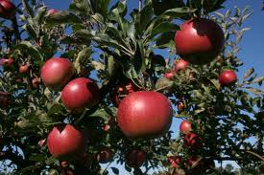
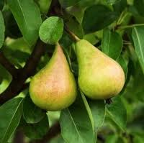
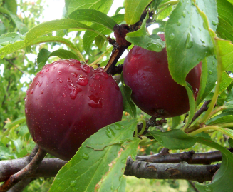
Pruning Apples, Pears and Plums
Notes:
Researchers and growers have developed many different training systems for fruit trees. All of these systems aim to increase light penetration within the tree canopy, so that more fruit buds develop and trees produce greater yield per acre. Each training system works best for a certain size of tree and orchard density. In the medium-density central leader system, portions of trees are cut back severely for several years to stimulate growth. Emphasis is placed on building a large, strong framework to support future crops. Apple, pears and plums in a medium-low and medium-high density orchard have been trained mainly to the central leader system.

Slide 14
Pruning Apples, Pears and Plums
Modified Central Leader training
  Strong central trunk
  Scaffold limbs 4-7
  Scaffold placed vertically and around the leader
  Moderate annual pruning when mature
Notes:
In review, a tree trained to a central leader has one main, upright growing stem (the central leader) with 4-7 main scaffold branches evenly spaced around the trunk. On larger trees, secondary scaffolds higher up on the main leader would also be allowed to develop

Slide 15
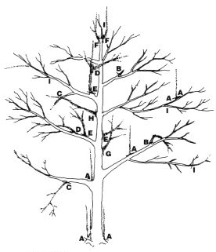
A – Suckers (root and crown)
B – Stubs or broken branches
C – Downward growing branches
D – Rubbing branches
E – Shaded interior branches
F – Competing leaders
G – Narrow crotches
H – Whorls
I – Heading back or growth diversion
Notes:
Shown here and the following slides are undesirable types of growth that should be corrected through pruning.

Slide 16
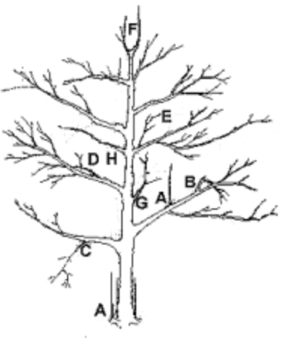
Pruning Apples, Pears and Plums
Pruning bearing trees – “Mold and Hold”
  Prune back scaffolds to allotted space
  Contain leader growth – cut to weak side shoot
  Do not allow upper scaffolds to shade lower scaffolds
Notes:
Older trees can be held in their allotted space by mold and hold cuts, which are devigorating heading cuts made into two-year-old wood. Maintain a single leader and an overalll “Christmas Tree” shape.

Slide 17

Pruning Apples, Pears and Plums
Do not allow interior of tree to become too dense
Renew bearing surface of tree
Notes:
Maintaining a “Christmas Tree” shape reduces shading of lower scaffolds. Additional thinning is needed to allow light into the interior of the tree.

Slide 18

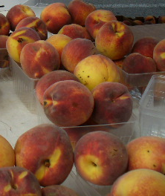
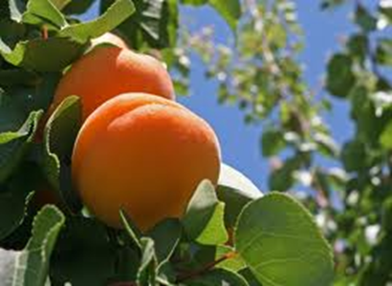
Peaches and Nectarines
Notes:
Like apple, researchers and growers have developed numerous training systems. Presented here is the open center training system, which is widely used in the peach and nectarine growing regions of Illinois.

Slide 19
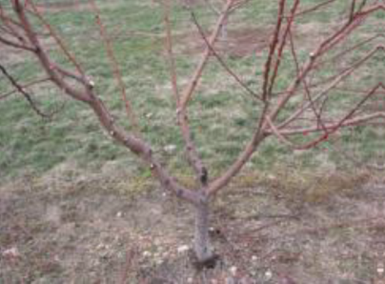
Peaches and Nectarines
Open center training
  No central leader
  Scaffold limbs connected in a short space on the trunk
  Short trunk
  3,4, or 5 scaffold limbs form the open center framework
Notes:
In review, a tree trained to an open center has no main leader, but several main scaffolds that branch out from approximately the same height on the tree. Peaches and nectarines are often trained to open centers

Slide 20
Peaches and Nectarines
Open center training
  pruning bearing trees
    Annual heavy pruning is necessary to retain quality bearing wood, stimulate bearing wood and keep fruits close to trunk
    Annual pruning renews the bearing surface of the tree
    Bearing wood should be ¼” to 3/8” in diam., 12-24” long, (no longer than 30”) reddish-brown in color
Notes:
Peach and nectarine bear on 1 year old wood, so the goal of pruning is to encourage new growth in balance with consistent yield. Peaches are pruned relatively heavy to maintain a reduced height which in turn maintains a fruit zone closer to the ground. Keep in mind that sufficient 1 year old wood must be retained for the next season crop. Bearing wood should be ¼” to 3/8” in diam., 12-24” long, (no longer than 30”) and reddish-brown in color.

Slide 21
Effect of shoot length on fruit diameter (cm) and fruit weight (G)
Shoot length | Fruit diameter (cm) | Weight (G)
less than 1” | 6.44 | 143
1” to 12” | 6.54 | 148
18’ to 24” | 6.80 | 165
P - value | 0.0214 | 0.0462
Effect of retaining long (>12”) or short (<12”) shoots on yield, average fruit weight (FW) and crop value of ‘Redheaven’ peaches.
Treatment | Fruit per tree | Yield (lbs) per tree | Avg. FW (G) | Crop value ($/tree)
Short shoots | 1593 | 404 | 106 | 20
Long shoots | 1813 | 416 | 111 | 30
From R. Marini, 2004 Fruit Grower News 43 (4) 17-20
Notes:
1 year old shoots tipped between 18 and 24” are the most productive, but make sure they are the proper diameter as well, between ¼” to 3/8” in diameter.

Slide 22
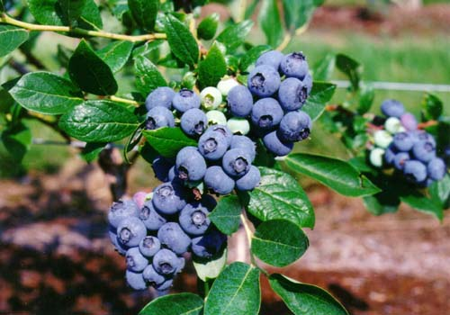
Blueberries
Notes:
Our next crop example is blueberry. Blueberries are a long-lived shrub and with proper maintenance can live and be productive well over 40 yrs.

Slide 23
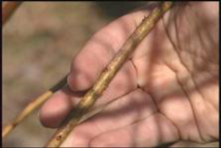
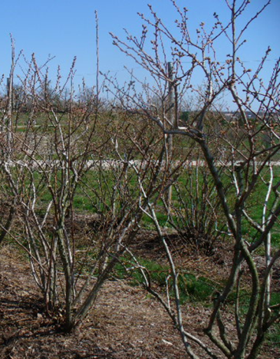
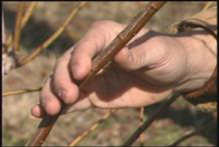
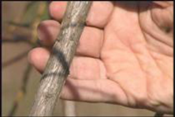
Understanding the Blueberry Plant
Cane age
  Year 1
  Year 2-3
  Year 4 and after
Notes:
The most productive canes on a blueberry plant are 2and 3 years old with production dropping off at 4 years and older. So the goal of pruning is to encourage new cane production that results in a bush with equal number of canes ranging in age from 1 to 6.

Slide 24
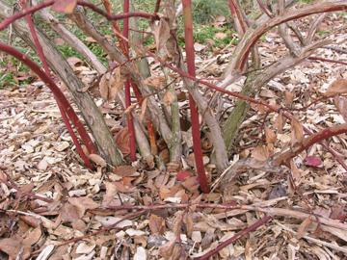
Understanding the Blueberry Plant
Cane growth
  New canes are reddish in color
  Older canes have a heavier, grayish bark
Notes:
Younger canes are easily distinguished from older canes. Young canes are reddish in color, smaller in diameter and more tender. As canes age, they increase in diameter and change to a rougher grayish bark.

Slide 25
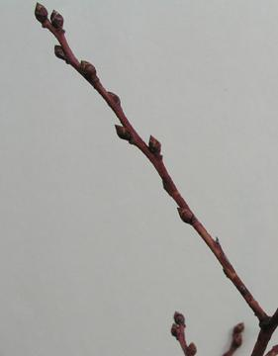
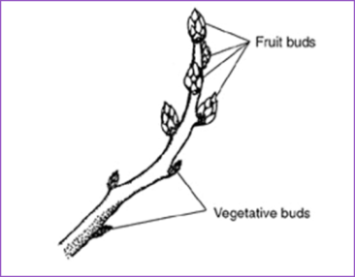
Understanding the Blueberry Plant
Fruiting buds are round, plump, and produce flowers
Vegetative buds are smaller, elongated, can produce lateral branches and leaves
Notes:
Blueberries are a good example of plant that produces fruit buds on shoot tips. In the case of blueberries, thinning cuts are more appropriate than heading cuts unless height reduction is the goal. In this case, heading cuts for height control must be made after final harvest, but before fruit buds develop—usually no later than early to mid-August in Illinois.

Slide 26
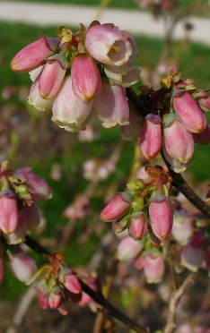
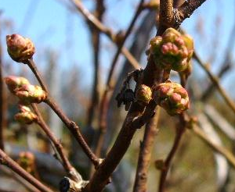
Understanding the Blueberry Plant
Fruiting bud
Vegetative bud
Notes:
Vegetative buds are located below fruiting buds on blueberries and give rise to lateral shoots and leaves.

Slide 27
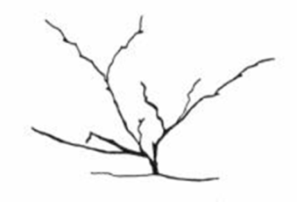
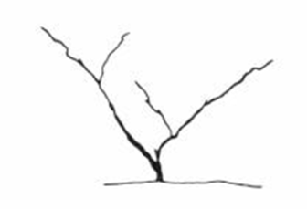
Pruning Young Blueberry Plant
Year 1-2
Minimal pruning
Remove weak twiggy growth
Remove damaged or diseased wood
Remove flower buds
Notes:
The goals when pruning young blueberry plants is to obtain full production as soon as possible by developing good structure and maintaining good air circulation. The first few years require minimal pruning, only enough to remove weak twiggy growth and damaged or diseased wood. The plants should not be allowed to produced the first two years after planting by removing flower buds.

Slide 28
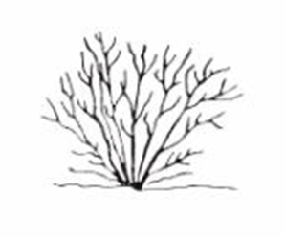
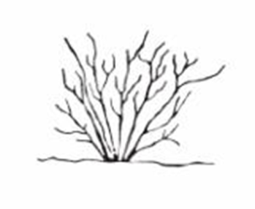
Pruning Young Blueberry Plant
Year 3-5
Minimal pruning
Remove weak twiggy growth
Remove damaged or diseased wood
Allow a small crop in year 3 (0.5-1pint/bush), gradually increase crop in year 4-5
Notes:
Follow a similar pruning regimen years 3-5. The only difference is a small crop can be allowed in year three. A small crop would be considered ½ to 1 pint harvested per bush. Gradually increase the crop in years four and five.

Slide 29
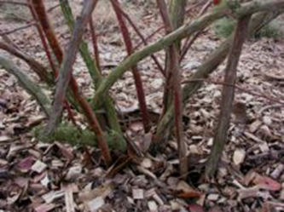
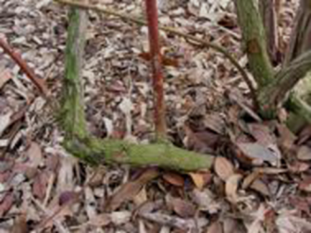
Pruning Mature Blueberry Plant
Remove 20% of the oldest canes each year (usually 1-2 canes)
  Remove to the ground
  Remove to a strong upright side shoot
Notes:
Blueberry plants are considered mature in the sixth year after planting. Additional pruning is needed to maximize yield, fruit size and quality, plus encourage consistent cropping. If the plant has been adding new canes every year, there should be a good mix of cane ages. Because canes 2-3 years old are the most productive, the goal in pruning is to stimulate production of new canes. This is done by removing 20 of the oldest canes each year, which is usually 1-2 canes. When a cane is removed, it is usually removed to the ground or to a strong upright side shhot.

Slide 30
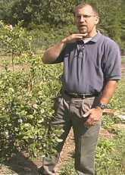
Pruning Mature Blueberry Plant
Remove low growing fruiting wood at base of plant
Most efficient harvest is from “knees to face”
Notes:
When selecting canes to remove, always target weak twiggy growth and damaged or diseased wood. Also remove low growing fruiting wood at the base of the plant. These canes are not only difficult to harvest, but tend to be of poorer quality due to poor light interception.

Slide 31
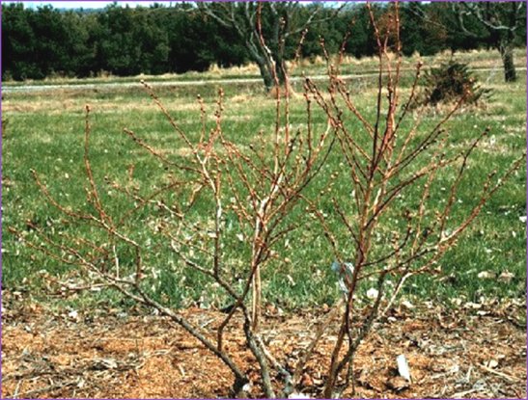
Pruning Mature Blueberry Plant
Detail prune
Thin out interior of bush
Thin out flower buds
Notes:
If your plants tend to overbear, with numerous small fruits rather than larger ones, thin the fruit buds by clipping back some of the small shoots carrying a heavy load of flower buds. Thin out the center of the bush to allow for maximum sunlight protection.

Slide 32
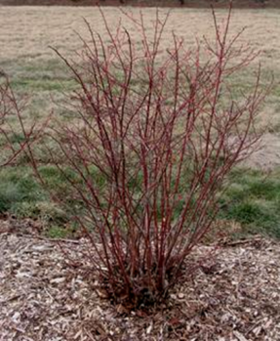
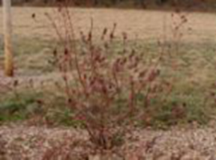
Pruning Mature Blueberry Plant
Consider growth habit
  Upright growth habit
  Remove older center canes to open up bush
  Bluecrop, Collins, Lateblue, Elliot, Reka, Duke, Legacy, Nelson
Spreading growth habit
  Prune to upright growth
  Blueray, Berkeley, Coville, Patriot, Nui, Summit, Toro, Chandler
Notes:
Blueberry cultivars differ in their growth habits. Some grow very upright and require additional pruning to remove older canes in the center to open up the bush. Others have a more spreading habit and require pruning cuts to direct growth more upright.

Slide 33
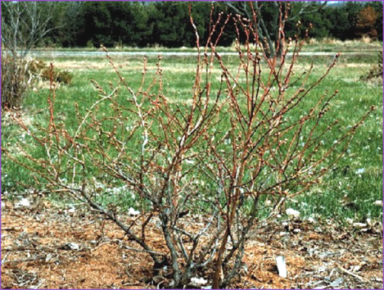
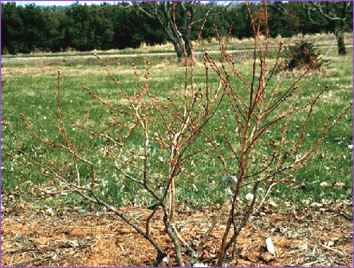
After
Before
Notes:
Pictured here are before and after pruning photos of a mature blueberry bush. Note that the older canes in the center were targeted for removal to not only encourage new cane growth, but also to open up the center of the bush for good light penetration.

Slide 34
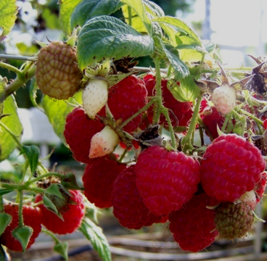
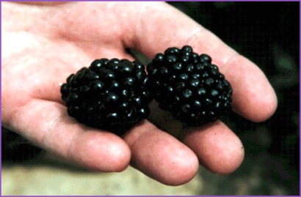
Cane Fruits --Brambles
Notes:
In this section, pruning details for raspberries and blackberries will be discussed.

Slide 35
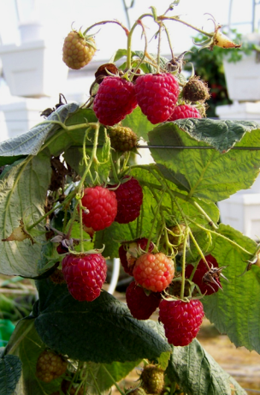
Pruning and Training Brambles
Summer-bearing Raspberries
  Red
  Purple
  Black
Fall- Bearing
  Red and Yellow Everbearing
Notes:
There are many types of raspberries and they each have specific pruning needs based on their growth characteristics.

Slide 36
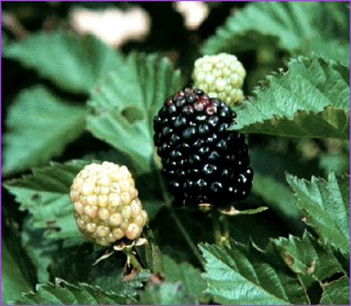
Pruning and Training Brambles
Blackberries
  Erect thorny
  Erect thornless
  Eastern semi-erect
Notes:
As with raspberries, blackberries cultivars can vary widely in growth characteristics which requires specific pruning techniques to maximize production.

Slide 37
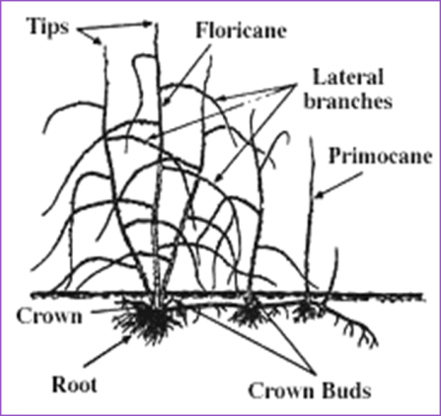
Pruning and Training Brambles
Biennial plants
Types of Canes:
  -Primocanes
    vegetative
  -Floricanes
    bear flowers and fruit
Notes:
With the exception of everbearing raspberries and blackberries, all brambles have a similar life cycle. Brambles are a perennial plant that produces biennial canes. This means the crown and root system lives for many years, but the canes produced only live for two years. First year canes are called primocanes. In most cases, primocanes are vegetative and do not produce flowers and fruit the first year. Second year canes are called floricanes, and by the name you can deduce that floricanes produce flowers and fruit—then they die. As previously mentioned, everbearing raspberries and blackberries are the exception to most brambles. They produce flowers on the primocane in year one, then produce flowers lower on the cane in year two.

Slide 38
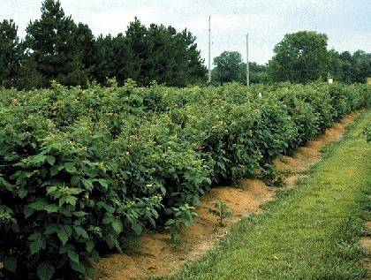
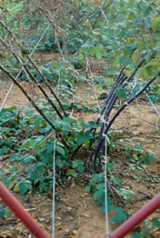
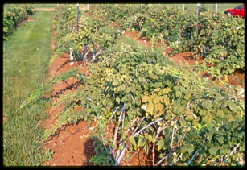
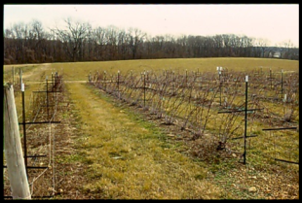
Pruning and Training Brambles
Trellis
  No trellis
  Steel posts + twine
  Permanent trellis
Notes:
It’s a good idea to trellis plants to keep them from drooping over to the ground when they are heavy with fruit. Trellising makes harvesting fruit easier and keeps berries from rotting when they come in contact with the ground. Those that do require a more substantial trellis include the semi-erect blackberries, trailing blackberries and black raspberries. Most erect blackberries and red and yellow raspberries are free standing, but can benefit from at least a temporary trellis during the harvest season.. And depending on cultivar, some purple raspberries require more than a temporary trellis. Recent advances include a movable arm trellis for blackberry production, but will not be presented in this module.

Slide 39
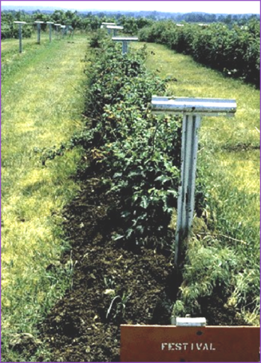
Pruning and Training Brambles
Pruning fall-bearing red raspberries
  Remove all canes in late winter
Notes:
Everbearing raspberries have several names, which includes the already mentioned everbearing, but also primocane bearing and fall bearing. Everbearing raspberries are considered the easiest to manage compared to other brambles. Because everbearing raspberries produce a large crop on the primocanes, there is no need to hold the canes over into the second year—unless you want the much smaller crop that will be produce on the floricanes. For this reason, everbearing raspberries canes are completely removed in late winter. The following spring, new primocanes will emerge and produce a crop that same year.

Slide 40
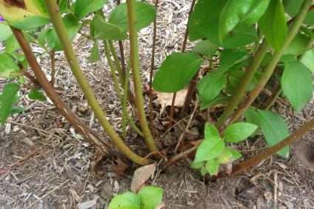
Pruning and Training Brambles
Red (and Purple) Summer-bearing Raspberries
  Remove old floricanes in winter
Thin remaining canes to 3-4 /ft²
Notes:
Going back to red raspberries that produce only on the floricanes in the second year, which are often referred to as summer-bearing raspberries. Cultivars that fall in this category are not pruned the first year. The first dormant season, thin canes leaving three or four per linear foot of row. Hedge the row to 5 feet, however never remove more than ¼ of the cane. Keep the hedgerow 6 to 18 inches wide The second dormant season and thereafter, remove all fruited floricanes and thin remaining primocanes to three or four per linear foot of row.

Slide 41
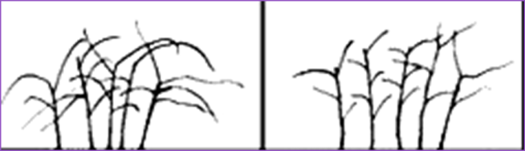
Pruning and Training Brambles
Pruning black raspberries and erect blackberries
  Tip primocanes in early summer 36-40”
  Remove dead floricanes in winter
  Thin remaining canes to 3-6 per plant (black raspberries) or 6/sq. ft. (blackberries)
  Shorten laterals to 12-18”
Notes:
Black raspberries and erect blackberries are manage similarly as red raspberries, with two added steps. Production can be increased on these cultivars by tipping canes in early summer, which results in lateral branching. Throughout the summer, cut tips of non-trellised primocanes off when they reach a height of 24 inches for black raspberries and between 3 and 4 feet for erect blackberries. If black raspberries are trellised, they can be cut at 30 inches. Cut the canes that bore the fruit to the ground after harvest or in the dormant season. In late winter, cut the laterals back 7-12 inches for black raspberries and 1 foot for erect blackberries. Be sure to remove laterals for both that are near the ground

Slide 42
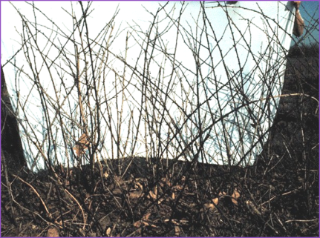
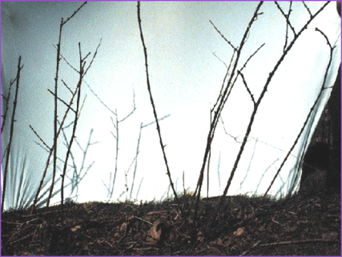
Pruning Erect Blackberries
Before After
Notes:
Shown here is before and after thinning of erect blackberries, Note that laterals have been shortened as well.

Slide 43
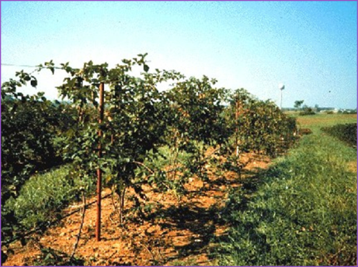
Pruning and Training Brambles
Pruning semi-erect blackberries
One or two –wire trellis system
    Top wire 6 ft. from ground
Summer tip primocane when they reach the top wire
Notes:
Semi-erect raspberries require a trellis with a top wire at six feet, similar to what is used for grapes.

Slide 44
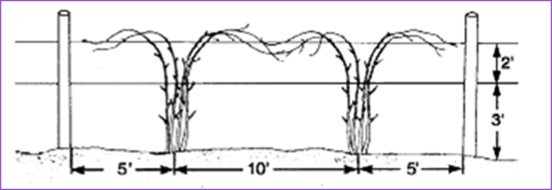
Pruning and Training Brambles
Pruning semi-erect blackberries
  Remove old floricanes in winter
  Select 8-10 strong canes and tie to the trellis in winter or early spring
  Remove remaining canes
  Prune laterals to 18-24”
Notes:
In summer, tie 6-8 canes per plant to the trellis in the shape of a fan. Cut the canes off when they are about 6 inches past the top wire, which promotes laterals. Cut out low lying laterals and drape remaining laterals over the trellis so they do not root at the tips. In March, shorten laterals to between 18 and 24 inches. Remove fruit producing canes immediately after harvest.

Slide 45
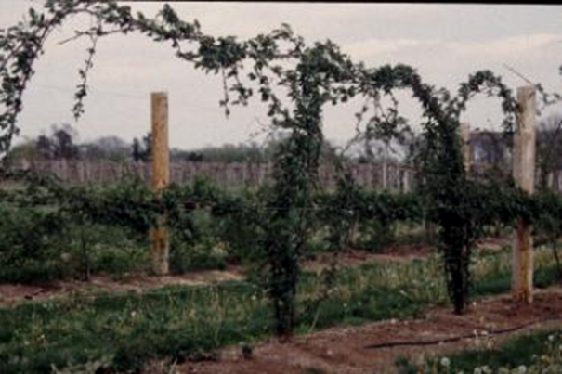
Pruning Semi-erect Blackberries
Notes:
Shown here are the laterals draped over the trellis to prevent tips from rooting

Slide 46
References
Byer, P. 2009. Pruning Fruits. Missouri State University Dept. of Agriculture
Miller, S. 2008. Peach Systems: Training and Production; USDA-ARS, AFRS, Kearneysville, WV
Westwood, M. N. 1993. Temperate Zone Pomology Physiology and Culture. Timber Press
Notes:
Above are just a scant few of the resources available to further your understanding of pruning fruit plants.

Slide 47
Resources
How to Prune Young and Bearing Apple Trees http://www.wvagriculture.org/images/Literature/How_to_Prune_Young_and_Bearing_Apple_Trees.pdf
Pruning Peach Tree http://pubs.ext.vt.edu/422/422-020/422-020_pdf.pdf
YouTube video - Pruning a Mature Peach Tree http://www.youtube.com/watch?v=u42z2WuC4Nw
YouTube video - Pruning Apple Trees http://www.youtube.com/watch?v=tEwUeCmuTMI
Notes:
Additional resources available on the web to further your understanding of pruning fruit plants.

Slide 48
To reach us
Contacts | Contact information
Elizabeth Wahle | wahle@illinois.edu
Jeff Kindhart | jkindhar@illinois.edu
Rick Weinzierl | weinzier@illinois.edu
Notes:
Listed above are contacts at University of Illinois Extension should you have additional questions related to pruning fruit plants.

Slide 49
If you have questions …
University of Illinois Extension Local Food Systems and Small Farms team
  http://web.extension.illinois.edu/smallfarm/
USDA’s Start2Farm site
  http://www.start2farm.gov/
Notes:
Our beginning farmer training program ended in the fall of 2015. The best way to pursue answers to questions about fruit and vegetable production in Illinois is to contact educators on the University of Illinois Extension Local Food Systems and Small Farms team. Extension programs in other states are operated by the land-grant university in each state. Additionally, USDA’s Start2Farm site provides listings of farmer training programs in specific states and localities.

