Slide 1
Preparing a New Generation of Illinois Fruit and Vegetable Farmers a USDA NIFA Beginning Farmer and Rancher Development Program Project Grant # 2012-49400-19565 http://www.newillinoisfarmers.org
Notes:
The following presentation was part of a beginning farmer course, “Preparing a New Generation of Illinois Fruit and Vegetable Farmers,” offered by the University of Illinois and the Illinois Migrant Council from 2012 through 2015. This course was funded by the United States Department of Agriculture’s National Institute of Food and Agriculture, and specifically by the Beginning Farmer and Rancher Development Program. For more information about the program and for links to presentations and resources on many other topics, see the website newillinoisfarmers.org.

Slide 2
Soil Testing
Growing a New Generation of Illinois Fruit and Vegetable Farmers
Shelby Henning, Jeff Kindhart
and Mike Krueger
March 2015

Slide 3
Do I need to test my soil?
YES
The basis for proper nutrient management (and optimal yields) it to conduct soil tests.
ACME SOIL TESTING KIT
Easy to use!
Just add dirt and water!
Highly accurate!
This isn’t what we’re talking about! Soil testing is sound science and should be carried out by a qualified laboratory

Slide 4
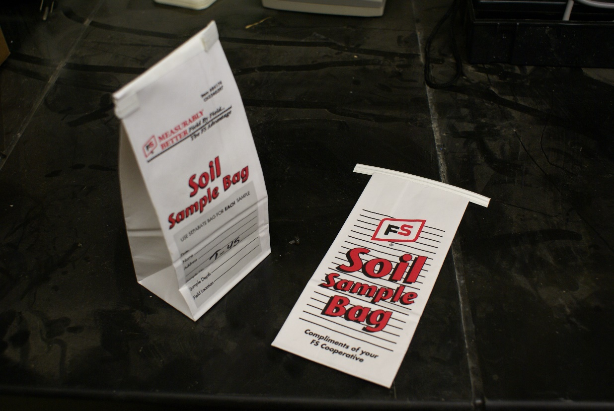
Find a certified lab near you
Illinois Soil Testing Association
http://www.soiltesting.org/labcertification.html

Slide 5
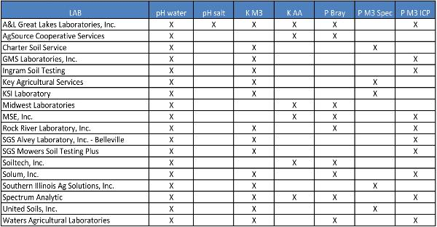
A point to consider: Not all labs offer the same tests.
http://www.soiltesting.org/5certifiedlabs.html

Slide 6
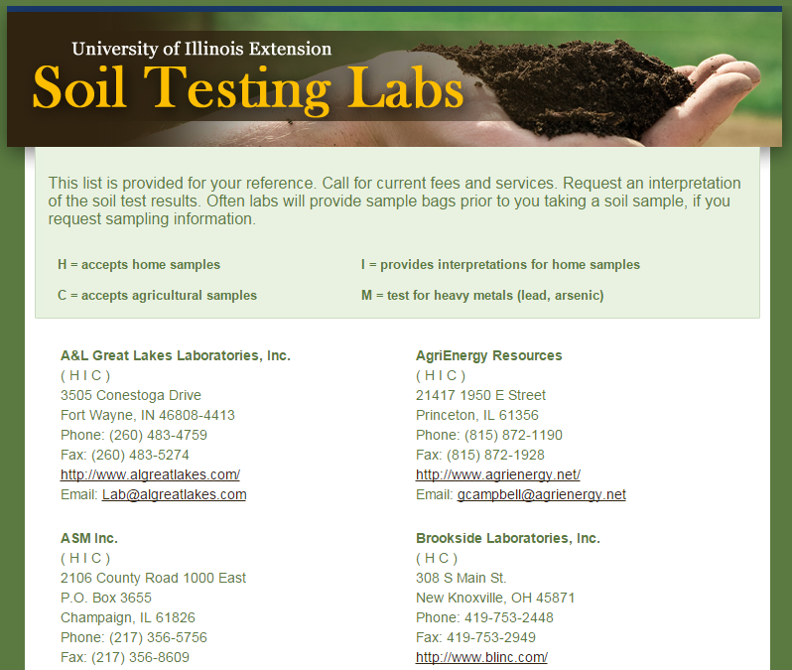
Not all labs cater to the small grower or provide interpretations
http://urbanext.illinois.edu/soiltest/

Slide 7
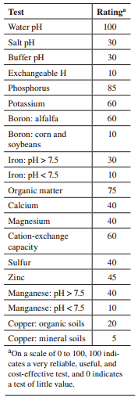
A point to consider: Not all tests are 100% accurate.
Lab accreditation helps! – Use a certified lab!
https://extension.cropsci.illinois.edu/handbook/pdfs/chapter08.pdf

Slide 8
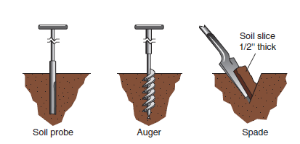
How do I take a soil sample?
How to take samples with a soil probe, an auger, and a soil spade
https://extension.cropsci.illinois.edu/handbook/pdfs/chapter08.pdf

Slide 9
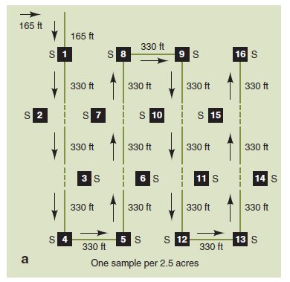
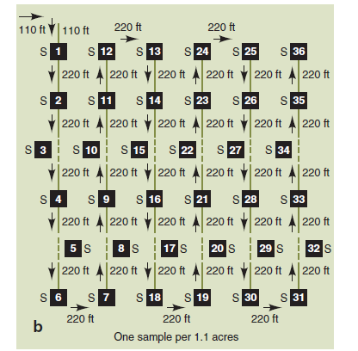
Taking a field representative sample
How to collect soil samples from a 40-acre field. Each sample (diagram a) should consist of five soil cores, 1 inch in diameter, collected to a 7-inch depth from within a 10-foot radius around each point. Higher frequency sampling (diagram b) is suggested for those who can use computerized spreading techniques on fields suspected of having large variations in test values over short distances.
https://extension.cropsci.illinois.edu/handbook/pdfs/chapter08.pdf
http://www.nrcs.usda.gov/wps/portal/nrcs/surveylist/soils/survey/state/?stateId=IL

Slide 10
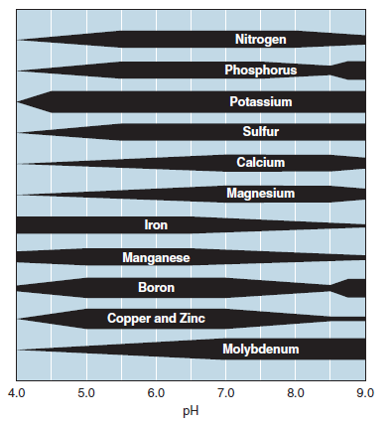
Nutrient availability is controlled by soil pH
https://extension.cropsci.illinois.edu/handbook/pdfs/chapter08.pdf

Slide 11
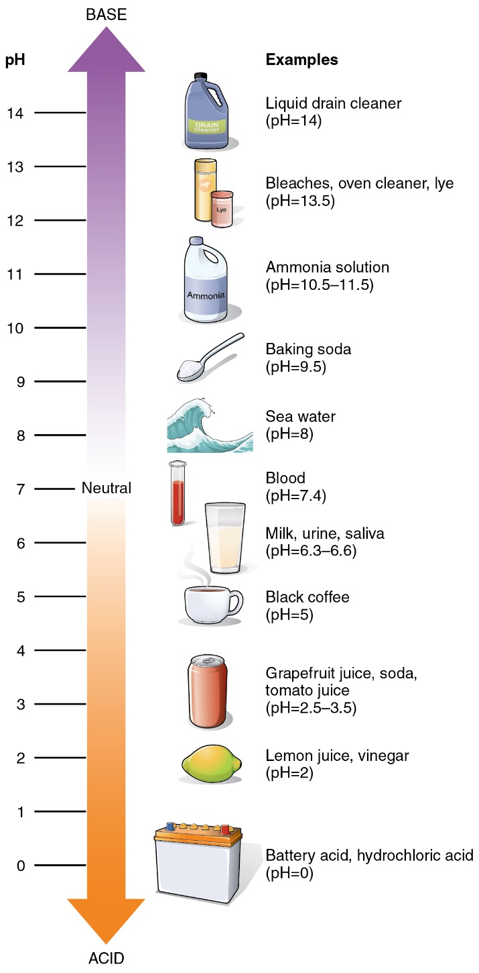
How pH measurements are made
This is the first test you should do
Remember soil pH controls availability
Reactive dyes
Fairly low-tech, simple
pH paper
Cheap, simple
pH meter
Good meters aren’t cheap
1:1 paste is made,
measured after short time

Slide 12
What is optimal?
A pH of 6-6.5 is generally considered ideal
https://extension.cropsci.illinois.edu/handbook/pdfs/chapter08.pdf

Slide 13
What if my pH is too high?
https://extension.cropsci.illinois.edu/handbook/pdfs/chapter08.pdf

Slide 14
Some things to remember
Granular sulfur is the cheapest and most readily available acidifying agent (there are many)
But being granular takes longer to carry out the desired soil acidification
Don’t apply more than 2 lbs. sulfur/100 ft² per application at one time.
Wait at least 3 months to make another application
RETEST!

Slide 15
What do I do is my soil is too acidic?

Slide 16
Not all lime is created equal
8 mesh = 0.093 inch diameter
60 mesh = 0.0098 inch diameter

Slide 17
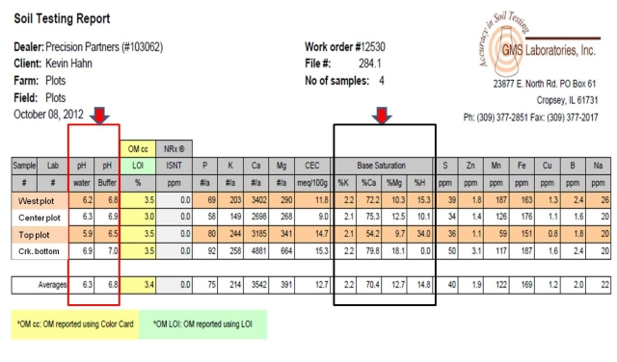
Last thought on pH adjustment
If you send your sample to a reputable lab, they will often generate a report and tell you how much, and what, to use as an amendment.

Slide 18
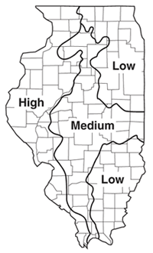
Soil phosphorous
Generalized map of subsoil phosphorous
supplying power in Illinois
https://extension.cropsci.illinois.edu/handbook/pdfs/chapter08.pdf

Slide 19
P-testing: accepted methodologies
Bray-Kurtz P1 (1945) extraction method
Dilute acid 0.025 M HCl; 0.03 M NH₄F)
Used for low to neutral pH soils
Olson extraction method (1954)
0.5 M NaHCO₃
Used only for high pH soils typical of Western states
Mehlich 2 extraction method (1984)
0.2 N CH₃COOH; 0.25 N NH₄NO₃; 0.015 NH₄F; 0.013 N HNO₃; 0.001 M EDTA
Robust
P content of extract determined by flame photometry, inductively coupled plasma emission spectroscopy (ICP), colorimetrically, etc.
The type of test can change recommendations

Slide 20
P fertilization guidelines
Guidelines based on:
Soil test value
Type of crop
Estimates of crop removal
Midwest growers guide recommendations
Crops cultivated on mineral soils will benefit if from added P if test is less than 35-40 ppm (Bray)
Mineral soils > 80 ppm, no additional P is recommended

Slide 21
How much P to add?
Applying P₂O₅ fertilizer at 90-100 pounds per acre will increase the soil P test level by about 10 pounds per acre.

Slide 22
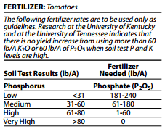
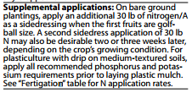
Further P fertilization guidelines
http://www2.ca.uky.edu/agc/pubs/id/id36/id36.pdf

Slide 23
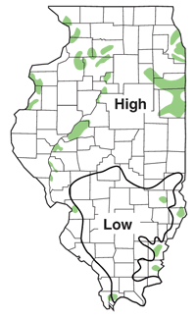
Soil Potassium
K⁺
K⁺
K⁺
Green shaded areas of sandy soils with
very low CEC test values
CEC corresponds with K-supplying power of soil
K⁺
K⁺
https://extension.cropsci.illinois.edu/handbook/pdfs/chapter08.pdf

Slide 24
K-testing
Extraction with Mehlich 3, NH₄C₂H₃O₂
Amount of K in extract measured by ICP, flame photometer

Slide 25
K fertilization guidelines
K recommendations are based on:
The soil test value
Soil CEC
Crop
Estimates of removal

Slide 26
K fertilization guidelines
Midwest growers guide recommendations:
Vegetables usually benefit from K fertilization is soil test is:
Less than 85 ppm K on a soil with a low CEC (~4)
Less than 115 ppm K on a soil with medium CEC (~16)
Maximum K recommendation is 300 lbs K₂O/A/Yr.
K fertilizer not recommended if test is:
Greater than 135ppm K on a soil with low CEC
Greater than 165 ppm K on a soil with medium CEC

Slide 27
Potassium fertilization guidelines

Slide 28
Soil N testing
Standard tests aren’t available to predict how much N a vegetable crop needs
Fertilizer N requirement affected by:
Experience (on farm trials can help optimize)
Soil type (“bad soils” need more N fertilizer)
Cropping history
Organic matter amendments
Crop culture system

Slide 29
Soil N testing
No perfect N test (yet)
Soil NO₃⁻-N prior pre-plant or prior to sidedressing
ISNT
Still needs research and development to determine usefulness to specialty growers
Soil incubations followed by N analysis

Slide 30
N fertilization guidelines
Vary between crops
Affected by plant population

Slide 31
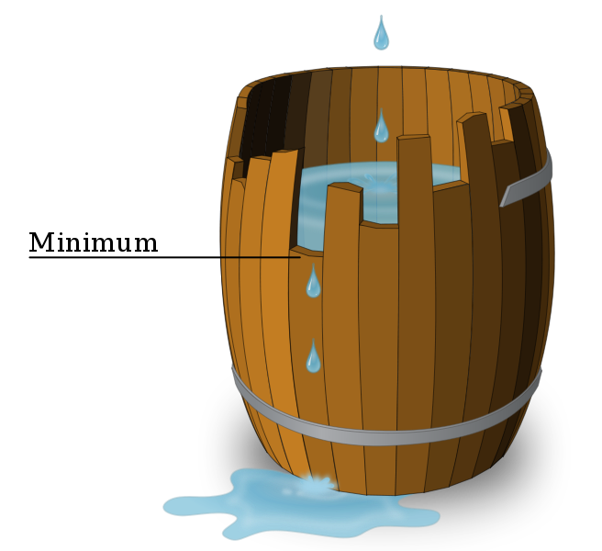
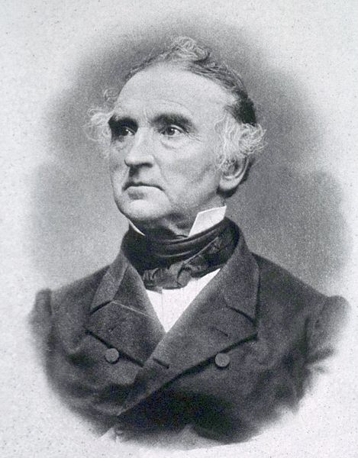
Why is soil testing important for specialty crop producers?
N
P
K
Ca
Mg
S
Justus von Liebig’s “law of the minimum” –
“Plant growth is controlled not by the total amount of resources available, but by the scarcest resource”

Slide 32
Problems more commonly found in specialty crops
Phosphorus scores too high
Advising on foliar feeding
Nutrients out of balance?
“Disease” associated with fertility

Slide 33
Other differences
Fertilizer materials used
Timing of application
Method of application
Fertilizer input expenses are normally not that significant in the overall cost of production
Excess fertilizer may result in problems beyond the simple waste of money

Slide 34
Tools in addition to soil testing utilized by Illinois specialty crop producers
Visual inspection
Downloaded feeding schedules
Tissue analysis
Petiole sap testing

Slide 35
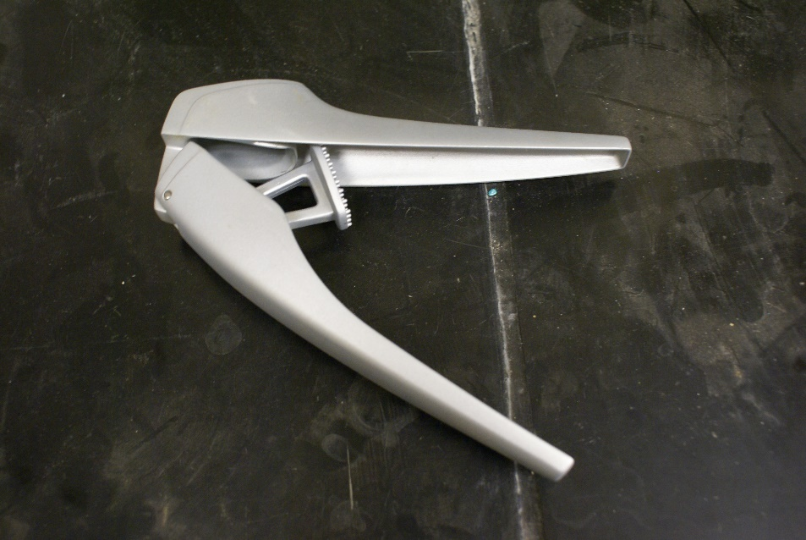
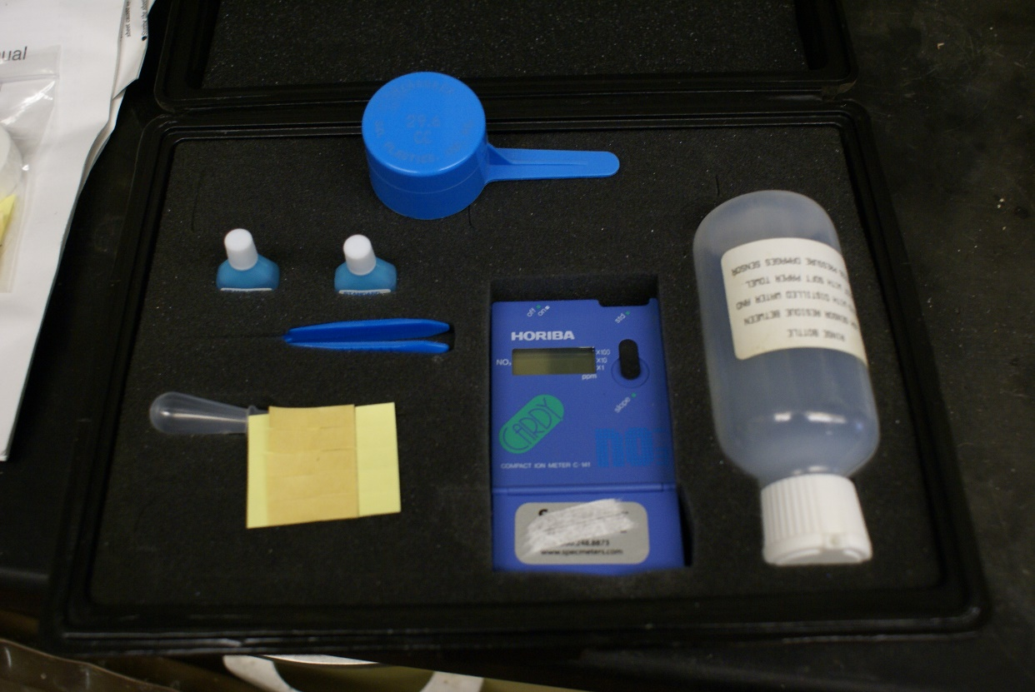
Petiole sap testing
Relatively simple, used with N and K
Immediate results
Useful for making timely adjustments in fertilizer application rates when using fertigation.
An on-farm crop management tool and are meant to supplement, not replace, standard soil testing and nutrient management
A NO₃⁻-N testing kit

Slide 36
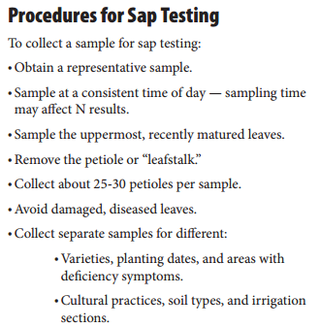
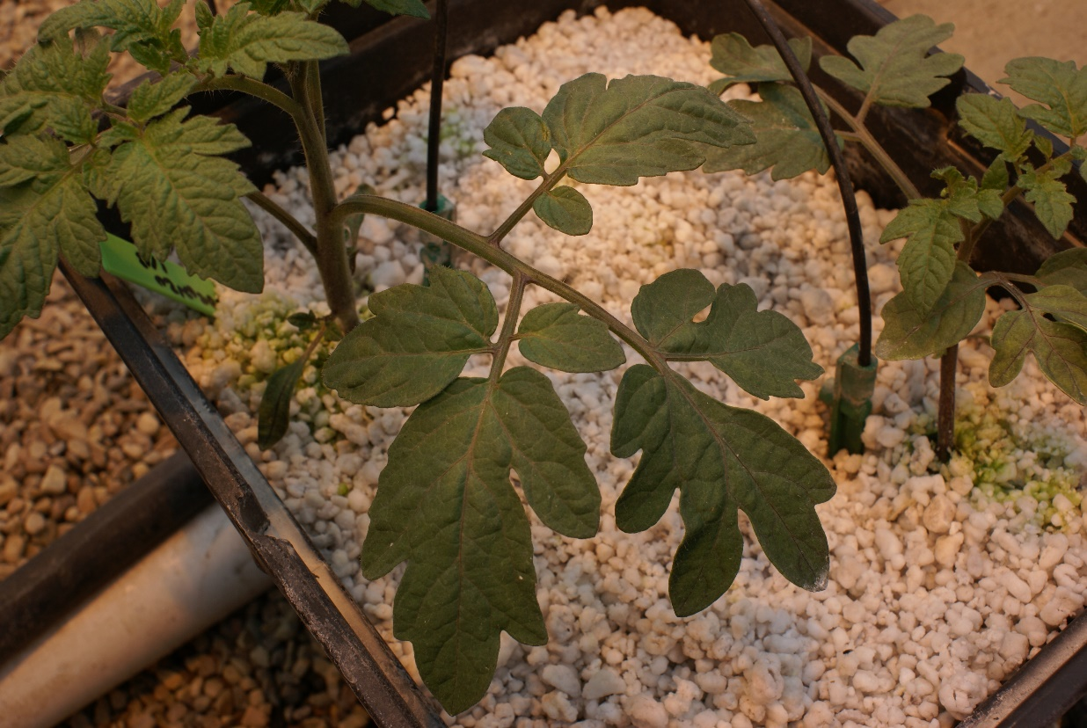

Slide 37
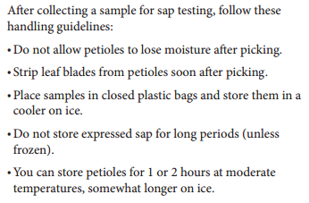
Procedures for Sap Testing

Slide 38
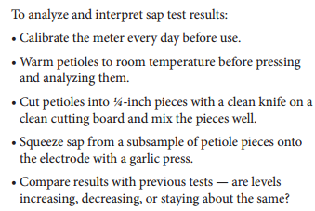
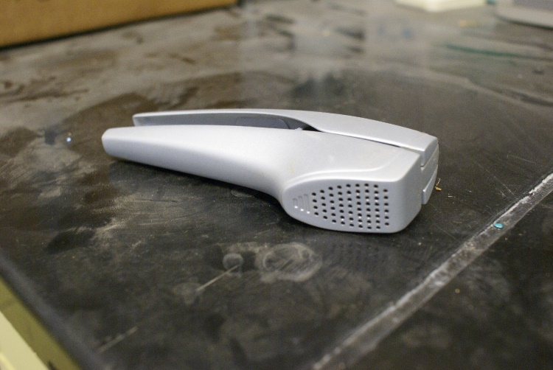
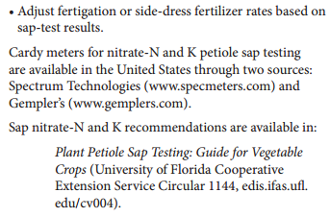
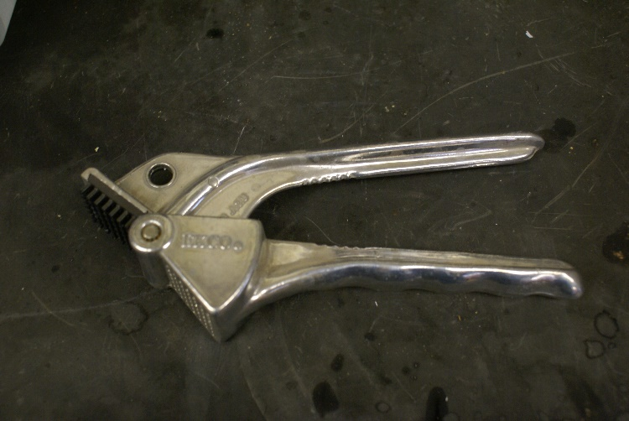
Procedures for Sap Testing
Specialized plant sap press
Inexpensive garlic press

Slide 39
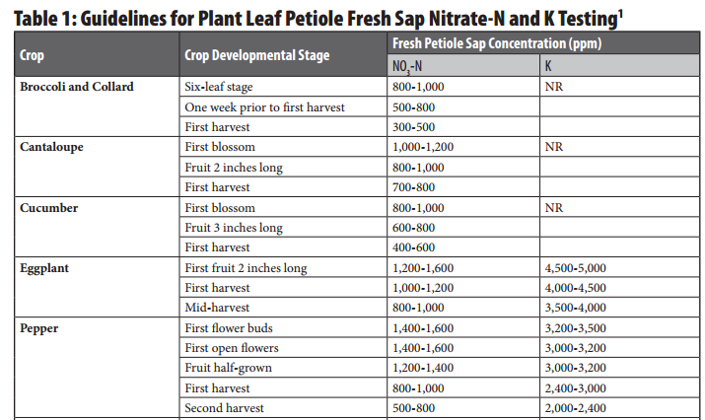
Detailed list also available on page 14 of the Midwest Vegetable Production Guide for Commercial Growers
http://mwveguide.org/

Slide 40
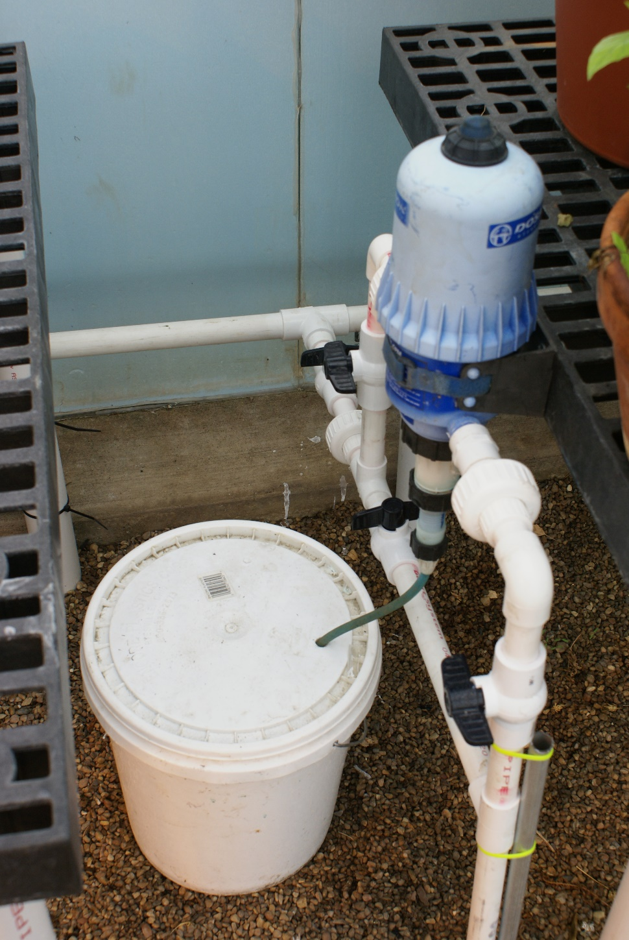
Fertigation
“The application of fertilizers,
soil amendments, or other water-soluble
products through an irrigation system”

Slide 41
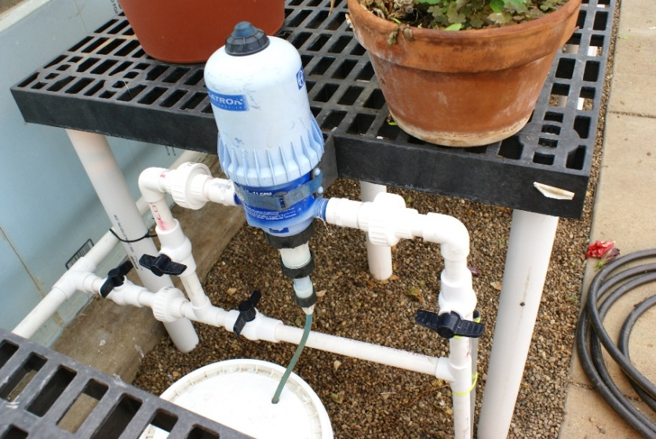
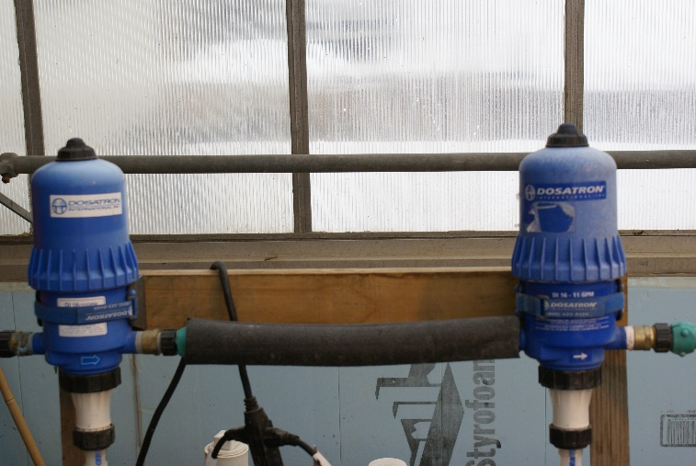
Fertigation
If you do not have properly functioning check valves and interlocks, the injected chemicals could backflow into the water source.
EPA and many state regulations specify that each system must contain a reduced pressure zone backflow prevention system
Most regulations require a power interlock between the irrigation pump and the chemical injector unit, a low pressure shut down switch and a check valve on the chemical injection hose.
For specific requirements, check with the appropriate local or state agency.

Slide 42
Fertigation recommendations
For N fertilization only
Based on 150 lb actual N/A with 50 lb N/A applied preplant and the remaining N divided into equal amounts to be fertigated on a weekly basis
Fertigation can begin 10-14 d after transplant assuming 50 lb/A was applied preplant
Total N required | Actual N/week (lb/A) | Ammonium nitrate (lb/A/wk) | Ammonium nitrate (lb per 1000 plants/wk) | Calcium nitrate (lb/A/wk) | Calcium nitrate (lb/1000 plants/wk)_
75 lb/A | 7 lb 8 oz | 22 lb 6 oz | 5 lb 5 oz | 48 lb 6 oz | 11 lb 8 oz
100 lb/A | 10 lb | 30 lb | 7 lb | 64 lb 8 oz | 11 lb 6 oz

Slide 43
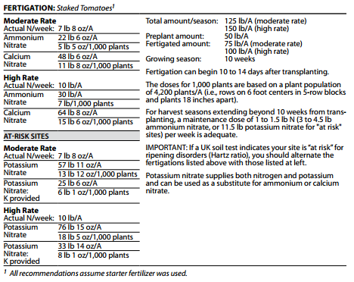
http://www2.ca.uky.edu/agc/pubs/id/id36/id36.pdf

Slide 44
Fertigation
Most growers use ammonium, calcium, or potassium nitrate, usually dissolved in water prior to fertigating.
Many fertilizers are easily soluble together, care must be taken not to mix fertilizers that may precipitate when together.
This can lead to clogs at emitters, resulting in inadequate irrigation.
Often, high-phosphorous fertilizers can precipitate when mixed with sufficient concentrations of calcium.

Slide 45
Final thoughts on soil testing
On-farm tests can assist in optimizing a fertility program
Know who are your extension agents and get to know them
Remember that quality soil testing labs often give liming and fertilization recommendations
Repeat soil testing every 3-4 years

Slide 46
Additional resources
http://www2.ca.uky.edu/agc/pubs/id/id36/id36.pdf
http://mwveguide.org/
https://extension.cropsci.illinois.edu/handbook/pdfs/chapter08.pdf
http://www.nrcs.usda.gov/wps/portal/nrcs/surveylist/soils/survey/state/?stateId=IL
http://www.extension.umn.edu/agriculture/nutrient-management/nitrogen/nitrogen-application-with-irrigation-water-chemigation/

Slide 47
To reach us
Contacts | Contact information
Jeff Kindhart Shelby Henning Rick Weinzierl Mary Hosier Mike Krueger | jkindhar@illinois.edu shenning@illinois.edu weinzier@illinois.edu mhosier@illinois.edu kruege13@illinois.edu

Slide 48
If you have questions …
University of Illinois Extension Local Food Systems and Small Farms team
http://web.extension.illinois.edu/smallfarm/
USDA’s Start2Farm site
http://www.start2farm.gov/
Notes:
Our beginning farmer training program ended in the fall of 2015. The best way to pursue answers to questions about fruit and vegetable production in Illinois is to contact educators on the University of Illinois Extension Local Food Systems and Small Farms team. Extension programs in other states are operated by the land-grant university in each state. Additionally, USDA’s Start2Farm site provides listings of farmer training programs in specific states and localities.

