Slide 1
Preparing a New Generation of Illinois Fruit and Vegetable Farmers a USDA NIFA Beginning Farmer and Rancher Development Program Project Grant # 2012-49400-19565 http://www.newillinoisfarmers.org
Notes:
The following presentation was part of a beginning farmer course, “Preparing a New Generation of Illinois Fruit and Vegetable Farmers,” offered by the University of Illinois and the Illinois Migrant Council from 2012 through 2015. This course was funded by the United States Department of Agriculture’s National Institute of Food and Agriculture, and specifically by the Beginning Farmer and Rancher Development Program. For more information about the program and for links to presentations and resources on many other topics, see the website newillinoisfarmers.org.

Slide 2
Preparing a New Generation of Illinois Fruit and Vegetable Farmers Pollination, Pollinators, and challenges
Rick Weinzierl

Slide 3
Definitions, courtesy of Wikipedia (with a few edits)
Pollination: Pollination is the process by which pollen is transferred from the anther (male part) to the stigma (female part) of flowers, thereby enabling fertilization and reproduction.
In spite of a common perception that pollen grains are gametes, like the sperm cells of animals, this is incorrect; pollination is an event in the alternation of generations. Each pollen grain is a male haploid gametophyte, adapted to being transported to the female gametophyte, where it can effect fertilization by producing the male gamete (or gametes), in the process of double fertilization).
A successful angiosperm pollen grain (gametophyte) containing the male gametes gets transported to the stigma, where it germinates and its pollen tube grows down the style to the ovary. Its two gametes travel down the tube to where the gametophyte(s) containing the female gametes are held within the carpel. One nucleus fuses with the polar bodies to produce the endosperm tissues, and the other with the ovule to produce the embryo. Hence the term: "double fertilization".
In gymnosperms (including conifers) the ovule is not contained in a carpel, but exposed on the surface of a dedicated support organ such as the scale of a cone, so that the penetration of carpel tissue is unnecessary. Details of the process vary according to the division of gymnosperms in question.
Pollination, aided by wind, insects, or other animals, allows flowering plants to produce seeds and fruits.

Slide 4
and more from Wikipedia (also with minor edits) …
Pollinators are the organisms that carry pollen from the stamen to the stigma … they may be insects, birds, bats, or occasionally other animals.
Pollenizers are plants that serve as the source of pollen for successful pollination and fertilization. While some plants are capable of self pollenization, the term is more often used in pollination management to refer to a plant that provides abundant, compatible, and viable pollen at the same flowering time as the pollenized plant. For example, most crabapple varieties are good pollenizers for any apple variety that blooms at the same time, and are often used in apple orchards for that purpose. Some apple cultivars produce very little pollen; some produce pollen that is sterile or incompatible with other apple varieties. These are poor pollenizers. A pollenizer can also be the male plant in dioecious species (where entire plants are of a single sex), such as with kiwifruit or holly.

Slide 5
OK, so flowers …
may each include male and female organs that are self fertile ... and may or may not benefit from pollen transfer from male to female flower parts by insects or other pollinators
Pollen transfer may be physical, by wind or gravity (think corn, beans, peaches)
may each include male and female organs, but pollen from another cultivar or variety may be needed for successful fertilization
Nearly all apples and most sweet cherries, for example
may occur separately as male and female flowers on the same plant
Cucurbits
may be on separate male and female plants
Asparagus, kiwi, holly, and gingko (and detassled corn grown for seed production)

Slide 6
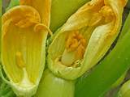
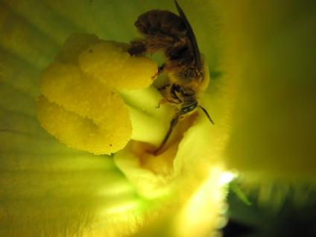
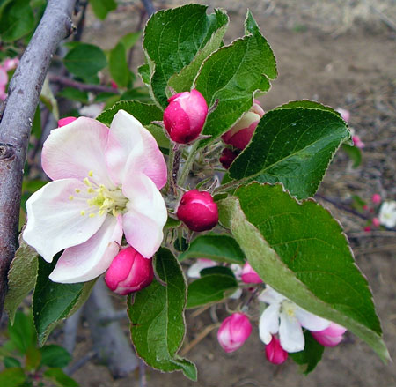
Male (left) and female (right) flowers occur on the same squash plant.
Apple flowers have male and female parts.

Slide 7
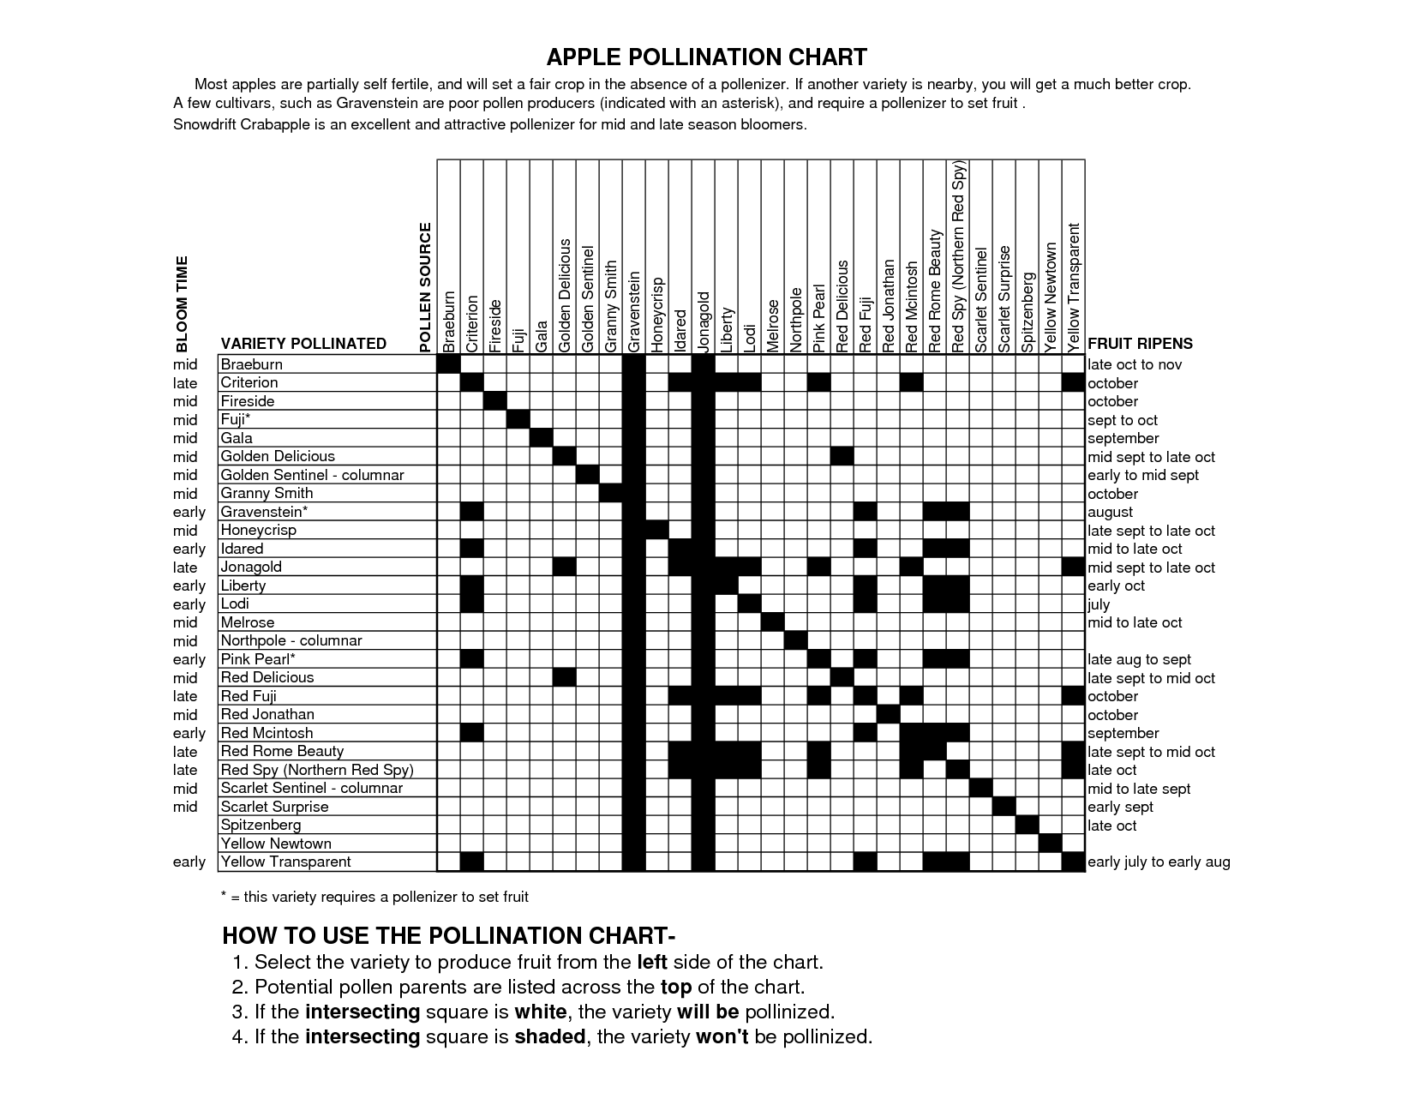
Pollenizers

Slide 8
Insect-aided pollination …
may occur without management
If the result of wild honey bees, it’s not really “natural” … honey bees are not native to North American but instead imported by European immigrants
Insect pollinators include bees, wasps, butterflies, moths, flies, beetles, and other insects that visit flowers for pollen or nectar
may be managed
Honey bees
Bumble bees, orchard mason bees (blue orchard bee, hornfaced bees), and leafcutter bees … are sometimes cultured
Squash bees, digger bees, and carpenter bees may be conserved

Slide 9
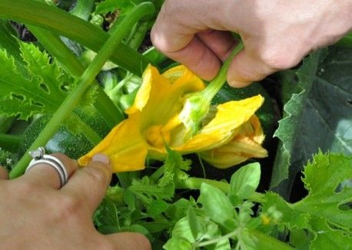

Slide 10
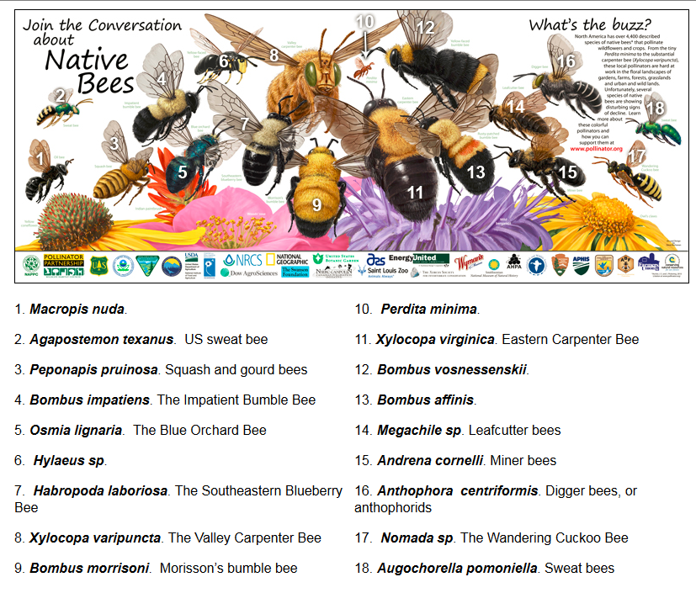
http://www.pollinator.org/NativeBees.htm

Slide 11
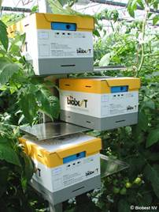
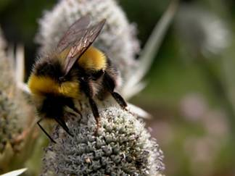
Bumble bees … wild and managed pollinators.

Slide 12
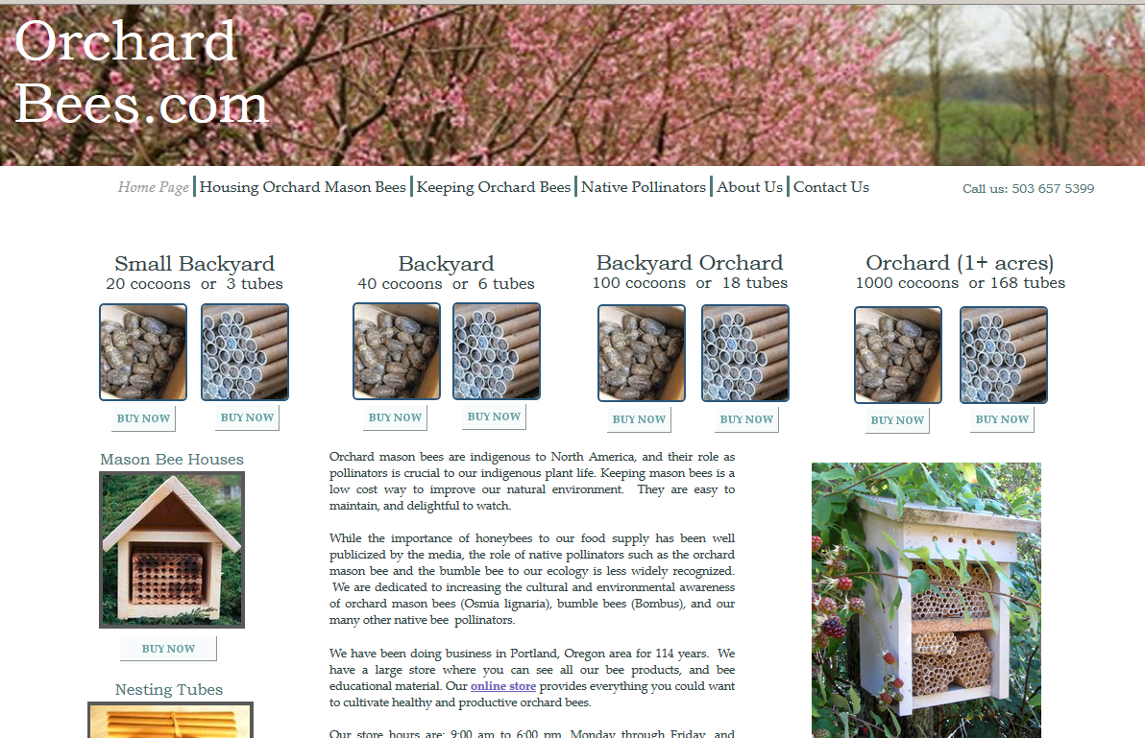

Slide 13
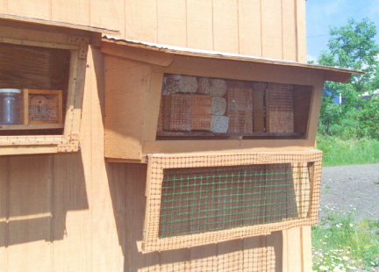
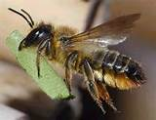
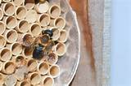
Leafcutter bees

Slide 14
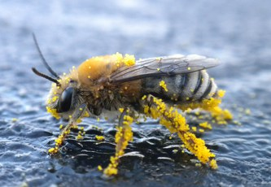
Squash bees … nest in ground. They look similar to honey bees but with fuzzier legs that lift dry pollen from squash blossoms, and male bees have a yellow spot on their face that resembles a nose.
They begin foraging (visiting cucurbit flowers) at or before dawn. Male and unfertilized female squash bees spend the night in flowers that have wilted during the day. In the morning, they chew their way out and start foraging and mating. Because they nest 5 to 20 inches below the soil surface, conservation tillage and no-till practices allow their survival.

Slide 15
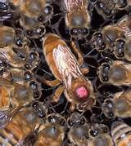
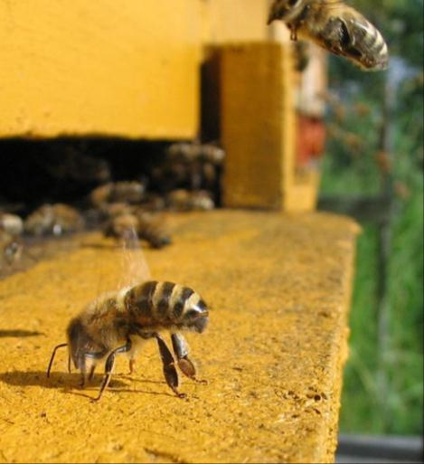
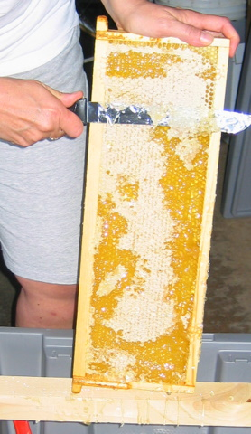
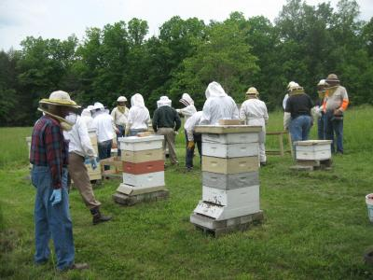
Honey bees

Slide 16
Using bees for pollination
 | Honey bee hives/A | Alternatives
Apples | 1.2 | 250 orchard mason bees/A
Blueberries (bees augment yield and size) | 4 | 1-4 bumble bees or southeastern blueberry bees / bush
Muskmelon | 2-3 | Conserve squash bees
Cucumber | 2-3
Pumpkin | 1
Squash | 1
Watermelon | 1-5
Distributors of bumble bee colonies provide recommendations for outdoor and high tunnel / greenhouse uses.

Slide 17
Challenges … threats to pollinators, beekeepers, and specialty crop production
Host plant / habitat loss
Climate and weather
Insecticides
Overall use
Neonicotinoids
Parasites and pathogens
Varroa and tracheal mite
Bacteria and viruses
Migratory beekeeping
Colony collapse disorder

Slide 18
Insecticide management
Fruit and vegetable growers can promote or hurt the survival of pollinators
http://extension.entm.purdue.edu/publications/E-53.pdf

Slide 19
Neonicotinoid Insecticides
Krupke, C.H., G.J. Hunt, B.D. Eitzer, G. Andinao, and K. Gvien. 2012. Multiple Routes of Pesticide Exposure for Honey Bees Living Near Agricultural Fields. PLOS ONE: http://www.plosone.org/article/info%3Adoi%2F10.1371%2Fjournal.pone.0029268.
Dively, G.P., and A. Kamel. 2012. Insecticide Residues in Pollen and Nectar of a Cucurbit Crop and their Potential Exposure to Pollinators. Journal of Food and Agricultural Chemistry 60 (18): 4449-4456. http://pubs.acs.org/doi/abs/10.1021/jf205393x.
Hopwood, J., M Vaughan, M. Shepperd, D. Biddinger, E. Mader, S. Hoffman-Black, and C. Mazzacano. Are Neonicotinoids Killing Bees? Xerces Society. http://www.xerces.org/wp-content/uploads/2012/03/Are-Neonicotinoids-Killing-Bees_Xerces-Society1.pdf

Slide 20
Characteristics of Neonicotinoids
Persistence
Likelihood of Transport (solubility)
Toxicity

Slide 21
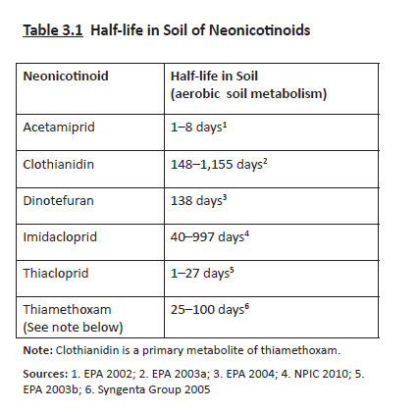

Slide 23
Solubility of permethrin (Pounce)is 0.4 ppm; solubility of chlorpyrifos (Lorsban) is 1 ppm … in comparison with most other insecticides, the neonicotinoids are more soluble in water than most.

Slide 25
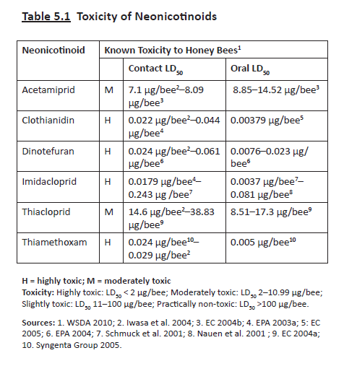

Slide 26
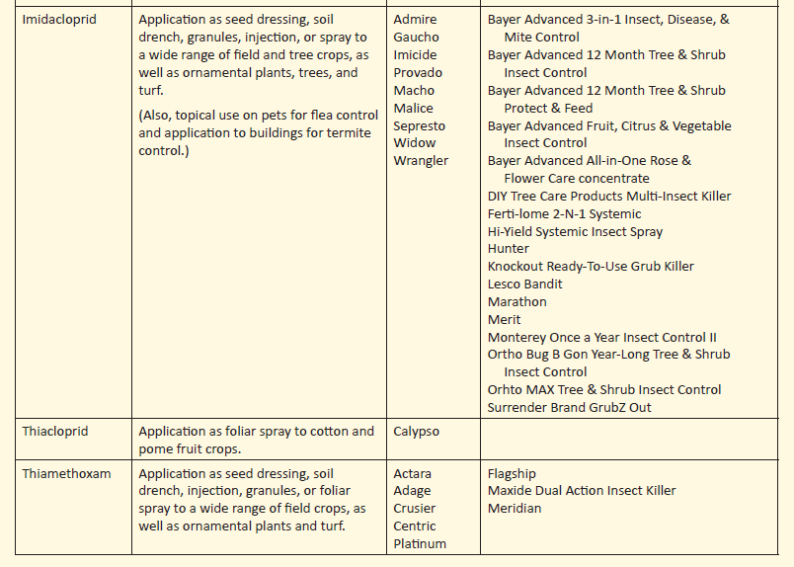

Slide 27
So …
Expect increasing regulatory action of some kind in the next few years (maybe).
Until then … we should not use neonicotinoids that are especially toxic to bees if applications (even seed treatments) will result in bee kill. Particularly toxic neonics include …
Imidacloprid (Admire Pro, many homeowner products)
Thiamethoxam (Actara, Platinum)
Clothianidin (Poncho seed treatments)
Dinotefuran (Scorpion, Venom)
Use of these products (imidacloprid and thiamethoxam) as seed treatments on cucurbits presents little or no systemic risk, but later uses do result in more significant contamination of pollen and nectar.
Seed treatments on seedcorn … the large scale of use presents real risks, with little evidence of real need to reduce losses to insects

Slide 28
Habitat management
NRCS EQIP for pollinator habitat
http://www.nrcs.usda.gov/wps/portal/nrcs/main/national/plantsanimals/pollinate/
Attracting Pollinators …
http://www.fs.fed.us/wildflowers/pollinators/documents/AttractingPollinatorsV5.pdf
High Value Pollinator Plants http://www.nrcs.usda.gov/Internet/FSE_DOCUMENTS/nrcs141p2_029849.pdf

Slide 29
http://www.xerces.org/wp-content/uploads/2013/01/InstallGuideJobSheet_UpperMidwest_CnsrvCvr.pdf

Slide 30
http://www.xerces.org/wp-content/uploads/2013/04/using-farmbill-programs-for-pollinator-conservation-2ndEd.pdf

Slide 31
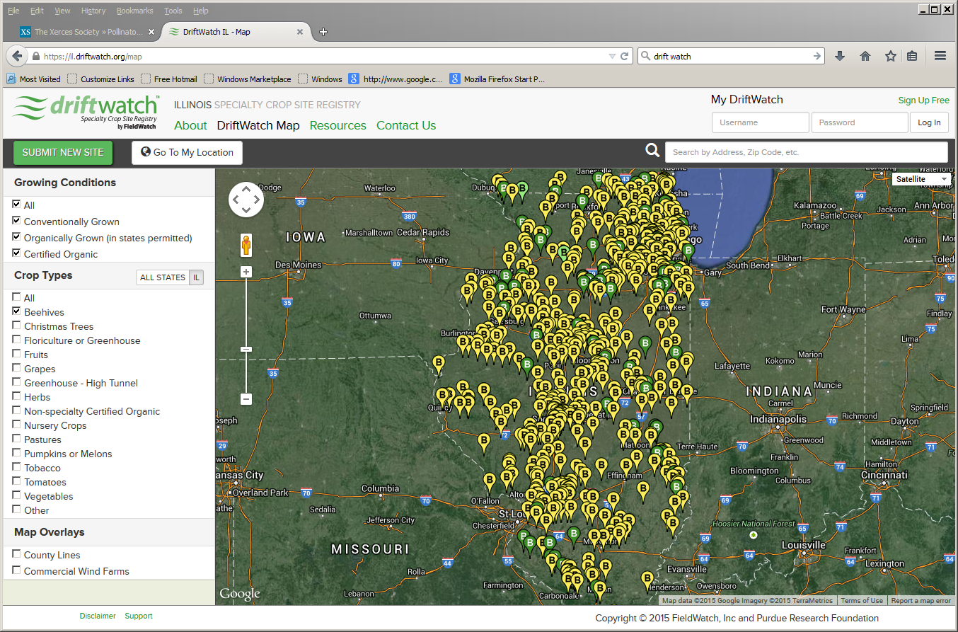

Slide 32
To reach us …
Contacts | Contact information
Rick Weinzierl | weinzier@illinois.edu

Slide 33
If you have questions …
University of Illinois Extension Local Food Systems and Small Farms team
http://web.extension.illinois.edu/smallfarm/
USDA’s Start2Farm site
http://www.start2farm.gov/
Notes:
Our beginning farmer training program ended in the fall of 2015. The best way to pursue answers to questions about fruit and vegetable production in Illinois is to contact educators on the University of Illinois Extension Local Food Systems and Small Farms team. Extension programs in other states are operated by the land-grant university in each state. Additionally, USDA’s Start2Farm site provides listings of farmer training programs in specific states and localities.

