Slide 1
Preparing a New Generation of Illinois Fruit and Vegetable Farmers a USDA NIFA Beginning Farmer and Rancher Development Program Project Grant # 2012-49400-19565 http://www.newillinoisfarmers.org
Notes:
The following presentation was part of a beginning farmer course, “Preparing a New Generation of Illinois Fruit and Vegetable Farmers,” offered by the University of Illinois and the Illinois Migrant Council from 2012 through 2015. This course was funded by the United States Department of Agriculture’s National Institute of Food and Agriculture, and specifically by the Beginning Farmer and Rancher Development Program. For more information about the program and for links to presentations and resources on many other topics, see the website newillinoisfarmers.org.

Slide 2
Growing a New Generation of Illinois Fruit and Vegetable Farmers
Conventional and Organic
Fertilizers
Shelby Henning and Jeff Kindhart
March 2015

Slide 3
What is fertilizer?
“Any organic or inorganic material of natural or synthetic origin that is added to a soil to supply one or more plant nutrients essential to the growth of plants”
Conventional/inorganic/synthetic: Manufactured
But what about organic synthetics such as urea (NH₃)₂CO?
Organic: Naturally occurring mineral deposits or
organic materials
Saltpeter = KNO₃= bat guano
Rock phosphate
Greensand
Limestone
Crop residue, animal waste, other organic waste products such as ash, biosolids, compost, seaweed, peat

Slide 4
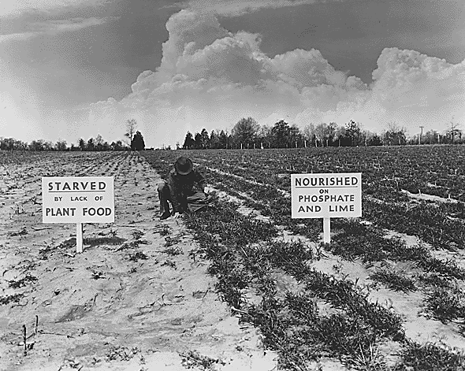
Do I need fertilizer?
Crop demands more than soil supply
Can the plant tell where
it comes from?
Mechanisms of
plant uptake
Genotype vs phenotype
Non-responsive soils?

Slide 5
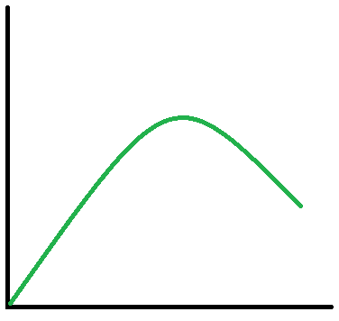
Optimizing returns on fertilizer inputs
The law of diminishing returns applies to fertilizer use
Use just enough to provide for optimal crop response
On-farm trials can help dial in specific needs
Best (point of diminishing returns)
CROP YIELD
Waste of resources
Better
Good
FERTILIZER INPUT

Slide 6
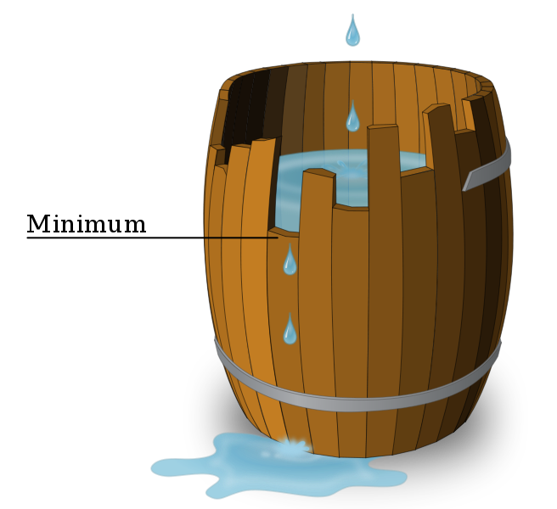
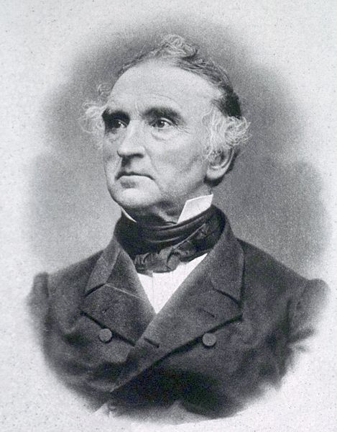
The essential nutrients
The element must be required for the plant to complete its life cycle (AKA seed to seed)
No other element may substitute
The element is directly involved in
the nutrition of the plant
N
P
K
Ca
Mg
S
Justus von Liebig’s “law of the minimum”–
“Plant growth is controlled not by the total amount of resources available, but by the scarcest resource”

Slide 7
The essential nutrients
Carbon
Hydrogen
Oxygen
Not derived from soil or fertilizer
“Structural nutrients”
Macronutrients
Nitrogen
Phosphorous
Potassium
~50 mg/kg in the plant
“Primary nutrients”
Calcium
Magnesium
Sulfur
“Secondary nutrients”
Derived from soil or fertilizer

Slide 8
The essential nutrients
Micronutrients
Boron
Manganese
Copper
Molybdenum
Iron
Zinc
Derived from soil or fertilizer
< 50 mg/kg in the plant
Definitely!
You very rarely have to worry about micronutrient deficiencies.
Micronutrients are required by plant in very, very low amounts.
Fertilizing with micronutrients frequently causes more problems than the application was supposed to solve
Silicon
Sodium
Vanadium
Chlorine
Cobalt
Nickel
Uncertain!

Slide 9
What’s in the bag?
For routine plant culture, macronutrients most important
For instance a typical fertilizer bag will have a guaranteed analysis aka grade.
What’s on the bag varies from state to state but usually includes…
Name, brand, or trade-mark
Guaranteed chemical analysis
Potential acidity (CaCO₃ equivalent)
Manufacturers name and address
Net weight of the fertilizer in the container
Complete vs. incomplete (usually, but not always 3 numbers)
20 – 20 -20 vs. 46 – 0 – 0 vs. 15 – 0- 15

Slide 10
What’s in a typical fertilizer?
ILLIZER BRAND
COMPLETE FERTLIZER
Guaranteed analysis!
10 – 10 - 10
I
N
P
K
% N
% P (as P₂O₅)
% K (as K₂O)
ILLIZER Fertilizer Co.
Branson, Mo.

Slide 11
Crop utilization of fertilizer N
Fertilizer N uptake efficiency varies (FNUE)
Soil N-supplying capacity
Weather conditions
Crop growth and N uptake
Soil N mineralization
N losses
Typical uptake efficiency is 30-50% of N fertilizer applied
Even with high N rates, the soil often supplies the majority of crop N
Proportion of N uptake decreases during the growing season
Progressive depletion of fertilizer N
Plant and microbial uptake
N losses from the system
Ongoing soil N availability through
mineralization

Slide 12
Synthetic N fertilizer
The percentage of N in the fertilizer
Weight * analysis = amount of N per unit amount (Lb./Lb., etc.)
Additional information is usually supplied regarding the N present (generally for synthetic N)
Water insoluble nitrogen (WIN) – Slowly available
Water soluble nitrogen (WSN) – Quickly available
WSN - 4-6 week response
Over-application can cause injury, too much vertical growth
WIN – much less likely to injure, much slower response

Slide 13
Synthetic N fertilizer
Why does fertilizer “burn” plants?
Over-application (please calibrate your equipment)
Improper post-application handling
Some more prone than others
Corrosivity
Salt index (classifies fertilizer material relative to each other and shows which is most likely to cause injury)
http://www.soils.wisc.edu/extension/wcmc/2008/pap/Laboski1.pdf

Slide 14
Salt index continued
http://www.soils.wisc.edu/extension/wcmc/2008/pap/Laboski1.pdf
Reid, K. 2006. Soil fertility handbook. Ontario Ministry of Agric., Food and Rural Affairs. Publ. 611.

Slide 15
Synthetic N fertilizers – Anhydrous NH₃
Advantages:
High N content (82-0-0)
Reduces transport, distribution, and storage cost
Lost cost of manufacture compared to other synthetic N fertilizers
Used to make other fertilizers
Disadvantages
Must be stored and applied under pressure
Hazardous to health
High concentrations can be lethal
Highly corrosive
Safety equipment is critical (goggles, gloves,
gas mask, bucket of water)
Has a drastic effect on soil
Partial sterilization
Solubilzation of organic matter
pH 9 or higher
Diversion for illicit drug synthesis
Normally used for cash-grain crops, specialty crops
not so much

Slide 16
Synthetic N fertilizers – Aqua NH₃
Low-pressure solution of NH₃ in water (ammonium hydroxide solution)
Contains 20-25% N
Not suitable for surface applications
Not common in vegetable crop culture

Slide 17
Synthetic N Fertilizers – Urea Ammonium Nitrate (UAN)
UAN is a nonpressure solution of ammonium nitrate, urea, and water.
Two grades are most common: 28-0-0 and 32-0-0
The lower analysis material contains more water and can be stored at lower temperatures.
Salt crystals will form at about 0ºF for 28 percent solution and at about 32ºF for the 32 percent solution.
UAN solutions have an advantage in terms of handling
Can be pumped, mixed with chemicals and sprayed
They are corrosive and will quickly destroy brass, bronze and zinc, carbon steel and cast iron
UAN doesn’t corrode aluminum alloys, stainless steel, rubber, neoprene, polyethylene, vinyl resins, and glass.

Slide 18
Synthetic N Fertilizers - Urea
Fertilizer grade 46-0-0
Undergoes enzymatic hydrolysis and subsequent nitrification
H₂NCONH₂ + H₂O ←→ 2NH₃ + CO₂ → 2 NO₃⁻
Advantages
High N content
Water soluble
No health hazard
No danger of fire or explosion
Disadvantages
Subject to losses if not properly managed
NH₃ toxicity (avoid placement with seed)
Rapid nitrification

Slide 19
Synthetic N fertilizers – Ammonium Nitrate
Fertilizer grade 31-0-0
More popular in Europe than the U.S.
Cakes during storage
Half the N is NO₃⁻ (leaching issues)
Fire and explosion hazard
Can be difficult to obtain

Slide 20
Synthetic N Fertilizers – Ammonium Sulfate
Fertilizer grade 21-0-0-24
Advantages
Acidic
No need to incorporate
Slows nitrification
Also supplies S
Good physical properties
Disadvantages
Can easily cause injury to above ground plant parts
Low N content

Slide 21
Synthetic N Fertilizers – Potassium Nitrate
KNO₃ is especially useful where a highly soluble, chloride-free nutrient source is needed.
All of the N is immediately available for plant uptake as nitrate
Vegetable and orchard crops sometimes are fertilized with a nitrate-based source of nutrition in an effort to boost yield and quality
Contains a relatively high proportion of K, with a N to K ratio of approximately 1:3.
Many crops have high K demands and can remove as much or more K than N at harvest.
Applications of KNO₃ to the soil can be made before the growing season or as a supplement during the growing season
A diluted solution is sometimes sprayed on plant foliage to stimulate physiological processes or to overcome nutrient deficiencies.
Foliar application of K during fruit development can be advantageous for some crops, since this growth stage often coincides with high K demands during the time of declining root activity and nutrient uptake.
Commonly used for greenhouse plant production, fertigation, and hydroponic culture.

Slide 22
Synthetic N fertilizers – Calcium Nitrate
15.5-0-0
Also supplies calcium (19% Ca)
Water soluble
Suitable for preplant fertility, sidedressing, fertigation, foliar applications
No volatile N losses
Popular for correcting blossom end rot in tomato, pepper and eggplant as well as correct cork spot and bitter pit in apple and pear.

Slide 23
Synthetic N Fertilizers – Ammonium Phosphates
Monoammonium phosphate (MAP) 11-52-0
Diammonium phosphate (DAP) 18-46-0
Ammonium polyphosphate (APP) 10-34-0
Advantages
Provide P as well as N
Disadvantages
Can overapply P if using as sole source of N

Slide 24
Slow/controlled release synthetic N fertilizer
Controlled-release nitrogen – designer N release: 70-270 d
Slow-release i.e. urea form, sulfur-coated urea, PCSCU, IBDU, WIN
Advantages
More uniform growth
Not likely to cause damage
Losses through soil or air less likely
Disadvantages
May not work on cold soil
Most are expensive
May not see quick plant response

Slide 25
Stabilized synthetic N fertilizers
N fertilizer formulated to include compounds intended to decrease N losses and increase fertilizer N use efficiency
Generally urea or ammonium-based
Examples:
N-n-butyl-thiophosphoric-triamide (NBPT)
DCD (dicyandiamide)
Stabilized ≠ slow or controlled release
May or may not work, sometimes decrease yield
Cost can be a concern

Slide 26
Organic N fertilizers
The major agricultural source of fixed N prior to 1920
Wide variety of materials
Low N content
No negative consequences?/Can’t over-apply?

Slide 27
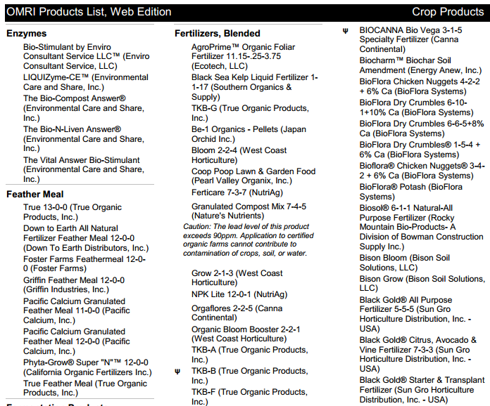
Organic N Fertilizers
http://www.omri.org/sites/default/files/opl_pdf/crops_category.pdf

Slide 28
Organic N Fertilizers – Animal Manure
Of local importance
Disposal a problem for confinement operations
N content depends on
Kind of animal
Feed and bedding material
Method of:
Handling
Storage
Application
Average N content: 10 lb N/ton (0.5%)
50% of the N is available in the first year after

Slide 29
Organic N fertilizer – sewage sludge
Treated to reduce pathogens, odor, and heavy metal concentrations
By adding lime to precipitate heavy metals
Aerobic or anaerobic digestion
By dewatering
Extent of treatment varies:
Class A: no restrictions, better grade
Class B: restricted use
Both classes may contain radioactive or pharmaceutical wastes
Contains organic (complex N compounds) and
inorganic N (as NH₄⁺)
Contains most other macro and micronutrients

Slide 30
Organic N fertilizer – sewage sludge
N content of sewage sludge is variable
Application rates determined by:
Crop N requirement
Content of plant-available N, including:
NO₃⁻-N
NH₄⁺-N, with adjustment for volatilization losses
Mineralizeable organic N as estimated by incubation
assays
P content
Sludge applied at agronomic N rates supplies excessive P
Heavy metal content
Often determines annual and cumulative soil loading
limits

Slide 31
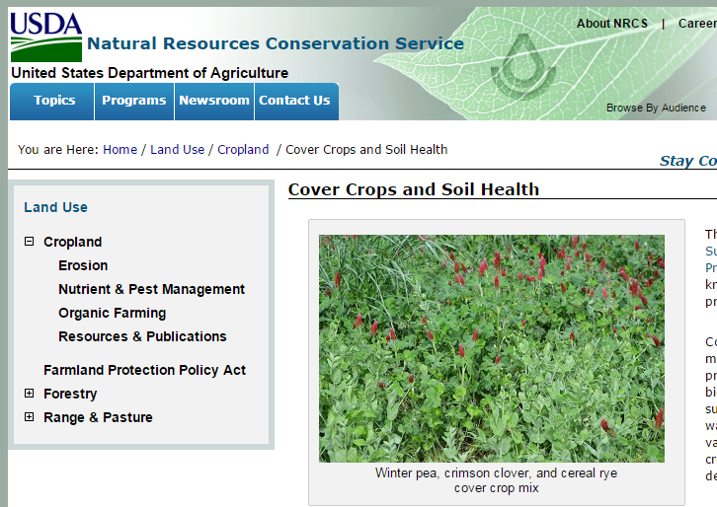
Organic N fertilizer – green manure/cover crops
For summer cash crop, use as
winter cover
Plant in fall
Kill or harvest in spring
By plowing under (green manure)
or herbicide
Source of N
Not all N is plant available
Supplemental N may be needed
Non-leguminous crops do not supply much N
Reduced NO₃⁻ leaching from soil from assimilation
Increase in soil organic matter
Reduced erosion
There are many options: http://www.nrcs.usda.gov/wps/portal/nrcs/detailfull/national/landuse/crops/?cid=stelprdb1077238

Slide 32
Organic N fertilizer – animal by-products
Products of the slaughterhouse industry
Blood meal (highest N of all the natural organics) (12-1.5-0.5)
Bone meal
Feather meal
Fish meal/emulsion
Tend to have offensive odor
Generally expensive
Slow-release of nutrients

Slide 33
Organic N fertilizer – mineral forms
N does not normally occur in mineral forms
Except as fixed NH₄⁺ in rocks and clay minerals
Fixed = not available
Or, as nitrate salts in arid regions
Chilean nitrate = nitratine = NaNO₃
Acatama desert, Chile; Death Valley, CA
Bat guano = KNO₃

Slide 34
P fertilizers
Back to the bag: what does the number
mean?
Actual % of P?
No (P₂O₅), to get the actual % P x by 0.44
Why?

Slide 35
Seasonal uptake of P by plants
Unlike N
Taken up throughout the life of the plant
Early growing season most critical
A paradox: P required for root growth, root growth limits P uptake
Root system not well developed in seedlings
Cool weather slows plant growth – purple corn?

Slide 36
Synthetic P fertilizers – phosphoric acid
Fertilizer grade 0-50-0
Made from rock phosphate
Some use in fertigation
Main use is manufacture of other P fertilizers

Slide 37
Synthetic P fertilizers – calcium orthophosphates
Single superphosphate
AKA ordinary superphosphate (OSP); normal superphosphate (NSP)
Fertilizer grade: 0-20-0-12 (8.6%P; 12% S)
Leading P fertilizer until 1950’s
Main limitation is low P analysis
No longer available in the U.S., still used in other parts of the world
Triple superphosphate (TSP)
AKA concentrated superphosphate
Fertilizer grade 0-46-0
Contains very little S
High analysis reduces costs
Leading P fertilizer in the U.S. in the 1950’s and 1960’s
Still widely available

Slide 38
Synthetic P fertilizers – ammonium phosphates
Monoammonium phosphate “MAP”
Fertilizer grade 11-52-0
Diammonium phosphate “DAP”
Fertilizer grade 18-46-0
Most common P fertilizer in the U.S.
Ammonium polyphosphate “APP”
Fertilizer grade 10-34-0
Used in fluid fertilizers

Slide 39
Synthetic P fertilizers – ammonium phosphates
Advantages
Completely water soluble
Supply P as well as N
High P content
Minimizes shipping, handling, and storage costs
Application flexibility
Liquid or solid
Increased P uptake in the presence of NH₄⁺

Slide 40
Synthetic P fertilizers – ammonium phosphates
Special advantages of MAP
Increased N efficiency
No NH₃ volatilization
No NH₃ toxicity
Easier to manufacture
Requires a lower grade of phosphate rock than DAP
Advantages of PAP
High P content
High P solubility
Good agronomic effectiveness except in cool soils

Slide 41
Synthetic P fertilizers – nitric & potassium phosphates
Nitric phosphate
Fertilizer grade 20-20-0
Only 50% of the P is water soluble
Best suited for acid soils
Mainly used in Europe
Potassium phosphate
Two types:
KH₂PO₄ (0-52-35)
K₂HPO₄ (0-41-54)
Main use is for small areas/extremely valuable crops
Advantages
High content of P and K
P is 100% soluble
Supply K without Cl⁻
Disadvantage
Cost can be prohibitive

Slide 42
Organic P fertilizers - animal manure
Accounts for most organic P applied to cropland
Also contains inorganic P
P form and content depend on:
Type of animal
High content of total and organic P in poultry manure
Feed
Storage
Decreases of organic P
Increases inorganic P
General composition: 0.5-0.25-0.5 by weight
Available P: <2 lb per ton
High levels of available P in
heavily manured soils

Slide 43
Organic P fertilizers – sewage sludge
Contains 2-4% P (dry weight basis)
Most of the P is inorganic
Typical applications supply excessive P for crop production
Can have problems with heavy metal accumulation

Slide 44
Organic P fertilizers – rock phosphate
An important P fertilizer in the U.S. until the 1950’s
Still used in the tropics
Mined from phosphate rock reserves in the U.S.
Florida
N. Carolina
Utah
Idaho
Tennessee
Obtained by:
Strip mining (surface) in the East
Shaft mining (below ground) in the West
Very limited fertilizer value unless the soil pH is <6
Release depends on granule size

Slide 45
Synthetic K fertilizers
These are all mined from mineral deposits
KCl AKA muriate of potash
Fertilizer grade 0-0-60 (“red”) or 0-0-62 (“white”)
Most common K fertilizer
Mined from natural deposits of sylvite
Largest deposits are in Saskatchewan
Less expensive than N or P fertilizer

Slide 46
Processed mineral forms of K
K₂SO₄ AKA sulfate of potash
Fertilizer grade 0-0-50-17 (S)
Used on Cl⁻ sensitive crops (potatoes, tobacco)
KNO₃
Fertilizer grade 13-0-44
Main use for:
Fruit trees
Cotton
Vegetable crops

Slide 47
Processed mineral forms of K
Alkaline K fertilizers
K carbonate
K bicarbonate
K hydroxide
Good for use on acid soils
Increase the efficacy of P fertilizers
Cost is the main limitation
K fertilizers containing S
K thiosulfate
K polysulfide
Suitable for foliar applications and fertigation
Expensive

Slide 48
Organic K fertilizers
Animal manure
K content less variable than for N or P
Lower for liquid than dry manure
Average composition: 0.5-0.25-0.5
Available K: <4 lb/ton
Kelp & seaweed
Contain inorganic K salts
KCl, K₂CO₃, etc.
These water soluble salts will leach into the soil

Slide 49
Final thoughts to consider
Is there a difference?
There are ways to offset possible negative effects
There is still a lot to learn, the fertilizer industry is massive, this presentation is not the whole story on fertilizer materials
For maximum efficacy conduct on-farm trials
What works for you, works for you. That’s the bottom line

Slide 50
To reach us
Contacts | Contact information
Jeff Kindhart Shelby Henning Rick Weinzierl Mary Hosier Mike Krueger | jkindhar@illinois.edu shenning@illinois.edu weinzier@illinois.edu mhosier@illinois.edu kruege13@illinois.edu

Slide 51
If you have questions …
University of Illinois Extension Local Food Systems and Small Farms team
http://web.extension.illinois.edu/smallfarm/
USDA’s Start2Farm site
http://www.start2farm.gov/
Notes:
Our beginning farmer training program ended in the fall of 2015. The best way to pursue answers to questions about fruit and vegetable production in Illinois is to contact educators on the University of Illinois Extension Local Food Systems and Small Farms team. Extension programs in other states are operated by the land-grant university in each state. Additionally, USDA’s Start2Farm site provides listings of farmer training programs in specific states and localities.

