Slide 1



Preparing a New Generation of Illinois Fruit and Vegetable Farmers a USDA NIFA Beginning Farmer and Rancher
Development Program Project
Grant # 2012-49400-19565 http://www.newillinoisfarmers.org
Notes:
The following presentation was part of a beginning farmer course, “Preparing a New Generation of Illinois Fruit and Vegetable Farmers,” offered by the University of Illinois and the Illinois Migrant Council from 2012 through 2015. This course was funded by the United States Department of Agriculture’s National Institute of Food and Agriculture, and specifically by the Beginning Farmer and Rancher Development Program. For more information about the program and for links to presentations and resources on many other topics, see the website newillinoisfarmers.org.

Slide 2
Growing a New Generation of Illinois Fruit and Vegetable Farmers
Irrigation
Jeff Kindhart and Jeremy Shafer
April 2015

Slide 3
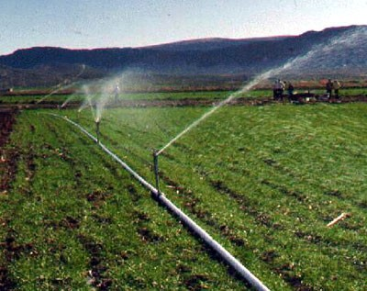
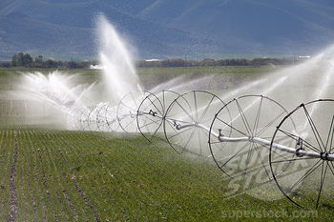
Notes:
There are many different types of irrigation used for horticultural crops in Illinois. The familiar moveable pipe seen in the upper left is still somewhat common but has largely been replaced by other methods for most crops in Illinois. The wheel line system in the bottom right is used for various crops but probably most commonly on sod farms in Illinois.

Slide 4
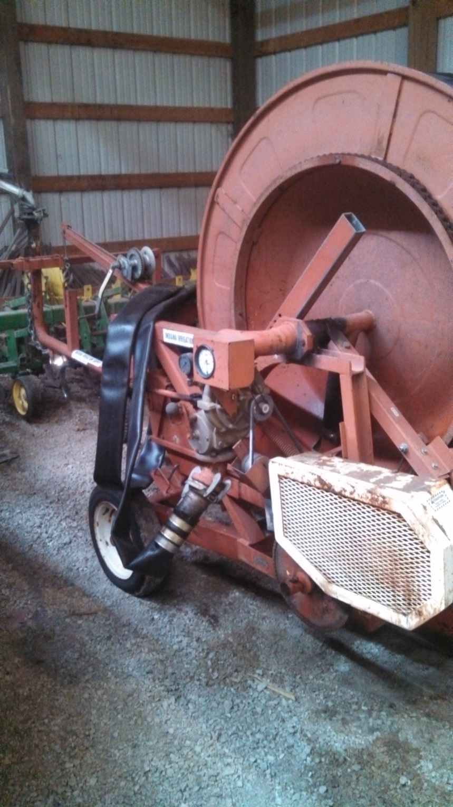
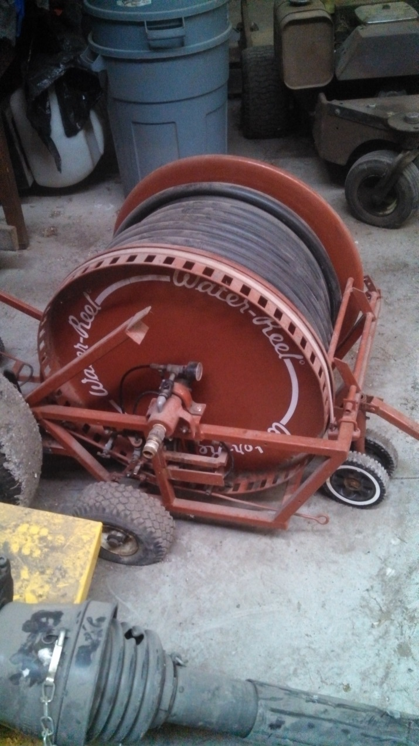
Notes:
Irrigation water reels come in varying sizes. They can also come with or without a booster pump. The irrigation gun is on its own wheels and is drug out into the field while the reel cart remains stationary on the edge of the field. During operation, the reel cart pulls the gun back across the field until it reaches the reel cart and hits the shut off switch on the cart. One major advantage of this type of system is portability. A few disadvantages are leaving an alley open for the irrigation gun to travel on and high winds can greatly effect normal coverage area. It is commonly used for sweet corn in the vegetable production arena.

Slide 5
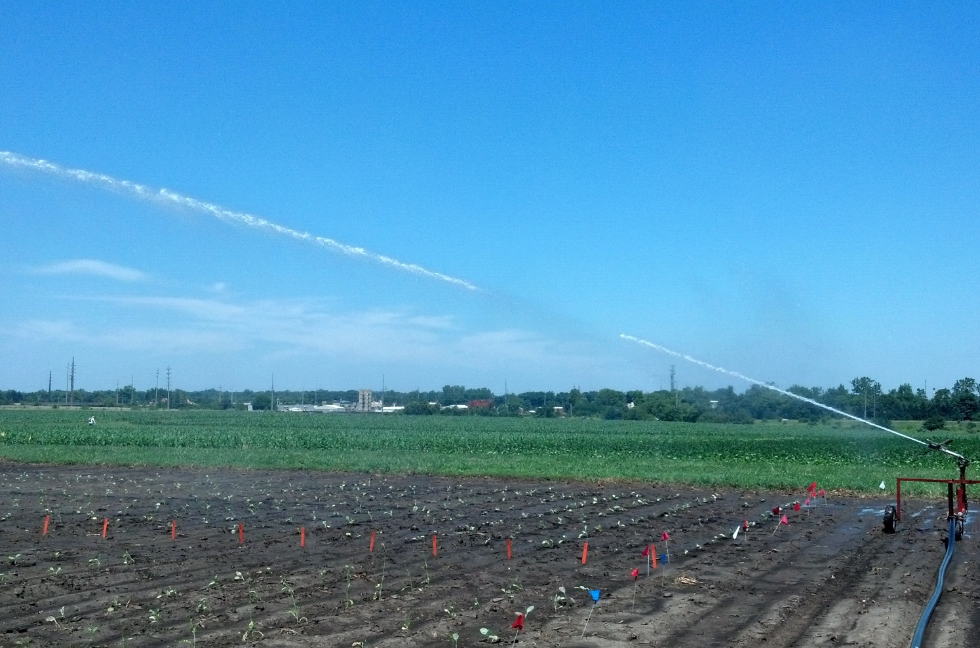
Irrigation gun with reel cart
Notes:
Here is one of our traveling irrigation guns being used to water broccoli and cabbage transplants. Our guns have a range of 120 foot diameter, so six foot alleys are left unplanted every 120 foot for this type of watering.

Slide 6
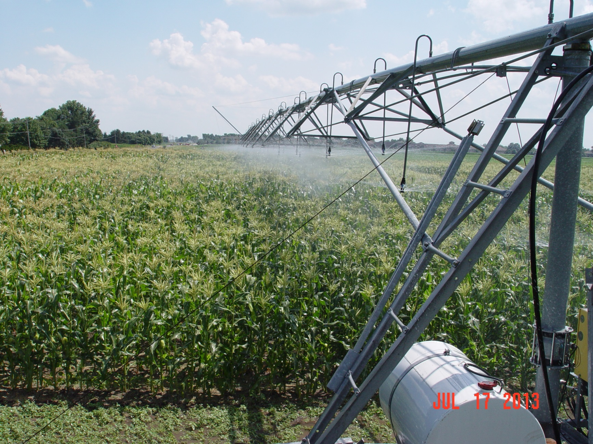
Notes:
This is a self-driven linear irrigation system. This type of system is expensive, but very accurate. Since water comes out of suspended boom type nozzles, light wind is not a major problem with coverage. This linear system works excellent on sweet corn, edemame and snap beans. Time consuming to move between fields.

Slide 7
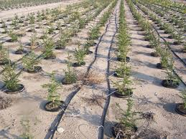
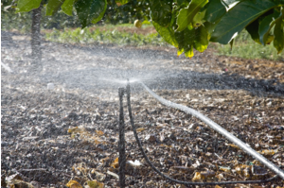
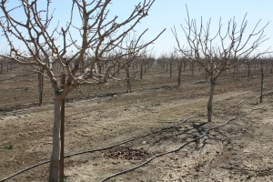
Notes:
Micro sprinklers put on much lower volumes of water at much lower pressures than the previous examples we have looked at. This allows growers to utilize smaller pipes and pumps. As they only water areas that are crop adjacent rather than the entire field there are some inherent efficiencies with these type of systems. Micro sprinklers might be used in a pot in pot nursery production area or in orchards.

Slide 8
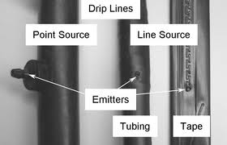
Notes:
Water is supplied in these systems typically using small plastic “pipes” or “tubes”. In some cases the pipes are solid and holes are punched in only where irrigation is desired. This system is known as point source emitters. In other cases, most commonly, the holes are already manufactured into the pipe at fixed settings i.e. every 12” or every 18” etc. This is referred to as line source emitters.

Slide 9
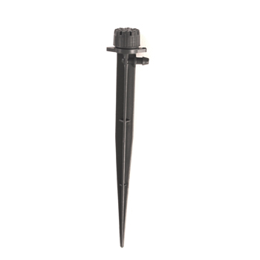
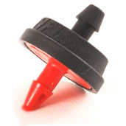
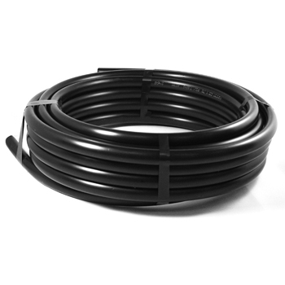
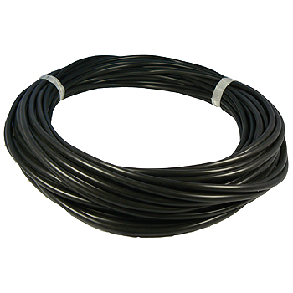
Notes:
Here are some of the materials used for point source irrigation. The bottom left is the tubing used to distribute the water down the row. The upper left is a pressure compensating emitter. The red barbed end is placed into the distribution pipe. The smaller diameter pipe in the bottom right hand corners attaches to the black end of the emitter on one side and to the spray stake in the upper right on the other end. The spray stake where the water emerges from is placed near the plant to be irrigated. Pressure compensating emitters are needed when the field being irrigated has more than 3% slope. Otherwise the plants at the low end of the field would receive much more water than those at the high end of the field.

Slide 10
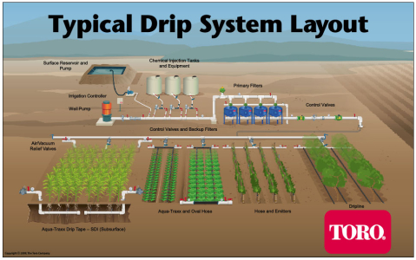
Notes:
Drip or trickle irrigation systems are the most common for vegetable production. These systems like micro sprinklers only apply small volumes of water to areas that are immediately crop adjacent. They are low pressure systems operating at less than 15 psi and afford growers the ability to use smaller pumps and pipes than other systems. This is a diagram showing components of a whole farm drip irrigation system layout.

Slide 11
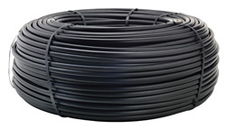
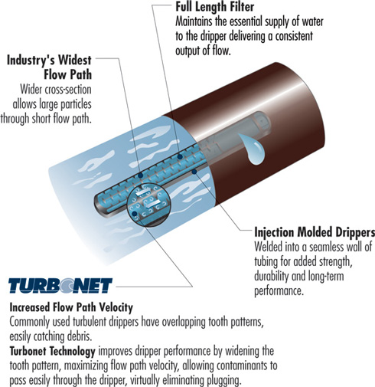
SPECIFICATIONS
Wall thickness (mil):
  0.540" (45 mil)
  0.620" (45 mil)
  0.690" (48 mil)
  0.820" (60 mil)
Nominal flow rates (mil): 0.26, 0.4, 0.5, 1.0, 2.0
Common spacings: 18", 24", 30", 36", 42", 48", 60"
Recommended filtration: 120 mesh
Recommended operating pressure: 10 to 30 psi
Notes:
For perennial crops like small fruit plantings or Christmas tree plantings, heavy duty line source emitters might be used such as this product from Netafin®.

Slide 12
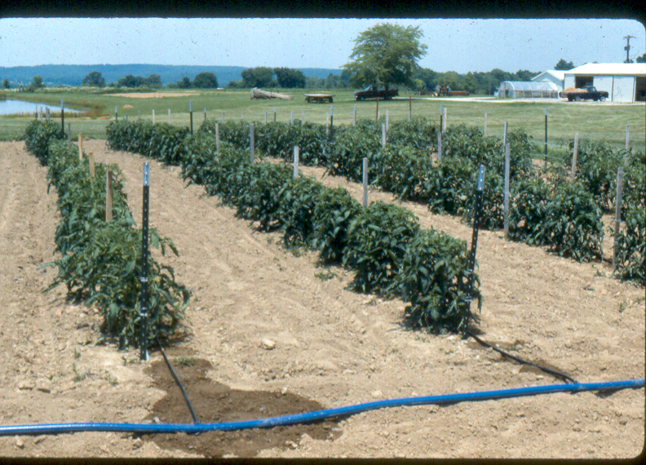
Notes:
Drip lines such as T-Tape® are most commonly seen in vegetable and small fruit production in Illinois. This tried and proven system of irrigation works well and has become very widely adapted. It is suitable for small gardens and large 100+ acre fields. As you can see in this picture field operations like spraying, training, or harvesting can actually be carried out while the crop is being irrigated. As the area between the rows is not wetted, weed pressure can also be reduced.

Slide 13
Considerations for drip irrigation
Water Source
Design
Operation and Maintenance
Other
Notes:
That are many considerations for a drip irrigation system. First is what will be used for a water source. Overall design of the system is also of paramount importance. If you are not an engineer and do not have experience in designing irrigation systems it is a good idea to work with an irrigation dealer that will provide design as part of their service. In many cases when extension personnel go out on farm visits we see failure to properly operate the system. It makes little sense to purchase a system and then not utilize it to obtain the maximum return on the investment.

Slide 14
Water Source Problems
Surface
  Herbicide contamination
  Disease organisms
  Size
  Excessive algae
Well
  Size/Capacity
  Iron
  Sand
Municipal
  Volume/Pressure
Notes:
Each potential water source comes with concerns. Surface water concerns include contamination, size, and algae load. Well sources come with concerns over size/capacity and also water quality issues like excessive iron or sand. Concerns with municipal water are price and issues related to volume and pressure.

Slide 15
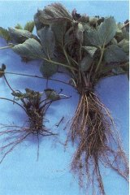
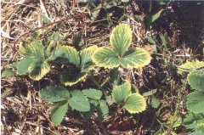
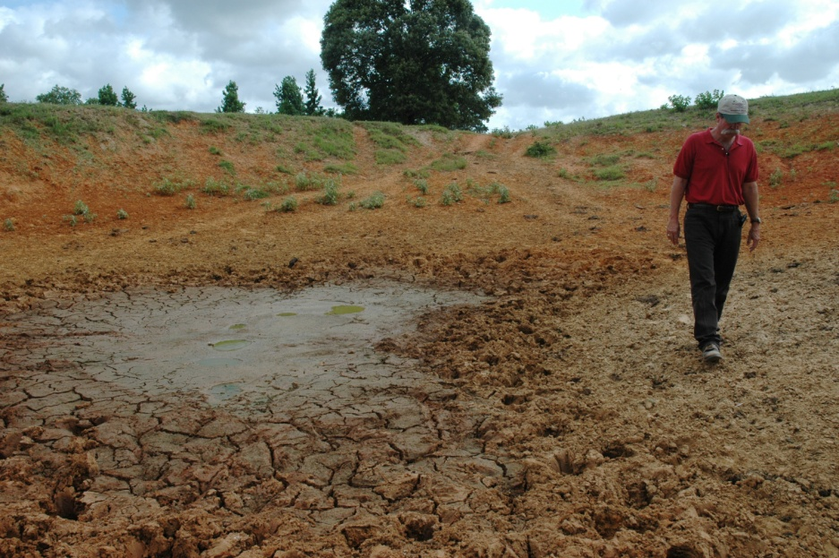
Surface Water Problems
Notes:
Upper left pictures shows strawberries showing atrazine injury from being irrigated from a pond surrounded by corn fields that have been treated with atrazine. The upper right shows a strawberry plant with black root rot causal organisms like pythium, fusarium, and phytophthora can be harbored in ponds and lakes. Ponds must be of sufficient size to provide enough water in even the driest years.

Slide 16
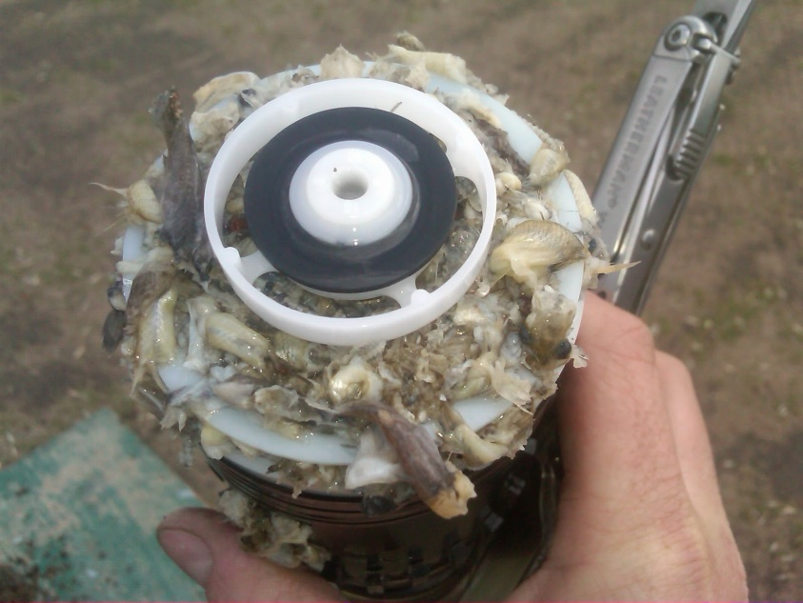
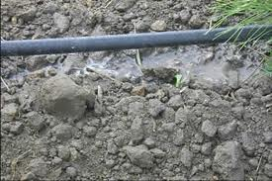
Algae Problems
Notes:
Algae can plug inlets, pumps, and emitters.

Slide 17
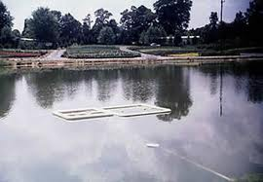
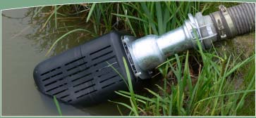
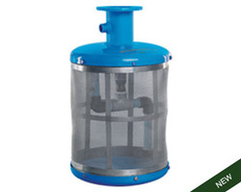
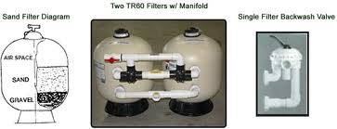
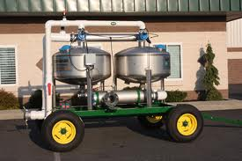
Algae Solutions
Notes:
Dealing with algae in surface water calls for a multifaceted approach. Inlet screens are important and inlets should be kept elevated from pond floor by suspending them from a floating raft. All surface water should be passed through sand media filters before final distribution through trickle lines. Some herbicides can be used on the irrigation pond but be careful with selection to make sure that the herbicide is safe and legal to use on water sources used for irrigation.

Slide 18
Water Source Problems
Surface
  Herbicide contamination
  Disease organisms
  Size
  Excessive algae
Well
  Size/Capacity
  Iron
  Sand
Municipal
  Volume/Pressure
Notes:
When using well water for irrigation, considerations should include size, capacity, and water quality; especially iron and sand.

Slide 19
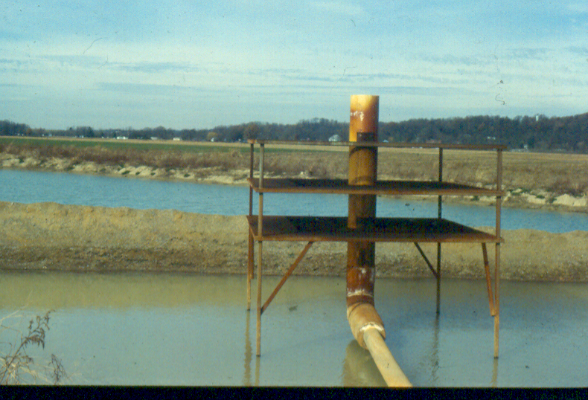
Notes:
Some wells have such high iron content that they require treatment before use. This is an example of an adapted crawdad aerator in Illinois.

Slide 20
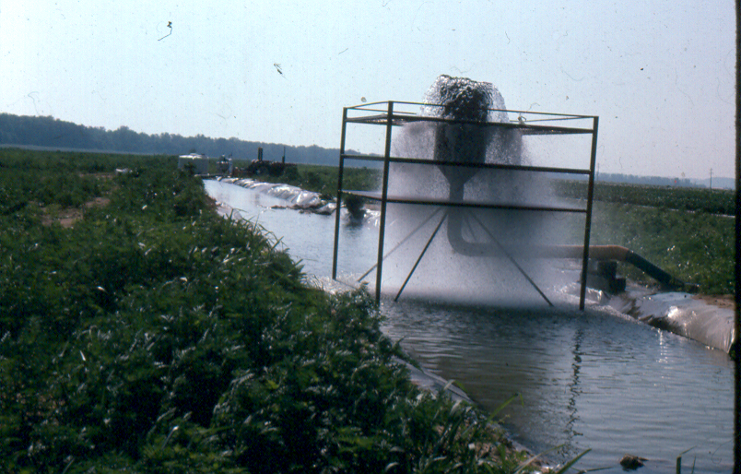
Notes:
Here you can see it running on a farm in Illinois. The water is oxygenated which results in the iron being converted to an oxidized state where it can be precipitated and filtered out prior to being pumped out to the field containing trickle lines. Most farms will not require this extreme of a treatment measure, but it is important to have irrigation water analyzed prior to using so that strategies can be developed to deal with any water quality issues that might be present.

Slide 21
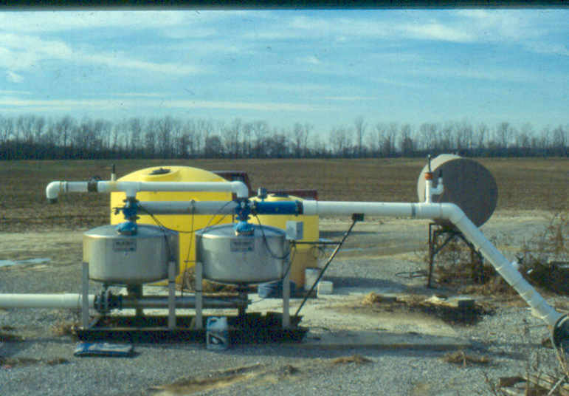
Notes:
Some growers still use sand media filters even when coming from a well water source although this is normally only if there are water quality issues associated with the well like excessive sand or high iron.

Slide 22
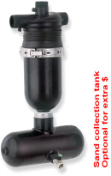
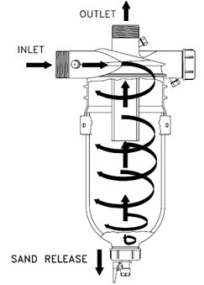
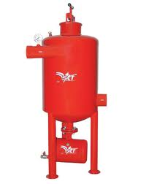
Notes:
Wells that tend to pump sand along with the water can be addressed in many cases by use of cyclonic filters. They are designed to swirl the water as it passes through the filter and sand winds up settling out . Periodically the valve is opened at the bottom of the tank to remove the accumulated sand.

Slide 23
Water Source Problems
Surface
  Herbicide contamination
  Disease organisms
  Size
  Excessive algae
Well
  Size/Capacity
  Iron
  Sand
Municipal
  Volume/Pressure
Notes:
We’ll now discuss problems associated with various water sources.

Slide 24
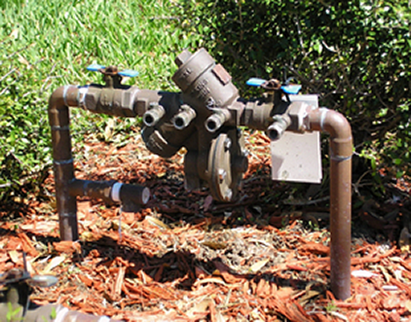
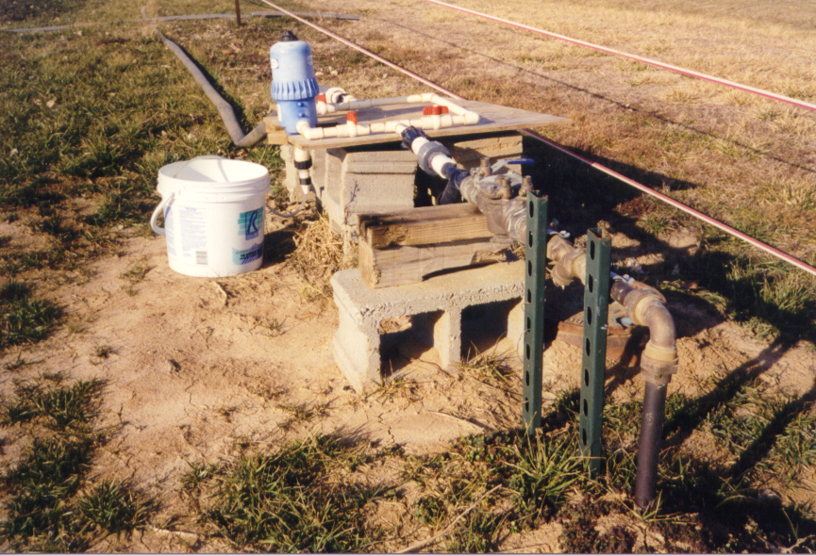
RPZ Backflow
Preventer
Notes:
It is common in Illinois for small growers to start out using municipal water as their irrigation source. Although the water may be expensive, the expenses of pumps and well drilling or pond digging is avoided. If you are only going to use your system to apply water, then it can normally be used without any special concerns. However, some growers apply pesticides through the irrigation system (chemigation) and many if not most apply fertilizers through the irrigation system (fertigation). If chemigation or fertigation is practiced, growers must have a RPZ (reduced pressure zone) backflow preventer installed after the meter and before the site of introduction of chemicals. In some cases a vacuum break will also be required. You must check with your municipal water supplier to obtain the type of backflow preventer they require. Additionally, it must be installed and inspected by someone from their approved vendor list of installers and inspectors. Failure to comply will put you at risk of significant fines even if nothing goes wrong and you just get caught. Failure to comply and something does go wrong will make you liable at the very least for replacement of all of your neighbors meters and other required replaced equipment. In other words, you can not afford to not comply.

Slide 25
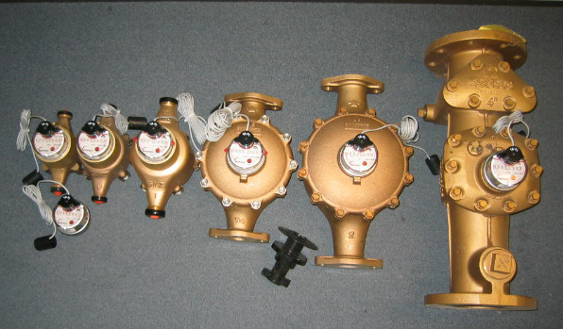
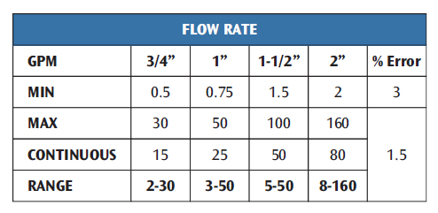
Notes:
Most residences have a 3/4 “ meter which is fine for taking a showers and running the dishwasher, but is often not capable of delivering a high enough flow rate for even a modest sized irrigation project. As you can see in the chart above switching from a ¾ to 1” meter increases flow rate by 66%. It does not matter how well you design the rest of your system if the meter can not supply the required flow rate the system will NOT work properly.

Slide 26
Considerations for Drip Irrigation
Water Source
Design
Operation and Maintenance
Other
Notes:
Now let’s look as design aspects for drip irrigation systems.

Slide 27
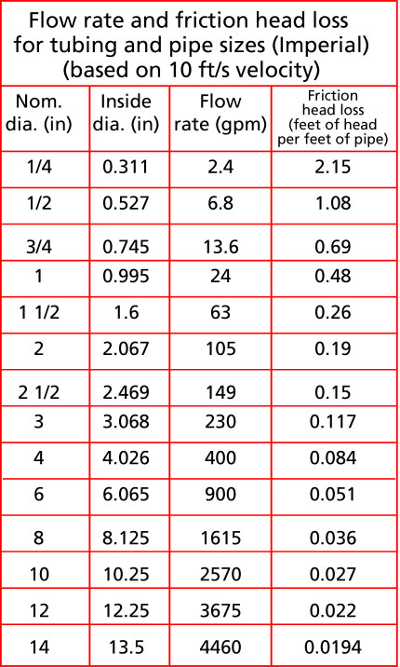
Notes:
Just like meter size, the size of the pipe you use to deliver the water to the field is critical. Intuitively one might think that ½” pipe would carry half the amount of water that a 1” pipe would carry. However, you can see from the chart that ½” pipe will carry 6.8 gallons per minute while 1” pipe will carry 24 gallons per minute which is nearly four times as much.

Slide 28
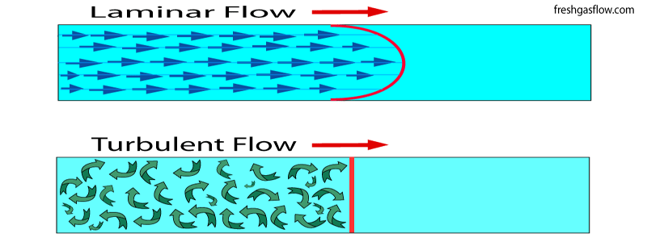
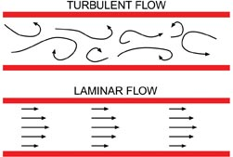
Notes:
In pipes, even though the interior wall may look smooth is has imperfections which result in turbulence. This turbulent flow pushes against the main laminar flow. The larger the pipe the higher the percentage of laminar flow, so flow rates increase dramatically.

Slide 29
Types of Problems
Water Source
Design
Operation and Maintenance
Other
Notes:
As we continue to talk about design, let’s look at how we decide how much water we will need to deliver so we get our pumps or meter and pipes sized appropriately.

Slide 30
Notes:
Trickle tapes come in a variety of thicknesses, emitter spacings, and in some cases numerous flow rates while other times only high flow and low flow options (two flow rates) exist.

Slide 31
Notes:
T-tape or other similar line source emitter drip tape is most commonly used. These products tends to be far superior to drip tape for accuracy, consistency, and uniformity when compared to “soaker” hoses.

Slide 32
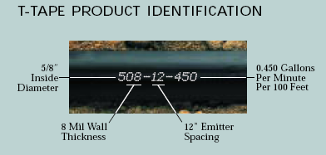
Notes:
The tape is typically stamped with a code that provides information about the tape including I.D., thickness, emitter spacing, and flow rate. So if we know the flow rate is .45 gallon per minute per 100 feet then 20 rows 100 feet long would require that we deliver 9 gallon per minute to the field (20 x .45 = 9). Going back to our previous information, you would find that this means that assuming water was not being used anywhere else in the system (no one is taking a shower or doing laundry etc.) a ¾” meter would be sufficient and we would need minimum pipe size of ¾” also. This assumes that the field is located within relatively close proximity to the water supply. If the field is located far from the water source than larger pipe size could be required.

Slide 33
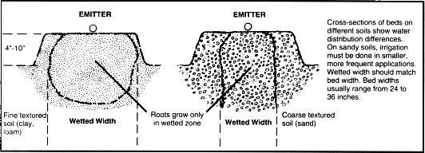
Notes:
The way the irrigation water distributes in the bed is dependant on soil factors. Course textured soils tend to wet up and down with less lateral movement. Very fine textured soils may have low infiltration rates and be accompanied with the problem that water may be running off the bed even though the soil is only wetted a few inches deep. Because of this high flow tapes are most common on sand and low flow tapes are perhaps better suited for heavy clay soils.

Slide 34
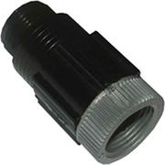
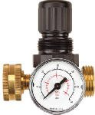
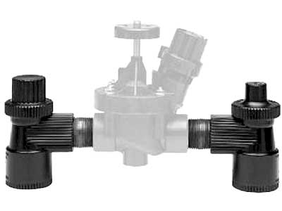
Notes:
Most manufacturers specify the operating pressures for their tapes. Commonly this will be in the 8 to 15 psi range. Growers should equip their system with some type of pressure regulating device to avoid excessive pressure. Failure to do so can result in rupturing the tape.

Slide 35
Types of Problems
Water Source
Design
Operation and Maintenance
Other
Notes:
Next we will talk about operation and maintenance of trickle irrigation systems.

Slide 36
Clogging Emitters
Physical
  Silt
  Sand
Biological
  Algae
  Bacteria
Chemical
  Calcium, magnesium, iron, and manganese
  Fertilizer
Notes:
Emitter clogging can be a problem if the system was not well designed. Emitters can become clogged with physical debris such as sand or silt and also from biological agents like algae and/or bacteria. Both physical and biological problems normally occur with insufficient filtration efforts on the part of the grower. Chemicals can also be a source of clogging emitter. Chemical problems can be reduced or avoided by having surface and well water sources tested prior to use. Also be sure to use proper water soluble fertilizers that are mixed in such a way that there are not compatibility issues.

Slide 37
Constituent | Level of Concern
 | Low | Moderate | High
pH | <7.0 | 7.0-8.0 | >8.0
Iron (Fe) mg/L | <0.2 | 0.2-1.5 | >1.5
Manganese (Mn) mg/L | <0.1 | 0.1-1.5 | >1.5
Hydrogen Sulfide (H₂S) mg/L | <0.2 | 0.2-2.0 | >2.0
Total Dissolved Solids (TDS) mg/L | <500 | 500-2000 | >2000
Total Suspended Solids (TSS) mg/L | <50 | 50-100 | >100
Bacteria Count (#/ml) | <10,000 | 10,000-50,000 | >50,000
Notes:
Some various irrigation water parameters that can be analyzed and the risk associated with the various potential results.

Slide 38
Most Common Problem
Management
Management
Management
Notes:
Management of the system is by far the most common problem we see. You have spent the money to have an irrigation system in place. In order to maximize your return on investment, you must properly manage the system. In the case of overhead irrigation with sprinklers, we commonly water once a week. With trickle irrigation systems we typically water several times a week in most cases for most crops and in some cases we may water twice a day or even more.

Slide 39
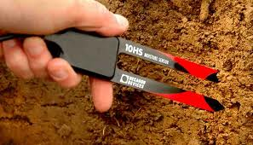
Monitor soil moisture
Factors that influence
soil moisture
Sun
Wind
Rain
Temp
Relative humidity
Crop removal
Notes:
How much water do we need to apply? Sun, wind, rain, temperature, relative humidity, and crop removal all impact soil moisture level. Obviously, a newly set tomato transplant does not remove as much water as a mature fruiting vine. Since so many factors impact soil moisture levels, growers should utilize some method of frequently monitoring (once a day or more for many crops) soil moisture levels.

Slide 40
Soil Moisture
Monitoring Techniques
The "Feel Method"
Neutron Probe
Electrical Resistance
Soil Tension
New Technology
Computerized Irrigation Scheduling
Notes:
Driving by the field on your way home and seeing it through the vehicle glass does NOT constitute any method of soil moisture monitoring. The feel method, which is likely most common but perhaps not best, is to feel the soil to divine the level of soil moisture. Far superior to the drive by method best used in conjunction with some other method. Of the above listed methods measuring soil tension with a tensiometer is the most widely adapted by Illinois’ vegetable growers.

Slide 41
Notes:
Tensiometers are long tubes with a ceramic tip at one end and a vacuum gauge on the other. The tube is completey filled with water and then placed in the ground in accordance with the accompanying directions. As soil dries water is pulled through the ceramic tip resulting in an increase in vacuum on the tensiometers gauge. As soil moisture increases through rainfall or irrigation, water passes from the soil through the ceramic tip back into the tube of the tensiometer resulting in a decrease in the vacuum gauge.

Slide 42
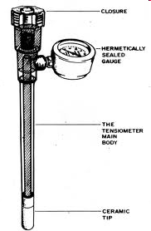
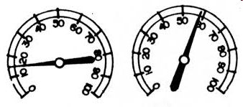
Notes:
Diagram of a tensiometer showing the gauge at 15 and 59 centibars of tension.

Slide 43
Notes:
Tensiometers come in various lengths so that they can be placed at levels appropriate for the crop being monitored. This chart shows recommended lengths for various crops.

Slide 44
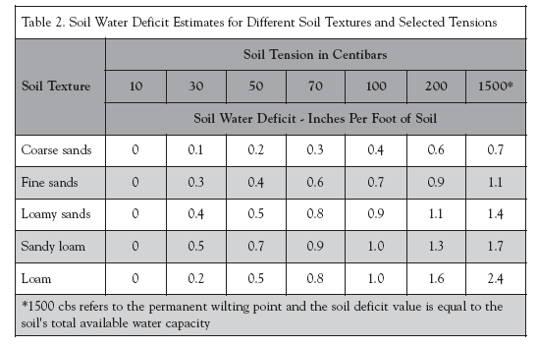
Notes:
When using a tensiometer,a grower would look at the centibar reading and make irrigation decisions based on soil type. Sandy soil requires irrigation be turned on at lower readings than loam soils because sandy soils can not hold as much water as loams. Growers develop a feeling for when to turn on irrigation in individual fields with experience, but charts like the one above provide a good starting place.

Slide 45


Notes:
While large farms and golf courses may utilize computerized irrigation systems or even smart phone apps this is not common for smaller operations.

Slide 46


Notes:
Lastly, do know that there will be leaks. They can come from hoes, cricket moles, and voles love to chew trickle lines.

Slide 47

Notes:
Make sure when ordering your tape you order splicers at the same time. You will need them!

Slide 48
Resources
Drip Irrigation for Vegetable Production (and info sources at the end)
Maintaining Drip Irrigation Systems (Kansas State University)
Drip Irrigation (Washington State University Small Farms Team)
Drip Irrigation Web Links (University of Missouri)
Indiana Irrigation, a Midwestern supplier
DripWorks, a supplier for small growers
IrrigationTutorials.com

Slide 49


To reach us
Contacts | Contact information
Jeff Kindhart | jkindhar@illinois.edu 618-695-2770
Rick Weinzierl | weinzier@illinois.edu 217-244-2126

Slide 50
If you have questions …
University of Illinois Extension Local Food Systems and Small Farms team
  http://web.extension.illinois.edu/smallfarm/
USDA’s Start2Farm site
  http://www.start2farm.gov/
Notes:
Our beginning farmer training program ended in the fall of 2015. The best way to pursue answers to questions about fruit and vegetable production in Illinois is to contact educators on the University of Illinois Extension Local Food Systems and Small Farms team. Extension programs in other states are operated by the land-grant university in each state. Additionally, USDA’s Start2Farm site provides listings of farmer training programs in specific states and localities.

