Slide 1



Preparing a New Generation of Illinois Fruit and Vegetable Farmers a USDA NIFA Beginning Farmer and Rancher
Development Program Project
Grant # 2012-49400-19565 http://www.newillinoisfarmers.org
Notes:
The following presentation was part of a beginning farmer course, “Preparing a New Generation of Illinois Fruit and Vegetable Farmers,” offered by the University of Illinois and the Illinois Migrant Council from 2012 through 2015. This course was funded by the United States Department of Agriculture’s National Institute of Food and Agriculture, and specifically by the Beginning Farmer and Rancher Development Program. For more information about the program and for links to presentations and resources on many other topics, see the website newillinoisfarmers.org.

Slide 2
Growing a New Generation of Illinois Fruit and Vegetable Farmers
USDA NIFA Beginning Farmer and Rancher Development Program
Grant # 2012-49400-19565
Introduction to soils
J. D. Kindhart & Ellen Philips
March 2015

Slide 3
Soil
This definition is from Soil Taxonomy, second edition
Soil is a natural body comprised of solids (minerals and organic matter), liquid, and gases that occurs on the land surface, occupies space, and is characterized by one or both of the following: horizons, or layers, that are distinguishable from the initial material as a result of additions, losses, transfers, and transformations of energy and matter or the ability to support rooted plants in a natural environment.
Notes:
One definition of soil.

Slide 4
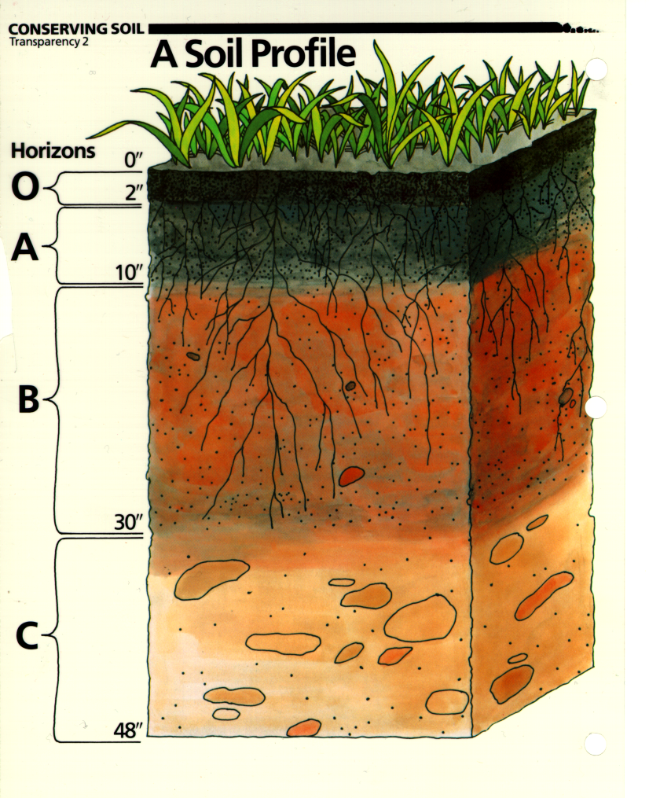
Ideal Soil Profile
Soil Horizons
0 feet - surface
(O horizon)
A horizon
  Topsoil
(E horizon)
B horizon
  Subsoil
C horizon
  Substratum
  Parent Material
  Regolith
  Bedrock
2 inches to 5+ feet
Notes:
The soil profile varies in depth by geographic region and forces of both nature and man. Erosion, sediment deposition and tillage are some of the factors that can impact the soil profile. A “typical” soil profile is shown in the diagram.

Slide 5
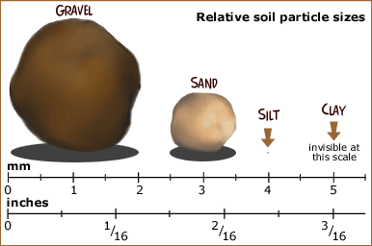
Notes:
The mineral component consists of various sized particles. In some cases very large gravel particles may be present, commonly sand, silt and clay are present. These are differentiated from on another on the basis of size as seen in the diagram. The percent of each, sand, silt and clay, is what determines the soils texture.

Slide 6
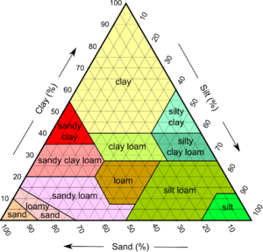
Soil Texture
Notes:
This is a soil texture triangle. Soil texture is determined by triangulating the % sand, silt and clay. More or less equal part of all three give rise to soil that is referred to as loam which is commonly touted as the best soil for many plant species.

Slide 7
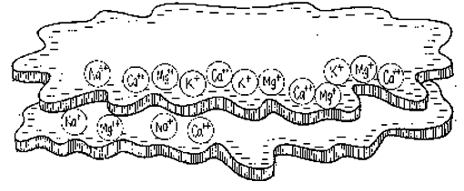
Cation Exchange Capacity: CEC
Notes:
Another property of soils is cation exchange capacity. This refers to the negative sites that occur on the outer surface of soil colloid and also organic matter. For field production, high CEC is considered desireable because these sites temporarily hold cations (positively charged ions) many such as calcium, magnesium, potassium, and iron are required for plant growth. The exchange sites help to keep positively charged plant nutrient from being washed away or leached into deeper layers of the soil profile where there are fewer roots available for nutrient uptake.

Slide 8
16 Essential Nutrients
Structural Nutrients
- Carbon (C)
- Oxygen (O)
- Hydrogen (H)
Major (macro) nutrients
  Nitrogen (N)
  Phosphorus (P)
  Potassium (K)
Micronutrients
  Boron (B)
  Chloride (Cl)
  Copper (Cu)
  Iron (Fe)
  Manganese (Mn)
  Molybdenum (Mo)
  Zinc(Zn)
Secondary nutrients
  Calcium (Ca)
  Magnesium (Mg)
  Sulfur (S)
Notes:
There are 16 commonly recognized nutrients essential for plant growth. Many believe there are a few additional required elements for normal plant growth but because of the way essential has been defined it is likely this list of 16 will remain as the only essential elements. Of these, we do not worry about supplying carbon, hydrogen and oxygen. The other 13 are all things that growers may be concerned about being present in sufficient quantities. The major elements are required in the highest volumes, followed by the secondary nutrients. Micronutrients are typically only required in small or trace amounts but even though they are not required in large volumes there are several situations in which they can be the limiting factor to plant growth and/or crop yield.

Slide 9
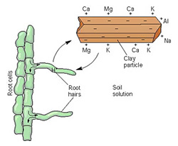
Notes:
Plant nutrients may already be dissolved in the soil solution or may become dissolved in the soil solution after being displaced from a cation exchange site by another cation such as hydrogen, sodium or aluminum. Plant roots uptake nutrients from the soil solution.

Slide 10
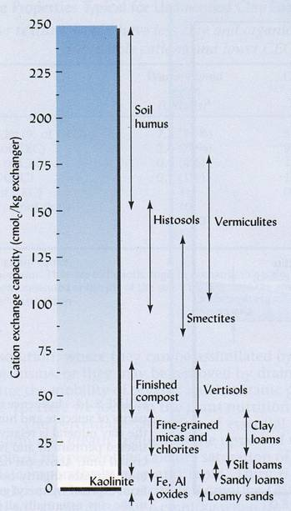
Notes:
The amount or number of cation exchange sites is refered to as the soils cation exchange capacity and is commonly reported on soil tests. Sand has few exchange sites while silt has more and clay even more than silt. However, As this slide illustrates, soil humus (commonly derived from organic matter) has the greatest potential to increase soil cation exchange capacity.

Slide 11
Cation Exchange Capacity (CEC)
The total number of exchangeable cations a soil can hold
  amount of its negative charge
Soil Texture CEC Range
(meq/100 g soil)
organic soils > 50
clays 25-50
silts 8-30
sands 5-15
Notes:
Some potential CEC values from various soil types.

Slide 12
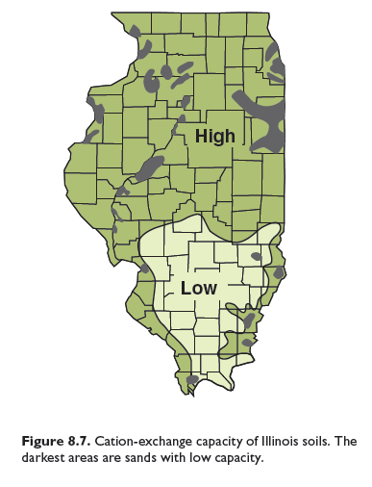
Notes:
This map show generally expectation of CEC throughout the state of Illinois.

Slide 13
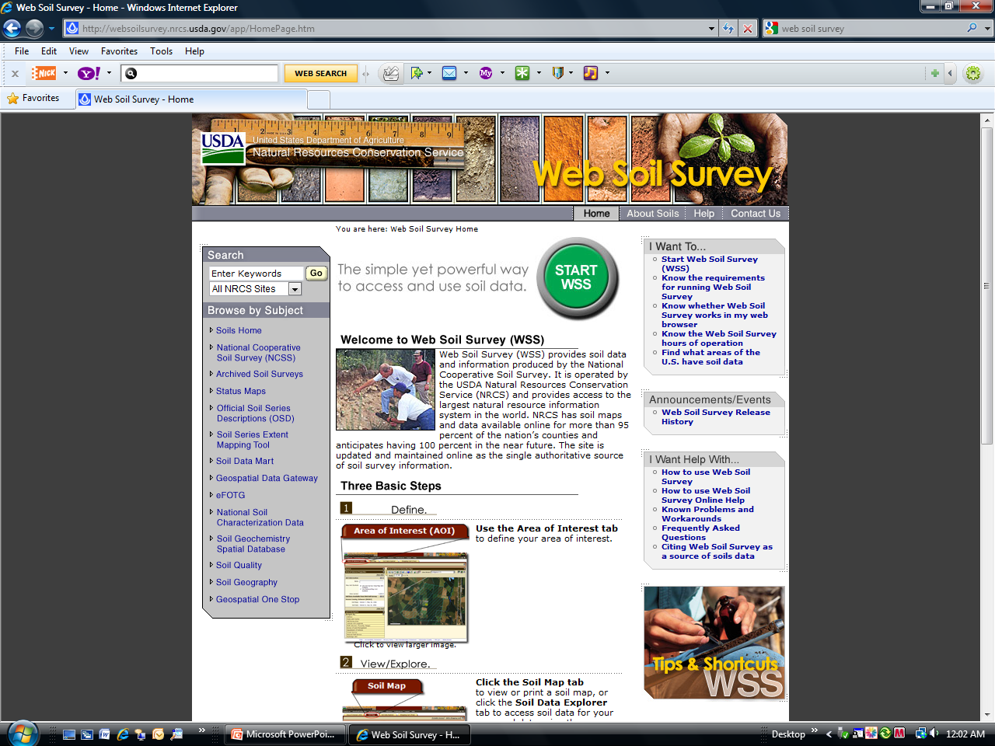
What Soil is on Your Property?
http://websoilsurvey.nrcs.usda.gov/app/
Notes:
Before deciding to purchase or rent a piece a property it might be a good idea to learn about the sites soil(s). The soil surveys are now online and can be easily accessed.

Slide 14
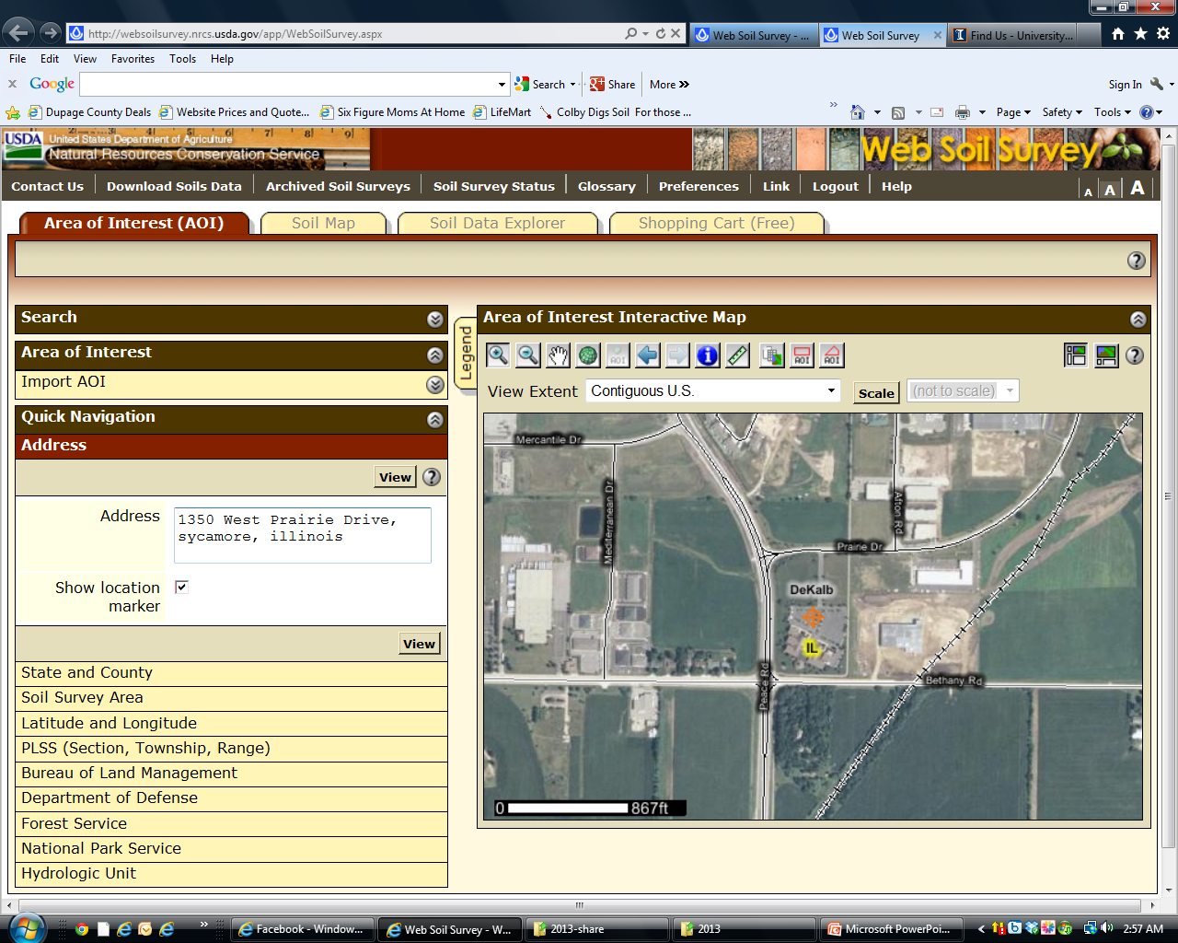
Notes:
One method of navigation will allow you to simply enter the physical address of the property in question.

Slide 15
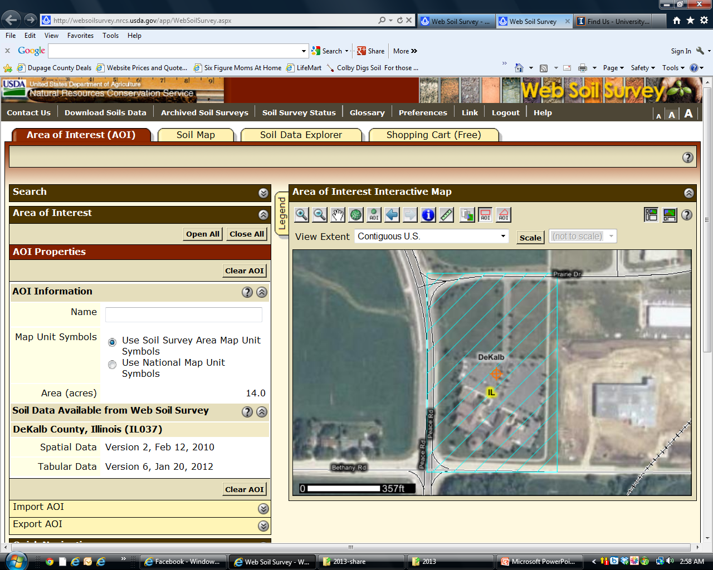
Notes:
The area of interest can then be refined.

Slide 16
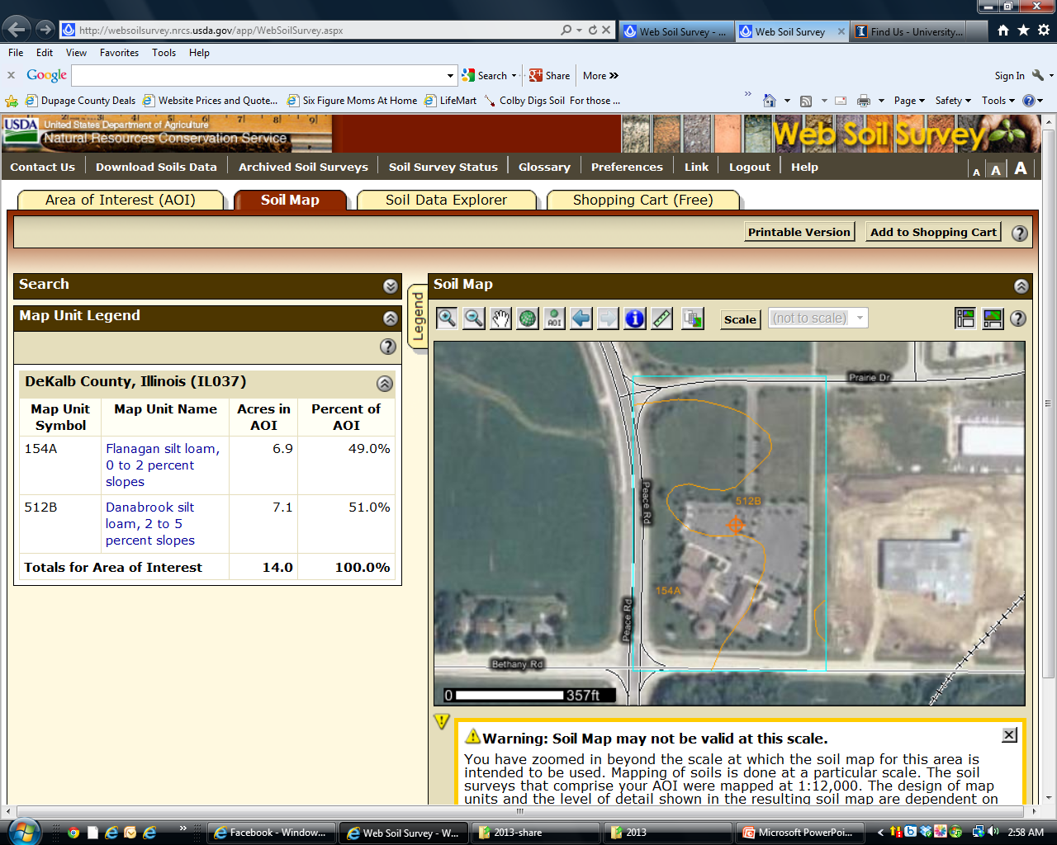
Notes:
Once you have selected the specific location you are interested in then soil types and subsequent characteristics of those soil types can be further explored.

Slide 17
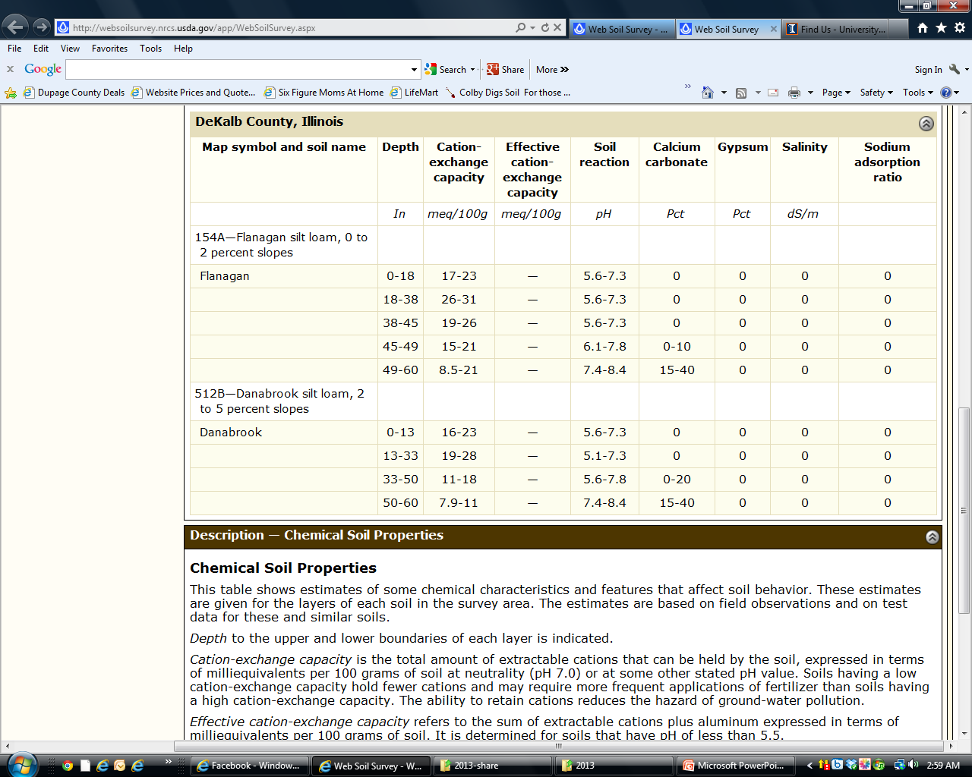
Notes:
Detailed information about the soil series found on this particular farm in Dekalb County.

Slide 18
Some Factors Influenced by Soil Type
Plant Selection: grow adapted varieties
Irrigation: Soil types directly impacts plant available water
Drainage
Fertilizer recommendation
Yield potential
Herbicides: read label for special instructions
Notes:
Because soil type has a direct impact on so many aspects of agronomic and horticultural production, it is important to study soil maps of areas one is interested in renting or purchasing.

Slide 19
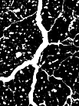
SOIL STRUCTURE
Granular structure
Blocky structure
Relationship between structure and porosity
Notes:
While soil type is determined by geographic location, soil structure is also important and can be improved or damaged based on horticultural practices such as tillage, cropping, and use of cover crops. Soil structure is defined by the way individual particles of sand, silt, and clay are assembled. Single particles when assembled appear as larger particles. These are called aggregates .

Slide 20
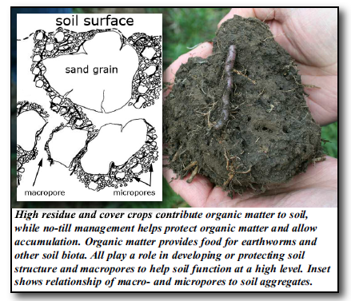

Slide 21
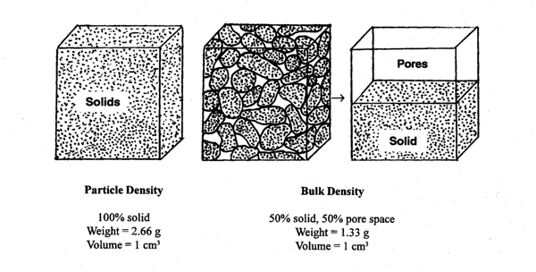
Bulk Density
Notes:
Bulk density refers to the weight of soil per unit volume. Soils with good structure and good soil health tend to have lower bulk density and provide improved plant growth. Practices that destroy good soil structure tend to increase bulk density and reduce plant growth and yields. Examples could include excessive tillage, high traffic or field preparation when soil is too wet.

Slide 22
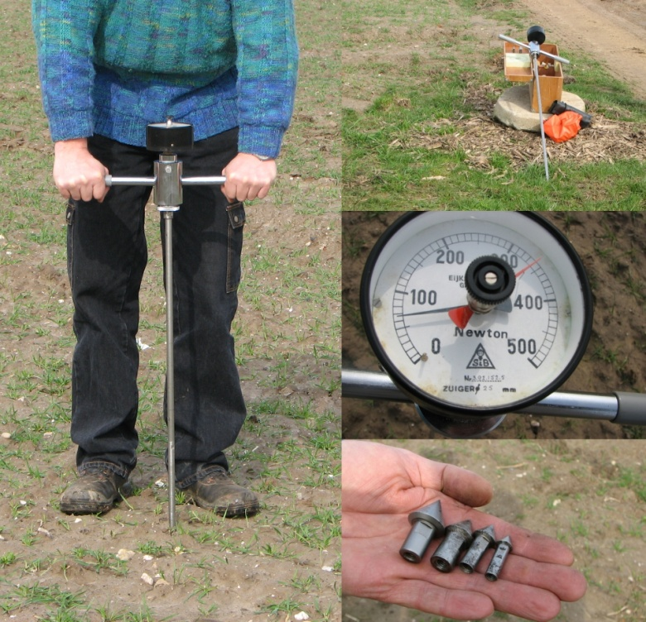
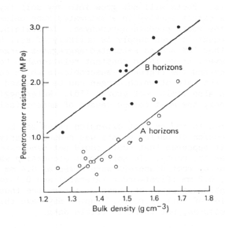
Penetrometer
Notes:
One device to measure bulk density is a penetrometer.

Slide 23
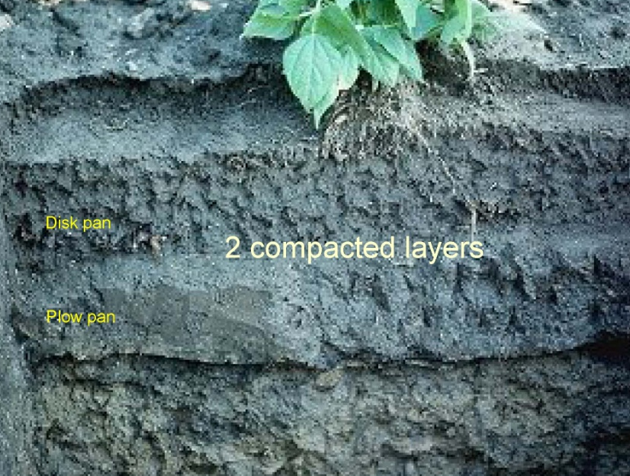


Compacted Zone
Impermeable Layer
H₂O
H₂O
Non-Compacted
Compacted
Notes:
Compaction zones often develop as the result of repeated tillage at the same depth.

Slide 24
Preventing and Repairing Compaction
Break up compacted layer
  Double digging
  Sub soiling
  Core aeration of lawns
Plant deep rooted plants
  Tillage radish
  Annual Ryegrass

Slide 25
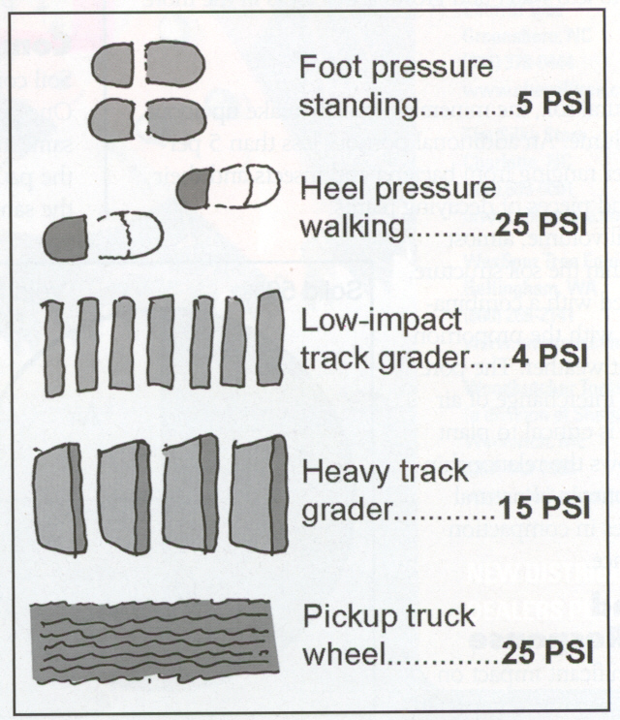
Preventing and Repairing Compaction
Prevent further compaction
  Minimize Tillage
    Minimize Rototilling
    Vary depth of tillage each year
  Minimize walking on soil
    Raised beds guide traffic
  Do not drive cars or other large vehicles across soil
    Develop drive aisles
Urban, 2008
Notes:
Marble example

Slide 26
Interpreting Soil Test Results

Slide 27
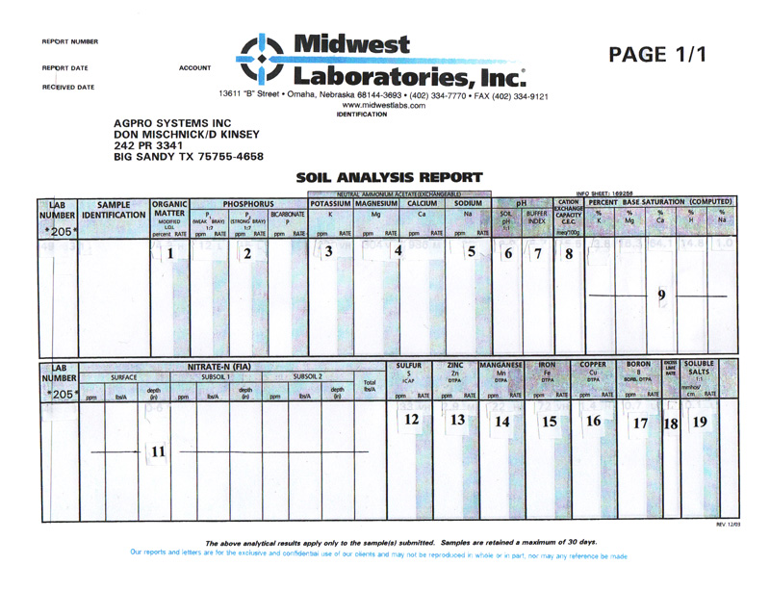
Notes:
Nutrient levels are reported by some labs such as this one in parts per million (ppm).

Slide 28
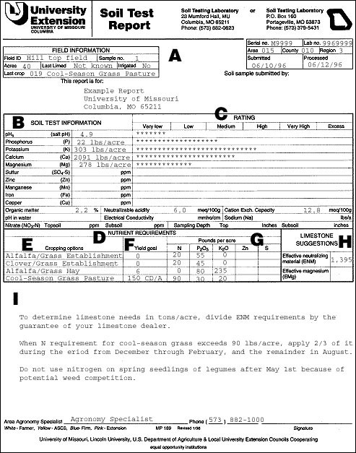
Notes:
Other labs like this give nutrient levels in pounds per acre. It is critical you are certain which method you are looking at.

Slide 29
Pounds/A = ppm x 2
Notes:
Pounds per acre is equal to 2 x ppm.

Slide 30
Acre Furrow Slice
Tilled Soil
D
W
AFS = D x W = 2,000,000 pounds
Notes:
The reason is that one acre furrow slice (a 6.5” slice of soil across one acre) weighs 2,000,000 pounds

Slide 31
Recommendations

Slide 32
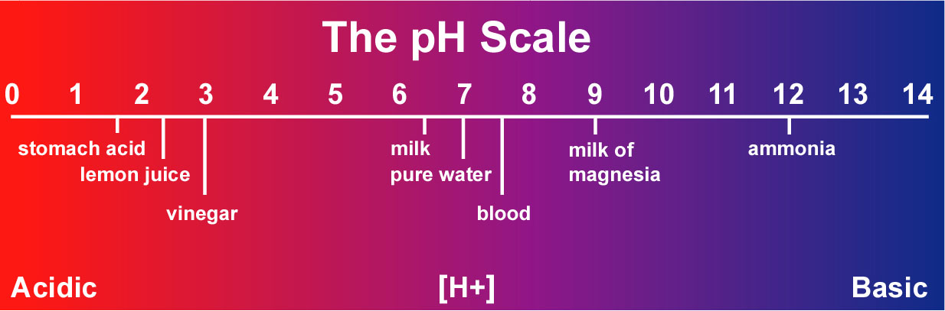
Soil pH
Measure of alkalinity or acidity on a scale of 0 - 14
0
7
14
Acidic
Neutral
Alkaline
Notes:
For blueberries acidic soil (less than 5.8) is required, and if planted into neutral soil the plants will die. However for most crop soil pH of 6.5 to 7 is desrieable.

Slide 33
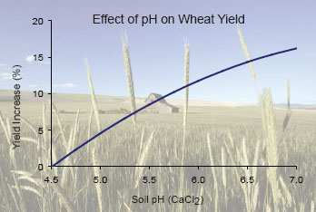
Adjusting pH
Notes:
The impact of pH on crop yield has been widely demonstrated on numerous crops.

Slide 34
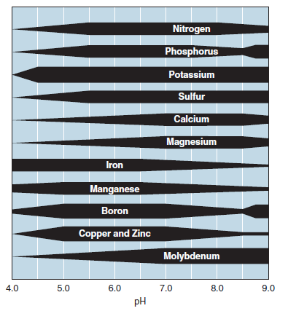
Notes:
By adjusting pH we maximize the availability of many plant nutrients. This leads to the statement that lime is the cheapest fertilizer one can buy. You not only are applying calcium and magnesium but you are at the same time shifting the pH to increase the plant available levels of many other nutrients.

Slide 35
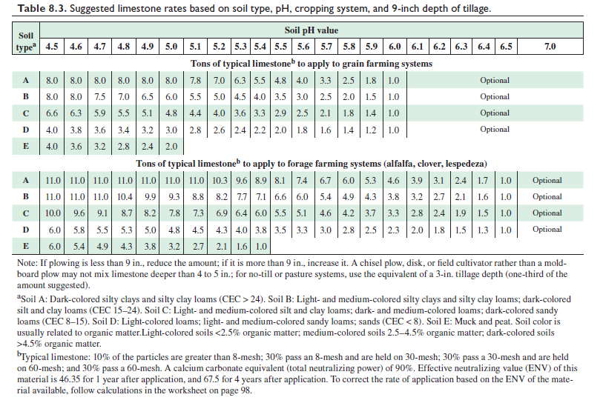
Notes:
Limestone recommendations can be found in the Illinois Agronomy Handbook.

Slide 36
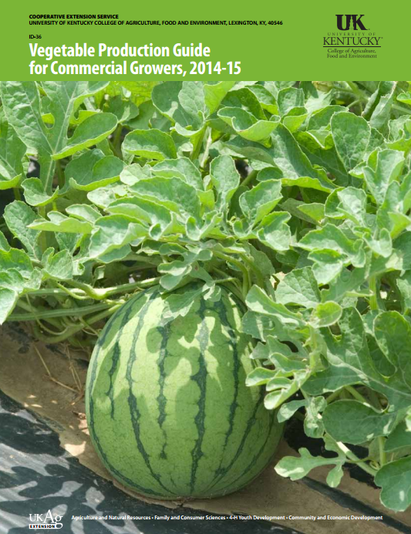
http://www2.ca.uky.edu/agc/pubs/id/id36/id36.pdf
Notes:
Fertilizer recommendation can be found from numerous sources such as the University of Kentucky Vegetable Production Guide for Commercial Growers.

Slide 37
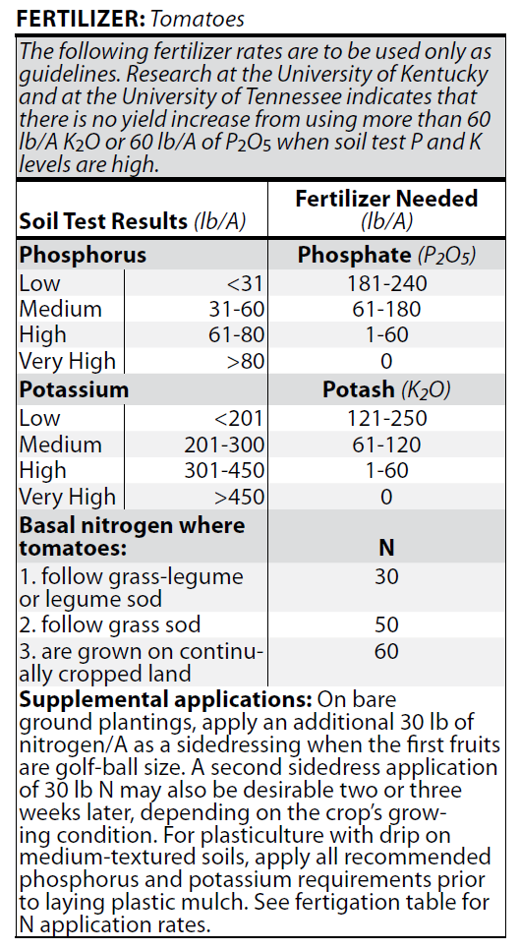
Notes:
For these recommendation make sure you soil test results are either in or converted to pound per acre. Then locate where you soil test results fall and apply the amount of recommended P and K (phosphorus and potassium) Additional information on the amount of nitrogen to apply is also provided.

Slide 38
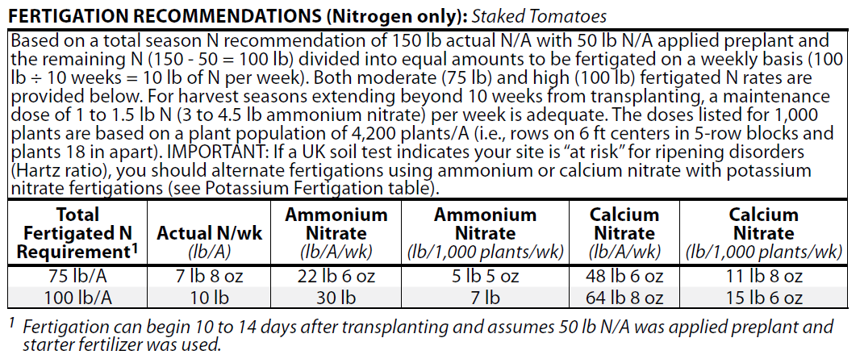
Notes:
For some crops like tomatoes we are using for this example. Fertility is not only provided by pre plant application but also subsequent application af fertilizer are applied through the irrigation in a process known as fertigation.

Slide 39
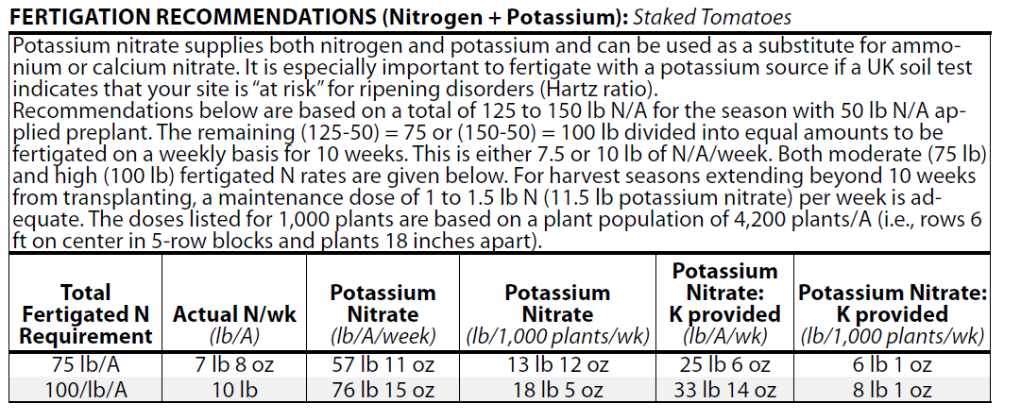
Notes:
A different fertigation schedule for tomatoes if growers feel they need additional potassium to avoid yellow shoulder disorder a common problem throughout the midwest.

Slide 40
Problems more commonly found in specialty crops
Phosphorus scores too high
Advising on foliar feeding
Nutrients out of balance?
“Disease” associated with fertility
Notes:
It is much more common to see market gardens than commercial row crop fields where there has been routine application of fertilizer without monitoring by soil tests. This can lead to excessive phosphorus levels and also development of problems with base saturation that is to say nutrients may become out of balance. Foliar feeding is normally practiced only to address specific problems rather than being utilized as a means of providing normal plant nutrition. Examples would include sprayed calcium applications to address bitter pit of apple and blossom end rot of tomato. To abiotic diseases that are caused b fertility issues.

Slide 41
Other differences
Fertilizer materials used
Timing of application
Method of application
Fertilizer input expenses are normally not that significant in the overall cost of production
Excess fertilizer may result in problems beyond the simple waste of money
Notes:
Because of the crop value and diversity of species cultivated specialty crops differ from row crops with regards to fertilizer in several ways. High crop values allow for use of some fertilizer materials that would b cost prohibitive on row crops. Fertigation is often used to apply nutrients weekly throughout the majority of the growing season rather than just one or two fertilizer applications.

Slide 42
Tools in addition to soil testing utilized by Illinois specialty crop producers
Tissue analysis
Petiole sap meters
Visual inspection
Notes:
In addition to soil test, other testing procedure are occasionally used for specialty crops. Obviously visual inspection is always important but also tissue tests and petiole sap analysis are sometimes used to determine plant needs and make adjustments to fertility programs.

Slide 43
To reach us
Contacts | Contact information
Jeff Kindhart | jkindhar@illinois.edu
Rick Weinzierl | weinzier@illinois.edu
Notes:
Keep it brief. Make your text as brief as possible to maintain a larger font size.

Slide 44
If you have questions …
University of Illinois Extension Local Food Systems and Small Farms team
  http://web.extension.illinois.edu/smallfarm/
USDA’s Start2Farm site
  http://www.start2farm.gov/
Notes:
Our beginning farmer training program ended in the fall of 2015. The best way to pursue answers to questions about fruit and vegetable production in Illinois is to contact educators on the University of Illinois Extension Local Food Systems and Small Farms team. Extension programs in other states are operated by the land-grant university in each state. Additionally, USDA’s Start2Farm site provides listings of farmer training programs in specific states and localities.

