Slide 1
Preparing a New Generation of Illinois Fruit and Vegetable Farmers a USDA NIFA Beginning Farmer and Rancher Development Program Project Grant # 2012-49400-19565 http://www.newillinoisfarmers.org
Notes:
The following presentation was part of a beginning farmer course, “Preparing a New Generation of Illinois Fruit and Vegetable Farmers,” offered by the University of Illinois and the Illinois Migrant Council from 2012 through 2015. This course was funded by the United States Department of Agriculture’s National Institute of Food and Agriculture, and specifically by the Beginning Farmer and Rancher Development Program. For more information about the program and for links to presentations and resources on many other topics, see the website newillinoisfarmers.org.

Slide 2
Preparing a New Generation of Illinois Fruit and Vegetable Farmers Hydroponic Production
Jeff Kindhart
September 2015
Notes:
Hello. I am Nathan Johanning, Extension Educator with the University of Illinois Extension and today we are going to talk about cover crops for fruit and vegetable production.

Slide 3
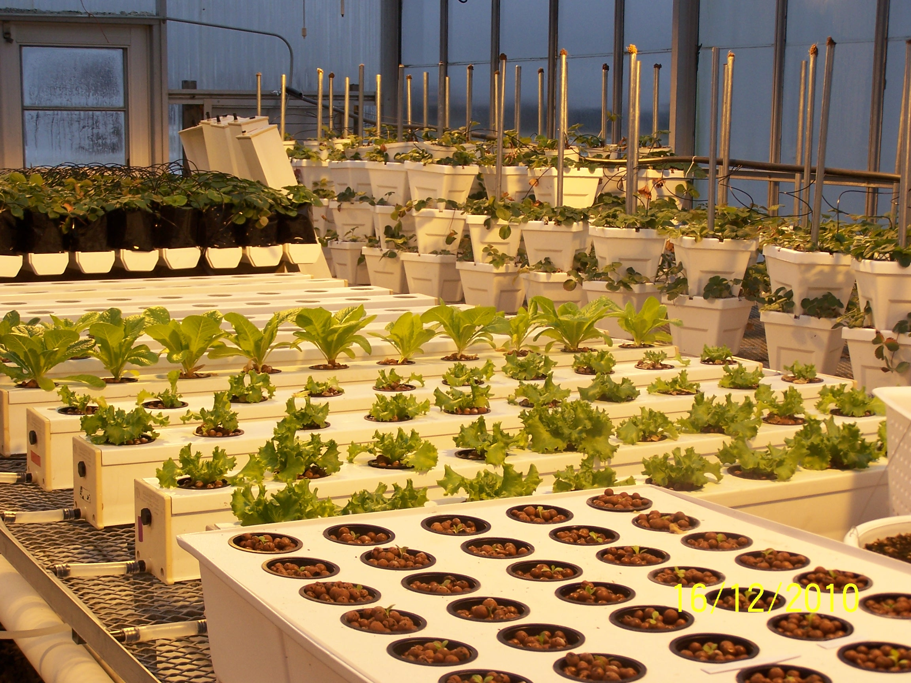
Hydroponic – Water Work
AKA hydroculture
Growing plants without soil (not geoponic)
Essential elements provided in solution in water
Term first appears in 1939 Science article by William Gericke he credits W.A. Satchel

Slide 4
Why ?
Stable yields
Rapid crop development
Avoid soil borne pathogens
Allows crop production where there is no soil or contaminated soil (roof tops, abandoned buildings)
Lower bulk density of common substrates makes this method a better choice for vertical growing
Food Safety?????

Slide 5
Disadvantages
No or little buffering no power or no water = Disaster
Requires a much higher level of management
Expense (equipment and supplies and labor)
Difficult to conduct organically

Slide 6
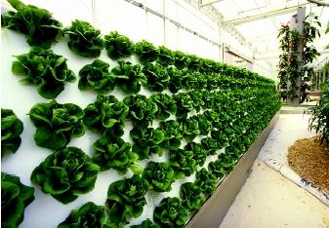
History
Ancient gardens of Babylon ???
Being done in 1600’s but with minimal understanding
Francis Bacon & others
1937 William Gericke – UC – coined term (credited Satchel) and promoted system
1938 UC’s Dennis Hoagland and Daniel Amon publish bulletin “The Water Culture Method for Growing Plants Without Soil”
1940’s Used on Pacific rim islands (soilless atolls) for food production
1960’s NFT
1980’s Epcot Center

Slide 7
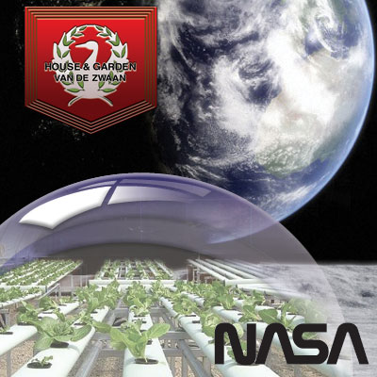
CELLS – Controlled Ecological Life Support Systems

Slide 8
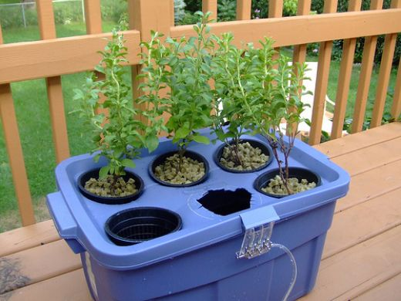
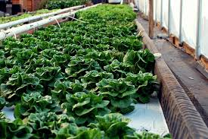
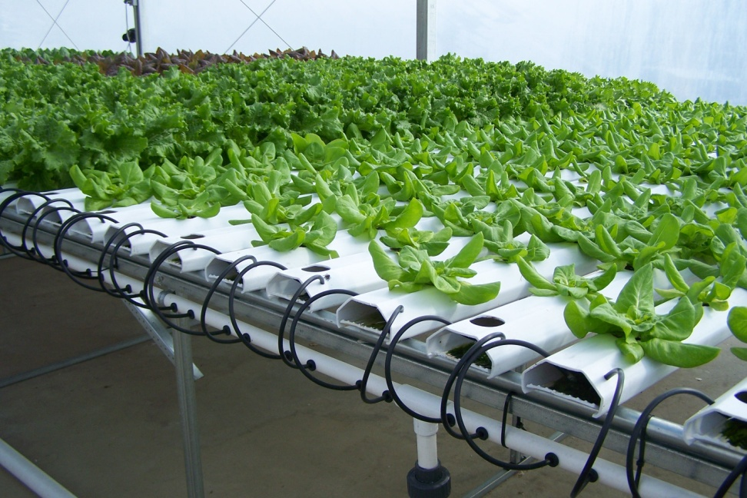
Types
Static
Intermittent flow
Continuous flow

Slide 9
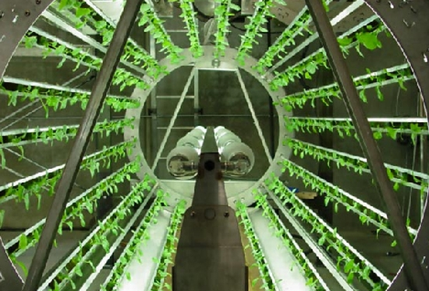

Slide 10
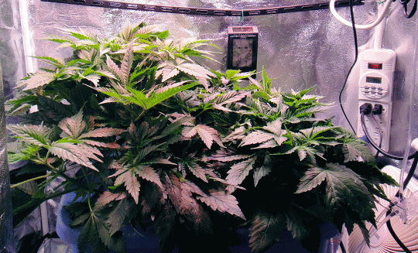
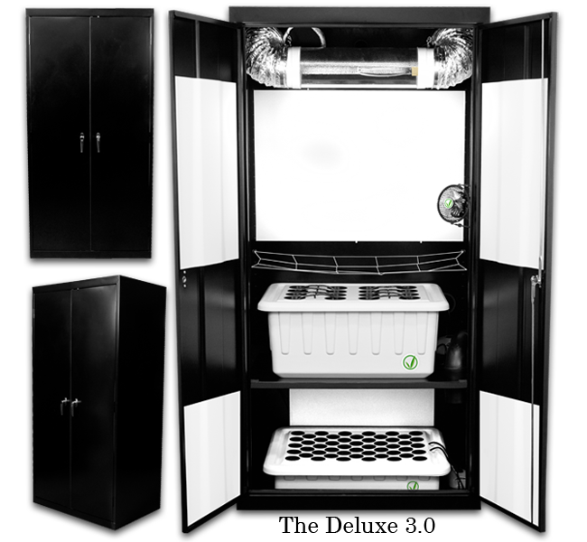
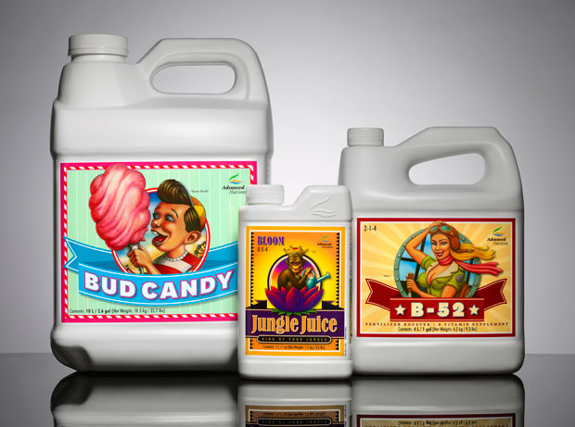

Slide 11
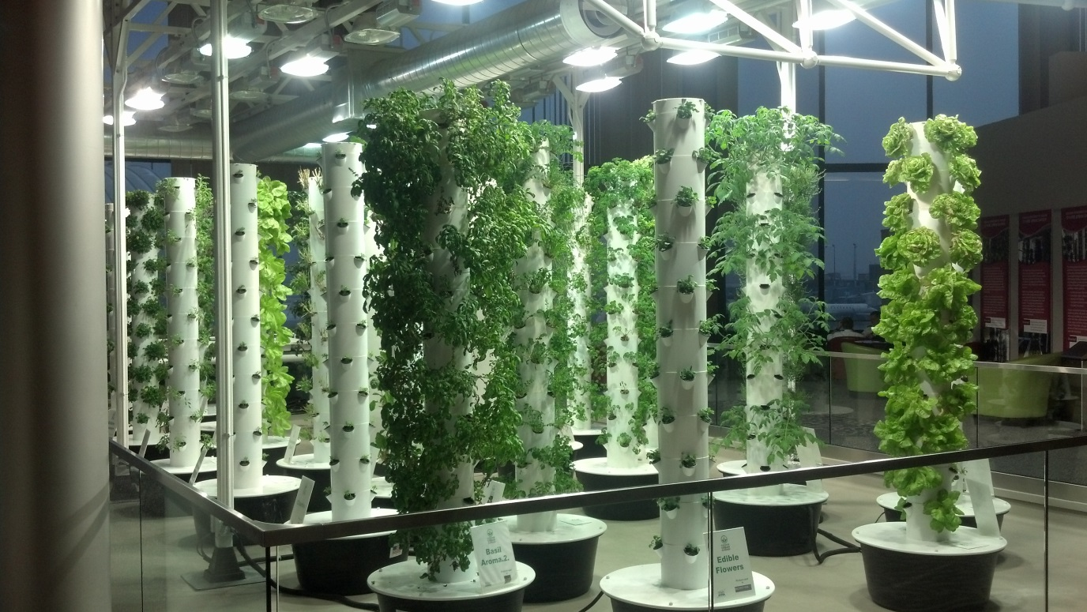
Hydroponics for urban food production
Sam Wortman
Assistant Professor
Department of Crop Sciences
swortman@illinois.edu

Slide 12
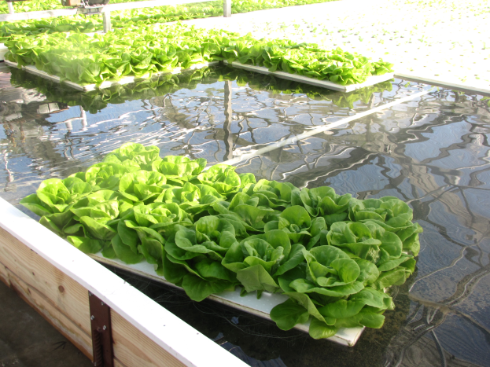
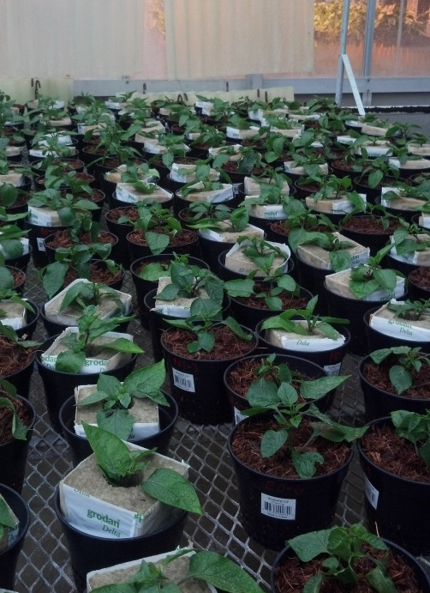
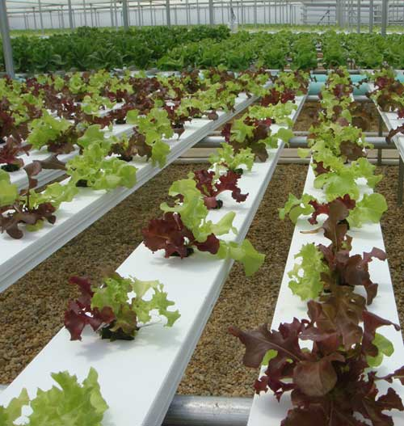
Hydroponic production systems
Water culture
Floating raft
Aeroponics
Nutrient film technique
Ebb-and-flow
Soilless media culture
Rockwool
Vermiculite
Perlite
Coco coir

Slide 13
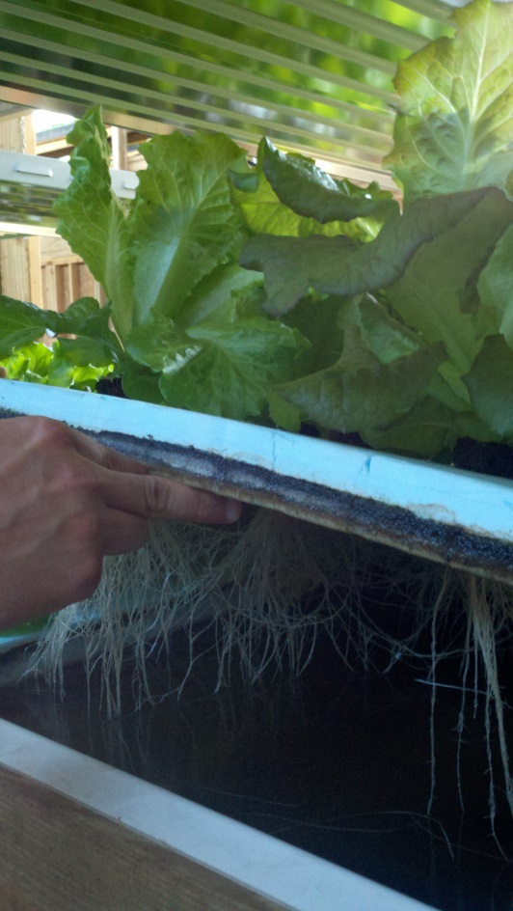
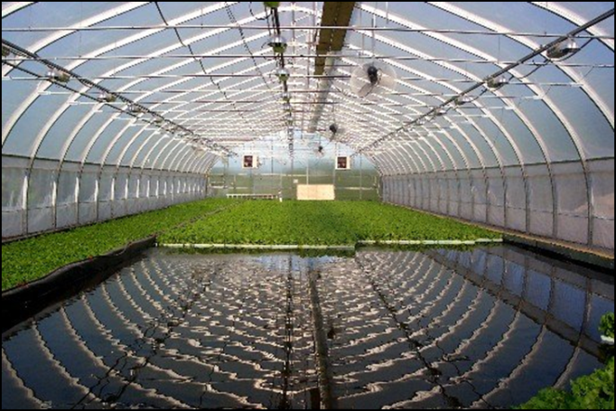
Floating raft systems
Roots are continuously saturated in water
Seedlings started in soilless media and transplanted into rafts
Requirements:
Root aeration
Root darkness (avoid algae growth)
Plant support

Slide 14
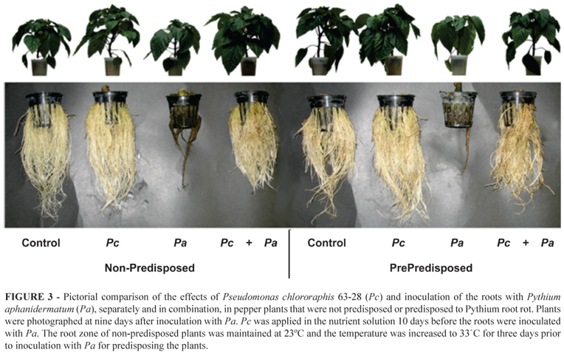
Floating raft systems
Benefits:
Low cost and maintenance
Rafts can be maneuvered through the bed
Popular in aquaponic systems
Drawbacks:
Root disease
(Pythium spp.)

Slide 15
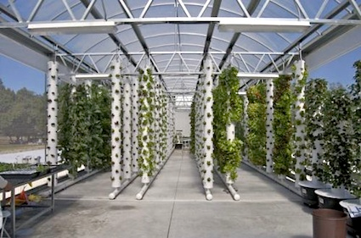
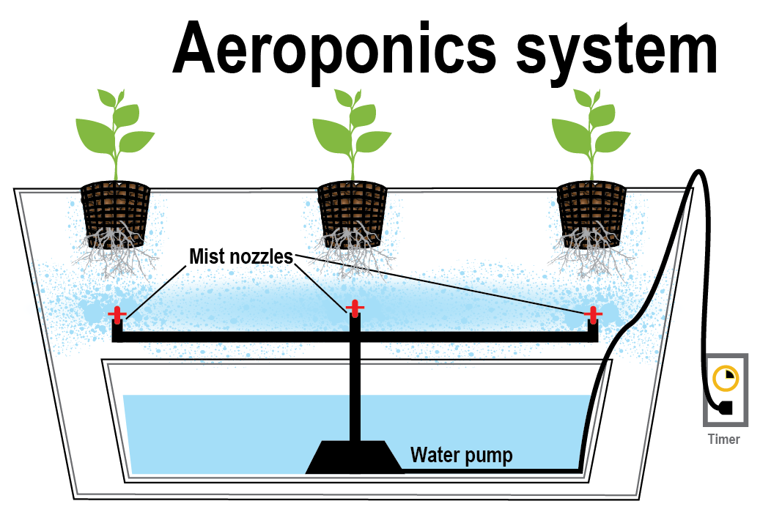
Aeroponic systems
Roots are bathed in a nutrient mist
Popular for plant physiology studies, less common commercially
A-frames and vertical columns possible

Slide 16
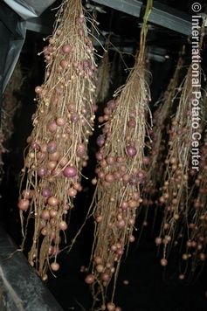
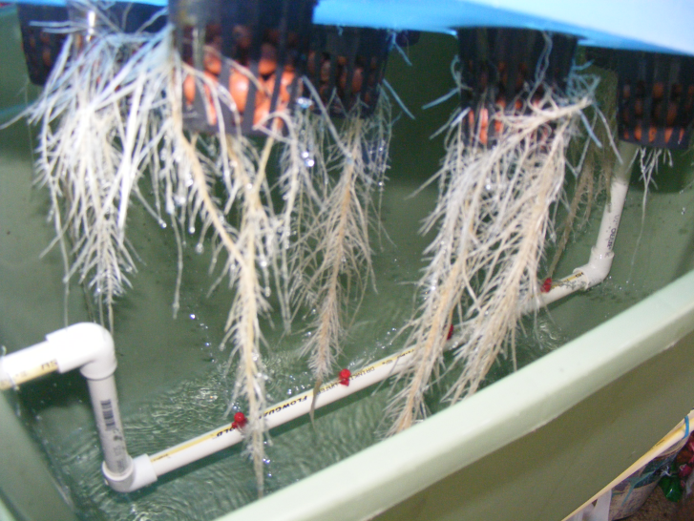
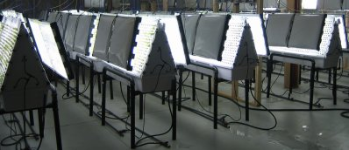
Aeroponic systems
Benefits:
Provides sufficient oxygen, minimizes disease
Used for growing root crops hydroponically (e.g., seed potatoes and medicinal roots)
Drawbacks:
Energy intensive

Slide 17
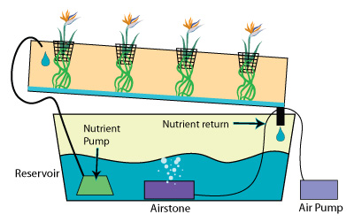
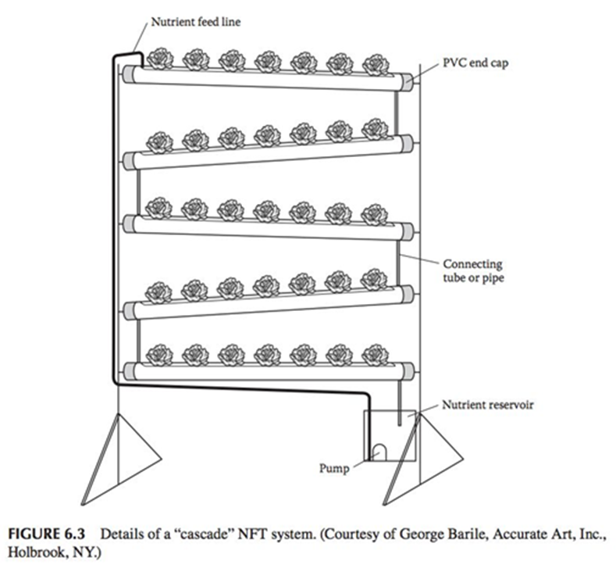
Nutrient film technique
Similar to floating raft
Nutrient solution continuously circulates/passes through bottom of root zone
Nutrient solution is gravity-fed through troughs and pumped back to supply line

Slide 18
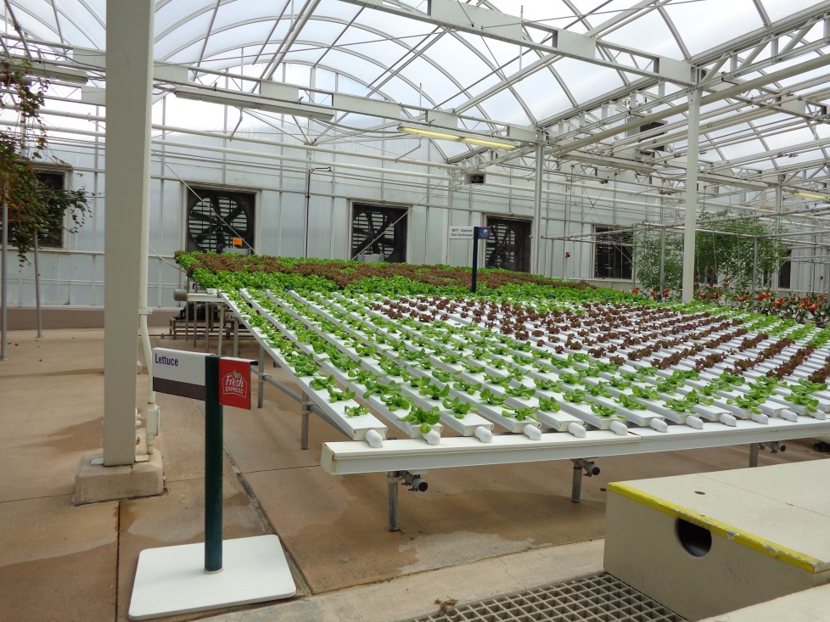
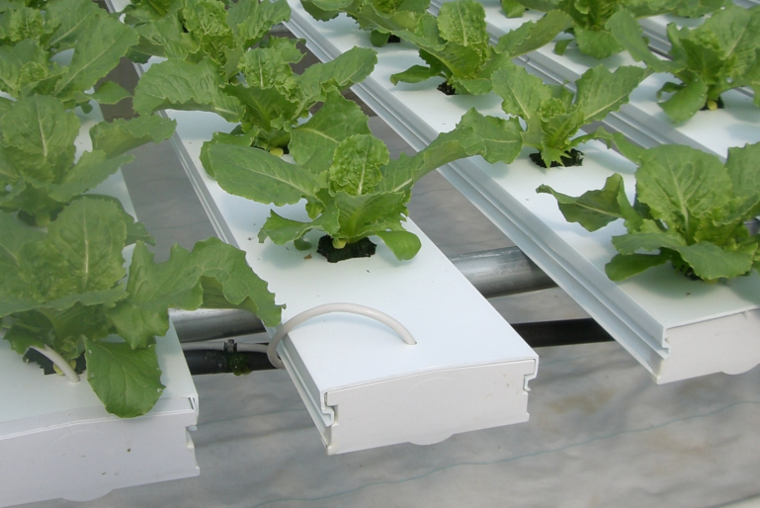
Nutrient film technique
Benefits:
Improved oxygenation of roots
Can construct from home gutters
Drawbacks:
Troughs can get clogged by root mass, water level rises, oxygen level decrease
Most suitable for short-term crops (lettuce, herbs)

Slide 19
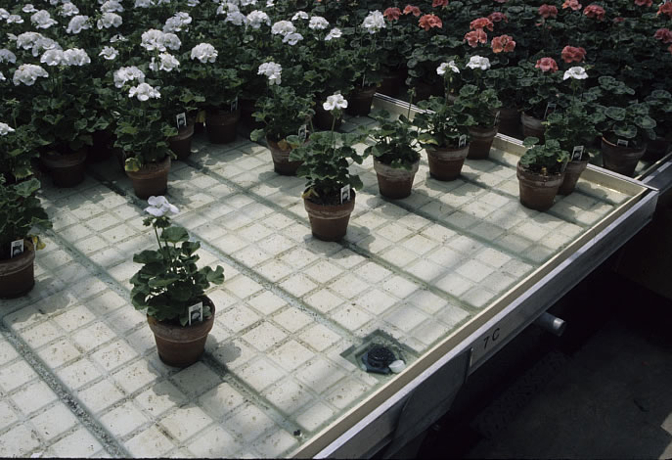
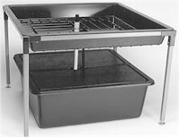
Ebb-and-flow systems
a.k.a. flood-and-drain systems
Essentially sub-irrigation
Tables or trays are flooded intermittently
Flood tables have trenches to allow for complete drainage

Slide 20
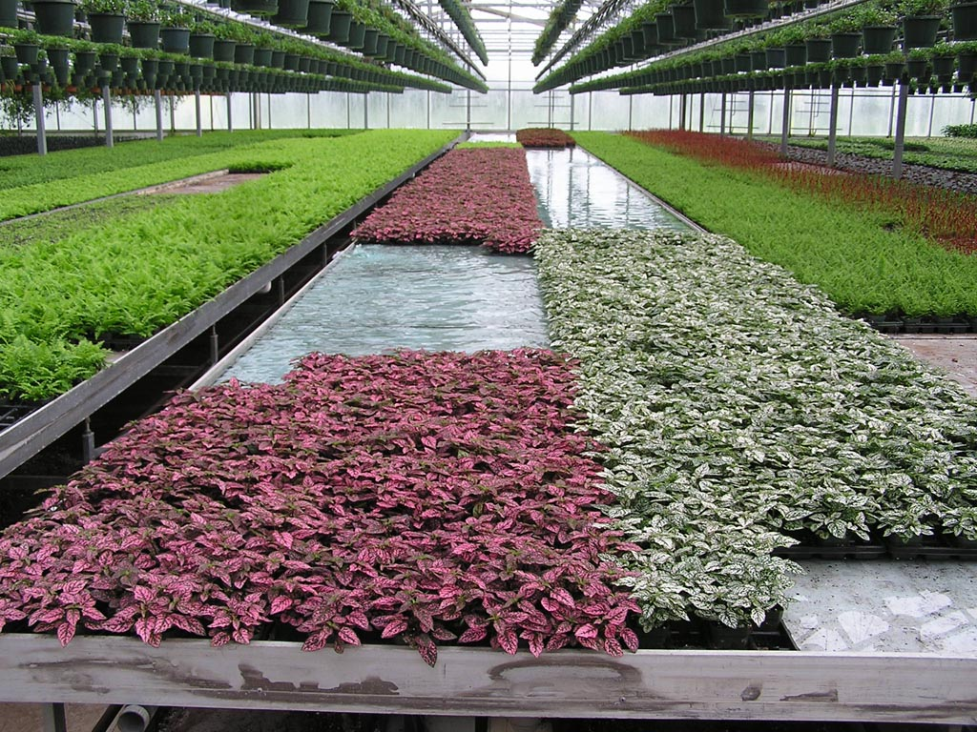
Ebb-and-flow systems
Benefits:
Popular for potted ornamentals
Roots are well oxygenated
Drawbacks:
Plant can become stressed during “ebb” phase
Frequency and duration of flooding depends on growing media and crop

Slide 21
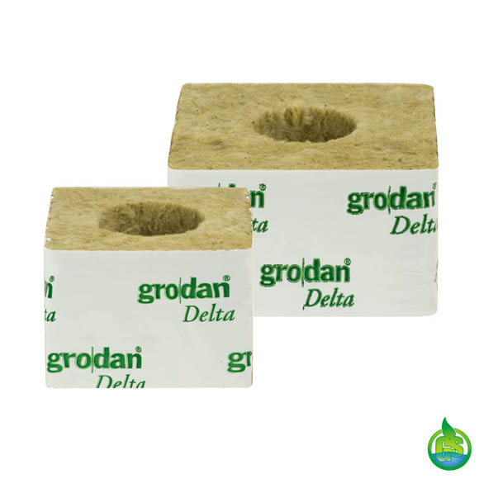
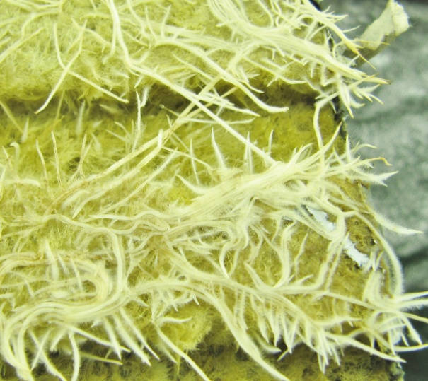
Soilless culture systems - Rockwool
Stone wool made from basalt (lava rock), heated to 1,500°C, spun into threads, and cooled ( 1 m³ basalt = 90 m³ stone wool)
95% pore space, 80% water-holding capacity
Slightly alkaline, but no buffering capacity

Slide 22
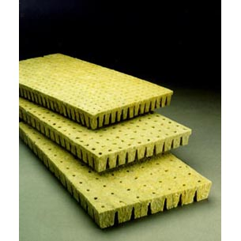
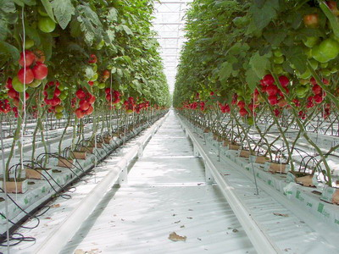
Rockwool
Come in varying sizes to accommodate germination through maturity
5,000 acres of greenhouse crops grown in rockwool in the Netherlands
Drawbacks:
Not biodegradable, though Grodan offers recycling

Slide 23
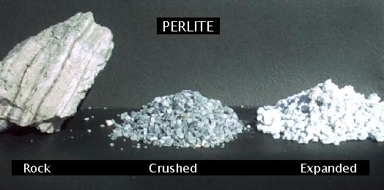
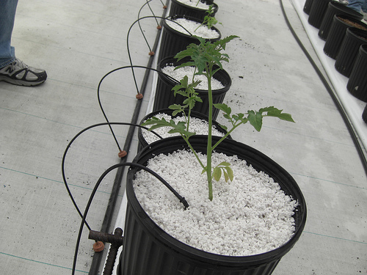
Soilless culture systems - perlite
Silica mineral mined from lava flows, heated to 760°C forming small, spongy, sterile, lightweight kernels
Hold 3-4x weight in water
No buffering or CEC capacity
No nutrient value
Rigid structure good for aeration

Slide 24
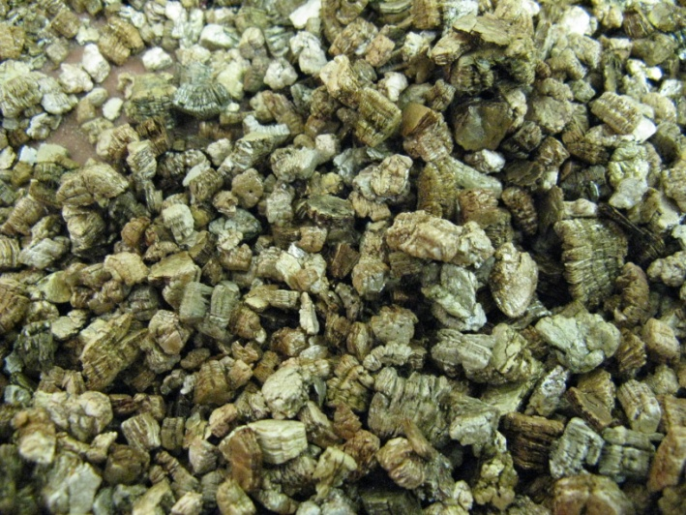
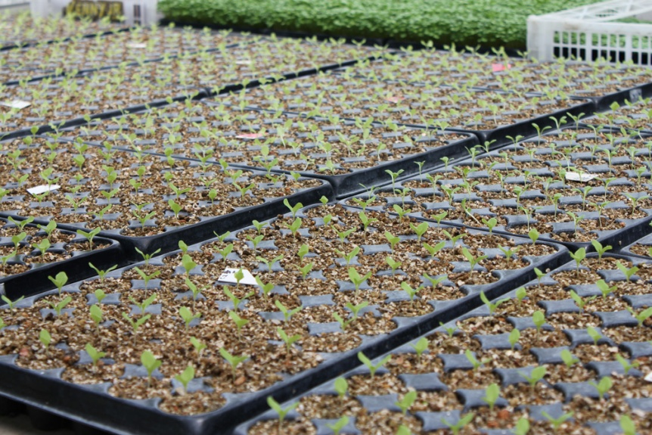
Soilless culture systems – vermiculite
Mica mineral that expands at 1,100°C forming porous, spongy, sterile kernels
Light weight and high water holding capacity
Unlike rockwool and perlite, has high CEC (contains some plant available Mg and K)

Slide 25
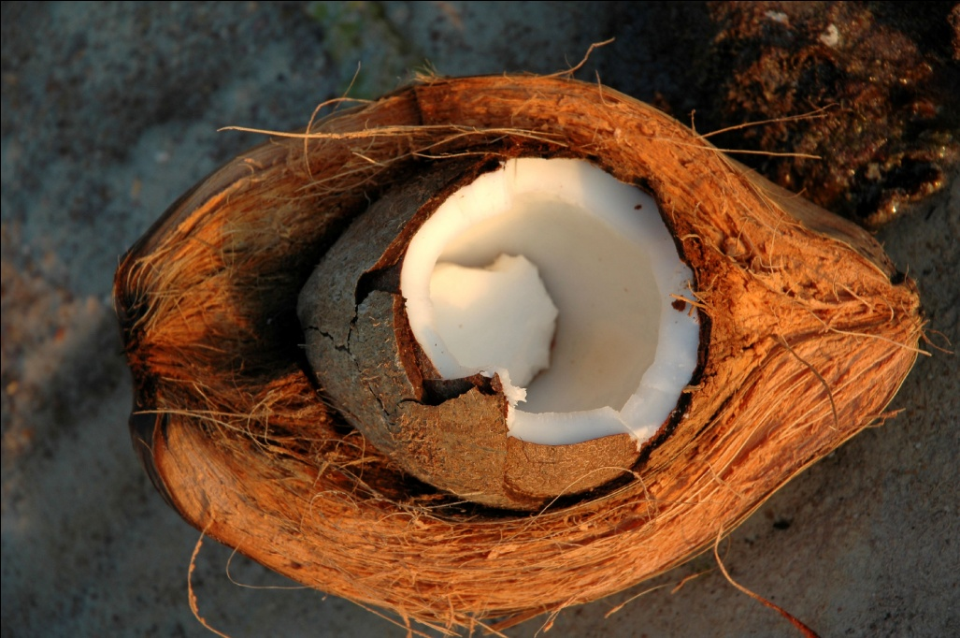
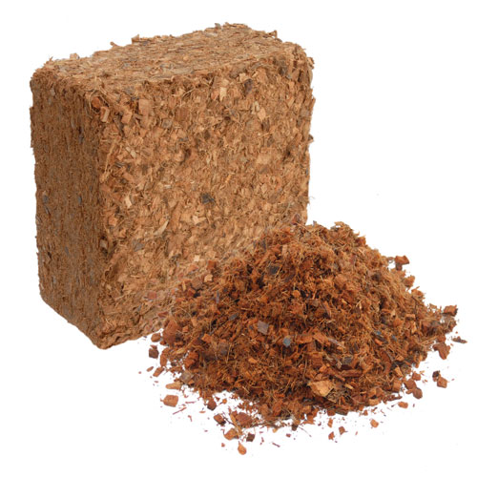
Soilless culture systems – coco coir
Ground-up coconut palm husks
Good air capacity, capillarity, and moisture retention
pH 6 with high CEC (from lignin and cellulose)
Coir pith (part of the fiber) is a dust that can be converted into a hydroponic medium

Slide 26
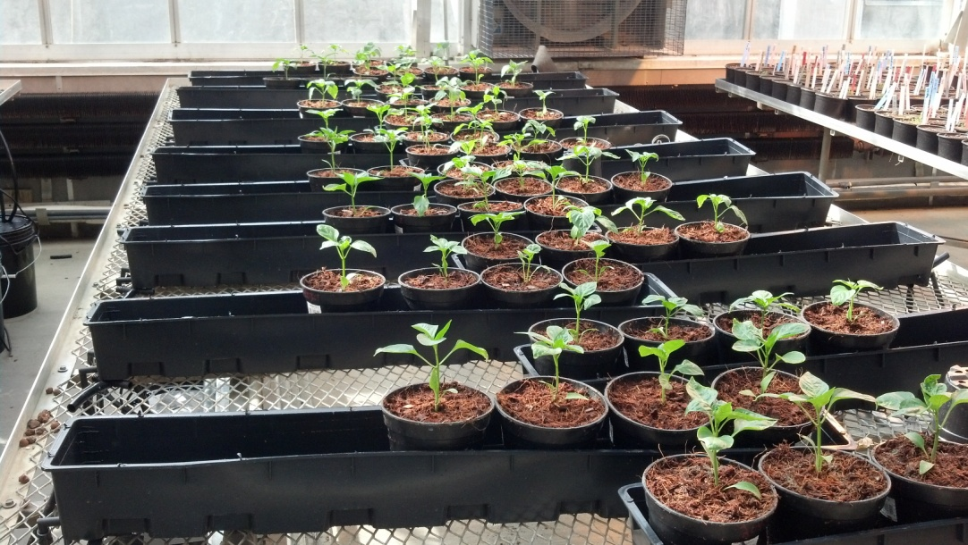
Benefits of coco coir
A potentially sustainable, renewable resource
Though coconuts are coming from SE Asia
Could be recycled as a soil amendment
Many growers switching from rockwool
In theory, coco can be inoculated with beneficial microbes

Slide 27
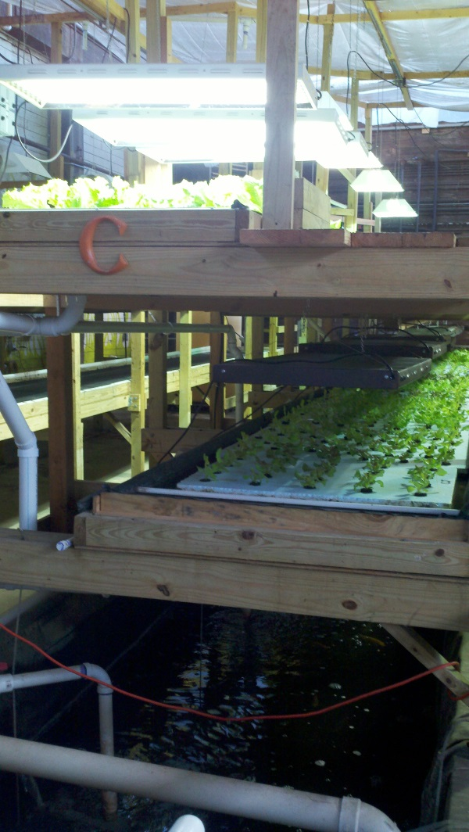
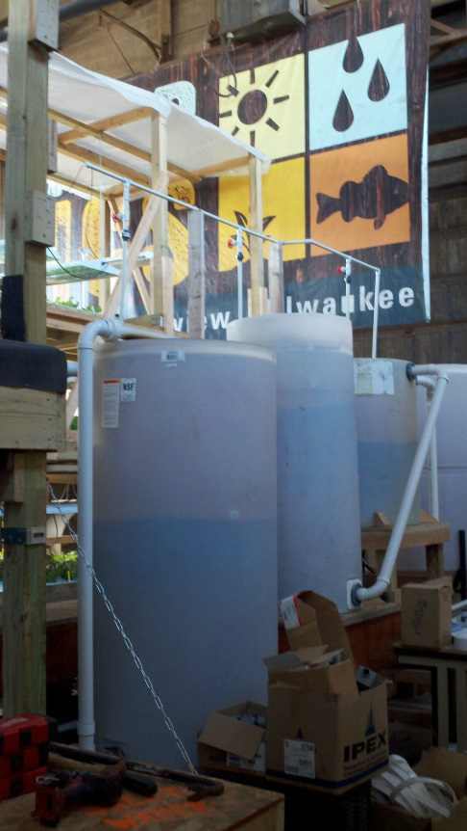
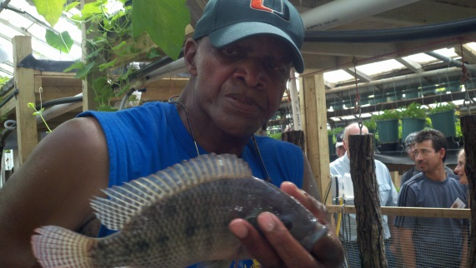
Hydroponics vs. aquaponics?
Aquaponics = aquaculture + hydroponics
Fish effluent is used as fertilizer for plants, and plants filter water for fish
Microbes convert ammonia to nitrate

Slide 28
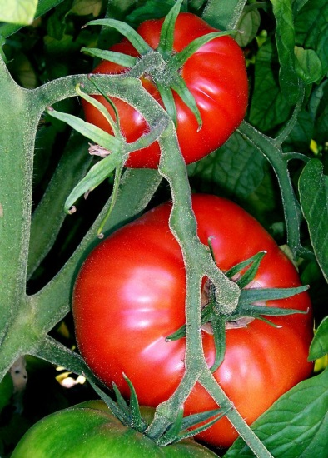
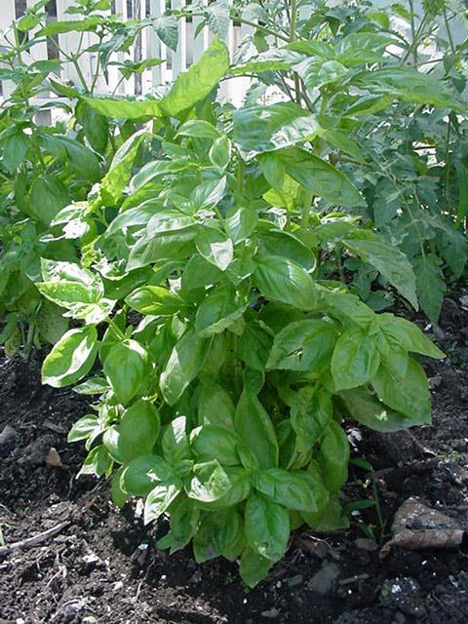
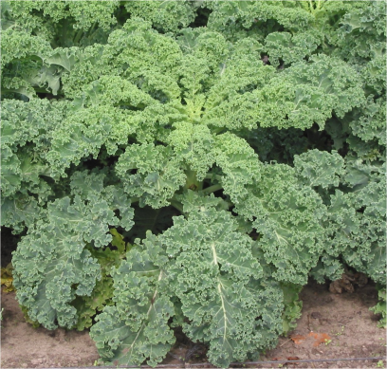
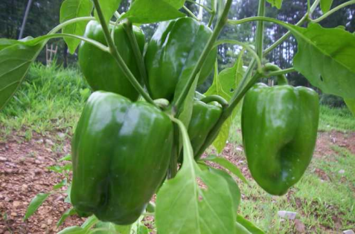
Aquaponics solution is typically about 5-40% dilute compared to ideal hydroponic conditions
Hoagland’s solution…
N = 210 ppm
P = 31 ppm
K = 235
Ca = 200
S = 64
Mg = 48
B = 0.5

Slide 29
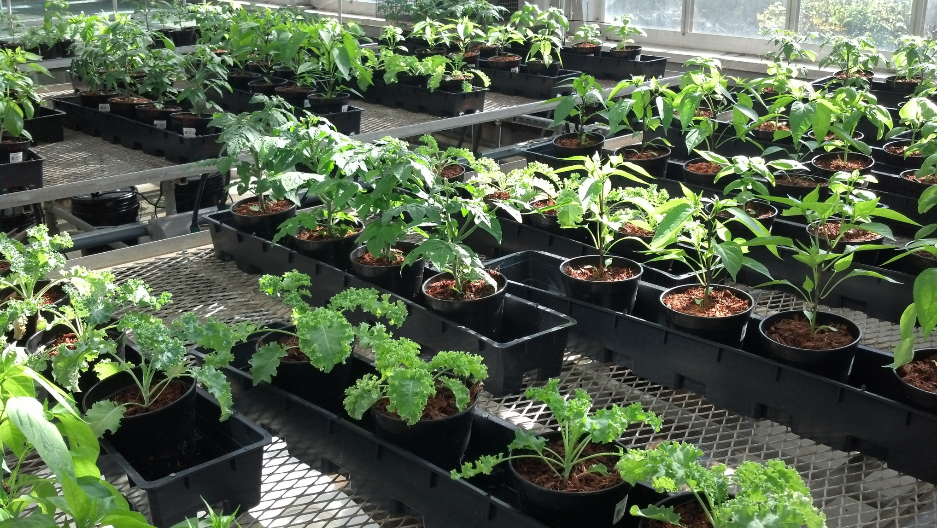
Hydroponics vs. aquaponics: which crops make sense?

Slide 30
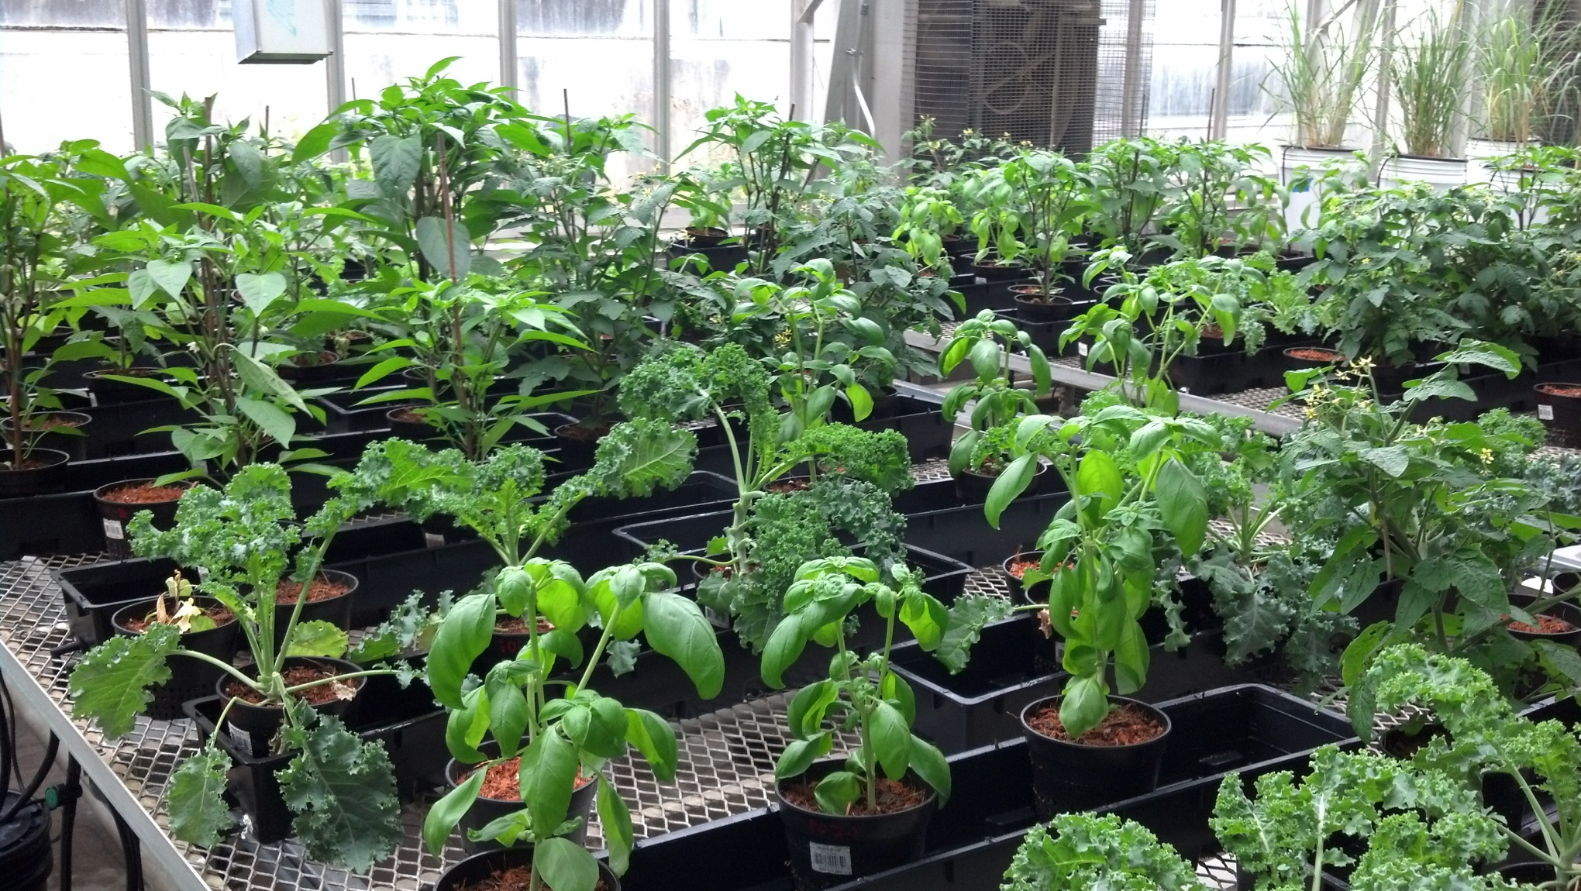
Plants can survive in aquaponic solution…

Slide 31
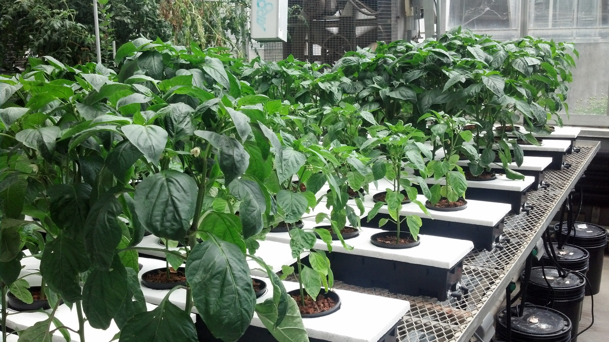
But can they thrive???
Most advocates of aquaponics suggest 90% of the profit is in the vegetables…

Slide 32
What is in Illinois?
Ebb and Flow – mostly ornamental
Gutter systems
Bag Culture
Bato Buckets (dutch buckets)
Vertical Systems

Slide 33
Gutter Systems

Slide 40
pH and EC

Slide 64
Seeded 11/20
Planted 12/11
Picked 3/18 – 6/25
Yield 34.2 pounds 71 fruit

Slide 65
19.2 pounds 46 fruit

Slide 69
If you have questions …
University of Illinois Extension Local Food Systems and Small Farms team
http://web.extension.illinois.edu/smallfarm/
USDA’s Start2Farm site
http://www.start2farm.gov/
Notes:
Our beginning farmer training program ended in the fall of 2015. The best way to pursue answers to questions about fruit and vegetable production in Illinois is to contact educators on the University of Illinois Extension Local Food Systems and Small Farms team. Extension programs in other states are operated by the land-grant university in each state. Additionally, USDA’s Start2Farm site provides listings of farmer training programs in specific states and localities.

