Slide 1



Preparing a New Generation of Illinois Fruit and Vegetable Farmers a USDA NIFA Beginning Farmer and Rancher
Development Program Project
Grant # 2012-49400-19565 http://www.newillinoisfarmers.org
Notes:
The following presentation was part of a beginning farmer course, “Preparing a New Generation of Illinois Fruit and Vegetable Farmers,” offered by the University of Illinois and the Illinois Migrant Council from 2012 through 2015. This course was funded by the United States Department of Agriculture’s National Institute of Food and Agriculture, and specifically by the Beginning Farmer and Rancher Development Program. For more information about the program and for links to presentations and resources on many other topics, see the website newillinoisfarmers.org.

Slide 2
Growing a New Generation of Illinois Fruit and Vegetable Farmers
High Tunnel Construction
and operation
J. D. Kindhart, Kyle Cecil, Mike Roegge, Zack Grant and Shelby Henning
February 2015

Slide 3
Hightunnels.org
High tunnels are unheated, plastic-covered structures that provide an intermediate level of environmental protection and control compared to open field conditions and heated greenhouses
Notes:
Definitions of what a high tunnel is vary from group to group.

Slide 4
University of MN
A high tunnel, by definition, is a non-permanent structure that has no electrical service, no automated ventilation and no heating system.
Notes:
Some groups are very limiting while others are more permissive of what can be included in a “high tunnel”. NRCS Fact Sheets also show variation in their definition from state to state.

Slide 5
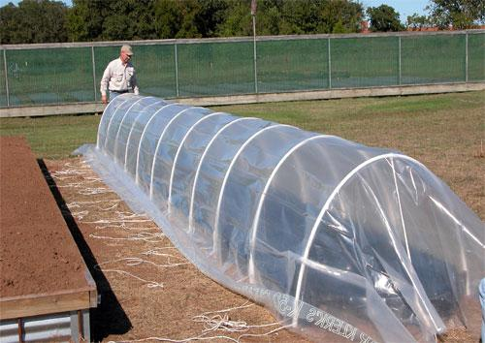
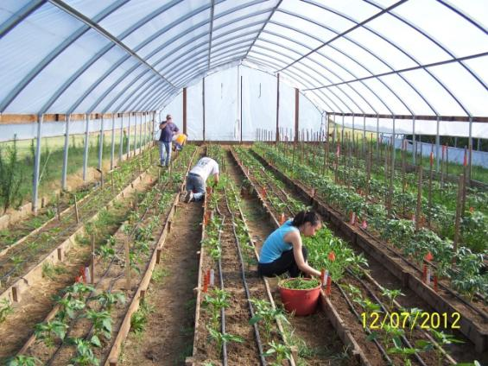
Notes:
In general a high tunnel is any greenhouse type structure that does not have any supplemental heat source. At the point when supplemental heat is supplied the structure transitions from a high tunnel to a greenhouse. It is in contrast to a low tunnel also shown above because it is tall enough to allow people to walk around inside and may also afford equipment to enter.

Slide 6
Common High Tunnel Crops in Illinois
Tomato
Pepper
Cucumber
Raspberry
Strawberry
Blackberry in northern IL
Lettuce and other Greens
Notes:
Although nearly every crop likes the high tunnel environment, because it is high value real estate most growers reserve their tunnel space for a few crops. The economic opportunity and crop response to the high tunnel environment make these crops the ones most commonly grown.

Slide 7
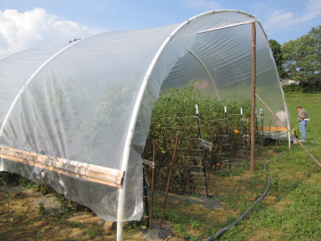
Homemade
Notes:
Although there are many different plans from various sources on how to make a “homemade” high tunnel, this strategy very often yields less than desirable results. In many cases a significant capital investment is made in materials that when assembled fail to perform adequately or as desired.

Slide 8
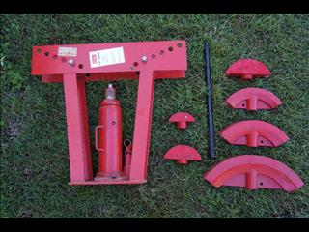
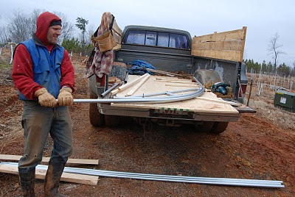
Notes:
For growers that insist on making their own high tunnels for small structures jigs can be made to bend the pipe. Larger structures using heavier pipe may require the use of pneumatic or hydraulic pipe benders.

Slide 9
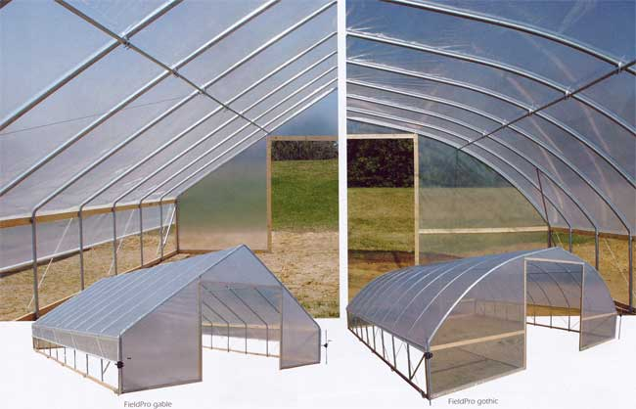
Prefabricated
Notes:
For most growers the purchase of a prefabricated structure is the best choice.

Slide 10
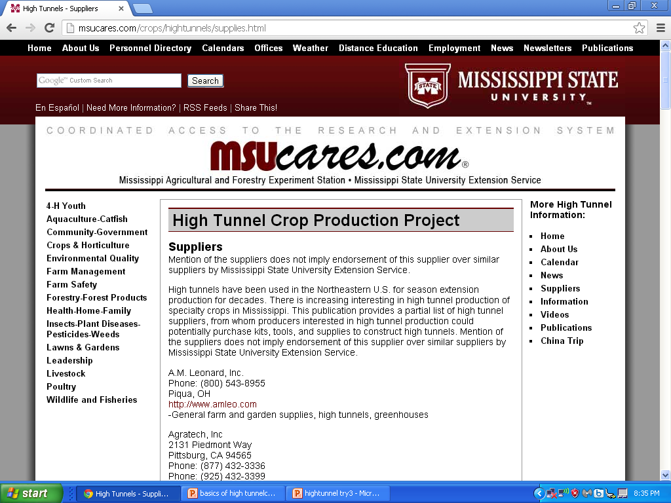
Notes:
There are many manufacturers high tunnel structure the list at MSU shows the name and contact information for over thirty vendors. Those participating in the EQUIP program will want to check with NRCS to determine vendors and structures that are approved in their state.

Slide 11
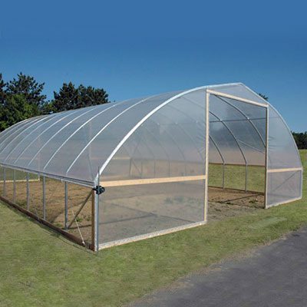
Gothic
Notes:
There are 3 common styles of greenhouses and high tunnels. The gothic style is designed to shed snow better than a quonset type house.

Slide 12
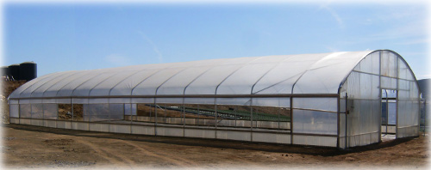
Quonset
Notes:
Quonset style high tunnel are common. They should ideally have a straight sidewall rather than being ground to ground. The sidewall allows use all the way up to the edge and allows for ventilation when the sides are opened.

Slide 13
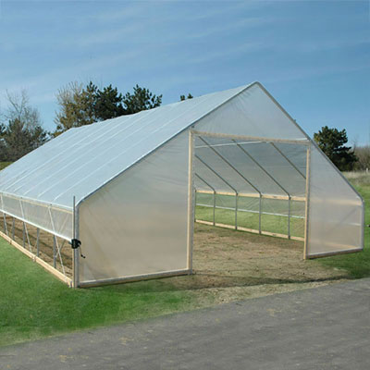
Gable
Notes:
Gable style houses should offer the most snow shed as they typically have a high pitch.

Slide 14
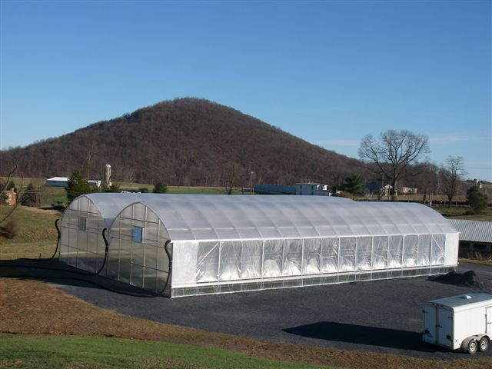
Gutter Connect
Notes:
In addition to single bay high tunnel there are also gutter connected structures. These structure offer more protected square foot inside with less square footage of exterior wall for heat loss. When you compare two 30’ x 96’ structures with a gutter connected 60’ x 96’ assuming a 6’ tall sidewall because we have eliminated two extertior walls there is 1152 square foot less exterior wall for heat loss. The example above is showing gutter connected gothic style structures.

Slide 15
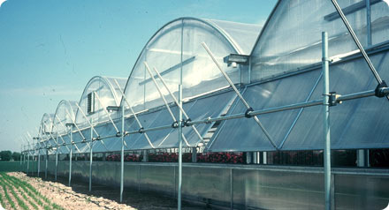
Notes:
This is an example of a multi bay gutter connected quonset style house. Sometime referred to as barrel style.

Slide 16
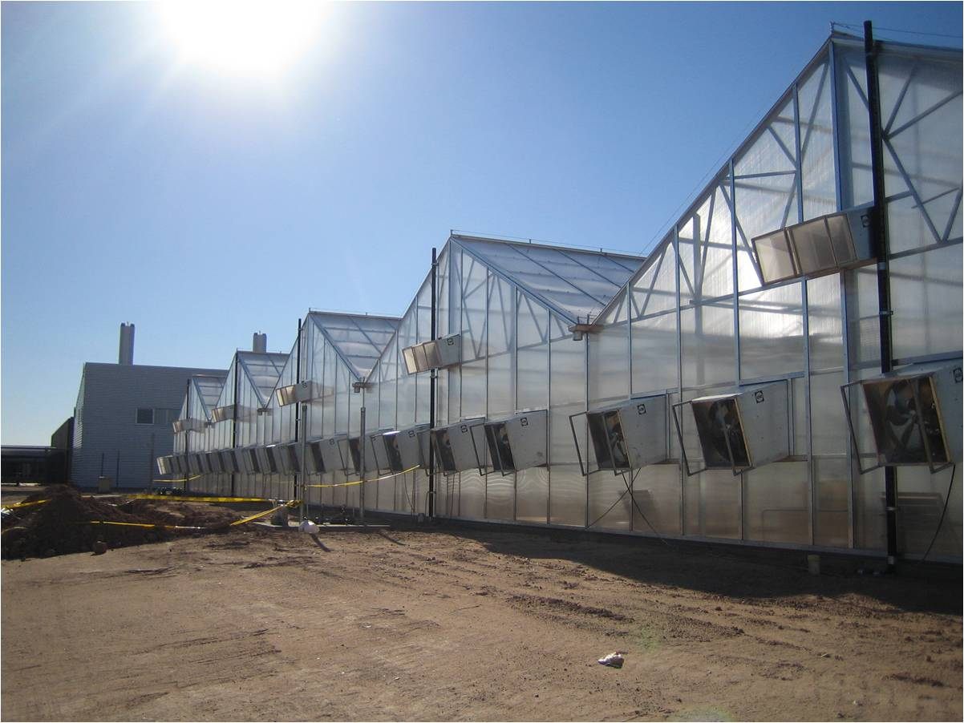
Notes:
Gutter connected gable style high tunnels are also available.

Slide 17
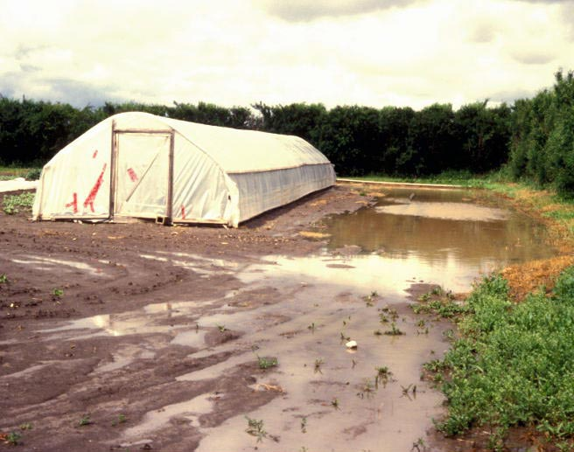
SITE SELECTION
Notes:
Choose a site with good drainage. This is not a good site for a high tunnel.

Slide 18
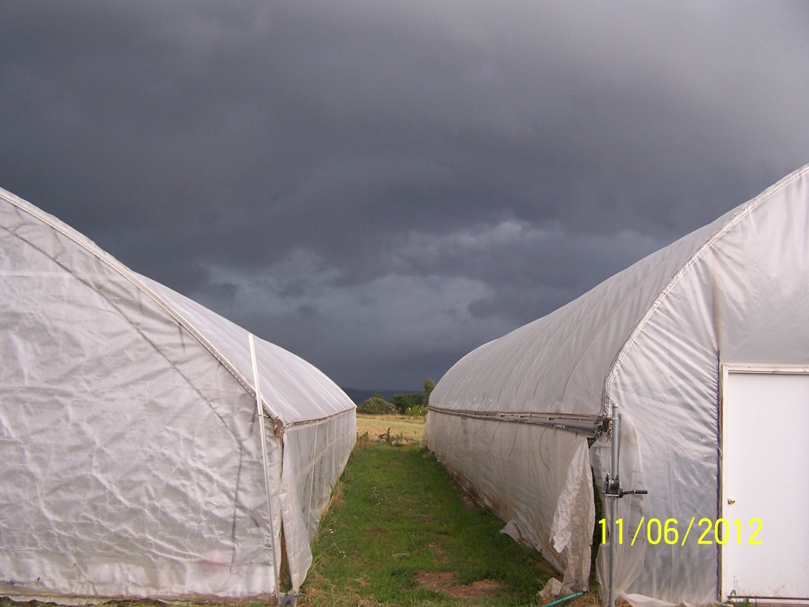
Subject to forces of nature: wind or snow damage
Notes:
Remember that these are subject to forces of nature. Problems can occur at any time of the year. Choosing a site that is well protected can unfortunately be a double edged sword. While it may protect from high winds with a thunderstorm it may also block summer prevailing breezes needed to keep the tunnel cool.(or at least less hot)

Slide 19
Notes:
Tunnels can be damaged in an instant by high winds.

Slide 20
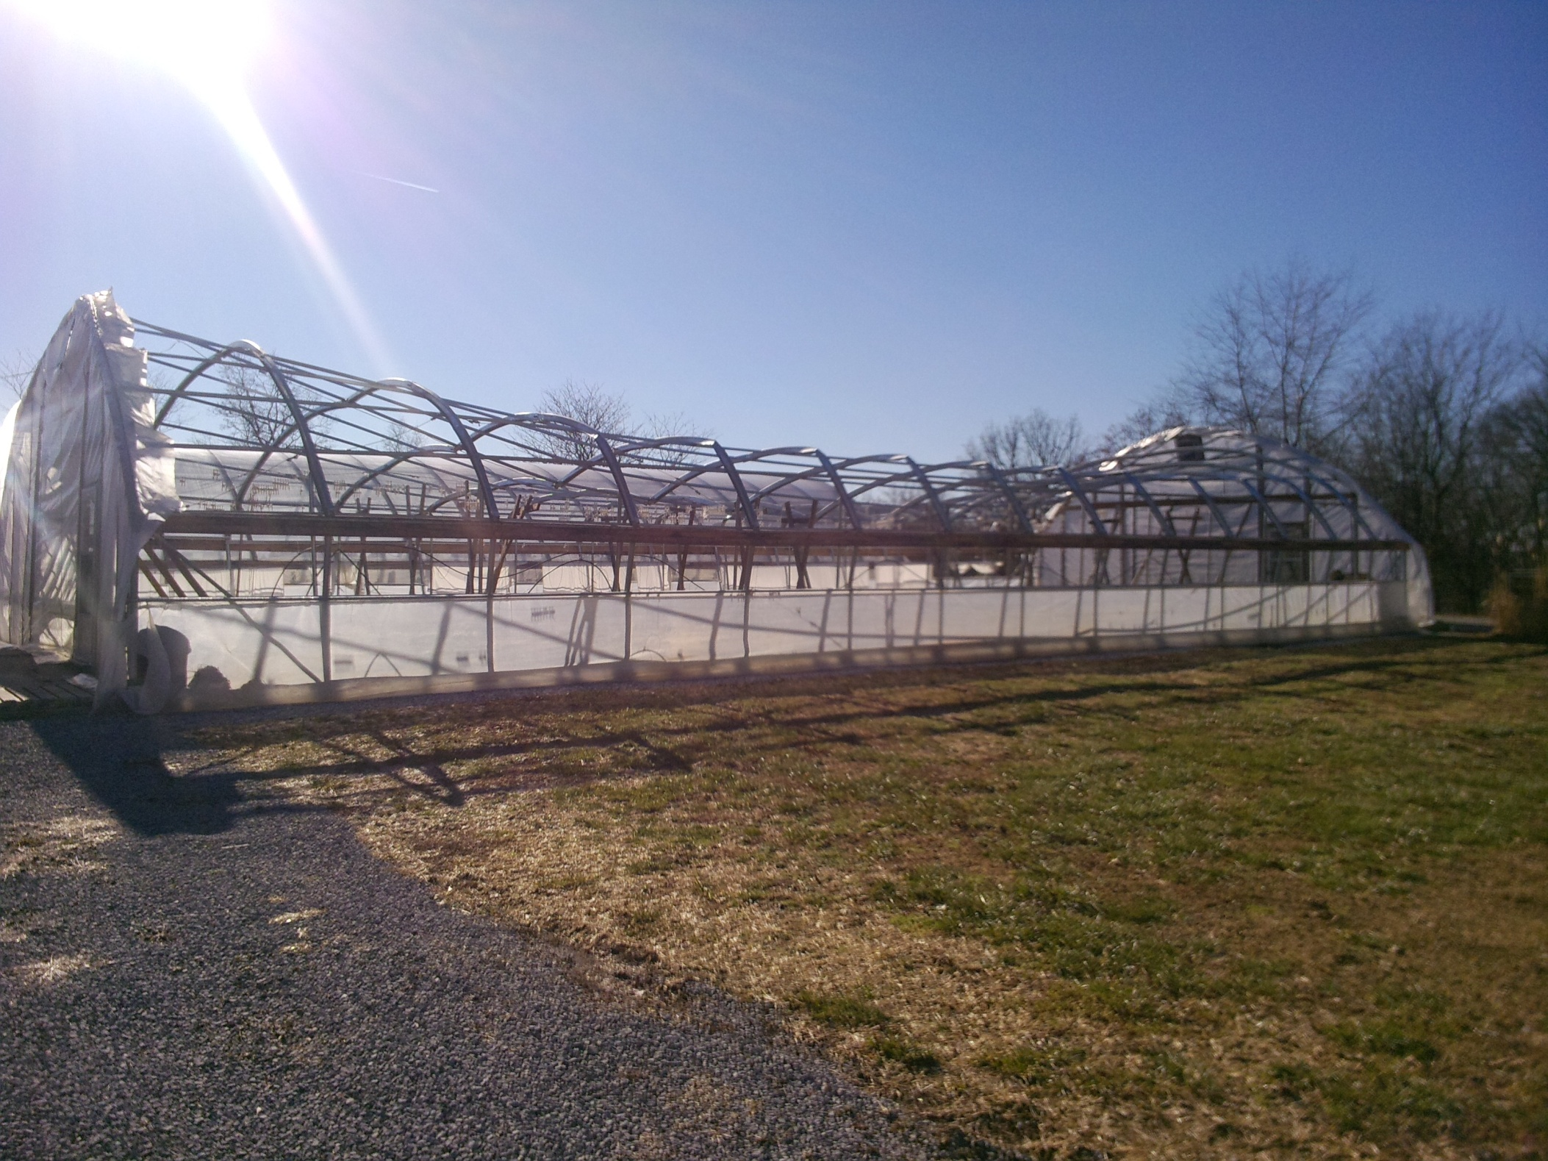
Notes:
They can also be damaged by accumulated snow and/or ice.

Slide 21
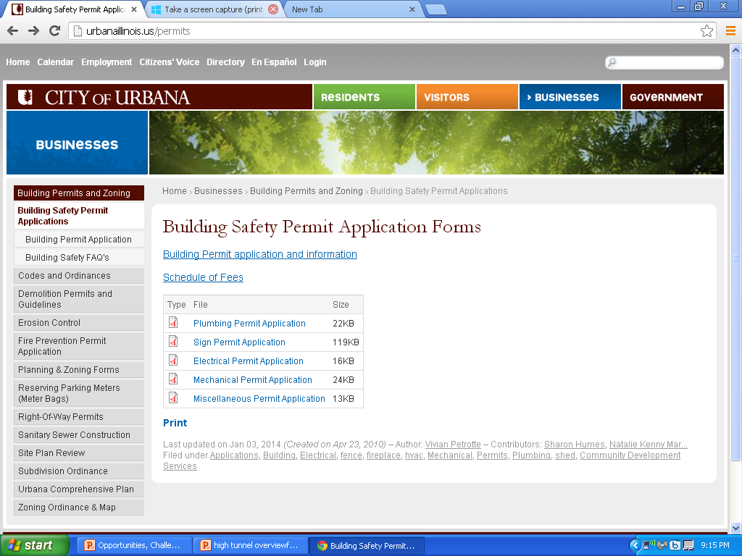
Urban growers need to check local zoning ordinances and building laws
Notes:
Growers need to check with their township city and county for any ordinances that may be relevant and to obtain any permits that may be required. This needs to be done before you order a tunnel and find out you will not be allowed to erect it on the site you had planned.

Slide 22
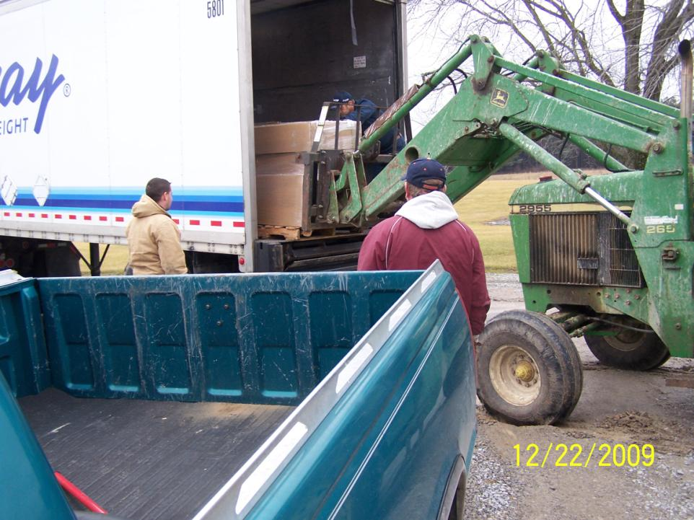
Notes:
The high tunnel will arrive by tractor trailer and ideally you should have equipment such as a 70hp+ tractor with front end loader and forks. It can be unboxed and offloaded by hand but things can get lost, it takes a long time, and it makes for a mad tractor trailer driver.(sometimes really mad)

Slide 23
Pieces and Parts
Notes:
There will several boxes filled with parts ranging in size from really big to really small. There are almost never any parts you do not need so don’t lose any.

Slide 24
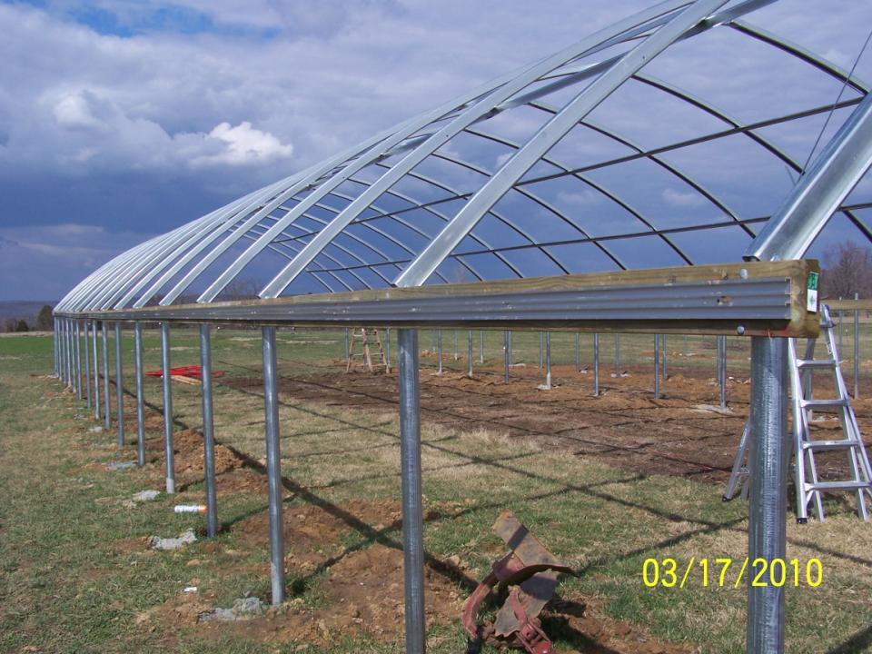
Purlins
Bows
Hip Board and Wiggle Wire Extrusion
Ground Post
Notes:
This is high tunnel anatomy 101. Ground post are straight pipes that form the sidewalls of the structure. Bows form the arch and are connected to corresponding ground post on either side of the tunnel. Purlins attach to bows and provide rigidity to the structure. A hip board is normally supplied by the owner and not part of the kit. In a few cases the hip board may be a metal and supplied with the tunnel but more often than not this is not the case. An extrusion is commonly attached to the hip board which in conjunction with wiggle wire is what will hold the plastic that covers the tunnel in place.

Slide 25
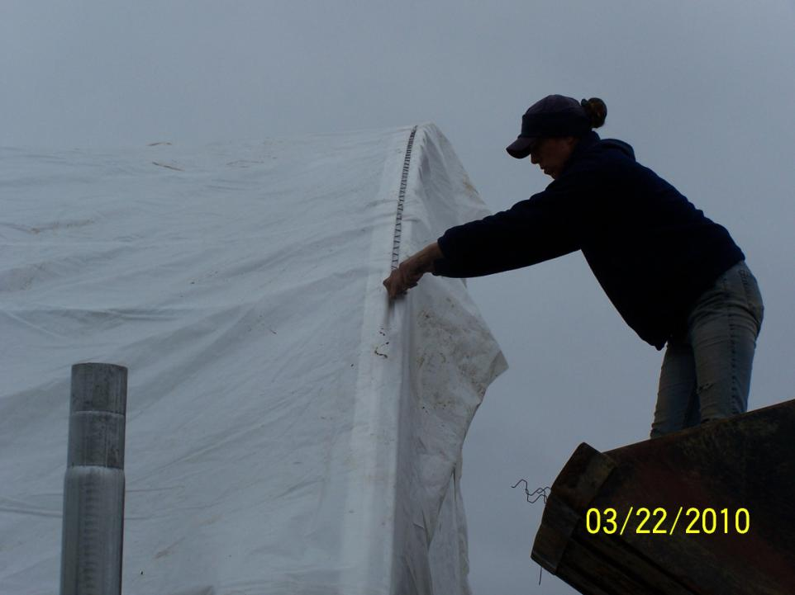
Notes:
This is wiggle wire being installed to hold the plastic in place on the structure.

Slide 26
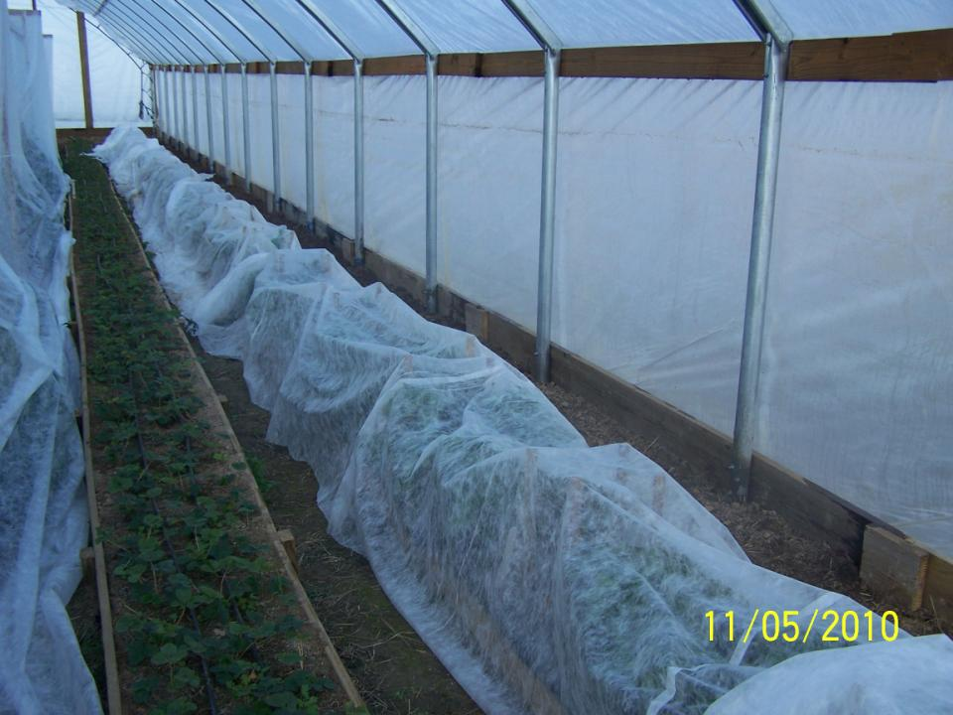
Notes:
In addition to the hip board shown earlier, growers normally need to also supply a base board visible here. Organic grower should note that they may not use treated lumber for the hip and base boards.

Slide 27
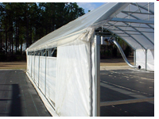
Notes:
High tunnels have sides that can be opened or closed to provide ventilation. This is an example of a drop down curtain.

Slide 28
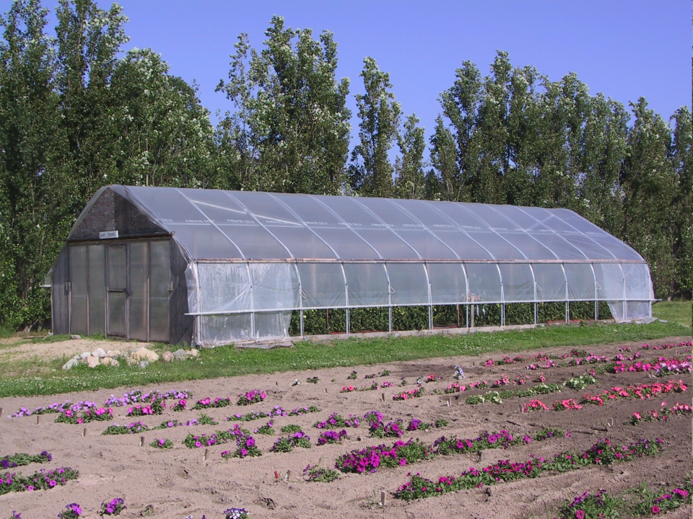
Notes:
In contrast to the drop down curtain seen in the previous slide this is a roll up curtain. There are advantages and disadvantages to both types but the grower must choose one or the other.

Slide 29
Bow spacing usually 6’ or 4’
Bows
Ground Post
Notes:
The ground posts and bows are commonly spaced at 4’ or 6’ although other spacing can be found.

Slide 30
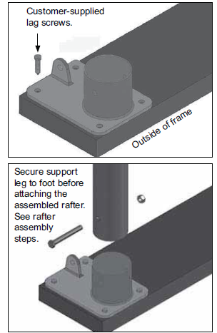
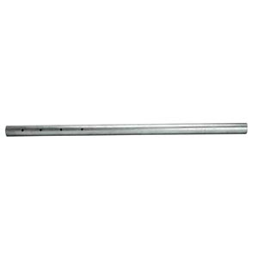
Anchoring
Notes:
The ground posts are held in place most commonly by one of three methods. The left picture is a short piece of pipe (normally around 3’) that is pounded into the ground with a sledgehammer. While cheap and perhaps easy not always the most affective at keeping your structure where u last left it. The middle picture shows a foot that the ground post sits in and is secured. This is common employed where a grower is putting up a structure where there is existing concrete. Old confinement hog house operations are typical examples of where this would be used in Illinois. The right hand picture shows 8’ ground post that are set 2’ below grade in 42” of concrete. They result in a 6 foot sidewall.

Slide 31
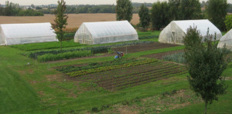
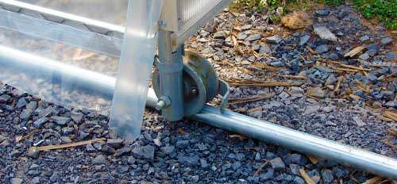
Moveable
Notes:
There are also moveable tunnels. Although far less common than stationary tunnels they can be used in a fashion that a single tunnel may provide protection to three separate sites and crops. In some cases these tunnels roll along fixed pipe and in other cases tires are placed along the structure it is moved and then the tires are removed. Once in place these are often pinned into place using large steel stakes or rods.

Slide 32
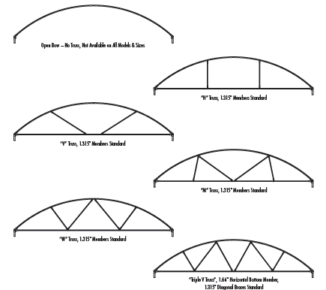
Notes:
One additional consideration for your high tunnel is the bow configuration. Cheaper tunnels tend to have open bows and more expensive ones have some type of trussing. Here are some common truss configuration list in order of strength. Trussing is important in areas of high snow load or if the grower in planning on placing dead load on the structure by trellising to it or growing plants suspended such as hanging baskets.

Slide 33
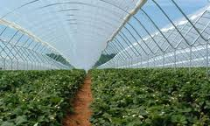
Notes:
This is an example of a tunnel that has a very low load capacity. Plastic need to be removed every winter because it is not capable of supporting and snow load.

Slide 34
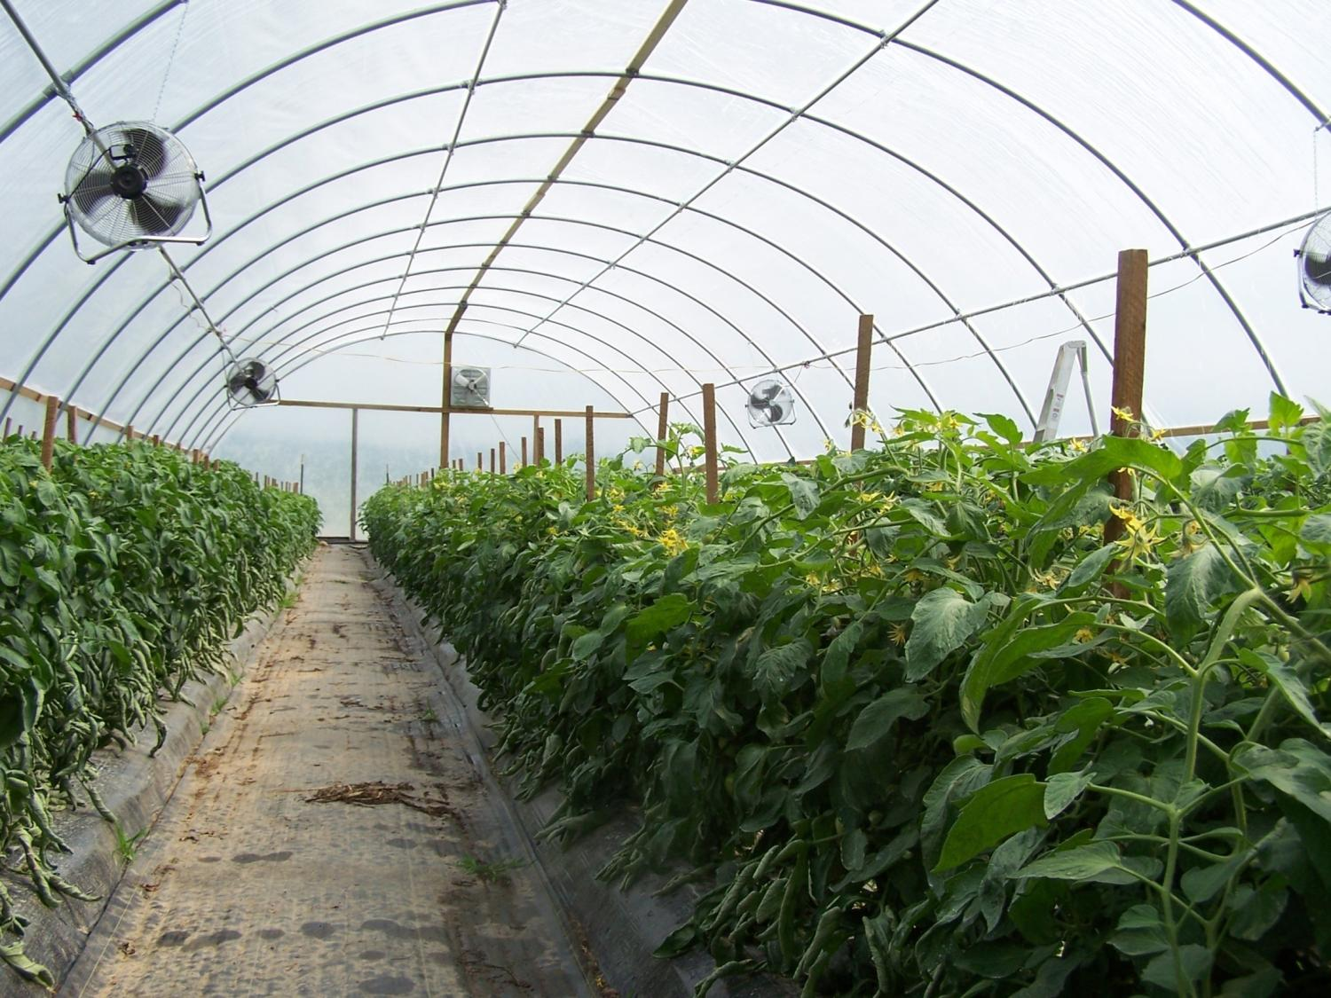
Notes:
Here is an example of a tunnel that had four purlins but no ridge purlin. The almost always leads to problems. You can see the grower has fashioned 1” x 3” into a center perlin.

Slide 35
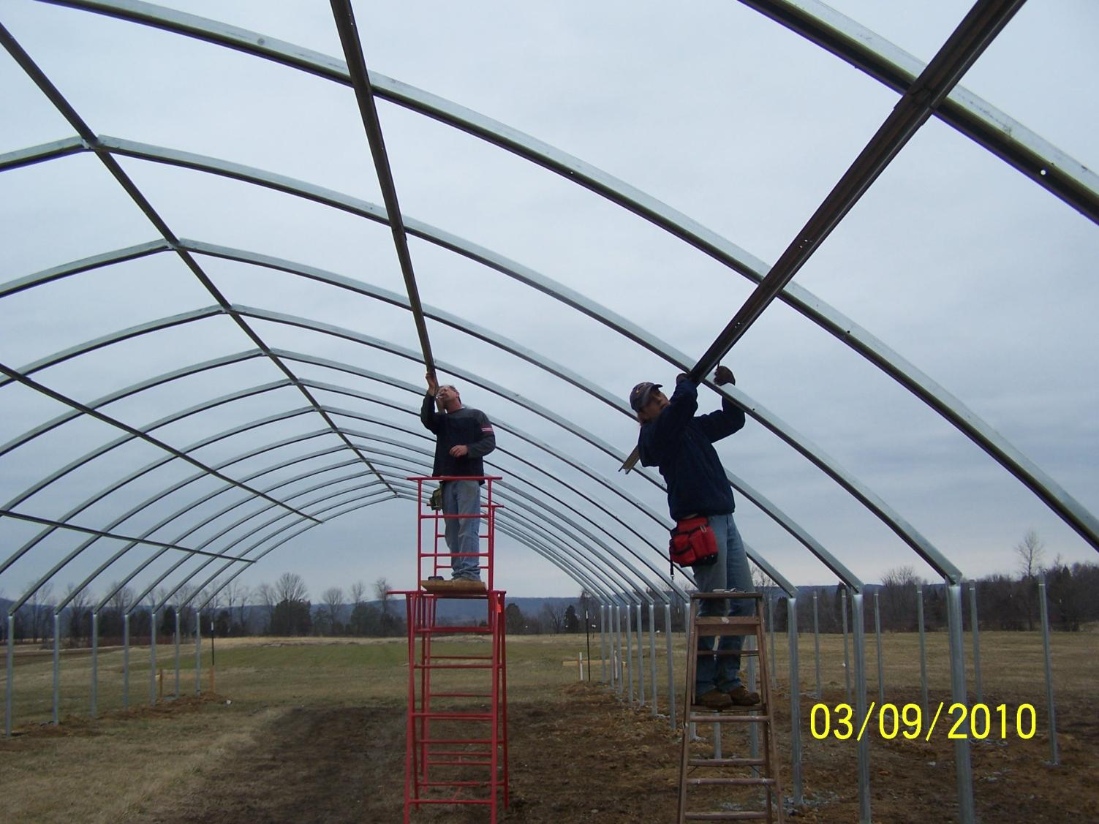
Notes:
In general, there should be a ridge perlin and typically more perlins lend to greater durability of the structure.

Slide 36
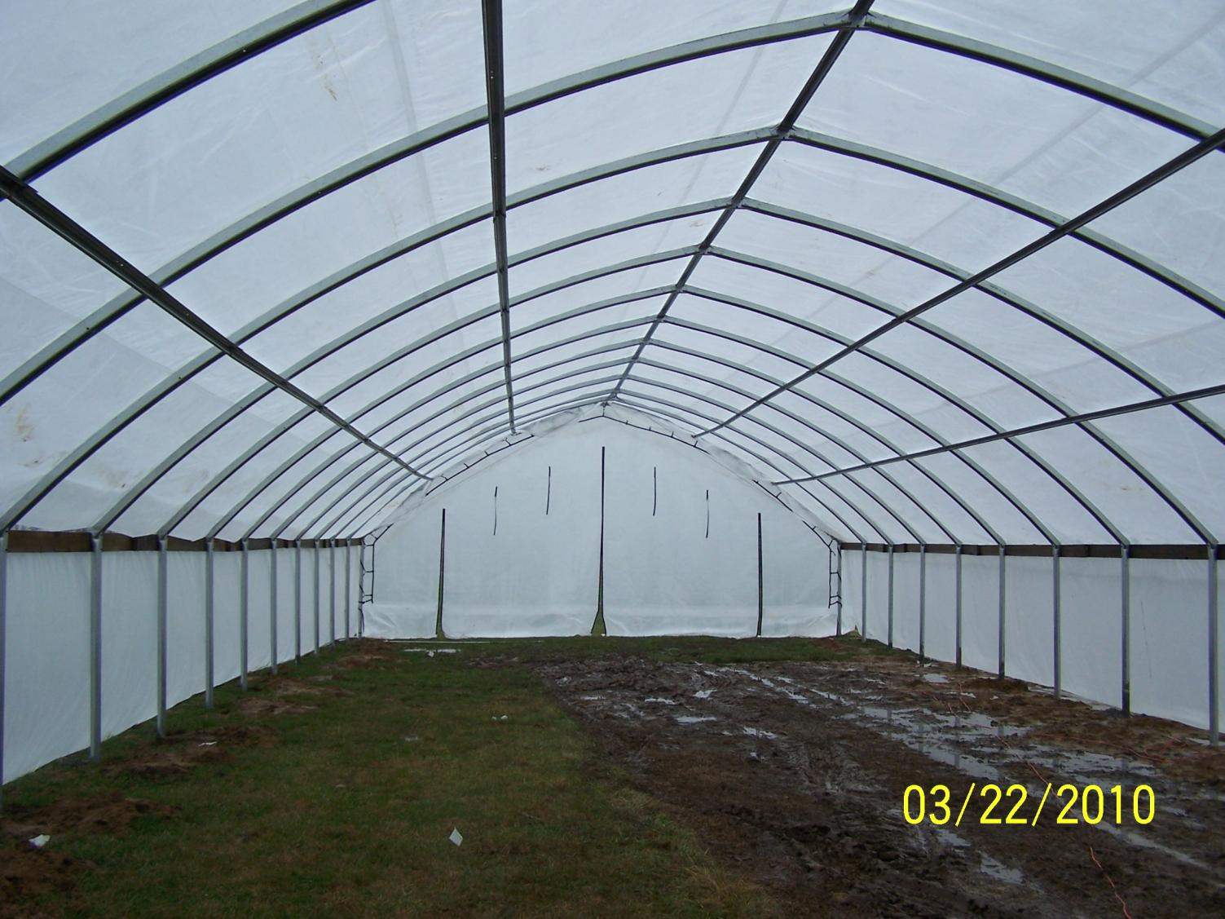
Notes:
Open bow high tunnel

Slide 37
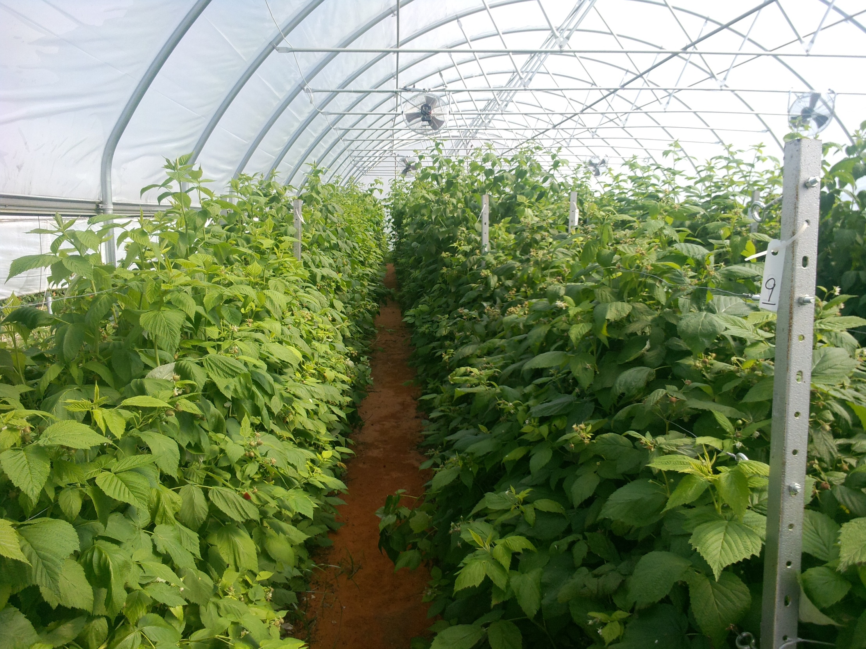
Notes:
High tunnel with a W truss.

Slide 38
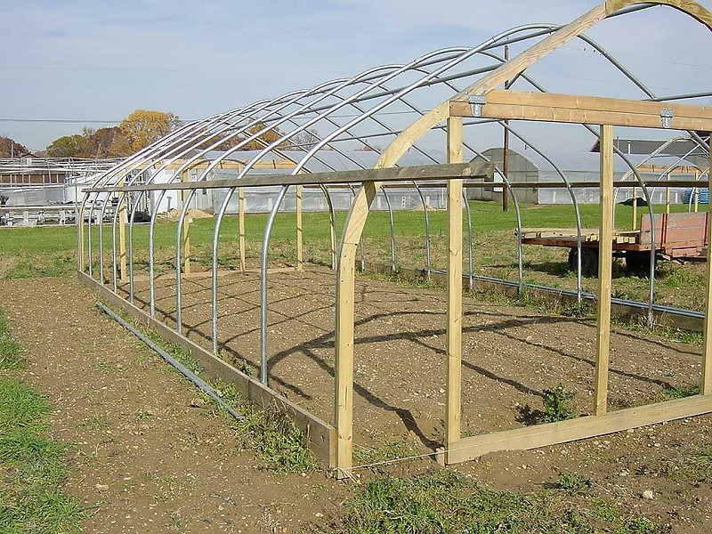
Notes:
End walls are not normally a part of the high tunnel package itself. They may often be purchased as a separate kit or growers may construct their own. The end wall construction is very important although not always well done by the grower. In this case the end walls appear quite durable and have been constructed with wood.

Slide 39
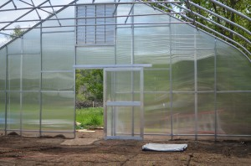
Notes:
Steel or aluminum material can also be used for end wall construction

Slide 40
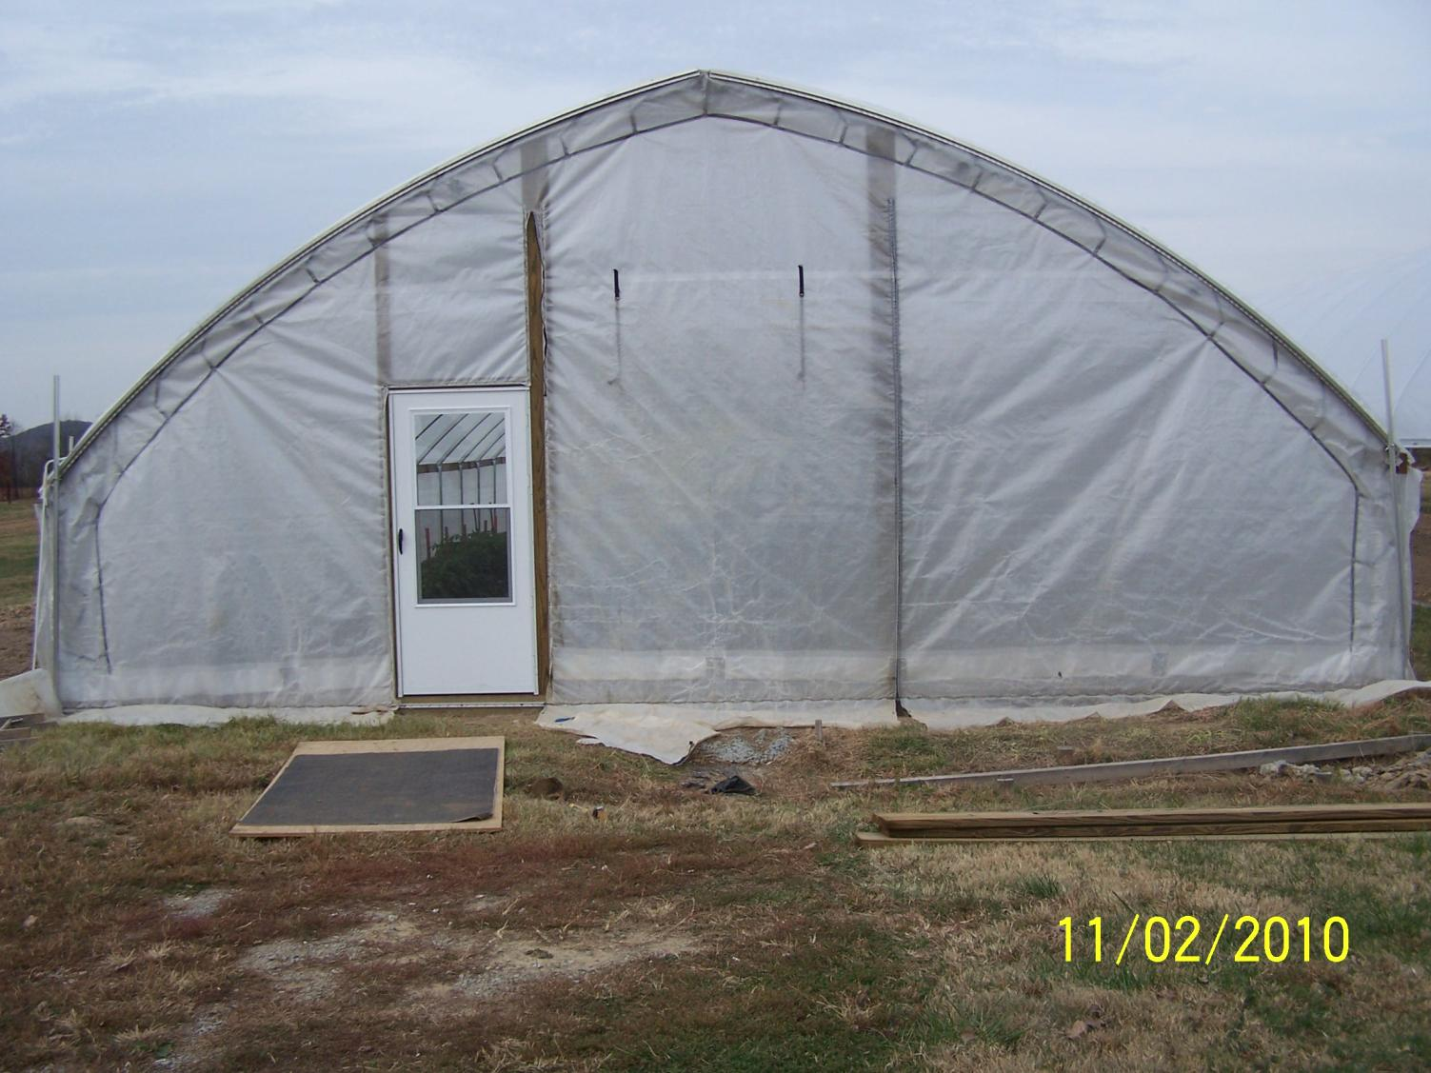
Notes:
Here is an example of a tunnel without adequate end wall support. There are only three uprights across a thirty foot span.

Slide 41
Glazing
Notes:
The material used to cover a high tunnel is referred to as glazing.

Slide 42
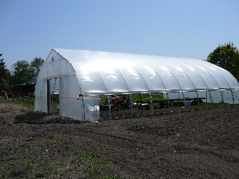
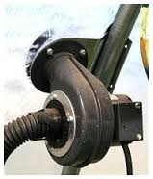
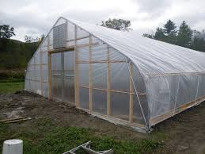
Poly
Notes:
Polyethylene is most commonly used because of its lower expense. It may be installed in a single layer or growers may install two layer and use a small inflation fan to blow air between the two pieces. Double inflated poly as this is commonly refered to offers a much higher R value (level of insulation) and may help reduce condensation.

Slide 43
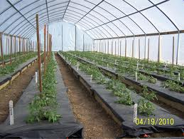
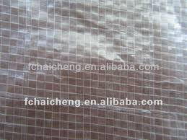
Cloth or Fabric
Notes:
Greenhouse cloth or fabric is also a fairly common glazing material for high tunnels. It may be more durable than poly and also offers a higher R value than single poly.

Slide 44
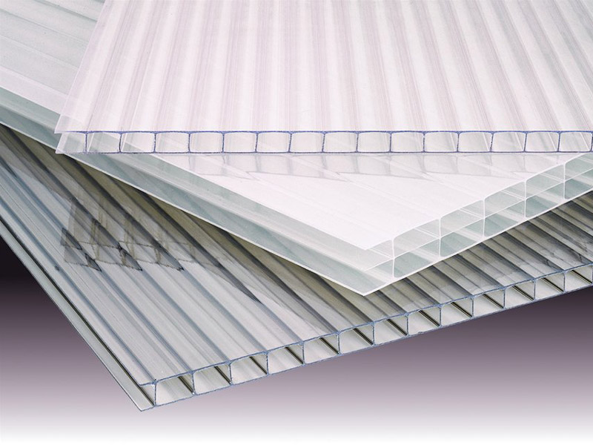
Polycarbonate
Notes:
Polycarbonate is a very durable high R value material that is used only sparingly for high tunnel because of its expense. When used on high tunnels it is normally used as material for covering the end walls.

Slide 45
Construction

Slide 46
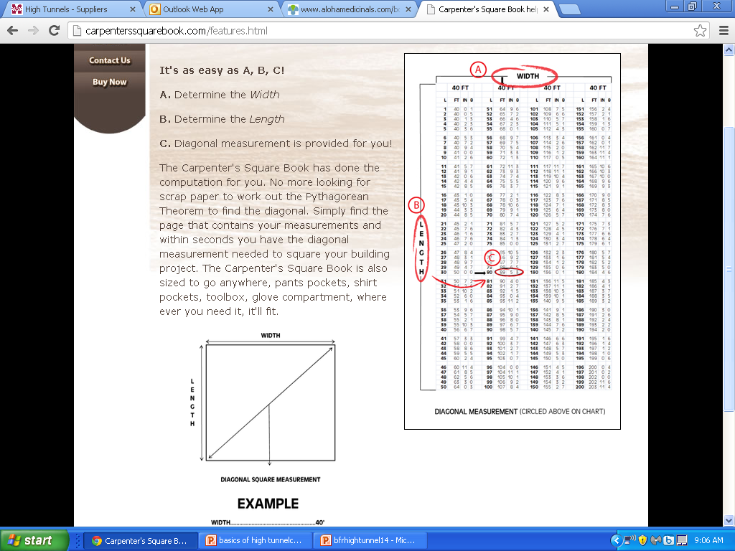
Notes:
Before you begin, first determine length of the diagonal based on the size of your structure. Either crank it out with the pathagareun theory, or my personal choice, look it up on a chart like this one.

Slide 47
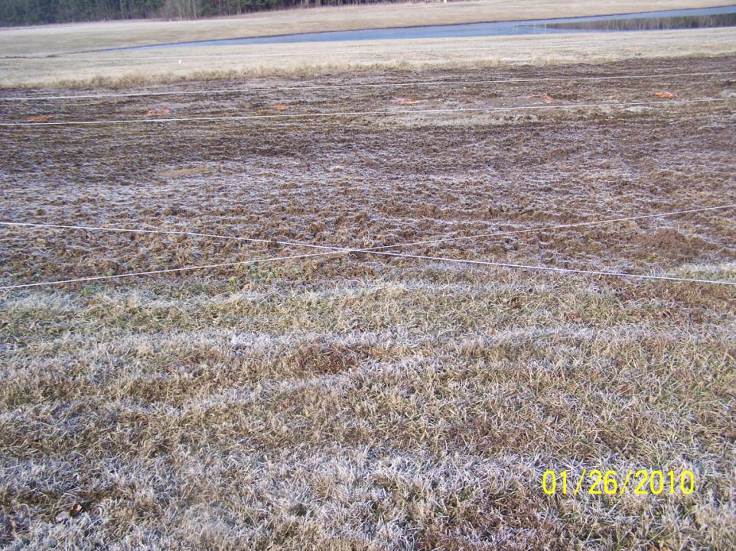
Notes:
We find it helpful to then get 6 pieces of string , two each cut to length for the width and length and diagonal measurements for your particular high tunnel. The are then attached to four stakes. When the strings are drawn tight the footprint of the building is easily discernable. This is useful to making subtle shifts in where the building will sit prior to construction of the batter boards. This is really a helpful step for those not in the habit of siting buildings.

Slide 48
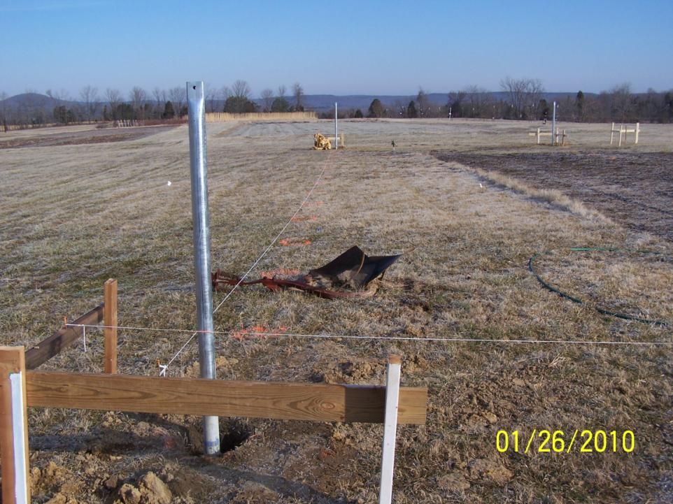
CONSTRUCTION
Notes:
Once you have figured out EXACTLY where you want the structure construct a set of batter boards in each of the four corners.

Slide 49
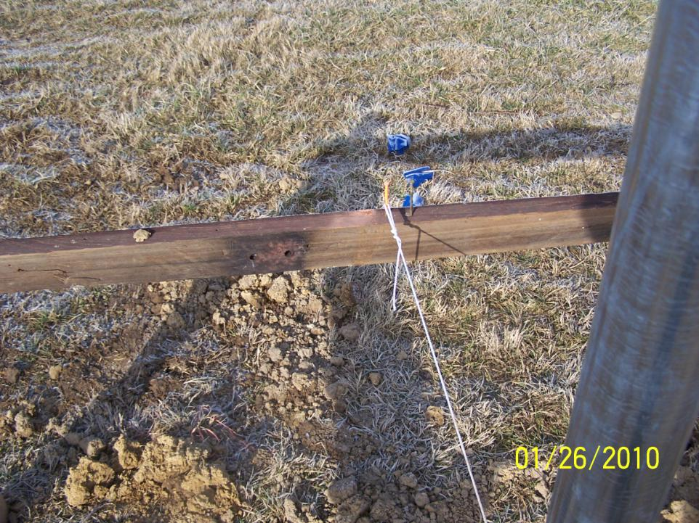
Notes:
Two nails are placed in each horizontal board. One at the exact dimension of the structure and on offset by ½ the diameter of the pipe used for the sidewalls. These are CRITICAL measurements and must be done without slack in the tape measure. Once the nails are in place a string is stretched between the nails and pulled as tight as possible to form the exact footprint of the building. This string is first places on the nails representing the actual dimension not the offset.

Slide 50
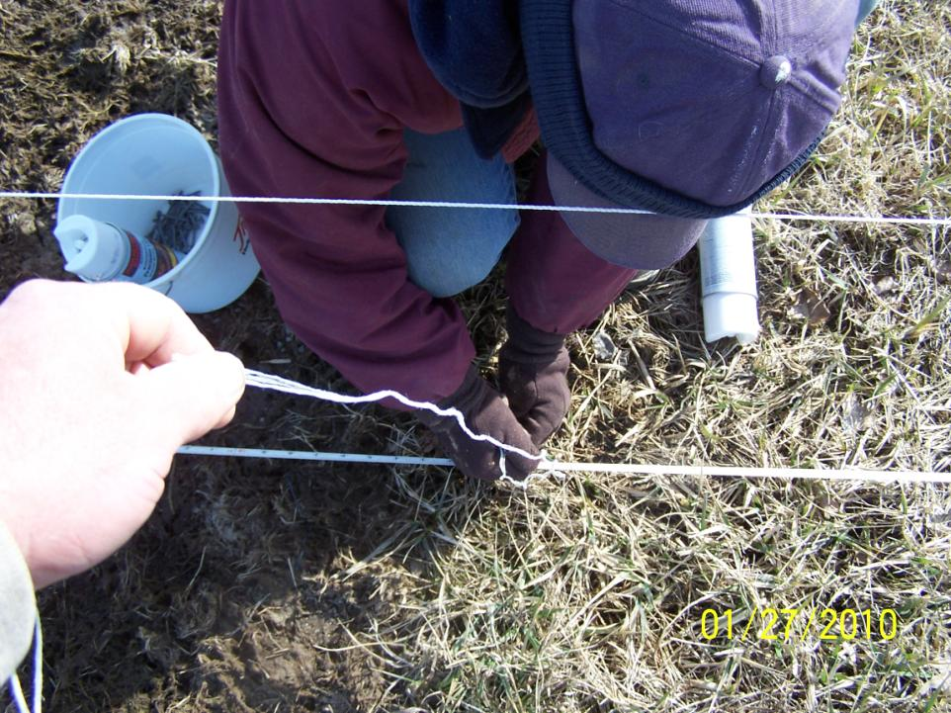
Notes:
At this point the holes for all of the ground posts are marked. The corner post is located at the intersection of the stings. Subsequent posts spacing along the length of the building are marked by tape measure and the width is marked by dropping a plum bob from the string attached to the batter boards. We used roofing nail to mark the exact location.

Slide 51
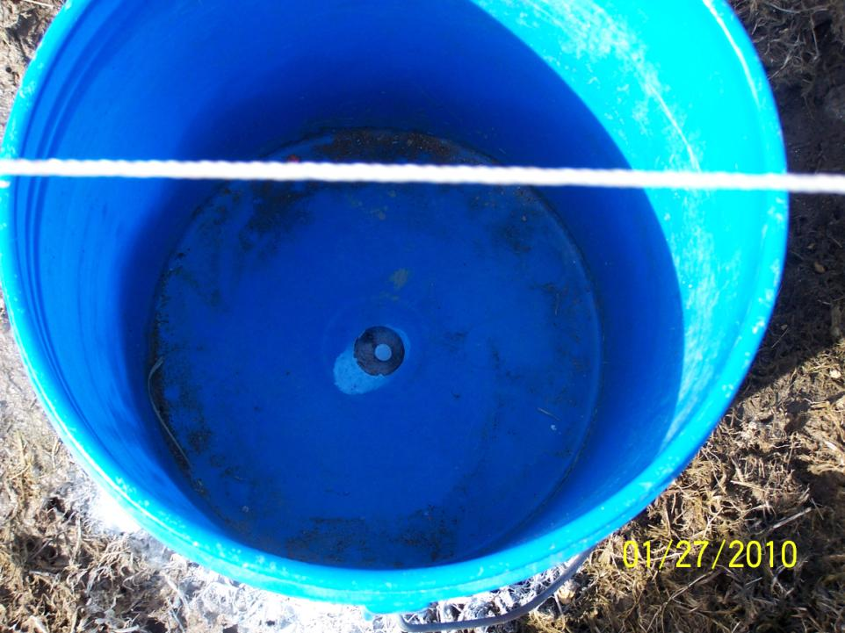
Notes:
Once the roofing nail is in place we used a handcrafted device made from an old five gallon bucket as a marking stencil. The middle of the bucket which has a hole in it is placed directly over the nail.

Slide 52
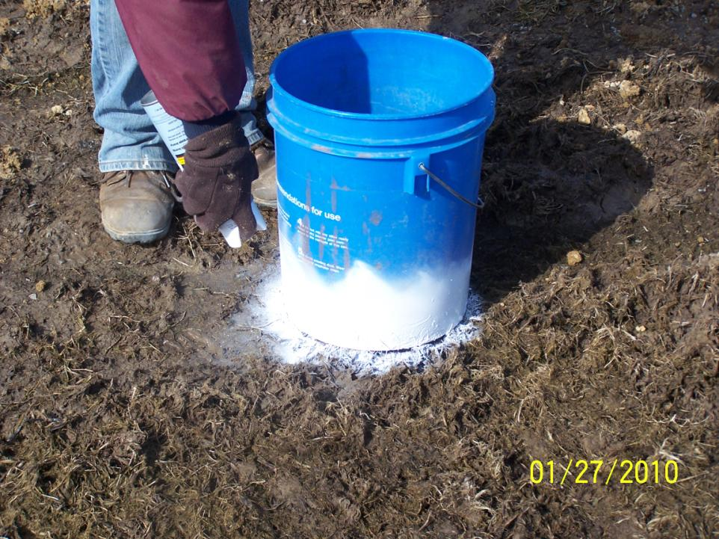
Notes:
The center and outside are then marked using spray paint.

Slide 53
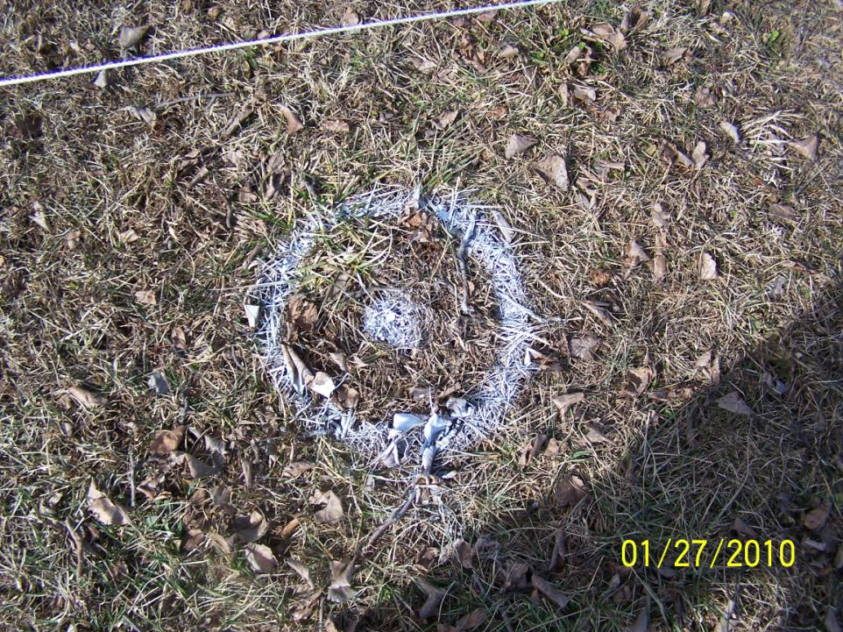
Notes:
The result is a bullseye which allows for easy alignment of the post hole if you are using ground posts that will be in concrete. If you are using ground post that will be driven into the ground then you are now ready for that step.

Slide 54

Notes:
For concrete buried ground posts you are not ready to dig the holes. Typically a 42” deep hole is recommended by the manufacturer. Existing utilities MUST be located before this step to avoid hitting them.

Slide 55

Notes:
Once the hole have all been dug the strings are shifted on the batter board to the ½ the diameter of the pipe offset position. The point where the strings cross now is the EXACT location of the corner posts outside walls.

Slide 56

Notes:
Corner posts are set using hand mixed concrete. They are plumbed in both directions and set at the correct depth to obtain the height desired for your site. These are set using hand mixed concrete so that you have all the time you need to get these post set at the correct height and make certain the are in the correct location and plumb. It is CRITICAL these be right.

Slide 57

Notes:
Once the corner post have been given time to set. Then stings are placed as seen to mark post height and location. Spacing can also be marked by placing tape or marker on the string at the appropriate intervals.

Slide 58

Notes:
Posts are all set in concrete normally delivered by truck rather than hand mixed.

Slide 59

Notes:
Once the posts have cured the bows are assembled and hoisted in place. This can be done with a front end loader or high lift. The first bow is normally held in place with a rope until three or four bows have been put in place and the center purlin attatched.

Slide 60

Notes:
Much of the work will occur high in the air requiring scaffolding or a cherry picker.

Slide 61

Notes:
ALL bolts should be placed facing the same direction to reduce chances of damaging polyethylene cover that will be installed later.

Slide 62

Notes:
The last bow is always the prettiest.

Slide 63

Notes:
After the bows are all in place then the remainder of the purlins are installed.

Slide 64

Notes:
All sharp corners must be covered with duct tape to prevent damaging the cover that will be installed.

Slide 65

Notes:
If you are using a kit that has a curtain type end wall covering like this FarmTek house the are lashed onto the end bows and then the extrusion for holding the wiggle wire is being installed here.

Slide 66

Notes:
It is noteworthy that while the wind may not blow all summer it will blow every day you are building your high tunnel. It will also blow anytime you are trying to install the cover.

Slide 67
Notes:
Once the cover has been pulled into place over the bows it is then attached using wiggle wire as seen here. The large cover is normally pulled tight by two individual working at opposite ends of the structure starting at the center and then working down while pulling the cover tight between them as they go.

Slide 68

Notes:
This is the person on the opposite end working to keep the cover tight and attaching it with wiggle wire.

Slide 69


Perimeter Drain
Notes:
At some point during the construction a perimeter drain system can be installed. These are normally required for EQUIP participants and are a good idea for everyone. There is a great deal of watershed from these structures and a drain to carry it away helps to keep it from running into the structure.

Slide 70

Notes:
Interior of structure just after installation of cover.

Slide 71

Notes:
Once ground has dried it can be worked.

Slide 72

Notes:
Some growers use raised beds constructed by hand, some use tractor mounted equipment to make raised beds and still others may opt to make permanent constructed beds.

Slide 73

Notes:
Permanent beds can be worked with small gas or electric powered tillers.

Slide 74
Fertility
Cropping cycle often shorter so care with organic or slow release fertilizer
High density should impact fertilizer recommendations ….. But how???
Small raised beds require careful calculations and measurements
Salt buildup can occur
Normally split between preplant and fertigated
Notes:
When working beds any fertilizer that may be required is commonly incorporated. Fertilizers will be covered next month.

Slide 75


Slide 76


Slide 77

Notes:
Once worked beds are screeded.

Slide 78

Notes:
Then two drip tapes and black plastic mulch is installed.

Slide 79

Notes:
Plants are normally set by hand. Bulb planters like seen in Julie’s hand are commonly used to make the planting hole for this operation.

Slide 80
Spacing issue
Tunnels are vital real estate
  Tight spacing needed for high yields
  Tighter spacing can increase insect and disease problems
Tighter spacing may impact cultivar performance
Notes:
Spacing of plants within the high tunnel is often tighter to allow more plants within the given area.

Slide 81

Notes:
Tomatoes after planting.

Slide 82

Notes:
Early planting of frost sensitive crops requires the use of row covers within the high tunnel.

Slide 83

Notes:
A light weight row cover protected all but the north most plant in these rows when outside night time temperatures dipped to 16 degrees F.

Slide 84
Training and Trellising
The value of the space dictates careful consideration of training systems
Cultivar selection may predicate the type of training system i.e. tomato
  Determinate
  Indeterminate
Notes:
While tomatoes commonly are trained regardless of whether they are raised in a field or in the high tunnel many crops like cucumbers and peppers are commonly trained inside the high tunnel even though they are not normally trained when field raised.

Slide 85



Notes:
Various trellised crops in a high tunnel.

Slide 86

Notes:
Many tunnels are not capable of supporting the load of the crop being raised so free standing trellises are often required.

Slide 87
Notes:
Trellised indeterminate tomatoes are show growing in a high tunnel.

Slide 88

Notes:
Raspberry and cucumber trellis being used in a high tunnel.

Slide 89

Notes:
A high tunnel with both determinate staked tomatoes and trellised indeterminate tomatoes.

Slide 90

Notes:
A single 90’ row of indeterminate tomatoes can weigh 2000 pounds.

Slide 91




Pollination
Notes:
Many crops raised in the high tunnel require either wind or insect pollination. Providing a mechanism for pollination such as bumble bees, electric vibrating pollinators or even leaf blowers may increase yields. This is especially true for early production when pollination will be occurring when the tunnel in not open for ventilation.

Slide 92

Notes:
Some crops will completely fail to produce if pollination needs are not addressed.

Slide 93

Notes:
While the high tunnel environment tends to greatly reduce the number and severity of pest problems it will typically not eliminate all of them. Pesticide applications for both organic and non organic growers is a common practice.

Slide 94

Notes:
This is a steam generator that is being used in research projects by the University of Illinois.

Slide 95

Notes:
Steam can reduce weed and soil borne pathogen very effectively.

Slide 96
IRRIGATION
Notes:
As it does not ever rain in the high tunnel, irrigation is extremely important.

Slide 97
Irrigation
Likely used to deliver fertilizer
High density and warm temperatures can result in relatively high demand particularly as crop is maturing….some growers will use twin tapes
Needs to be MANAGED otherwise still may experience BER and cracking

Slide 98


Notes:
Irrigation management should involve tools such as tensiometers shown here to help the grower better manage oil moisture.

Slide 99

Ventilation & Circulation
Notes:
Temperatures within the high tunnel are most commonly controlled by opening the sidewalls to allow heat to escape. The temperature at which ventilation should begin varies by crop and weather conditions. Ventilating a tunnel at too low of a temperature can cost the growers plant growth and delay early harvest. Failing to ventilate in time can result in loss of yield and even plant death. Many growers will also install fans in the high tunnel like those shown here to provide air circulation. Air circulation helps to control humidity and also keeps the temperature more uniform throughout the house.

Slide 100

Shadecloth
Notes:
Many growers are using shade cloth in late July and August to help reduce temperatures inside the high tunnel.

Slide 101
Hydroponic Production
Plants grown without soil
Allows production on sites with contaminated, poor or no soil.
Soil pathogens not a factor
Early yields
Large yields
Quality produce
Notes:
Although a small percentage of growers in Illinois are currently using hydroponic production systems interest and adoption of this method is increasing. It is well suited where there are soil problems or no soil such as if the high tunnel is on a concrete slab. Because there is no soil used in this system soil pathogens are seldom a problem and the system boasts rapid crop growth and development. The produce harvested tends to be high yielding and high grade out of above average product.

Slide 102

Notes:
Hydroponic strawberry production in Pope county Illinois

Slide 103

Notes:
Hydroponic tomato production in Union county Illinois.

Slide 104


Slide 105
If you have questions …
University of Illinois Extension Local Food Systems and Small Farms team
  http://web.extension.illinois.edu/smallfarm/
USDA’s Start2Farm site
  http://www.start2farm.gov/
Notes:
Our beginning farmer training program ended in the fall of 2015. The best way to pursue answers to questions about fruit and vegetable production in Illinois is to contact educators on the University of Illinois Extension Local Food Systems and Small Farms team. Extension programs in other states are operated by the land-grant university in each state. Additionally, USDA’s Start2Farm site provides listings of farmer training programs in specific states and localities.

