Slide 1
Preparing a New Generation of Illinois Fruit and Vegetable Farmers a USDA NIFA Beginning Farmer and Rancher Development Program Project Grant # 2012-49400-19565 http://www.newillinoisfarmers.org
Notes:
The following presentation was part of a beginning farmer course, “Preparing a New Generation of Illinois Fruit and Vegetable Farmers,” offered by the University of Illinois and the Illinois Migrant Council from 2012 through 2015. This course was funded by the United States Department of Agriculture’s National Institute of Food and Agriculture, and specifically by the Beginning Farmer and Rancher Development Program. For more information about the program and for links to presentations and resources on many other topics, see the website newillinoisfarmers.org.

Slide 2
.
GROWING A NEW GENERATION OF ILLINOIS FRUIT AND VEGETABLE FARMERS
Converting to Year-Around Greenhouse Production: Why and How
J. D. Kindhart
February 2015

Slide 3
Converting a high tunnel
Carefully evaluate market and income potential
Evaluate crops being raised and cultural systems to be used
Add heat
Lighting?
Energy conservation possibilities
Notes:
Before deciding to convert a high tunnel to a greenhouse for longer season extension or even all year production many things should be considered. First realistically evaluate the market and income potential for the off season produce you are considering producing. Greenhouse crop production varies from field production and therefor requires growers study cultural systems used for greenhouse production of the crops they plan to raise. There are also several considerations for how you will heat your greenhouse. You will also need to consider if supplemental lighting will be required. High tunnels are typically not constructed for year round production so growers should also think in terms of energy conservation possibilities.

Slide 4
Why convert?
Year round demand?
Potential to make income?
No longer have winters off!
Notes:
Interest in even longer season extension than can be afforded by a high tunnel is increasing for numerous reasons. These may include one or more of the following: Year round demand from some types of institutional buyers like nursing homes, hospitals and others. Weighted demand for produce in all but late December and early January from institutional buyers like elementary and high schools as well as colleges and universities. Additionally, the ability to provide heat allows an insurance policy for growers that are continually pushing the envelope for how early they can plant frost sensitive vegetables in their current high tunnels. The ability to provide supplemental heat early in the growing season allows for better growth during cold wet periods often experienced in late March and early April and also allow growers to do a much better job controlling humidity levels in the spring and fall growing season.

Slide 5
Notes:
When considering the economics of greenhouse production numerous land grant institutions as well as other sources have prepared budgets that can be found by simply using an internet search engine to find greenhouse vegetable crop budgets. When looking at these sample budgets rely on those from place with similar climates. It is likely that greenhouse production in southern states likely has lower heat bills and higher production levels in winter than Illinois and conversely northern states would have higher heat bills and lower production levels for most vegetable crops.

Slide 6
Heating options
Hot water / Boiler
Boiler Types
Fire tube
Water tube
Water jacket
Fuels
Waste wood/biofuel
Waste Oil
Firewood/Coal
Gas
Unit Gas Fired Heaters
Notes:
Greenhouses can be heated in a number of different ways. Boilers, hot water heaters, and gas fired unit heaters are three common choices. They each have advantages and disadvantages. There are also considerations for what type(s) of fuel will be utilized. Greenhouses are normally not heated using a ducted central furnace like in a residential structure. Also it is common to see pollution injury to plants when growers attempt to use residential ventless propane heaters. The type of heating system and fuel(s) used need to be decided on a number of factors including purchase price, installation expenses, and yearly operational cost.

Slide 7
Heat Requirement
Hand calculation
Greenhouse volume
GH surface area
R-value of glazing
Etc.etc.etc.
Online calculators
Notes:
Proper sizing of heating units can be done in two ways. A google search of “calculating greenhouse heating requirements” will provide you with information on how to hand calculate the required BTU. Since I am not a mathematician I do not like to do the math. The same search will show you where to find calculators where you enter the parameters for your individual greenhouse (style, size, glazing material, etc) and it will determine your required BTU’s

Slide 8
R value of some common glazing materials
Single layer 6 mil poly R = 1.15
Double inflated 6mil poly film R = 0.7 Polycarbonate 10mm double wall R = 0.53
Notes:
The greenhouse covering has a significant impact on heat requirement.

Slide 9
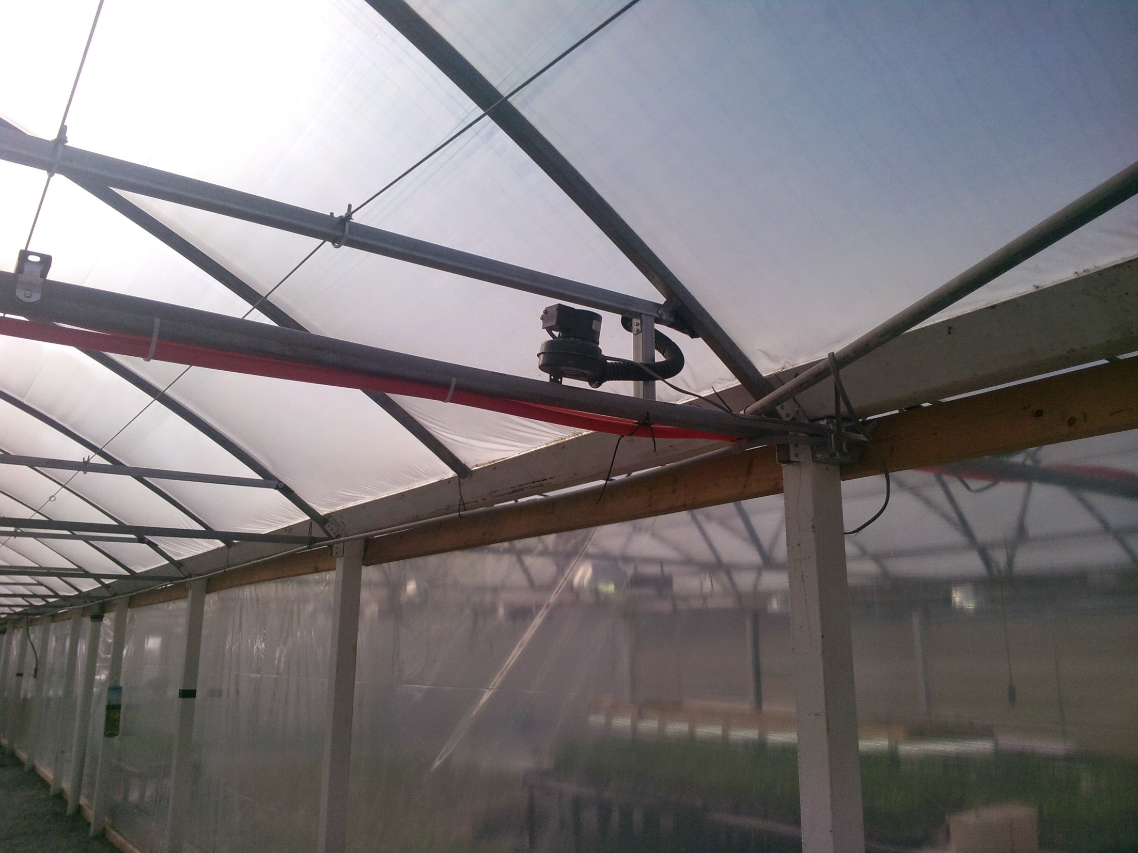
Notes:
Inflation fan for double inflated poly system.

Slide 10
Other heat considerations
Split required BTU amount to avoid a zero heat situation
Have back up systems in place
Extra fuel
Stand by electrical generator
Wired with disconnect switch
Fired periodically to make sure it will work when needed
Notes:
When using unit heaters, if it is determined that 400,000 btu of heat is required for the greenhouse, this will normally be provided with 2 - 200,000 or 250,000 btu units. The two units are controlled with a two stage thermostat so that if the primary unit is unable to keep up then the second unit also is utilized. This can potentially result in some energy saving but more importantly will hopefully allow the grower to maintain temperatures above freezing in the greenhouse even in the event that one of the units fails.
Growers utilizing boiler or hot water heat will normally have unit heaters also in place sized to maintain temperatures above freezing on the coldest night.
Additionally all heating requires electricity for blowers, gas valves, controls etc., making a backup generator a necessity for greenhouse operations.

Slide 11
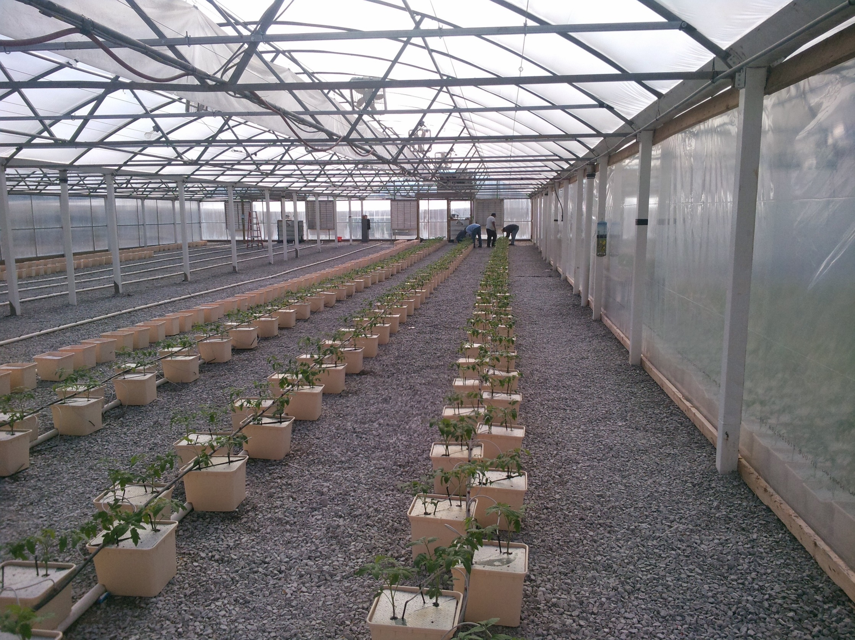
Notes:
A large three bay gutter connected greenhouse used for vegetable production in southern Illinois.

Slide 12
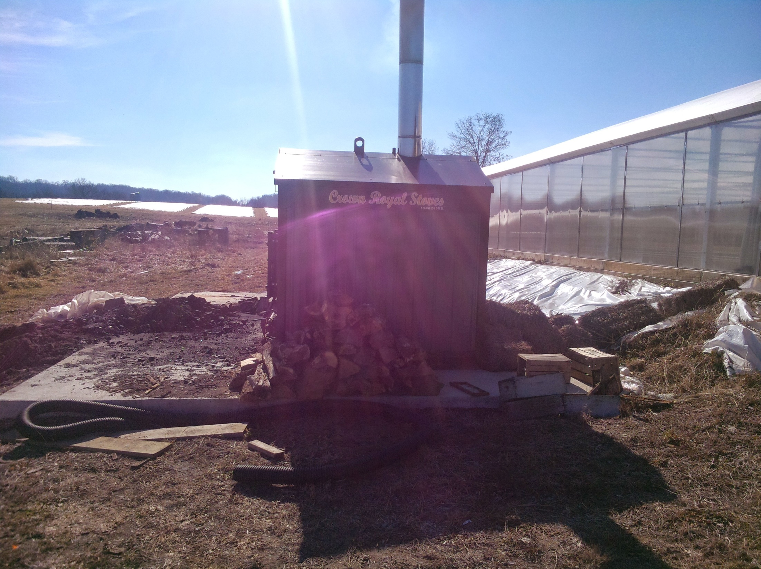
Notes:
Large outdoor wood boiler. New EPA regulations which take affect this year, 2015, will impact the price and availability of larger boilers like this one.

Slide 13
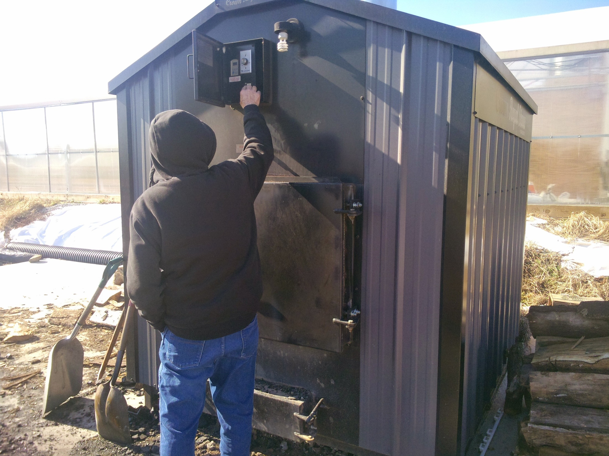
Notes:
Setting blower motor so firebox door can be opened.

Slide 14
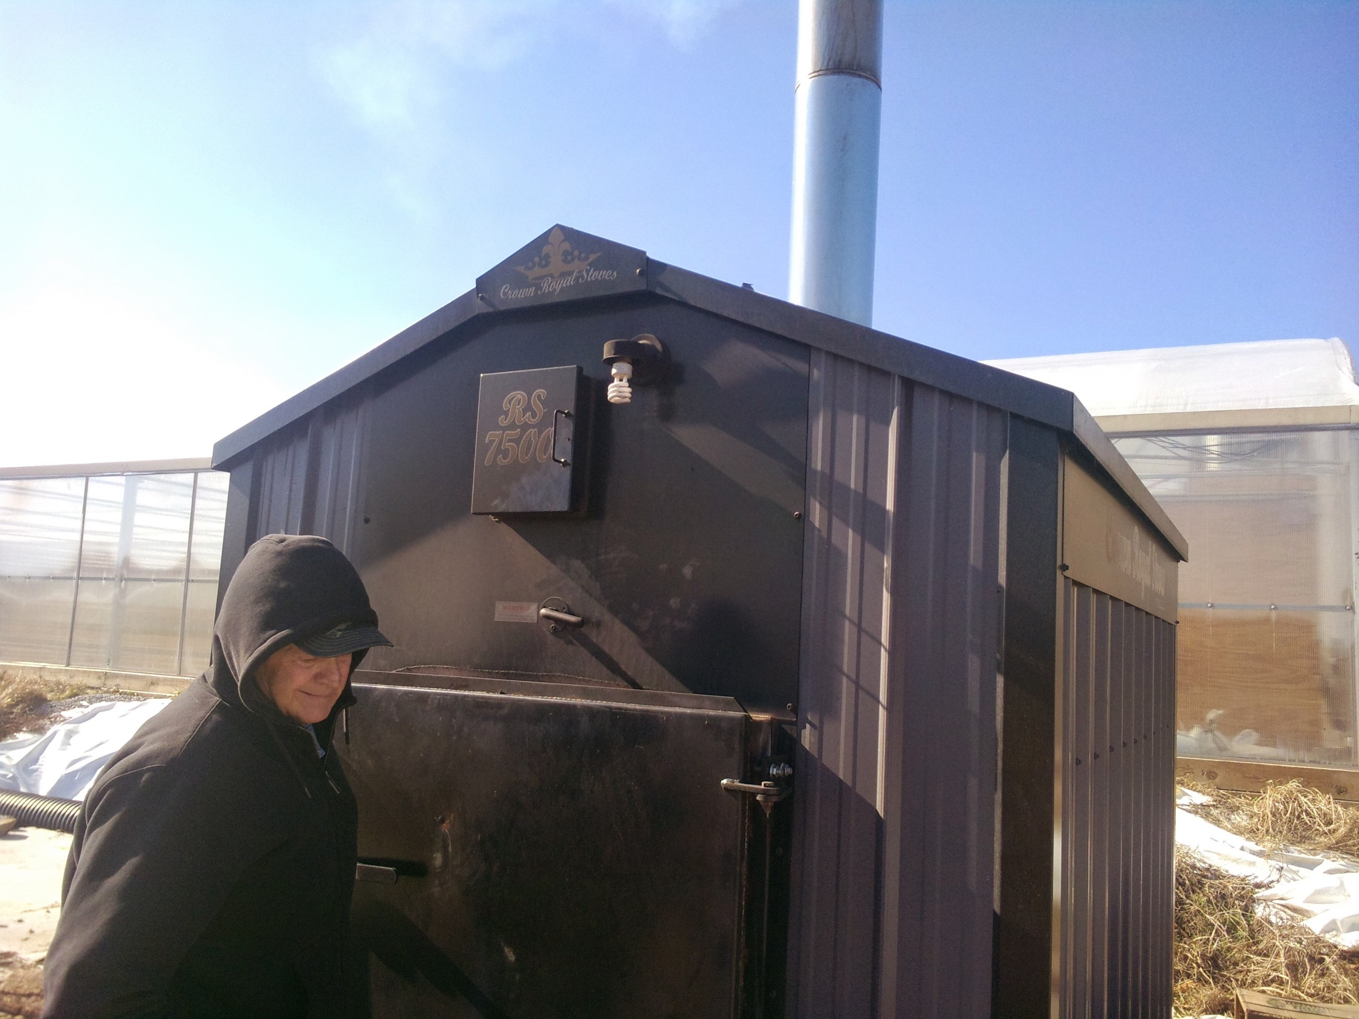
Notes:
Cracking firebox door.

Slide 15
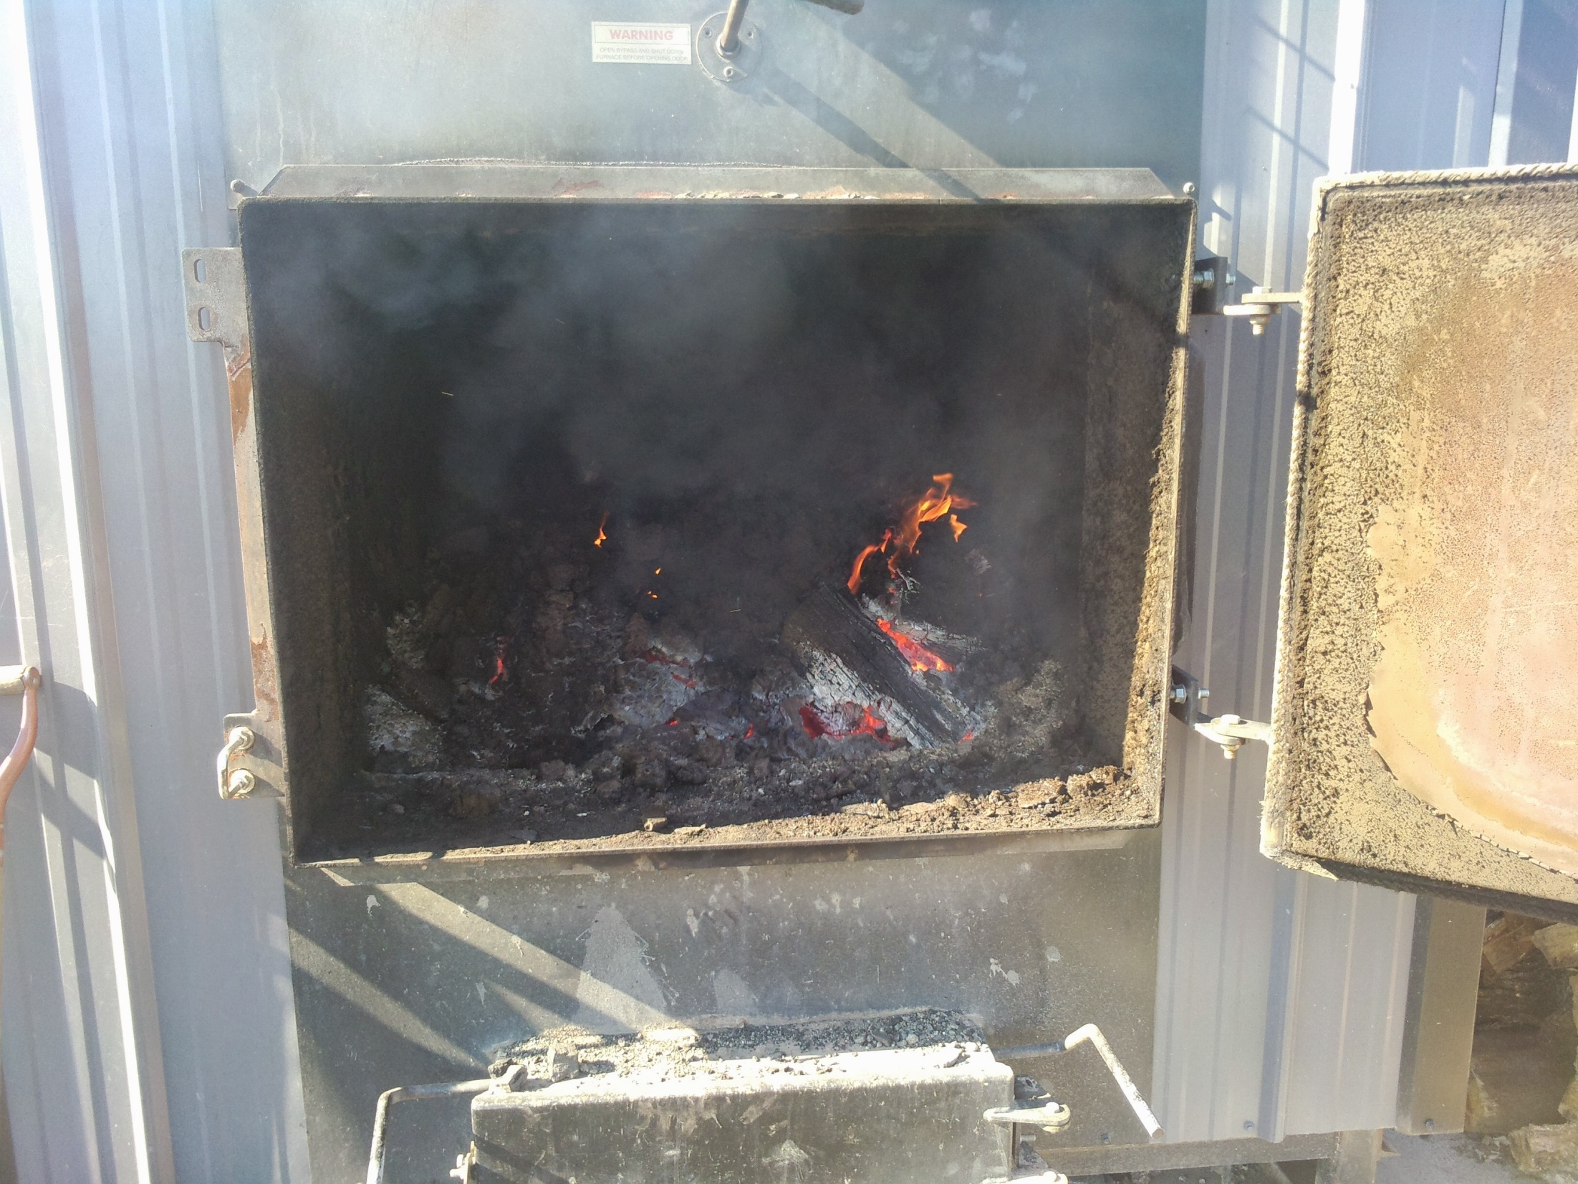
Notes:
Open firebox with burning firewood.

Slide 16
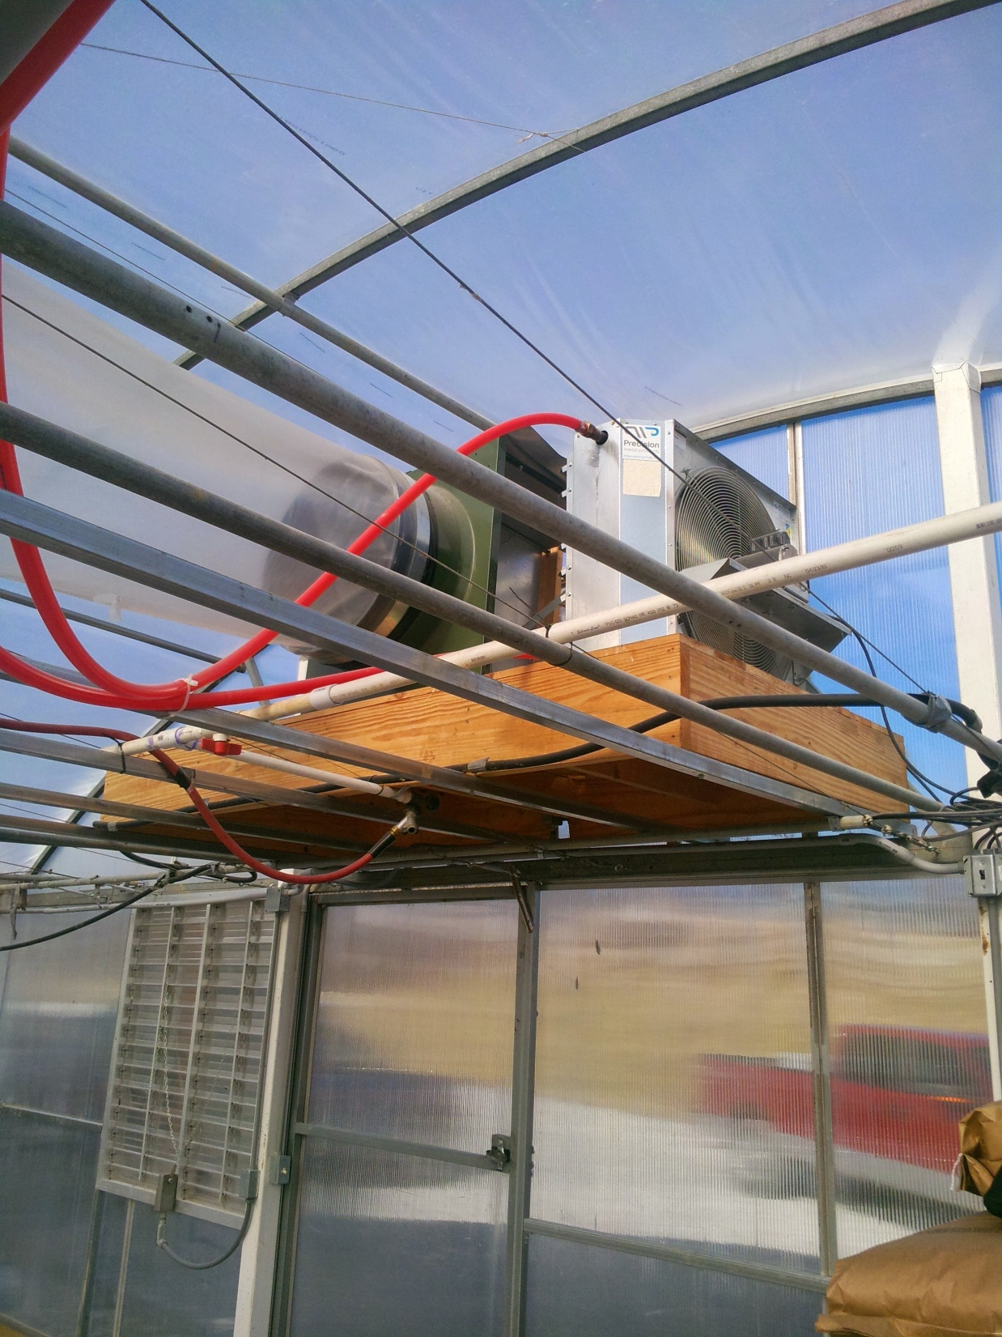
Notes:
Heat exchanger for the wood fired boiler previously shown. The orange tubing visible in the slide is pex tubing which carries warm water from the boiler to the heat exchanger and cool water from the exchanger back to the boiler.

Slide 17
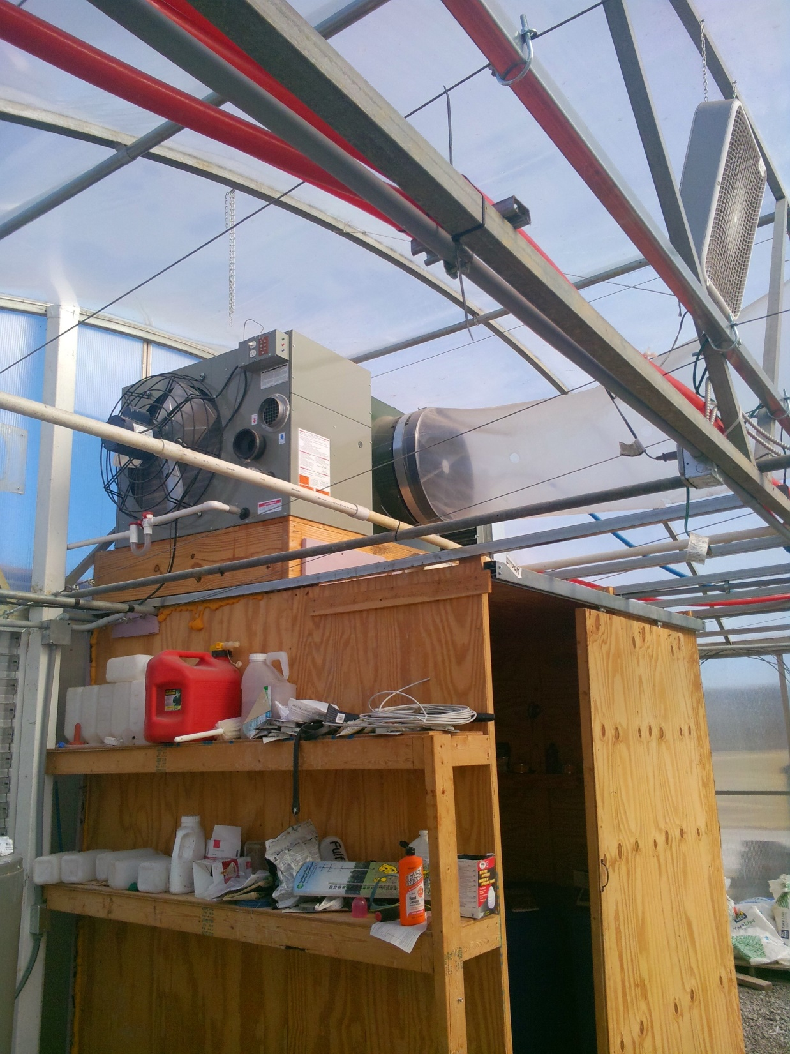
Notes:
Propane fired unit heater which serves as backup should something go wrong with the wood fired boiler and waste oiler heaters that are in this greenhouse.

Slide 18
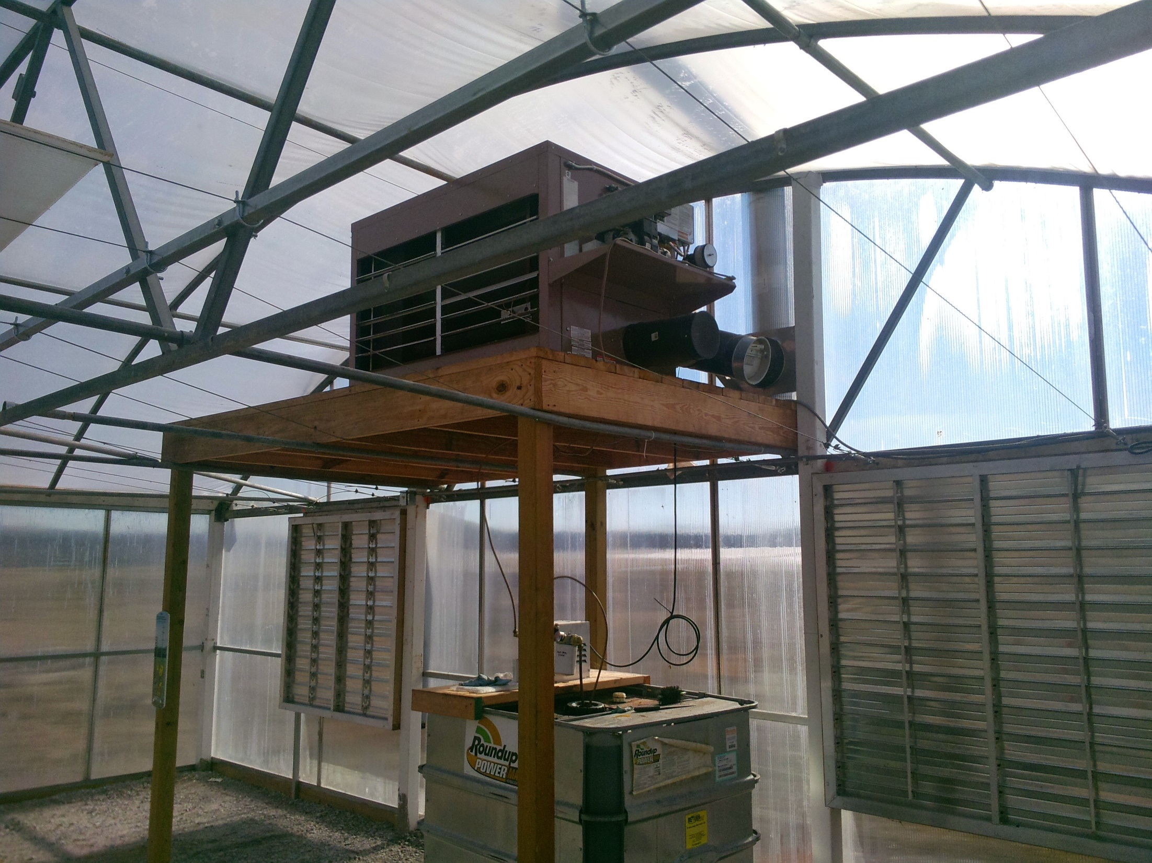
Notes:
Waste oil heater. In addition to the waste oil reservoir below the furnace a much larger holding tank is located outside the greenhouse. The waste oil burner is designed as a back up heating system behind the wood boiler.

Slide 19
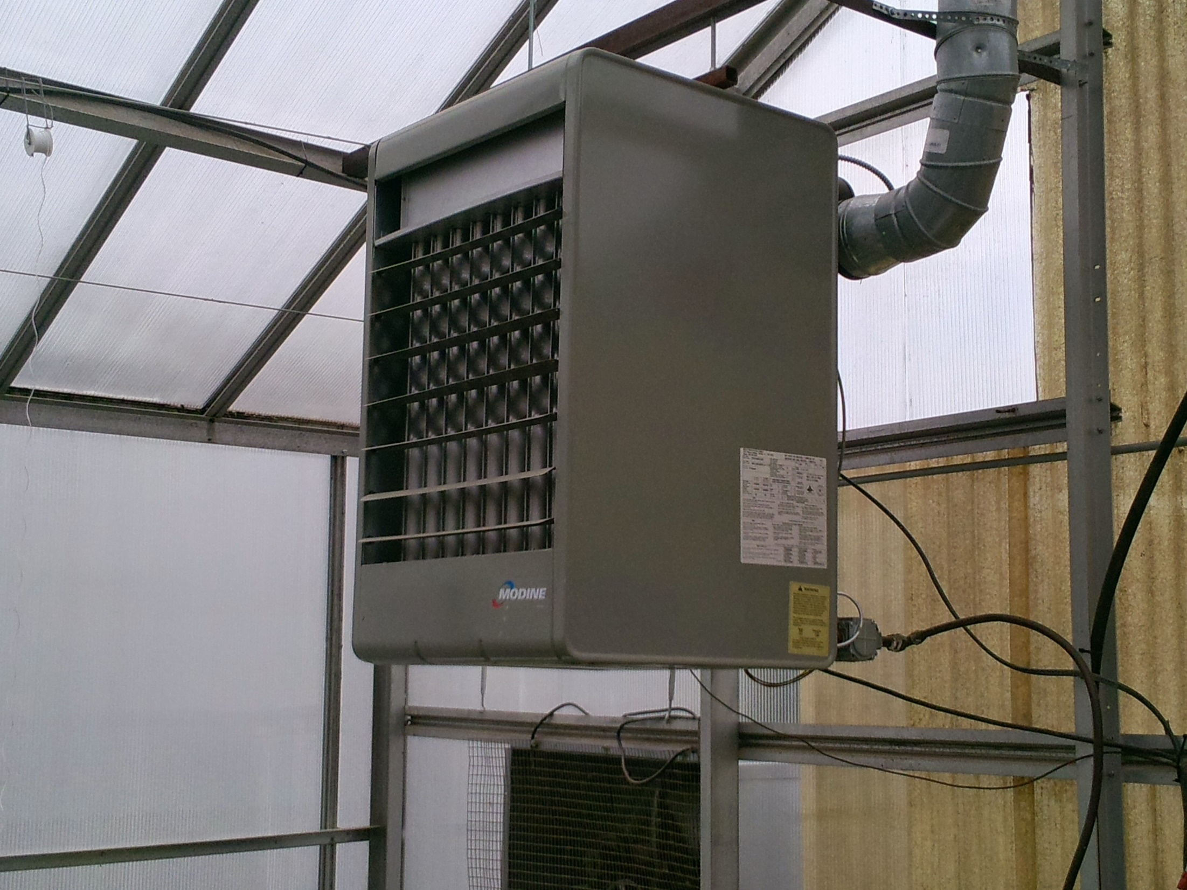
Notes:
Propane fired unit heater.

Slide 20
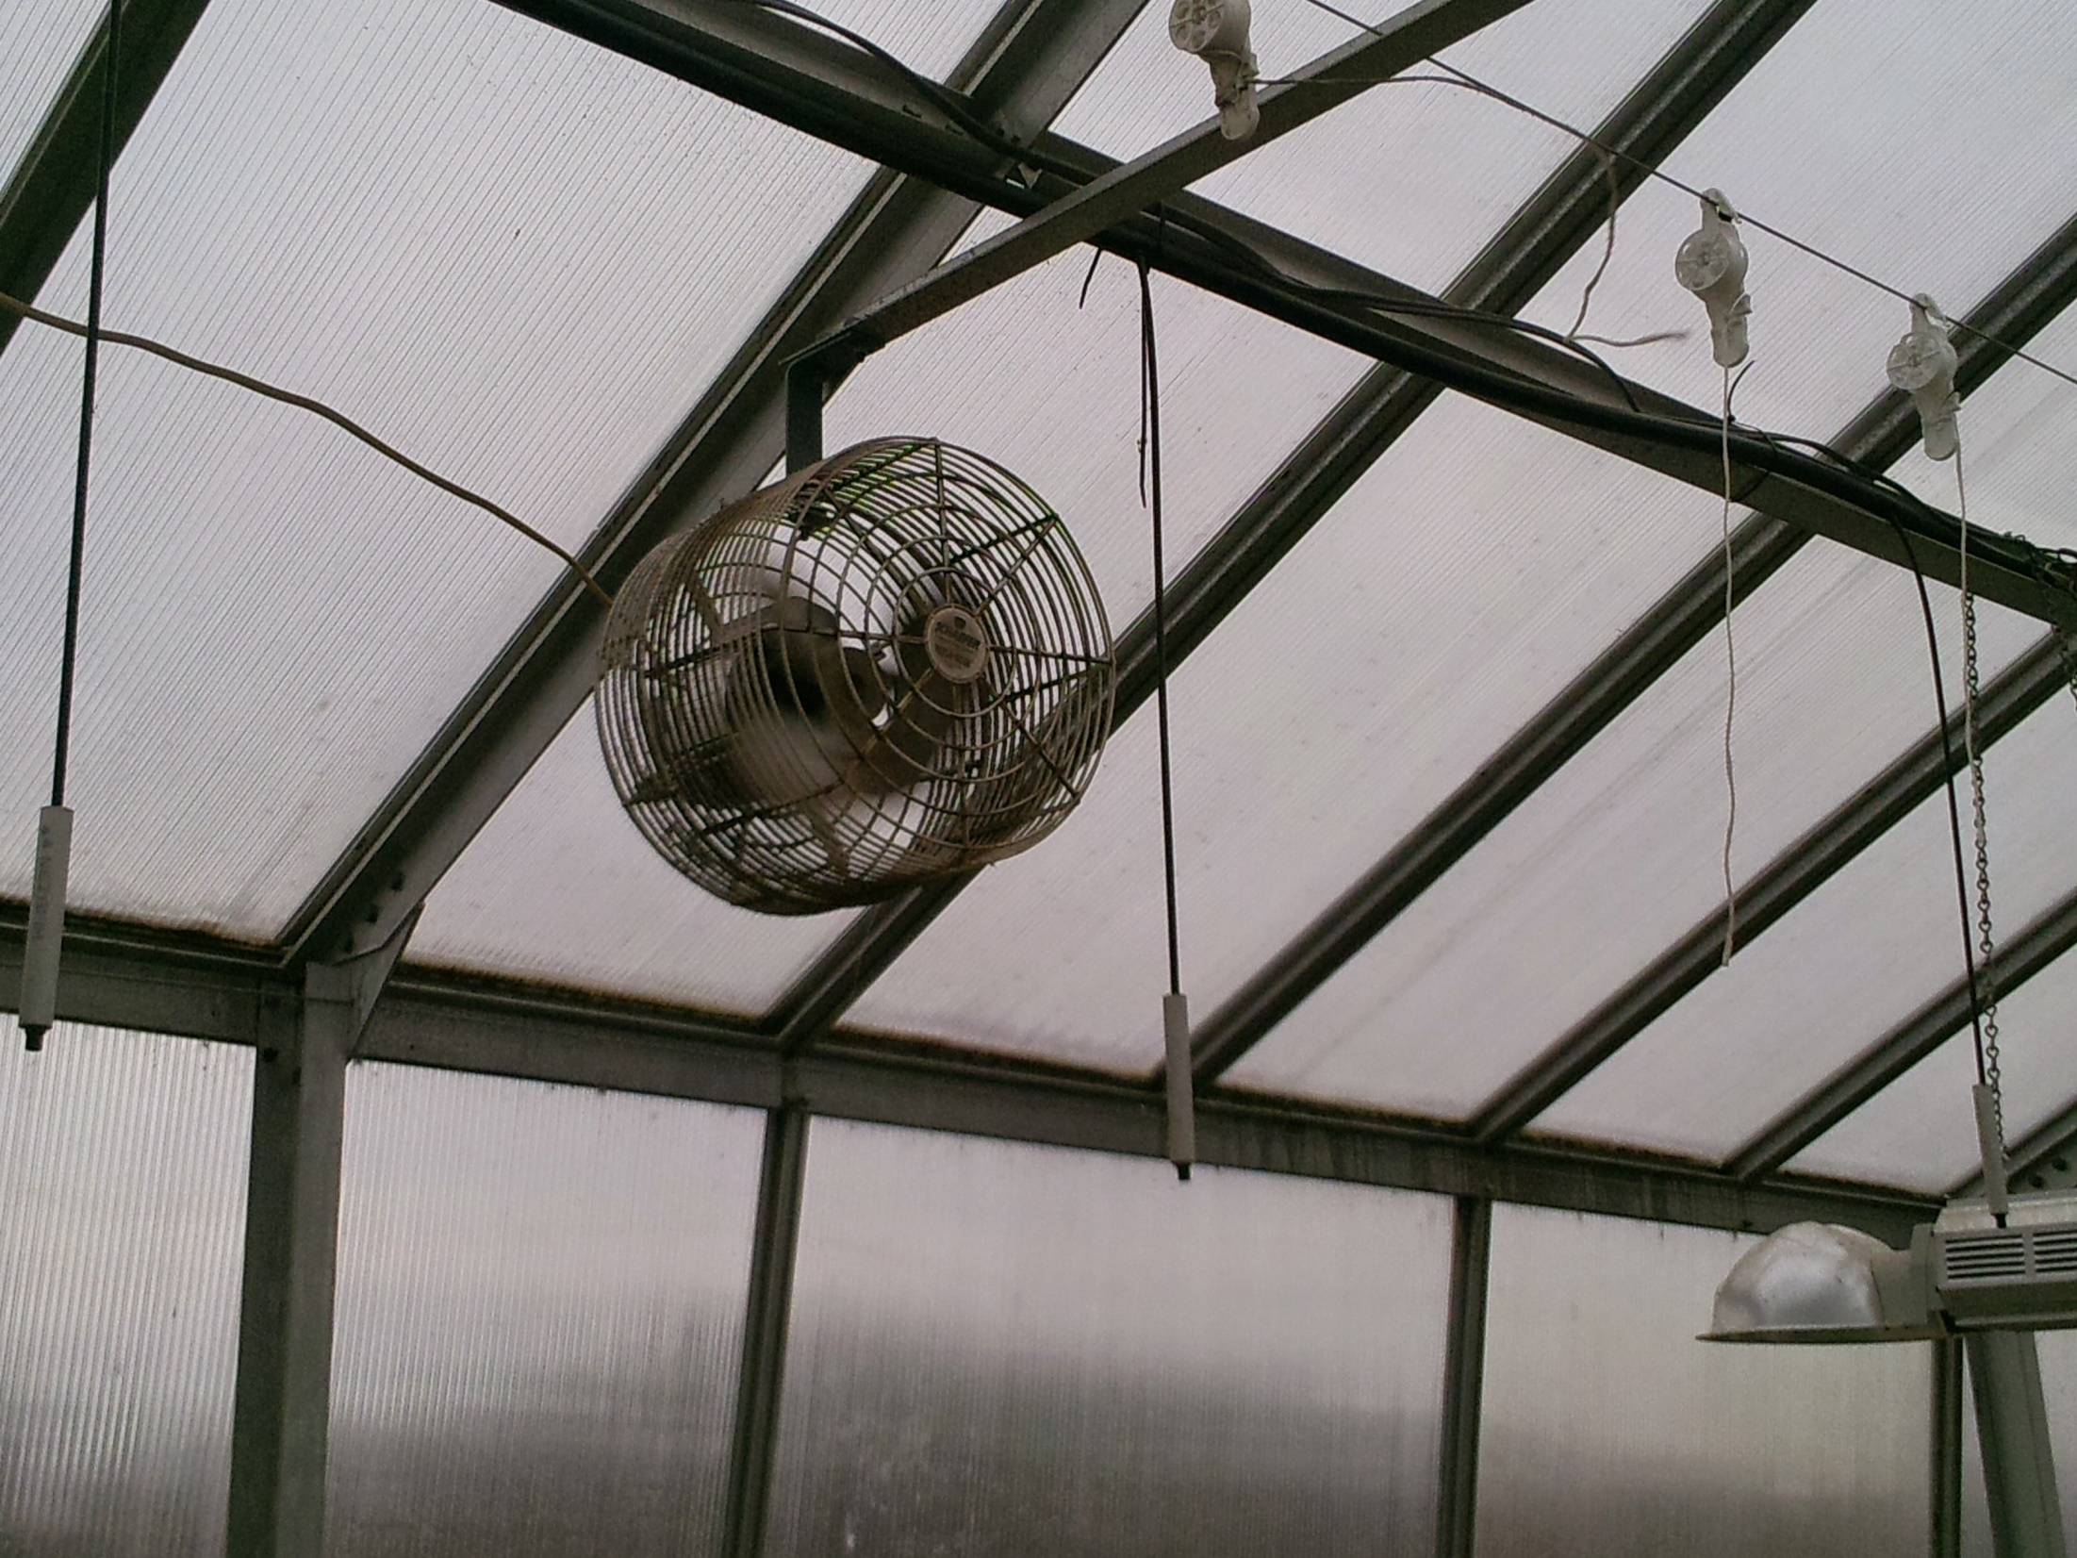
Notes:
High velocity horizontal air flow fans, commonly called HAF fans are commonly used in a greenhouse to make temperatures more uniform throughout the greenhouse.

Slide 21
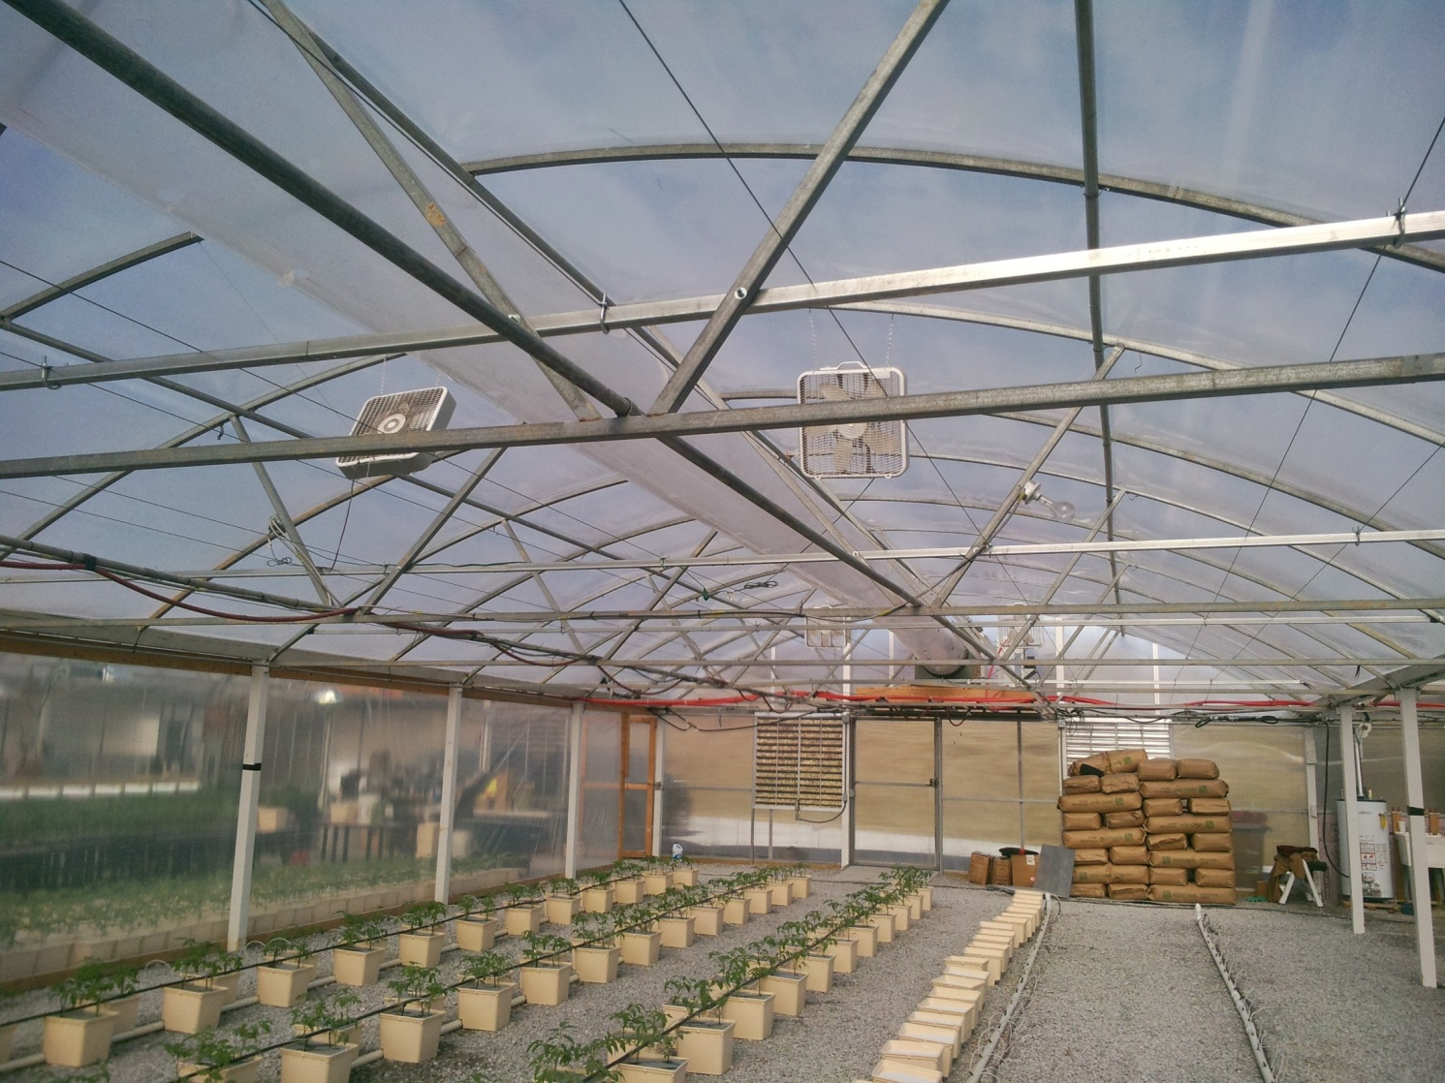
Notes:
Fan-jet or power tube polyethylene heat distribution tube to get more uniform heat distribution throughout the greenhouse.

Slide 22
Greenhouse Cooling
Ventilation fans
Whitewash
Shade cloth
Fan and pad
Notes:
Greenhouses concerns quickly change from heating to cooling even on cold day when the sun is shining. Nearly all greenhouse rely on electrical fans in conjunction with motorized shutters as their first line of cooling. With the onset of summer temperatures, typically sometime in June, additional measures of whitewash or shade clothe are also commonly used. Some greenhouses may also have fan and pad cooling similar to what is now commonly call swamp coolers. The fan and pad cooling greatly loses efficiency when the ambient relative humidity levels are high.

Slide 23
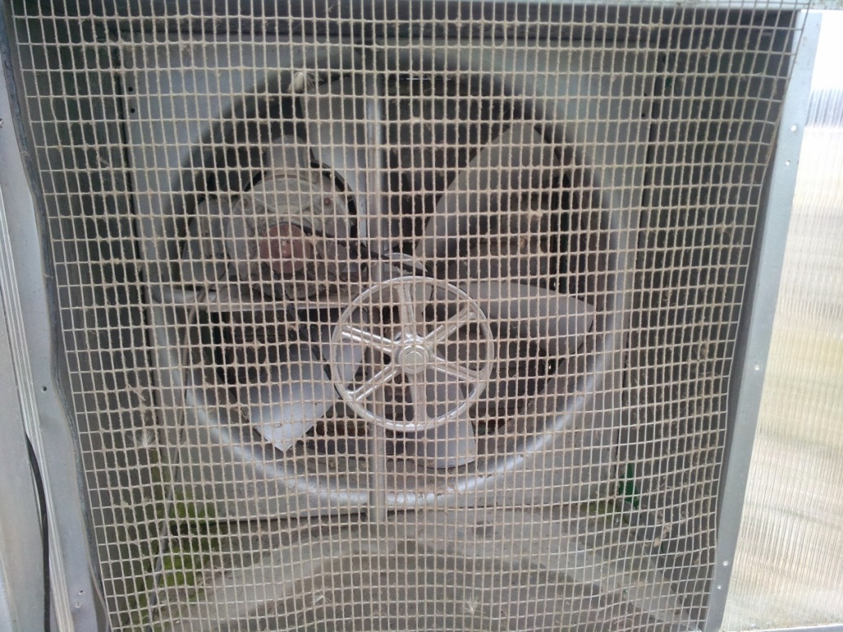
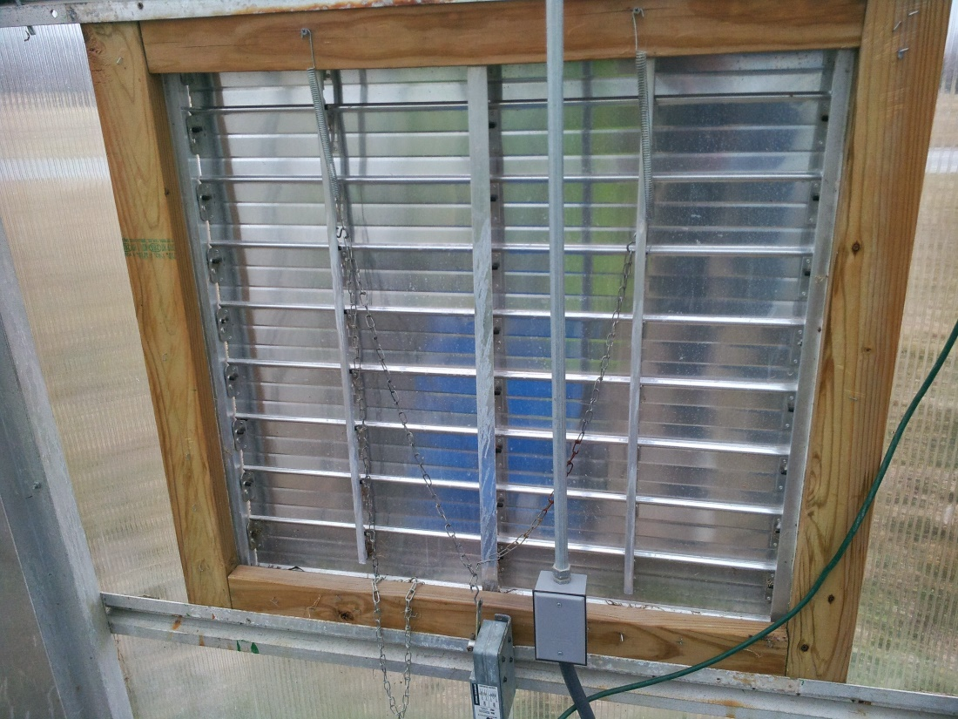
Notes:
Motorized inlet shutter and exhaust fan for cooling greenhouse. These are also useful in reducing humidity levels inside the greenhouse.

Slide 24
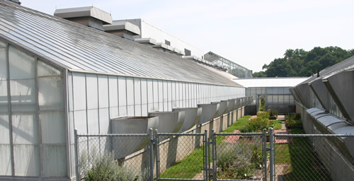
Notes:
Greenhouses at the Urbana/Champaign campus that have been whitewashed to help keep greenhouse temperatures cooler in summer time.

Slide 25
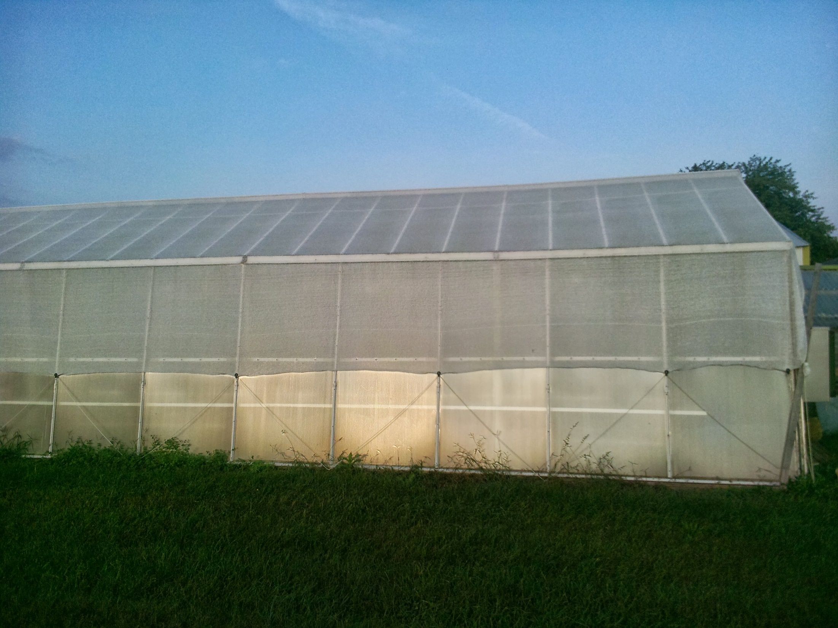
Notes:
Greenhouse at DSAC that has been covered with 50% white shade cloth to help control greenhouse temperature in summertime.

Slide 26
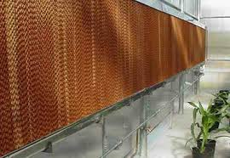
Notes:
A fan and pad cooling system that helps reduce greenhouse temperatures through the process of evaporative cooling.

Slide 27
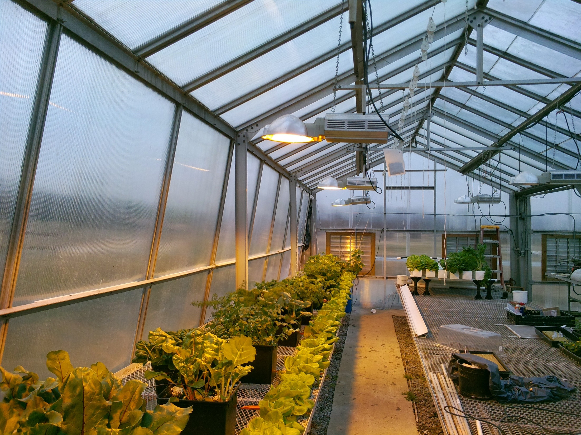
Notes:
Supplemental lighting is not a component for most new greenhouse growers. The HID or LED that can be used tend to be expensive to purchase and the HID lights are also expensive to operate.

Slide 28
Crops
Tomato
Pepper
Cucumber
Lettuce
Herbs
Notes:
There are many crops often raised in the field that can be raised as greenhouse crops. Selecting the right crop is a function of grower expertise and marketing opportunities.

Slide 29
Cultural Systems
Soil
Hydroponic
Notes:
Greenhouse production can be done in beds very similar to high tunnel production only with the addition of heat or increasingly is being done using hydroponic systems. Hydroponic systems may offer earlier and larger yields but also require higher degrees of management and significant additional capital investment for materials and supplies.

Slide 30
Bonuses
Better ability to control humidity
More rapid crop development
More predictable
Notes:
Simply adding heat to the high tunnel to make it into a greenhouse that may only be utilized for an additional couple of months and not all year long has proven to be beneficial for many growers. The addition of heat allows growers to do a much better job controlling humidity early in the growing season reducing disease problems. Also the heat allows for better and more predictable early season growth and early yields.

Slide 31
Drawbacks
EXPENSE
Insect pests
Notes:
The addition of heat definitely increases operating expenses. The increased expenses come from both equipment and fuel purchases. Additionally, the longer the growing season the more likely growers may have to combat more traditional greenhouse pests like whiteflies and thrips which can represent significant control challenges.

Slide 32
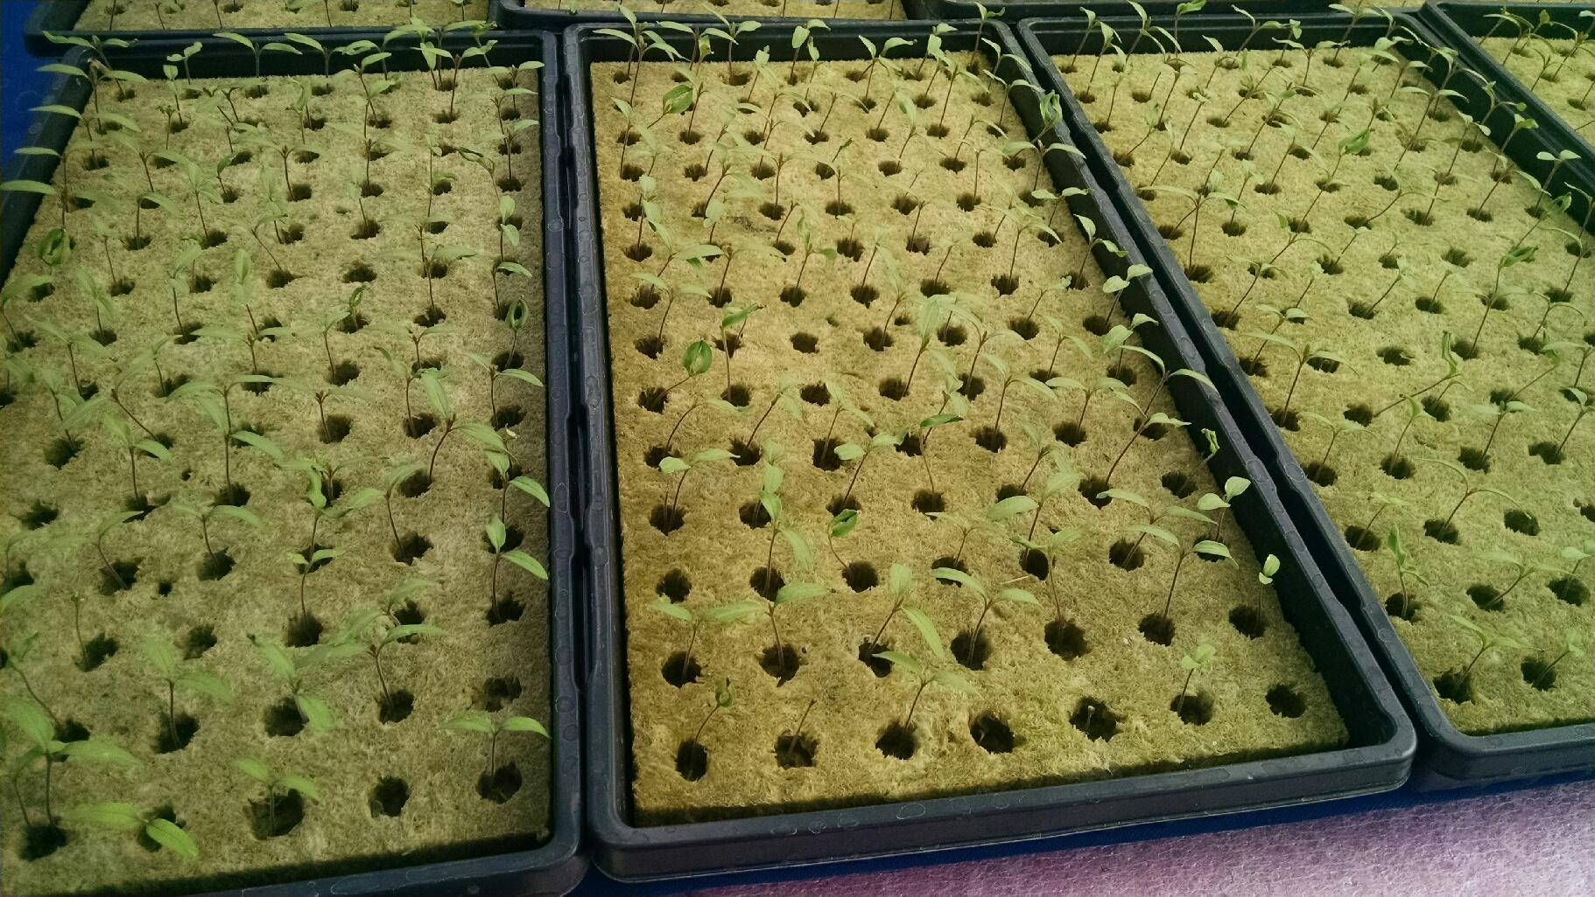
January 5
Notes:
Tomato transplants seeded on January 1.

Slide 33
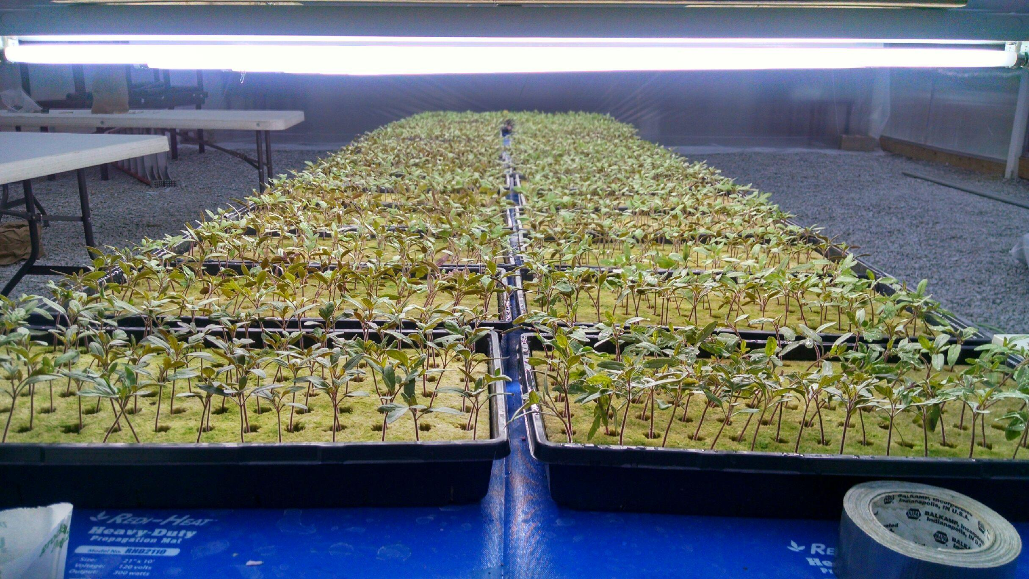
January 12
Notes:
Tomato transplants seeded on January 1.

Slide 34
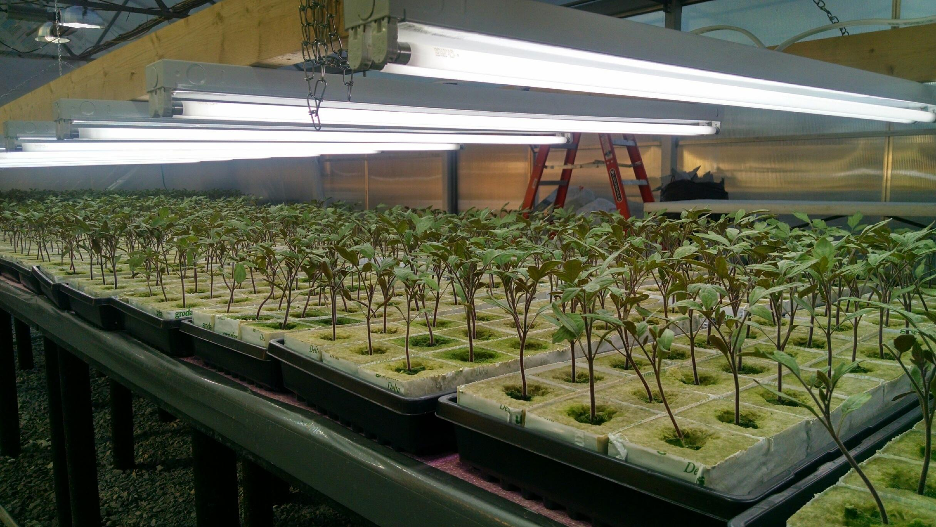
January 20
Notes:
Tomato transplants seeded on January 1.

Slide 35
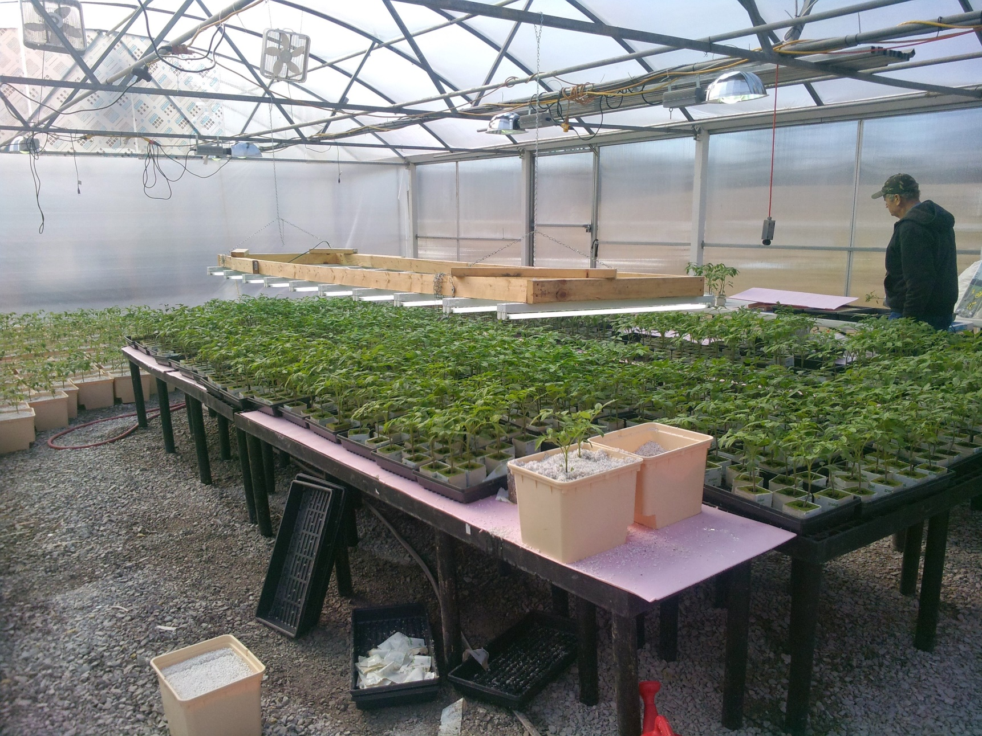
January 30

Slide 36
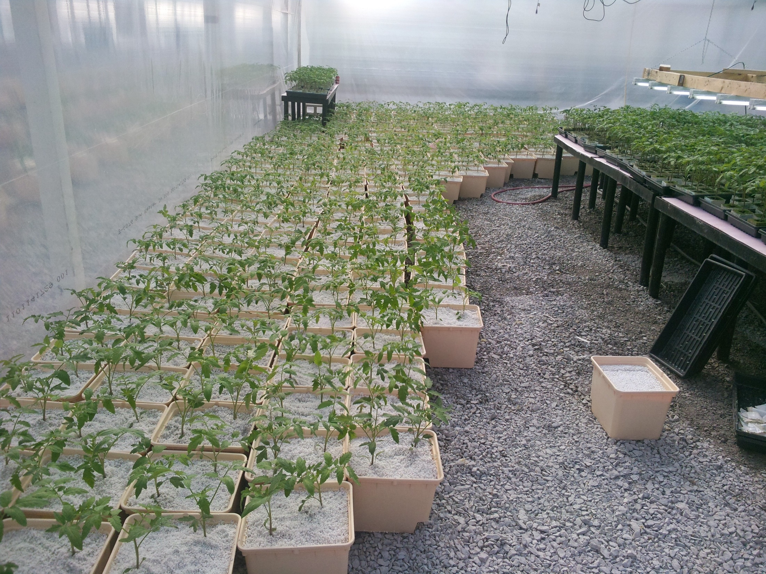
Notes:
4 week old transplants move up to a Dutch bucket.

Slide 37
Notes:
Dutch buckets being placed in greenhouse.

Slide 38
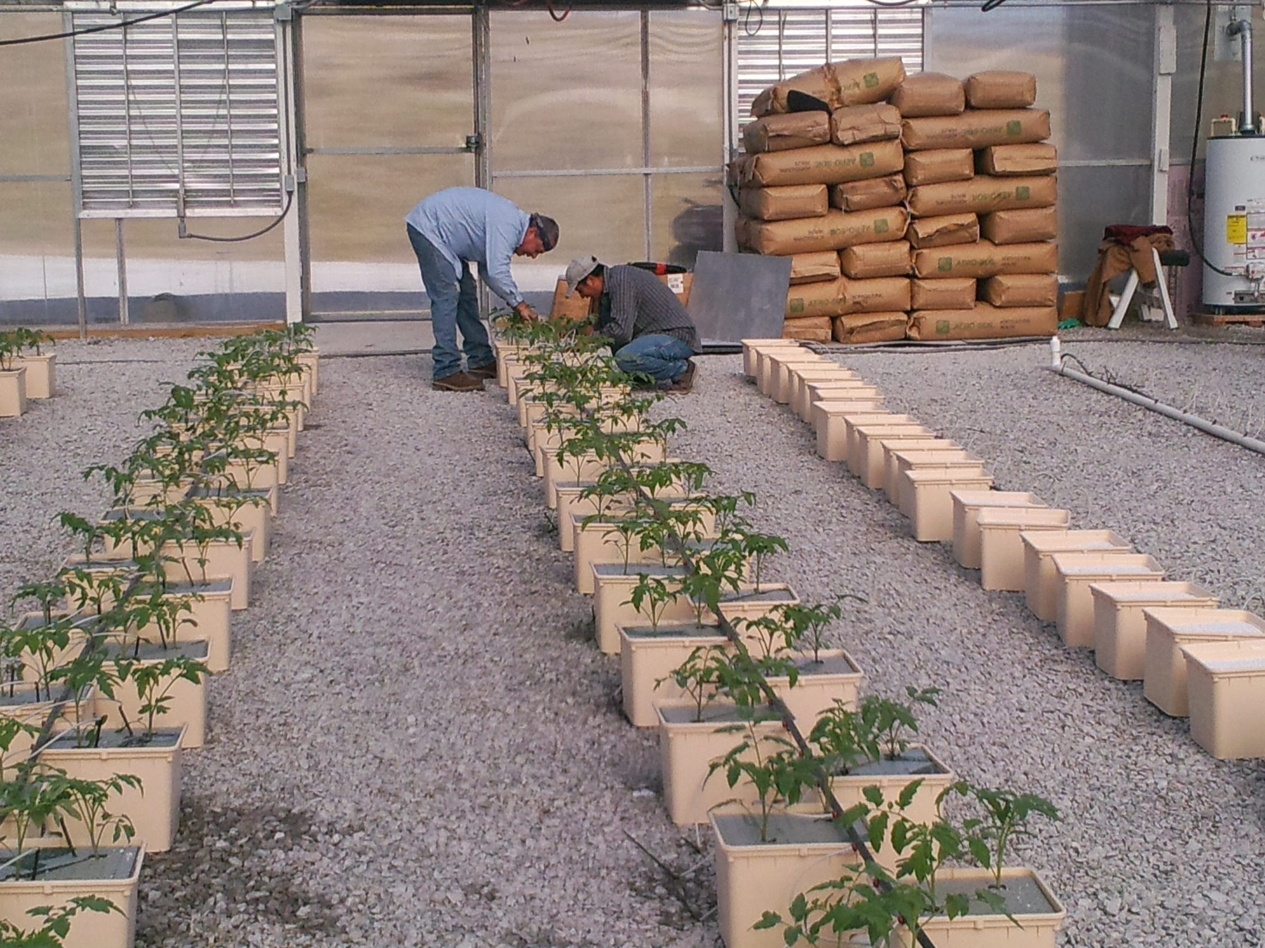

Slide 39
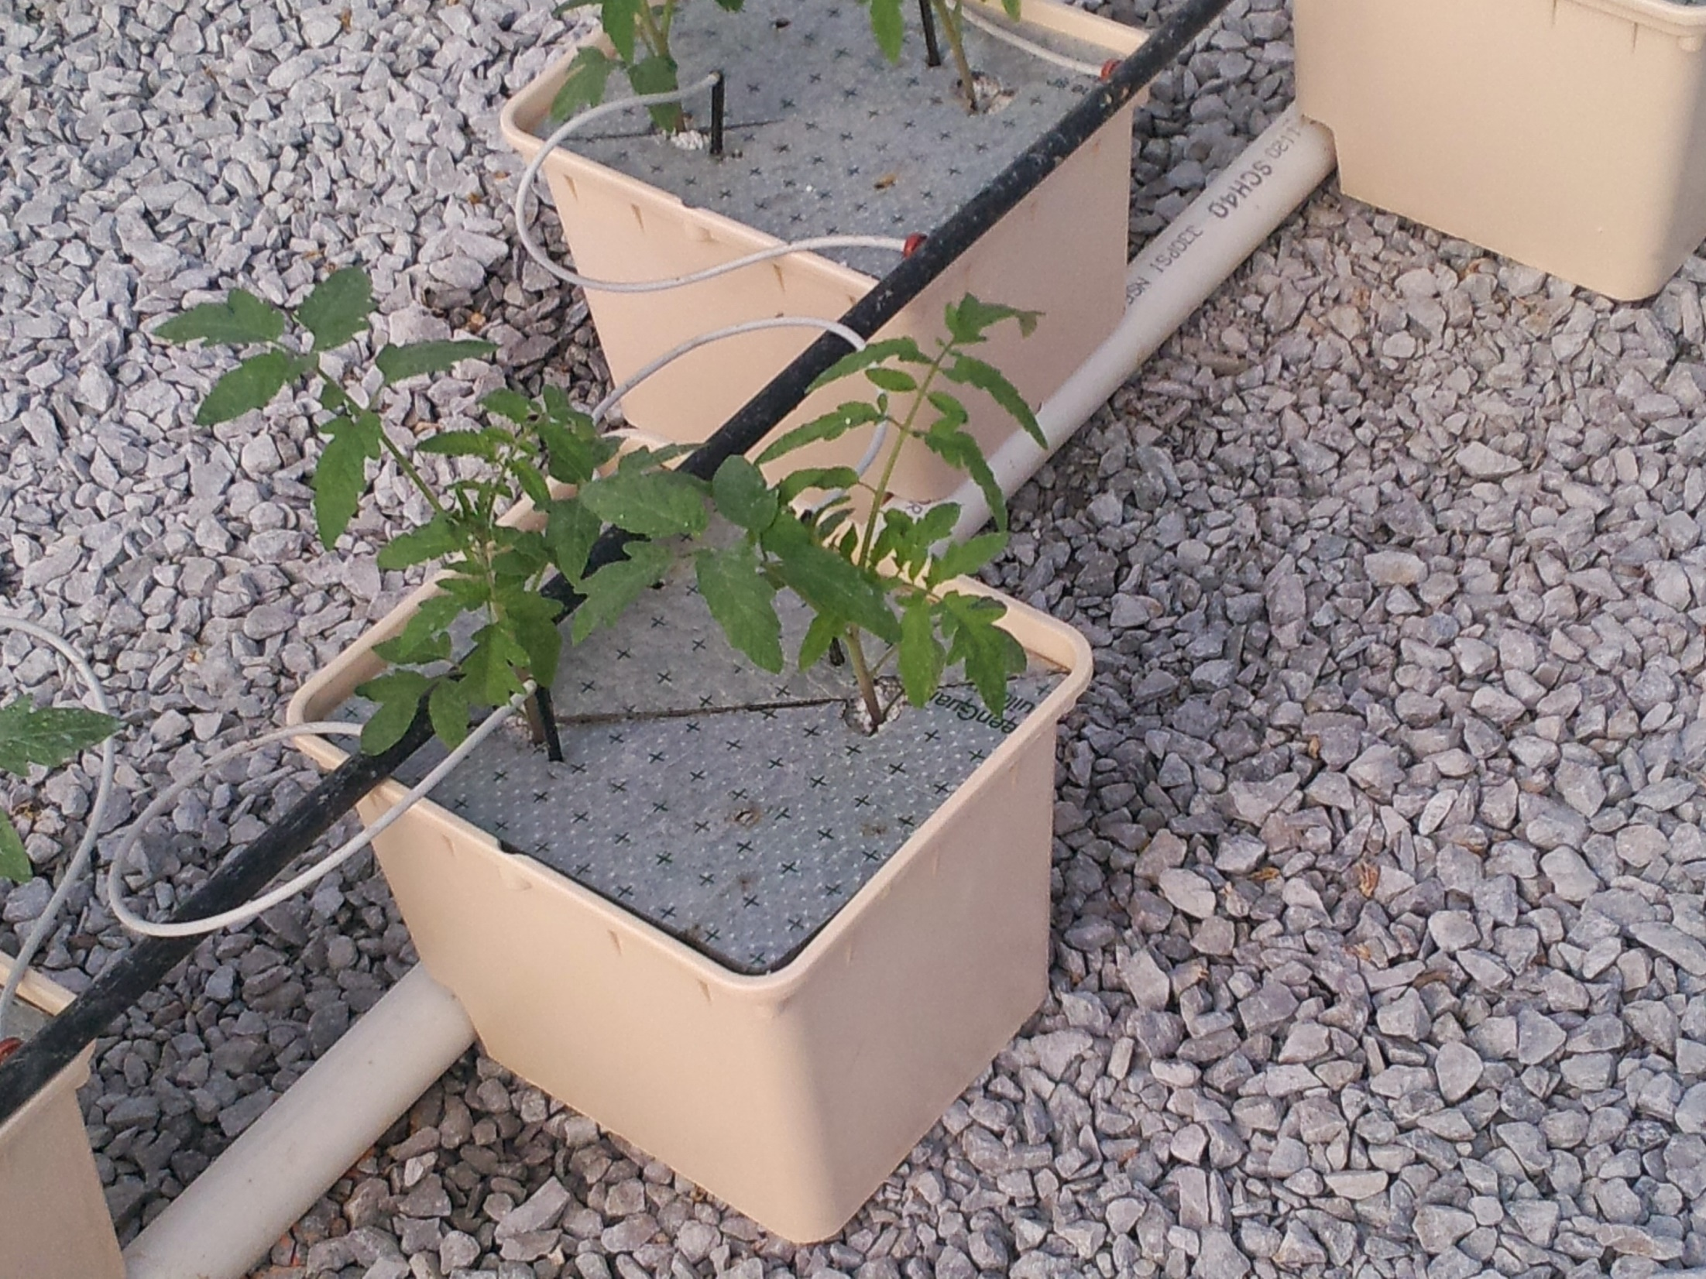
Notes:
A single ducth bucket containing two tomato plants. Each plant has its own emitter for irrigation and the buckets which are filled with perlite have a styrofoam plate placed on top to reduce algae growth on the perlite.

Slide 40
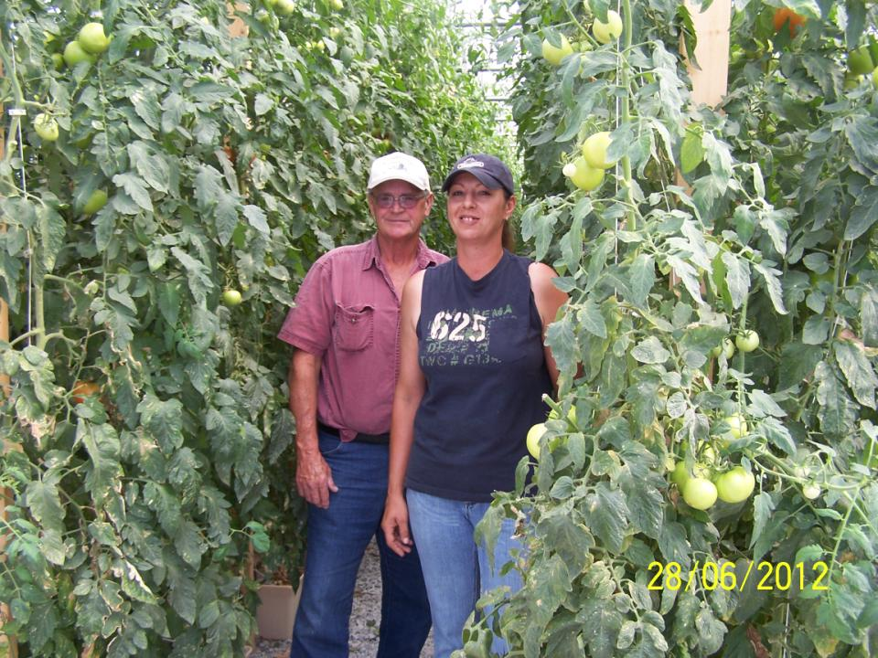
Notes:
Hydroponic greenhouse tomatoes in southern Illinois on June 28.

Slide 41
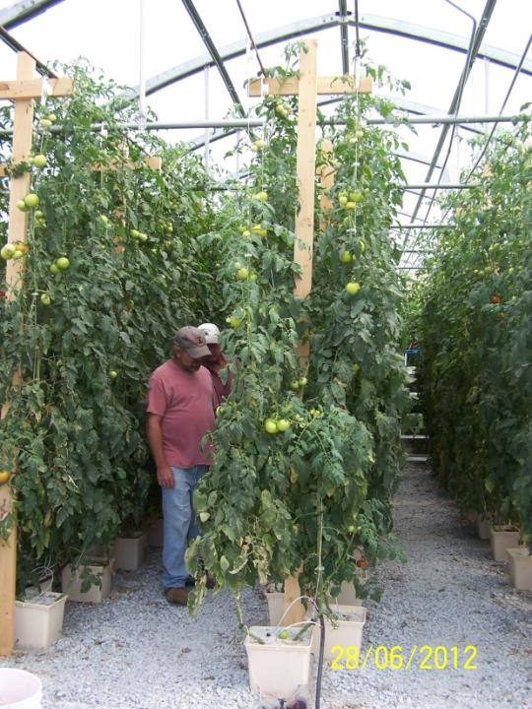
Notes:
Notice the trellis supports. This production system involves seeding around January 1 and harvest into September or October. The greenhouse is left vacant in November and December. This is a common schedule in Illinois as productivity levels decline rapidly in the fall with waning day length.

Slide 42
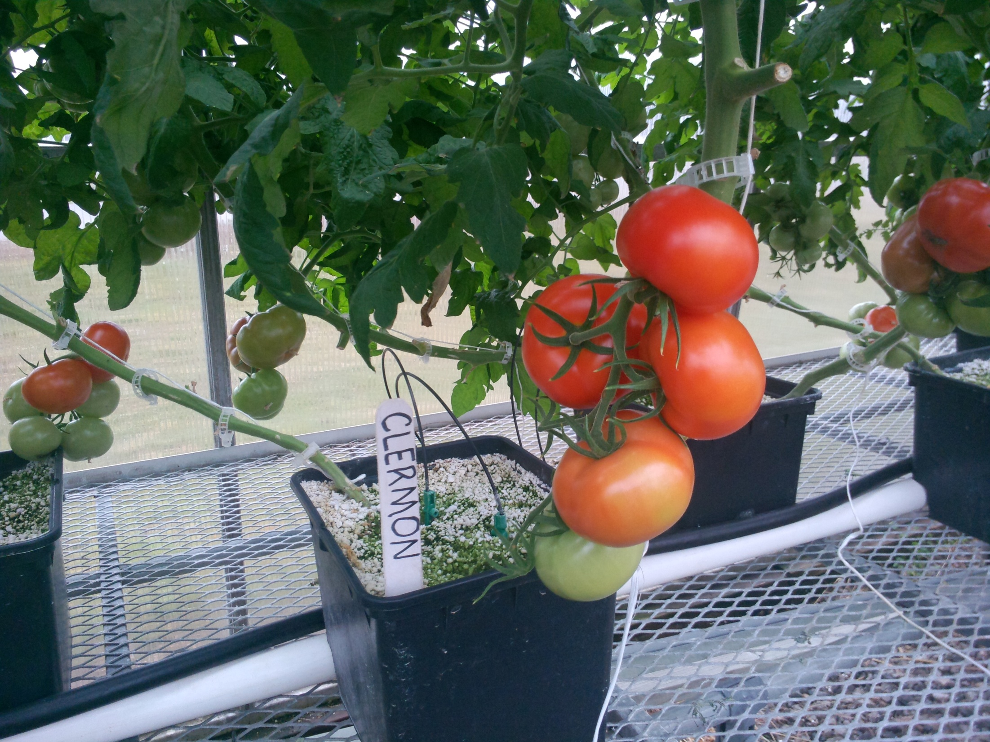
Notes:
Hydroponic tomatoes tend to be high quality with much higher grade out of marketable fruit. It may be a useful tool for those wanting to raise heirloom varieties with less cracking.

Slide 43
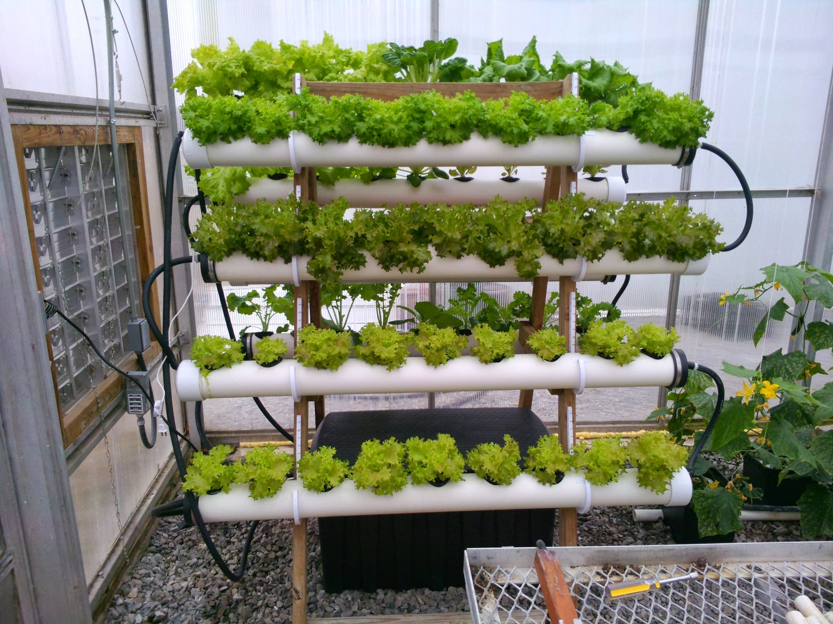
Notes:
Hydroponic lettuce is likely better suited for true year round production.

Slide 44
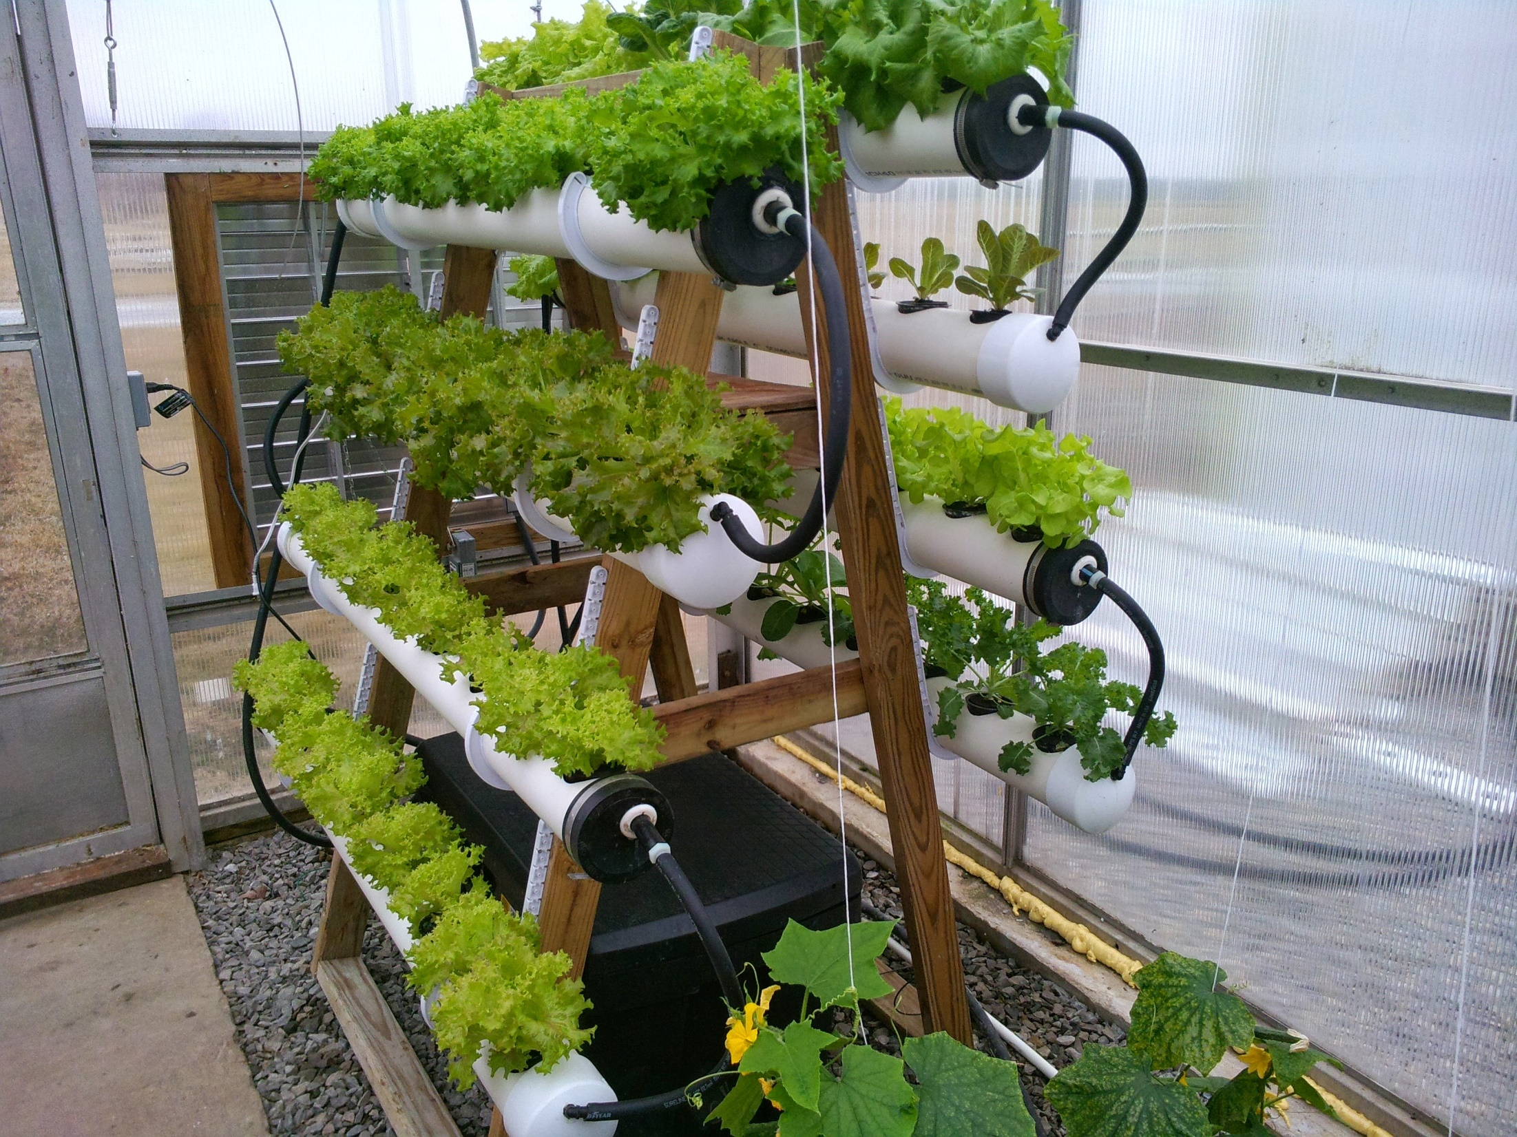
Notes:
This is a home made A frame to allow for vertical integration in an attempt to raise more produce per square foot of greenhouse floor space.

Slide 45
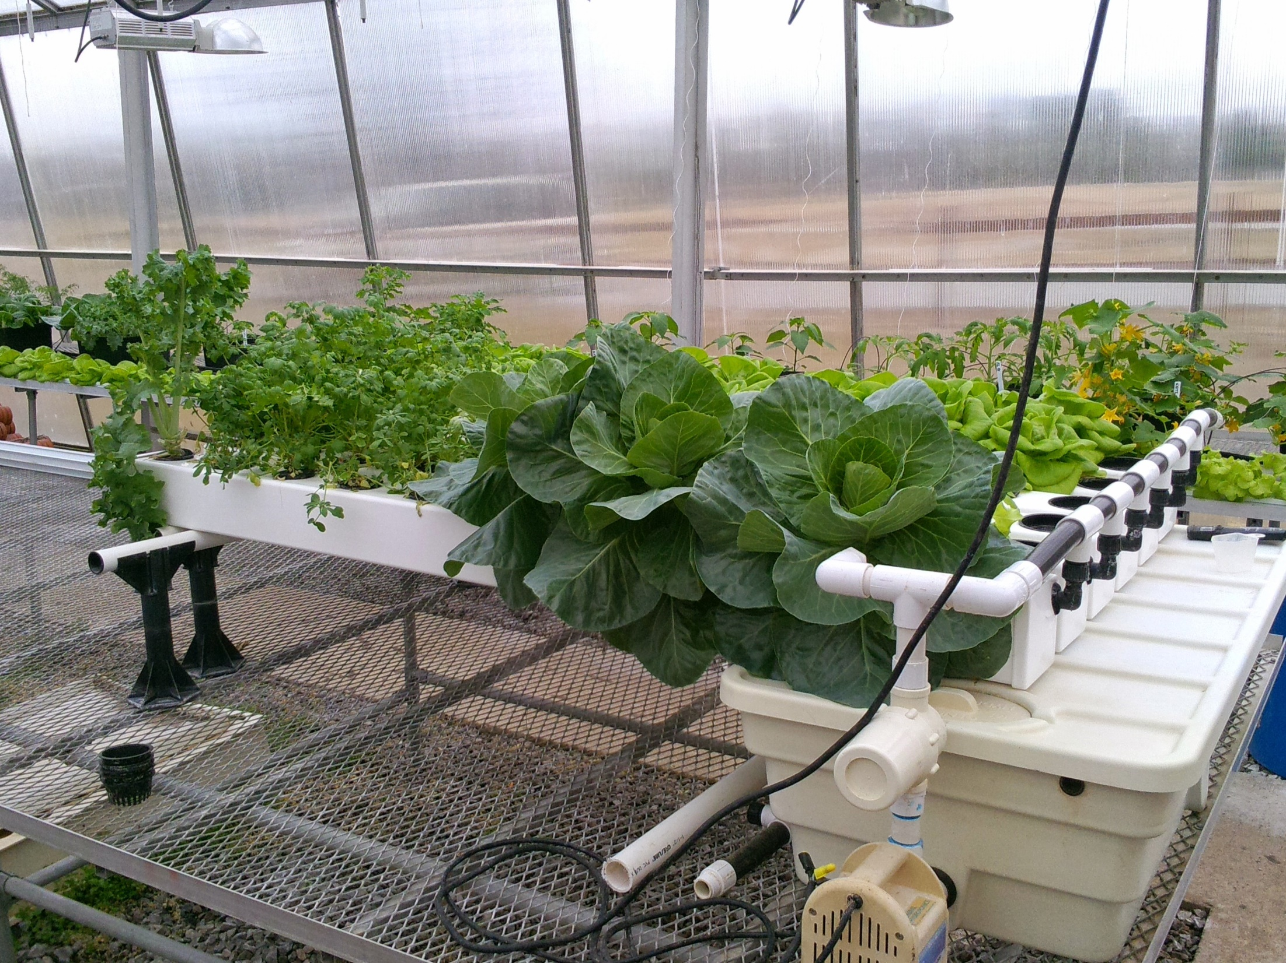
Notes:
Commercially available sytem for hydroponic plant production.

Slide 46
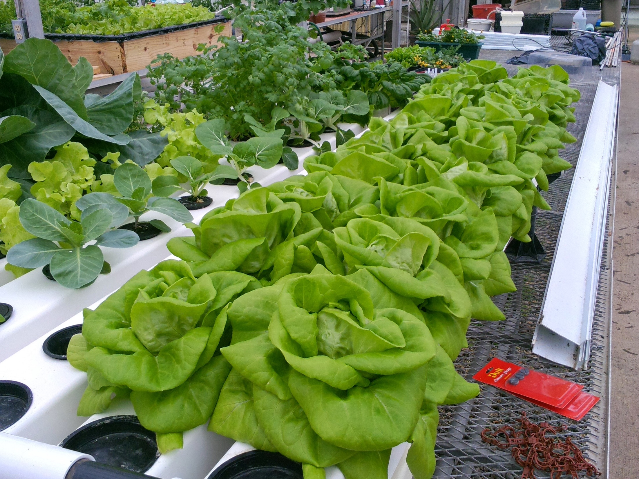
Notes:
Lettuce ready for harvest.

Slide 47
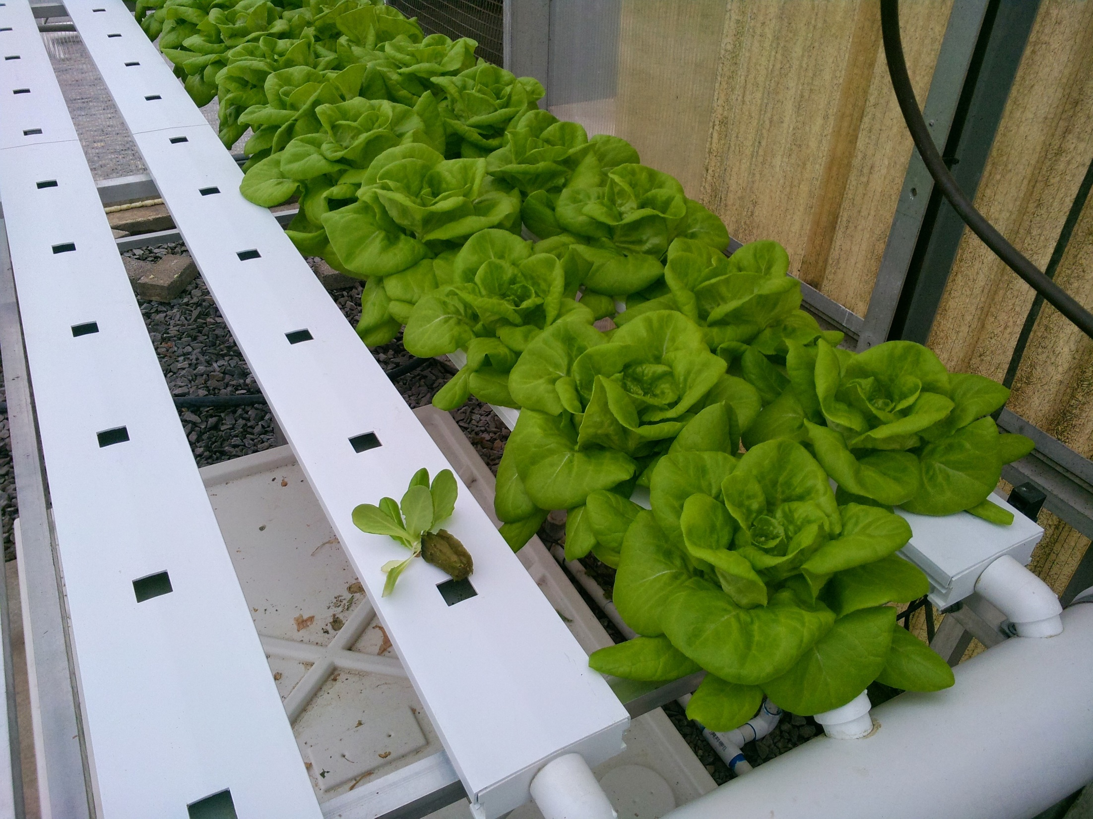
Notes:
The use of nutrient film technique (NFT) in channel or sometimes called gutters in increasingly common in Illinois. Seedlings are grown in rock wool blocks as seen on left. The block with seedling in then placed in the holes in the channel lid.

Slide 48
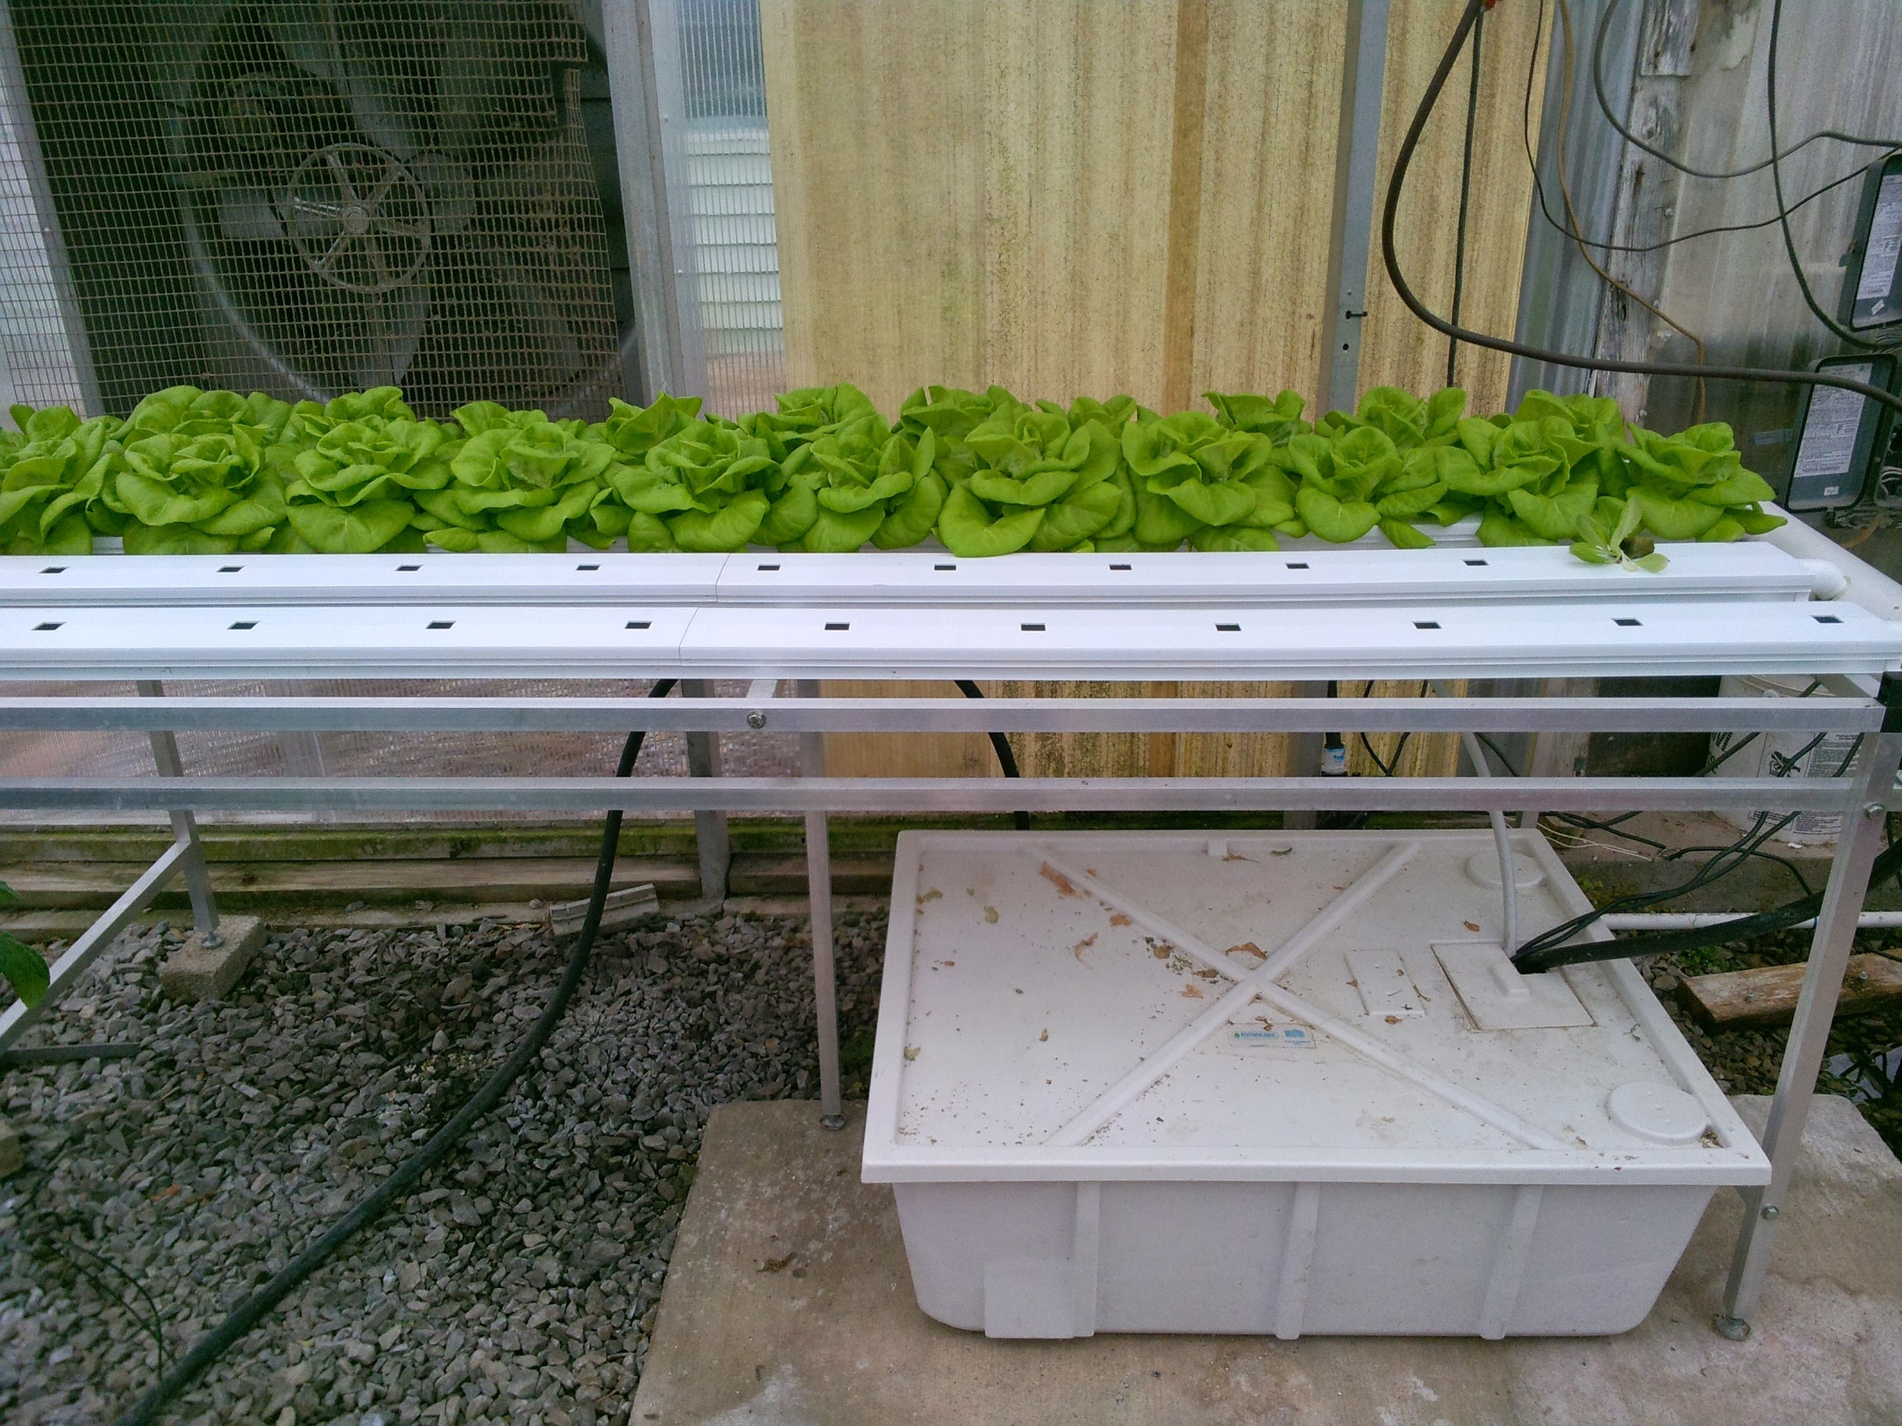
Notes:
A commercially available small NFT system. The reservoir filled with hydroponic solution contains a small pump which trickles nutrient solutions continuously down each trough. The material is then returned to the tank.

Slide 49
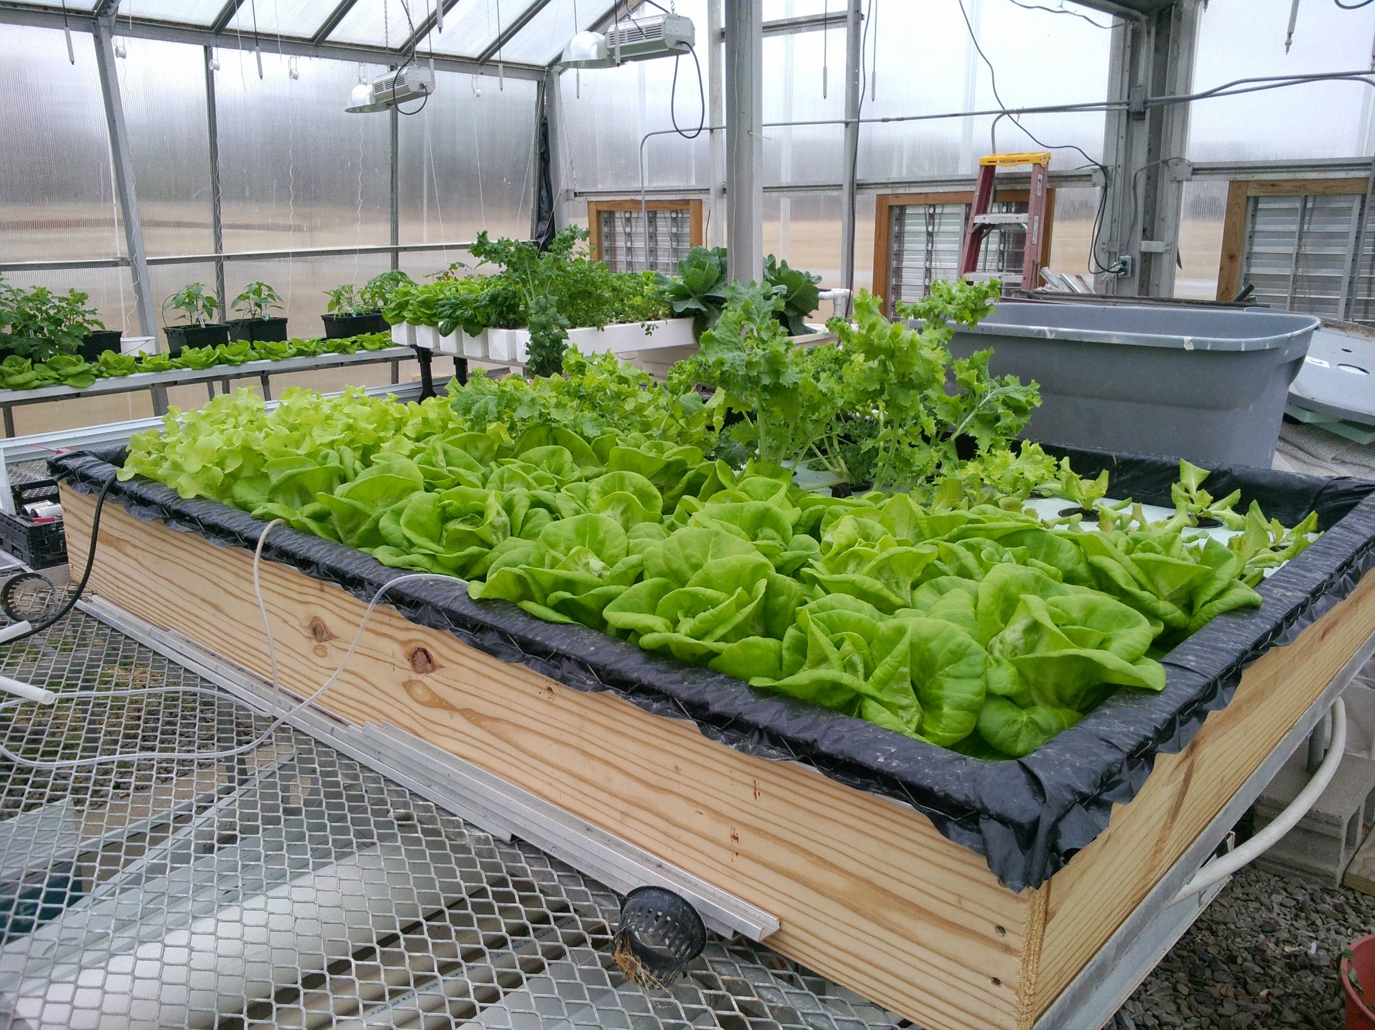
Notes:
Float bed or deep water hydroponic is another choice for hydroponic lettuce production.

Slide 50
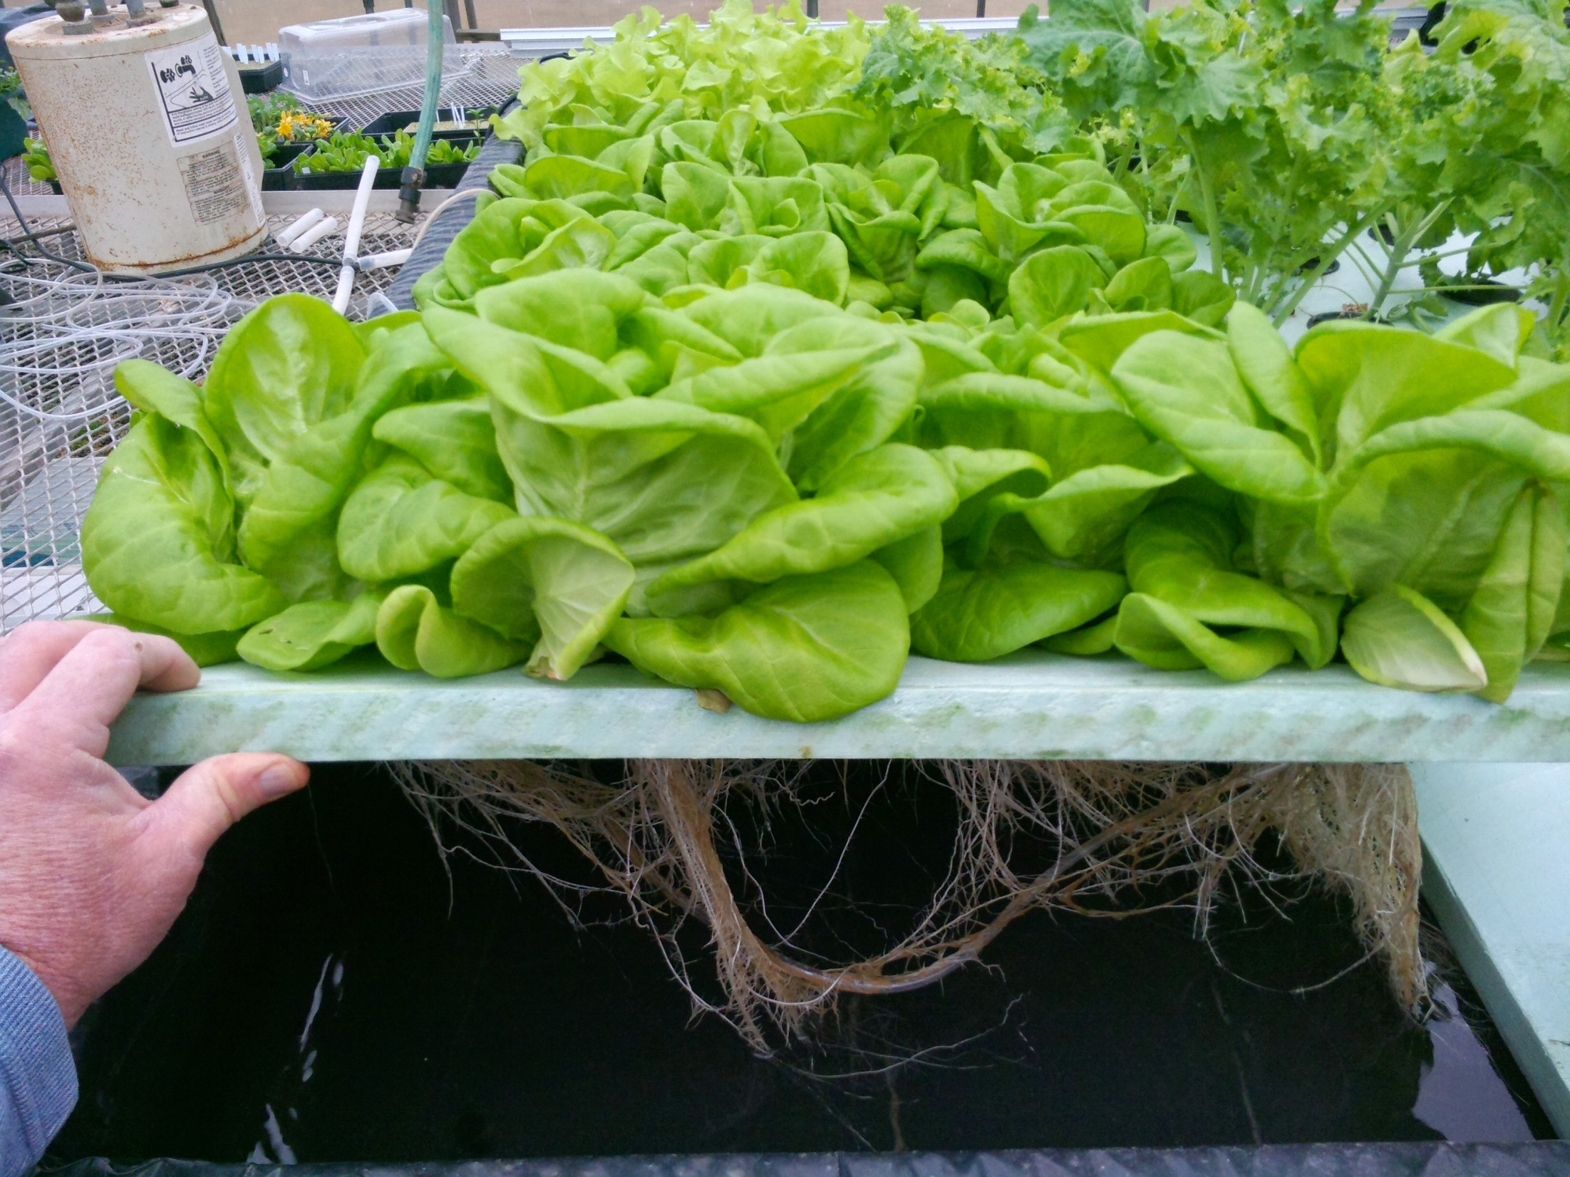
Notes:
Float bed lettuce ready for harvest.

Slide 51
To reach us
Contacts | Contact information
Jeff Kindhart | jkindhar@illinois.edu
Mike Roegge | roeggem@illinois.edu
Nathan Johanning | njohann@illinois.edu
Rick Weinzierl | weinzier@illinois.edu

Slide 52
If you have questions …
University of Illinois Extension Local Food Systems and Small Farms team
http://web.extension.illinois.edu/smallfarm/
USDA’s Start2Farm site
http://www.start2farm.gov/
Notes:
Our beginning farmer training program ended in the fall of 2015. The best way to pursue answers to questions about fruit and vegetable production in Illinois is to contact educators on the University of Illinois Extension Local Food Systems and Small Farms team. Extension programs in other states are operated by the land-grant university in each state. Additionally, USDA’s Start2Farm site provides listings of farmer training programs in specific states and localities.

