Slide 1
Preparing a New Generation of Illinois Fruit and Vegetable Farmers a USDA NIFA Beginning Farmer and Rancher Development Program Project Grant # 2012-49400-19565 http://www.newillinoisfarmers.org
Notes:
The following presentation was part of a beginning farmer course, “Preparing a New Generation of Illinois Fruit and Vegetable Farmers,” offered by the University of Illinois and the Illinois Migrant Council from 2012 through 2015. This course was funded by the United States Department of Agriculture’s National Institute of Food and Agriculture, and specifically by the Beginning Farmer and Rancher Development Program. For more information about the program and for links to presentations and resources on many other topics, see the website newillinoisfarmers.org.

Slide 2
Growing a New Generation of Illinois Fruit and Vegetable Farmers Farm Safety
Jeff Kindhart and Jeremy Shafer
April 2015

Slide 3
Farm Safety
Agricultural work is both dangerous and hazardous!!!
Danger: The possibility of suffering harm or injury
Hazard: An unavoidable danger or risk, even though often foreseeable
Personal Safety
Legal Responsibilities
Moral Responsibilities
Notes:
Agriculture work is both dangerous and hazardous. Growers should think in terms of their own personal safety as well as the safety and legal and moral responsibilities that they have for their employees.

Slide 4
Personal Health and Safety
Eye protection
Sun glasses, Safety glasses, Prescription glasses
Physical injury
Glaucoma
Hat and Sunscreen
NCI 2011 Study – Farmers have higher rates of skin cancer than general population
Notes:
We’ll start by discussing eye protection. Potentials for eye injuries are everywhere. From apple pruning to pumpkin picking numerous farm activities have the potential to cause eye injury. We most commonly think about physical injury which can be addressed through safety glasses. Additionally, growers should consider protecting their eyes from excess UV radiation through either sunglasses or appropriately coated prescription glasses. Protecting one’s skin from excessive UV radiation is also very important. Routine use of hat and sunscreen should be standard practice. A 2011 study by the National Cancer Institute showed farmers have higher skin cancer rates than the general population.

Slide 5
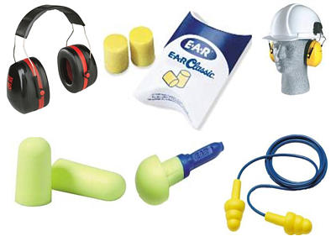
Hearing Protection
Over ear
In ear
In ear + over ear
Notes:
Hearing loss is common among agriculture workers. The powered equipment in common use for many hours of each work day often generate noise levels of sufficient quantity to result in ear damage. Farmers and their employees should always wear hearing protection when warranted. Various types of hearing protectors offer varying degrees of protection. When deciding what type of hearing protectors to purchase, growers should consult manufacturer information and select those that afford the appropriate level of protection.

Slide 6
Gloves and Good Shoes
Gloves should fit and provide the appropriate degree of protection and grip for the tasks being performed
Shoes capable of keeping feet both comfortable and dry are well worth the investment.
Steel toed and/or chemically resistant boots may be appropriate for some activities
Notes:
Gloves and good shoes are also an important part of farm safety. Gloves should be appropriate for the size of the individual and the task being performed. Footwear should be selected that keeps feet dry and comfortable. They should be slip resistant and completely cover the foot. Open toed footwear is never recommended. Laces should always be tied to avoid slips, trips, or entanglements.

Slide 7
High tunnels and greenhouses are particularly good places to experience excessively high temperatures in summer.
Notes:
High tunnels and greenhouses are particularly good places to experience excessively high temperatures in summer.

Slide 8
Heat Illness
Heat exhaustion and stroke are definite concerns for agricultural workers.
May be fatal in severe cases and heat stroke may have some long term health consequences for some victims.
Make sure you and your employees do not dehydrate and exercise good judgment.
Smart phone apps can warn of heat warning and advisories to alert you to the need for extra caution
Notes:
Heat exhaustion and heat stroke are two common forms of heat induced illness. Extreme cases of heat stroke can be fatal and even when not a single event may result in long term health consequences. During periods of high heat it is critical that you and your employees have access to something to drink and exercise good judgment in amount of time spent on tasks and taking breaks. Growers may benefit from downloading apps that provide heat warning and advisory alerts.

Slide 9
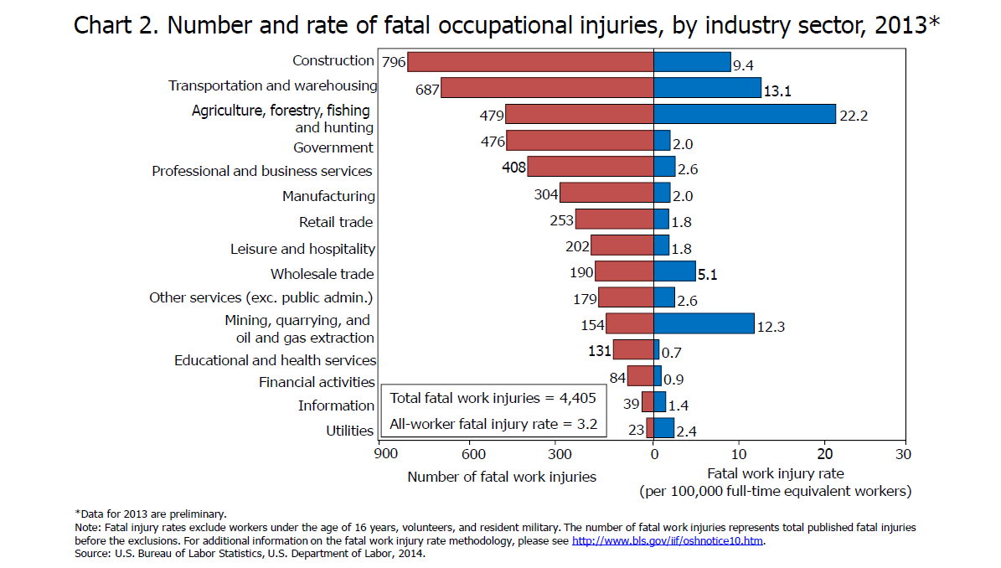
How Dangerous?
Notes:
Up until now this talk has largely centered on personal safety. It is important to understand just how dangerous this industry is for all who participate in it. The nature of the activities being performed, machinery and tools being utilized, typical long days, and the environment where the tasks are being performed, almost all have a degree of danger. According to US Dept. of Labor, 479 fatal accidents occurred in 2013 performing agriculture, forestry, fishing, and hunting occupations. The right half of the table shows just how truly dangerous agriculture is. The fatal injury rate per 100,000 full time equivalents is highest in the agriculture, forestry, fishing, and hunting category. The 22.2 per 100,000 rate for agriculture is nearly 70 percent higher than the next highest occupational sector.

Slide 10
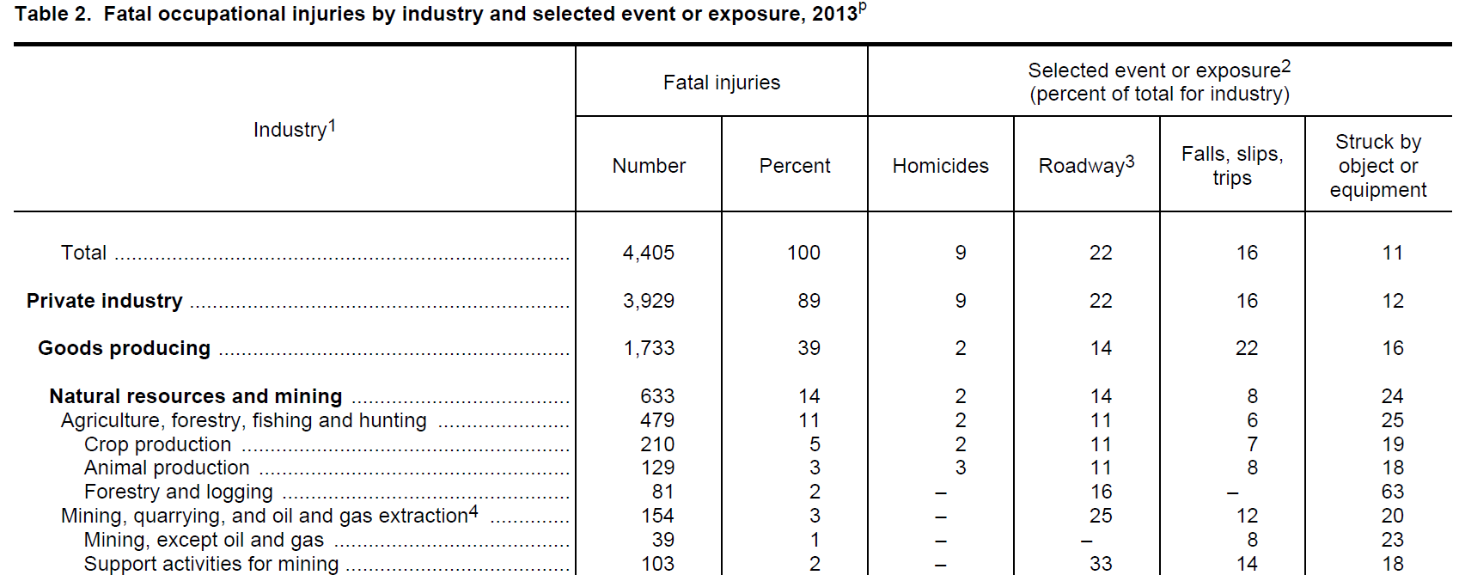
Notes:
This slide shows a general breakdown of how the 2013 fatalities occurred.

Slide 11
Common Perils
Tractor Rollovers
Power Take Off and or Machinery Entanglement
Grain Bin Accidents
Notes:
Some of the more common accident causes are listed here. Tractor rollovers tend to be the number one cause of fatal injuries. Power take off and grain bin accidents tend to be significant contributors to farm fatality numbers.

Slide 12
Notes:
Agricultural related morbidity and mortality information from the United States Center for Disease Control.

Slide 13
Information on Tractor Safety
http://www.aces.edu/farmsafety/documents/Tractor_Machinery.pdf
A graphic slide set from Alabama Extension showing consequences of tractor and machinery accidents.
Notes:
Information on properly operating a tractor should always begin with both a thorough reading and understanding of the manufacturer supplied owners manual. If you have purchased a used tractor which did not come with a manual, you should obtain one. Many manuals are available as free PDF downloads on the internet. Most can be ordered through dealerships. All safety decals, stickers, guards, and shields should always be maintained as designed unless there has been a factory authorized retro-fit. If you are unfamiliar with basic tractor operation procedure, there are numerous training materials available online from both public and private sector websites. Even if you are familiar with these procedures, it would be good to find training materials that you like to properly train all of your family members and employees that might operate the tractor. The same holds true for virtually all other farm equipment.
I would encourage employees be shown the slide set at the above link so that they have a concrete understanding of the potential outcome from failure to properly operate a tractor or machinery.

Slide 14
More from Alabama Extension
A Farm Safety Management Plan for Alabama Farmers (PDF file) - without pictures
Farm Safety Management Plan Presentation (PDF file) - with pictures for use in training
General Farm Safety Rules (PDF file) - all participating farmers must review all of the rules and use only those that apply to their unique operation
Electrical Safety Rules (PDF file) Fire Safety Rules (PDF file)
Tool Safety Rules (PDF file) Machinery Safety Rules (PDF file)
Animal Safety Rules (PDF file) Toxic Safety Rules (PDF file)
All Farm Safety Rules (MS Word file) - a list of all rules that can be modified
PTO and Post Hole Digger Safety(YouTube video)
How to Install and Maintain a Shaft Cover on a Tractor PTO(YouTube video)
Notes:
There are many very good websites devoted entirely to farm safety. Here are some training materials available from Alabama Extension that could be easily adopted to any farm.

Slide 15
Other lesser talked about perils
Weather
Chainsaw Accidents
Electrocutions
Carbon Monoxide Poisoning
Etc.
Notes:
There are many different ways accidents can occur in agriculture. Here are a few of the “more common” lessor perils that annually result in agricultural fatalities.

Slide 16
Weather - Lightning
Open cab tractor
Field workers on foot
Weatherbug or other smart phone app that has lightning notification
Losing a few bushel of produce in NEVER worth trading for a persons LIFE!!!!!
Notes:
Lightning has decreased as a fatal event in agriculture overall largely due to most tractors now having an enclosed cab. Open cab tractors, while far less common in row crop production, are very much still commonplace for specialty crop producers. Lightning is not only a problem for individuals in open cab tractors, but also for all field workers on foot. When lightning is present, workers must be immediately removed from harms way until after the danger has passed for several minutes. Smart phone apps like Weatherbug that provide lightning notification are very worthwhile downloads.

Slide 17
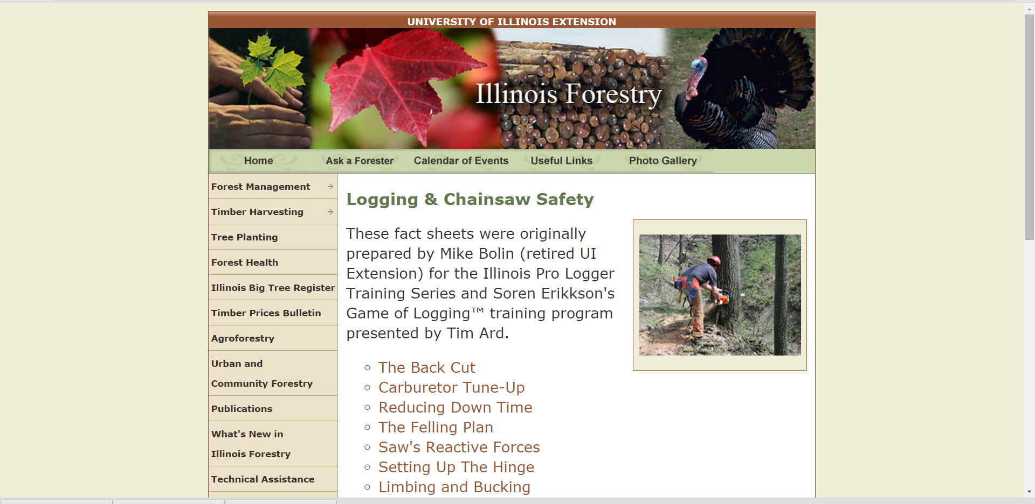
Chainsaw Safety
http://web.extension.illinois.edu/forestry/timber_harvest/logging_chain_safety.html
Notes:
Accidents that result from chainsaw operating are commonplace. In many cases, it is not the actual chainsaw that causes the injury, but instead the injury is the result of being struck by branches or trees, falling, or tripping. There is a training site devoted to chainsaw safety operated by the University of Illinois Dept. of NRES. In addition, they also offer chainsaw safety clinics periodically.

Slide 18
Electricity
Greenhouses are commonly well grounded structures made of electrical conductive metal.
Greenhouses are often wet environments making them a better than average potential for electrical shocks.
Wire greenhouse circuits in accordance with electrical standards including conduit where appropriate and use of ground fault interrupt devices.
Notes:
Electrical shocks and electrocution do unfortunately occur in agricultural production. While these can occur while operating any electrical device, we should be especially careful with electricity in greenhouse and high tunnel settings. Wire greenhouse circuits in accordance with electrical standards including conduit where appropriate and use of ground fault interrupt devices.

Slide 19
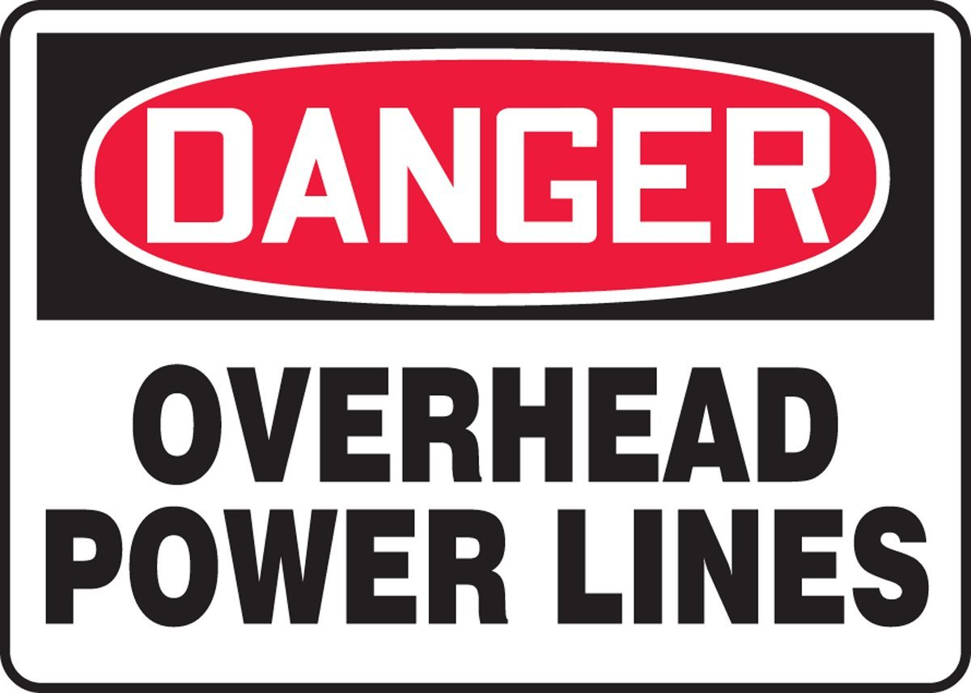
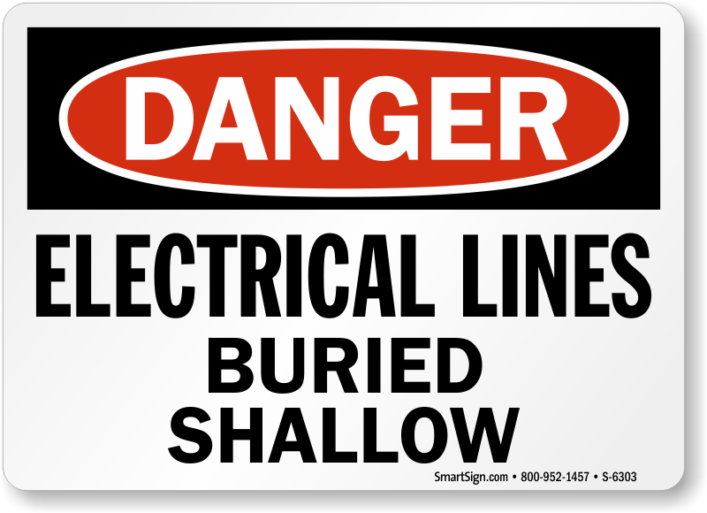
Overhead and Underground
Notes:
Be mindful of overhead and buried electrical lines that can cause serious injury or death.

Slide 20
Ladders, Lifting and Falls
http://umaine.edu/publications/2326e/
Notes:
Agricultural workers should be mindful of safe ladder operation and be receive training on proper lifting techniques.

Slide 21
Carbon monoxide
Greenhouses, high tunnels, coolers, packing sheds and other possible farm structures have the potential to hold carbon monoxide from internal combustion engines and poorly vented heating sources.
Always afford ventilation when operating gasoline powered engines
Have heat sources inspected
Carbon monoxide detectors.
Notes:
Carbon monoxide poisoning is another potentially fatal hazard for farmers. Operating gas powered engines or non-electric heat sources in enclosed areas has the potential to result in carbon monoxide poisoning. Always afford ventilation when operating gasoline powered engines in enclosed areas such as greenhouses, high tunnels, coolers, and packing sheds.

Slide 22
Legal Responsibilities
If using pesticides you must be in compliance with US EPA worker protection standard
http://www.epa.gov/agriculture/htc.html
OSHA Reg’s. often not applicable
Notes:
Any farm utilizing pesticides must be in compliance with the US EPA worker protection standard also known as WPS. This law has elements requiring employee training, right to know, requirements for personal protective equipment, and more. More information on the US EPA WPS can be found at the above link.
I am certain nearly everyone is familiar with US Dept. of Labor OSHA regulations. Most farms are exempted from these regulations, however, even though your farm may be exempt from their regulations, it is still good to review their guidelines, training materials, and educational opportunities.

Slide 23
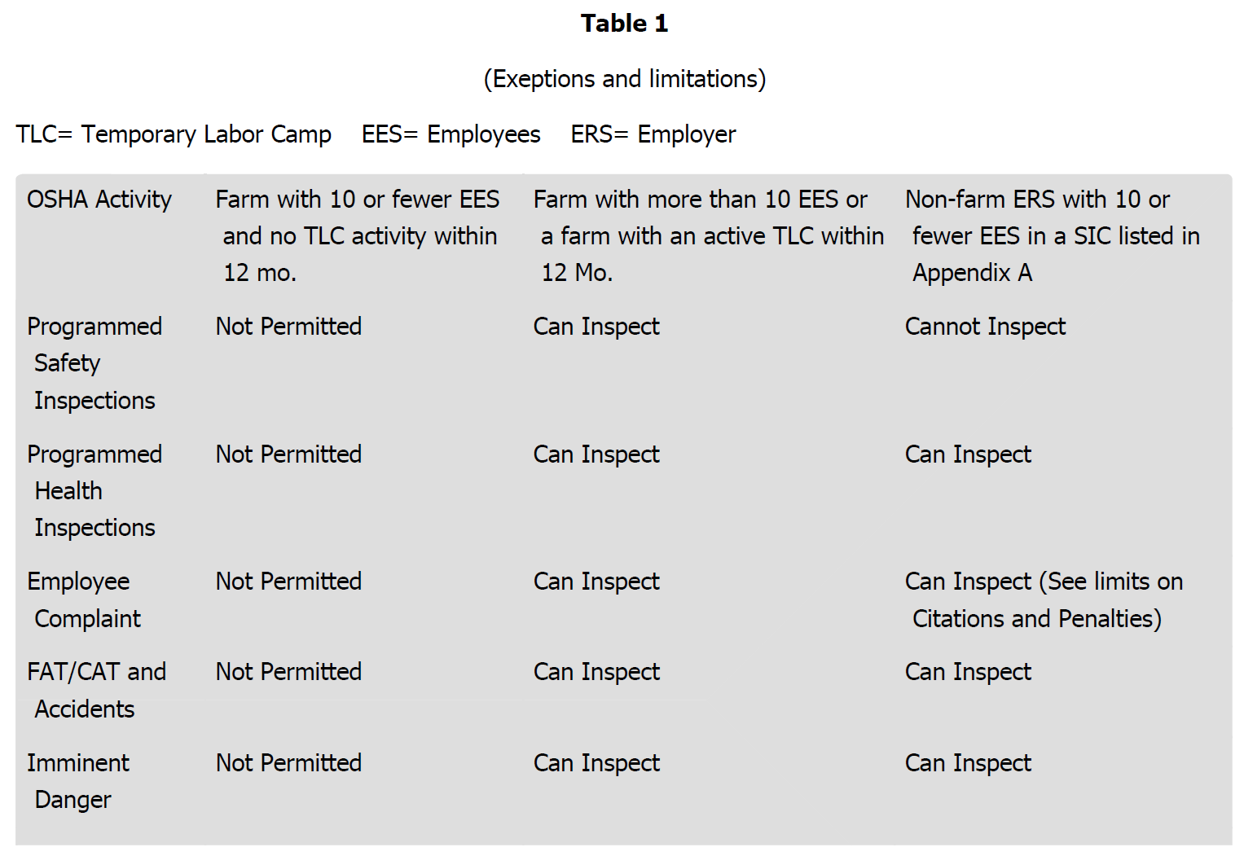
Notes:
This slide shows the exemptions and limitations associated with OSHA regulations.

Slide 24
Biological Hazards
Vector-borne disease
Venomous wildlife and insects
Poisonous plants
Notes:
One final thought on farm safety. Growers should be mindful to protect themselves and their employees from biological hazards. Vector- borne diseases, such as West Nile disease and Lime disease make it so growers should consider the use of insect repellants for personal protection in certain situations. Everyone on the farm should be mindful of the potential for insect and spider stings and bites. Those with anaphylactic concerns should carry EPI pens or other appropriate rescue measures. The hot environment of the greenhouse can sometimes lead to significant populations of brown recluse and black widow spiders. In the southern part of the state where venomous snakes are indigenous, farmers and their employees should have training on identification of any potential threats. Outbreaks of poison ivy are common and for some individuals may become relatively severe. Protective measures should be undertaken when dealing with poison ivy. Like Mama always said, leaflets three, let it be.

Slide 25
To reach us
Contacts | Contact information
Jeff Kindhart Jeremy Shafer Rick Weinzierl | jkindhar@illinois.edu jshafer@illinois.edu weinzier@illinois.edu

Slide 26
If you have questions …
University of Illinois Extension Local Food Systems and Small Farms team
http://web.extension.illinois.edu/smallfarm/
USDA’s Start2Farm site
http://www.start2farm.gov/
Notes:
Our beginning farmer training program ended in the fall of 2015. The best way to pursue answers to questions about fruit and vegetable production in Illinois is to contact educators on the University of Illinois Extension Local Food Systems and Small Farms team. Extension programs in other states are operated by the land-grant university in each state. Additionally, USDA’s Start2Farm site provides listings of farmer training programs in specific states and localities.

