Slide 1



Preparing a New Generation of Illinois Fruit and Vegetable Farmers a USDA NIFA Beginning Farmer and Rancher
Development Program Project
Grant # 2012-49400-19565 http://www.newillinoisfarmers.org
Notes:
The following presentation was part of a beginning farmer course, “Preparing a New Generation of Illinois Fruit and Vegetable Farmers,” offered by the University of Illinois and the Illinois Migrant Council from 2012 through 2015. This course was funded by the United States Department of Agriculture’s National Institute of Food and Agriculture, and specifically by the Beginning Farmer and Rancher Development Program. For more information about the program and for links to presentations and resources on many other topics, see the website newillinoisfarmers.org.

Slide 2
Preparing a New Generation of Illinois Fruit and Vegetable Farmers
Cover Crops for Vegetable and Fruit Production in Illinois
Nathan Johanning
with contributions from Mike Plumer, Jeff Kindhart,
Rick Weinzierl, and Sam Wortman
September 2015
Notes:
Hello. I am Nathan Johanning, Extension Educator with the University of Illinois Extension and today we are going to talk about cover crops for fruit and vegetable production.

Slide 3
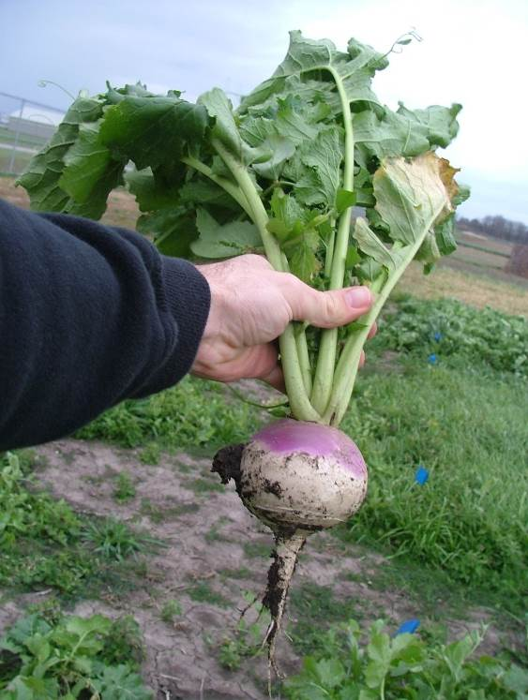
Cover Crops Defined
Crops planted for the purpose of conserving natural resources, improving soil health, and/or preserving, adding or cycling nutrients, and managing weeds
Often planted during times when no other cash crop is present
  Over winter or between summer crops
Notes:
Cover crops are crops planted for the purpose of conserving natural resources, managing weeds, improving soil health, and/or preserving, adding, or cycling nutrients in the soil among many other benefits. Often cover crops are planted during times when no other cash crop is present which could be over winter or between summer crops.

Slide 4
Why Use Cover Crops?
Prevents erosion
Reduces soil compaction
Improves soil drainage
Breaks up plow pans
Increases water infiltration
Increase soil organic matter
Suppresses weeds
Scavenges and holds nutrients
Produce nitrogen
Improves soil tilth
Protects water quality
Habitat for beneficial insects, pollinators, earthworms, and soil microbes
Suppress nematodes
Improves overall soil health = Increased crop health!!
Different cover crops provide different benefits!!
Notes:
Cover crops have many benefits including those for the soil such as preventing erosion reducing compaction, improving drainage, breaking up hard pans and increasing water infiltration and soil organic matter. Also cover crop can suppress weeds, scavenge, hold and produce nutrients, protect water quality, provide a habitat for beneficial organisms and suppress nematodes, overall providing a healthy soil. However, different cover crops do provide different benefits.

Slide 5
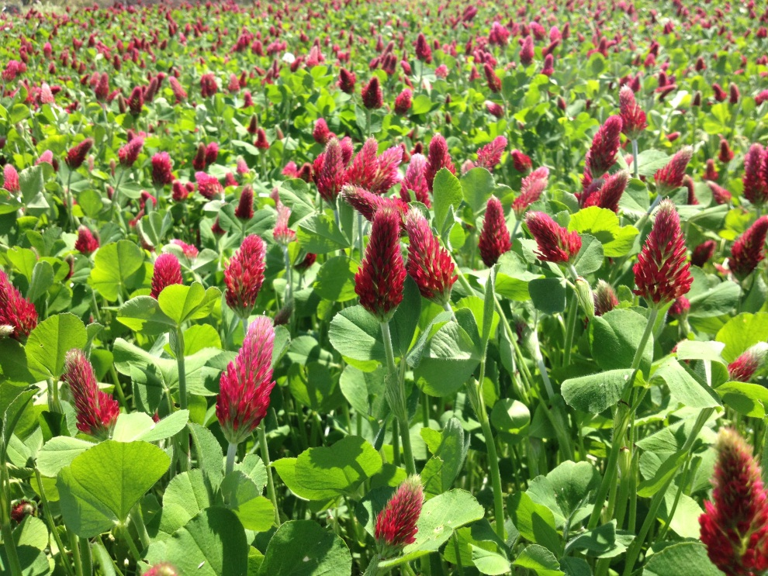
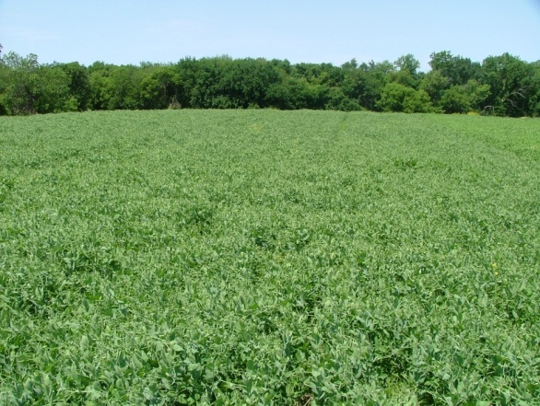
Plant Nutrient Production and Recycling
Nitrogen
  Nitrogen scavenging (catch crops)
  Biological nitrogen fixation
  What is a realistic goal for adding N to the system?
Notes:
As we have mentioned many cover crops have the ability to either scavenge or produce nutrients especially nitrogen. This can be a great source of nitrogen for future fruit and vegetable crops.

Slide 6
Will you be able to replace synthetic N on your farm?
  http://smallfarms.oregonstate.edu/calculator
Notes:
This rate calculator tool is a great way to get an estimation of how much nitrogen a cover crop may have produced based on sampling a small area of crop biomass and getting the weight and lab analysis for nitrogen. In general nitrogen production can very greatly based on the weather and most importantly the growth stage of the cover crop. Typically the longer a legume cover crop has been growing the greater the amount of nitrogen it has produced.

Slide 7
Soil Organic Matter (SOM) has economic value
Cover crops are key to building SOM!
Every 1% point increase in SOM adds about 1 inch of water holding capacity/acre, each inch is 1 week in a drought
Water infiltration and soil aggregation increases, while erosion and bulk density decreases
Nutrient efficiency improves
  Value of N from SOM: $9-$15/acre
Increased SOM and cover cropping have shown yield stability in years with low rainfall, compared to rotations without cover crops
Notes:
Soil Organic Matter is a major contributor to the health and productivity of our soils and cover crops are very important in building organic matter. For every one percent of organic matter, the soil can hold an additional 1 inch of rain which can be crucial under drought conditions. Organic matter also helps aggregate the soils and provide better structure which allows better water infiltration and decreases erosion and the bulk density of the soil. Organic matter also contributes nutrients to the soil especially nitrogen, phosphorus, and sulfur which also future crops can benefit from. Overall, these qualities provide yield stability especially in drought years by allowing the soil to hold more water and nutrients.

Slide 8
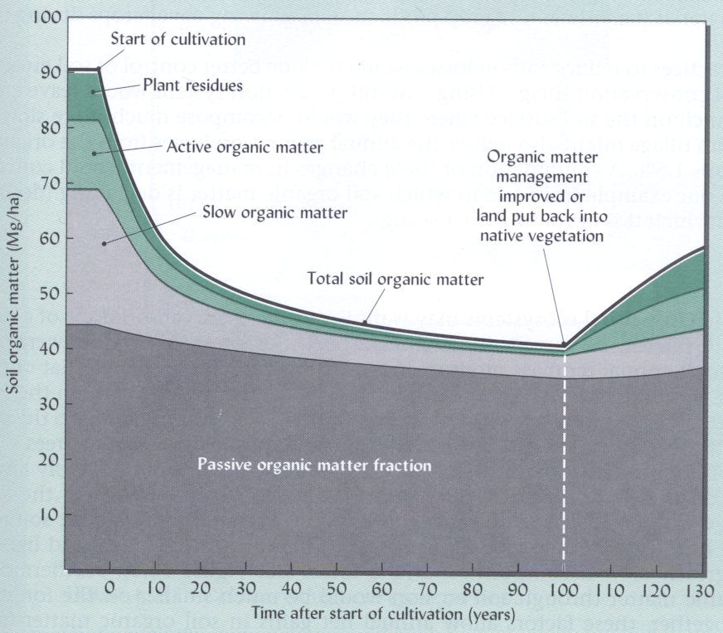
Tillage Can Reduce Soil Organic Matter
(Brady and Weil 1999)
Notes:
Unfortunately there are many things we do that can actually reduce soil organic matter and most importantly tillage. Every time we till or work the ground we break up the natural structure of the soil and expose organic matter that quickly breaks down as it is exposed to oxygen. While tillage is essential to some fruit and vegetable crops, this is a very important thing to understand so we can look for ways to reduce any unnecessary tillage passes, work towards no-till production for some crops and consider how to help rebuild organic matter when tillage is necessary.

Slide 9
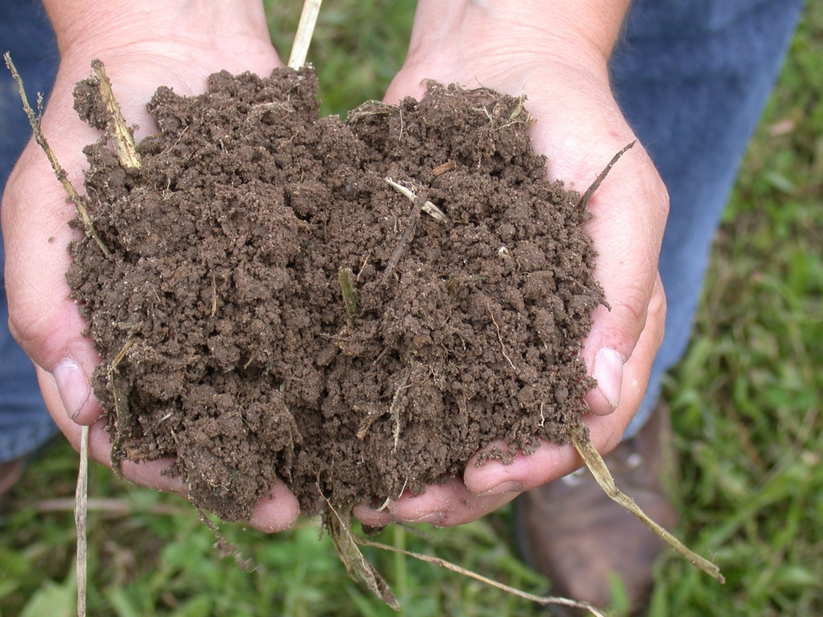
Profitable Production Practices Can Actually Increase Organic Matter!
- Photo courtesy of S. Snapp
Notes:
There are many profitable production systems and practices that we can incorporate into fruit and vegetable production, while maximizing yield and also building soil organic matter.

Slide 10
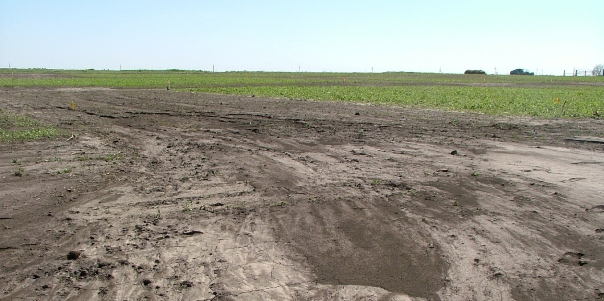
Cover Crops are an Important Soil Conservation Tool
Soil coverage (most species living or dead) reduces erosion especially on highly erodible soils
Notes:
Cover crops are also an important part of preventing soil erosion. Soil coverage from cover crops can greatly prevent the loss of soil which keeps it in the field where it benefits you the most!

Slide 11
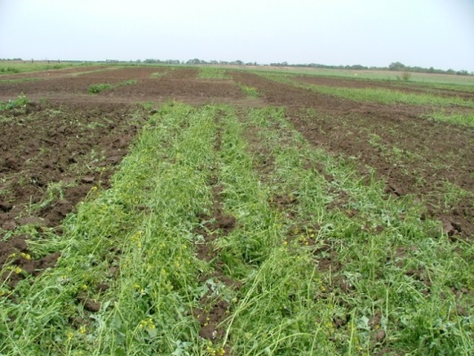
Fuel Soil Microbial Communities
Including cover crops in rotation results in changes to the structure of microbial communities – so what?
  Increased microbial diversity and resilience
  Depending on management, cover crops can increase fungal populations
Fungi – specifically AMF (arbuscular mycorrhizal fungi) – are essential for nutrient cycling and adsorption of immobile elements
  Hosts = tomato and pepper
  Non-hosts = Brassica crops
Notes:
Many cover crop systems can also increase the microbial communities in the soil which can lead to a greater diversity of many beneficial soil microorganisms which can help to plant growth and the cycling of nutrients. One fungi that is very beneficial to nutrients cycling is arbuscular mycorrhizal fungi.

Slide 12
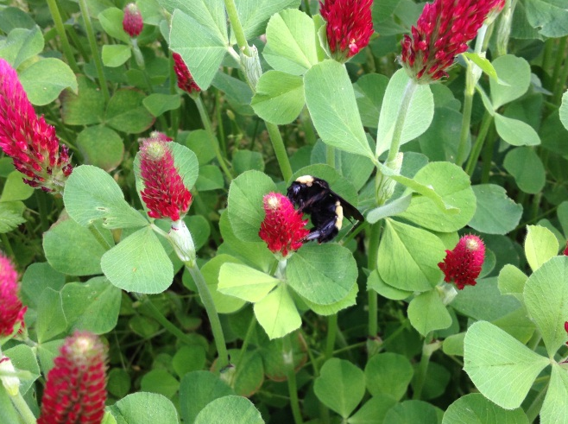
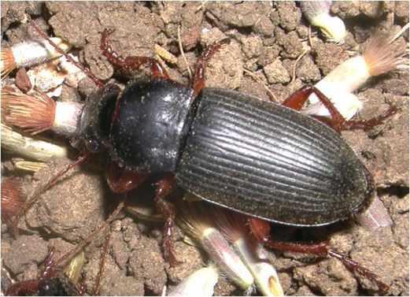
Habitat for Beneficial Insects
  Cover crops increase weed seed predators
  Cover crops increase pollinator populations
    Researchers in Georgia were able to eliminate one pesticide application in cotton by attracting beneficial pest predators
Notes:
Beneficial insects can thrive with the added cover and habitat that cover crops provide. These insects play many roles in the cropping system including pollination and being a predator of weed seeds. In a long term cover crop system, cover crops have the potential for reducing some pest pressure.

Slide 13
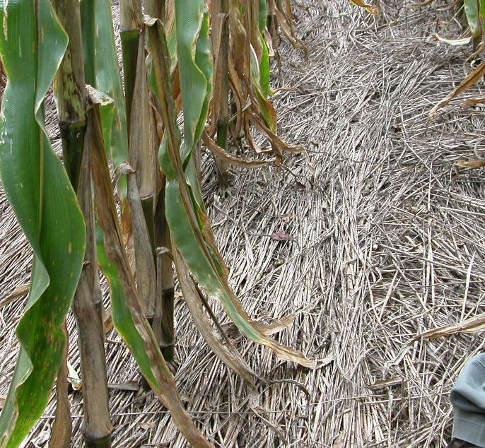
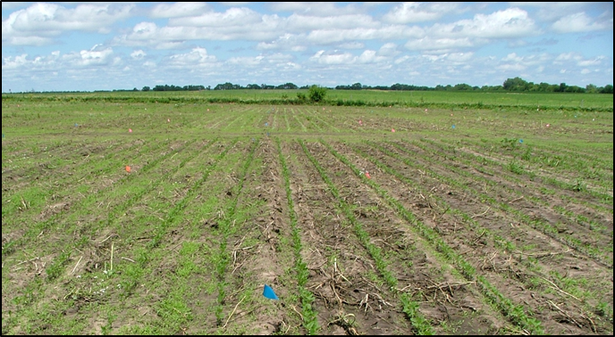
Weed Suppression
  Light interception
  Lower soil temperature
  Physical interference
  Delayed soil N release
  Allelopathic phytotoxins
Notes:
Cover crops can also help to suppress weeds especially with no-till production. Residue can block light and physically prevent weeds from germinating and moderate soil temperatures and nutrient release slowing new flushes of weed growth. Also some cover crops such as cereal rye have allelopathy which means that the plant produces chemical compounds that suppress other plants from germinating around them.

Slide 14
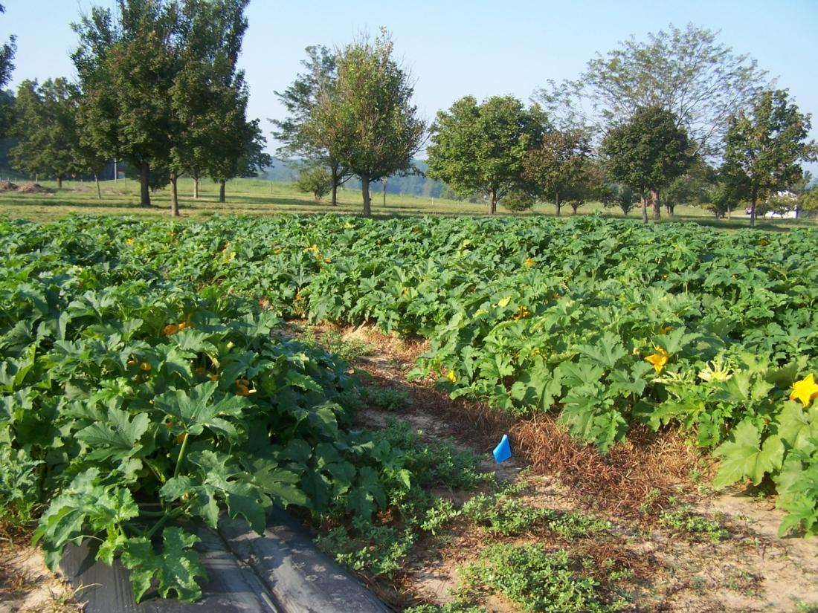
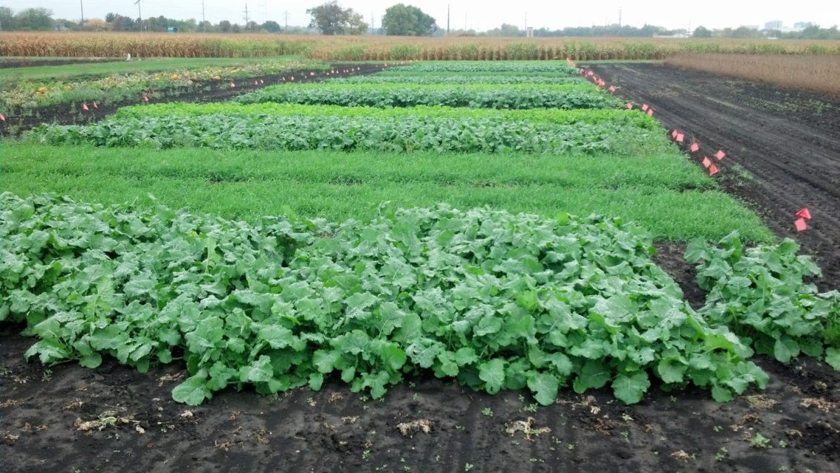
Biofumigation
Mustards produce isothiocyanates. Flail/mow and incorporate for biofumigation. Results (disease and weed suppression as well as crop establishment) can vary.
Notes:
Certain cover crops such as those in the mustard family also have the potential to be used as biofumigants. Mustards produce isothiocyanates and if you chop green residue and incorporate into the soil, the release of these compounds can help suppress diseases and reduce weed populations. However, results can very greatly on the environmental conditions and crop growth and thus far has not proven as consistent as other forms of fumigation.

Slide 15
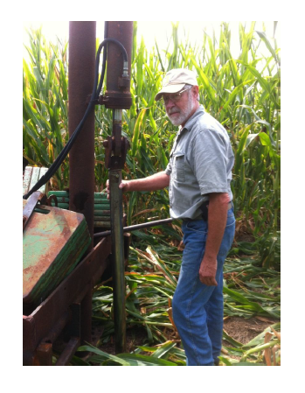
Mike Plumer, retired U of I Extension Educator and cover crops / no-till authority. Currently an agricultural consultant in southern IL.
Notes:
The next few slides are from some research conducted by Mike Plumer, retired U of I Extension Educator and cover crops / no-till authority in Southern Illinois.

Slide 16
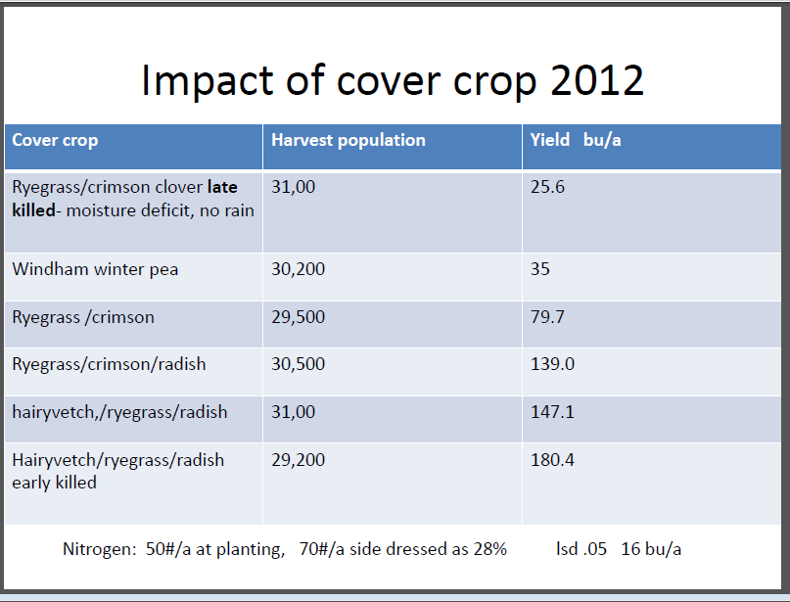
Notes:
This slide shows the impact of cover crops on field corn during a drought year such as 2012. You can see that many of the cover crop treatments provided a much higher yield especially considering many non-cover cropped fields stuggled to make even 20 or 30 bushels per acre with many much less than that. This also illustrates the importance of how you manage a cover crop. Note that the late killed cover crop on the top was the lowest yielding as during very dry conditions cover crops can actually pull too much moisture out of the ground. Thus if it is very dry early in the season it is important to pay close attention to the cover crops and terminate them early before that remove all of the moisture from the soil.

Slide 17
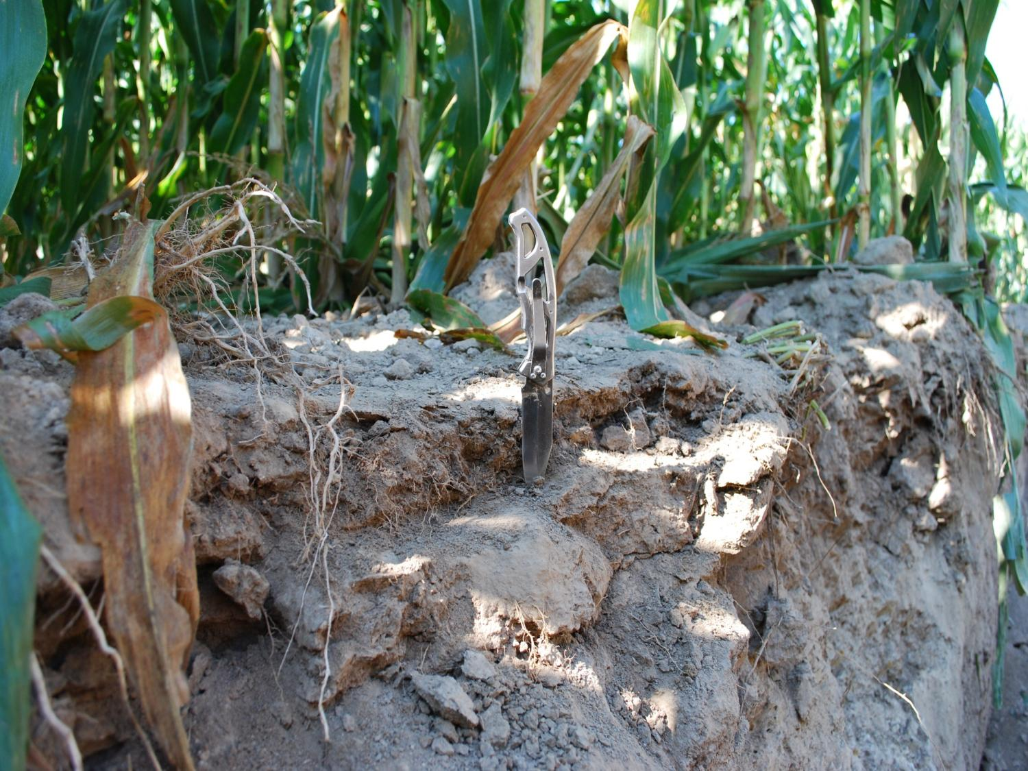
Continuous no-till with spring vertical tillage … note compaction layers.
Notes:
This shows a very good example of how compacted soils can get. Where the knife is shows a hard pan formed by even modest tillage. These layers can greatly decrease a crops ability to root into the soil.

Slide 18
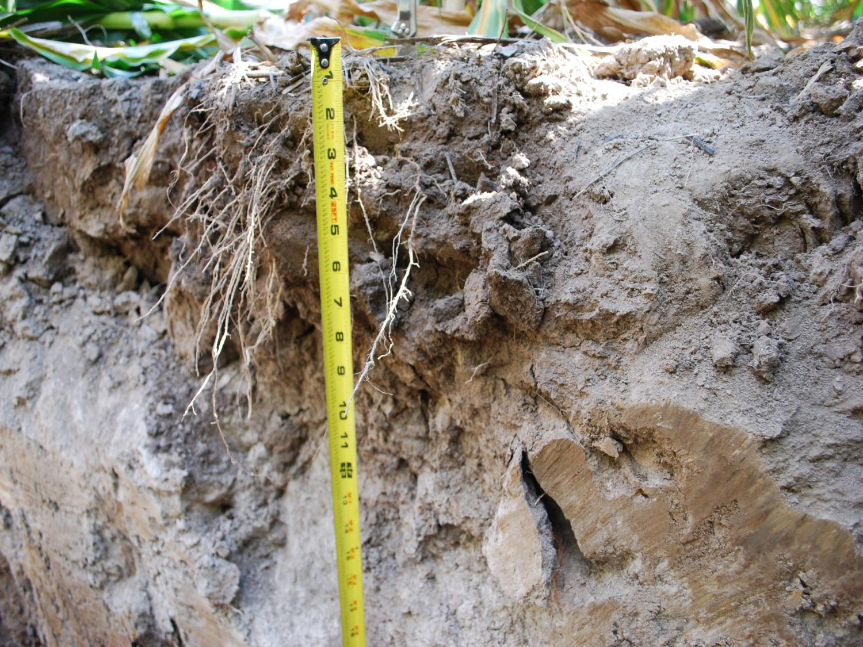
Notes:
Consequently here is the amount of root growth the in this field has.

Slide 19
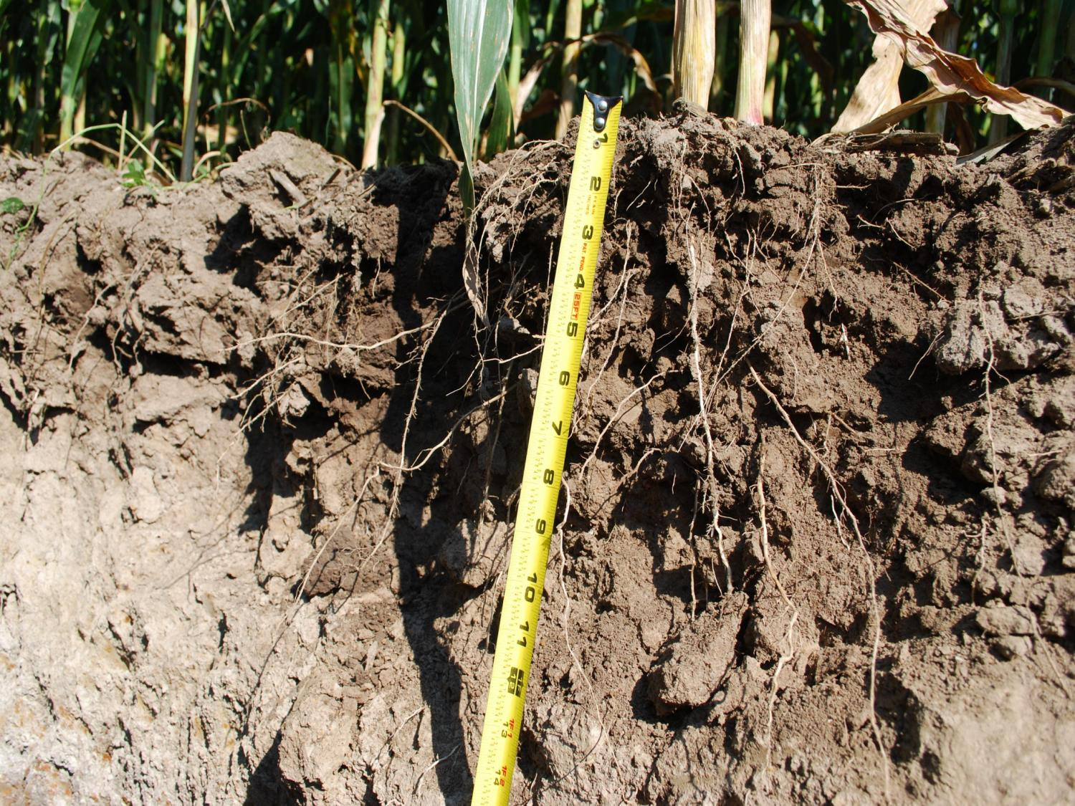
Soil tilth after multiple years of cover crops and no-till
Notes:
Compare that with this image of corn roots after multiple years of cover crops and no-till production.

Slide 20
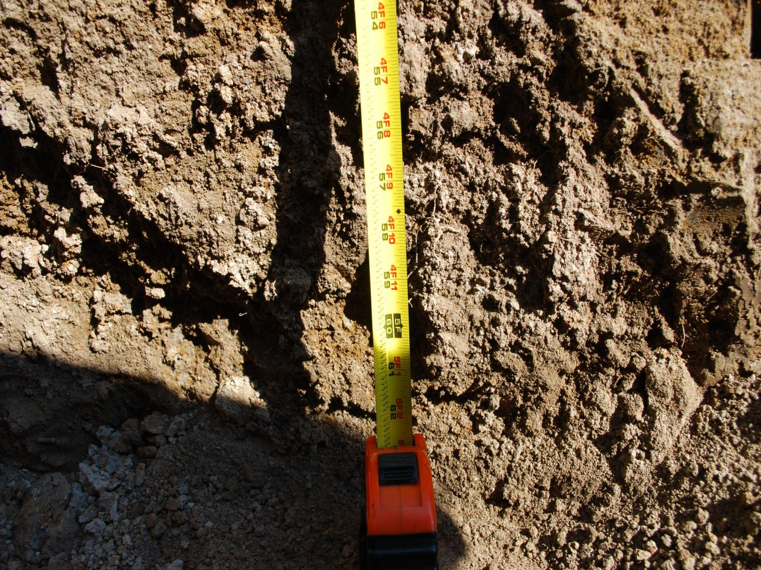
Corn root depth after years of cover crops
Notes:
After many years of no-till and cover crops, crop roots can find old root channels from cover crops and root very deeply into the soil. In this case almost 5 feet deep.

Slide 21
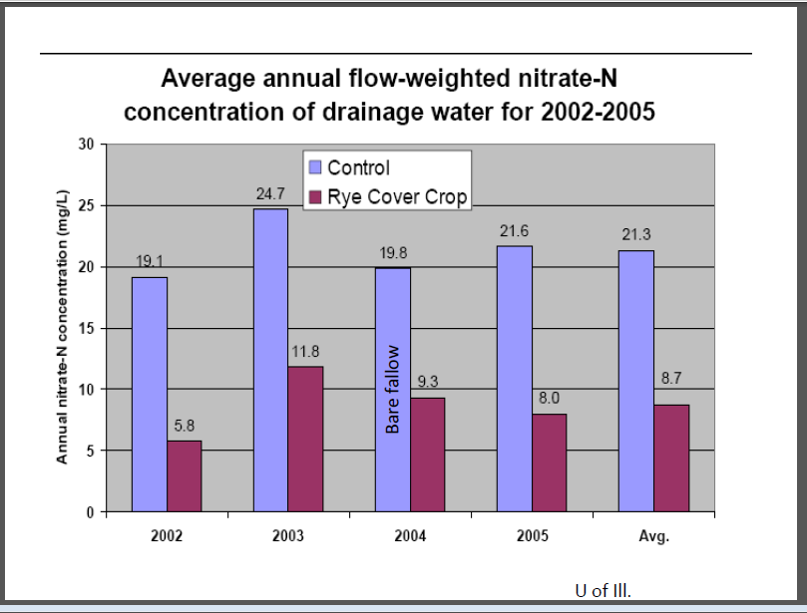
Notes:
Cover crops are also very good at trapping nutrients. This graph shows the differences in nitrate concentration in drainage water from two field one with no cover crop and the other with a cereal rye cover crop. In general the cereal rye is able to reduce nitrate levels by more than half compared with having no cover crop. Not only is that nitrogen staying out of our lakes a rivers but the cover crop also keep it in place for future crops to use.

Slide 22
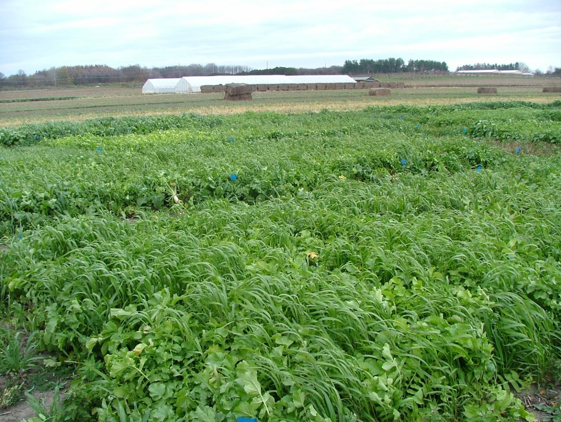
Cover Crops for Vegetable Cropping Systems in Illinois
Notes:
Now lets talk specifically how to use cover crops in specialty crop production!

Slide 23
How to Use Cover Crops in Vegetable Crop Systems
Fall/Winter crop to be left in place to protect soils and hold nutrients
Summer fill between crops
Main crop during the primary growing season
  Good to incorporate into a crop rotation
  Helps break disease and insect cycles from continuous vegetable production
  Excludes production of cash crop
Notes:
Cover crops can be used to cover fields over the winter or between any summer plantings. Also cover crops can be used as a “green” fallow treatment to build the soil for a season rather than cropping it. This can be a great addition to a crop rotation, helping to break up disease and insect cycles, and manage weeds all while build the soil as well.

Slide 24
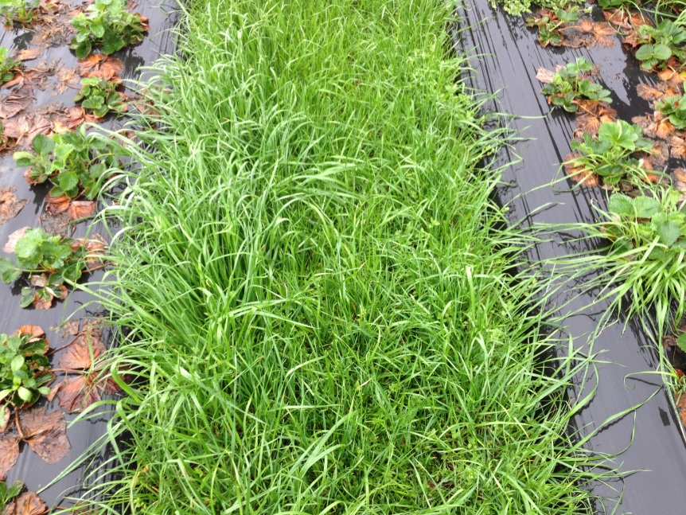
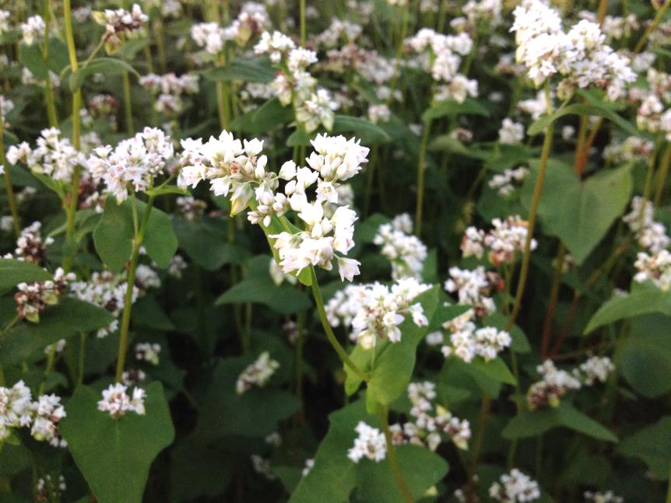
How to Use Cover Crops in Vegetable Crop Systems
Companion crop planted between rows of the vegetable crop (between rows of black plastic!)
Pollinator Habitat
  Strips of Buckwheat planted around cucurbits
Residue cover for no-till production
Notes:
Also you can plant cover crops between crop rows and this works especially well between rows of black plastic as the top picture shows annual ryegrass planted between rows of plasticulture strawberries. Cover crops are also important as a pollinator habitat to encourage the pollinators many fruit and vegetable crops need. And lastly cover crops can provide residue to utilize with no-till vegetable production.

Slide 25
No-till/Cover Crop Benefits in Fruit and Vegetable Production
Cleaner fruit/fruit not lying directly on the soil
Weed Control
Easier field access/harvesting under adverse weather conditions
  Especially less muddy after rains
Preserve soil moisture
Nitrogen production (legumes)
Notes:
Cover crops especially have a very important roll in no-till fruit and vegetable production. Residue can keep low and ground growing fruits clean of soil, suppress weeds, and help hold moisture in the soil. Also, it allows for better field access after rains which can be very important for crops that have to be harvested regardless of the weather. An many cover crops can also help add and hold nutrients for future crops to use.

Slide 26
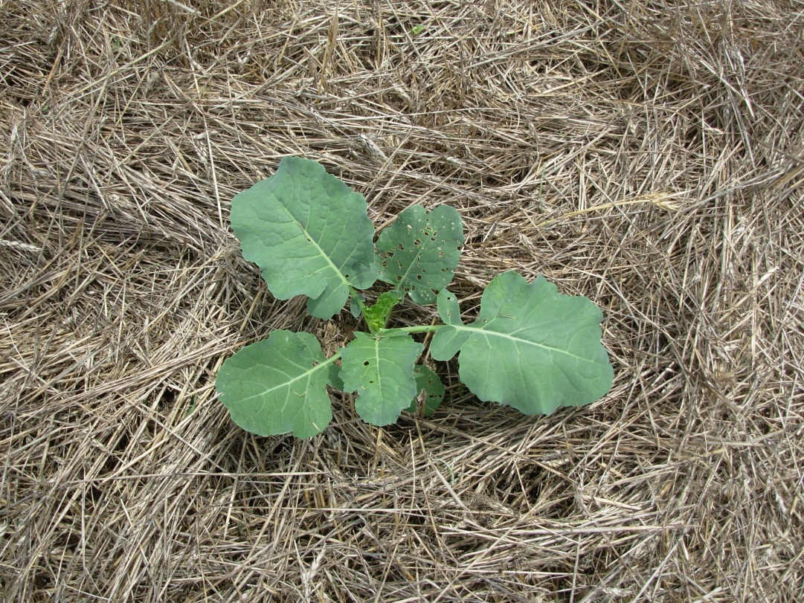
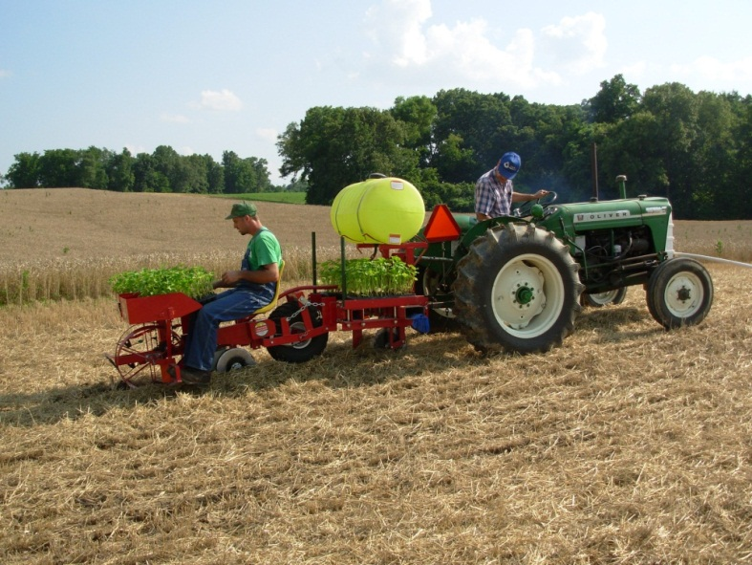
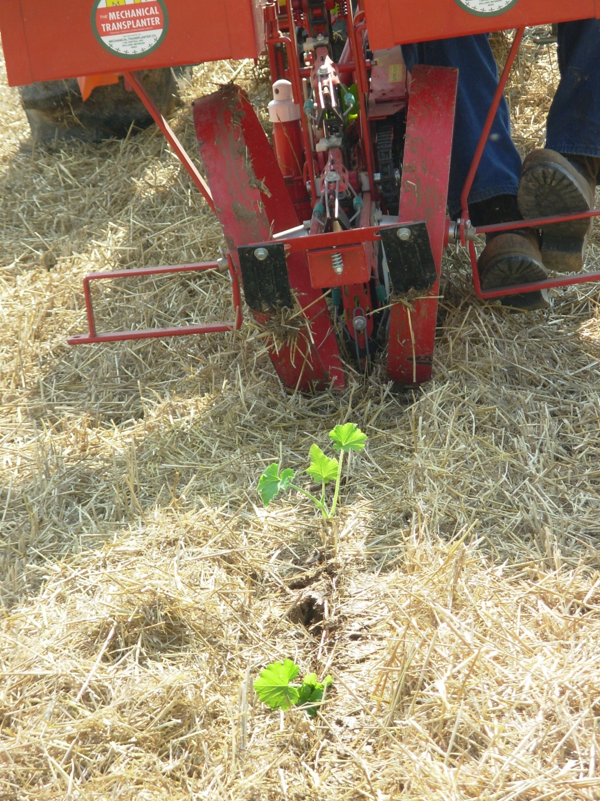
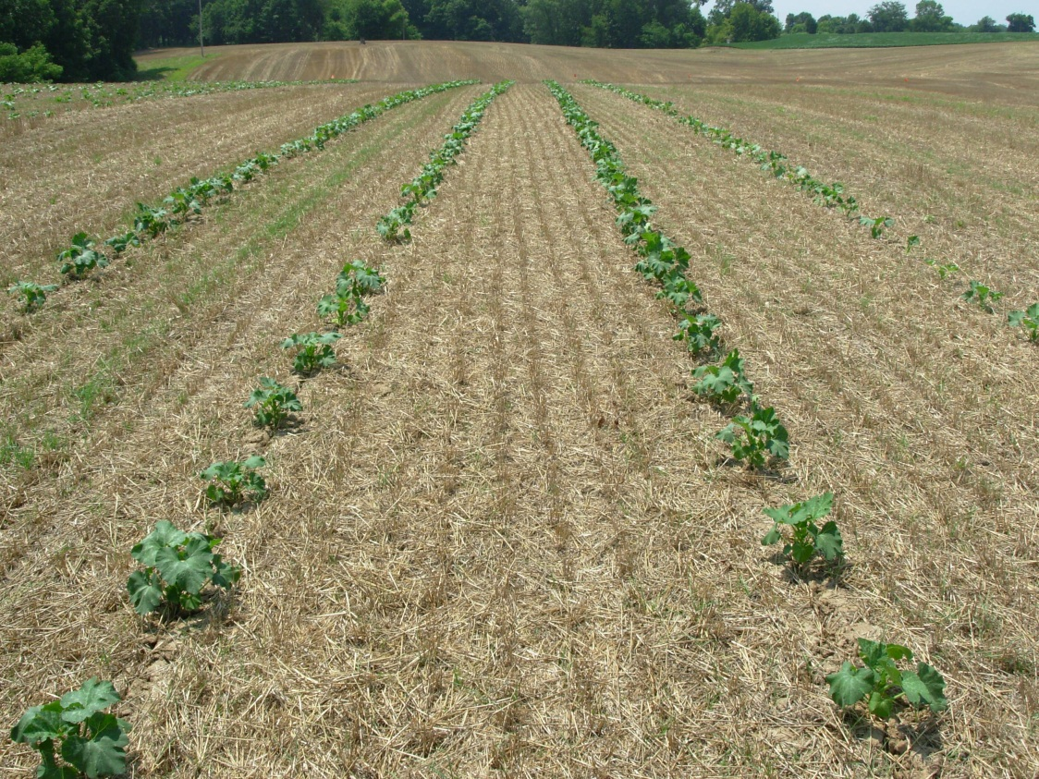
Notes:
Here you can see some examples of cover crops and no-till vegetable production. A the top left we have a picture of a fall crop of broccoli no-till planted after a cereal rye cover crop. The remaining pictures are of no-till transplanting pumpkins after wheat.

Slide 27
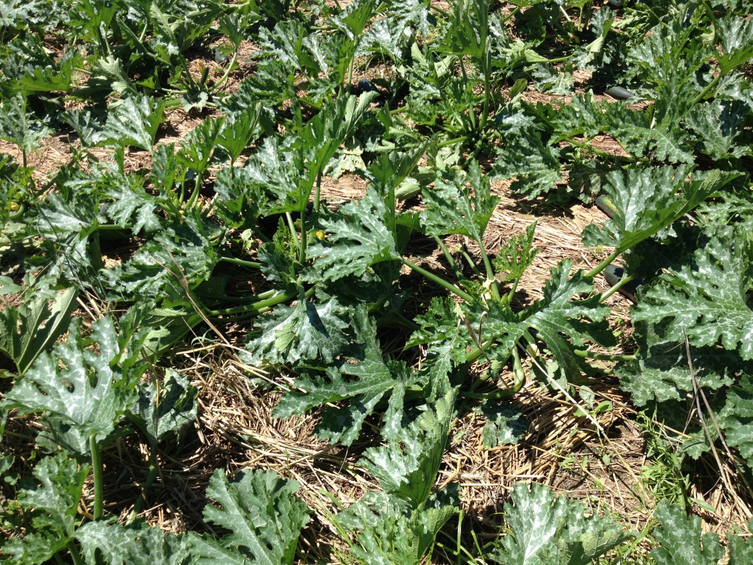
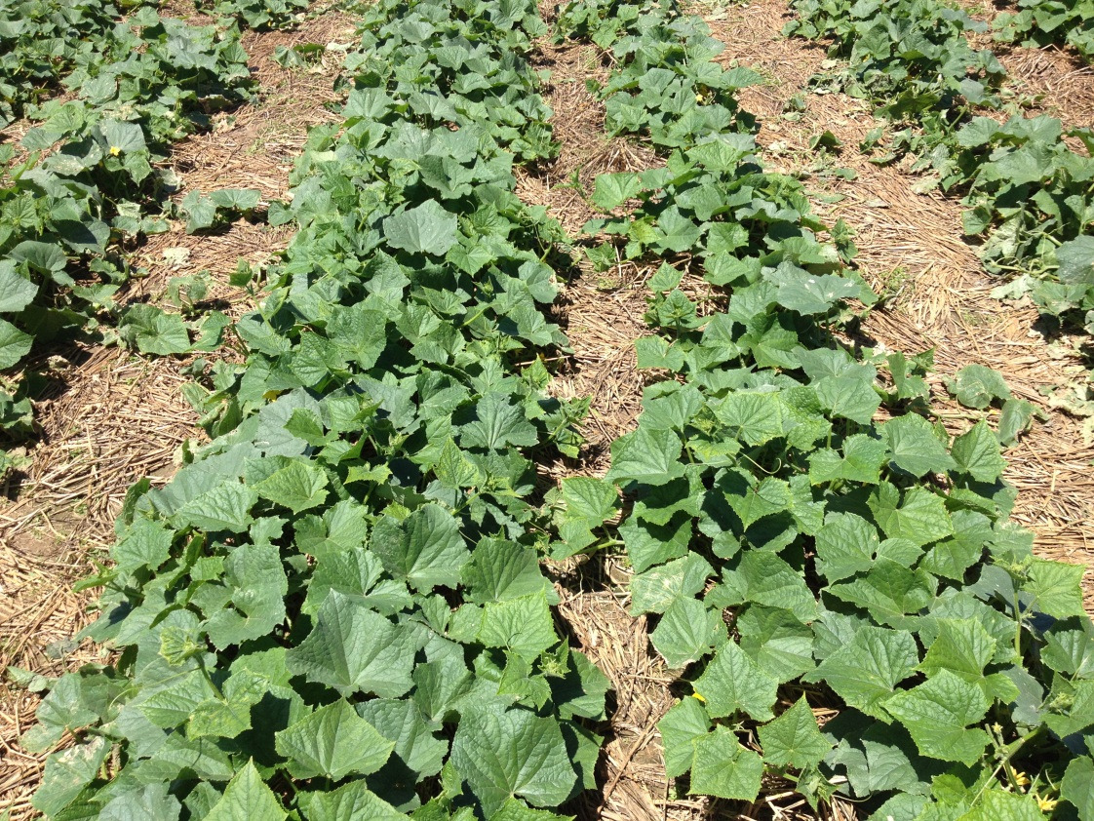
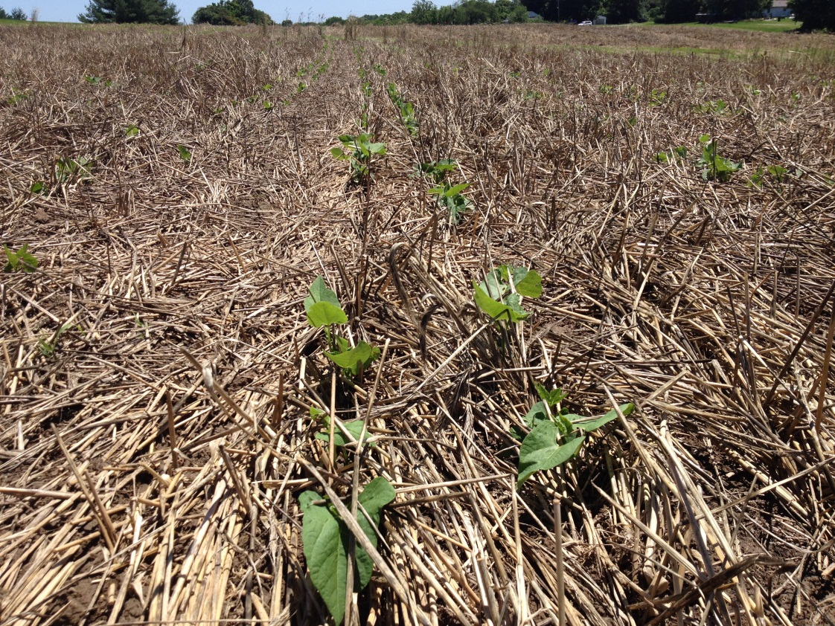
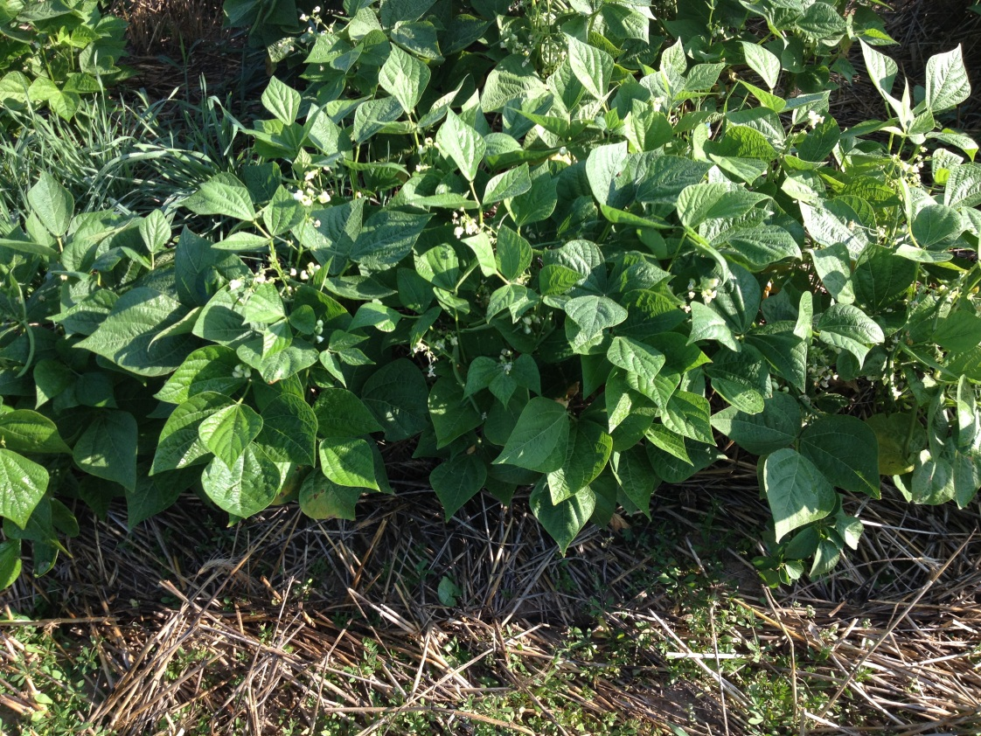
Notes:
Here are some additional no-till crops. At the top we have no-till transplanted zucchini (left) and cucumbers (right). Then below we have no-till planted green beans. All of these were following a oilseed radish/crimson clover/cereal rye cover crop.

Slide 28
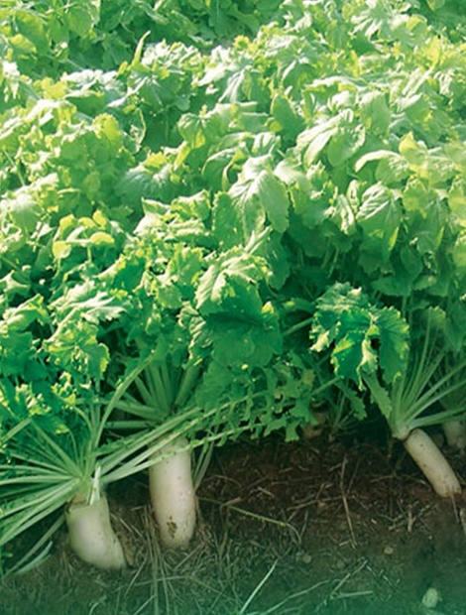
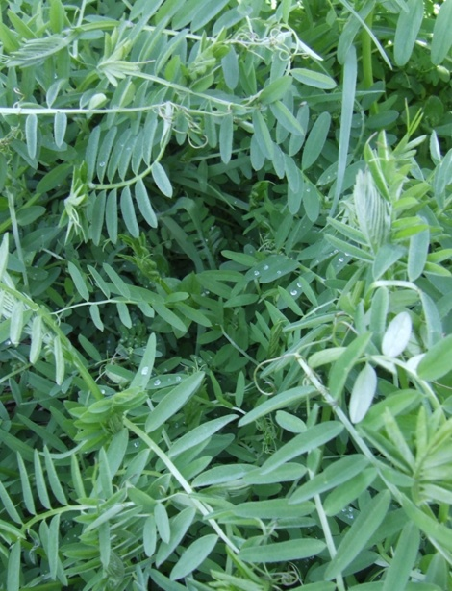
What to Look For in A Cover Crop
• Fast germination and emergence
• Competitiveness
• Tolerance to adverse climatic & soil conditions
• Ease of suppression/residue management
• Fertility/soil quality benefits
• Low-cost
Notes:
When choosing a cover crop, here are some things to consider. You want something that germinates quickly and is very competitive with weeds. It also needs to be tolerant to diverse environmental conditions and the residue should be easy to manage. It should provide some benefit to the soil or production system while still being economical to utilize. Now we will briefly discuss the attributes of some common cover crop species.

Slide 29
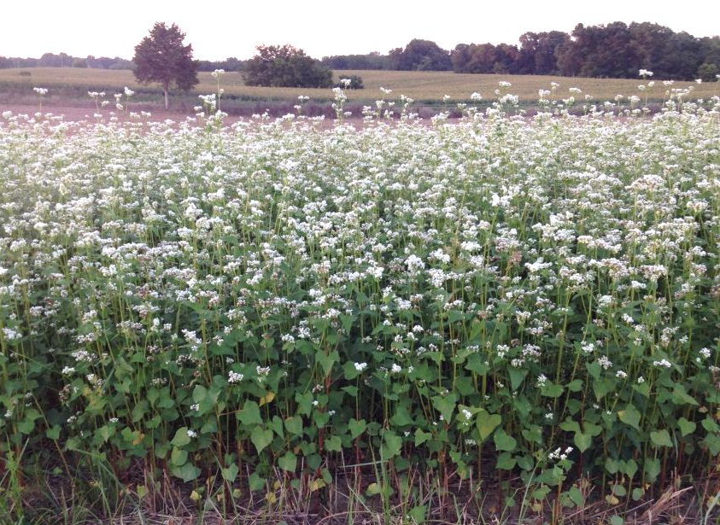
Buckwheat
Great at improving soil tilth
Quick to establish
Very good at mineralizing phosphorus in the soil
Very competitive with weeds
Caution can re-seed!
  Plan to kill about a 7-10 days after flowering (~40 days after planting)
Great quick, summer cover between crops
  Seeding rate: 30-50 lbs/A
Notes:
Buckwheat is a great summer cover crop that is very good competitor with weeds and good at increasing plant available phosphorus. It is quick to establish and can start to form mature seeds in around 40 days. Buckwheat can re-seed itself so make sure to terminate it 7-10 days after first flowering to prevent it becoming a weed problem.

Slide 30
Oats (Spring Oats)
Establishes fast, good erosion control
Will pick up nitrogen
Winter kills at around 20 degrees
  Winter oats grow all winter in southern Illinois
Reduces winter annuals
  Seeding rate: 30-50#/a
Easy to plant into in spring
Notes:
Spring oats is another quick to establish cover crop that grows well during the spring and summer. It is good at scavenging nitrogen and will nature terminate in the fall at once temperatures get down in the low 20s

Slide 31

Crimson Clover
Annual Clover
Great soil builder
Excellent nitrogen producer (Legume)
Rapid vigorous growth
Establish late summer/early fall
  Seeding rate: 10-20 lbs/A
Small seed is easy to over-seed and establish into existing crops
Notes:
Crimson Clover is a great winter annual clover that is an quick to establish and great at producing nitrogen. It needs to be established by late summer or early fall to ensure that it will overwinter. Since crimson cover is an annual plant it naturally will die off usually by late spring making it easy to manage.

Slide 32
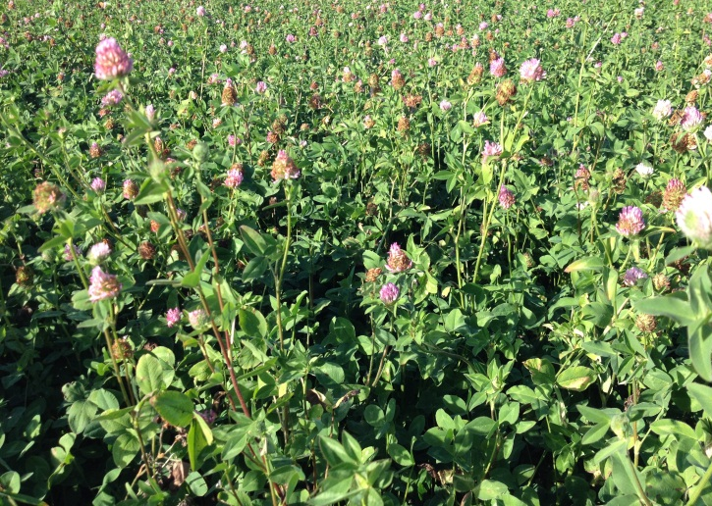
Red Clover
Excellent nitrogen producer
Slower to establish than crimson clover
  Often seeded with a companion crop of oats
Establish late summer/early fall or early spring
  Seeding rate: 8-12 lbs/A
Good for year-long cover
  Can be mowed and will regrow
Notes:
Red clover is an excellent nitrogen producer and is a perennial clover. It often is more slow to establish than crimson clover so often red clover is seeded with oats as a companion crop. Planting is similar to crimson clover, however, since it is a perennial it is good for a “green” fallow year and can be mowed repeatedly at full bloom and it will regrow. It can be terminated either with tillage or herbicides.

Slide 33
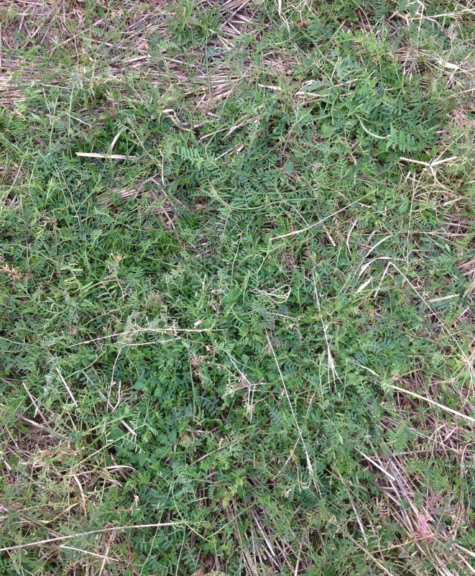
Hairy Vetch
Good weed suppression while growing
Very good as a nitrogen producer
Can produce a lot of biomass and can be difficult to manage at planting
Establish in late summer/early fall
  Seeding Rate: 12-20 lbs/A
Notes:
Hairy vetch is another good legume cover crop that can produce a lot of nitrogen. It can also produce a large amount of biomass which can be difficult to manage at planting time so it is important to have equipment that can handle high residue conditions.

Slide 34
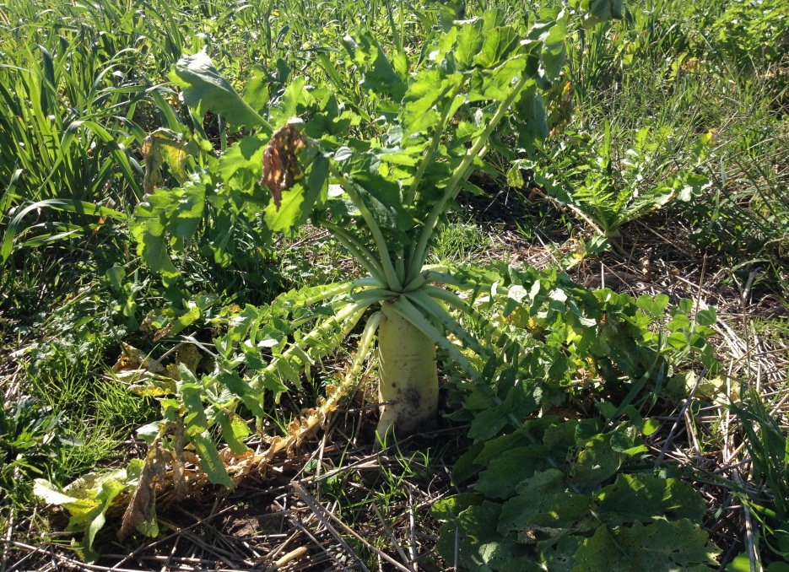
Oilseed Radish
Aerate the soil
Easy to establish
Great nutrient scavenger
  The root holds a lot of nitrogen
Winter-kill and must be fall planted early
  Ideal = Mid-August to Mid-September
  Seeding Rate: 1-5 lbs/A
Notes:
Oilseed Radishes are a very popular cover crop known for there ability to aerate and loosen the soil and also to scavenge large amounts of nutrients especially nitrogen. They winter-kill and MUST be seeded by Mid-August to Mid-September to have substantial growth to provide the most benefit.

Slide 35
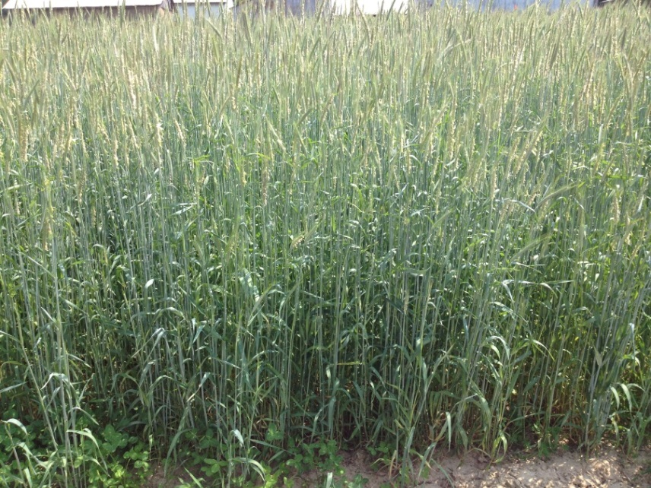
Cereal Rye
Allelopathy (weed supression)
Great soil builder
Produces more biomass than other small grains
Deeper rooting than most other small grains
Good nitrogen scavenger
  less need for supplemental N for cover crop growth
Very cold hardy and can be planted late (Nov.)
  Seeding rate 40-90 lbs/A
Notes:
Cereal rye is a great biomass producer and weed supressor. It has allelopathy which also helps it suppress weeds. It is deeply roots and a good scavenger of nitrogen. Most noteably it is very cold hardy can be planted late into the fall with good establishment.

Slide 36
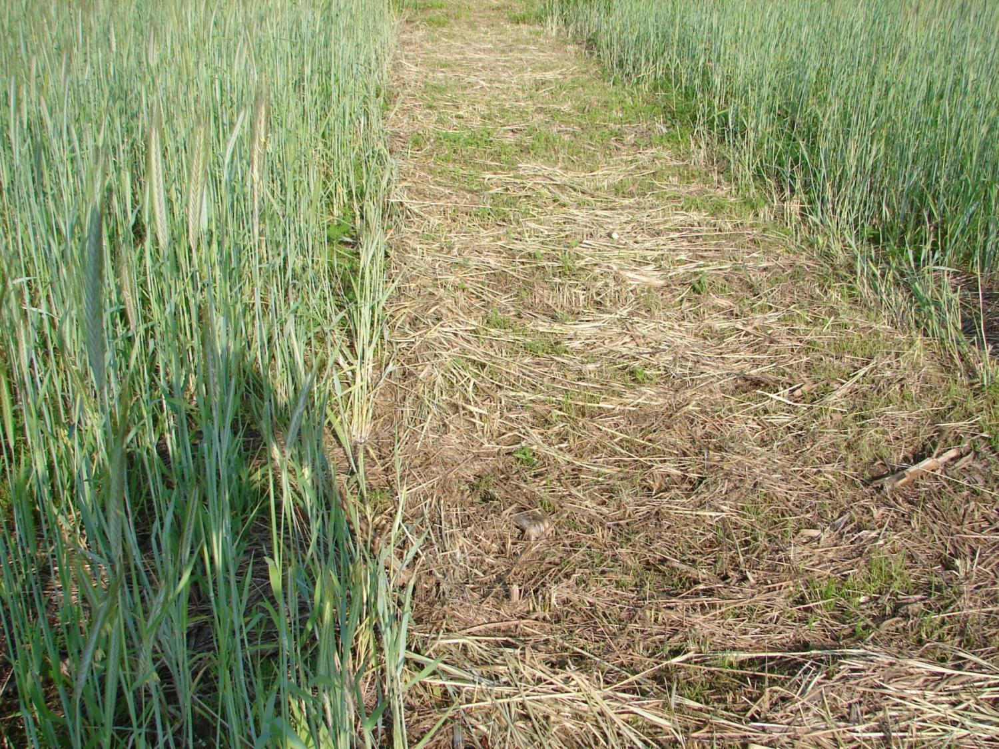
60#/a cereal rye, mowed at pollination
- 2 weeks later – no marestail
Notes:
This picture shows the weed suppressing power of cereal rye 2 weeks after being mowed. Cereal rye is especially good at combating marestail.

Slide 37
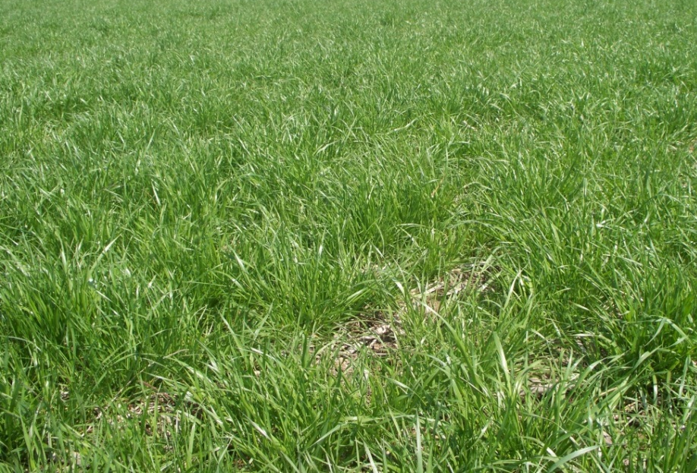
Annual Ryegrass
Great soil builder
Rapid vigorous growth
Excellent nitrogen scavenger
VERY deep rooted (+3 ft)
  Good at penetrating hard-pans and tolerates poorly drained soils
  Lots of fibrous root mass which builds soil organic matter
Establish late summer/early fall
  Seeding rate 12-20 lbs/A
Always plant a known variety; not VNS
Notes:
Annual Ryegrass is a great soil builder with a massive amount of root growth. It is very deeply rooted with roots going 3 feet or deeper. It also has the ability to root through and break up hard-pans and compaction in the soil. Annual ryegrass can be a challenge to terminate with herbicides so make sure to monitor growth and consult someone with experience to avoid issues or utilize tillage. For the best results always use a know variety of annual ryegrass as not all perform the same.

Slide 38
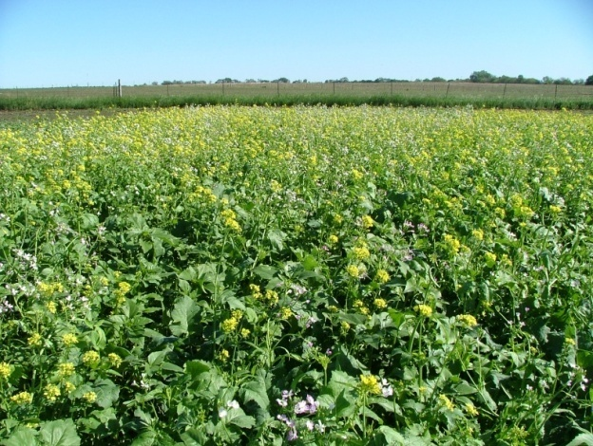
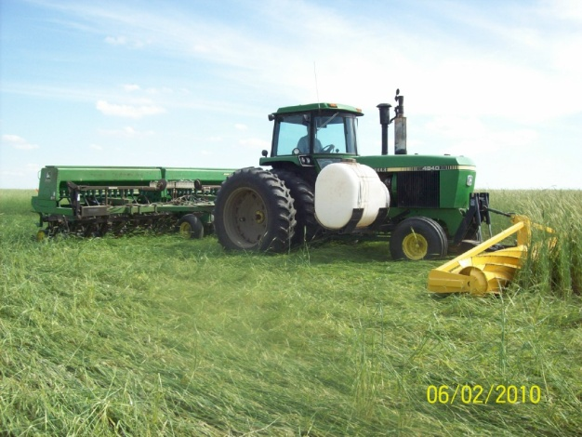
Proper Cover Crop Selection and Management is Important
Understand the biology and cost of the cover crop
Consider the management goals
Consider possibility of mixtures
Notes:
Selecting and managing cover crops it very important to their success! Make sure you understand the biology of cover crops, your management goals, and consider the possibility of using multiple cover crops together.

Slide 39
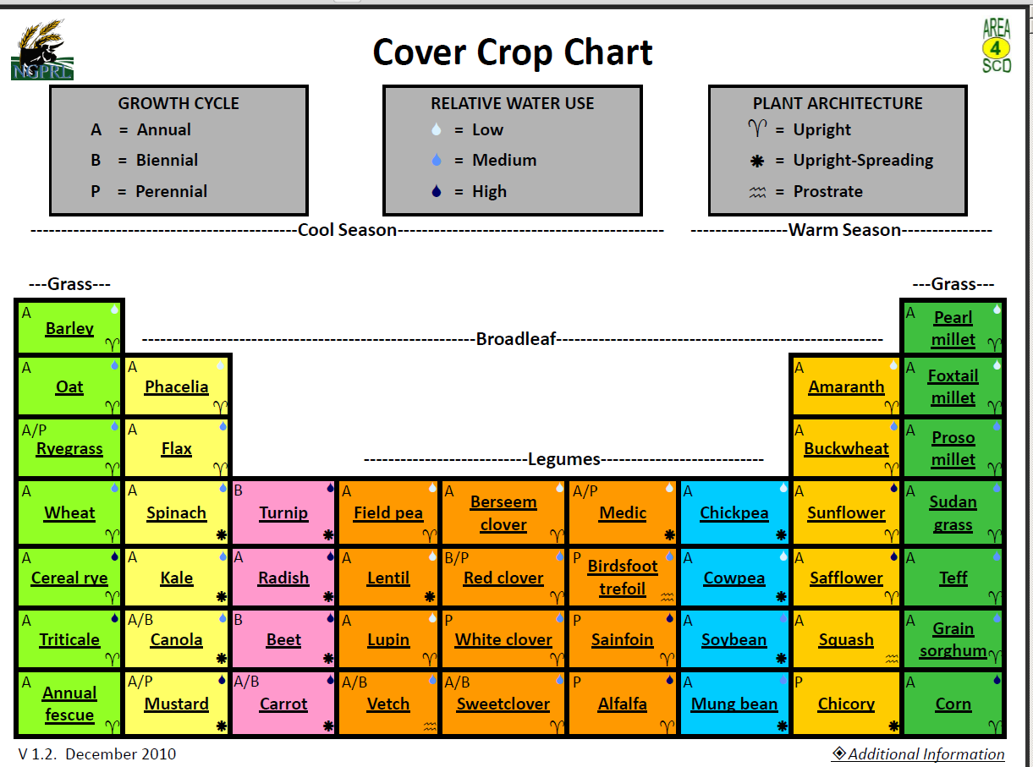
http://www.ars.usda.gov/SP2UserFiles/Place/54450000/CCC/CCC_v13_5_2012.pdf
ARS-USDA, Mandan
Notes:
This USDA Chart is very helpful at laying out the different cover crops and some traits of each.

Slide 40
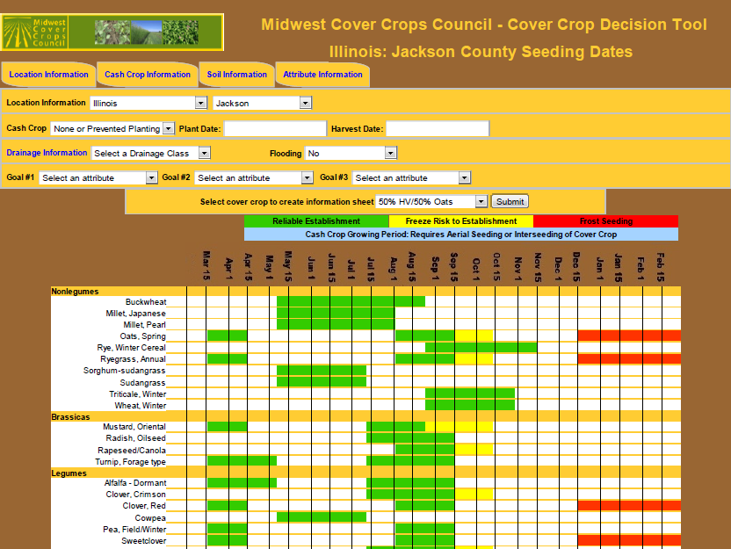
mccc.msu.edu
Notes:
Also the Midwest Cover Crop Council has a great cover crop selector tool which can help you get specific information about cover crop performance and planting dates tailored to your area and specific county.

Slide 41
Planting
Planting date is critical to performance and winter hardiness
Each cover crop needs specific management
If using a mix of species decrease seeding rates compared to seeding crops alone
Method of planting
  Broadcast
    Fast but variable success, may need some minor soil movement or rainfall
  Drilling
    Best and most reliable, most efficient use of seed, takes more time, added expense
  Aerial seeding
    takes luck (timely rain), good timing
Notes:
Planting date is critical in determining cover crop performance and winter survival. If you are planting multiple cover crops together make sure to decrease the seeding rates accordingly to prevent too much competition and wasting seed. There are multiple ways to seed cover crops. Broadcast seeding is by far the fastest, but you usually need some minor soil movement or rainfall to get germination. Drilling seeds with a grain drill is by far the best method to achieve a consistent and reliable stand. Also in crops that are to tall to drive through cover crops can be seeded by plane as well.

Slide 42
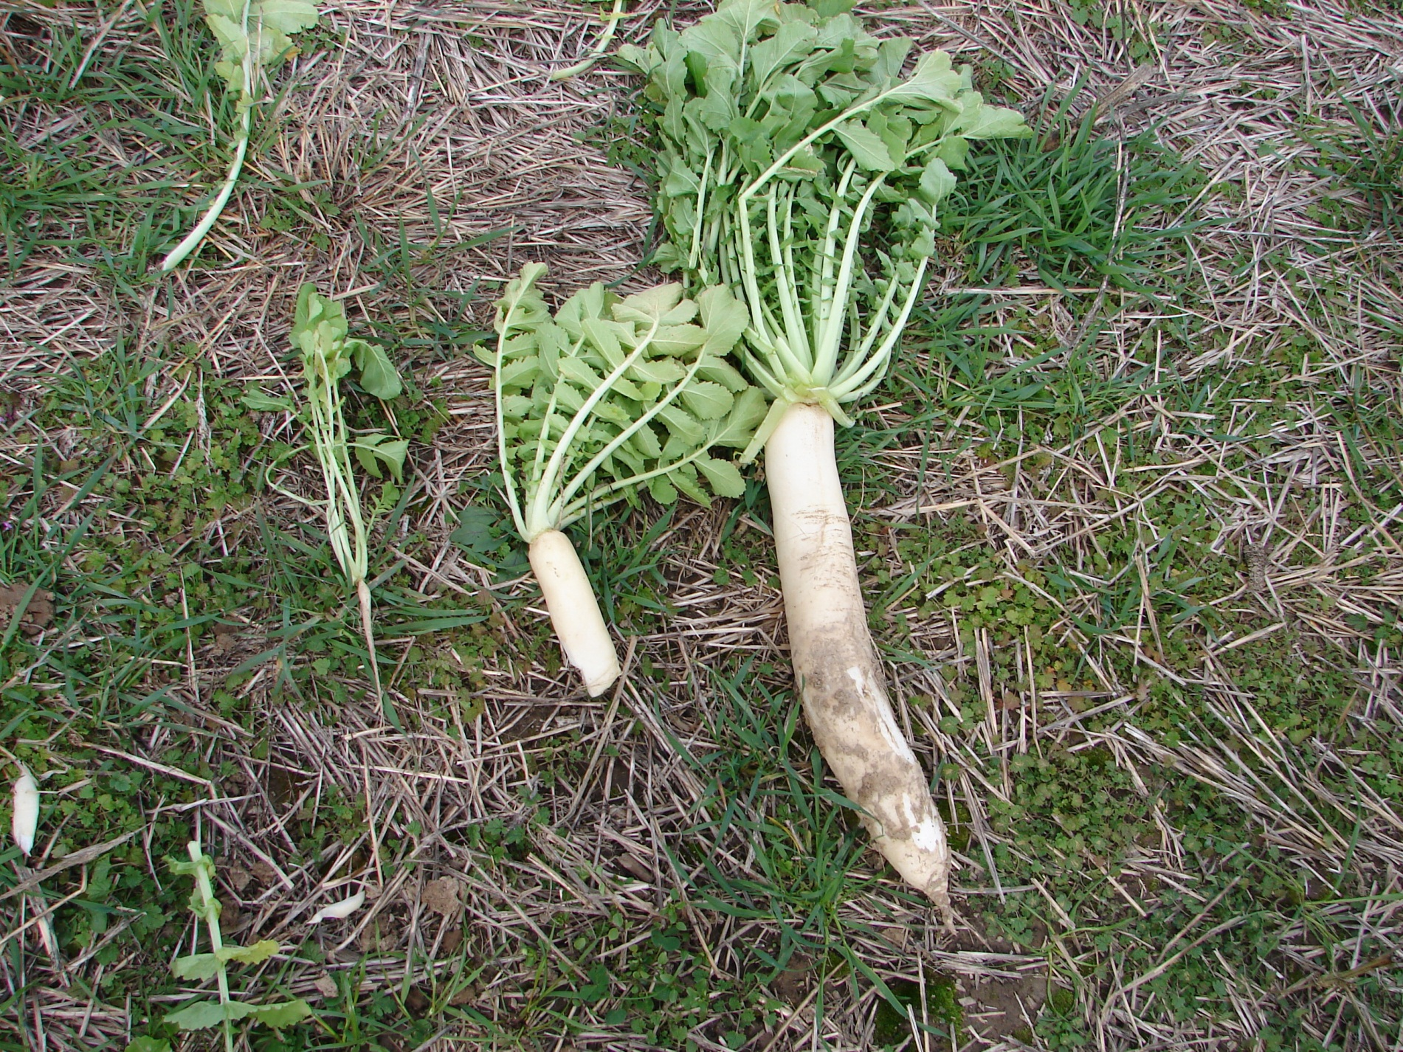
Seeding date is critical to developing radish—
It likes warm weather and nitrogen
Date of planting study
Near I-70
Oct 1 Sept. 15 Aug. 15
as of November 12
Mike Plumer
Notes:
As I mentioned planting date is critical and here you can see the difference that planting date has on oilseed radishes. Note that if you plant too late you will get very little growth and likewise very little benefit from the cover crop.

Slide 43
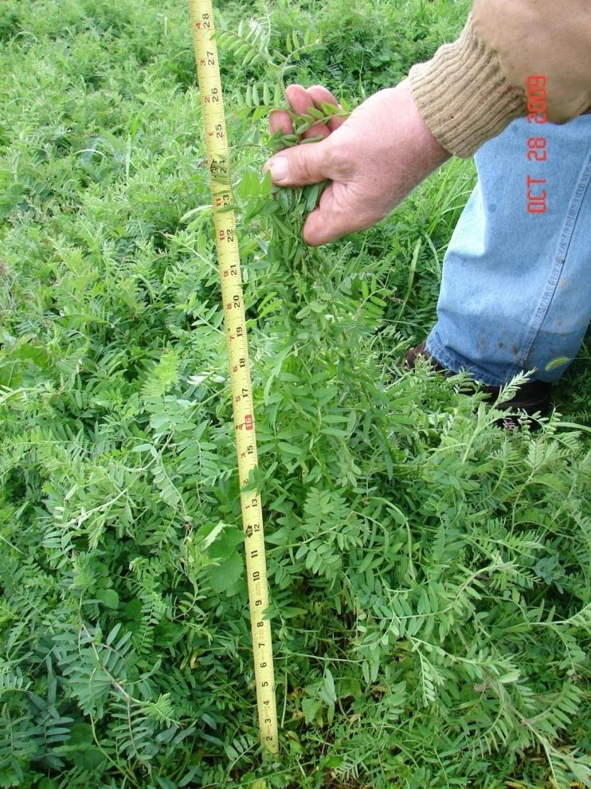
Planting Date Performance
Hairy Vetch
Planted July 23rd
  209 #/A Nitrogen as of Dec. 23
Planted 10 days later
  168 #/A Nitrogen as of Dec. 23
Notes:
Here also you can see the differences in nitrogen production from hairy vetch even with 10 days difference in planting date resulting in around 40 pounds less nitrogen produced.

Slide 44
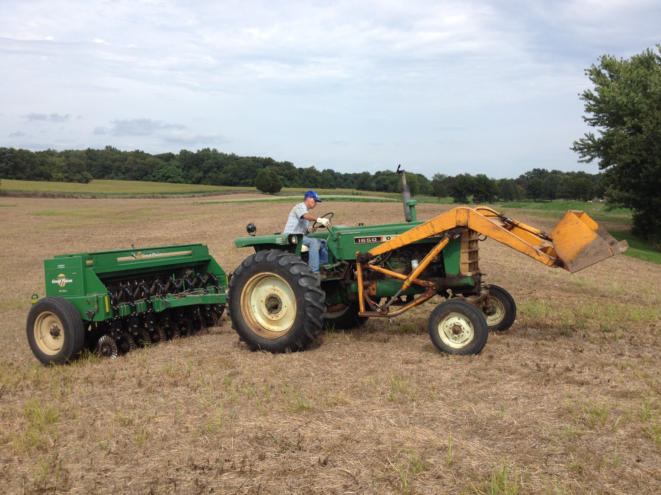
Drilling cover crops produces the best stand that establishes the quickest
Notes:
For planting drilling produces the best stand that establishes the quickest.

Slide 45
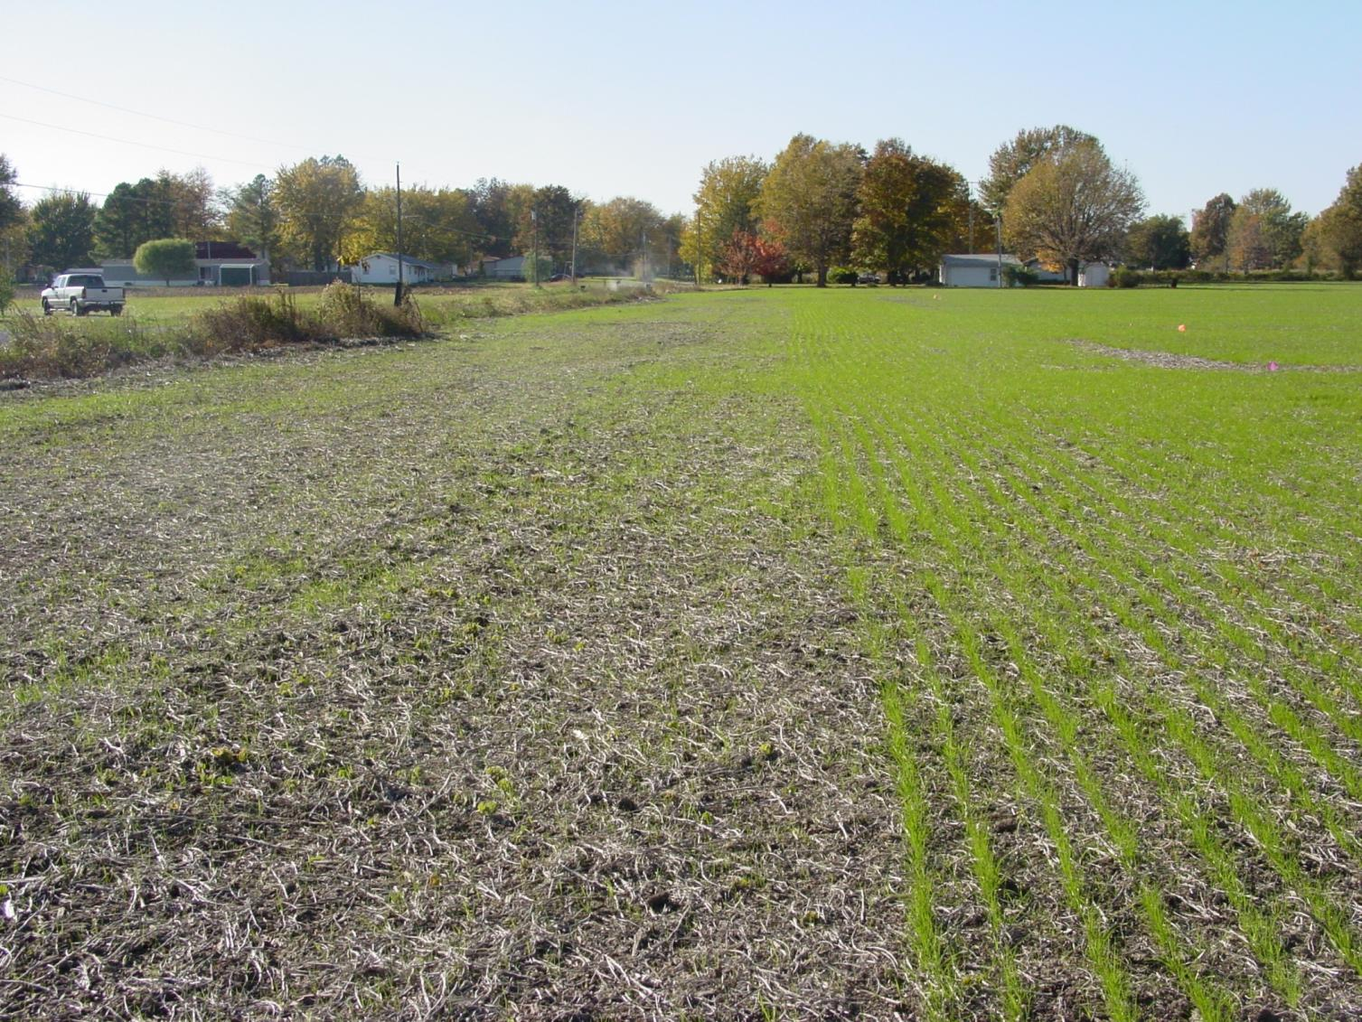
Broadcast/harrow vs Drilled
Notes:
Here you can visually see the difference in the stand with a broadcast seeding and light harrow compared with drilling.

Slide 46
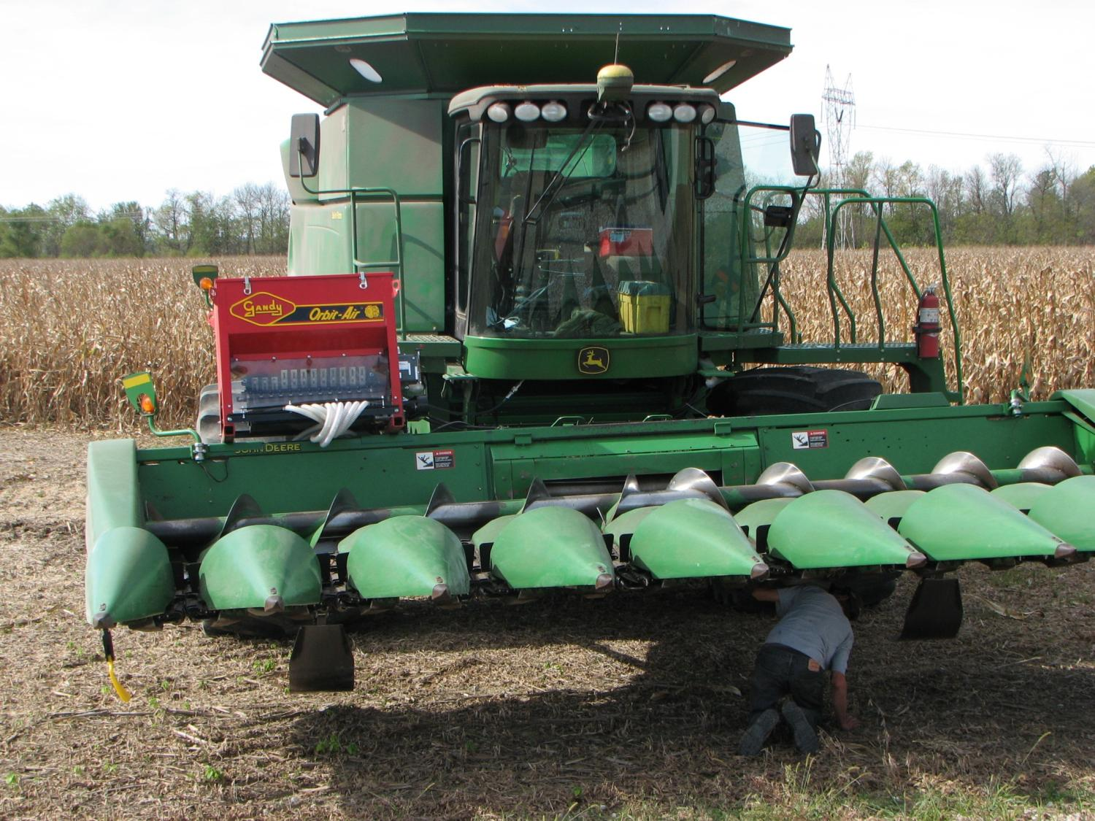
Notes:
Seeders can also be incorporated with other equipment going through the field. This combine has an air seeder attached that delivers seed between each row as the corn is being harvested.

Slide 47
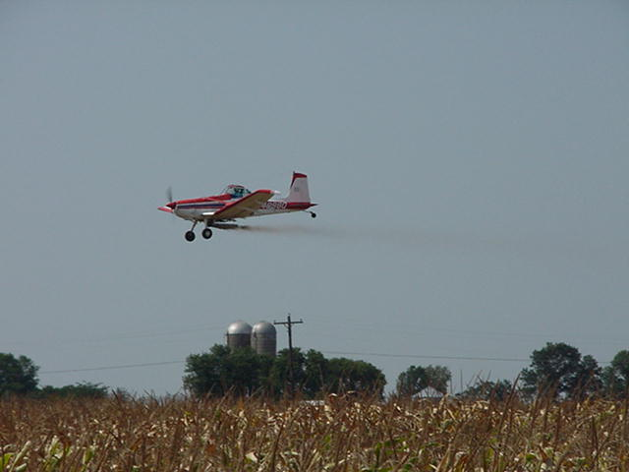
Aerial Seeding Turnips, Oats and Rye
Notes:
On taller crops aerial seeding can be a good way to plant cover crops in a timely fashion while a crop is still in the field.

Slide 48




Cultipackers and corrugated rollers can be used to improve seed-soil contact before/after broadcast seeding
Notes:
For many cover crops culitpackers and corrugated rollers can be very useful to make a firm seed bed for better broadcast seed establishment on loose, tilled soils.

Slide 49

Cover Crop Mixes
Can be companion crop to enhance growth
  ie. oats
Mixing species can allow you to capture the benefits of multiple crop species
  ie. cereal grain + legume
Some blends competitive/allelopathic
Can be difficult to control in spring
  Due to differences in growth patterns/maturity/species
Notes:
Cover crop mixes can be very beneficial and help to establish slower growing cover crops or just to gain more diverse benefits from a cover crop planting make sure to balance mixes so they are not too competitive with each other. Also different crops can mature differently adding challenges to spring termination.

Slide 50

http://www.greencoverseed.com/smartmix_web/smartmix_web.htm
Notes:
This is just one example of an online calculator to help determine the best proportions of cover crop seeds when planting a cover crop mix.

Slide 51

Termination
Herbicides, Roller Crimper, Mowing, Tillage…
Many cover crops such as cereal rye are easiest to terminate around flowering or pollination
Best control roller/crimping cereal rye at pollination (ave. 95% control)
Notes:
Cover crop termination is another important part of managing cover crops. Herbicides roller/crimpers, mowing, and tillage among others are all good termination methods. Often many cover crops can be easier to terminate as they approach flowering especially cereal rye. Different termination methods are effective on different cover crops so make sure you understand the growth and biology of your cover crops to choose the best method.

Slide 52
A Cover Crop Rotation for Your Farm
  How can I build a crop and cover crop rotation that will help meet most of my cash crop N demands and build soil organic matter?
  Example:
2014 |  |  |  |  |  |  |  |  |  |  | 2015 |  |  |  |  |  |  |  |  |  |  | 2016
J | F | M | A | J | J | A | S | O | N | D | J | F | M | A | J | J | A | S | O | N | D | J | F | M | A | J | J | A
 | Onions/ Lettuce |  |  |  |  | Oats/Radish/ Crimson Clover |  |  |  |  |  |  | Tomatoes |  |  |  |  |  | Hairy vetch + Cereal Rye |  |  |  |  |  | Cucumber
Notes:
Here is a sample cover crop rotation you might use on your farm. You have early spring vegetables that come out and then follow that with an oats/radish/crimson clover mix. Then the next spring you plant tomatoes following that cover crop mix. After the tomatoes, you plant a hairy vetch/cereal rye mix and no-till cucumbers into that the following spring. This is just one example to get you thinking about how to use cover crops. There are countless other rotations you could come up with!

Slide 53
Tips to Success with Cover Crops
Manage the cover crop as another crop
Have a “Plan B”
  Know that weather and crop growth might require a modification to your management plan
Consider planting date when choosing a cover crop
Don’t give up if at first you don’t succeed
  Learn from your experiences and explore ways to overcome any challenges
  Different soils and field conditions can change the performance of these cover crops
  Keep records on what you have done so you can determine what works best for you!
Notes:
Here are my tips to be successful with cover crops. First manage the cover crop as an other crop to get the best performance. Then know that weather and the environment can change your plans so have a back up plan especially for spring termination. Always consider the planting date when choosing a cover crop. As we discussed the wrong planting date alone can lead to poor cover crop performance. Most importantly, learn from your experiences and explore ways to over come any challenges you might face. Keeping good notes and records on your cover crops can greatly help you to improve your cover cropping in the future.

Slide 54


Information on Cover Crops
-University Extension
- Field Days
-Seed Dealers
-Conferences
Notes:
For more information on cover crops the book “Managing Cover Crops Profitably” and the “Midwest Cover Crop Field Guide” are great resources. In addition consult specialists and experiences growers to learn more about cover crop. Cover crop field days and events are very popular and often provide a lot of great information.

Slide 55

Great Success
Notes:
And finally a picture of great success with cover crops. This is a local grower that has great success with using annual ryegrass between rows of black plastic in plasticulture strawberry production. The crop is broadcast seeded before setting the strawberries and mowed in the spring to maintain a living cover that make frequent harvest easier especially in a wet year while benefiting the soil as well.

Slide 56


To reach us
Contacts | Contact information
Nathan Johanning | njohann@illinois.edu
Jeff Kindhart | jkindhar@illinois.edu
Sam Wortman | swortman@illinois.edu
Rick Weinzierl | weinzier@illinois.edu
Notes:
Please contact us if you have further question about cover cropping. Thank you!

Slide 57
If you have questions …
University of Illinois Extension Local Food Systems and Small Farms team
  http://web.extension.illinois.edu/smallfarm/
USDA’s Start2Farm site
  http://www.start2farm.gov/
Notes:
Our beginning farmer training program ended in the fall of 2015. The best way to pursue answers to questions about fruit and vegetable production in Illinois is to contact educators on the University of Illinois Extension Local Food Systems and Small Farms team. Extension programs in other states are operated by the land-grant university in each state. Additionally, USDA’s Start2Farm site provides listings of farmer training programs in specific states and localities.

