Slide 1



Preparing a New Generation of Illinois Fruit and Vegetable Farmers a USDA NIFA Beginning Farmer and Rancher
Development Program Project
Grant # 2012-49400-19565 http://www.newillinoisfarmers.org
Notes:
The following presentation was part of a beginning farmer course, “Preparing a New Generation of Illinois Fruit and Vegetable Farmers,” offered by the University of Illinois and the Illinois Migrant Council from 2012 through 2015. This course was funded by the United States Department of Agriculture’s National Institute of Food and Agriculture, and specifically by the Beginning Farmer and Rancher Development Program. For more information about the program and for links to presentations and resources on many other topics, see the website newillinoisfarmers.org.

Slide 2

Growing a New Generation of Illinois Fruit and Vegetable Farmers
Composting
Ellen Phillips
June 2015
Notes:
This presentation is part of the Growing A New generation of Illinois Fruit and Vegetable Farmers program. It covers Composting on the farm in Illinois. My name is Ellen Phillips a retired extension educator.

Slide 3




Today’s Objectives
Compost
Rules and Regs
Methods of Composting
Key Factors in Composting
Using Compost
Notes:
Today we will look at what compost is.
We will also cover the rules and rags for Illinois.
Next we will get an overview of the different methods of composting from small to large scale.
Then we will look at the key factors that needed to be monitored in order to create good quality compost.
Lastly, we will look at some ways to use compost.

Slide 4
Compost:
Organic residues, or a mixture of organic residues and soil, that have been mixed, piled, and moistened, with or without addition of fertilizer and lime, and generally allowed to undergo thermophilic decomposition until the original organic materials have been substantially altered or decomposed.
Sometimes called "artificial manure" or "synthetic manure." In Europe, the term may refer to a potting mix for container-grown plants.
Composting:
A controlled biological process which converts organic constituents, usually wastes, into humus-like material suitable for use as a soil amendment or organic fertilizer.
Soil Science Society of America: Soil Glossary
https://www.soils.org/publications/soils-glossary#
Notes:
The Soil Science Society of America defines compost is any organic materials that are put into a pile of some sort, mixed together with moisture added and then goes through a composting process to become a soil amendment.
Composting is the process by which those organic materials are decomposed into a soil amendment Today we will be talking about the key components needed to speed up natural decomposition within the composting process.

Slide 5
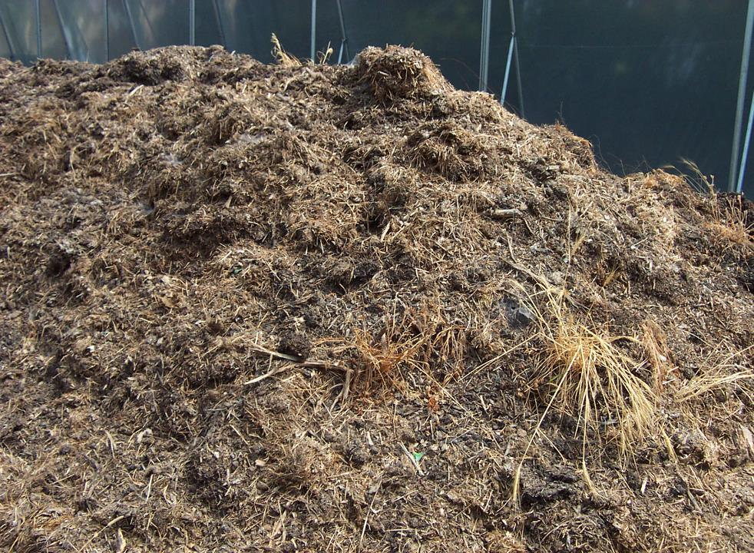
Compost Benefits to Soil
Improves soil structure and strength, increasing porosity and decreasing compaction
Decreases bulk density
Increases water infiltration, permeability and
increased water holding capacity
Increases cation exchange capacity
Encourages soil biological community
Modifies pH
Suppresses plant diseases
Ellen Phillips
Notes:
Why go to the effort of composting, and it is a lot of effort to do it well, there are a lot when it benefits of the soil amendment of compost to improving the soil.
Compost can increase the amount and strength of soil aggregates result in an increase in porosity.
This directly impact the soil by increasing the water infiltration and water holding capacity
Compost increases the cation exchange capacity which allows more nutrients to be held in the soil.
The composting process depends on the wide variety of soil microbes which result in a soil amendment alive with an active biological community
Depending on the organic materials that are put into the pile, compost can modify the pH to be more neutral.
There is quite a bit of research demonstrating the benefits of compost and suppressing plant diseases

Slide 6
Today’s Objectives
Compost
Rules and Regs
Key Factors in Composting
Using Compost
Notes:
Let's look at the rules and regulations you need to be aware of in order to compost in Illinois

Slide 7
Local Municipality Rules/ Codes
Does a compost pile require a license or approval?
May have special requirements on location of bins,
types of bins, etc.
Some don't allow food scraps
Notes:
Municipalities and towns may have individual rules regarding whether or not they allow composting.
Often they have specific rules about location and types of composting allowed
They may also get very specific as to what can be put into the compost pile – such as not allowing any food scarps, particularly meat or dairy product
Check with your local town and county for regulations.

Slide 8
Illinois EPA Composting Permit
NOT Required if . . .
Your farm/stable
  your manure.
  no additions to compost pile brought from off the farm.
No setbacks for active composting area.
Site is located on the farm in which the compost is applied.
Site is operated by the farmer of the property.
Farmland is in production of crops annually.
Size of the compost site is less than 2% of the acreage of the property.
Notes:
In Illinois there are specific rules if you're going to do large-scale composting
Composting permits are normally required by the Illinois EPA for large-scale composting operations. However if you are composting on a farm there are some exemptions
You may have a large-scale composting site on your farm if you do not bring in anything from outside of the farm such as leaves or manure from a neighboring farm
The farm must also be producing crops on annual basis and the compost site must be operated by the farmer
Before starting a large-scale composting operation check with your county as well as the Illinois EPA and Illinois Department of Ag for specific regulations that would affect the manner in which you are going to compost

Slide 9
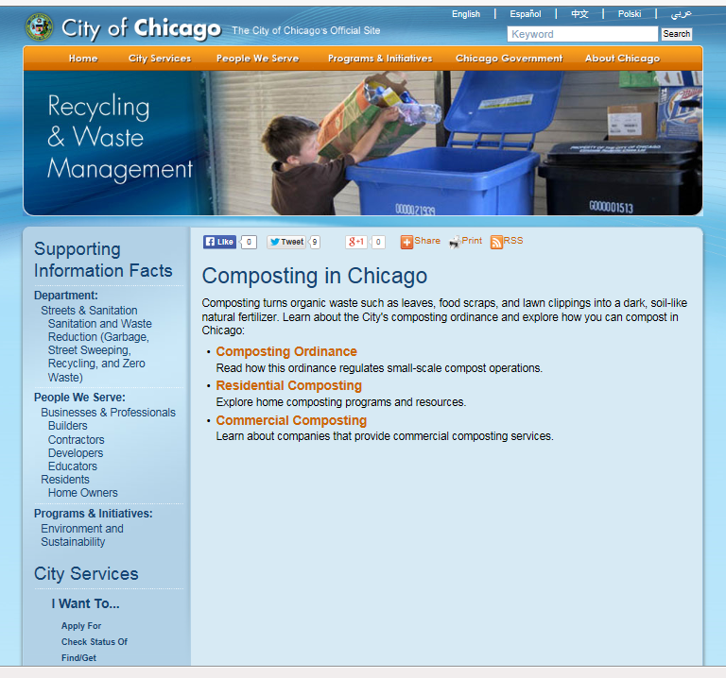
www.cityofchicago.org/city/en/depts/streets/supp_info/composting/ composting_ordinance1.html
Notes:
This is an example of Chicago's website Different levels for backyards versus larger scale composting

Slide 10

Organic Rule for Compost
process that combines plant and animal materials with
in-vessel or static aerated pile system
  must maintain at a temperature between 131 °F and 170 ° F for 3 days.
windrow system
  must maintain at a temperature between 131 °F and 170 °F for 15 days, during which time, the materials must be turned a minimum of five times
www.ecfr.gov/cgi-bin/retrieveECFR?gp=&SID=2fbb9d9e19ad3c5e3266d55fec8743a9&mc=true&n=sp7.3.205.c&r=SUBPART&ty=HTML#se7.3.205_1201
Notes:
If you are an organic farmer compost is an excellent way to improve soil amendments that are specific rules in order to be in compliance with the national organic program and those are listed here
there are specific rules regarding the type of materials I can go into the compost pile
We will be talking primarily about window system so I will point out that the window system must maintain a temperature between the hundred 31°F and had a 70°F for 15 days during that time the materials must be turned a minimal five times so that would be one of your goals in your composting system if you want to have that compost meet the standards for the national organic program

Slide 11
Organic Guidelines
The guidance document allows compost if
  more flexibility in how compost piles are constructed and monitored.
  assuming acceptable feedstocks are used
  if the compost achieves 131°F for three days
  the pile is mixed or managed to ensure that all of the mixture achieves this temperature
the organic rule does NOT require that manures come from organic livestock farms to be used in organic compost production.
National Organic Standards Board (NOSB) addendum (NOSB, 2010)
Notes:
The 2010 Organic Standards addendum does allows for more flexibility in the feedstocks of the compost and allows for manure from any source to be used.

Slide 12
Finished Compost
  Field application based on nutrient application
Illinois rules for applying compost
  No setbacks
  No permit for application
    Default rate of 20 tons/acre/year
    Applying more requires Illinois EPA permission
Notes:
In Illinois there are rules regarding the application of compost to soil. There are no setbacks but there is a maximum rate is 20 tons per acre per year. You can get an exemption by the Illinois EPA

Slide 13
Today’s Objectives
Compost
Rules and Regs
Methods of Composting
Key Factors in Composting
Using Compost
Notes:
Where many different ways to compost
How you compost depends on your farm, organic materials you have to compost and your potential use for compost

Slide 14
Vermicomposting
Compost produced using red-wiggler worms to decompose materials
National Organic Program compost requirements can also be met by vermicompost
Requirements:
It is made from allowed feedstock materials
  (either nonsynthetic substances not prohibited at §205.602, or synthetics
  approved for use as plant or soil amendments);
Aerobicity is maintained by regular additions of thin layers of organic matter at 1–3 day intervals
Moisture is maintained at 70–90%
The duration of vermicomposting is at
  6–12 months for outdoor windrows
  2–4 months for indoor container systems
  2–4 months for angled wedge systems
  30–60 days for continuous flow reactors
~ NOP, 2010b
Notes:
The National Organic Standards of 2010 addendum does have some guidelines on Vermicomposting but anyone can do this both small and large scale
Vermicomposting is utilizing red-wiggler worms to decompose materials
One benefit of this is that it can be done indoors.

Slide 15
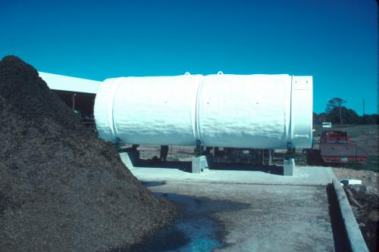
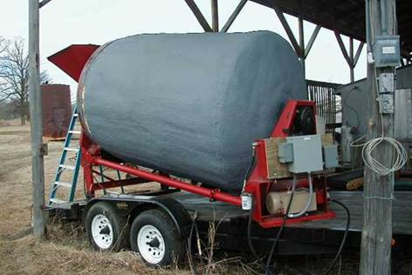
In-Vessel Composting
Uses a motor to turn
Very rapid process
Relatively high cost
Can use everything from small barrel to cement mixer or larger
www7.tamu-commerce.edu/agscience/res-dlc/horse/horse.html
www.mn.nrcs.usda.gov/partnerships/pembina/in-vessel_composter.htm
Notes:
In-vessel composting is a rapid method to compost that utilizes some kind of mechanism that continually turns the compost, speeding up the decomposition process.
The main advantage is a small footprint on the farm and a quick turn around time.
The main drawback is the equipment and potential expense of building or buying the compost system

Slide 16
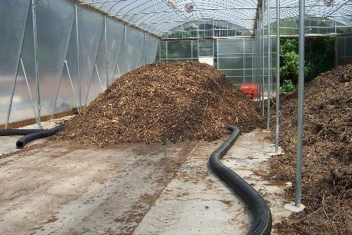
Passively aerated windrows
Tube for air flow
Either inflow or
suction
Ellen Phillips
Mixed materials built on bed with aeration tubes embedded
Normally not turned
Not as uniformly composted
Aeration by mechanical blowers or vacuum
Composting ~ 30 days
Followed by curing ~ 30 days
Notes:
Passive aerated windrow systems are static piles with tubing that mechanically moves air through the pile
The air can be blown into the tube and move up through the pile, demonstrated by the red arrows or it can use vacuum suction to pull outside air down through the pile.
The main advantage is that the pile does not have to be moved.
The main disadvantages are that the piles can dry out quickly so moisture has to be monitored closely.
The main concern is that the outside materials may not be hot composted since they are not at the center of the pile.

Slide 17
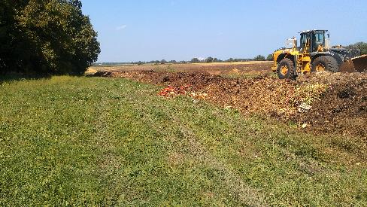
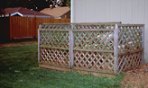
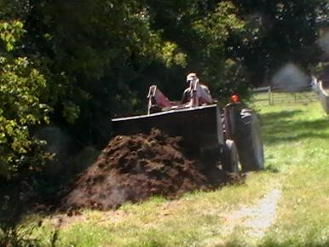
Piles/ Windrow
Flexible size
Hand or machine turned
Ellen Phillips
Ellen Phillips
Notes:
Piles and windrows are the most common composting systems.
Composting bins work well for small scale composting and should be about a cubic yard in size.
Windrow are basically long compost piles. The size depends on the equipment available to use. A front-end loader or skid loader work well to turn smaller piles. Large compost turning machine can be used on large scale multiple windrow sites.
The main advantage of these systems are that the piles are turned regularly so the compost is usually good quality throughout.
The main disadvantage is that the piles do need to be turned on a regular basis and usually requires some machinery.

Slide 18
Today’s Objectives
Compost
Rules and Regs
Methods of Composting
Key Factors in Composting
Using Compost
Notes:
There are several factors that must be monitored to create quality compost.
Today, we are focusing on pile or windrow composting systems.

Slide 19
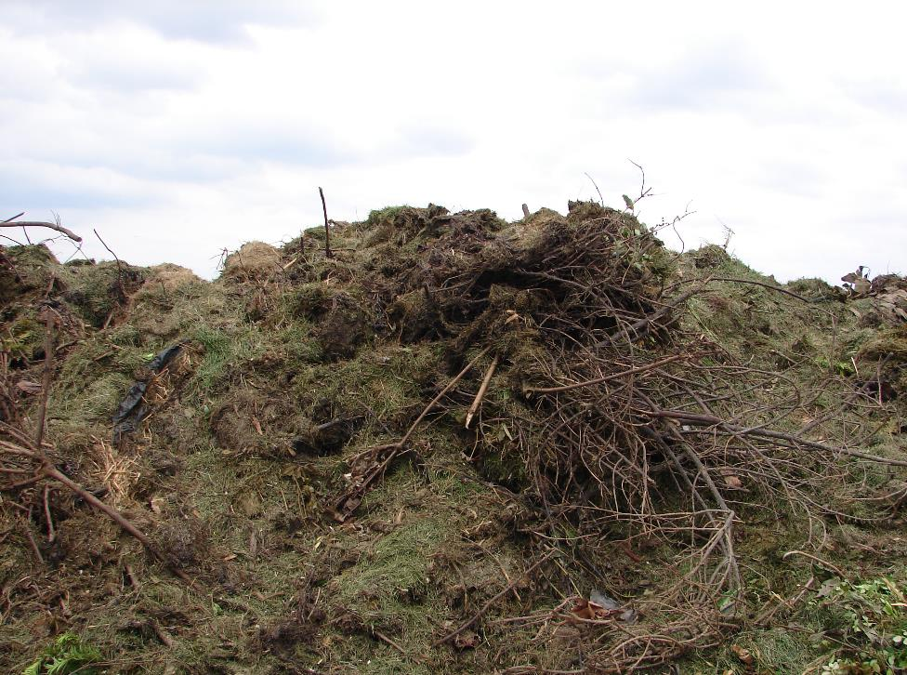
Rotting vs. Composting
Decompose
verb de·com·pose \ˌdē-kəm-ˈpōz\
: to cause something (such as dead plants and the bodies of dead animals) to be destroyed and broken down by natural biological processes, chemicals, etc.
http://www.merriam-webster.com/dictionary/decompose
Ellen Phillips
Notes:
There is a difference between a rotting pile of organic materials and composting.
Composting requires monitoring conditions with the pile to maintain optimum conditions for decomposition to occur.

Slide 20
Microbe Mix
Bacteria
  Primary decomposers
  Create the heat in the pile
What do they need
live and multiply?
Water films to live in
Source of food
  Need carbon for energy
  Need nitrogen for proteins
Need air
Fungi
  Primary decomposers
  Better at decomposing wood materials
  Important in curing and binding particles together
Composting Goal!
Keep them happy and multiplying
Biological community
  Everything else
  Add soil to compost pile to inoculate
Notes:
The focus of hot composting is on keeping the microbe happy that are decomposing the organic materials .
These microbes include:
Bacteria which are the primary decomposers and create the heat within the pile.
Fungi that are also decomposers, especially of more woody materials.
And there are multitudes of other creatures from amoebas, to insects, to earthworms.
What the microbes have in common that they must have to survive are a water film to live in, a source of food that has the right balance of carbon and nitrogen and lastly they need air.
Give them all of these things and they will multiply and very quickly decompose the organic materials you have placed in the pile.

Slide 21
Passive/ Inactive/ Cold Compost
Pile of organic materials left alone to decompose over an extended period of time
may or may not use a compost recipe
no attempt to adjust moisture content or the C:N ratio
not aerated
temperatures are not monitored
  Pile may not heat to kill pathogens or weed seeds
May turn anaerobic
  Foul odors
not approved for certified organic production.
Notes:
Passive composting, other wise also known as inactive or cold composting requires the least amount of attention once the pile is created.
The right types of organic materials in the correct amounts is placed into the pile, If may heat up, but if it is not turned it may not decompose quickly. If it is not turned, it may go anaerobic and different organisms take over, possibly causing it to smell. Since it is not turned regularly, this composting method does not meet organic standards.
To cold compost well, try to watch what materials are placed into the pile, turn it every so often and expect compost to be finished in about a year.

Slide 22
Active/ Hot Composting
Encourage microbes to multiply and decompose organic materials
Pay attention to:
  Pile Size
  Carbon to nitrogen ratio
  pH
  Moisture content
  Aeration
  Temperature
Notes:
For compost to be created quickly, with a couple of months, as well as to meet the organic standards, it needs to be actively hot composted.
This requires paying close attention to several factors including those listed here which we will discuss individually.

Slide 23
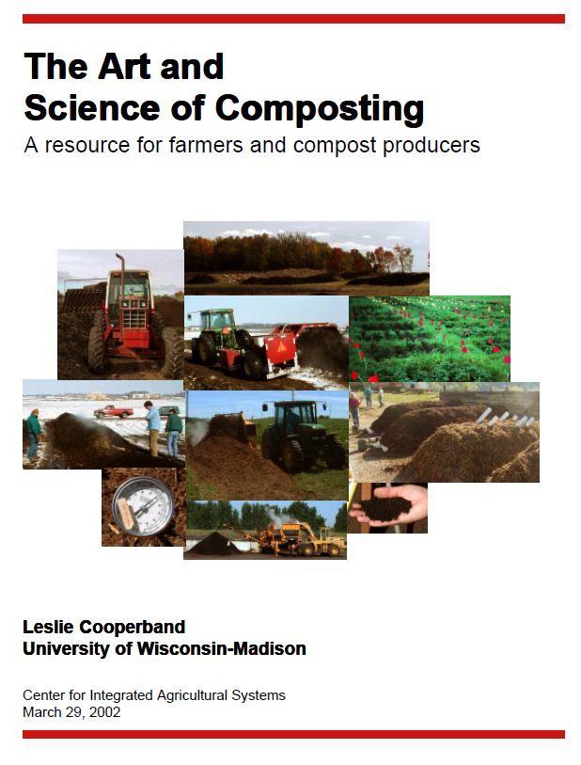
Sources of information
Midwest Extension Composting School
  Focus on the science of large-scale composting
www.cias.wisc.edu/wp-content/uploads/2008/07/artofcompost.pdf
Notes:
There are many resources to learn how to compost. Many are listed at the end of this presentation.
Two that I want to highlight are the publication “The Art and Science of Composting” from the University of Wisconsin which gives a nice overview of the composting process.
If you want some hands-on experience at building and monitoring piles, plan to attend the Midwest Extension Composting School. It is offered somewhere in the Midwest every year, usually in June.

Slide 24
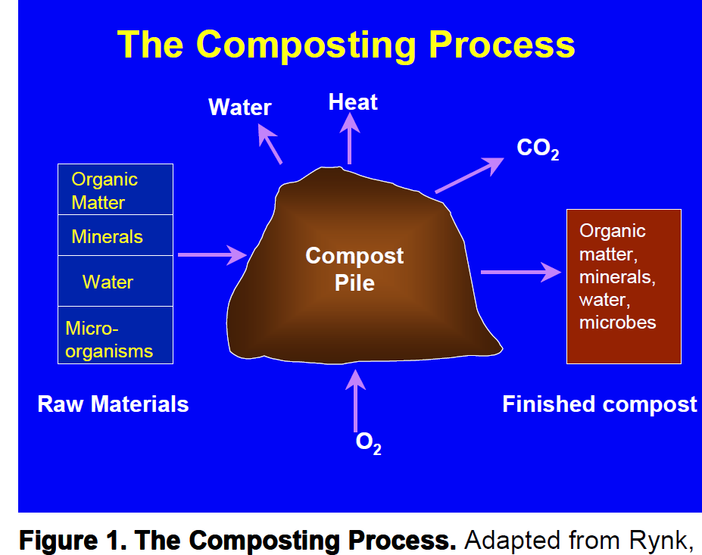
The Art and Science of Composting
Notes:
The composting process is actually fairly simple.
Take organic materials, add some microbes by adding some soils, keep it moist to provide a home for the microbes.
The microbes create the heat that helps to kill weed seeds and pathogens.
The result is a soil amendment rich in organic matter that improves soils and readily available nutrients for plants.

Slide 25
Recordkeeping
Compost recipe
Daily temperatures
Moisture content
Oxygen content
Turning
Curing time
Use
Notes:
Creating quality compost requires regular monitoring of some factors such as moisture and temperatures.
Therefore, some recordkeeping is important. Recordkeeping is essential in order to meet the organic standards.
Items to record are the materials that were added for the compost recipe.
Regular monitoring to the temperature, moisture and oxygen.
When and how it was turned.
How long it cure and methods to analyze compost quality
Lastly record where and how the compost was used.

Slide 26
Key Factors in Composting
Pile Size
Carbon to nitrogen ratio
pH
Moisture content
Aeration
Temperature
Notes:
When creating compost, the size of the pile does matter

Slide 27
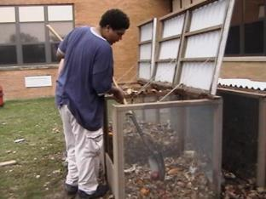
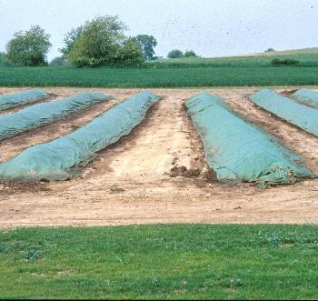
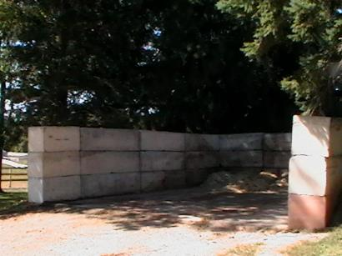
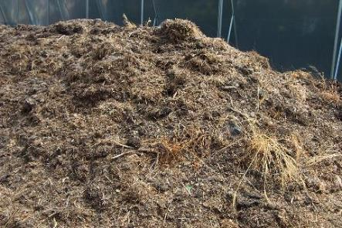
Bins/ piles/ rows
Ellen Phillips
Ellen Phillips
Ellen Phillips
Ellen Phillips
Notes:
Depending on the amount of materials a bin may or may not be needed.
For small scale composting or it the compost must be contained, a bin can be created out of simple materials similar to those shown on the right.
On farm, you can chose to simply form piles or windrows of organic materials. This makes it easier to turn with equipment.

Slide 28
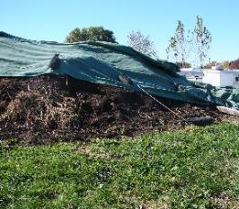
Bin Construction
Bin size
  Depends on equipment - width fit to your equipment
  Minimum 3’x3’, any length
  Maximum – what equipment can turn 10’x10’, any length
Bin materials
  Any materials
  Do not need a bin, piles can do fine
  A roof/ tarp gives control over moisture
Durable slab
  May be required depending on site conditions
  Makes it easier to use equipment
Water available to adjust moisture
Ellen Phillips
Notes:
The normal recommendation is that the pile be a cubic yard in size for small scale composting. This allows air to flow through the pile with convection.
The pile can be larger if it will be turned on a regular basis to incorporate air.
Compost pile do not have to be covered, however a tarp can help control the moisture content during a wet spring or in a dry summer period.
Depending on the soil and water table conditions of your site, you may be required to place the piles on a more permanent base.
Place the piles close to a water source you can use to add moisture to the pile.

Slide 29
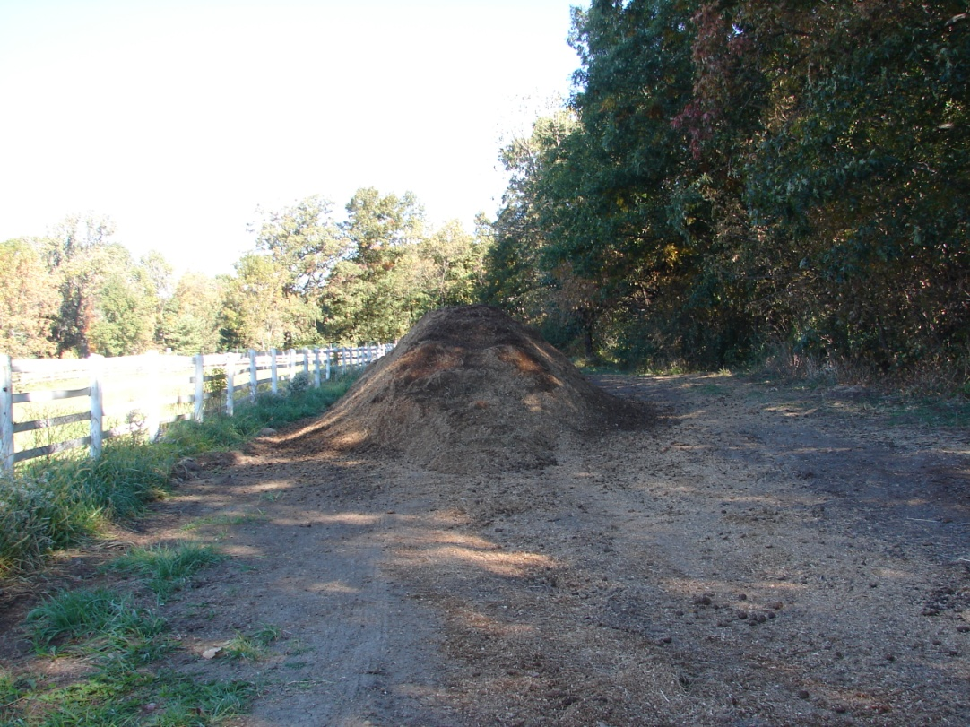
Where should the pile/row go?
Away from surface water
Space to turn equipment
Access in bad weather
Shade doesn’t matter (heat comes from microbes)
Ellen Phillips
Notes:
There are not many restrictions as to where the pile can be placed on your property. Check with your town or county.
A high water table or being close to a lake or stream should be a concern.
Keep in mind that large equipment like a tractor may need access and will need room to move the material.
Compost will need to be turned, even in wet spring weather so a firm traffic area is needed
Shade is not a concern since the heat of the pile is created by the microbes and not the sun.

Slide 30
Key Factors in Composting
Pile Size
Carbon to nitrogen ratio
pH
Moisture content
Aeration
Temperature
Notes:
Microbes need to eat so the Carbon: Nitrogen ratio of organic materials is important.

Slide 31
Carbon to Nitrogen Ratio
(What to put in the pile)
Desired C:N ratio for pile 30:1
Follow compost recipe
  http://www.klickitatcounty.org/solidwaste/fileshtml/organics/compostcalc.htm
  http://compostingtechnology.com/resources/compost-calculator-tool/
Don’t add: meat, dairy, oil based items, weed seeds, diseased plant materials, pet waste
Notes:
Compost microbes use carbon as their energy source and nitrogen to build protein to multiply.
A ratio of 30 carbon to 1 nitrogen is needed for optimum growth.
In large scale composting have the compost recipe close to this ratio is important and beyond the scope of this presentation.
The two resources listed give some insights into how to combine organic materials for the right balance.
It is equally important to not place materials into the pile that can be a detriment.
Meat and dairy items will attract pests such as raccoons
Oil based items are difficult for microbes to decompose and will slow down the decomposition process.
Weed seeds plant diseases and diseases carried in manure of meat eating animals may not be killed it the hot composting process is not done well.

Slide 32
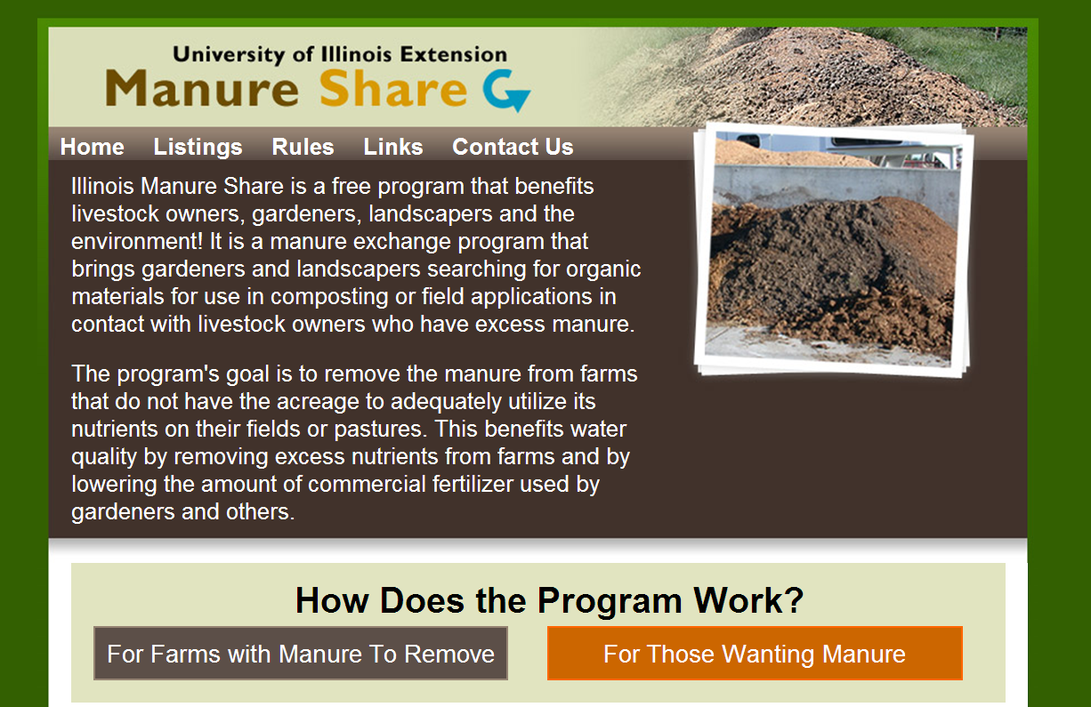
web.extension.illinois.edu/manureshare
Notes:
Manure from grass fed animals such as cows, horses and goats is a good source of nitrogen for the compost pile.
To find a source of manure close to you go to the University of Illinois Manure Share website.

Slide 33
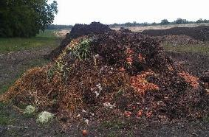
Culls and other food/ produce waste
Problems
  High moisture content resulting in wet pile
  and large amount of leachate
  Sometimes hard, thick shells, rinds, etc.
  that do not readily decompose
  Odor production -- mainly ammonia
Solution
  Absorb moisture by mixing with a bulking agent to increase density
    Use high C:N ratio materials such as leaves, sawdust , shredded newspaper
  Check pile regularly for leachate, turn pile to distribute moisture
  Leachate can be reapplied to the compost
  Grind into finer materials for even distribution in pile and greater distribution of composting microbes to speed up decomposition Also, reduces animal interference with the pile
  Reduce Odor - good aeration is critical
Ellen Phillips
Notes:
Produce farms have a lot off culls or other discarded fruits and vegetables.
These will compost very well.
However, there are some concerns.
This produce tends to be high in moisture and therefore dry, high absorbing materials should be matched with it to avoid polluting leachate running from the pile.
Some fruit and vegetable have a hard, thicker shell or rind that takes a long time to break down. If possible these should be chopped or ground up before placing them in the pile
Piles high in food tend to have odor problems due to poor aeration since materials are so wet. Turning the pile often is important.

Slide 34
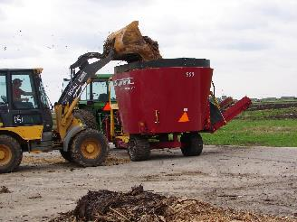
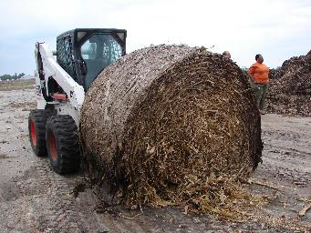
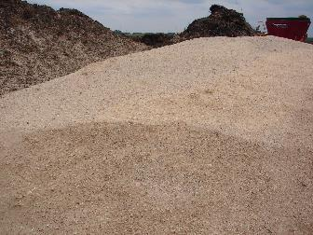
Produce/ Food composting
Need Grinder
Dry, high carbon materials
Ellen Phillips
Ellen Phillips
Notes:
Large scale grinders are available.
Old, bad round bales provide a cheap source of dry materials.

Slide 35
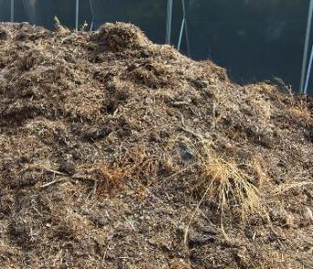
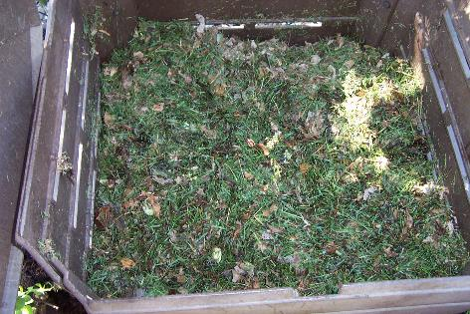
Building pile
Add soil to inoculate with microbes
Mix/turn materials well
May need to add nitrogen fertilizer to balance C:N
Should heat up within hours
Ellen Phillips
Ellen Phillips
Notes:
To build a pile, simple add materials into the pile, inoculate the pile with microbes by adding some soil.
If the organic materials are high in carbon, you may need to add some nitrogen fertilizer or manure to create the right C:N ratio.
If everything it right, the pile should heat up within a couple of hours.

Slide 36
Once a pile – it’s a pile
Don’t add anything else
Or
It won’t finish composting!
Notes:
The secret of composting is that once you have a pile created and everything appears to be working well – let it compost.
Do not add anything else or it won’t finish compost.

Slide 37
C:N ratio of finished compost
Finished Compost
  C:N < 20:N will be released
  C:N > 30:N will be tied up
  C:N = 20:1-30:1 very slow release of N
Notes:
Letting the pile finish composting is important so that the final C:N ratio is between 20 and 30 C:N
If the final compost is not finished the C:N ratio can remove nitrogen from the soil causing plants to be deficient in nitrogen.

Slide 38
Key Factors in Composting
Pile Size
Carbon to nitrogen ratio
pH
Moisture content
Aeration
Temperature
Notes:
pH of the compost pile is affected by the organic materials used.

Slide 39
pH
pH indicates acidity or alkalinity
pH affects nutrient availability and microbial activity
Ideal compost between 6.0 – 8.0
Compost range pH 5.5 – 9.0
  Depends on source materials, compost process
  Lime can be added to adjust pH higher
Most manure composts have a pH of 7 or higher
Notes:
The pH of the compost pile is generally not a concern unless acid materials such as pine needles are being used.
A simple pH test kit can be used to check the pH and lime can be added if needed to keep the pile close to a neutral pH.

Slide 40
Key Factors in Composting
Pile Size
Carbon to nitrogen ratio
pH
Moisture content
Aeration
Temperature
Notes:
Moisture content is critical for composing to occur

Slide 41
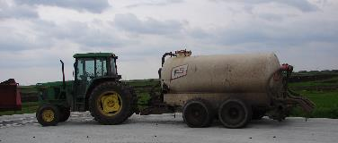
Moisture content
Optimal range 46% - 65%
Monitor with moisture meter or by hand
Dry
  Not enough water for bacteria to live
  Decomposition slows down
  Solution: Add water
Wet
  Not enough air for microbes
  Odor due to anaerobic digestion
  Decomposition slows
  Solution: turn pile, add dry materials
Ellen Phillips
Notes:
The microbes must live in water, therefore keeping the pile moist, not wet is critical to good composting.
The optimal moisture content is between 46 and 65% moisture content, approximately the feel of a wet sponge.
Moisture meters or oven tests and be used to determine the moisture content, but experience in knowing what moist compost feels like is often the best tool.
It the pile is too dry, add water.
If it is too wet, there may not be enough air for the microbes, so the pile should be turned.

Slide 42
Key Factors in Composting
Pile Size
Carbon to nitrogen ratio
pH
Moisture content
Aeration
Temperature
Notes:
Microbes need air to live.

Slide 43
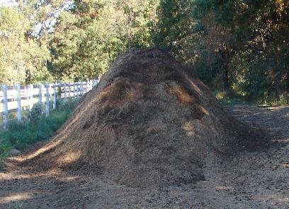
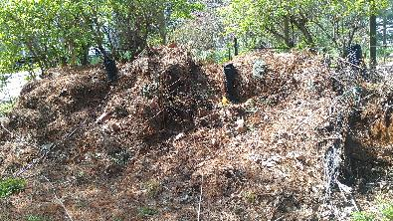
Oxygen Content
Hot air
rises
Atmospheric oxygen -21%
Oxygen levels in compost air
  < 6%, microbes die, odor
  Optimal 10-16%
  > 16% to minimize odors
As pile heats up, more oxygen will be consumed
Ellen Phillips
Adding air
  Heat in pile
  Turn pile
  Increase bulk density
  Put in air tubes (PVC pipes)
Ellen Phillips
Notes:
Air content is a difficult thing to measure without sophisticated tools.
Oxygen content should be maintained between 10 and 16 %.
Pile naturally created convection forces drawing cool air through the pile as the hot air rises out of the pile.
Therefore focusing on the bulk density of the materials and turning the pile will usually maintain the right amount of air in the pile.

Slide 44
Key Factors in Composting
Pile Size
Carbon to nitrogen ratio
pH
Moisture content
Aeration
Temperature
Notes:
Temperature tells you is everything is going well in the pile.

Slide 45
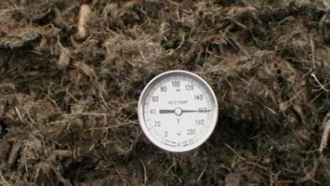
Temperature
Moisture moderates wide swings in temperature
Monitor with a compost thermometer
OPTIMAL temperature
  130 °F – 150 °F
  heat-loving (thermophilic) bacteria vigorously decompose organic materials
Pathogen reduction
  131°F pathogens are destroyed
  145°F fly larvae and most weed seeds are destroyed
Ellen Phillips
Notes:
When bacteria are multiplying and decomposing organic materials they create heat.
Therefore the center of the pile tends to be between 130 and 150 degrees.
These temperatures indicate that you have a hot compost system and that pathogens and weed seeds are being killed.
When the bacteria run out of food, their numbers decrease and so does the temperature.

Slide 46
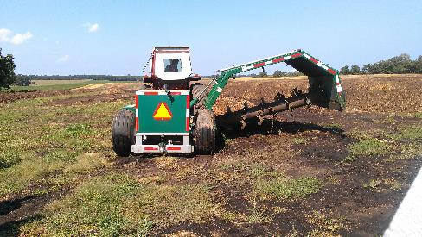
Temperature
Low temperatures <130 °F
  Microbes have run out of food
  Solution: turn pile
Excessively high temperatures
  > 160 °F
  Microbes begin to die
  Solution: turn pile
Ellen Phillips
Ellen Phillips
Ellen Phillips
Notes:
When the pile cools down, below 130 degrees, it is sign that it is time to turn the pile.
Excessive heat above 160 degrees can kill off the working microbes so the pile should be turned.

Slide 47
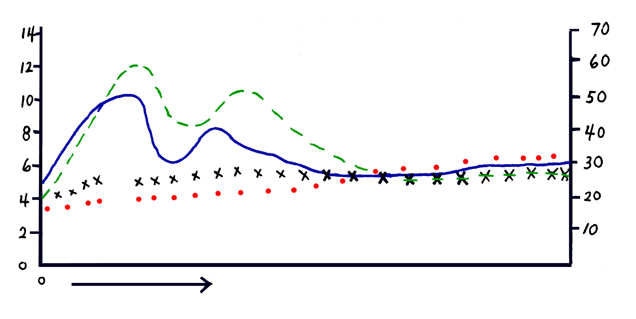
Microbial Population Dynamics
During Composting
Bacteria
Temp
Log #
cfu’s/g
Temp ºC
Actinomycetes
Fungi
Time
F= C º x 1.8 + 32
Midwest Composting School
Notes:
The hot composting system is doing well if the pile goes through numerous heating/ cooling cycles as you turn the pile.
At some point most of the fresh organic materials will have gone through the first stages of decomposition and the bacteria will run out of the easily decomposable materials.
If you turned the pile and it does not heat up, the pile is probably ready for the curing phase.

Slide 48
Curing
Temperature
Curing
Curing
Let it set
Minimal time 1 month
Reduces organic acids and other chemicals
Caution
don’t let pile go anaerobic
End
Pile remains at air temperature
Depends on intended use
Time
Notes:
Curing means the pile is allowed to sit and only be turned if it gets wet from a rainstorm.
During this time other organisms such as fungi take over transforming some toxic elements, and helping to create aggregates such that finished compost looks like soil.

Slide 49
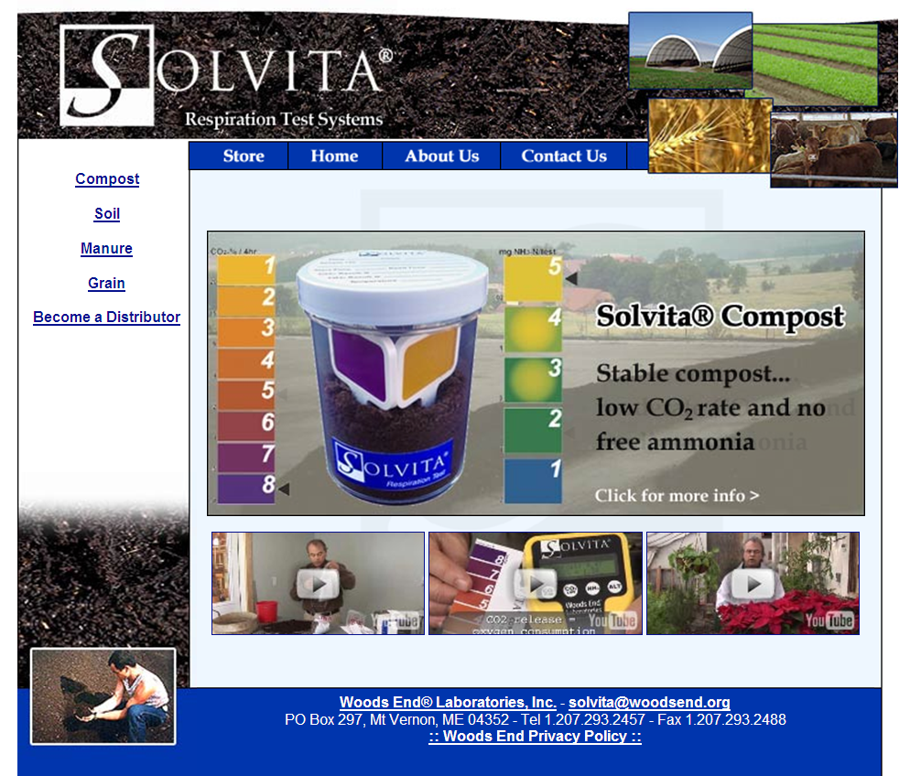
http://solvita.com/compost.html
Notes:
To have confidence the composted has finished curing you can use a Solvita test.
They are rather expensive, but let you know the toxic chemicals are now removed.
You can also plant some cucumbers in the compost. If they grow, the compost is ready.
$95.00 2261 Solvita Compost Maturity Test Woods End Lab 2261
$79.00 2262 Solvita Compost Maturity REFILL Woods End Lab 2262
$275.00 2265 Solvita Compost Masterkit Woods End Lab 2265
$504.00 2266 Solvita Compost Maturity Test -- BULK LAB PACKAGE Woods End Lab

Slide 50
Today’s Objectives
Compost
Rules and Regs
Methods of Composting
Key Factors in Composting
Using Compost
Notes:
Compost can be used in many ways around a farm.

Slide 51
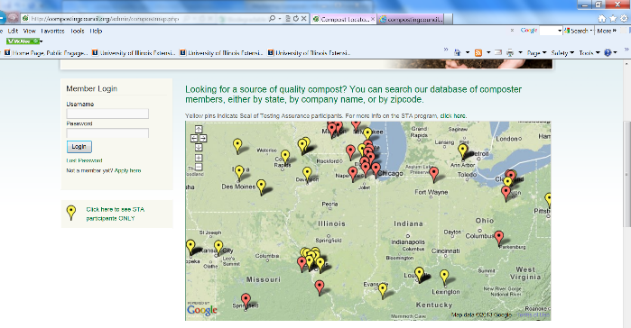
Buying Compost
Ask for compost test results
Buy the correct grade of compost
compostingcouncil.org/admin/compostmap.php
Notes:
If this presentation has convinced you that composting takes too much time, which I hope if didn’t.
Or if you need more compost than you can create on your farm, it is possible to purchase compost from large-scale composter.
The Composting Council maintains a list of composting facilities.
They can provide you with an analysis of the compost you purchase.

Slide 52
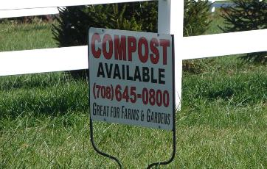
Free Compost?
If compost isn’t produced in a satisfactory way with records
  precautions similar to those for raw manure should be used when applying it
Ellen Phillips
Notes:
It is tempting to take advantages of free sources of “compost”
Compost available sign from a farm or stable does not guarantee it was composted.
However, they may not make the effort to produce quality compost, so there is no guarantee of the quality of this compost with out asking questions about their procedure and testing.
They should be able to provide you records, especially if you need them to meet organic standards.

Slide 53
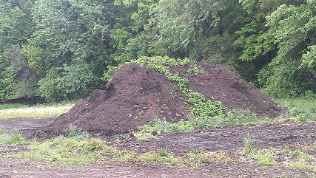
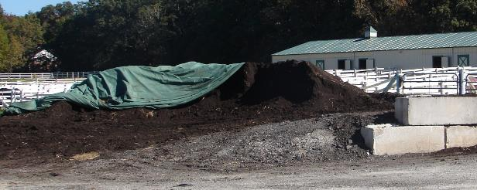
Finished Composted
Once compost is finished, cover the pile to protect it from contamination.
New weed seeds!
Ellen Phillips
Ellen Phillips
Notes:
If you have taken the time to create quality compost, don’t let it be recontaminated afterwards.
Use a tarp to keep weed seeds out.
Place it away from runoff sources of possible pollutants.

Slide 54
GAPs for using Compost and Teas
Manure and compost application rules are being evaluated, should be released fall 2015
No manure teas
Compost tea
  safety dependent on compost used and protection from contamination
  Heat treatment possible to lower microbial risks
  Not recommended for GAP
Notes:
Compost is an excellent amendment for produce fields and orchards.
Currently the Good Agricultural Practices (GAPs) recommendations are being reconsidered. By fall of 2015 new guidelines should be available on using both manure and compost.
There are usually minimal restrictions on using quality compost in production soils, fields or orchards.
There are restrictions on using manure and compost teas
The safety of compost tea depends on the compost used and method of brewing. If done wrong it can actually encourage pathogens. It is beyond the scope of this presentation to discuss this. Should you decide to use compost tea, do your research to use it in a safe manner.

Slide 55
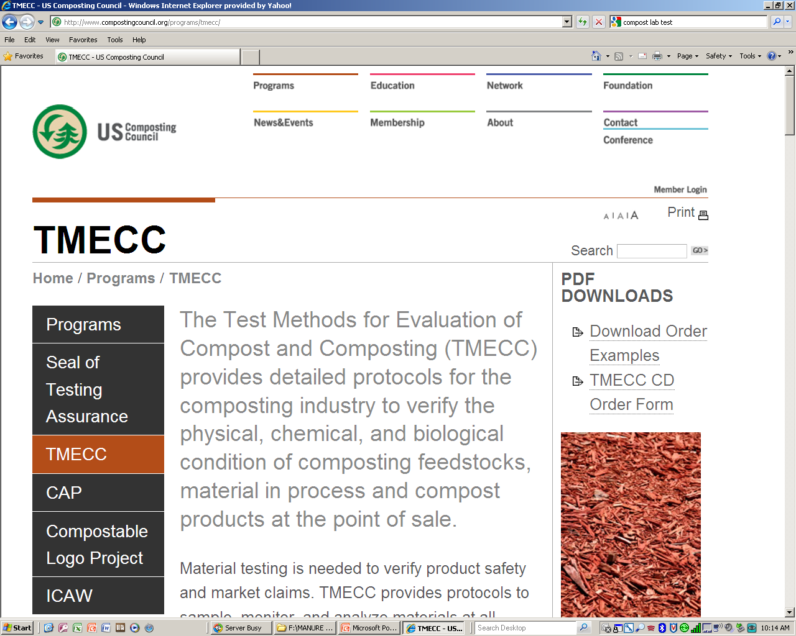
Composting Council Seal of Testing Assurance www.compostingcouncil.org/programs/tmecc/
Certified Compost Products analyzed for:
pH
soluble salts
nutrient content (total N, P2O5, K2O, Ca, Mg)
moisture content
organic matter content
bioassay (maturity)
stability (respirometry)
particle size (report only)
pathogen (Fecal Coliform or Salmonella)
trace metals (Part 503 regulated metals)
Notes:
The Composting Council does have a “Seal of Testing Assurance program which many large scale composter participate in.
They maintain a list of labs that you can have your compost analyzed as well for nutrients, hazards and pathogens.

Slide 56
Compost testing
Many labs
Cost
  $30-400
Notes:
The cost for composting can be expensive with simple nutrient analysis running about $30 and a complete analysis being hundreds of dollars.

Slide 57
Typical Compost Analysis
(dry weight basis)
Total N: 3%
NH4-N: 500 ppm
NO3-N: <2 ppm
Total P: 0.88%
Total K: 0.83%
pH; 7.2
C:N ratio: 8:1
Electrical conductivity: 3.5 mmhos/cm
503 metals: below EPA limits
Moisture content: 40% water
U.S. Composting Council
Notes:
Most compost is not really high in nutrient content, most of the benefits are from the organic matter that is added to the soil .
This is a typical analysis of compost.
Compost made from manures tend to be a bit higher in nitrogen and other nutrients than a compost primarily of plant based organic materials.

Slide 58
Nutrient Availability from Compost
Compost does not steadily release nutrients
  Suring first year
    10 to 25% of compost N maybe plant-available
    40% and 60% for P and K may be available
these are only estimates and actual availability depends on
  quality of the compost
  growing season environment that affects decomposition and N mineralization
http://www.extension.org/article/18567
Notes:
http://www.extension.org/article/18567
Because the compost must be further decomposed within the soil system to release the nutrients, this must be taken into consideration in your soil fertility planning.
In general, it is assumed that 10 to 24 % of the nitrogen will be available the first year the compost has been added.
This will change depending on the climate and soil conditions.
The article listed has a good discussion on how to interpret compost additions to soil

Slide 59
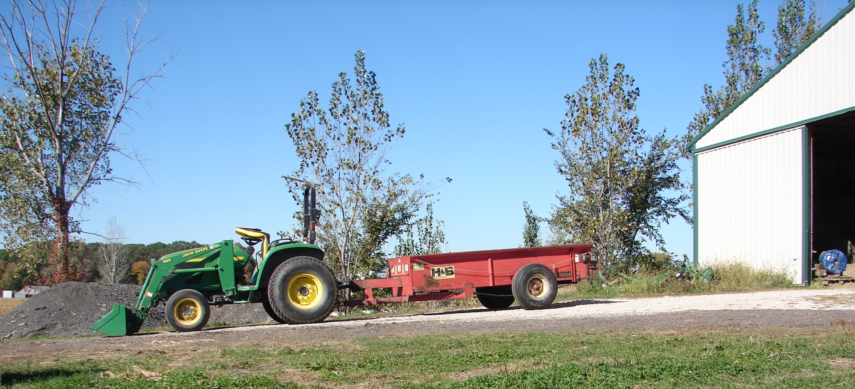
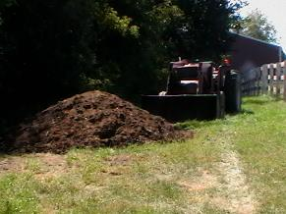
Who’s going to haul it?
Where’s this
bucket been?
Ellen Phillips
2” of compost per acre = 300 cubic yards or 150 tons
Ellen Phillips
Notes:
A general recommendation is to apply 2 inches of compost each year. This equates to about 150 tons of compost per acres.
To not recontaminate the compost, make certain equipment used to apply it are clean.

Slide 60
Record keeping – Application
Whenever compost is applied to your land, it is important to keep good records of:
  the date
  amount applied
  nutrient content
  soil test results
  weather conditions
Notes:
Record keeping is important to recognize the benefits of compost to your soil management plan.
Keep records of when and how it is used.

Slide 61
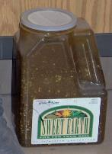
Selling Compost
Fertilizer
Or
Soil Amendment?
Watch your wording!
Before selling compost check:
  Illinois Fertilizer Act
  Illinois Soil Amendment Act
  Composting Permitting laws
Paul Walker
Illinois State University
compost
Notes:
It may be possible to make some money by selling the compost you create.
Be very careful in doing so.
It can impact your necessity to have a permit – so check with the county and IL EPA
Be careful of the “benefits” you put in advertisement to make certain the compost does not fall into the categories of a fertilizer or soil amendment which are registered products in Illinois.

Slide 62
Summary
Compost is an excellent soil amendment
Know the Rules and Regs for composting in your municipality
Key factors in composting
  Pile size
  Moisture content
  Temperature
  Carbon to nitrogen ratio
  Aeration
  pH
There are numerous ways to use compost
Notes:
Compost is an outstanding soil amendment and all soils can benefit by adding it.
Produce farms create a lot of organic materials that can be easily composted, but know the rules and regulations that may apply to your situation before starting.
Hot composting creates the best compost but it requires close attention to several key factors.
There are numerous methods to compost. I hope you can find one that fits within your farming system so that you to can create an excellent soil amendment to improve your soil.

Slide 63
Resources
Chicago home composting
www.cityofchicago.org/city/en/depts/streets/supp_info/composting/home_composting.html
Making and Using Compost for Organic Farming
www.extension.org/article/18567
On-farm Composting
http://compost.css.cornell.edu/OnFarmHandbook/onfarm_TOC.html
Commercial On-Site Food Composting Systems
  The Earth Tub, by Green Mountain Technologies: http://compostingtechnology.com/products/compost-systems/earth-tub (external)
  The WISErg Harvester: http://wiserg.com/ (external)
  The Worm WigWam: http://wormwigwam.com/ (external)

Slide 64
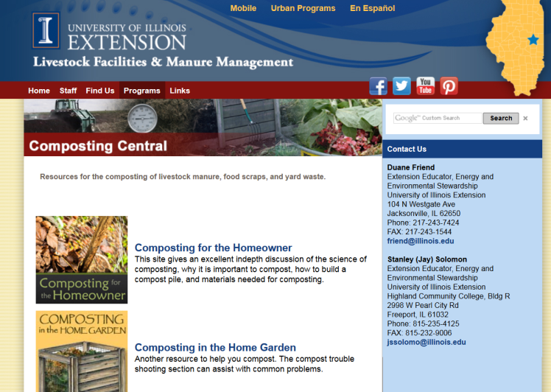
web.extension.illinois.edu/compostingcentral/

Slide 65
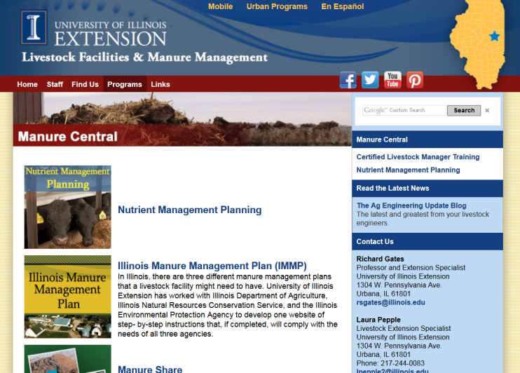
web.extension.illinois.edu/manurecentral/

Slide 66
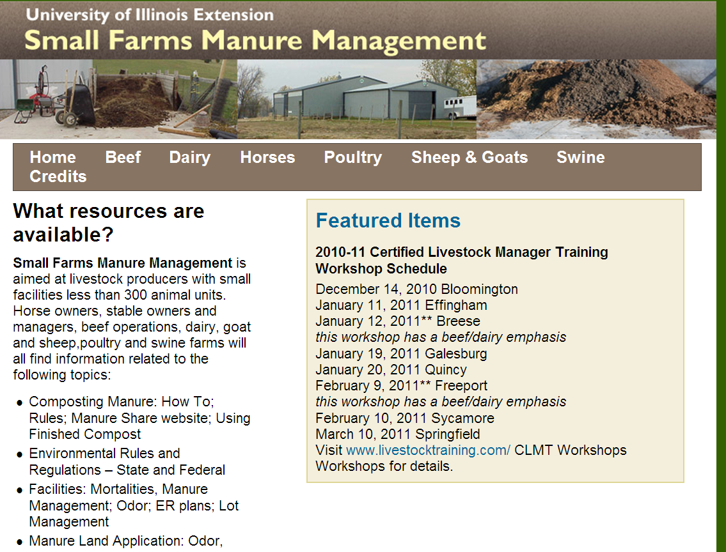
web.extension.illinois.edu/sfmm/

Slide 67
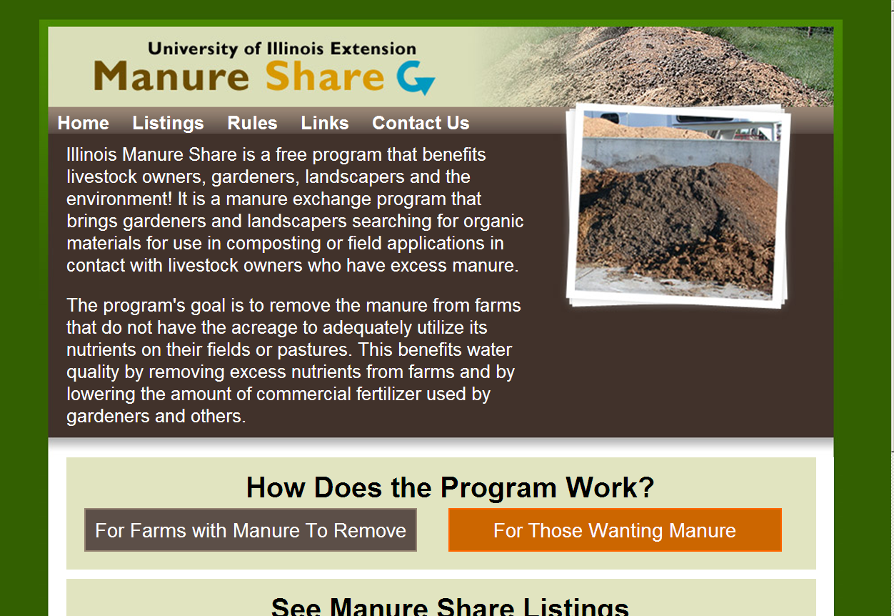
web.extension.illinois.edu/manureshare/

Slide 68
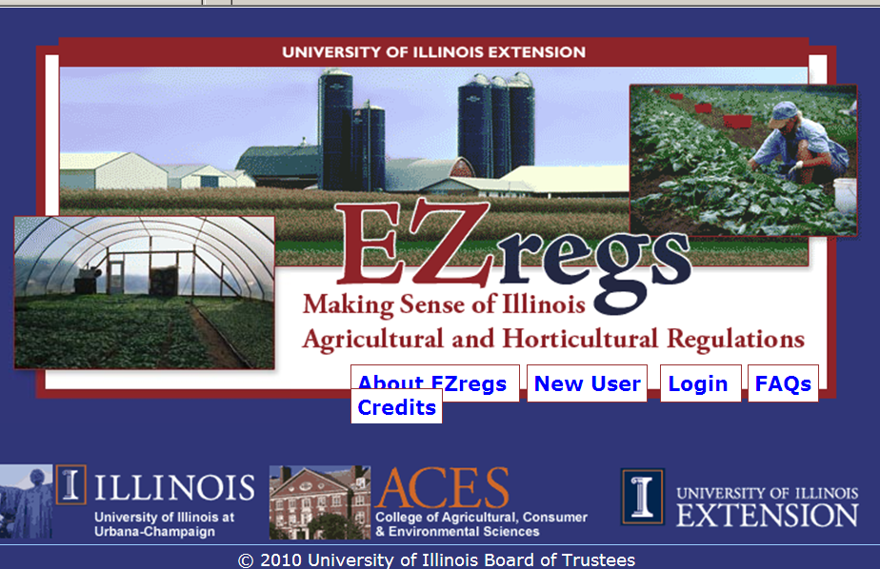
web.extension.illinois.edu/ezregs/

Slide 69
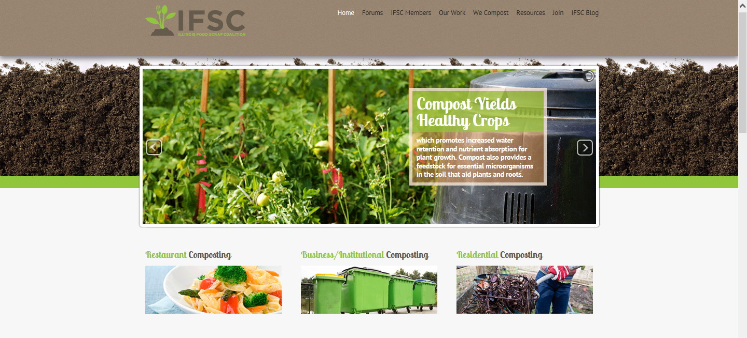
http://illinoiscomposts.org/

Slide 70
To reach us
Contacts | Contact information
Rick Weinzierl | weinzier@illinois.edu
Ellen Phillips | Emplap@yahoo.com

Slide 71
If you have questions …
University of Illinois Extension Local Food Systems and Small Farms team
  http://web.extension.illinois.edu/smallfarm/
USDA’s Start2Farm site
  http://www.start2farm.gov/
Notes:
Our beginning farmer training program ended in the fall of 2015. The best way to pursue answers to questions about fruit and vegetable production in Illinois is to contact educators on the University of Illinois Extension Local Food Systems and Small Farms team. Extension programs in other states are operated by the land-grant university in each state. Additionally, USDA’s Start2Farm site provides listings of farmer training programs in specific states and localities.

