Slide 1
Preparing a New Generation of Illinois Fruit and Vegetable Farmers a USDA NIFA Beginning Farmer and Rancher Development Program Project Grant # 2012-49400-19565 http://www.newillinoisfarmers.org
Notes:
The following presentation was part of a beginning farmer course, “Preparing a New Generation of Illinois Fruit and Vegetable Farmers,” offered by the University of Illinois and the Illinois Migrant Council from 2012 through 2015. This course was funded by the United States Department of Agriculture’s National Institute of Food and Agriculture, and specifically by the Beginning Farmer and Rancher Development Program. For more information about the program and for links to presentations and resources on many other topics, see the website newillinoisfarmers.org.

Slide 2
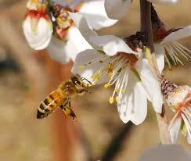
Beekeeping Basics for Fruit and Vegetable Producers
Stu Jacobson, Ph.D.
Illinois Queen Initiative
Notes:
This presentation is a very basic introduction to keeping honey bees. If you want to learn more, consider contacting the beekeeping association in your area and attending several of their meetings. The best time to start beekeeping is in April or May, depending on whether you live in the southern, central or northern part of Illinois. By going to one or more meetings this fall or winter, you will be in a much better position to begin this coming spring.

Slide 3
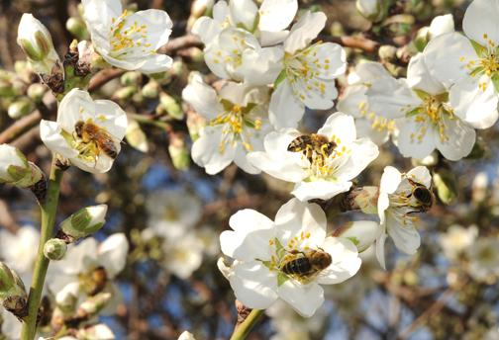
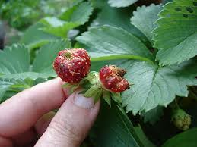
Honey bees are the primary pollinators for horticultural crops
Except for small areas (<1/3 acre) or those adjacent to a large area of uncultivated ground you will need honey bees…
If you want better fruits than these strawberries.
http://entomology.ucdavis.edu/
Notes:
If you are growing a few fruit trees such as apples and peaches, small fruits or members of the squash family, and have not seen many bees visiting the flowers, you will most likely need honey bees if you expand your area of these crops to one-half acre or more. This assumes that you do not have an acre or more of uncultivated land adjacent to your property that is not heavily wooded.
Most native bees need areas that are grassland and woodland with a mix of native plants as well as bare areas for ground nesting species, such as those that pollinate squash and cucumbers.

Slide 4
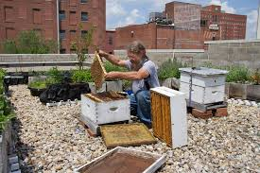
Advantages of Honey Bees
There are lots of informational resources available about how to manage honey bees.
There are 22 beekeeping associations in Illinois where one can receive assistance and mentoring.
Honey bees can be kept almost anywhere on a few square yards; they are compatible with horticulture crops and can be kept in yards with poultry.
Notes:
A list of local beekeeping associations can be found at the Illinois State Beekeeping Association website (list at http://www.ilsba.com/). Bees hives need to be fenced off from livestock such as pigs, goats, cattle and horses.

Slide 5
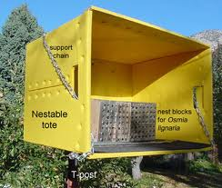
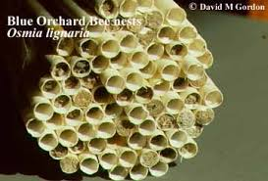
What about native species such as the Blue Orchard Bee?
This bee actually has more diseases then honey bees and requires specialized management.
Native species can supplement honey bees if you provide appropriate nesting areas and a variety of nectar sources for them.
Notes:
A great deal is yet unknown about native bees, of which there are thousands of species across the country. Very few beekeepers have experience with native bees. So unlike raising honey bees, you are far less likely to encounter someone who lives less than one-three hours distant who can help you with native bees.

Slide 6
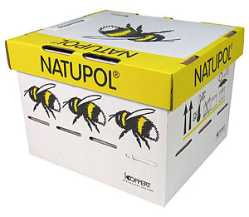
Bumble bee hives also can be purchased.
However, the colonies last only 8 to 10 weeks and they are implicated in spreading diseases to native bumble bees.
Bumblebee Hive - Class C
Covers up to 5,000 Square Feet
SKU: 1530003 $109.97
Bumblebee Hive - Class A
Covers 10,000 - 15,000 Square Feet
SKU: 1530001 $249.95
Notes:
If you produce apples, peaches or cherries and do not plan to raise fruits or vegetables such as melons, cukes or pumpkins, bumble bee colonies may make sense for you. Bumblebee hives last approximately 8 to 10 weeks and will have to be purchased again for summer pollination or for the following year. Bumble bees also work well in greenhouses where honey bees do not do well; the latter fly to the glass and try to leave.

Slide 7
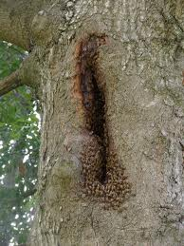
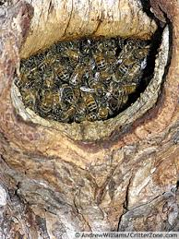
You may already have feral or domestic honey bee colonies nearby.
If you see honey bees on flowers on your property or nearby, that is most likely the case.
flicker.com critterzone
Notes:
Honey bees will fly more than 2 miles to visit attractive nectar sources when there are few such sources closer by or the flowering plants nearer to the colony produce less nectar or nectar lower in sugar. Less attractive crops such as cucumbers may be visited only if they are nearby -- perhaps as close as 100 feet or so – and if there is a lack of attractive flowers in the area.

Slide 8
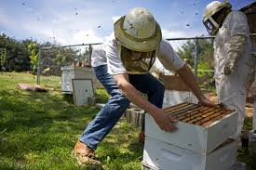
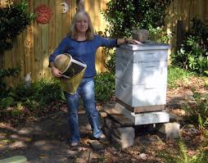
In many cases your choices are to rent colonies or to manage your own.
The subject of renting honey bee colonies was covered in a previous presentation.
This presentation will focus on very basic considerations in acquiring and managing your own colonies.
dailyegyptian popularmechanics.com
Notes:
There are a number of good books on beekeeping as well as informational resources on the web. Bee Source (beesource.com) is one of the best websites with a number of discussion threads. There is also a good deal of misinformation on the web. Beekeeping in the Midwest, published in 1976 by the University of Illinois Urbana-Champaign, is available free; refer to the website listed on the last page. It is an excellent resource, however, it’s important to note also that it has out-dated recommendations regarding preventive use of antibiotics. In addition, several pests of honey bees are not covered because they appeared in this country a number of years after the book’s publication.

Slide 9
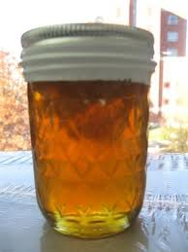
Advantages of having your own honey bee colonies
You won’t have to find colonies to rent – which sometimes is not that easy.
You can control the timing of pollination
You can sell your own honey along with your fruits and/or vegetables.
Adding locally-produced honey can attract new customers.
Notes:
When starting out with a package or a swarm on comb foundation, it’s not that common to harvest any honey. By the second year one can reasonably expect to harvest anywhere from 30 to over 100 lbs of liquid honey per colony. Apiary sites surrounded largely by row crops will offer little early forage for bees which then cannot increase their populations in order to take advantage of later spring sources such as black locust or bramble species.

Slide 10
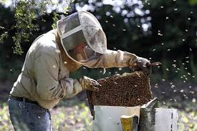
Potential disadvantages of having your own honey bee colonies
You will have initial expenses, about $350 for the first hive, less for additional ones.
You will need to learn new management skills.
Notes:
Getting stung, a major disadvantage for some people, will be covered later in this presentation.

Slide 11
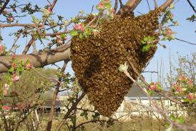
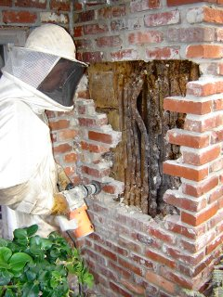
Colonies also may die and need replacement @ $80-100 per colony
However, one also can divide another, populous colony; and sometimes find swarms or do “cut-outs” from buildings or trees
cornell.apiculture.image stclairbeekeepers.com
Notes:
Dividing colonies correctly takes some experience; an example of where mentoring pays off. Beekeepers who call their local U of I Extension office can be put on a swarm call list. Fire departments also keep swarm lists. Residents in the area call in if they have a swarm on their property. Sometimes the swarms end up being yellow jacket or wasp nests. Learning how to do a “cut out” is best done by helping someone who has sufficient experience.

Slide 12
Other cost saving measures
You can buy colonies for less than $300 each.
HOWEVER – make sure they have been inspected and are healthy (IL Department of Agriculture Bees and Apiary Program (http://www.agr.state.il.us/programs/bees/).
Never buy used, empty hives, etc – deadly disease spores can persist in them for years.
You can make your own hives, although it is usually not cost effective.
Notes:
When buying a colony of bees, be sure to ask the seller for a certificate that the colony or colonies you are buying have been inspected within the previous few months. It’s generally better to buy colonies in the spring or summer than in the fall, especially for the beginner. This is another example where having an experienced beekeeper along would be helpful. The inspection only certificate only certifies that a colony is free of specific diseases. It will not certify, for example, that it is a populous colony worth the asking price.

Slide 13
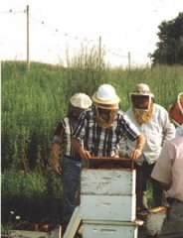
More cost and grief saving measures
Join your local beekeeping association as well as the Illinois State Beekeeping Association
Find at least one mentor – stay clear of those who are overly opinionated or need to show how much they know.
Notes:
The Illinois State Beekeeping Association is the statewide beekeeping organization (http://www.ilsba.com/). Each year the ISBA holds an annual meeting at the Illinois Department of Agriculture Building on the State Fairgrounds in Springfield. There is also an annual summer meeting that rotates between the three north-south regions of the state. These meetings feature nationally known speakers. Regional/local associations usually meet monthly and often feature speakers or other types of programs.

Slide 14
How many colonies to start with?
If feasible, it’s a good idea to start with two colonies.
This allows you to compare them, which is especially useful if one colony has problems, for example a failing queen.
Then too, with queen problems, one can partially remedy the situation by moving frames of young larvae over to the apparently queenless colony, while waiting to receive another queen
Notes:
Another possibility is to buy only one colony and team up with another beginner and help each other out by working the colonies together.

Slide 15
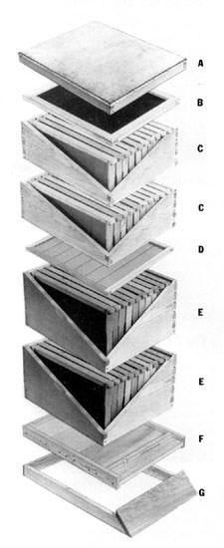
Equipment you will need for one hive:
A. Outer cover
B. Inner cover
C. 2 medium honey supers
(D. Queen excluder - optional)
E. 2 deep hive bodies
F. Bottom board
Also 20 deep and 20 medium frames and wax
foundation for each frame (pictured in the hive
bodies). Frames hold the combs that bees
build from the wax foundation
http://www.ent.uga.edu/bees
Notes:
During the first year you probably won’t need two medium honey supers, although at least one is a good idea so that the queen will have enough room to produce lots of young bees. If the bees run out of room to store honey, they will place in the combs needed by the queen. The result could be a colony that has too small a population for optimal overwintering.

Slide 16
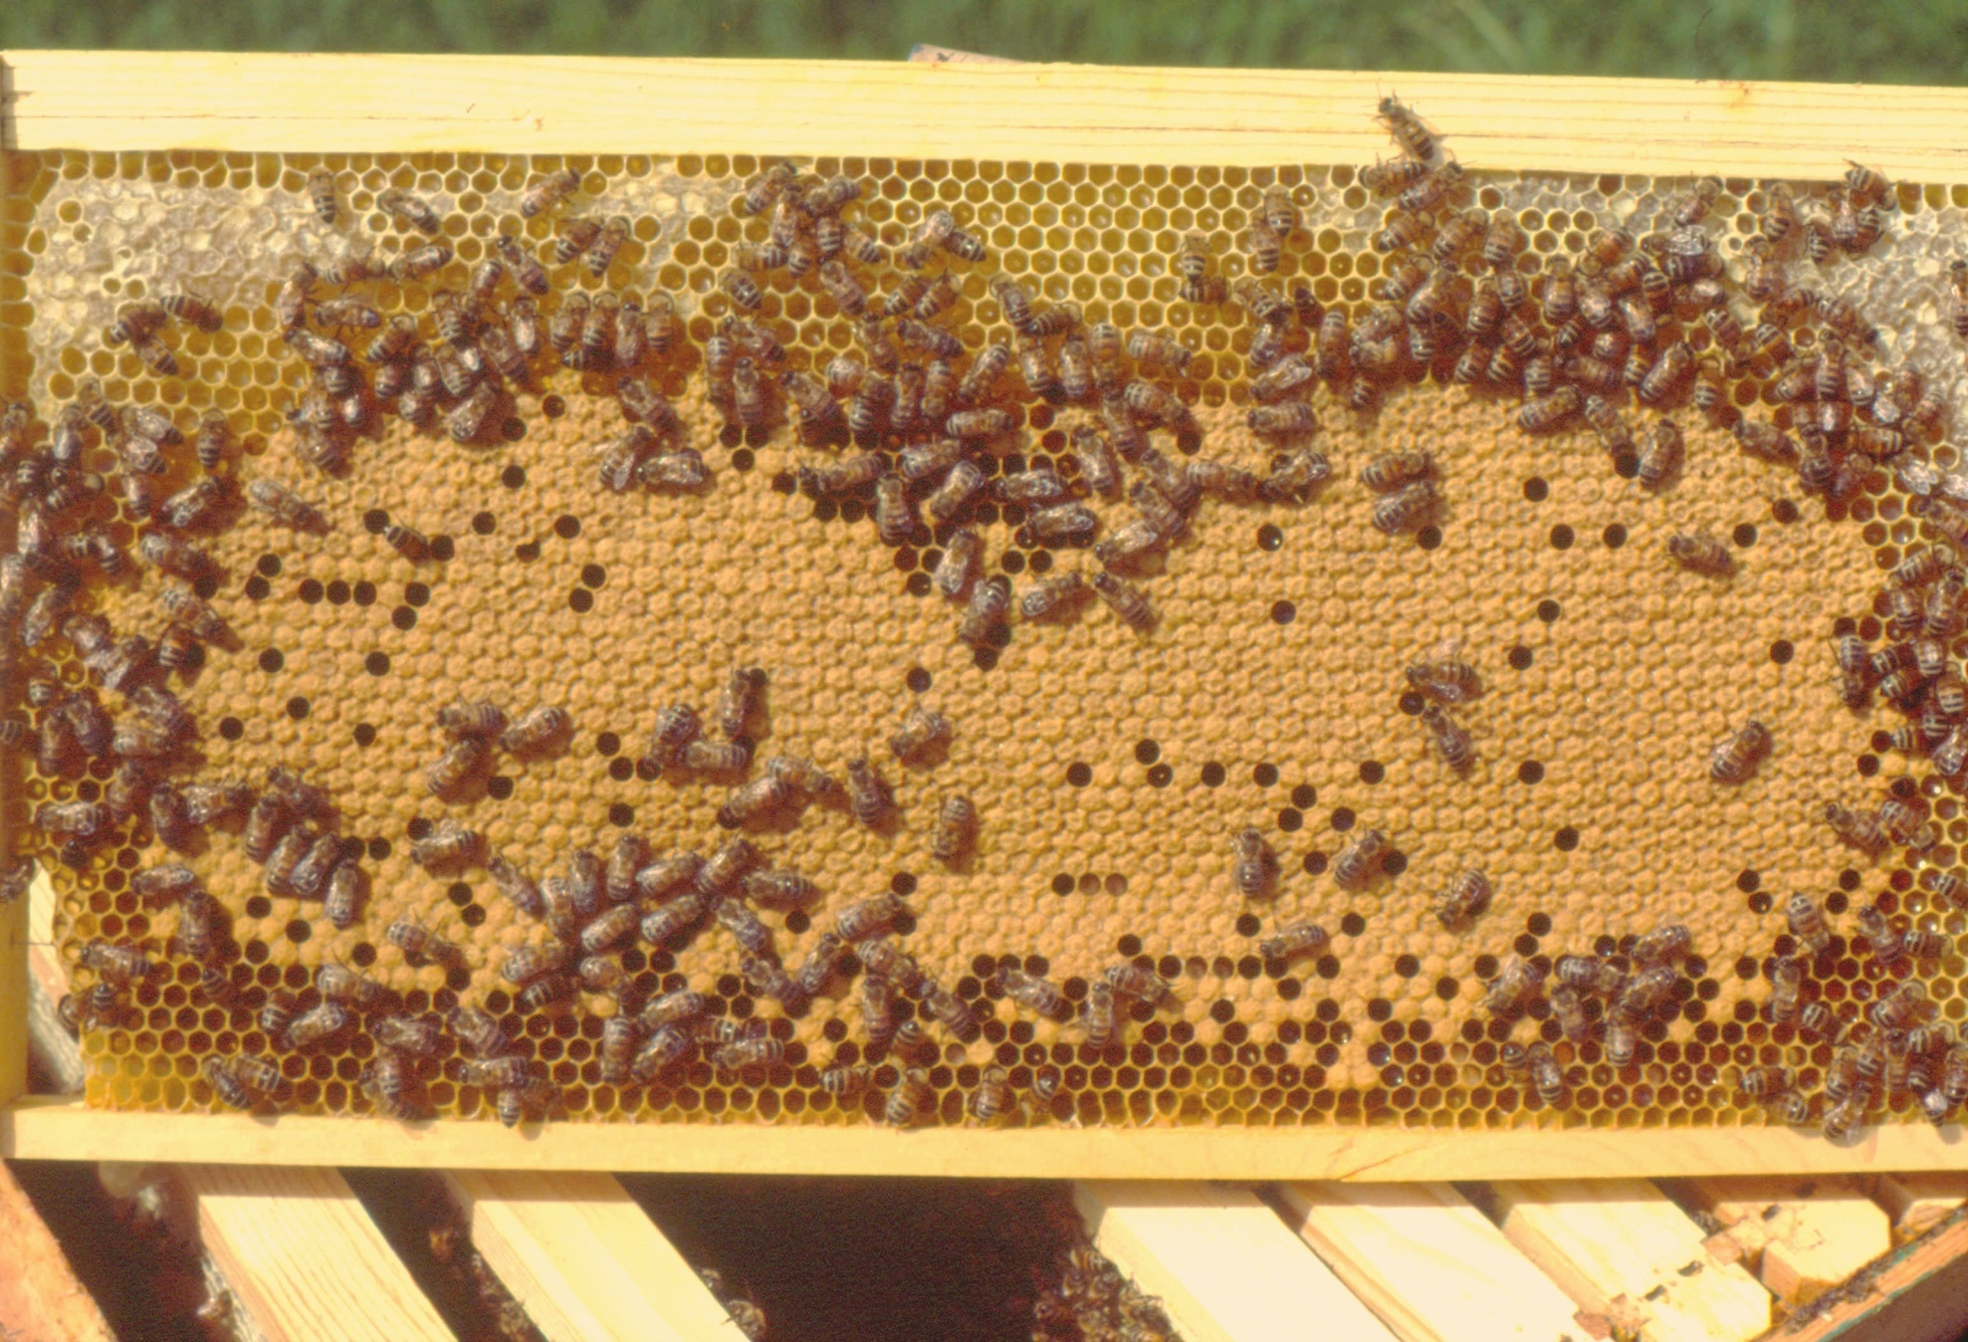
Deep Frame of Capped Brood
Capped Brood
Honey
Nectar
Capped Brood
Notes:
This is a fairly typical frame of capped brood comb. Capped brood is composed of cells containing honey bee pupae covered with a thin layer of beeswax. The term brood also refers to bee eggs and larvae. It is quite common to see the upper and lower corners of brood frames filled with honey or nectar which is on its way to becoming honey.

Slide 17
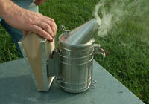
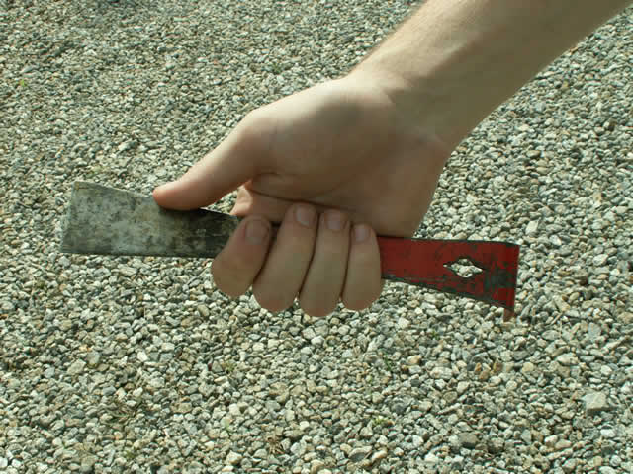
Additional Supplies Needed
Smoker
Hive tool
Hat and veil
Gloves
Bee suit -- not necessary
unless you are afraid of
bees.
http://www.ent.uga.edu/bees
Notes:
Bee suits are fairly expensive and hot. Part of beekeeping is becoming comfortable with bees buzzing around your head. Learn good smoker technique from experienced beekeeper, even one with only a year under her or his belt. One of the advantages of starting with a nuc or a package is that they are not defensive.

Slide 18
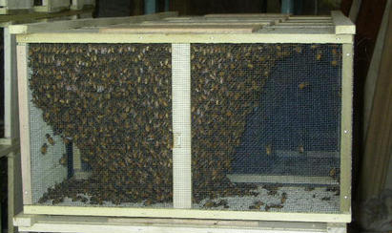
How about the bees?
Beginners usually start with a package of bees which contains 2 or 3 lbs of young bees and a young queen in a small, separate cage.
In many cases these can be ordered through local beekeeping associations – a service to their
members.
Western Bee Supplies, Inc.
Notes:
A number of local associations do group orders of package bees and these also can be ordered through beekeeping equipment suppliers.

Slide 19
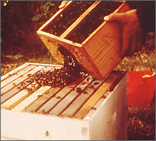
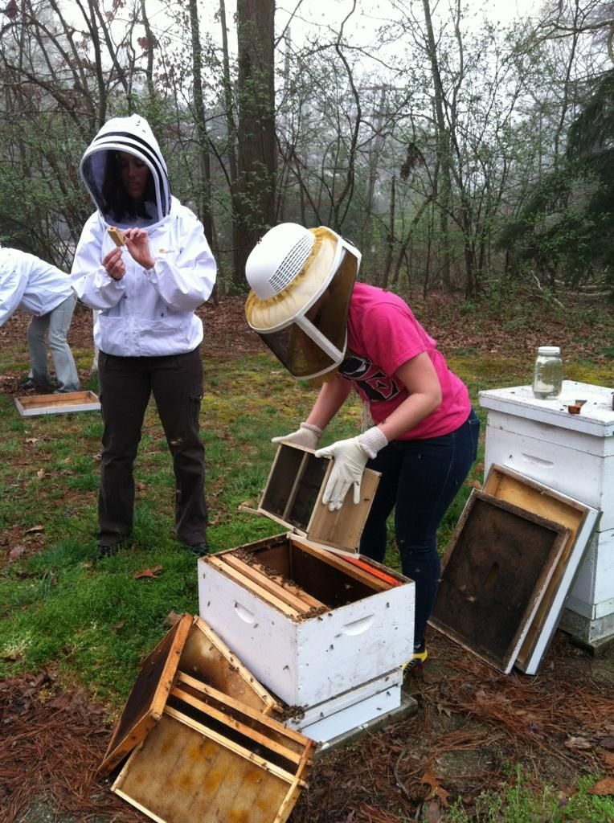
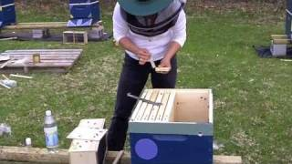
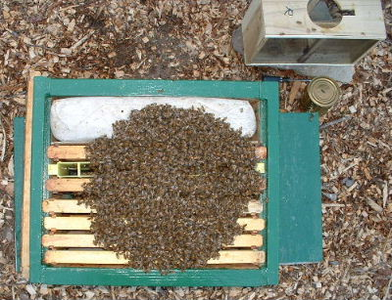
Hiving package bees.
Notes:
Package bees are not inclined to sting. They will need to be fed sugar syrup after being hived. The woman in the white bee jacket in the right-hand photo is holding the queen cage.

Slide 20
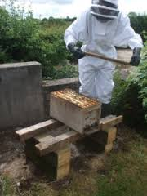
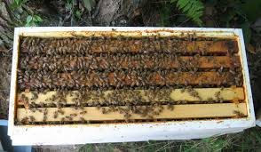
Another, often better option is to buy a nucleus (nuc) colony.
A nuc is a small, 4 or 5 frame colony with a laying queen and combs with larvae and pupae as well as ones with honey and pollen.
Beekeepers in your area may have nucs, or you can find a list of those selling nucs on the website of the Illinois Queen Initiative (illinoisqueeninitiative.com).
hansenhives.com bestbeekeeping.com
Notes:
Nucs are small bee colonies and need to be inspected by an IDOA apiary inspector before being offered for sale. They cost about $125-140 each and will almost always grow more rapidly than a package. In addition, they have fewer queen problems. Unfortunately, they are often in short supply.

Slide 21
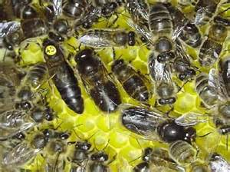
Who’s who in the colony?
Honey bee colonies consist of up to 60,000 female worker bees;
Hundreds of drones (male bees) during the growing season;
One queen -- normally – the mother of all the bees in the colony.
In this photo the queen is on the
left with a numbered disk on her
back, a drone is in the middle and
a worker on the right.
Can you find another drone?
Illinois Queen Initiative Image
Notes:
The queen is marked with a numbered disk glued onto her thorax for identification purposes. Notice that the queen has a much longer abdomen than the workers or drones. A drone’s larger thorax contains more powerful flight muscles and larger eyes; the better to see and pursue the queen in flight 100 feet in the air or so. Typically, an unmated queen will mate on the wing with 10-20 or more drones. The workers, as the name implies, do all the work in the colony; unless, of course, one counts laying 1500 eggs a day as work.

Slide 22
About stinging:
What to do to avoid being stung:
Wear protective clothing – start with gloves; always use a veil
Use a smoker; keep it lit
Open hives in warmer weather whenever possible: 75-95º F (55-65º OK for brief glances at top of frames)
Use slow movements- no jerking or slapping at bees
Take extra care around hive; don’t stand in bee flight path
Don’t remove veil too soon after opening a hive
Keep gentle bee stock
Scrape sting out promptly if stung!
Notes:
A lot of avoiding being stung when opening a bee hive is using common sense: cover your skin completely, at least until you get to know how gentle your bees are; use a smoker – it’s thought to mask the alarm pheromone released when a colony is manipulated; don’t stand in the bees line of flight. The bees keep the interior of the cluster at about 93 degrees F; they don’t appreciate it when the cluster is disturbed in cold or even cool weather and will respond accordingly. Trying to work a hive at night is also not a good idea.

Slide 23
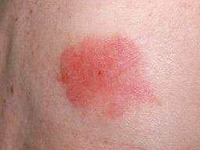
Normal Reaction
Pain, and later, itching at sting site
Redness at sting site
Swelling – often relatively large for those rarely stung - doesn’t mean you’re allergic.
These reactions are normal the first few times you get stung.
After a few stings these symptoms
are uncommon.
Getting stung now and then
is part of beekeeping.
skinsight.com
Notes:
When I was about 20 years old I was stung just above the right eye. The next morning my eye was nearly swollen shut, but there was little redness or itching. Within 24-48 hours the swelling subsided. In comparison, when working with African bees in Venezuela I was often stung dozens of times each week, albeit usually through my work shirt or gloves. I had no problems with swelling, itching or redness.

Slide 24
Allergic Reaction
Widespread, rapid swelling
Itching elsewhere on body
Swelling inside the throat
Disorientation feeling
Loss of consciousness
Those who experience these symptoms should seek immediate medical attention!
Notes:
Regarding widespread itching: persons who are hyper-allergic to bee venom could be stung once on the back, for example, and in 5-10 minutes feel itching on the bottom of their feet. In addition, they may feel swelling in their throat and lose consciousness. Take them immediately to the emergency room or call an ambulance if this happens to you. Persons with these symptoms should not take up beekeeping.

Slide 25
As you can see, beekeeping is not for everyone.
You will need to make a commitment of time and money and be willing to be stung at times.
If after viewing this presentation you are still interested in beekeeping, plan to attend a meeting of your local association.
Get to know several beekeepers in your area. Ask if you may visit their bee yards an look over their shoulders.
Most beekeepers are eager to share their knowledge and love of bees.
Notes:
Beekeepers are a pretty unique bunch. You will meet a lot of very helpful individuals at local beekeeping association meetings.

Slide 26
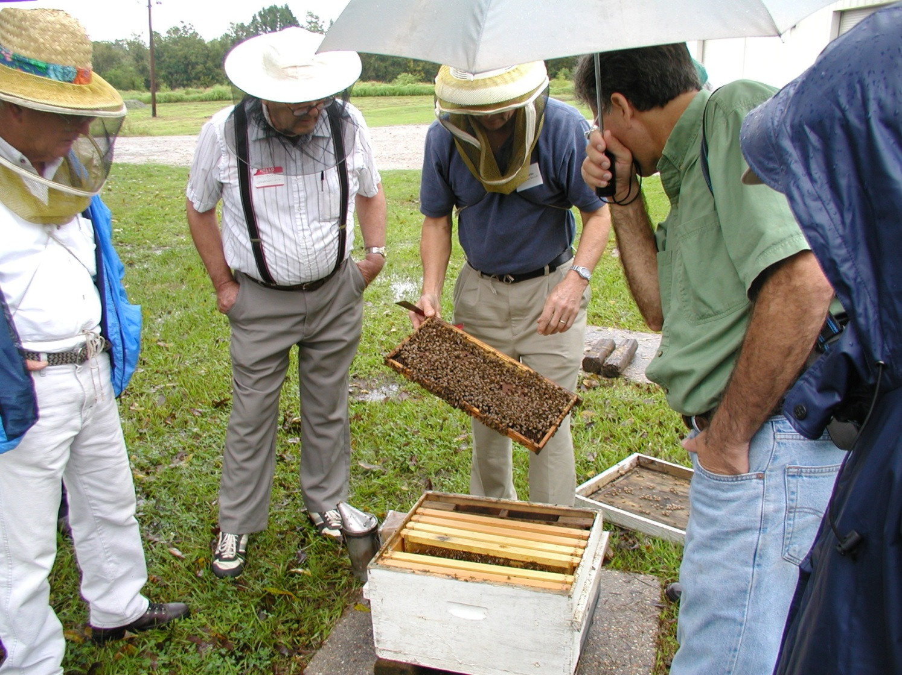
Find a mentor, maybe two.
Notes:
Having an experienced mentor is one of the best ways to learn how to keep bees. Recognize that there is a diversity of views about different management concerns. Which strategy one chooses can depend on concerns about overuse of chemicals versus “natural” beekeeping, on the type of bees you have, and whether or not producing a large honey crop is you sole objective. There is an old saying that when you have 10 beekeepers in a room, there are at least 11 different ideas about how to keep bees.

Slide 27
Keys to Successful Beekeeping
In order to understand proper colony management, one needs to learn a good deal about honey bee biology and behavior.
This necessitates reading as well as observation and learning from one or more mentors.
Many of the beekeeping associations offer classes for beginners; the U. of Illinois also offers one at the Urbana-Champaign campus.
(http://www.life.illinois.edu/entomology/bee-course-html )
Notes:
Beginning beekeepers should go into their hives on a frequent basis. The major goal of the first year, other than having a thriving hive the following spring, should be to learn as much as one can through hands on experience; it should not be to make honey the first year, although that does happen fairly frequently. In addition, seek out other opportunities for learning by visiting more experienced beekeepers, perhaps offering to assist them with certain tasks, such as requeening a colony or making a divide or split.

Slide 28
If you have questions …
University of Illinois Extension Local Food Systems and Small Farms team
http://web.extension.illinois.edu/smallfarm/
USDA’s Start2Farm site
http://www.start2farm.gov/
Notes:
Our beginning farmer training program ended in the fall of 2015. The best way to pursue answers to questions about fruit and vegetable production in Illinois is to contact educators on the University of Illinois Extension Local Food Systems and Small Farms team. Extension programs in other states are operated by the land-grant university in each state. Additionally, USDA’s Start2Farm site provides listings of farmer training programs in specific states and localities.

