Slide 1
Preparing a New Generation of Illinois Fruit and Vegetable Farmers a USDA NIFA Beginning Farmer and Rancher Development Program Project Grant # 2012-49400-19565 http://www.newillinoisfarmers.org
Notes:
The following presentation was part of a beginning farmer course, “Preparing a New Generation of Illinois Fruit and Vegetable Farmers,” offered by the University of Illinois and the Illinois Migrant Council from 2012 through 2015. This course was funded by the United States Department of Agriculture’s National Institute of Food and Agriculture, and specifically by the Beginning Farmer and Rancher Development Program. For more information about the program and for links to presentations and resources on many other topics, see the website newillinoisfarmers.org.

Slide 2
Growing a New Generation of Illinois Fruit and Vegetable Farmers USDA NIFA Beginning Farmer and Rancher Development Program Grant # 2012-49400-19565 Basics of Commercial Vegetable Production
Mike Roegge, J.D. Kindhart and
Nathan Johanning
Notes:
Notes
The Basics of Vegetable Production is one of the first topics in our year-long program for new fruit and vegetable farmers. In our first class we also cover the basics of fruit production and the basics of business planning and marketing for new farmers.

Slide 3
Why grow vegetables?
Greater income potential than grain crop production
Also has greater labor demands than grain crops
Lower equipment costs (no $250,000 combines)
Provide a good alternative or addition to row crops
Viable operation on small acreage
Add additional family member(s) to an existing farm enterprise
Diversify an existing row crop operation
Recently the demand for local food has greatly increased
Farmer’s Markets, Restaurants, Grocery Stores, Food Service Companies, Government Institutions…
In some areas demand is greater than the ability to supply
Can be a part-time operation
Notes:
There are many reasons that new farmers might choose to grow vegetables. A small amount of land used to produce fruits and vegetables can produce an income MUCH greater than can be produced on the same land used for grain crops. Sales from a few acres of fruit and vegetable production can provide a significant supplemental income for new farmers who still have other jobs, for farms where an additional family member is entering the business, and for small farms where grain crops do not provide a sufficient income. Small-scale fruit and vegetable farming can be done on a part-time basis, and at least several different fruit and vegetable crops can be grown in most situations. One additional compelling reason to grow fruits and vegetables is to meet an increasing demand for fresh, locally grown produce.

Slide 4
Successful operations have:
Quality as the number 1 goal
Effective crop and pest management, timely harvests, and good post harvest handling
Market high quality produce (rest to neighbors or food banks)
Know your market(s)
Types and quantities of produce at appropriate times and price
Regional preferences (e.g. straightneck vs. crookneck squash)
Ethnic makeup and preferences
A very strong work ethic … (or a great labor pool)
Notes:
For vegetable production to be a profitable and viable commercial endeavor, successful operations are almost characterized by at least these three traits. They select and plant specific varieties, practice effective irrigation and pest management techniques, harvest at the right time, and handle harvested produce so that it retains its quality … taking high quality produce to the market is THE number 1 priority. They have studied and observed their markets – their customers -- and have adapted their operations to meet their needs. For example, sweet corn buyers include processors, wholesale distributors, local grocery stores, and people of several ethnicities who buy directly from farm stands and at farmers’ markets … they may each want a slightly but significantly different type of sweet corn. And all successful growers have a strong work ethic … and that needs to be rewarded by the operation’s income. As you develop your business plan, be sure to pay yourself for the work you will do.

Slide 5
Getting Started
Start small and expand as you increase your knowledge and experience!
Don’t exceed your marketing capacity
Try to get better before getting bigger
If possible, start with crops you have some experience with growing. Gain comfort with commercial production systems and markets before expansion.
Notes:
Growers should start at a reasonable scale. Reasonable as to what can be maintained, harvested and marketed. Also consider how much you can afford to lose should things not go according to plan. Uncontrollable factors such as certain diseases or weather problems can result in total losses as can poor cultural practices that can occur especially when first starting out.

Slide 6
To begin a small farm enterprise, you will need …
Land
How much depends upon desired goal; ½ acre to 10 acres is a common range
Equipment and machinery … from hand tools to tractors and tractor-powered implements
The capacity to do hand labor!!!
At least some capital -- amounts vary by crops and scale of operation … start-up costs for small-scale vegetable production are relatively low
A basic understanding of the markets available to you and the current and potential demand for crops you decide to grow
Notes:
An obvious essential for commercial vegetable production is land. Where greenhouses and high tunnels are used, as little as ½ acre may generate significant income. Many direct-market vegetable farms operate on less than 10 acres, and only a few in Illinois are larger than 30 acres. Equipment needs vary among different types of operations. Almost all require a high-quality walk-behind rototiller, and for operations larger than 1-2 acres, a small tractor. We will discuss equipment needs in more detail later, but it’s always wise to budget for expanding equipment needs. Hand labor will be essential … as is at least some start-up capital. Fortunately, start-up costs are much lower for vegetable production than most other farming enterprises, simply because less land and less expensive equipment are needed. We will discuss marketing in more detail later, but plans for where and how you are going to sell your crops should be the basis for what you plant.

Slide 7
At the beginning, you don't have …
Experience growing vegetables or fruits as a profit-making business
Knowledge of the growing practices for most specific vegetables and fruits
Most of the specific equipment may be needed … a good tiller, small tractor, plastic layer, high tunnel, etc.
An established market
Notes:
Most of you in this course, at this stage, lack experience, knowledge about “best” practices for growing specific crops, and most of the equipment you will need. If you have not been growing and selling produce, you do not have established, loyal customers. We will not magically make you into an established grower during the year you are in this course, but we will help you learn as much as possible; we will also steer you toward lots of other programs that can add to your knowledge and understanding of fruit and vegetable production … so don’t let the challenges overwhelm you. After all, everyone else started in exactly the same place as you are now.

Slide 8
Recordkeeping
Keep track of all income, expenses, sales tax, labor, etc.
Take good notes on field production information
Planting dates, varieties, environmental conditions, pesticides used/effectiveness
Makes a good reference for future years
Pricing must be based to allow return on all investments
Notes:
We can’t stress the importance of good records. You’ll need good records for all sorts of reasons: determining planting/harvest schedule, which pesticides were used where and what is the harvest restriction, which varieties did a good job and which didn’t, how much production did you get from this amount of row, etc. You’ll refer to these records somewhat frequently, so make sure the notes you take are precise and make sense to you.

Slide 9
Business Planning
Insurance
Liability, crop insurance
Labor considerations
Minimum wage, worker safety, Workman’s Comp
Taxes and Accounting
Sales tax, income tax, Schedule F, deductions, record-keeping
Food safety
Farm safety plans, GAPs, traceability
Zoning
Establishing a corporation or LLC
Notes:
These decisions are of great importance to growers so take the time to understand them. It may seem to you that all you really need to do is grow a good crop, but you’ll need to know about these issues to be successful. It may seem like you’re regulated to the extreme, but in many instances you’ll regret not knowing more about these factors. There will be time devoted to these issues later in the year in this class.

Slide 10
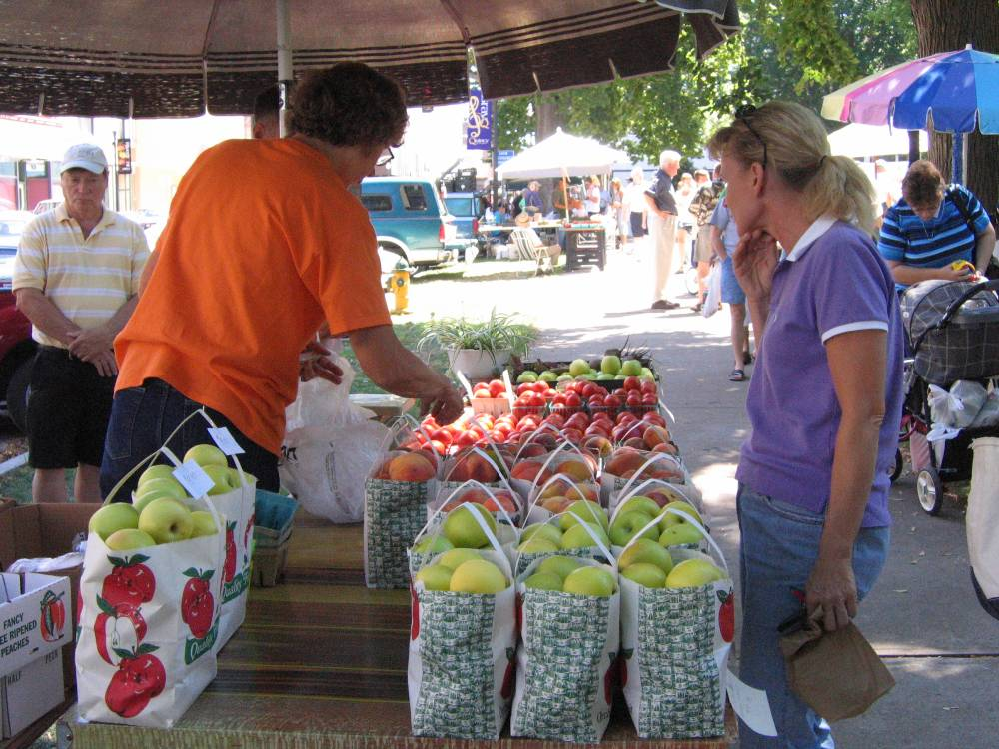
Marketing
Direct Market
Farmers market
CSA(Community Supported Agriculture)
Retail on farm
Wholesale
Produce auctions
Terminal
Local stores/restaurants
Hospital/nursing homes
Schools
Cooperative w/ others
Combination of above
Remember that your marketing plans determine the crops you will grow … base your planting decisions on what your customers will buy and when they will buy it.
Notes:
There are many different types of marketing arrangements, and during your growing career, you may focus on one or several. Most new fruit and vegetable growers in Illinois will focus on direct marketing to consumers, through farmers’ markets, CSAs, and on-farm markets. These are usually the markets that pay top prices, but wholesale markets also offer opportunities. Farmers receive lower prices from these buyers, but wholesaling at least a portion of your produce, even for small farms, can bring in significant income. Small farms may also join together in co-ops, formally or informally, or aggregate their produce using food hubs to better meet the needs of buyers.

Slide 11
Farmers Markets, for example …
Appearances make a sale … make a neat and attractive display with clean, high-quality produce
Quality leads to loyal customers
Clearly mark prices
Provide as wide variety of produce as practical
Be friendly, clean, and courteous when at display
Overhead shelter helps
Provide samples??
Provide recipes and preparation tips
Be aware of and follow regulations … market rules, insurance, health department rules, certification for scales, measurements for containers (small and large versus quart, ½-peck, and peck), sales tax!!
Notes:
The local Farmers Market often provides the greatest opportunity for beginning farmers, as there is an established time and place that consumers know about and are attracted to. Your challenge will be to entice those potential customers to your stand. Attractive displays can and will attract customers. As you go about designing your stand, arranging produce in an attractive and eye catching way, always keep in mind how your clients will view it. Create an interest and make the display “call out” to those who walk by. Customers develop relationships with vendors/growers over time, and it may be difficult initially for new vendors to attract customers. But don’t give up, use this as an opportunity to develop your display. There will be additional time later in the year devoted to marketing.

Slide 12
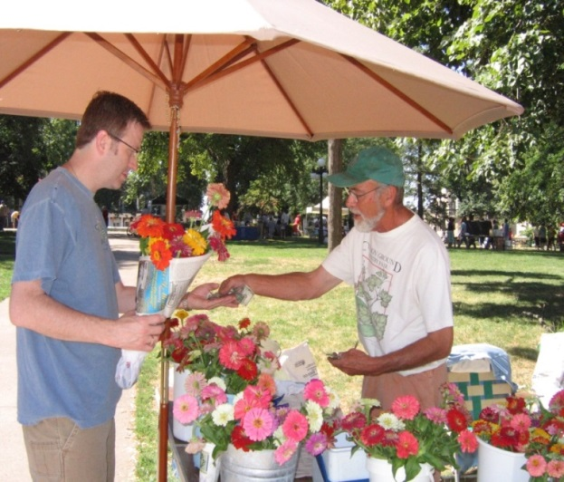
Conventional vs. Organic
Usually a decision based on personal opinions
Organic crops usually command higher prices but have lower yields
Producing crops organically usually is more expensive and labor intensive.
Certification is required if annual sales exceed $5,000 and you identify your produce as Organic.
Notes:
One of the first decisions you’ll make is the one of growing organically or conventionally. Remember to consider the needs of your customers when making this decision. There are advantages and disadvantages to both methods. And if you sell more than $5000 annually you must go through the certification process to call and label your operation organic.

Slide 13
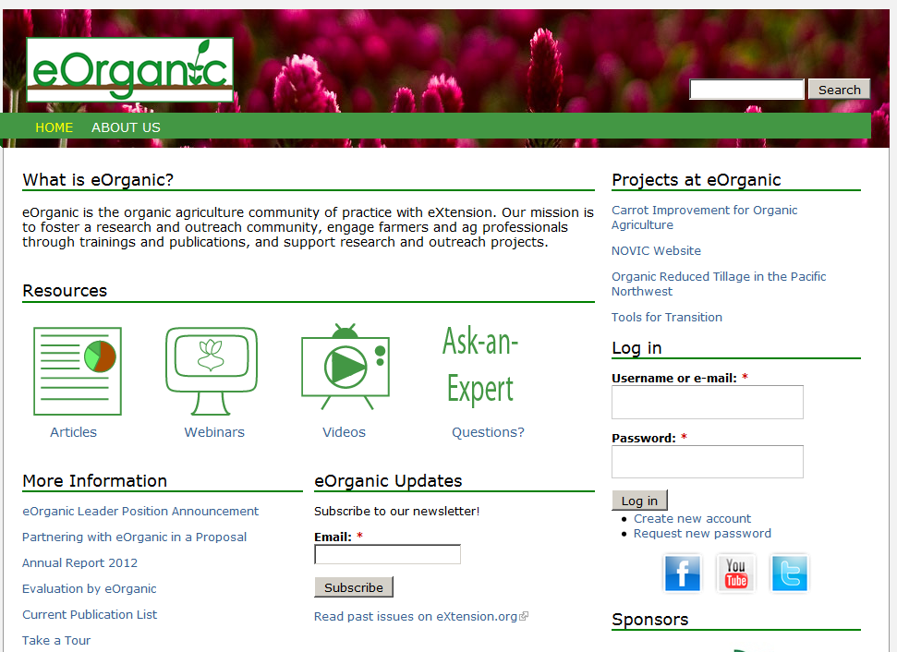
http://eorganic.info/
http://illinoisorganicgrowers.org/
Notes:
There are organizations and web sites that provide useful information to growers of organic vegetables. Take advantage of them. The IL Organic Growers Association is a relatively new organization that represents growers throughout the state. They offer educational programs throughout the year.

Slide 14
Equipment
Equipment needs vary with the size of the operation. A small operation might require hand tools and a tiller while a large operation would have multiple tractors, tillage implements, transplanter, planter, sprayer, plastic mulch layer, etc.
Greenhouses and high tunnels

Slide 15
Basic Field Equipment
Hand tools (hoes, shovels, etc)
Tiller (Walk-behind, or tractor mounted)
Tractor
Planter
Plastic mulch layer
Transplanter
Packing/washing equipment
Cultivator
Sprayer
Fertilizer Spreader
???
Engineer your own equipment!!!

Slide 16
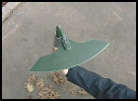
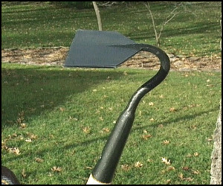
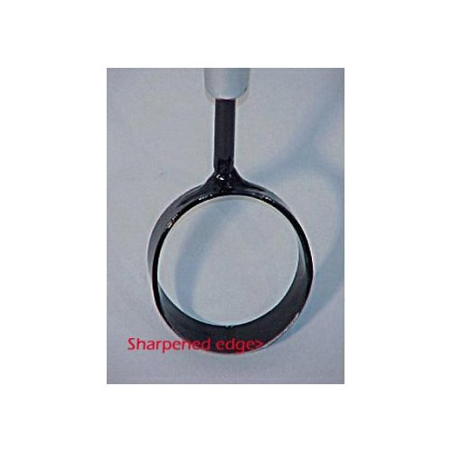
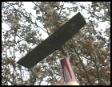
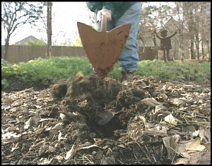
This is an old design with a perfectly curved blade and keen edge that's ideal for cutting weeds and roots.
I like the fact that the blade is not welded, but part of the entire head
Circle hoe ideal for close weeding without harming crop
The triangular design is excellent for making furrows as well as for close weeding and cultivating.
This one is sharpened on the sides as well as the bottom. Loosening the soil and slicing through weeds is a snap. Because of the wide blade, it works well for grading, too
Notes:
There are a number of heads available on hoes that make them attractive for specific needs. For instance the circle hoe pictured in the middle is perfect for hoeing close to plants and to trickle irrigation systems as the sharp edge is on the inside of the circle, away from tender stems so they’re not harmed.

Slide 17
Notes:
These are various types of planters that growers use in their operation. The lower left corner shows an EarthWay seeder, which most all farms have had at one time or another. It’s the basic tool for most large garden growers. Various seed plants can be utilized to seed various sized seed much more efficiently than hand planting. Other, more sophisticated and sturdier planting devices are show. The Jang and Planet Junior seeders also utilize a seed plate that matches up to the seed being planted to deliver a single seed at a time to the soil. There are other seeders available. Some can be attached to form multiple row seeders or attached to frames and pulled by tractors. The 6 row seeder shown on the lower right is specifically designed for small seeds, such as greens. These come in other widths, from one row up to the 6 row shown here.

Slide 18
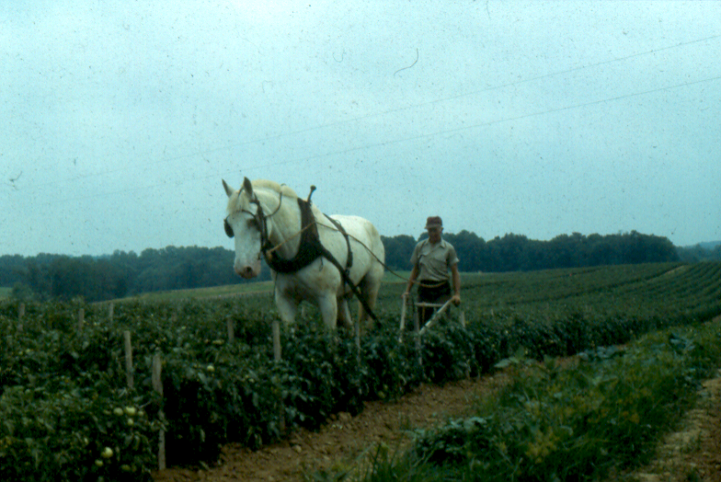
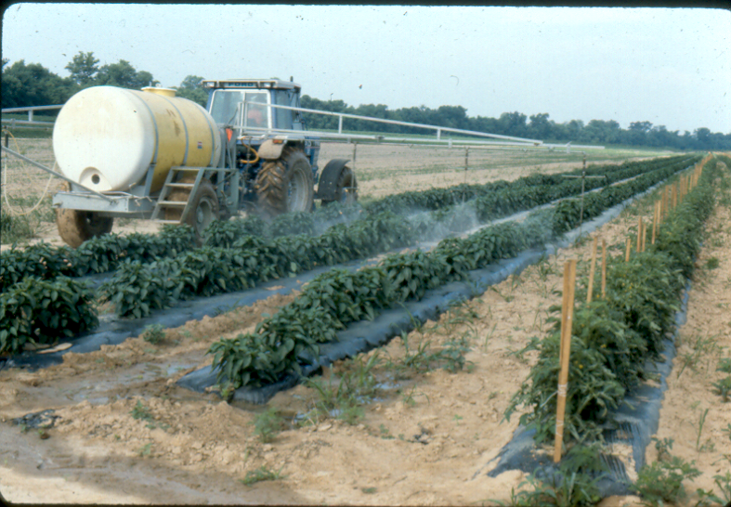
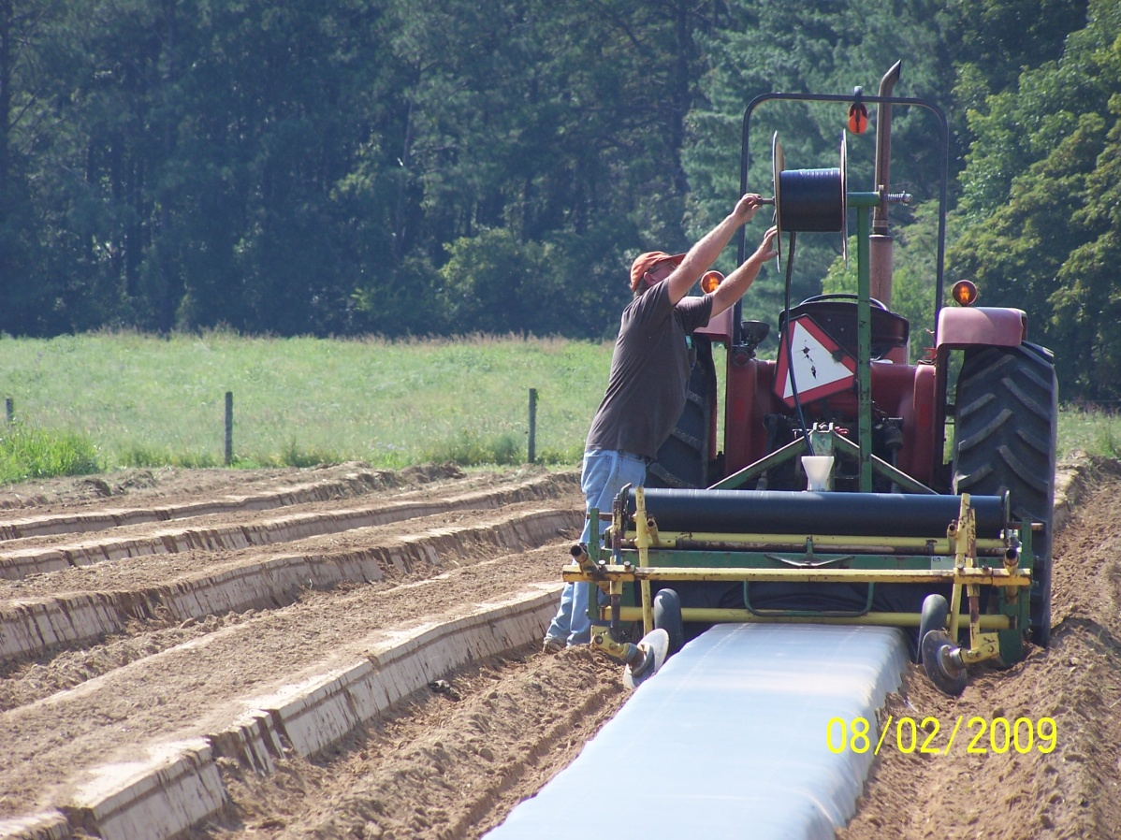
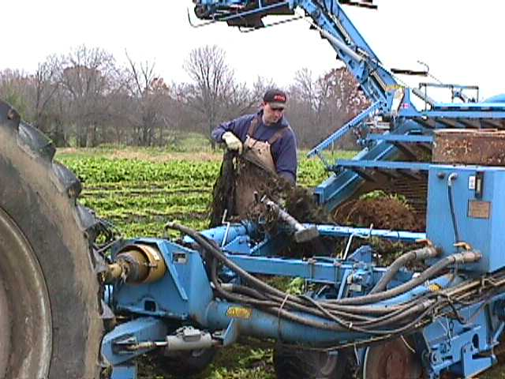
Notes:
These are some types of equipment you may or may not require in your operation, depending upon the crops grown and size.

Slide 19
Other Equipment Needs
Soil thermometer
Plant sh2 sweet corn at >65 degrees F
Irrigation
Supply lines, drip tape, back-flow preventer
Harvest and marketing equipment
Spade, knife, tubs, totes, cleaning, processing, packages
Season Extension
Row covers, High/low tunnels, cold frame
Coolers
Air conditioner with cool-bot, walk-in coolers
Notes:
The equipment needs of a beginning farmer will vary dependent upon what crops he/she determines to be most desirable to grow. However there are a few basic items that most every farm will require. Think about what tasks need to be accomplished: tillage to prepare the ground, planting or transplanting of seed or plant, insect, weed and disease management, harvest, irrigation for the crop, etc. Many of you may be gardening now, and you realize the time commitments required to accomplish these tasks at the garden size. To step up your production to larger size, you will probably require some mechanical aids. You’ll also be required to know how these tools function to be effective. New skill sets will be required as you step up your production.

Slide 20
Estimated Equipment Needs for Various Sizes of Vegetable Farms.
Scale | Seed Starting | Power Source and Tillage | Direct Seeding | Production Equipment | Cultivation | Harvesting | Postharvest Handling | Delivery
1-3 acres | small hoop house, grow lights, planting trays | rototiller or walking tractor, custom work | Earthway seeder, Cyclone seeder | Back-pack sprayer, irrigation, tools | Wheel hoe, hand hoes, digging forks, spades | Field knives, hand boxes, buckets, carts | Bulk tank, canopy, packing containers | Pickup with topper or van
4-6 acres | 1000 sq. ft. greenhouse, cold frames, field tunnels, planting trays | 35-40 hp tractor, with creeper gear, power steering, high clearance | Planet Jr. plate seeder | 1-row transplanter, irrigation, more tools | Cultivating tractor (IH Super A or IH 140) | Potato digger, bed lifter, wagon, more boxes, buckets | Roller track conveyor, hand carts, walk-in cooler | Cargo van
7-10 acres | Additional cold frames, planting trays | 40-60 hp tractor, chisel plow, spader | Stanhay preceision belt seeder with belts | 2-row transplanter, sprayer, | Tool bar implements: beet knives, basket weeder | More field crates | Barrel washer, spinner, pallet jack | 1 ton truck with refrigeration
20 + acres | 2,000 sq. ft. greenhouse | 80 hp tractor with loader bucket and forks, compost spreader | Nibex or Monosem seeder | Irrigation, bed shaper, mulch layer | Sweeps (Besserides), Buddingh finger weeders, flame weeder, potato hiller, 2nd cultivating tractor | Asa lift, harvest wagon | Wash line, larger cooler, packing shed and loading dock | Refrigerated truck
Market Gardening: A Start-up Guide
https://attra.ncat.org/attra-pub/summaries/summary.php?pub=18
Table 2. Estimated Equipment Needs for Various Sizes of Vegetable Farms.
Scale | Seed Starting | Power Source and Tillage | Direct Seeding | Production Equipment | Cultivation | Harvesting | Postharvest Handling | Delivery
1-3 acres | small hoop house, grow lights, planting trays | rototiller or walking tractor, custom work | Earthway seeder, Cyclone seeder | Back-pack sprayer, irrigation, tools | Wheel hoe, hand hoes, digging forks, spades | Field knives, hand boxes, buckets, carts | Bulk tank, canopy, packing containers | Pickup with topper or van
4-6 acres | 1000 sq. ft. greenhouse, cold frames, field tunnels, planting trays | 35-40 hp tractor, with creeper gear, power steering, high clearance | Planet Jr. plate seeder | 1-row transplanter, irrigation, more tools | Cultivating tractor (IH Super A or IH 140) | Potato digger, bed lifter, wagon, more boxes, buckets | Roller track conveyor, hand carts, walk-in cooler | Cargo van
7-10 acres | Additional cold frames, planting trays | 40-60 hp tractor, chisel plow, spader | Stanhay preceision belt seeder with belts | 2-row transplanter, sprayer, | Tool bar implements: beet knives, basket weeder | More field crates | Barrel washer, spinner, pallet jack | 1 ton truck with refrigeration
20 + acres | 2,000 sq. ft. greenhouse | 80 hp tractor with loader bucket and forks, compost spreader | Nibex or Monosem seeder | Irrigation, bed shaper, mulch layer | Sweeps (Besserides), Buddingh finger weeders, flame weeder, potatoe hiller, 2nd cultivating tractor | Asa lift, harvest wagon | Wash line, larger cooler, packing shed and loading dock | Refrigerated truck
Notes:
This table was provided by ATTRA, and will help you in your decision making process as to what types of tools may be required for various sized operations. If your operation grows over time, remember that the tools that were useful to you yesterday will still be required (to some degree) tomorrow. If nothing else, this table will help you plan for your budget needs and cause you to think critically about what specific items are required for various sized operations.

Slide 21
What crops to plant?
Those which you can successfully raise and market for the greatest return on investment.
Which crops are easiest to raise or sell?
Which crops provide best return?
What crops do I feel comfortable growing?
Which crops fit land, labor, capital and equipment resources
Notes:
This question is best answered by your clientele and what you are able to grow. Obviously the more choices of product you can offer, the more potential you have of attracting customers. But you’ve got to know your customer wants and needs. For instance, if part of your customer base is enticed by ethnic vegetables, it makes little sense to concentrate on sweet corn, tomatoes and green beans. For most Farmers Markets, a “one stop shop” concept seems to attract customers. 40 years ago there was the bread shop, the meat shop and vegetable stand, but today we find all those available under one roof. The same holds true for Farmers Markets. The more varied choices you have to offer, the more customers you can attract. Don’t forget about growing some “unique” items, something that sets your stand apart from the others. Be different and unique, keep up to date on what the popular crops are. As one vendor said, “I watch the cooking shows over the winter to see what unique products are being featured and then plant them”.

Slide 22
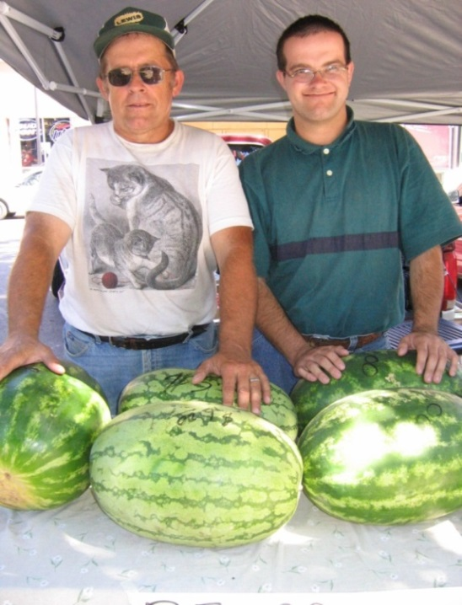
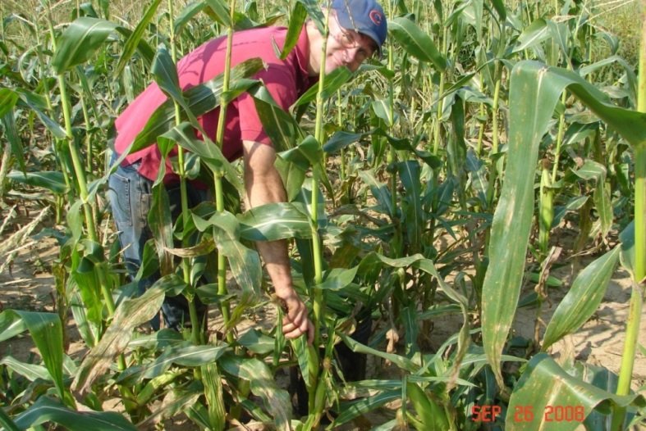
Illinois vegetable crops
Major crops
Sweet corn
Cucurbit crops - pumpkin, squash, melons
Green beans
Tomatoes
Horseradish
Others
greens, onions, potato, asparagus, cole crops, pepper, beets, carrots, cauliflower, peas, cabbage, broccoli, lettuce, radish, spinach, melons, others
Notes:
These are the obvious vegetable crops grown in IL. There are many others that you should consider growing, depending upon clientele. It’s very rare to see a successful Farmers Market vendor that has just a few items available for sale. Most likely they’ll have a number of vegetables available.

Slide 23
Crop | Market* | Labor | Equipment | Pest Management Level
Asparagus | R/W | Medium | Little | Low-Moderate
Beans | R/W | High | Little | Low-Moderate
Beets | R | Medium | Little | Low-Moderate
Carrots | R | High | Little | Low-Moderate
Cabbage | R/W | Medium | Sprayer | High
Cauliflower | R/W | High | Sprayer | High
Broccoli | R | Medium | Sprayer | High
Lettuce | R | Low | Little | Low-Moderate
Muskmelon | R/W | Low | Sprayer | High
Onions | R | High | Little | Low-Moderate
*R = retail; W = wholesale
Notes:
This table provides some rudimentary ideas of cultural needs for various crops along with probable market. For instance, beets are listed as a retail market. Meaning there is very little potential in wholesaling beets in IL. The labor requirements are medium, equipment is listed as little and pest management level is low-moderate. Labor is low as beets don’t have many significant requirements once they’re planted. You can use a planter similar to the ones we viewed several slides ago, you don’t have to plant individually and they’re basically free of insect and disease concerns, they’re also a single harvest so labor needs are low. Broccoli on the other hand requires setting of transplants, some method of pest control to reduce caterpillar feeding (either sprays or floating row cover) and are multiple harvest, so labor needs are higher.

Slide 24
Crop | Market | Labor | Equipment | Pest Management Level
Peas | R | High | Little | Low-Moderate
Peppers | R | Medium | Little | High
Potatoes | R/W | High | Yes | High
Radish | R | High | Little | Low-Moderate
Spinach | R | Yes | Little | Low-Moderate
Sweet corn | R/W | High | Sprayer | High
Sweet potato | R/W | Low | Little | Low-Moderate
Tomato | R/W | High | Sprayer | High
Watermelon | R/W | Low | Sprayer | High

Slide 25
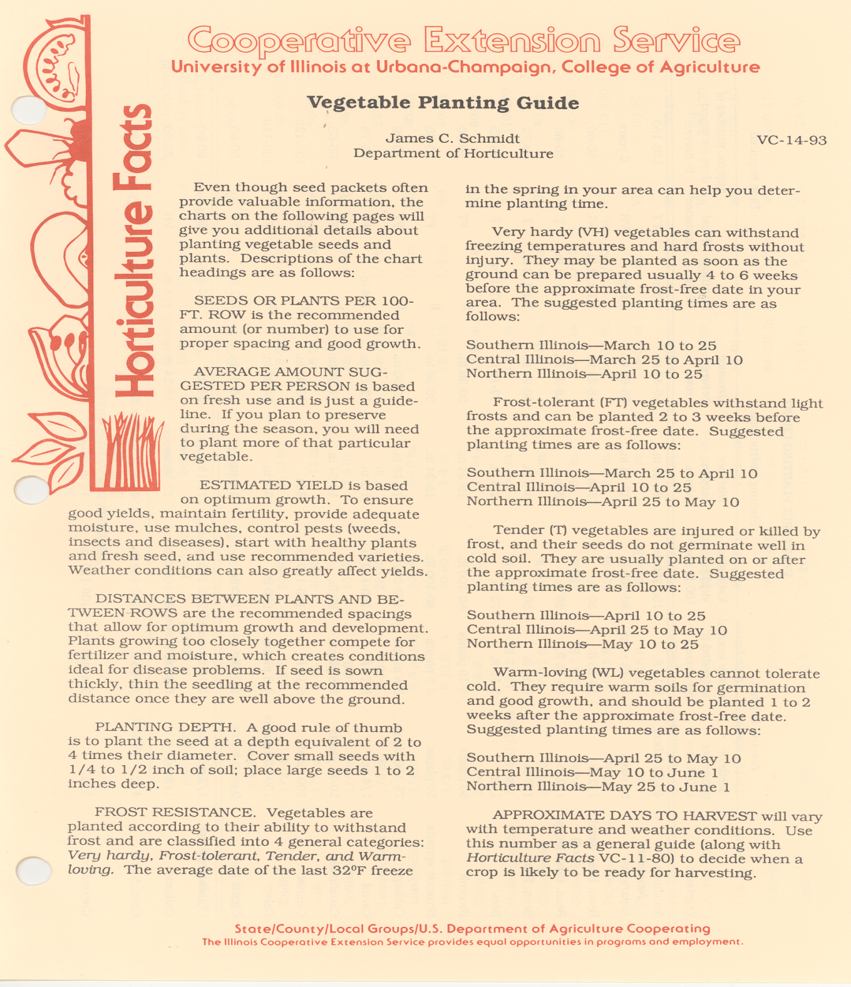
Notes:
This vegetable planting guide, written by Jim Schmidt, Extension Vegetable Specialist, is a useful tool for planning purposes. One item it provides is a guide to suggested plant dates for crops based upon cold sensitivity.

Slide 26
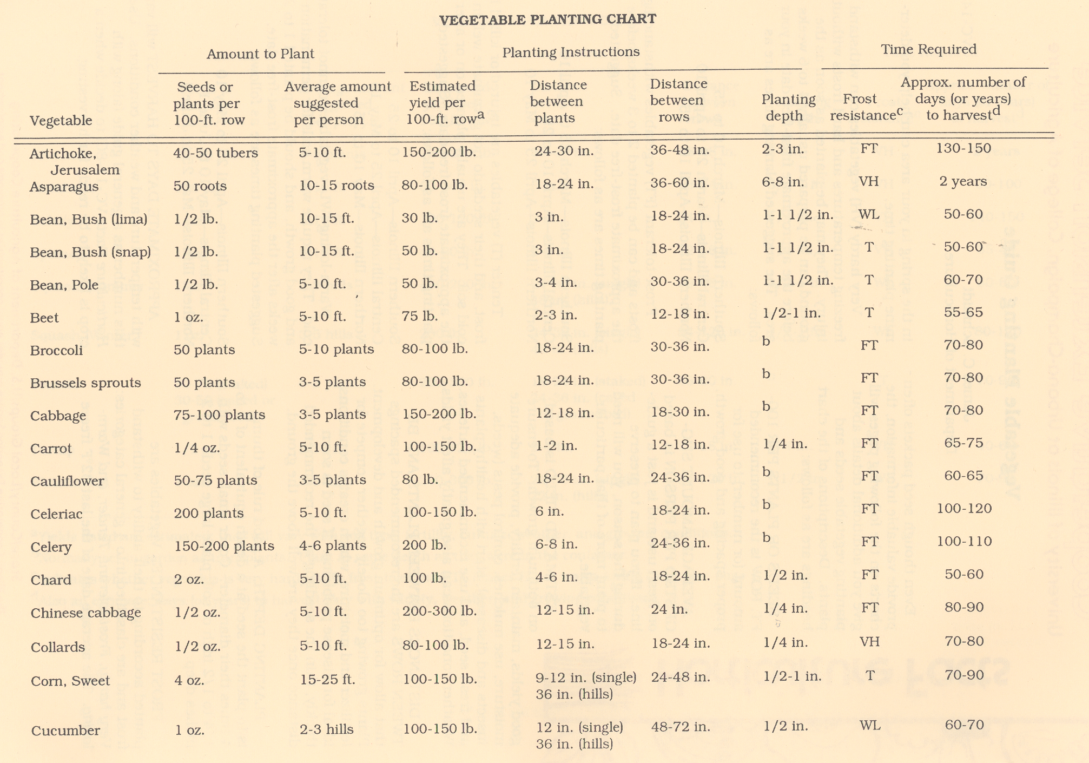
Notes:
This guide also provides suggestions on plant spacing (amount of space required by individual plants), approximate yields of various crops (to provide basic ideas of how much to plant to achieve a certain yield goal), how long those plants will take to mature, and how soon they can be planted (based upon cold sensitivity). This is a useful tool to help you in planning space requirements and determining when to plant and how much yield to expect.

Slide 27
http://njaes.rutgers.edu/pubs/urbanfringe/pdfs/urbanfringe-v07n01.pdf
Notes:
This is another similar tool that contains useful information on determining plant spacings and potential crop yields

Slide 28
Cultivar and Variety Selection
Cultivars are different in:
Response to environment
Growth habit, fruit shape
Overall yield
Maturity
Color
Flavor and nutritional value
Disease and insect resistance
Post-harvest stability
Market niche
Profit potential
Notes:
Once you determine which crops you’ll grow, you’ll next need to determine which specific varieties of the crop you want. Often times, the selections being offered in catalogues are huge, for some other crops there may only be a few choices. There are many factors to decide when it comes to selecting a specific variety or varieties. Customer wants should be a primary consideration. Do the clientele you’ll be selling to have hard and fast ideas of what is the ideal? For instance, sweet corn can be yellow in color, or white or bicolor. Many customers already have their mind made up as to which one they prefer. There may not be any difference in taste between them, but we are creatures of habit. How will different varieties respond to your management? Heirloom tomatoes have a much higher level of management necessary for successful culture and harvest compared to hybrids. These are some of the decisions you’ll need to think over when you select the cultivars for your farm.

Slide 29
Select cultivars or varieties based on …
Seed and plant stock catalogs, suppliers
Research reports
Midwest Vegetable Variety Trial Reports at: https://ag.purdue.edu/hla/fruitveg/Pages/MVVTRB.aspx
Extension programs
Other growers, farmers markets
Your experience and records
Disease resistance
For example, V, F, N designations in seed catalogs refer to Verticillium, Fusarium, Nematodes
Notes:
When selecting cultivars, consult with other experienced growers and review research reports from Universities who publish variety trial results. Seed companies have representatives who help their customers by providing consultations on variety selections. These individuals have the opportunity to review varieties and results from across the midwest under a variety of growing conditions. The time spent discussing variety selection can pay huge dividends. There will be future classes devoted to variety selection where we will explore these concepts in more detail.

Slide 30
Hardiness
Hardy crops can be planted 4 weeks before the last frost in the spring.
asparagus, broccoli, cabbage, horseradish, onion, peas, spinach, turnips
Semi-hardy crops can be planted 2 weeks before the last frost in the spring
carrots, cauliflower, lettuce, potatoes, beets, radish
Tender crops can be planted at the time of the last frost in the spring
green beans, corn
Very tender crops are planted at least 2 weeks after the last frost in the spring
cucumber, eggplant, lima bean, melons, squash, okra, sweet potato, peppers, tomatoes
And when is the last frost? Remember that if the average date for the last spring frost at your location is April 15, it will be later than April 15 in roughly half of all years. If the average date for the last frost is April 15, there is roughly a 25% chance of frost as late as April 25.
Notes:
When to plant vegetables. Let this be a guide to help you determine early plant dates for your crops. These dates are averages based upon climatic conditions over the past few decades. They are only suggestions. Never be fooled into planting your entire tomato crop on April 15 just because the weather averaged 65 degrees the first two weeks of April. Because you know that this is a weather anomaly. The first few warm days in April has most folks just itching to get started. So do take advantage of the opportunities, but don’t overplant sensitive crops. You’ll want to have supplies of fresh produce available for a lengthy growing season, so schedule your plantings to do so.

Slide 31
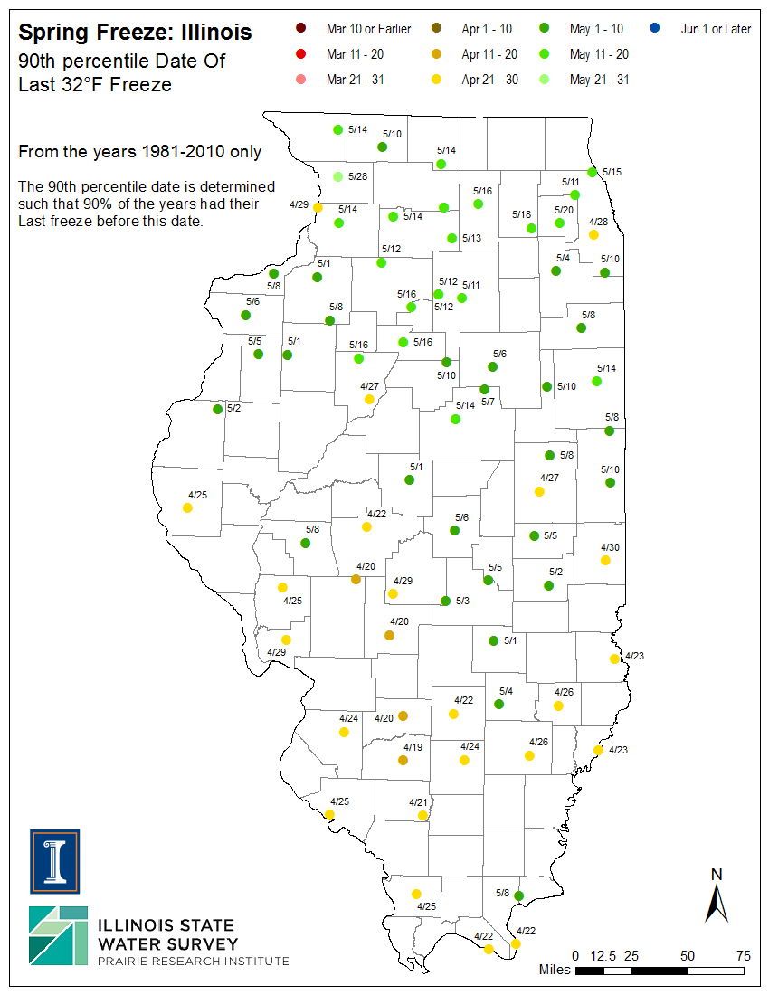
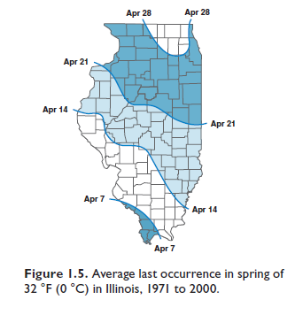
Average Frost Free Date

Slide 32
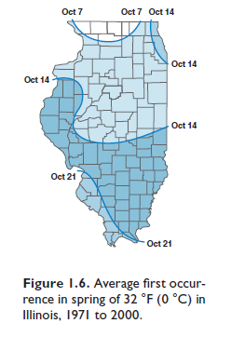

Slide 33
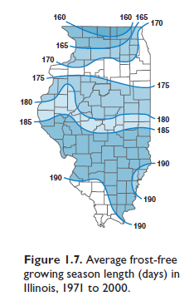
Growing season

Slide 34
Season Extension
Methods of protecting crops from the cold in the spring and fall thus “extending the growing season”
Very beneficial for increasing the diversity of crops early in the season for markets
Disadvatages:
Additional expense of structures and more labor intensive
Advantages
Higher price for earlier product, decreased disease issues, high quality products

Slide 35
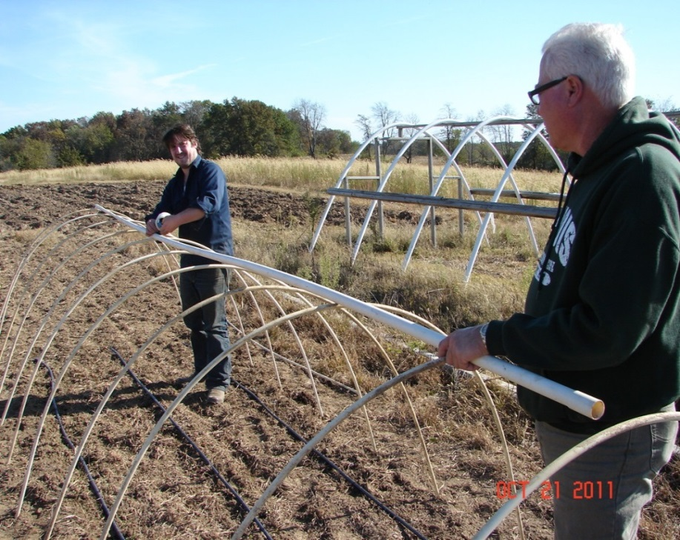
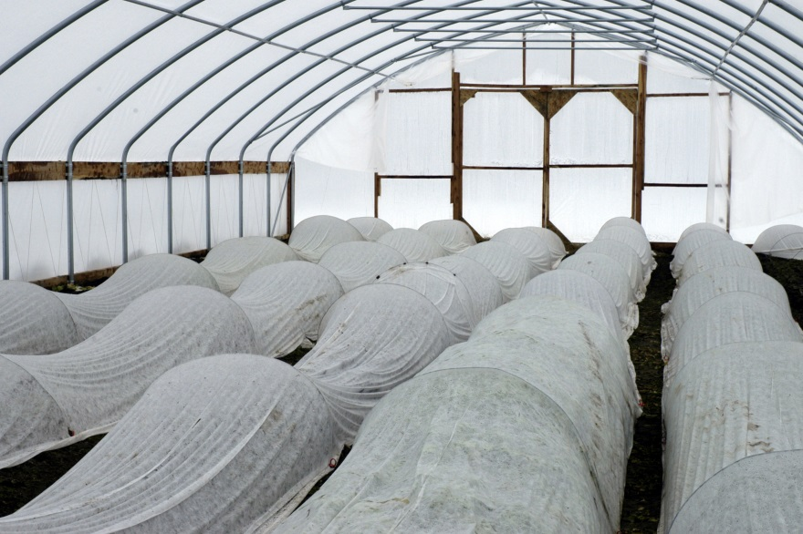
Extending the Season
Row covers
Hoop houses / high tunnels
Low tunnels
Notes:
There are several techniques growers can utilize to extend their growing season, allowing earlier as well as later harvests of vegetables. We’ll cover high tunnels later in another session. Low tunnels are simply as stated- small versions of a high tunnel. You can see a frame work of a low tunnel in the right hand picture. It will be covered with a floating row cover that will provide a little protection from season ending cold temperatures. These low tunnels can also be covered with clear plastic, but must be monitored closely for temperatures as they can heat up very quickly under sunny days. Row covers can be used without the structure and spread over plants to help protect them from cold temperatures. Depending upon the thickness of the row cover, up to 8-10 degrees of protection can usually be found with the heavier covers (1.5 ounce per square yard).

Slide 36
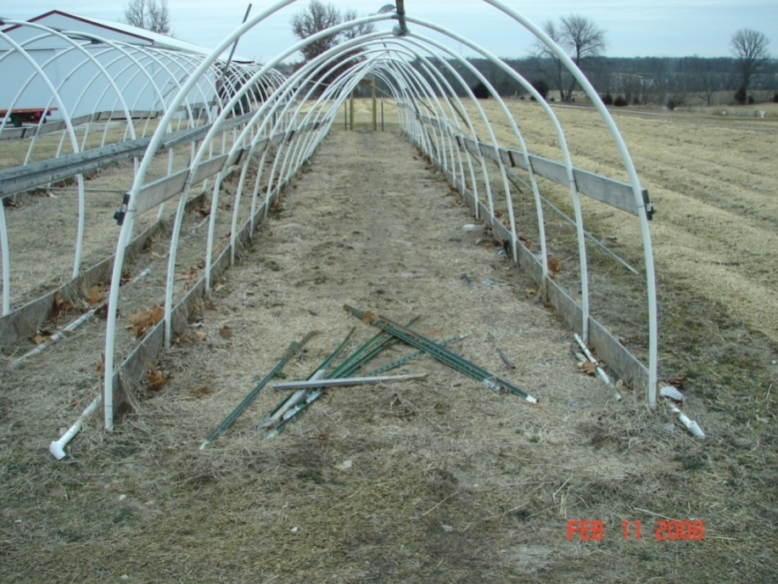
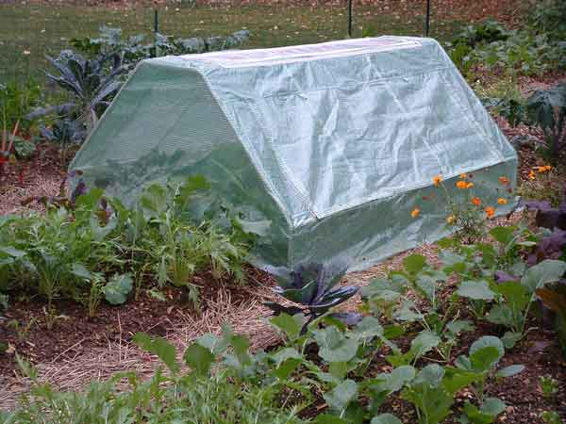
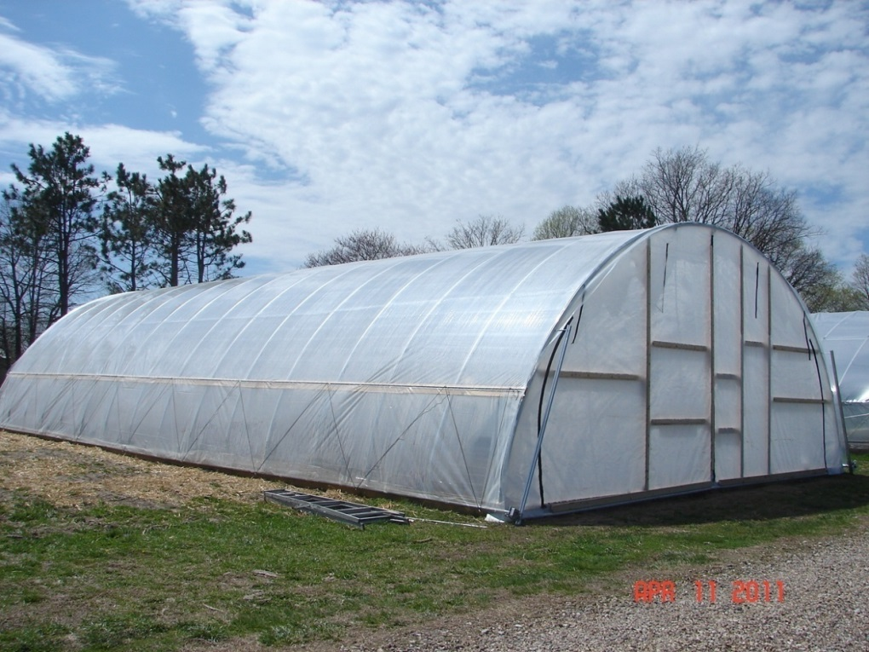
Notes:
High tunnels are larger in size and will provide much more capacity to moderate cold temperatures due to their size and capacity to store thermal heat. However, unless a row cover, or some other device, is utilized to trap that heat, it will escape through the plastic, which has very little if any insulation capacity. There are homemade as well as kits available to use for a high tunnel. There is another class devoted to high tunnels later in this series.

Slide 37
Fall Crops
Most don’t take advantage of fall season
Cool season crops- cole crops, leafy greens, etc.
Presents special “challenges”- moisture especially- more insects?- source of plants?
Mid July- beets, broccoli, cabbage, carrots, cauliflower, beans
Mid August- lettuce, spinach, turnip
Frost protection?- row covers
Notes:
Fall crops are an opportunity that many growers utilize to improve their marketing year. Some planning might be involved so that the crop matures prior to the market closing. Although fall and winter markets are appearing more frequently as opportunities for growers willing to plan for them. Growers with high tunnels can make use of their extended growing season and with some crops, such as spinach, are able to utilize their high tunnel year round.

Slide 38
Transplant vs Direct Seed
Transplants can give you a head start on the season compared with direct seeding
Avoids seed predation or seedling decay in cold or wet soils
Direct seeding can less costly than transplanting
Most small seeded crops that are direct-seeded will need to be thinned to achieve optimal growth
Beets, carrots, and head lettuce, for example
Often depends on the crop

Slide 39
Common Crop Planting Methods
Transplanted
Tomatoes
Peppers
Cole Crops
Sweet Potato
Direct-Seeded
Sweet Corn
Green Beans
Lettuce
Beets
Peas
Either
Cucurbit Crops

Slide 40
Start your own transplants?
Growing your own allows you plant the varieties YOU want and when YOU want to transplant them
Requires space to grow transplants (typically a greenhouse), specific knowledge of transplant production and requires and additional 5 to 8 weeks of labor.
Next month’s class focuses on transplant production
Notes:
Growing your own transplants allows you to determine which varieties you plant and when you plant. So if you have a favorite heirloom tomato you’ll either need to grow your own transplants or hire someone to do that for you. And for some producers, the headache of growing their own transplants is not worth the effort, so they purchase from other growers. Some crops almost require they be transplanted: tomatoes, cole crops, etc. as if direct seeded they would take too long to mature. There are special environmental requirements that specific seeds require (temperature, light, etc.) and following those recommendations will ensure a higher degree of success. There will be a session devoted to growing transplants in one of the later classes.

Slide 41
Site Selection
Soil type and fertility
All soils are not equal in terms of productivity and ability to grow vegetables
Soil type can impact which crops can be successfully grown
Cropping history: Know what has been grown and what pesticides have been used to avoid problems with herbicide carryover and insect, disease, and weed pressure
Site elevation
Notes:
Soil fertility and amendments will be covered in another session. But let this be a reminder to you that a proper soil test is the first step in the process of growing. Know your soil, it’s suitability (tilth, texture, organic matter, etc.) what your soil is capable of producing and the methods to best utilize and improve upon it. A good soil test is similar to a road map. The map tells you how to get someplace and the best route to get there. A soil test provides the same tools to help you arrive at a nutritionally balanced soil.

Slide 42
Pest Management: Weed, disease, and insect control
Integrated pest management (IPM) is essential to grow high quality produce- never rely upon a single control option, rather utilize as many as possible
Weed control: Herbicides, cultivation, tillage, hand weeding, mulches (Plastic, straw, paper), crop rotations, mowing, flaming
Insect control: Insecticides, row covers, rotations, hand-picking
Disease control: Fungicides, disease-free seeds and transplants, resistant varieties, rotations, sanitation
Notes:
After the crop is planted, the fun begins! In order for the crop to produce at optimal levels, pest management is necessary to keep the crop healthy. Insects, diseases and weeds, if allowed to survive at high levels can devastate a crop. These pests compete with the crop for nutrients, sunlight and moisture. Control of these pests can’t be accomplished without employing multiple control tactics. There are many methods, which can include both organic and conventional methods. No one method should be expected to provide 100% control.

Slide 43
Crop Families
Rotate fields (3 years) between crop families to reduce disease pressure
Alliums
onion, garlic, shallot, leek
Corn
Cucurbits
cucumbers, melons, squash, pumpkin
Cole
cabbage, broccoli, cauliflower, radish, brussel sprouts, horseradish, turnip
Legumes
beans, peas
Solanaceous
tomato, potato, pepper, eggplant
Goosefoot
beet, spinach, chard
Notes:
Rotating crop families is an excellent way to break up disease cycles. Plants in the same family support similar diseases, so rotating plant families can reduce the amount of disease inoculum present. A goal is to rotate plant families for a minimum of 3 years in the same location.

Slide 44
Harvesting
Depends somewhat upon personal preferences- ie- zucchini, sweet corn, cucs (pickling or eating) etc.
Harvest in early morning (during summer) if possible
Cool as soon as possible to reduce respiration
For most- harvest as close to ripe as possible, when plant sugars are highest (sweet corn, strawberries, etc.)
Notes:
Harvesting your crop to deliver to your market can be a rewarding experience. You’ve grown and nurtured the crop all year and now you can be rewarded for that effort. Make every effort to harvest the crop at the peak of freshness and maturity. And only take quality produce to the market. Although if you’ve early tomatoes that are 2nd or even 3rd in quality, you can most likely still market them if you’re the only one with tomatoes early in the season. During the heat of the summer, make every attempt to harvest when the product is at its coolest, which is first thing in the morning. Get the item to your packing shed or your assembly area as quickly as possible. If the item is to be cleaned, washed, sorted, topped, etc. do whatever tasks can be completed quickly and in the field then as soon as possible move out of the sun and heat. Utilize refrigeration, ice, cooling rooms, etc. to maintain high quality and freshness. Know which vegetables are most at risk for degredation and take special precautions. For instance, carrots can handle a little more heat than can lettuce and still maintain a quality product.

Slide 45
Harvesting
Make sure to harvest crops at the correct maturity for the given crop
In addition be prepared to provide adequate post-harvest storage conditions for the given crop
Post harvest handling is discussed in more detail later in the year.

Slide 46
Expenses for Vegetable Crops
Biggest expense is inputs: seed, plants, fertilizer, pesticides, machinery, fuel, land, etc. Vegetables are much cheaper than fruits.
Some fruit crops can cost up to $7000 per acre
Labor: must be supplied by you or by hiring others
Marketing costs: packaging costs, market fee (farmers market), advertising, road-side stand, etc.
Don’t sell too cheap! Know your costs
Notes:
Input costs for vegetable producers are not as high as they are for many fruit growers but can still be somewhat burdensome. The largest expense would be for land and machinery. As you go about budgeting expenses remember that you’ll need to recover your costs as well as some profit when you determine what your selling price will be. There will be a much more detailed class devoted to marketing/budgeting later in the session.

Slide 47
Possible Returns
*Avg. price, 2013 Quincy Farmers Mkt.
Crop Yield/ 100 ft. Price* Gross Income/ 100 ft. row
Asparagus 80-100# $2.50-3.00 $200-300
Bean, snap 50# $2-3 $100-150
Broccoli 80-100# $1.50-2.00/hd $100-150
Cabbage 150-200# $.50/lb $75-100
Cauliflower 80# $2.00/hd $150
Sweet corn 10 dz $5 $500
Cucumber 100-150# $.50 $50-75
Muskmelon 200# $3.00/hd $120
Onion 150# $1.50 $225
Pea 25-30# $2.00-3.00 $50-90
Pepper 75-100# $0.75 each $50-75
Potato 100-200# $1.00-1.50 $100-300
Notes:
Of course, it all comes down to making money. Presented here are some potential income figures you can use to help develop budgeting tools for your operation. These are rough estimates of yield.

Slide 48
Possible Returns
Crop Yield/ 100 ft. Price* Gross Income/ 100 ft. row
Sweet potato 80-100# $1.50 $80-150
Rhubarb 150-200# $1.50 $150-200
Summer Squash 150-200# $1 $150-200
Winter Squash 200# $.75 $150
Tomato 200-300# $2.00-2.50 $400-750
Watermelon 200-300# $5.00ea $100-150
*Avg. price, 2013 Quincy Farmers Market

Slide 49
Commercial Enterprise Budgets

Slide 50
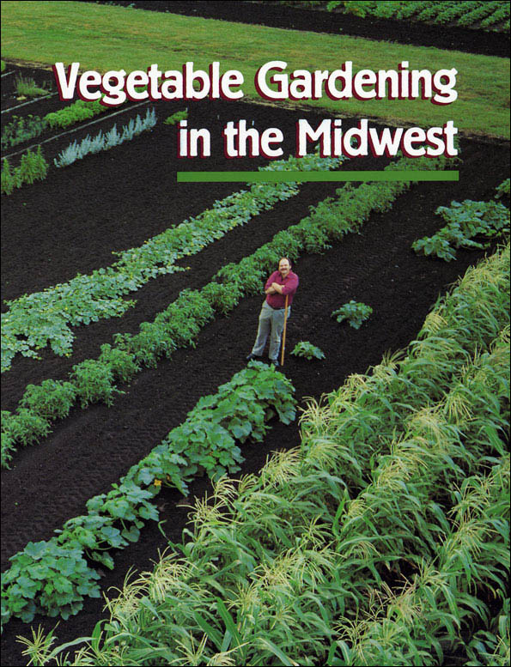
http://ia600706.us.archive.org/23/items/vegetablegardeni1331voig/vegetablegardeni1331voig.pdf
Notes:
One can never have enough references for vegetable gardening. While this specific one is targeted towards backyard gardeners, there is still useful information contained within it.

Slide 51
http://www.btny.purdue.edu/pubs/id/id-56/
Notes:
Each year the midwestern Universities collaborate to publish a commercial vegetable growers guide. Included within this document are insect, weed and disease tools for most vegetables grown in our area. Also included are fertility recommendations, some variety recommendations, and much more.

Slide 52
Resources
http://ia600706.us.archive.org/23/items/vegetablegardeni1331voig/vegetablegardeni1331voig.pdf
http://www.btny.purdue.edu/pubs/id/id-56/
http://web.extension.illinois.edu/vegguide/
http://www.urbanext.uiuc.edu/vegproblems/

Slide 53
To reach us
Contacts | Contact information
Mike Roegge | roeggem@illinois.edu
Jeff Kindhart | jkindhar@illinois.edu
Nathan Johanning | njohann@illinois.edu
Rick Weinzierl | weinzier@illinois.edu
Notes:
Keep it brief. Make your text as brief as possible to maintain a larger font size.

Slide 54
If you have questions …
University of Illinois Extension Local Food Systems and Small Farms team
http://web.extension.illinois.edu/smallfarm/
USDA’s Start2Farm site
http://www.start2farm.gov/
Notes:
Our beginning farmer training program ended in the fall of 2015. The best way to pursue answers to questions about fruit and vegetable production in Illinois is to contact educators on the University of Illinois Extension Local Food Systems and Small Farms team. Extension programs in other states are operated by the land-grant university in each state. Additionally, USDA’s Start2Farm site provides listings of farmer training programs in specific states and localities.

