Slide 1
Preparing a New Generation of Illinois Fruit and Vegetable Farmers a USDA NIFA Beginning Farmer and Rancher Development Program Project Grant # 2012-49400-19565 http://www.newillinoisfarmers.org
Notes:
The following presentation was part of a beginning farmer course, “Preparing a New Generation of Illinois Fruit and Vegetable Farmers,” offered by the University of Illinois and the Illinois Migrant Council from 2012 through 2015. This course was funded by the United States Department of Agriculture’s National Institute of Food and Agriculture, and specifically by the Beginning Farmer and Rancher Development Program. For more information about the program and for links to presentations and resources on many other topics, see the website newillinoisfarmers.org.

Slide 2
Preparing a New Generation of Illinois Fruit and Vegetable Farmers Basic Fruit Production
Elizabeth Wahle
Horticulture Extension Educator
December 2014
Notes:
Welcome to Basic Fruit Production. This an introductory learning module on the basics of small fruit and tree fruit production. The first half of this module will cover general production practices common to both small fruit and tree fruit, and the second half will emphasize crop specific needs using apple and peach as examples

Slide 3
Today’s objectives
Understand at a basic level …
Site selection, variety and rootstock selection, planting and training
Know that annual pruning is always necessary
Know that annual thinning of tree fruits is almost always necessary
Most perennial fruits are not suited to low areas or poorly drained areas.
Notes:
This module is designed to cover the basics of fruit production, including the components for good site selection, the selection of cultivars and rootstocks, the steps in the planting process, the importance of training and pruning and finally crop load management, which is also simply referred to as thinning.

Slide 4
Fruit plantings are a long term investment
Before you begin
Invest considerable effort into site selection
Soil preparation
and planting plans
Before you order plants
Learn about pollination needs
Winter hardiness
Susceptibility to pests
Notes:
Fruit growing is challenging and requires significant time on the grower’s part to manage successfully. Because many fruit crops are long lived, considerable time should be invested into understanding proper site selection, soil preparation, and planting plans to avoid costly mistakes that are difficult to correct once the plants are in the ground
Before ordering plants, one should also learn about their pollination needs, their susceptibility to pests and understand whether your plants are winter hardy and adapted to your site.

Slide 5
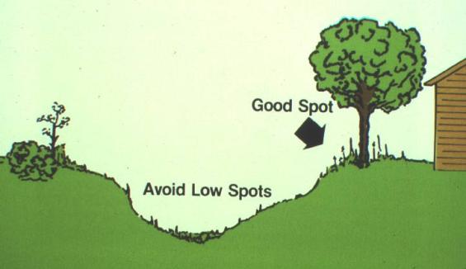
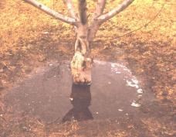
The optimal planting site
Full sunlight
Clean site (good weed control)
Good water and air drainage
Avoid frost pockets
Friable, fertile soil
Windbreak
Ready water supply
Notes:
Fruit plants are most productive if you carefully match them with the proper planting site, which in general is a site that is not susceptible to frost, receives full sunlight, has fertile, well-drained moisture retentive soils and is weed free.

Slide 6
Preplant soil recommendations
Begin soil preparation at least 1 year in advance of planting
Address drainage issues (fruit plants “hate” wet feet)
Tiling, terracing, ridges
Perform soil test and make appropriate adjustments
pH, Nitrogen(N), Phosphorus(P), Potassium(K) and organic matter (OM) most critical
Tissue analysis used after crop establishment
Clear site of weeds, particularly problematic perennial weeds
Notes:
Having said that, very few sites are naturally ideal. To create a successful site, begin at least 1 year ahead of planting to overcome problems like poor drainage, low soil organic matter, poor soil fertility, lack of water supply or established weeds or other problematic pests.

Slide 7
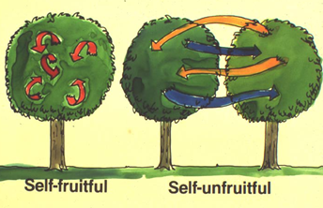
“General” Fruit Pollination Requirements
Self-fruitful
Peaches, nectarines, European plums/prunes, apricots, tart cherries, currants, gooseberries, grapes, raspberries, blackberries, blueberries and strawberries
Self-unfruitful
Apples, pears, most Japanese plums, elderberries and most sweet cherries
Notes:
In the flower, pollination is the transfer of pollen from the anther to the stigma. After pollination and fertilization, fruit set occurs. There are two types of pollination. Self-pollination occurs when the pollen is transferred from the anther to the stigma on the same flower, from another flower on the same plant, or from a flower on another plant of the same cultivar. Self-pollinated plants are said to be self-fruitful. Many plants cannot produce fruit from their own pollen and are considered self-unfruitful. These plants require cross-pollination for fruit set. Cross-pollination is the transfer of pollen from one plant to the flower of a genetically different plant or cultivar. Note that even when cross-pollination is not essential, it usually does improve the number and/or size of fruit that forms. Pollination is an important factor when selecting and planting tree and small fruits. A list of generalized pollination requirements for the various fruits is presented here.

Slide 8
Examples of “not the norm”
Partially to fully self-fruitful apples
Braeburn, Golden Delicious, Granny Smith, Red Rome
Pollen sterile apples
Baldwin, Creston, Gravenstein, Jonagold, Boskoop, Mutsu, Crispin, Rhode Island Greening, Roxbury Russet, Shizuka, Spigold, Stayman, Bramley’s Seedling, Wealthy and Winesap
If you plant one of these, you need to plant two more cultivars
Notes:
On the previous slide generalities about fruitfulness were listed for different fruit but understand exceptions commonly occur among cultivars of a particular fruit. For those listed in the self-unfruitful group, many exceptions do occur. Take apple for example. Most apples are self-unfruitful, but there are cultivars that are partially self-fruitful, fully self-fruitful and also cultivars that are pollen sterile. Most nursery catalogs provide information about fruitfulness and which cultivars are recommended for pollinating each other.

Slide 9
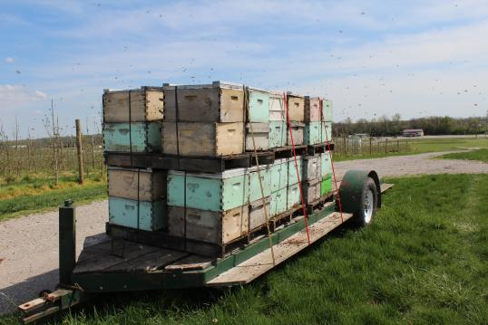
Pollinators
Examples of fruit that rely on insects to carry pollen
Strawberries, blueberries, apples, plums and sweet cherries
Examples of fruit that rely on gravity and wind to carry pollen
Peaches and grapes
Commercial bee hives brought in to pollinate a commercial apple crop
Notes:
With strawberries, blueberries, apples, plums and sweet cherries, insects carry the pollen from flower to flower, in other words, insects are the pollinators for these crops. Some fruits such as grapes and peaches rely on gravity or wind currents to carry pollen from their anthers to the pistil.
Heavy rains during bloom can interfere with pollen distribution or insect activity. Seed formation will be poor if pollination is inadequate, and seed formation is essential for the growth and development of most fruit.

Slide 10
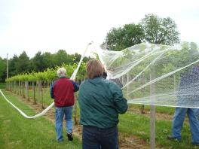
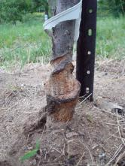
Vertebrate pest control
One growers solution to deer feeding on young fruit trees
Main pests
Deer
Voles and mice
Birds
Applying nets for bird control in grapes
Mouse girdled apple tree
Notes:
Voles, deer, and birds are the three major vertebrate pests of fruit plantings. Voles are mouse-like mammals that eat the bark and roots of young fruit trees and thornless blackberries in winter and are frequently a serious problem. Deer consume the new shoots of fruit trees. Birds damage the fruits of blueberry, cherry, gooseberry, and grape plantings.

Slide 11
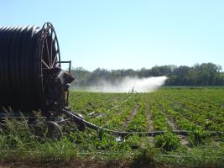
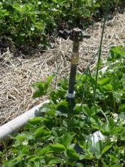
Irrigation
Most often needed
Dwarf apple
Brambles
Strawberries
Frost protection
Blueberries
Solid set risers for frost protection in strawberries
Notes:
Uneven precipitation can cause plant stress during critical growth periods, which will affect both crop productivity and produce quality. Most fruit crops require irrigation to minimize plant stress. Proper timing of water applications during appropriate periods can increase the yield and quality of most horticultural crops in Illinois in most years. Drip and overhead irrigation are the most common throughout Illinois.
Overhead irrigation can also be used to provide frost protection for certain small fruits, particularly strawberries. A properly designed and operated sprinkler irrigation system can provide frost protection for strawberries down to 22⁰ F or lower.

Slide 12
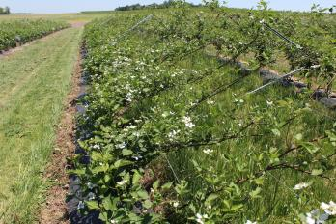
Staked and or trellised
Trellised high density apples
Dwarf and semi-dwarf apples
Grapes
Semi-erect blackberries
Blackberries on a movable trellis
Trellised grapes
Notes:
Due to the poor anchorage or brittle graft unions, many grafted dwarf apple trees require support, in the form of a trellis system and/or an individual post .
Other fruit crops that require a trellis are semi-erect blackberries and grapes.

Slide 13
Selecting cultivars
‘Honeoye’-main crop, large, taste good, powdery mildew resistant
Marketability
Harvest window
Taste
Shipping quality
Adapted to planting site
Susceptibility to pests
Ease/difficulty of production
Cost of production
Time commitment
‘Early Glow’-early, small, taste GREAT, powdery mildew susceptible
Notes:
Consider thoroughly which cultivars to plant. The first consideration is to determine how you intend to sell the fruit-remember--marketing, marketing, marketing! Roadside markets, pick your own, and, to some extent, wholesale fresh market growers all need a continual supply of products. Therefore, it is important to choose cultivars that will accommodate an extended marketing period. Information about various cultivars and their ripening sequences can be found in nursery catalogs, but keep in mind the dates in the catalog may need adjustment to fit you local climate.
Cultivars differ in their susceptibility to pests but remember the most pest resistant are not always the best tasting. Fruit and/or cultivars are can also differ in their adaptability to a particular planting site. For example, raspberries are more suited to the northern part of the state than the southern--unless you plan to grow them in a high tunnel. Several cultivars have been found to be very suitable for high tunnel production in the southern portion of the state. Certain cultivars of apples perform better in the north than in the south. Take for example McIntosh, a McIntosh tree will grow fine in Southern Illinois, but it is more suited to cooler climates so there is a issue with fruit drop and mealy fruit texture when grown in the south.
Before setting out large plantings of a new strain or cultivar, always plant a few plants on a trial basis. Also try to visit or talk to growers who may already have bearing fruit of a particular cultivar.

Slide 14
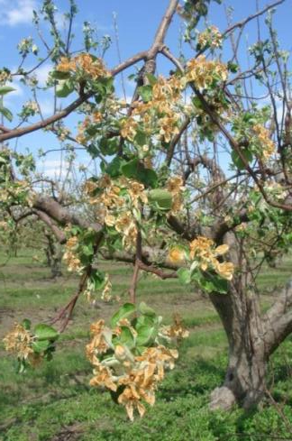
Focus on Tree Fruit
Frost ring (damage) on apple and pear
Potential to lose a crop due to early season cold temperature
Most
Apricot
Sweet cherry
Very
Peaches
Nectarines
Moderately
Plum
Pear
Sour cherry
Least
Apple
Apple bloom kill from late-season frost
Notes:
Although all fruit crops have similar but respective cultural needs, tree fruit are generally considered the most demanding. For the sake of time and focus, peach and apple will be used to demonstrate specific cultural needs
To start off, fruit trees vary in their susceptibility to winter cold injury Apples typically are least likely damaged by winter or late spring frosts, while apricots and sweet cherries are most susceptible (primarily because of their very early bloom) Other stone fruits and pears are intermediate in their susceptibility to cold injury. Apples are grown commercially throughout Illinois, whereas peaches are limited commercially to roughly south of Interstate 70, and a bit north as you approach the Mississippi River.

Slide 15
Rootstock selection
Notes:
Rootstocks for apple trees are special apple varieties that control the height of the tree and give it other special characteristics, such as resistance to insects or diseases, solid anchorage in the ground, and early fruit production. A cultivar is grafted onto this special rootstock, so you are essentially buying two plants—the rootstock that anchors the tree and the cultivar that produces the fruit. Pictured above is an apple cultivar grafted on to a non-dwarfing rootstock for size comparison.
Peach rootstocks on the other hand have been selected more for their tolerance to stresses than for their size control. Some of the stresses may include rootknot nematodes, calcareous soils, waterlogging, cold hardiness and peach tree short life.

Slide 16
Apple rootstocks
Woolly Apple Aphid Resistance
Fire Blight Resistance
Replant Disease Complex Resistance
Crown and Root Rots (Phytophthora)
Cold Hardiness
Productivity/Yield Efficiency
Low suckering and burr knots
Nursery friendly
Example of an apple rootstock that suckers
Notes:
Selecting a rootstock is just as important as selecting the cultivar that will be grafted to it. Rootstock cultivars differ in pests susceptibility, tolerance to certain growing conditions, productivity, growth characteristics and nursery adoption based on ease of production and grafting.

Slide 17
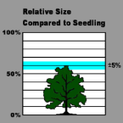
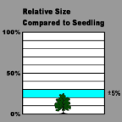
Most Common Apple US Rootstocks (% of seedling)
G.30
Dwarf (Requires support, except maybe M.26
B.9 (20%)
M.9 (30%) several clones
M.26 (35-50%)
Semi Dwarf (may need support)
M.7 (60%)
Semi Standard (free standing)
M.106 (70%)
M.111 (70%)
B.9
Notes:
Both rootstock and scion (top) cultivar affect the ultimate size of an apple tree. As shown above, the rootstock can affect branch angle, but also has an effect on percocity and longevity of the tree. Trees on the most dwarfing rootstocks may need staking to keep them upright

Slide 18
Peach Rootstocks
Seedling (12-15’) (in order of increasing cold hardiness—only an issue if production is marginal)
Halford
Lovell
Tennessee Natural
Bailey
Notes:
Peaches are almost exclusively available on seedling peach rootstock, which means there is no dwarfing effect. Almost all peach rootstocks are suitable for lighter, well drained, sandy-loamy soils. They do not tolerate wet conditions or wet, poorly drained soils. Mounding of planting sites or raised beds created for a better drained soil condition will help prolong tree life and reduce winter injury from late hardening off in the fall.

Slide 19
Notes:
Pictured here is an example of a fully mature commercially pruned peach tree on a non-dwarfing rootstock.

Slide 20
Nursery stock
Buy high quality
Reliable nursery
Most common
½” diameter
Bare-root (dormant)
One-year-old whips (single stem)
Two-year-old feathered tree (several branches)
Notes:
To increase your chance of success, buy high-quality plants from a reliable nursery. The most commonly sold stock are half-inch-diameter, bare-root, one-year old “whips,” usually just a single stem. Nurseries sometimes sell two-year old trees that may have several branches (sometimes called “feathers”). These two types of stock usually perform better than larger and older trees because small trees are easier to transplant and train to a desired shape. When ordering, request that plants arrive before growth has started, to prevent damage from shipping.

Slide 21
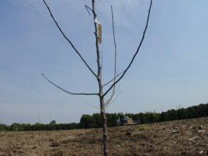
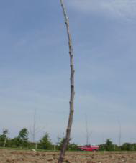
Feathered and whip trees
Notes:
Pictured here are an example of a feathered tree on the left and a whip on the right.

Slide 22
When trees arrive from the nursery
New dormant trees must not have open buds
Must be kept moist at all times
If trees cannot be planted due to weather, they must be kept in cold storage at 32 to 35 degrees F or placed in a box and covered with sawdust and kept in an unheated cellar.
Trees must not be stored with fruits or vegetables that produce ethylene
Notes:
Early spring is the best time to plant fruit trees. Plant as soon as you can after the soil has thawed and drained enough to work without destroying its structure and before your nursery stock starts to break bud and leaf out. It is best to prepare the soil the year before planting—getting you prepared and ready to plant before plants arrive from the nursery.
Improper care after plants arrive from the nursery can cause serious injury. Make every effort to set the plants in their permanent location before growth starts.
You can store plants in a walk-in cooler for a short time before planting or heeling-in. But do not store them in coolers with ripening fruits, which give off ethylene gas that can damage the nursery stock.

Slide 23
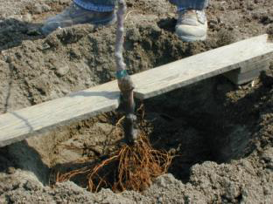
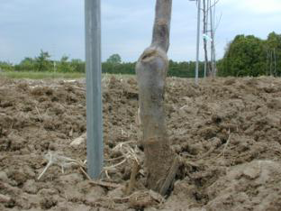
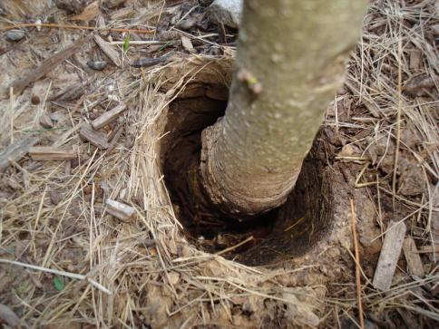
Tree planting with hand or augur
Soak roots in water and cut any damaged roots
Place the tree in the center of the hole and fill hole with top soil
Graft union must be 2 to 3 inches above the soil surface
Otherwise, dwarfing effect is lost if scion roots
The higher the graft union above the soil surface the smaller the tree will be
A tree planted too deep wallows after a wind
Notes:
Before you plant trees, trim off broken or injured roots. Do not let the roots dry out. Plants can die if roots are exposed to sun and wind. You may want to soak the roots in a pail of clean, cool water for 6 to 12 hours before planting. Dig planting holes large enough to accommodate the tree roots in their natural
position. Put aside the topsoil so you can replace it after planting.
Plant rootstocks with the graft union 2-3 inches above ground level. If the graft union is below the soil line, roots may develop on the base of the scion cultivar (upper portion of the graft), which results in the loss of the effect of the rootstock.
Carefully spread the roots out over loose soil in the bottom of the hole. Move the tree up and down slightly as you spread the first few shovels of topsoil back on top of the roots. This helps to settle the soil under and around the roots and gets rid of air spaces. Tamp the soil firmly while filling the hole. Water trees immediately after planting and water at weekly intervals for four to five weeks unless rainfall is adequate.

Slide 24
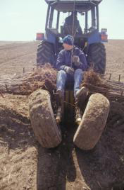
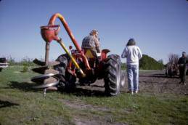
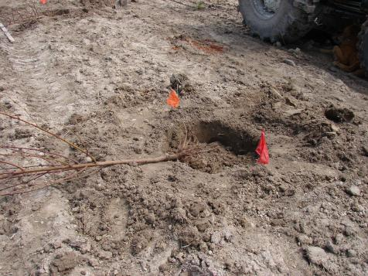
Other options for planting new trees
Tree planter
Used when planting large number of tree
Tree augur
Used in small size orchards
Notes:
When planting a large number of trees, it may be more efficient to plant with a tree auger or a tree planter.
When auguring the hole, make sure the sides of the holes do not develop a glazed skin. This glazing can act as an artificial barrier to root penetration as the tree roots grow, resulting in a pot-bound tree. If glazing is observed, score the side of the hole with a shovel to increase root penetration
Most large commercial growers utilize a tree planter and is probably the easiest method to plant trees. There are two major checkpoints in this system: 1) Make sure the union is set at the proper height. This is usually accomplished by having someone go along behind the planter and pull up or push down the tree. 2) Make sure the tree roots do not dry out. Carry only enough trees that when you plant the last tree the roots still have some moisture.

Slide 25
Purpose of training and pruning
Types of tree training
•Central Leader
•Open Center
•Vertical Axe
•Tall Spindle
•Super Spindle
•Palmette
•Espalier
•Tatura
Training directs tree growth into a desired shape and form to establish a specific structure.
Training young fruit trees is essential for proper tree and fruit development. It is more economical to direct tree growth with training than to correct it with pruning.
Pruning is the selective removal of a portion of a tree to correct or maintain tree structure.
Notes:
Training and pruning are two different aspects of modifying the natural growth patterns of a fruit tree. Whereas training focuses on tree development, pruning is used to maintain tree function and size. Training takes place usually in the first 4-5 years of the trees life, whereas pruning is done throughout the life of the tree. Early on pruning is used to control excessive vigor, but in declining years, pruning is used to invigorate and increase light pentration into the canopy

Slide 26
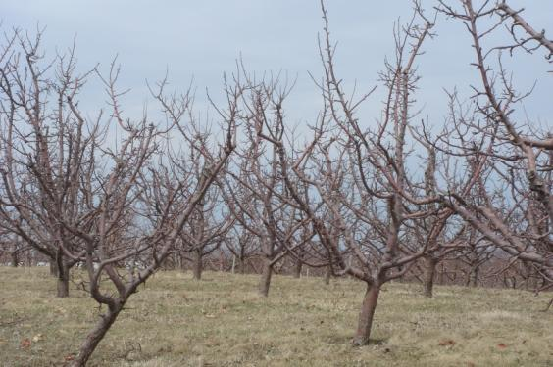
Training Systems for Fruit Trees
Central Leader
One main trunk is 5-8’ high
Lowest branch 18-22” from the ground
4-7 scaffold branches, 4-8” apart vertically
40-90º crotch angles
Notes:
A tree trained to a central leader has one main, upright growing stem (the central leader) with 4-7 main scaffold branches evenly spaced around the trunk On larger trees, secondary scaffolds higher up on the main leader would also be allowed to develop

Slide 27
Training trees to a central leader at planting
Head un-branched new trees at about 30 inches above ground or 8 to 12 inches above the top good lateral branch
In cultivars that tend to grow vertical branches, use spreaders to increase the branch angles in order to slow shoot growth and strengthen the branch angle.
Remove broken or downward branches and leave a small stub to allow for new bud growth at that site if desired. This cut is called a Dutch cut.
Notes:
Heading back un-branched new trees to 30” will bring the top and roots back into balance and cause buds just below the cut to grow and form scaffold branches. Cutting lower, 24 inches will result in excessive vegetative growth. Cutting too high, 36 inches will result in weak growth in the top of the tree as well as in lower areas.
The new shoots will be vigorous and upright growing with very narrow crotch angles. To prevent this, you need to force the new shoots to a more horizontal growth pattern using a branch spreading method
After a year of growth, head the central leader about one-third the length of the shoot that grew the first year. Several shoots should develop just below the heading cut. If the first set of scaffolds is vigorous and begins to grow too upright they should be spread using one of several methods to a 45- to 60-degree angle

Slide 28
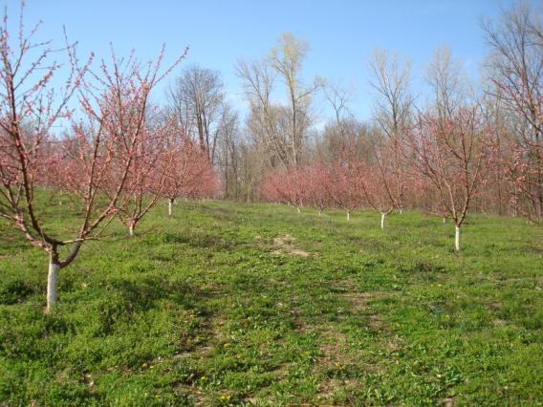
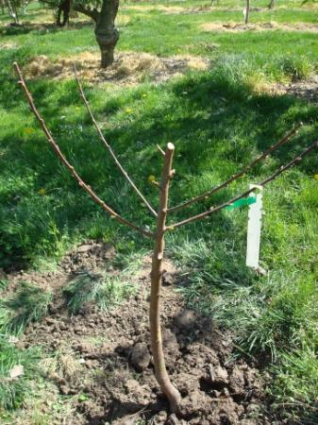
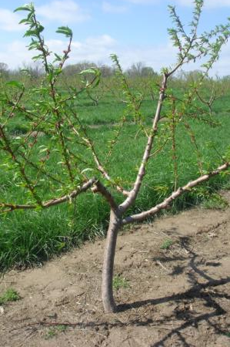
Training Systems for Fruit Trees
Open Center
A single trunk 18-30” high
2-5 scaffold branches close together vertically
Preferably, no branches facing southwest
Crotch angles 40-90º
Notes:
A tree trained to an open center has no main leader, but several main scaffolds that branch out from approximately the same height on the tree. Peaches and nectarines are often trained to open centers

Slide 29
Peaches and nectarines: Open center training and pruning
At Planting
If tree is un-branched (whip), head the leader at between 26 to 30 inches above ground when the buds start to swell in early spring.
If the tree has branches, select 3 or 4 branches located 15 to 30 “ above the soil line, preferably one at each compass point.
Cut back by ½ to an outward facing bud
Remove all branches less than 15” above the soil line and cut the tree off just above the topmost selected scaffold
Notes:
With un-branched trees, cut the tree at 26 to 30 inches above the ground after planting. The scaffold branches will develop within 4 to 6 inches below the cut.
If you purchase a tree with healthy branches located 15 to 30 inches above the soil line, select three or four branches, one at each of the compass points. Choose branches that initially develop from the main axis at a 60- to 90-degree angle. Cut them back by one-half to a healthy outside-facing bud. Remove all branches that are less than 15 inches above the soil line and cut the tree off just above the topmost selected scaffold.
During the summer, pinch off any shoots that begin to grow toward the center of the tree.
By the end of the first summer, trees should begin to take on the typical open vase shape. Three or four permanent scaffold limbs should be selected at this time and the others removed. The permanent or primary scaffolds chosen should be distributed evenly around the trunk, approximately 6 inches apart vertically. Small side branches along the scaffolds can be left for early fruiting. Do not select primary scaffold limbs that are directly above one another. The limbs selected should have an angle of 60 to 90 degrees from vertical.

Slide 30
Notes:
Pictured to the left is a depiction of a whip tree that has been headed back to start the open center training system. The top views show the selection of scaffold limbs on each of the compass points.

Slide 31
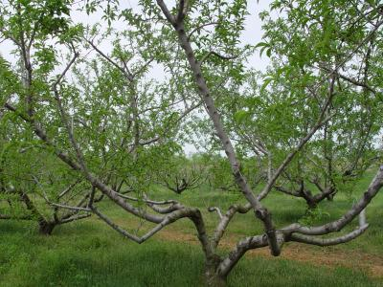
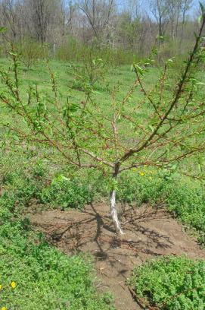
Notes:
Pictures here are peach tree in different stages of the open center training system. The left-hand picture shows a feathered tree that has been headed back to the open center training system.

Slide 32
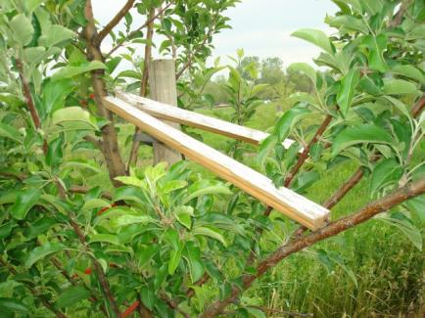
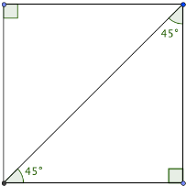
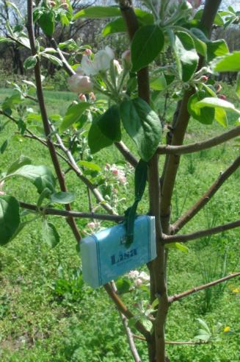
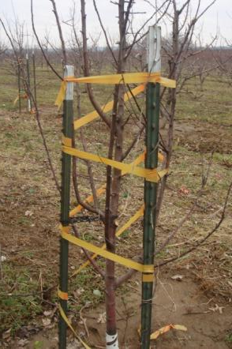
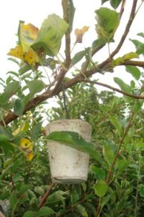
Care of Young Trees
Remove grass and weed competition
2-3’ out from base of tree
Prevent premature bearing
Remove fruit first two growing seasons
Use limb spreaders to hasten bearing (apple)
45º branch angle
Protect from pests
Notes:
Trees will grow much faster if grass and weeds over the root zone are removed Mulch can be placed around the tree if desired During the first 2 years of establishment, fruits should be removed.
It is also important that the limbs are spread when they are young. If a limb is not spread to a 45º to 90º angle, a bark inclusion can develop. This occurs when the bark of the trunk and the branch have been pressed together. This structure weakens the branch and serves as an entry point for pathogens. A wide-angled branch, however, allows for growth and expansion of both the trunk and the branch and produces a much stronger branch that can withstand future heavy crop loads.

Slide 33
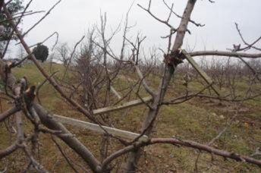
Branch Angle Effect on Vigor
The more vertical the shoot, the more vigorous it is
Vertical shoots also have stronger buds
Shoots growing below the horizontal plane are the weakest
Notes:
As mentioned in the previous slide, a more horizontally-trained limb can withstand a heavier crop load. But there are other affects when a branch is trained from a vertical to a horizontal position. Vigor is reduced both in shoot growth and bud development as a limb grows more horizontally but especially so with scaffolds below the horizontal plane. So developing the proper branch angle is really a balance between strengthening scaffold limbs and managing growth and productivity.

Slide 34
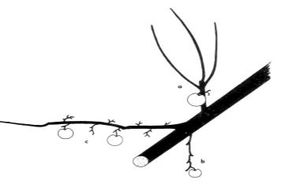
Branch angle’s effect on fruit formation
Branch angle affects fruit number and fruit size
Vertical branches have very few larger fruits
Horizontal branches have more fruits of moderate size
Below horizontal branches have less fruits of smaller size
Notes:
On the previous slides, it was noted that a more horizontally-trained limb can withstand a heavier crop load. An additional benefit of a horizontally trained limb is increased number of marketable fruits an in most cases will decrease the time to bear.

Slide 35
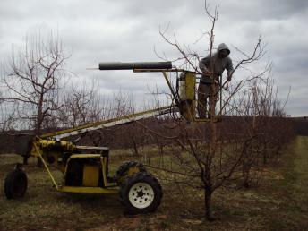
Annual Pruning
Notes:
Once fruit trees have been trained to a specific training system, the goal of annual pruning is to maintain that shape and to increase light penetration into the canopy to improve fruit color and increase fruit bud formation for the next year crop.

Slide 36
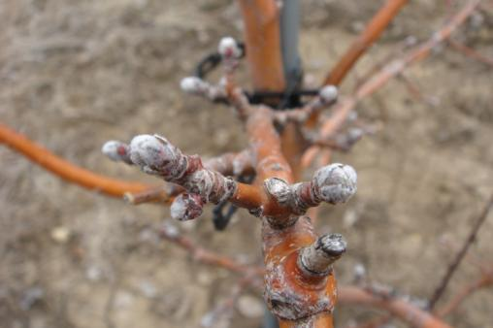
Flower Habits
Apple
Usually borne terminally on shoots or short spurs
Contain 5 (or sometimes 6) flowers
Center blossom opens first (determinate)
Peach
Solitary flowers from axillary buds of last year’s growth
So 15-20” of new growth each year are needed to maintain good cropping
Notes:
The flower buds of apple tree fruit are initiated and partially developed in the season previous to their unfolding into blossoms. Most flowers on apple are located terminally on short shoots—also known as spurs, which you can see pictured at the top and center. The period generally considered to be the time of most apple flower bud formation spans the 3 to 6 weeks after bloom, but may be influenced over a much longer period of time.
Peach trees bear fruit laterally on wood that grew the previous year as pictured in the bottom center.

Slide 37
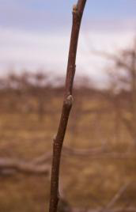
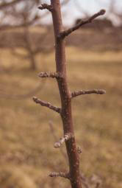
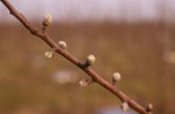
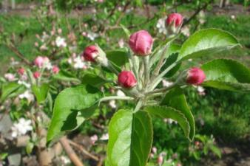
Apple buds
Leaf buds, fruit spurs, fruit buds and bloom
Notes:
The ability to identify flower buds is important in order to prevent the removal of too many. Flower buds are easily recognized by their shape. They are larger than leaf buds and are swollen near the base. In contrast, leaf buds are smaller and narrow. Apple trees generally bear flower buds at the tips of spurs and short shoots. It is important not to prune off all these short shoots since they are the site of future flower buds.

Slide 38
Peach buds
Flower buds are borne on 1-year old wood
Pictured here
Center bud is a leaf bud
The large bud on either side is a flower bud
Notes:
Flower buds of the peach are plump and roundish. The leaf or shoot buds are small, narrow, and pointed. On vigorous shoots, flower buds at a given node may occur in numbers of one, two or three. Where three buds are at a node (as pictured above), the usual arrangement is for the center bud to be a leaf bud while the outer buds are flower buds. On the shorter growth and spurs, flower buds are often borne singly beside a leaf bud. On very vigorous shoots, the buds may consists almost entirely of leaf buds.

Slide 39
Nutritional Requirements
Notes:
Nutritional requirements of fruit trees differ from those of agronomic crops and the orchard floor. Because fruit trees are perennial in nature, leaf or foliar analysis is recommended every three years to provide the most accurate information to determine nutritional needs of an orchard beyond the initial preplant fertilizer recommendations. Soil analyses are not nearly as accurate in determining the nutritional status of the orchard because factors such as rootstock, crop load, soil type and weather conditions influence whether or not trees are absorbing enough nutrients to produce maximum yields. The main value of a soil test is to monitor the soil pH

Slide 40
Thinning
To increase fruit size
To obtain annual production
To improve fruit quality
To avoid tree breakage
Notes:
Removing a portion of the crop results in increased size and quality for the remaining crop. The earlier the crop is thinned, the greater the increase in fruit size. For some crops, such as Golden Delicious apples, the tendency toward alternate bearing is very strong and annual thinning is a method to reduce that cycle.

Slide 41
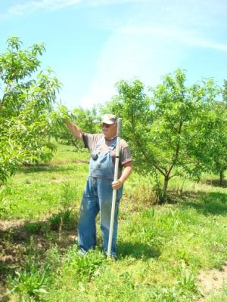
Methods of Thinning
Hand thinning
Mechanical removal (peach only)
Rope, string, club
Chemical (apple only)
Notes:
Depending on the type and the variety of fruit, fruit clusters should be broken up, leaving a single fruit. Apple and peach should be spaced from 6 to 8 inches apart on limbs
Hand thinning is the most labor intensive option and should be reserved as the final step in thinning to save time and labor costs. Hand thinning is appropriate for apples and peaches
Clubbing limbs or clusters is a method where a padded pole or a plastic bat works well. With them, limbs can be struck hard enough to knock off some fruit, yet not so hard that branches will be damaged. Thinning in this manner is much quicker than hand thinning, though not as precise. It may be necessary to follow up thinning in this manner either by hand thinning to break up clusters of fruit or by using a stick with a short piece of hose on the end to strike the cluster and dislodge some of the fruit. Best results from thinning using this method will be obtained in early morning or late evening when fruit stems are firm. Thinning in this manner is generally done when the largest fruit are between the size of a dime and a nickel. This method is more common in peaches but can be used in apples
Chemical thinning is almost exclusively used in apples. Commercial apple growers can spray their trees at the appropriate time with certain chemicals, which will cause some fruit to drop. It is a very precise operation, and either no thinning or overthinning can result. Good results depend on selection of the correct chemical, rate and time of application. Weather conditions before, during and after application can influence the results. When done properly, chemical thinning gives the best results of all the methods used, since it is done earlier than the others. Chemical thinning is also the least expensive method.

Slide 42
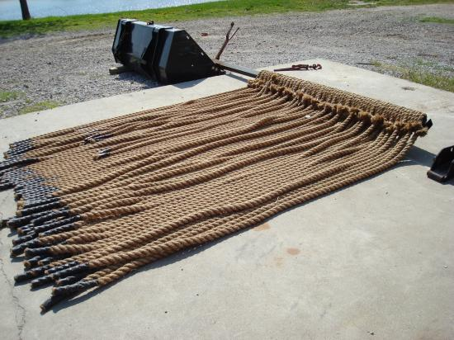
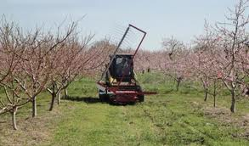
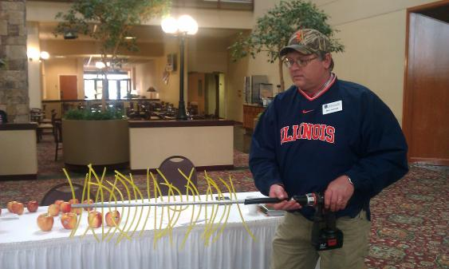
Bloom thinning peach
Ropes
Strings
Notes:
Thinning usually requires several steps. In the case of peaches, the first thinning pass would be a bloom thinner using ropes drug through the tree or a string thinner. If additional crop still needs to be removed, branches may be “clubbed” later when fruit are small and at a stage when they more easily detach from the tree—referred to as being loose. The final crop density is set by hand thinning.

Slide 43
Chemical thinning of apples
Notes:
43
Apple are the most responsive to chemical thinners, whereas other fruit crops for the most part rely on mechanical means to thin.

Slide 44
Publications
Pennsylvania Tree Fruit Production Guide
Available from:
Publications Distribution Center
College of Agricultural Sciences
The Pennsylvania State University
112 Agricultural Administration Building
University Park, PA 16802-2602
Phone: 877-345-0691
E-mail: AgPubsDist@psu.edu
Hard Copy: $35.00 + shipping
Electronic (PDF) Version: $30.00
Further details: http://tfpg.cas.psu.edu/
Apple Thinning Guide
by Philip Schwallier
Available from:
Great American Media Services
343 South Union Street
Sparta, MI 49345
$12.00 (includes shipping)
To order, contact Kim Meyers at
616-887-9008 or
kmeyers@greatamericanpublkush.com
Notes:
There is not just one recipe to chemical because too many factors influence the trees reaction to thinners. To get started, the following resources are recommended for apple growers thinking about using chemical thinners in their operation.

Slide 45
Thinning Materials
Lime sulfur (organic)
NAD (Amid-thin® W)
NAA (K-Salt™ Fruit Fix™ 200)
6-BA (MaxCel®)
Carbaryl (Sevin® XLR Plus)
Ethephon (Ethrel®)
Notes:
45
If you are an organic grower, there is an option for you in terms of chemical thinners and that is liquid lime sulfur. The other thinning agents listed are not accepted for organic certicfication.

Slide 46
Timing of Materials
Ethrel
Bees!
Sevin
NAA
Accel
6-BA
NAD
FB
PF
6
8
10
12
15
20
25
Notes:
46
Each thinning agent has a optimal application window and as you can see from the chart most chemical thinning is done between petal fall and 15mm fruit size.

Slide 47
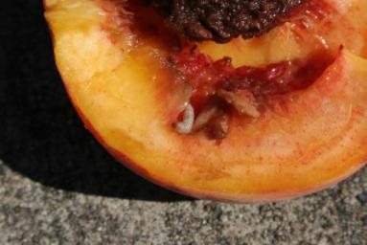
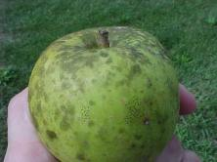
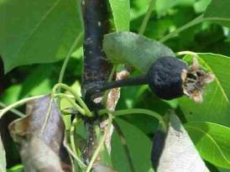
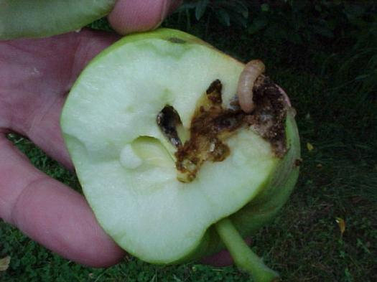
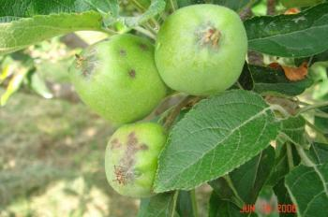
Fruit Tree Pests
Where?
Trunk
Roots
Leaves
Flowers
Fruit
Notes:
Whether your fruit production system will be certified organic or conventional, pest management is a significant component of all fruit production, and most especially tree fruit production. Throughout your upcoming sessions, pests of fruit trees and the integrated pest management approach to manage them will be further discussed

Slide 48
Resources
http://www.wvagriculture.org/images/Literature/How_to_Prune_Young_and_Bearing_Apple_Trees.pdf
http://pubs.ext.vt.edu/422/422-020/422-020_pdf.pdf
http://www.extension.org/blueberries
http://www.extension.org/grapes
YouTube video - Pruning a Mature Peach Tree
YouTube video - Pruning Apple Trees
Notes:
Above are just a scant few of the resources available on the web to further your understanding of fruit production.

Slide 49
To reach us
Contacts | Contact information
Mosbah Kushad | kushad@illinois.edu
Elizabeth Wahle | wahle@illinois.edu
Sonja Lallemand | lalleman@illinois.edu
Jeff Kindhart | jkindhar@illinois.edu
Rick Weinzierl | weinzier@illinois.edu
Notes:
Listed above are contacts at University of Illinois Extension should you have additional questions related to fruit production.

Slide 50
If you have questions …
University of Illinois Extension Local Food Systems and Small Farms team
http://web.extension.illinois.edu/smallfarm/
USDA’s Start2Farm site
http://www.start2farm.gov/
Notes:
Our beginning farmer training program ended in the fall of 2015. The best way to pursue answers to questions about fruit and vegetable production in Illinois is to contact educators on the University of Illinois Extension Local Food Systems and Small Farms team. Extension programs in other states are operated by the land-grant university in each state. Additionally, USDA’s Start2Farm site provides listings of farmer training programs in specific states and localities.

