Slide 1
Preparing a New Generation of Illinois Fruit and Vegetable Farmers a USDA NIFA Beginning Farmer and Rancher Development Program Project Grant # 2012-49400-19565 http://www.newillinoisfarmers.org
Notes:
The following presentation was part of a beginning farmer course, “Preparing a New Generation of Illinois Fruit and Vegetable Farmers,” offered by the University of Illinois and the Illinois Migrant Council from 2012 through 2015. This course was funded by the United States Department of Agriculture’s National Institute of Food and Agriculture, and specifically by the Beginning Farmer and Rancher Development Program. For more information about the program and for links to presentations and resources on many other topics, see the website newillinoisfarmers.org.

Slide 2
Growing a New Generation of Illinois Fruit and Vegetable Farmers Taxation for Small Farms
Rick Weinzierl
March 2015
www.newillinoisfarmers.org
Notes:
Hello, my name is Rick Weinzierl, and the topic that I will introduce in this webinar is taxation for small farms. This is part of a broader discussion of business planning and legal issues planning that that is presented in several of our classes and webinars as part of our beginning farmer course, “Preparing a New Generation of Illinois Fruit and Vegetable Farmers.” This course is funded by the United States Department of Agriculture’s National Institute for Food and Agriculture, and specifically NIFA’s Beginning Farmer and Rancher Development Program. Webinars and references on the topics that we cover in our classes are available online at www.newillinoisfarmers.org.

Slide 3
Objectives
Begin planning for tax liabilities and deductions
Sales tax, income tax, self-employment tax, and withholding taxes for employees
Schedule F, deductions, depreciation, and more
Excise, and property taxes
Notes:
In other webinars and discussions we address the importance of business structures, farm, liability, and crop insurance, and labor management and labor regulations. This discussion focuses planning for tax liabilities and deductions, specifically sales tax, income tax, self-employment tax, and withholding taxes for employees. You will begin to use, if you do not already, IRS Schedule F for reporting farm income and deductions for your federal tax return. We’ll also talk briefly about excise and property taxes.

Slide 4
Costs for small farms
Investments and expenses: Land costs, real estate/property taxes; equipment costs; fuel, electricity, and irrigation costs; seeds/planting stock; labor; insurance; income, self-employment, and sales taxes; and …
All of these components need to be considered in your business planning
Notes:
Remember that the discussion of taxes is important because tax liabilities have to be factored into your business plans. Tax liabilities are not really very different from the costs of land, equipment, fuel, seeds, or other expenses necessary for running your farm … they become part of the difference between gross sales and net, after-tax income.

Slide 5
Overall references on risk management and legal issues …
Illinois Direct Farm Business Guide
http://www.directfarmbusiness.org/
Farm Commons
http://farmcommons.org/
Illinois Small Business Development Centers
http://www.illinois.gov/dceo/SmallBizAssistance/BeginHere/Pages/SBDC.aspx
… and many others that are listed on slides that follow
Notes:
During the course of this discussion I’ll include links to several useful references or resources. Three that provide valuable information on a range of small farm business management issues are the Illinois Direct Farm Business Guide (an online publication), Farm Commons (a nonprofit agency that has archived webinars on a range of business management topics available online), and the Illinois Small Business Development Centers that provide one-on-one consulting services.

Slide 6
In the long run do not be too frugal to …
Pay for the services of a qualified attorney
Shop around for an insurance agent who understands your farm business
Pay for the services of a qualified tax accountant familiar with farm taxes
Notes:
An important disclaimer before I delve into this topic … I am not a tax specialist or a tax attorney. What I will do over the next several minutes is introduce you to several important topics that I’ve been taught in train-the-trainer sessions and that I am preparing to deal with as I start a small farming operation. You will become aware of some tax issues that you may not have thought of if you have not run an independent business before. With that awareness, you’ll need to follow up with your own research into details that affect you. And you’ll have to decide what management practices you can do on your own and what practices you may want to pay someone else to do. Remember not to be too frugal to pay for the services of a qualified attorney or a good tax accountant who is familiar with farm taxation.

Slide 7
Labor issues
Employee, independent contractor, or intern?
Employee handbook
Employment rules
Job descriptions
Minimum wage
Child labor
Unemployment insurance
Withholding taxes
Worker’s compensation
“Volunteers” who are compensated with “free” produce may not be viewed as volunteers under the Fair Labor Standards Act. If they are compensated, the fair market value of the produce is the basis for withholding taxes … often ignored, but at your own risk.
Notes:
Employment Law is long and complex. There are tons of regulations and rules. Related to taxation, at least three topics deserve your attention – whether or not someone is an employee, your obligation to pay unemployment insurance, and your obligation to withhold income taxes from employee’s checks. One issue surrounded by muddy water is practice of having “volunteers” come regularly to a small farm to help with harvest and be “rewarded” or “thanked” with a significant amount of produce or other farm products. “Volunteers” who are compensated with “free” produce may not be viewed as volunteers under the Fair Labor Standards Act. If they are compensated, the fair market value of the produce is the basis for withholding taxes … often ignored, but at your own risk.

Slide 8
Employee, Intern or Independent Contractor?
Fair Labor Standards Act Definition: 29 USC § 203
"Employ" includes “to suffer or permit to work.”
“Employee” is “any individual employed by an employer.”
Notes:
Another issue is whether or not someone who comes to your farm to work is an employee or an independent contractor. (We’ll save the topic of interns versus employees for another date, because wages, not taxation, are usually the focus of that distinction.) If someone is truly an independent contractor who comes to your farm to provide you a professional service, you are not obligated to withhold payroll taxes from the money you pay him or her. It might be tempting to want to avoid the payroll tax paperwork and call everyone an independent contractor “let” them report their income and pay their taxes on their own. But …

Slide 9
“Economic Reality” Test:
“Is the worker economically dependent on the business to which he renders service or, as a matter of economic reality, in business for him or herself?”
Factors:
the degree to which the alleged employee is independent or subject to the control of the "employer" as to the manner in which the work was performed;
the alleged employee's opportunities for profit or loss;
the alleged employee's investment in the facilities and equipment of the business;
the permanency and duration of the relationship between the business and the alleged employee;
the degree of skill required to perform the work of the alleged employee; and
the extent to which the services rendered are an integral part of the employing entity.
Notes:
Angela Tucker of Land of Lincoln Legal Services offered this explanation on the perils of describing an employee as a contractor. “Whether a worker is an employee or an independent contractor is an individualized fact question. This means that a jury decides – which also means that there are no bright line rules. Instead, it’s what [lawyers] call a “totality of the circumstances” test. This is a fancy way of saying you look at the whole situation. Courts have generally looked at the six factors in this slide. While none of these factors is by itself determinative, courts generally don’t care what you call the relationship – whether you call it employee or independent contractor. Also, courts will almost always find an employer-employee relationship where the employer exercises control over the manner in which the work is performed. Also, just because a working relationship is seasonal does not mean that workers will be considered independent contractors. Generally, if you want someone to be classified as an independent contractor, they have to have some skin in the game – that is, they have to share in the profit or loss of the business.

Slide 10
Unemployment compensation
Most for-profit employers are required to pay contributions (taxes) as soon as they have:
Paid $1,500 in wages in a single calendar quarter, or employed one or more persons for 20 weeks in a given calendar year; or
Paid $1,000 in cash wages in one calendar quarter for domestic work; or
Paid $20,000 in cash wages in one calendar year or employed 10 or more workers for 20 weeks in a given calendar year for farm work.
Notes:
How about unemployment compensation (insurance)? [Read slide.] However …

Slide 11
Unemployment compensation in agriculture
Under 26 U.S.C. ' 3306(a)(2), agricultural employment is subject to the Unemployment Compensation Act if the farm employer pays cash wages of $20,000 or more to employees during any calendar quarter of the current or preceding calendar year; or the farmer employs ten or more individual employees on at least one day during each of 20 different calendar weeks. However, the farmers spouse and children under 21 are not considered in determining whether the $20,000 cash wages or ten-employees test is met. Farm employers who meet either of the above tests are required to pay a tax based upon the amount of cash wages paid. 26 U.S.C. ' 3301.
If a farmer is subject to the Illinois Act (820 Ill. Comp. Stat. 405/211.4), the farmer must notify the Illinois Department of Labor within a specified time after operations begin. A quarterly return and tax payment (called "contributions") must be filed.
See http://www.farmdoc.illinois.edu/legal/minWage_empyTax.html
Notes:
[Read slide.]

Slide 12
What about FICA / Social Security and Medicare?
When are farmer-employers required to pay social security taxes on employee wages and what procedures must be followed?
The Social Security taxes are applicable to almost all farmers even if the farmer himself is the sole employee. Like other employers, a farmer has certain obligations to contribute to an employee's future social security benefits. Generally, employers are required to pay FICA (Federal Insurance Contributions Act) taxes upon the wages of an employee, other than the employer's children under the age of 18, who has either received wages of at least $150, or is one of several farmworkers who collectively were paid $2,500 or more during the year.
Notes:
How about social security and Medicare? [Read slide.]

Slide 13
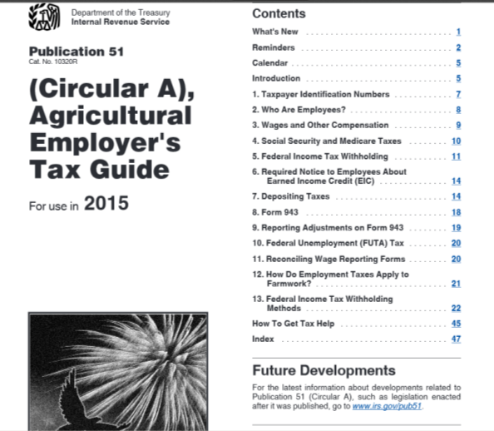
http://www.irs.gov/pub/irs-pdf/p51.pdf
Farmers and crew leaders also must withhold federal income tax from the wages of farmworkers if the wages are subject to social security and Medicare taxes.
Notes:
Farmers and crew leaders also must withhold federal income tax from the wages of farmworkers if the wages are subject to social security and Medicare taxes. IRS Publication 51, the Agricultural Employer’s Handbook provides guidance on withholding income taxes from employees’ wages.

Slide 14
Taxation of business income
Farmer’s Tax Guide, IRS publication 225 (91 pages)
http://www.irs.gov/pub/irs-pdf/p225.pdf
Ruraltax.org
http://ruraltax.org/
Tax Guide For Owners and Operators of Small Farms (http://ruraltax.org/files/uploads/TaxGuide%20Small%20to%20Midsized%20Farms%202011%2007%2014.pdf )
Introduction to Agricultural Federal Tax Issues
http://ruraltax.org/files/uploads/Introduction.pdf
Notes:
Moving beyond taxes associated with employees (and self-employment tax), all farmers face the challenge of reporting farm income and expenses and paying income tax on net farm income. All farmers need to consult IRS Publication 225, the Farmers’ Tax Guide for regulations and guidance on preparing Schedule F – Profit or Loss from Farming. Ruraltax.org’s Tax Guide for Owners and Operators of Small Farms is also very helpful, as is Introduction to Agricultural Federal Tax Issues by Ruby Ward of Utah State University.

Slide 15
Hobby versus business losses
Hobby losses not deductible
Is it a business?
Yes, if profitable 3 of the last 5 years, or IRS examines the following …
Is the endeavor carried out in business-like manner (LLC, separate banking accounts)?
Appropriate expertise or training?
Significant devotion of time … doing what?
Assets expected to increase in value?
Evidence of experience?
Examination of ongoing practices?
Some prior profits?
Other income?
Just for fun?
Notes:
Remember that establishing and running your farm as a business is essential if you are to be able to deduct legitimate farm expenses to establish net income. Hobby expenses and losses are not deductible. How does the IRS assess whether or not your farm is a business or a hobby? [Read slide.]

Slide 16
To document that your effort is a business …
Record your farm with FSA
Develop a viable business plan, keep books separately for your business
Show some profit in 3 of 5 years
Keep written records of time spent working or attending training, adaptations to increase income, reasons for losses
Notes:
To document that your farming effort is a business … [read slide].

Slide 17
Initial requirements related to taxes
Business probably needs a federal EIN (definitely if LLC)
Register with the Illinois Department of Revenue at the Illinois Business Gateway (https://mytax.illinois.gov/_/)
If you hire employees, register with the Illinois Department of Employment Security at http://www.ides.illinois.gov/Pages/default.aspx
Notes:
If you are a business, … [read slide].

Slide 18
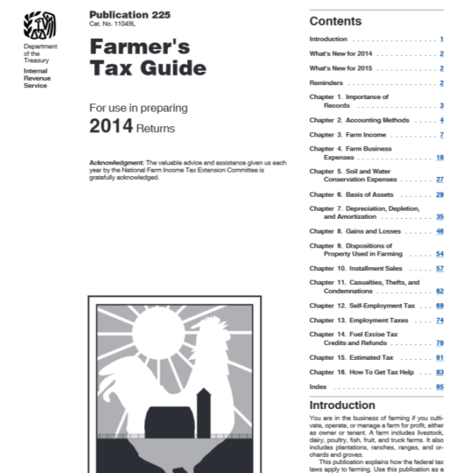
http://www.irs.gov/pub/irs-pdf/p225.pdf
Notes:
And be sure to get IRS Publication 225, the Farmers’ Tax Guide.

Slide 19
Farmer’s Tax Guide covers
Farmer’s Tax Guide covers … records, accounting methods, expenses, deductions, depreciation, self-employment taxes, employment taxes, excise taxes, and estimated taxes (and other topics).
Ruraltax.org offers sample tax returns (http://www.ruraltax.org/htm/sample-tax-returns) and explanations for how they are done. One that is very relevant is http://ruraltax.org/htm/sample-tax-return-ima-hopefull.
State income taxes are based on federal tax forms.
Notes:
Read slide

Slide 20
Self employment tax
Payment not required if profits less than $400
12.4% on first $118,500 of profit (or total income with other wages) for FICA (2015)
2.9% on all profits for Medicare
Notes:
Remember that you will need to pay self-employment tax on your farm net income. Payment is not required if your farm profits are less than $400. You are required to pay 12.4% on income up to $118,500 in 2015 for FICA and 2.9% on all profits for Medicare. Publication 225 provides instructions on payment methods and schedules.

Slide 21
Form 1099
Informational return
IRS uses to match income on tax returns
One copy sent to individual or other entity and one sent to IRS
You may need to issue them
You may receive them, and the amounts need to show up on your tax return
Notes:
As a farm business you may also ned to become more familiar with IRS Form 1099. These are called informational returns, and the IRS uses them match income and expenses on tax returns. The issuer of a 1099 sends one copy to an individual and the other to the IRS. You may need to issue them or you may receive them, and the income then needs to show up on your tax return.

Slide 22
Form 1099 required if …
1099-Misc for payments of $600 or more for rents and services or for payments of at least $10 in royalties
1099-Int for payments of $600 or more of business interest
Notes:
Read slide.

Slide 23
Payments (you make) that are not subject to a 1099
Payments other than medical or health care made to a corporation of any kind
Payments for merchandise, phone service, freight, storage, and similar items
Payments of rent to real estate agents
Wages and business travel allowances paid to employees
Payments made to tax exempt organizations
Notes:
Some payments you make are not subject to Form 1099 reporting. For example, …

Slide 24
Notes:
Herbicide … no, merchandise
Consultant … yes, >600 not a corporation
Soil testing … no, paid to corporation
Plowing … no, not over $600
Grain hauling … no, paid to LLC
Rent … yes, not paid to corporation or LLC
Interest … yes, >$600
Repairs … yes, >$600, not to corporation

Slide 25
Sales taxes
The tax rate for food is based on whether it is intended for consumption on or off the premises. Food for human consumption off the premises, and not for immediate consumption, has a 1% tax rate. The general 6.25% rate applies to all other food.
Food or not? If a pumpkin patch sells pie pumpkins and gourds, the pie pumpkin, if not intended for consumption on the premises, qualifies for the 1% tax rate. The gourd, if not edible, is taxed at the 6.25% rate.
Establishments that sell food primarily (more than 50%) in individualized servings are deemed to sell food for immediate consumption, and have a 6.25% tax rate.
The 6.25% rate applies to all sales of hot foods and all sales of alcohol.
Units of local government may levy additional taxes above the 6.25% rate. See http://www.sale-tax.com/Illinois.
Notes:
Remember too that you will need to pay sales taxes on your farm sales of fruits and vegetables. Read slide.

Slide 26
Exemptions for the payment of sales taxes
When a direct farm business purchases items from another business that are related to farm production, the purchase is exempt from the sales (use) tax (35 ILCS § 105/3-5). These include: farm chemicals; certain farm machinery and equipment and replacement parts (greenhouse structures such as horticultural greenhouses or hoop houses qualify as machinery or equipment, as well as lighting and mesh tables for the greenhouse, and carts protecting the plants during shipment); and precision farming equipment such as computers and GPS devices.
When a direct farm business purchases farm machinery or equipment primarily for the purpose of farm production incident to the purchase of service, the goods are exempt from the 6.25% service occupation/use tax (35 ILCS §§ 110/3-5, 115/3-5).
Notes:
There are times, however, when you are not required to pay sales taxes on certain purchases. [Read slide.]

Slide 27
Federal excise taxes
IRS Publication 510: Excise Taxes and IRS Publication 225: Farmer’s Tax Guide explain fuel excise taxes as well as which uses of fuel qualify for tax credits and refunds. Fuel used on a farm for farming purposes and fuel used for off-highway business purposes are exempt from excise taxes. Farmers may claim the tax as a credit at the end of the year or obtain quarterly refunds of the tax, depending on how the fuel was used. To substantiate claims, the IRS requires businesses to keep certain records, such as the name and address of the person who sold the fuel.
Notes:
And the same is true for excise taxes.

Slide 28
State excise taxes
Illinois Fuel Excise Taxes
The Motor Fuel Tax Law (35 ILCS § 505) and accompanying regulations (86 IAC Part 500) govern fuel taxation in Illinois. Any person who uses motor fuel for purposes other than operating a motor vehicle on a public highway can seek a refund of the state excise tax on fuel (35 ILCS § 505/13). Refunds are available to farmers for gasoline (taxed at 19 cents/gallon) and un-dyed diesel fuel (taxed at 21 1/2 cents/gallon). Form RMTF-11-A is the form used to make an Illinois motor fuel tax refund claim. Purchasers must retain proof of taxes paid.
Notes:
At the state level … [read slide].

Slide 29
Property taxes
The term "farm" does not include property primarily used for residential purposes, even though some farm products may be grown or farm animals bred or fed on the property incidental to its primary residential use. The assessment value for farm dwellings and parcels of property on which farm dwellings are immediately situated is 33 1/3% of fair market value (rather than the agricultural economic value) (35 ILCS 200/10-145).
Improvements, which include buildings such as on-farm retail stores or processing facilities for value added products, are assessed as part of the farm when such buildings contribute in whole or in part to the operation of the farm. Their assessment value is 33 1/3% of the value of the building's contribution to the farm's productivity, which is usually similar the building’s fair market value (35 ILCS 200/10-140).
Notes:
Read slide.

Slide 30
In the long run do not be too frugal to …
Pay for the services of a qualified attorney
Shop around for an insurance agent who understands your farm business
Pay for the services of a qualified tax accountant familiar with farm taxes

Slide 31
To reach us
Contacts | Contact information
Rick Weinzierl | weinzier@illinois.edu 217-244-2126
Mary Hosier | mhosier@illinois.edu 217-333-7512

Slide 32
If you have questions …
University of Illinois Extension Local Food Systems and Small Farms team
http://web.extension.illinois.edu/smallfarm/
USDA’s Start2Farm site
http://www.start2farm.gov/
Notes:
Our beginning farmer training program ended in the fall of 2015. The best way to pursue answers to questions about fruit and vegetable production in Illinois is to contact educators on the University of Illinois Extension Local Food Systems and Small Farms team. Extension programs in other states are operated by the land-grant university in each state. Additionally, USDA’s Start2Farm site provides listings of farmer training programs in specific states and localities.

