Slide 1
Preparing a New Generation of Illinois Fruit and Vegetable Farmers a USDA NIFA Beginning Farmer and Rancher Development Program Project Grant # 2012-49400-19565 http://www.newillinoisfarmers.org
Notes:
The following presentation was part of a beginning farmer course, “Preparing a New Generation of Illinois Fruit and Vegetable Farmers,” offered by the University of Illinois and the Illinois Migrant Council from 2012 through 2015. This course was funded by the United States Department of Agriculture’s National Institute of Food and Agriculture, and specifically by the Beginning Farmer and Rancher Development Program. For more information about the program and for links to presentations and resources on many other topics, see the website newillinoisfarmers.org.

Slide 2
Growing a New Generation of Illinois Fruit and Vegetable Farmers Thinking Beyond the First Year
Mike Roegge & Andy Larson
Local Foods & Small Farms Educators
September 2015
Notes:
Hello folks, I’m Andy Larson, Local Food Systems and Small Farms Educator for University of Illinois Extension. My colleague, Mike Roegge, and myself were tapped to be the voices of experience for this presentation on “Thinking Beyond the First Year.” Mike and his wife have 20+ years of experience growing fruits and vegetables, and my wife and I are in our second year of raising poultry. So, even though I am narrating this thing, rest assured that most of the content herein stems from Mike’s experience moreso than mine!

Slide 3
Objective
Emphasize things you have already heard
Income goal
Labor and retention
Grow with your experience
Reinvestment
Marketing and market development
What to do in the face of adversity
Notes:
The main thing we are attempting to do with this presentation is to re-emphasize points you have already heard several times throughout the course of this beginning farmer program. These are the ones that we think deserve mentioning again, because you are going to be facing these situations sooner than you think.
We are going to be talking about:

Slide 4
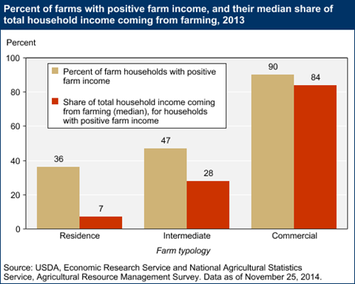
Income Goal
A realistic number, and a plan to reach it
Notes:
Let’s begin with your income goal.
It’s important to have a realistic income goal – an actual number, not just “as much as I can make.” Let’s be honest with ourselves, at some point it may not be worth it to farm anymore, given your opportunity cost. Your income goal sets your guidepost, it keeps you in reality, and it helps you to determine your marketing mix. It is the number from which almost everything else can be back-calculated.
For example, how do you decide how many row feet of carrots to plant? Well, how much profit do they yield per unit at different marketing outlets when you include all costs, and what proportion of your total revenue stream must the carrots account for? If you need way more carrots than you can actually handle growing in order to reach your goal, you either need to modify your production, your marketing, or your goal.
Your income goal needs to be in a pragmatic ballpark, and it may be useful to see what different sizes of farms contribute to their household incomes nationally. In the national ag census, if the operator reports being retired or having a major occupation other than farming, the farm is classified as a “residence” farm. If he or she reports farming as a major occupation and is not retired from farming, the farm is classified as “intermediate.” “Commercial” farms are those with $350,000 or more in gross cash farm income, regardless of the occupation of the principal operator.
As you can see, many of you will likely fit into the first two categories for quite some time. Consider what proportion of your family’s income will realistically come from farming, then set your income goal to make the effort worth your while.

Slide 5
Labor and Personnel
As grow in size and scope will be relying upon hired labor
Need to plan and budget accordingly
Need additional sales to pay for additional labor
Follow standard business practices w/ labor
W-2, witholding, FICA, SS, insurance, etc.
Consider offering “investment” of farm to employees as an incentive
Housing, profit sharing, giving them a certain market
Don’t expect employees to do jobs you wouldn’t do
Notes:
You pay H2A and they pay employee
Pay by the piece
Pay in such a way to provide incentive to do good work

Slide 6
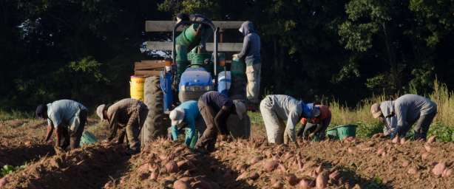
Labor and Retention
Your will probably need hired help sooner than you think…
$ gained or saved necessary to justify hiring
Hourly help vs. contractor vs. employee
Learn to use industry standard hiring practices
Credit: USDA
Notes:
Those who wish to make even a substantial part-time income from vegetable farming often need hired labor to generate sufficient revenue. So, in all likelihood, you are going to need to hire help, and it will probably be something you do sooner than you think. There aren’t always enough hours in the day. Plus, when you’re just getting started, it’s a lot easier to pay someone for a few hours of labor than it is to invest in the infrastructure or machinery necessary for you to efficiently do the work yourself.
How do you know when you need hire someone? Make sure you are keeping good records in order to determine which crops are actually making you money. It makes no sense to pay a person to pick a crop that is going to lose you money anyway. If a crop or enterprise is in the black financially, but you could be generating either additional revenue or cost savings if you had an another set of hands, then it’s likely worth your while to hire some help.
Know exactly what you are hiring. Many of you will likely get a neighbor kid to water the high tunnel while you’re gone for a weekend, and then pay him cash under the table. You may also hire a neighbor farmer to help with soil preparation or fertilizer application, but if that person is providing the equipment and/or expertise for the job, they are a professional contractor who should invoice you for payment. But as soon as you are looking to hire regular labor for regular times over the course of a growing season, and to whom you are providing the direction in their work, you are really bringing on an employee. Use good standard hiring practices, like withholding taxes, social security, and insurance.

Slide 7
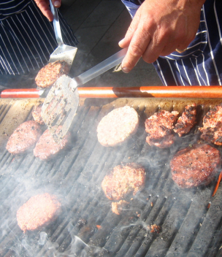
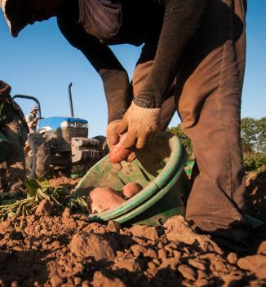
Labor and Retention
Decent wage
Depends on responsibility and geography
Pay that incentivizes performance
Credit: Jeremy Keith
Credit: USDA
Notes:
Hiring good help is hard. You have to remember, even though your dream is to farm like this, you are in the minority. You will not have local kids or adults falling over each other to do what they often consider “stoop labor.” You need people with stout constitution and strong work ethic, and it’s often hard to tell who these folks are until you have them on the job. You may even want to institute a review policy or a probationary period for new longer-term employees so you both have an “out” if the working relationship is not actually working.
For those you have determined to be an asset to you operation, and worthy of continued investment, there are a few things you can do to keep them around.
First, you need to provide them a decent wage, and “decent” really varies. Consider their opportunity cost; could be making much better, or easier, money flipping burgers? Going pay rates depend a lot on where you are located, and what kind of responsibility goes along with the job. If a person goes from farm hand to farm manager, give them a pay raise that is indicative of their increased responsibility and decision-making authority.
It may be wise to use a payment system that incentivizes good performance. For example, paying by the piece is very common for short-term employees in hand-harvested agriculture. Maybe an employee gets a bonus for exceptional performance at a farmers market, like a certain percent of sales or every dollar above a sales target.

Slide 8
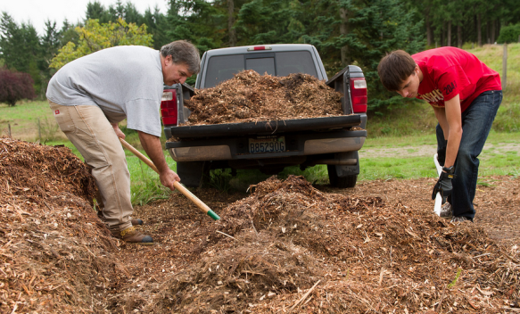
Labor and Retention
Decent working conditions
Safe equipment and proper ergonomics
Positive work environment
Credit: Rick Gordon
Notes:
Working conditions are a tough one. Farm workers are going to be dealing with dirt, mud, manure, heat, cold, rain, wind, flies, mosquitoes, hard physical work, and unruly customers, just to name a few. Still, at the very least, you should provide proper equipment and procedures with good ergonomics so no one gets hurt laboring on your farm. Have good sharp tools with appropriate length handles, appropriate size harvest totes so people aren’t handling too much weight, and easy access to water, restrooms, and a place to cool off. Have you every tried loading fresh, stringy mulch with a flat-bladed shovel. It sucks. You need a more appropriate tool, like a silage fork.
Also, provide a positive environment with both critical feedback and ample praise. Smile when you come out to meet your employees early in the morning. Tell people you appreciate their work at the end of the day. Give constructive criticism that can help people become more efficient workers. And never expect someone else to do a job that you wouldn’t do; you have to lead by example.

Slide 9
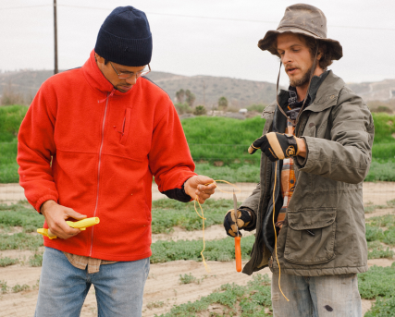
Labor and Retention
Professional development
Take the time to teach and give feedback
Increase responsibility or ownership
Credit: Suzie’s Farm
Notes:
Finally, if an employee is worth keeping for the long-term, that generally also means they are worth investing in. Take the time to teach them the best way to do things, and how you came to that conclusion. Talk about your decision-making process, even though it takes time to do so. Perhaps you can give them full responsibility and decision making authority over a crop, or a market. More ownership and agency in their work will only make people stronger forces for profitability on your farm.

Slide 10
Grow as you gain experience
Start small then expand as you gain knowledge and experience
Grow crops you know and understand then progress to others
Huge potential for wholesale of certain veggies
Sweat equity versus capital investment
As expand may require investment in resources- equipment, packaging, storage, transportation, etc.
Work smarter, not harder ☺
Plastic mulch, landscape cloth, high tunnels, etc.
Notes:
Don’t be scared to approach the produce manager at your local grocery store. They want to meet the demand for local food, too!
Are you in the position to grow and sell wholesale?
Don’t be afraid to ask questions of your customers. That’s grassroots, first-person market research.

Slide 11
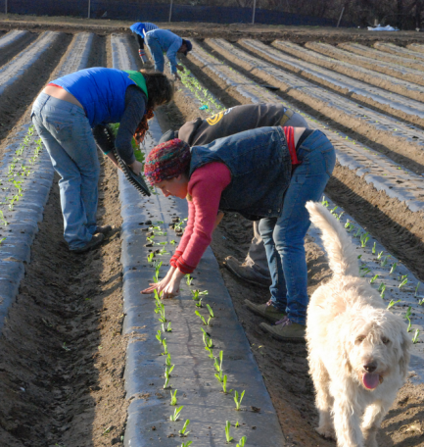
Grow With Your Experience
Work on someone else’s farm
Credit: Suzie’s Farm
Notes:
You will hear many people tell you to start small, and grow with experience. The best way to know whether vegetable farming is your “calling” is to do it. But before you start buying land and a tractor, maybe you want to try your hand at it in a way that is a bit lower-risk. Like on someone else’s farm as an employee or an apprentice. See what you’re good at, and see what you like to grow. Try to identify production and marketing efficiencies that can make the farm money. Try your hand at marketing and record-keeping. Identify niches in the marketplace that an enterprising beginning farmer, like yourself, might be able to fill down the road.

Slide 12
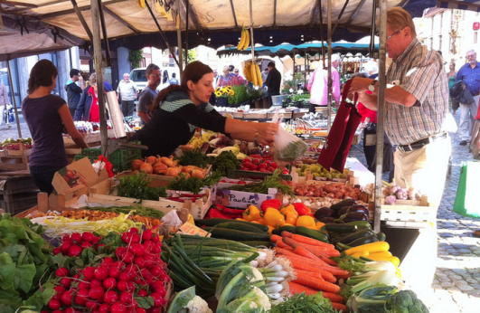
Grow With Your Experience
Start small, consider renting
Put in the time, sweat equity
Build your skills, brand, and market
Credit: Jeremy Keith
Notes:
When you do actually strike out on your own, start at a scale that seems manageable for your current skills and infrastructure (not to mention your pocketbook). It’s much better to make your first real mistakes at a scale you can recover from.
Beginning farmers are generally short on capital and long on labor. Rent land. Borrow machinery. Put in the time and build sweat equity.
Work on building your skills, building your market, and building your brand, all at the same time. Focus primarily on the crops you know you are good at growing and selling, while experimenting with other ones on the side.
But you might want to keep your town job, or your spouse’s town job. When you do decide to put your money where your mouth is and grow your farm, but your banker is trying to decide whether your farm is a worthwhile risk in the absence of substantial historical financial data, they are going to want to see a regular, reliable income stream you can fall back on.

Slide 13
Reinvest into farm
Prioritize needs and plan on how to provide for them
Sweat equity versus capital improvements
Farm is not static, will continually change depending upon clientele, markets, desires, etc.
As your resources expand, take these opportunities to upgrade (no summer vacations☺)

Slide 14
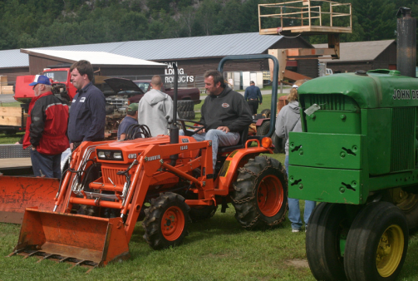
Reinvestment
Capitalize to increase efficiency and productive capacity, reduce labor
Buy bigger than you currently need
Credit: Jared and Corin
Notes:
As you continue to learn and grow and keep records and make decisions, you are going to notice inefficiencies –things that are too slow or too difficult to add much, if anything, to the bottom line – and you will start to develop a wish list in your head. “I would spend so much less time cultivating if I had a plastic mulch layer… I would have such a yield bump if I had decent irrigation…”
As you continue to build your own sweat equity, your financial resources will slowly expand and provide you opportunities to upgrade. But how do you know where to invest?
Prioritize capital purchases that increase your efficiency and/or your productive potential, which will help them pay for themselves quickly. Relatedly, labor is likely to be your biggest cost center, so think about how a capital investment can reduce labor.
And think about sizing your purchases a bit bigger than what you need right now, so you have some upside potential down the road. If you need a 30 horsepower tractor, see if you can afford a 50. If you’re going to put up a 72 foot high tunnel, see if you can go to 96. And get real familiar with buying and selling on Craigslist…
At the end of the year, even if you didn’t pay yourself because you reinvested in the farm, you are still building equity and productive capacity (not to mention minimizing your tax burden).

Slide 15
Marketing and Market Development
Never keep your marketing strategy static, look for opportunities
Consider all marketing options: direct sale (fm. Mkt., farm stand), wholesale (store, institution), cooperative (of growers), CSA, etc.
Investigate alternative crops to supplement existing
Be realistic. Talk to other growers to compare yields/time commitment/need/ease of mktg
Notes:
Cooperative = cooperation
What is missing in this market??? Ask those who know
What’s your marketing strategy? How do you draw them in to new products?

Slide 16
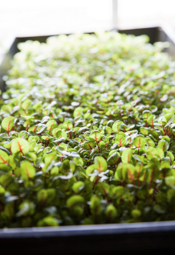
Marketing and Market Development
Constantly evaluate your marketplace
What is missing?
What is new and trendy?
What can I produce efficiently?
Credit: Marcy Leigh
Credit: SatrinaO
Credit: Plant Chicago
Notes:
Like it or not, your marketplace is constantly changing, and you have critically evaluate pretty much everything you are doing in order to determine whether you are leaving money on the table.
What is missing? Ask farmers market managers what they would like to see more of at their farmers market. Ask produce managers at grocery stores whether they do any local sourcing.
What is trending? Ask local chefs what the next big thing is going to be on their menus this season. Watch celebrity chefs on TV to see what they are talking about. We seen the demand for certain veggies skyrocket – think about kale, and radicchio, and microgreens.
And once you hear about some new things, ask other farmers if they have ever tried to grow it. Does it yield well? Does it have disease problems? Does it have decent shelf life? Not every opportunity is an opportunity…

Slide 17
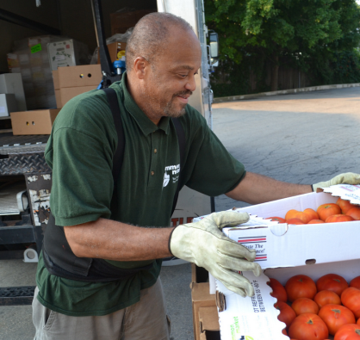
Marketing and Market Development
Don’t underestimate the potential of wholesale markets
Credit: USDA
Notes:
As you grow, don’t underestimate the potential of wholesale markets. Restaurateurs and retailers know that local food is hot, and many of them may be on the lookout for ways they can get in on the action. They may pay a bit less, but they will often make up for it in volume. Plus, eyeballs are worth something; if they are willing to feature you and your product on their signs or menus, then their customers become your customers, too. Yes, direct-to-consumer is generally going to bring you top dollar and build customer loyalty, but be sure take your transaction costs fully into account. How much are you spending on fuel for deliveries every month? How much are you paying those employees to be at four farmers markets per week?

Slide 18
What to do when it hits the fan
Plan, plan, plan
Modify, modify, modify
Have to be adaptable
Work with friends, neighbors, fellow growers to remedy
Learn from past mistakes. Think of potential pitfalls and what/how to avoid
Work the situation out and make the best of it
Punt
Notes:
Punt = know when to quit doing something

Slide 19
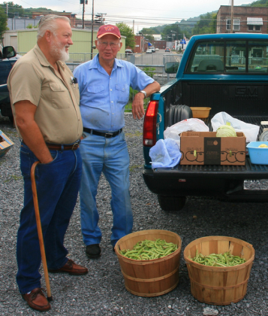
In the face of adversity…
Learn from each year’s challenges
Gather advice from peers and advisors
Go to Plan B, or Plan C
Accept help
Know when to fold ‘em…
Credit: Michael Quick
Notes:
They say that experience is that thing you get right after you really needed it.
It’s essential to have a peer network of farmers who have gone through the same trials and tribulations you are. Even if they don’t have an answer, at least they can sympathize.
It’s really hard to think of backup plans before you need them, and then to actually write them down so you remember what they were when you thought them up. This is where a farm handbook comes in mighty handy, especially if you have employees who need to know about Plan B.
No one is an island. Many farmers are lone wolves and fierce independents, but sometimes the universe throws you a bone when you need it the most. You have to be willing to catch it. Accept help when it is offered. Sometimes other people know you need it before you do.
There is a time to quit banging your head against the wall. Failure is an inevitable part of life, and of farming. Make your failures small and accept them as lessons for what not to do next time.

Slide 20
Summary
Set an income goal and plan for profitability
Find good help, and keep them
Grow your business with your skills/demand
Prioritize your capital investments
Constantly evaluate your marketplace
Learn from mistakes, and accept help
Notes:
Let’s look back at what we have covered in this presentation.
First, (read #1). What you produce, where you market, and how your business grows all stem from a realistic goal for income. Keep records, make good decisions, and plan for the profitability that you need.
Secondly, (read #2). Good help is hard to find. When you find it, invest in them so that they feel valued, educated, and loyal.
Third, (read #3). It’s okay to start small, rather than jumping in with both feet and your entire life savings. Make your mistakes early, preferably on someone else’s dime, and grow your skills.
Fourth, (read #4). Everybody wants land and a tractor, but are those wise investments right up front? What can you afford? What will pay for itself the fastest?
Fifth, (read #5). Your marketplace is always changing, with tastes, with trends, and with the economy. Keep your eyes open for new niches and better margins, but remember that not every opportunity is an opportunity.
Finally, (read #6). Stuff happens, and when it does, you are going to feel a lot more piece of mind if you have thought through the situation, or if you know who to call who has already been through it.

Slide 21
To reach us
Contacts | Contact information
Rick Weinzierl | weinzier@illinois.edu
Mike Roegge | roeggem@illinois.edu
Andy Larson | andylars@illinois.edu
Notes:
Thanks so much for your time and attention. I hope some of this resonates now, but if it didn’t, come and watch it again in a couple years. If you need to reach me or Rick or Mike about farming and the lessons we have learned, here is one way to reach us. Best of luck in your first year, and beyond.

Slide 22
If you have questions …
University of Illinois Extension Local Food Systems and Small Farms team
http://web.extension.illinois.edu/smallfarm/
USDA’s Start2Farm site
http://www.start2farm.gov/
Notes:
Our beginning farmer training program ended in the fall of 2015. The best way to pursue answers to questions about fruit and vegetable production in Illinois is to contact educators on the University of Illinois Extension Local Food Systems and Small Farms team. Extension programs in other states are operated by the land-grant university in each state. Additionally, USDA’s Start2Farm site provides listings of farmer training programs in specific states and localities.

