Slide 1
Preparing a New Generation of Illinois Fruit and Vegetable Farmers a USDA NIFA Beginning Farmer and Rancher Development Program Project Grant # 2012-49400-19565 http://www.newillinoisfarmers.org
Notes:
The following presentation was part of a beginning farmer course, “Preparing a New Generation of Illinois Fruit and Vegetable Farmers,” offered by the University of Illinois and the Illinois Migrant Council from 2012 through 2015. This course was funded by the United States Department of Agriculture’s National Institute of Food and Agriculture, and specifically by the Beginning Farmer and Rancher Development Program. For more information about the program and for links to presentations and resources on many other topics, see the website newillinoisfarmers.org.

Slide 2
Preparing a New Generation of Illinois Fruit and Vegetable Farmers MarketReady™ Getting Started in Wholesale Marketing
Nathan Johanning & Andy Larson
Notes:
Hello folks, I’m Andy Larson, Local Food Systems and Small Farms Educator for University of Illinois Extension. My colleague, Nathan Johanning, and I were charged with doing something of a dual-purpose presentation here, which would serve to reinforce some of the finer points of getting started in wholesale local foods marketing, but also provide a bit of a teaser to a larger-order marketing program we offer called MarketReady. MarketReady was created by University of Kentucky’s Food Systems Innovation Center, all based in research pertaining to what restaurants, schools, and retailers need in order to do business efficiently with local food farmers and vendors. We are currently revamping the program and plan to make it available again in 2016.

Slide 3
Why MarketReady?
To position specialty crop operations to fully capitalize on expanding local foods markets.
Meet requirements of commercial buyers
Emerging food safety standards
Meet the demands of a changing market
Notes:
You are all certainly well aware that the demand for local food continues to grow. But nowadays, household end-consumers are not the only buyers looking to get in on the action. Restaurants, natural food stores, conventional groceries, even schools and institutions are looking to source locally-produced foodstuffs, with particular emphasis on fresh fruits and vegetables. However, each of these larger-order markets comes with its own set of rules, expectations, and complications, not to mention updated food safety considerations coming down the pipe with the Food Safety Modernization Act. So, each of these opportunities comes with new demands on your time, and they will require constant attention to satisfy their changing needs.

Slide 4
The Changing Wholesale Environment
Increasing demand for Local Foods
The drivers are many
Traditional supply channels for commercial buyers not Local
Buyers adapting to consumer demand, etc.
Resulting increased demand for Local Product at HIGH VOLUMES.
Notes:
There are a lot of reasons that large-scale customers are getting into the local foods game, with a big one being that people are asking for them. Where were these carrots grown? What’s the story behind these microgreens? Is the chicken local?
However, getting their hands on locally-grown product may be a new thing to many chefs, retailers, and school lunch planners. They are very used to calling food service companies and supply houses, ordering a large quantity and diversity of products, and having them show up on their loading docks on neat pallets a day or two later. This level of service, not to mention the low prices available through large-volume suppliers, is very hard for the local farmer to compete with. And in many cases you probably shouldn’t try to compete on those characteristics. You should compete on quality, on uniqueness, on personal relationships, and on the story your consumer gets to know.
Still, even though you have a different hook, and a dedicated consumer demand, you still have to be able to supply a volume of product that is going to keep those grocery store shelves or restaurant pantries stocked for a week or so. You have to consider the traffic that your wholesale customer is going to experience on a daily or weekly basis, and continuously make sure that they can deliver on their promise of local product. You need to make each other look good!

Slide 5
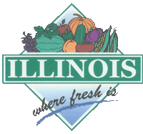
What to do?
Don’t abandon success!
Evaluate opportunities for ALL marketing options
Notes:
None of this is trying to convince you that you would be better off abandoning all your high-margin, direct-to-consumer markets. If you can make $500-1000 at a bustling Saturday farmers market, or you live on a well-traveled road where people will frequent your farm stand, by all means keep these markets if they are providing the return you need.
That said, we would highly encourage you to make a very detailed accounting of what those direct-to-consumer markets are costing you, as well as what they are making for you. Transaction costs are very real, and they can make or break the profitability of your marketing channels. For example, the price of your time, packaging, fuel, and depreciation should be subtracted out from your take at the farmers market. Labor, utilities, depreciation, and shrink should be rolled into your cost to operate a farm stand.
If the profit picture doesn’t look quite so rosy once you are accounting for all your costs, and you currently have, or intend to have, way more supply than you are likely going to be able to move through direct-to-consumer outlets, then it’s time to start thinking about wholesale opportunities in your area where you can make up for lower sticker prices with time saved and volume sold.

Slide 6
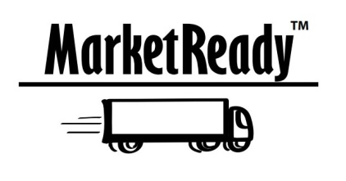
MarketReady Modules
Communication & Relationship Building
Packaging
Labeling
Pricing
Supply
Delivery
Storage
Invoicing
Insurance
Quality Assurance & Temperature Control
Certifications & Audits
Satisfaction Guarantee
Working Cooperatively
Marketing – An ongoing process
Local Products for Local Markets
Notes:
So this is the complete list of modules included in the original iteration of MarketReady. Even though we are redoing the delivery of this curriculum, this list of topics will likely stay largely the same because they are all quite important.
However, since this is just a teaser, and we don’t want you to have to sit and listen to my voice on a recording for hours on end, we are just going to touch on a few of the high points that are particularly useful to emphasize in a class like this.
So today, we’re going to talk about communication, packaging, labeling, pricing, delivery, and invoicing. And we’re going to try to do it in 30 minutes or less…

Slide 7
Communication & Relationship Building
Interview quotations about communication:
“Give us a phone call, (expletive)!”
“Keep me posted as to what’s happening. I need two weeks notice of any changes.”
“Communicate 2-3 times per week during produce season.”
“I need four days notice to re-supply elsewhere if farmers won’t have the product.”
Notes:
The original creators of MarketReady did lots of surveys, interviews, and focus groups, and they ended up with some great quotations that nicely capture the perspectives of wholesale buyers looking to purchase local food products. You will see examples of these quotations throughout the different modules.
All of these statements emphasize the absolute necessity for communication between the farmer and the buyer. These types of relationships are a lot more work for the buyer than their other relationships with food service suppliers. Think about how many farmers they would have to talk to get the same quantity and variety of product that they can get with one call to Sysco or Aramark.
Also, inventory and menu plans take time, and changes require some notice. Your customers may need to print menus, make pricing labels, or enter new SKUs into their point-of-sale system. It is essential to have an open line of communication with your wholesale customers, and to reach out on a very regular basis.

Slide 8
Communication
The grower must take initiative to communicate with the restaurant
“Successful growers create a line of communication between them and the chef.”
David Rand, Chicago City Markets Farm Forager
Clear communication only enhances the farmer-chef relationship—critical to developing the restaurant market and positive changes to a farm’s products
Call ahead…months ahead!
Notes:
Especially as new farmers, most people in this course are not going to have the luxury to rest on their laurels and wait for chefs and retailers to call them. You have to be the one to reach out. Cold calls can certainly work, but it is even better if you can get an introduction from someone with whom that chef or retailer already has a good business relationship. Networking is important, and having experienced peers that will vouch for you with potential customers goes a long way.
It is best to call the customer at a time when they are not crazy busy, and you have to have the information they need in order to form a business relationship. For example, if you want to reach a chef, it is best to call or visit between the lunch rush and the dinner rush. You need to anticipate their questions, and have answers readily available. When can you stop by with samples? What quantity do you have available? Which varieties? For how many weeks? At what price? Is there a discount for larger orders? When can you deliver? How is the product packaged? What are they payment terms? How far in advance do you need the order? If all of these things can get set up with one or two interactions, and you can get the terms in black and white with a sales agreement, you are going to look very professional and very capable right from the outset. Now you just need to deliver on your promises!
By the way, it never hurts to call a potential customer before you even have product to sell them. Let them know what you will be growing and that you would like to call them when the season begins. Ask when and how they would like communications from you. Ask them if they are looking for a particular product or variety you could grow for them. Start providing better-than-expected customer service long before you ever have your first sale. Look at this as an initial investment in a long-term business relationship.

Slide 9
Best Marketing Practices: Communication & Relationship Building
I understand the importance of advanced notice to the buyer about my products availability and changes in quantity or quality
I have the buyers contact information such as their direct phone numbers, and email; I understand the
best way to reach them
I understand wholesale food buyers have many demands on their time, therefore I make appointments in advance in order to meet with the buyer about my products
Notes:
Another hallmark of the current iteration of MarketReady is a checklist at the end of each module re-emphasizing some of the most important points.
[read bullet points]
The one thing I’d like to harp on is knowing the BEST WAY to reach your customer. We have a dizzying array of communication methodologies that people have access to nowadays. You and your customer have to come to some sort of agreement on which of these channels works best for you, and how often you expect to receive communication. For example, I have one chef that prefers to communicate with me by text message, and another that tends to call at 10pm the night before the delivery. One of those works well for me, the other one I am trying to train. I have a retail store that communicates via email, and another that likes to send me private messages on Facebook. Four customers, four different ways they prefer to communicate, if and when they remember to communicate. I’m not saying this is a good thing, either. It’s great to develop a communication routine with your wholesale customers, but it’s even better if you can harmonize that routine and that communication channel so it is much easier to keep track of all your customers.

Slide 10
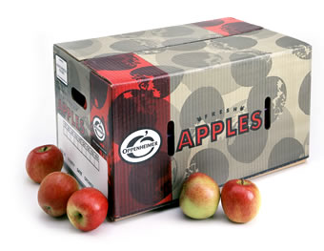
Packaging
Wholesalers and grocers look for “conventional” boxes
http://www.ams.usda.gov/grades-standards/vegetables
Sanitation and durability
Looking for traceability and function for packages down the road
Prefer ‘farm identification’ labels and packaging
Notes:
The next MarketReady module that I want to introduce is on packaging. This is something that you need to think through in advance, especially if your customers are used to receiving products that are packaged in an “industry standard” format. For example, if a retailer is used to receiving trimmed broccoli heads packed in crushed ice in a waxed 5/8 bushel box, you are going to have to talk with that customer and decide whether or not your product needs to be packaged the same way, or whether you can meet the same quality and consistency benchmarks without that degree of packaging. Do you know where to buy waxed boxes? Plastic pints? Clear clamshells? Twist ties? Bulk labels? This website from the USDA Ag Marketing Service can help you figure out what “industry standard” is supposed to look like for the produce you are growing.
I know all this sounds like a big pain, but there are reasons that a particular packaging methodology becomes the industry standard. It keeps the product in good shape, it transports well, it improves food safety, etc. There are good reasons not to deliver mixed greens in scented garbage bags…
Also, good product packaging helps with your communication, record-keeping, and branding. Not only can your packaging help to communicate things like lot number, variety, and sell by date, but a classy, consistent package can make you look much more professional.

Slide 11
Packaging and Image
Notes:
For example, which of these egg cartons better communicates professionalism and therefore affects your likelihood of buying? The one with the small Avery label and Microsoft clipart, or the full-color custom label that make Rebekah Grace look competitive with the other companies in the egg case? Your packaging says a lot about your brand, and therefore you as a farmer. As growers, we can get away with home-made websites and cobbled together marketing materials when we are handing the product to the consumer directly, but when there is an intermediary between the farmer and the person eating that product, we have to rely on packaging and labeling to tell our story.

Slide 12
Packaging
It doesn’t matter so much to me if greens and specialties come in a plastic bag…We can deal with that if the quality and consistency is there.”
Donnie Ferneau, Executive chef, Ferneau’s, Little Rock, AR
Notes:
All that said, sometimes your customers do not need for you to go to the extent that the USDA standards dictate. Maybe they want less packaging so they don’t have to open a bunch of bags or boxes, maybe they are going to repackage the product, maybe your packaging doesn’t fit in their cooler… Whatever the reason, make sure that the format in which you deliver the product communicates to the customer that you are a professional willing to meet their needs without ever diluting your farm brand.

Slide 13
Best Marketing Practices: Packaging
I understand industry standard packaging and am prepared to deliver that kind of package
I asked the buyer how they want products packaged
I will package appropriately to protect integrity, temperature and contamination
I will package to allow storage on pallets, in racks
Notes:
So, here’s our MarketReady checklist on packaging:
[read bullets]
Regarding that last bullet, make sure you know how your products are received and stored in inventory before they are ever put before the end-consumer. It’s hard to handle a pallet of bags, or a bag of boxes. You get my drift…

Slide 14
Labeling
Labels communicate a professional product
Labels should include:
Farm name, logo, contact information
Labels may also include
Field source, harvest date, use information, appropriate certifications, UPC or PLU codes
Labels should be weatherproof and not “get in the way” of the product
Notes:
Labeling generally goes hand-in-hand with packaging, and how those labels and packages look and work together as an item is going to go a long way to communicating your professionalism as a farmer-vendor.
In addition to maintaining your image and your brand, your labels serve to communicate information that is desirable to the consumer, and essential to the producer. For example, your label may indicate that you are certified organic, which is important to some consumers, but it may also have a field or lot number, which really is of no concern to the consumer. However, if you ever need to conduct a recall for food safety reasons, those lot number are going to become extremely important to you and your wholesale customers. There’s no better way to ruin your reputation as a food provider than to get somebody sick with a food-borne illness.
Labels, including the ink, the paper it is printed on, and the adhesive that sticks it to your package, have to be able to withstand all sorts of conditions. They may have to be able to withstand heat and humidity while they are in storage, sun and wind while they products are being packaged, and freezing cold or moisture as products are being stored or displayed. If your label doesn’t look as good when the end consumer puts the product in their fridge as it did when you received it from the printer, then either you or the label are not doing your job.
So labels have to communicate a ton of information and maintain your brand, but be careful that the label is not doing this in an obtrusive way that obscures your product.

Slide 15
Notes:
For example, the sausages in this retail meat case each have two labels, and this can be a bit of an issue. Sometimes the labels have duplicative information. On the left, that nice full-color label already told me that these pork sausages were from Pike Valley Farm and are USDA certified organic. Is there any way the variety and ingredients on the second label could have been included on the first, so as to eliminate the extra label?
On the right, an additional label is slapped crookedly on top of the original label. Even though this may have been done intentionally so the processor’s stamp was still viewable, it makes the product look sloppy, and further obscures what is inside the package. I would want to turn it over so I could get a good look at the product.

Slide 16
Best Marketing Practices: Labeling
I understand that labeling can help build my farm’s identity and improve product presentation
I have access to water-resistant labels that link my product with my farm but do not get in the way of product handling
I have explained to chefs the terms like “certified”, “sustainable”, and other phrases and what they mean when used on my labels or product packaging
Notes:
So there are things that labels must do, and must not do. Our MarketReady checklist…
[read bullets]
And there is a very good point here, make sure that every person in your supply chain understands what all those fancy words on your labels mean. If the retailer can’t explain what “grass-finished” means to the customer buying your steaks, or “certified naturally grown” means to the customer buying your tomatoes, that hurts your brand and may cost you a sale, which, who knows, may even cost you a long-term customer.

Slide 17
Pricing
Standard Retail Pricing
Margin-based retail pricing (used by almost all food retailers – standard retail price)
Food cost % = 1 - % margin
Target retail price = wholesale unit cost/food cost %
Example: A retailer wants to get a 40% margin on asparagus. A case standard is 28 pounds and costs $48.50 from the supplier. This comes to $1.73/pound cost to the retailer.
The food cost % in this case is 1 - .40 = .60
The target retail price to reach the margin with this method is $1.73/.60 = $2.89/lb.
Notes:
Okay, let’s touch on how to figure out what to charge your wholesale customers.
Standard retail pricing is very commonly based on margin, which is the markup the retailer is going to make on the wholesale cost from the farmer or supplier. This can vary widely depending on the product. Once they know their target margin and the wholesale cost, some quick division gets us their retail price.
A quick example: if a retailer wants 40% margin with asparagus, that means the wholesale food cost will represent 60% of the sticker price paid by the end-consumer. So the wholesale food price, which is $1.73 per pound, divided by that 60%, gives us a sticker price of $2.89, which is what the consumer will see on the shelf.
All of this is important to you because you probably have a better idea of what retail price you want the end-consumer to pay because that is the pricing structure you are more familiar with. Well, if you have an idea of what you think the end-consumer is willing to pay at the checkout line, and you know the intended margin by the retailer, this gives you a pretty good figure with which to start negotiated a wholesale price.

Slide 18
Standard Retail Pricing
How is the target margin determined by the retailer?
Spoilage – higher likelihood of loss means higher margin required to cover losses
Theft or unaccounted loss of inventory
Unsold inventory
Seasonality, demand, availability in other stores
Special promotions
Typical grocery produce margins run 33-50% and are variable across items
Notes:
Why are there such high margins built into retail prices? Well, by taking ownership of your product, your customer also assumes many of the risks of “shrink” associated with keep that product in inventory. If there is spoilage, theft, sales, or leftovers, your wholesale customer has to absorb that cost. If you can prove that your product has a much lower risk of shrink that conventional product sourced from a large corporate supplier, that may give you some leverage to increase prices down the road. However, don’t expect to impose frequent price increases on your wholesale customers. You can do so on occasion and with good reason, but you certainly don’t want to give the impression that you’re gouging anyone.
It is not uncommon to see 30-50% margin built into retail store prices. There are also so-called “loss leaders” with much lower margin, but they function to get people into the store. Think of the gallons of milk that are always in the back of the store so the consumer has to walk through all the other sections to get there.

Slide 19
Retail vs. Restaurant Pricing
Notes:
If you’re selling eggs for $9-10 per dozen at farmers market in downtown Chicago (which is totally possible, by the way), should you expect to receive those same prices from a restaurant or retailer?

Slide 20
Retail vs. Restaurant Pricing
Don’t assume retail prices will be competitive with farmers markets
Restaurants are a wholesale market—some may pay farmers’ market prices
Most chefs will tell you what they’re looking at for non-local prices
Notes:
Probably not…
Restaurants will still be expecting wholesale prices. They try to keep cost of food low because they have to pay for staff, infrastructure, utilities, shrink, etc.
Depending on their theme and format, some restaurants whose chefs and patrons are very committed to the idea of eating local may pay a premium for your product, and it certainly doesn’t hurt to test the waters.
However, when a chef is uncomfortable with your asking price, they may throw out what they would pay if they were buying from a food service warehouse. Realistically, chefs are generally not asking you to meet or beat that price, but they are likely trying to get you to move a little closer so as not to dramatically drive up their cost per plate. If the chef you are talking to will not move beyond the price from Sysco, maybe they aren’t that committed to sourcing local food.

Slide 21
Pricing
Account for the cost of getting your product to the restaurant
“We see what the product is selling for wholesale, figure in fuel costs and our time, and that’s what we stick with.”
--Brian Stout, Dowagiac MI, Green City Market, Chicago, IL
Notes:
As I mentioned earlier, please do not fail to account for marketing and transaction costs. Your time has a value, or at least an opportunity cost. If you were paying someone to deliver your products to restaurants, what would you pay them? $10-15 an hour? How many miles per gallon do you get with your diesel delivery truck? Alternatively, what the IRS rate for per miles travel expenses? I think it’s around $0.55 cents per mile at the moment. The price you receive must cover not only your cost of production, but your marketing costs as well. Otherwise you are losing money with every delivery you make, even if you don’t see it on the surface. The cool thing about wholesale markets is that a product delivery and transaction can take place in 10-15 minutes, rather than the 4-6 hours you’d spend selling the same volume of product at a farmers market.

Slide 22
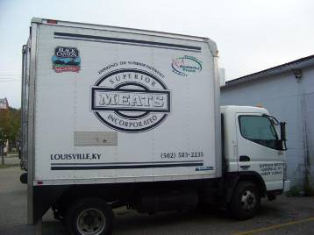
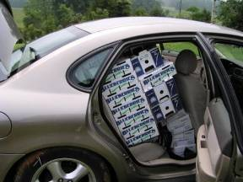
Delivery
Notes:
In the interest of time, I’m going to skip a few of our MarketReady checklists. I think you are starting to get the idea of how those modules work.
Let’s move on to delivery. It should come as no surprise to you that there more and less efficient ways to bring product to market. There are pros and cons to each. You Prius can’t move pallets onto loading docks, and your refrigerated box truck can’t get 55 miles to the gallon. However, depending on your scale, you may already have a vehicle which can, with some careful planning, get your products satisfactorily, whereas a refrigerated box truck may be out of your financial reach for a while. In that case, don’t let “perfect” get in the way of “good enough.”

Slide 23
Delivery
Be consistent
Try to find a specific time that work for both you and the buyer
Group deliveries together
Make a “delivery route” to maximize your efficiency of fuel and time.
Work cooperatively with other growers to transport product and reduce delivery costs
Notes:
When planning product deliveries, aim for consistency, so your customers can plan on you, and efficiency, so all your profit isn’t eaten up in marketing costs.
If you have several customers in one geographic area, start creating delivery routes with these deliveries grouped together in order to maximize the utility of your trip (maybe go do your grocery shopping, too). Check in with your customers on occasion to make sure the timing is still working well for them.
If you have several neighboring farmers who are servicing the same wholesale customers, it could benefit all of you to work cooperatively and combine deliveries, paying a reasonable delivery fee to the person who actually owns the delivery vehicle. Just make sure you branding and invoicing remain consistently high-quality with someone else delivering.

Slide 24
Invoicing and Records
“I want an 8 ½” x 11” piece of paper with the grower’s name, address, phone number, the product, how much it weighed and how much it cost. That’s it.”
--Jeff Newman, Executive Chef, Boone Tavern Inn, Berea, KY
Notes:
When you make a delivery, you need to provide an invoice. Period. There are not many restaurateurs or retailers who can keep in their head what they owe you even long enough to get back to their desk and write a check. They have a TON of things to think about, and being a small farmer, your delivery is probably not the biggest one they’re worried about today. As a matter of fact, many of them will not pay you right then and there. Some would prefer to send you a check, or simply to pay you upon the next delivery. Be aware of what your business can absorb in terms of accounts receivable, and come to an agreement on payment terms before you deliver the product to your customer.

Slide 25
Invoice Example
Farm Logo displayed prominently
Invoice date and number
Payment terms and due date specified
Space for customer contact information
Quantity, Product, Cost and Total
Your Farm’s complete contact information
Notes:
An invoice doesn’t have to be fancy, but it does have to tell what was delivered, the amount owed, and contact information for remitting payment. It is very easy to download serviceable, customizable invoice templates from the web, and most word processing software even include them.

Slide 26
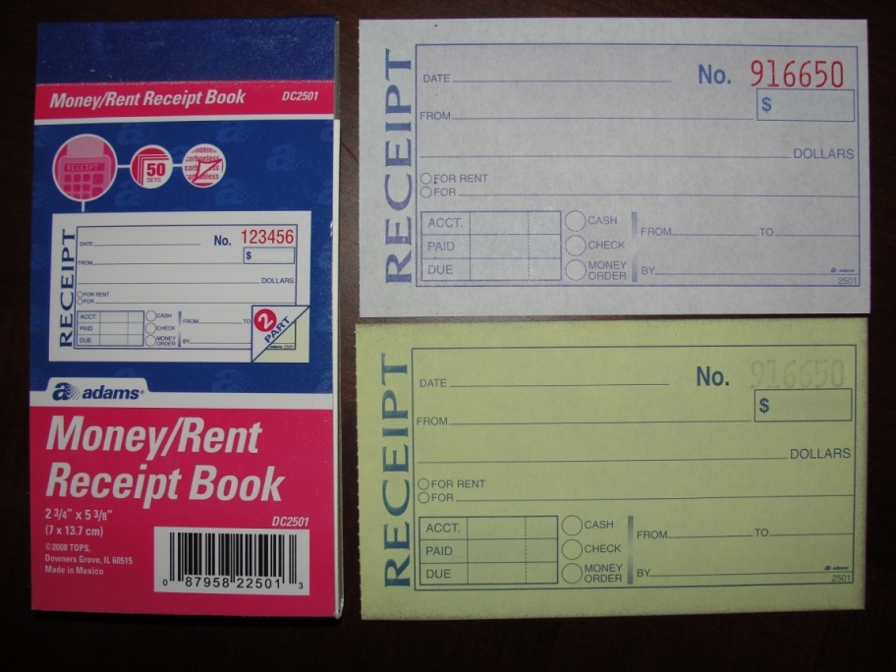
Invoicing and Records
Tracking Invoices
Save computerized documents in a word processing or other document file
Use an accounting software package to track all accounts
Use a simple invoice book with duplicate copies
“I keep it simple—just the little invoice book I bought at Walmart.”
--David Dedert, Quincy, IL
Sells pork directly to local country club
Notes:
But, since you’ve already heard me harp on record-keeping, it should not surprise you when I encourage you to use good accounting software to create and record your farm invoices. Quickbooks and Wave Accounting are pretty good, or you can move to something more farm-specific if it suits you better. Another big benefit of these programs is they also keep track of what you are owed, so you know whether you need to be collecting payment for the last delivery with this one.
Once again, however, don’t let perfect get in the way of good enough. If you and your customer are okay with little carbon copy receipt books, and you can both keep track of your accounts this way, good enough.

Slide 27
Basic Marketing Practices: Invoicing and Records
I will provide a numbered invoice form with farm name, address, phone number, and other contact information printed on it
The invoice form will have the date, P.O. number, product description, weight or quantity, price per unit and total price
I understand the invoicing procedures and have discussed them with the buyer. I have made sure that my invoice statement or system meets their requirements, including electronic delivery if required
Notes:
Here’s one last MarketReady checklist for you, just for good measure.
[read bullets]
You don’t want to get into the situation where your buyers are losing track of what they owe you and you end up providing de facto credit for their inventory. If you have not already, set up payment terms and stick by them. If your customers are not paying promptly and completely, they’re probably not the type of customer you want to keep.

Slide 28
Summary
Communicate early and often
Package for functionality and professionalism
Labels should communicate essential information and build your brand
When negotiating prices, know your costs and understand the buyer’s margins
Provide an invoice and keep a record for yourself
Notes:
This concludes our introduction to wholesale marketing in general and the MarketReady program in particular. For emphasis, here are a few of the messages we want you to take home from this presentation:
[read bullet] Communication is the foundation of your business relationship with wholesale buyers. They need to know what you’re growing this season, what you have available this week, and what time you’re showing up with it today. Don’t be a pest, but never let them feel out of the loop.
[read bullet] Know the industry standard for packaging and grading, but also know what works best for you and your customers locally, as long as it stands up to the rigors of marketing
[read bullet] You’ve put a lot of work into branding your farm and building your reputation for quality and professionalism, so make your label does your brand justice, while also providing the traceability you need to maintain food safety considerations.
[read bullet] Pricing is a hard game to master, but you’ll get more comfortable as you come to understand all the considerations built into a pay price. Don’t get too hung up on receiving farmers market prices if wholesalers can bring more to your bottom line by saving you time and increasing your sales volume.
[read bullet] Invoicing may seem like just another aspect of record-keeping, but this one is particularly important because it gets you paid! Come to agreement on payment terms, and consider a computerized way to keep track of it all.

Slide 29
To reach us
Contacts | Contact information
Nathan Johanning | njohann@illinois.edu
Andy Larson | andylars@illinois.edu
Rick Weinzierl | weinzier@illinois.edu
Notes:
That’s it from me! Thanks so much for your time and attention. Please feel free to drop us a line if you have additional questions about wholesale marketing of local foods, or if you are interested in attending a MarketReady program. Best of luck in your continued endeavors!

Slide 30
If you have questions …
University of Illinois Extension Local Food Systems and Small Farms team
http://web.extension.illinois.edu/smallfarm/
USDA’s Start2Farm site
http://www.start2farm.gov/
Notes:
Our beginning farmer training program ended in the fall of 2015. The best way to pursue answers to questions about fruit and vegetable production in Illinois is to contact educators on the University of Illinois Extension Local Food Systems and Small Farms team. Extension programs in other states are operated by the land-grant university in each state. Additionally, USDA’s Start2Farm site provides listings of farmer training programs in specific states and localities.

