Slide 1



Preparing a New Generation of Illinois Fruit and Vegetable Farmers a USDA NIFA Beginning Farmer and Rancher
Development Program Project
Grant # 2012-49400-19565 http://www.newillinoisfarmers.org
Notes:
The following presentation was part of a beginning farmer course, “Preparing a New Generation of Illinois Fruit and Vegetable Farmers,” offered by the University of Illinois and the Illinois Migrant Council from 2012 through 2015. This course was funded by the United States Department of Agriculture’s National Institute of Food and Agriculture, and specifically by the Beginning Farmer and Rancher Development Program. For more information about the program and for links to presentations and resources on many other topics, see the website newillinoisfarmers.org.

Slide 2
Growing a New Generation of Illinois Fruit and Vegetable Farmers learning to connect with commercial markets
Deborah Cavanaugh-Grant
February 16, 2013

Slide 3
Today’s Objectives
Familiarize yourself with MarketMaker and MarketReady
Understand the different markets available & begin to work on which is best suited for you
Know the business requirements for each different market type

Slide 4
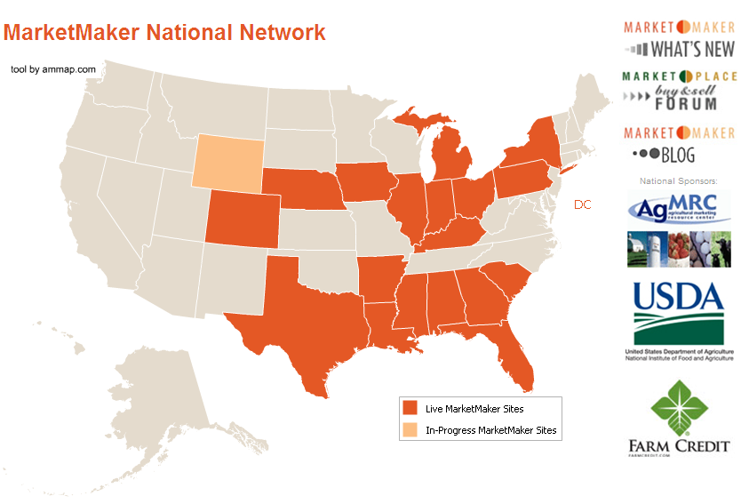

Slide 5
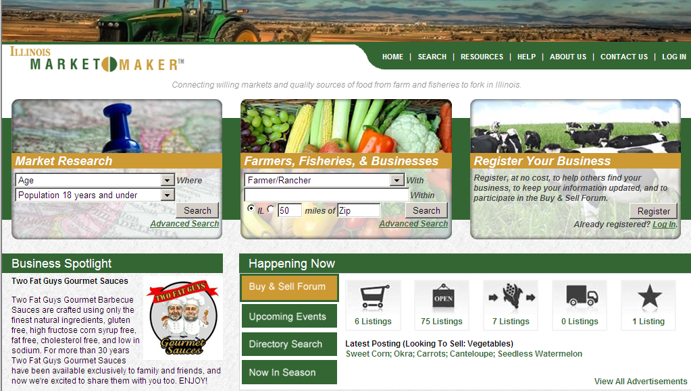

Slide 6

Special Thanks to Dr. Tim Woods from University of Kentucky for developing these materials through the MarketMaker partnership
http://www.uky.edu/fsic/marketready/

Slide 7
Why MarketReady?
To position specialty crop operations to fully capitalize on expanding local foods markets.
Meet requirements of commercial buyers
Emerging food safety standards
Meet the demands of a changing market

Slide 8
The Changing Wholesale Environment
Increasing demand for Local Foods
  The drivers are many
Traditional supply channels for commercial buyers not Local
  Buyers adapting to consumer demand, etc.
Resulting increased demand for Local Product at HIGH VOLUMES.

Slide 9
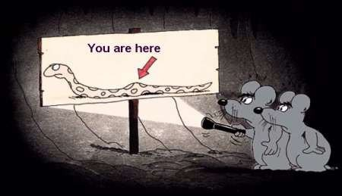
Keeping Things in Perspective

Slide 10
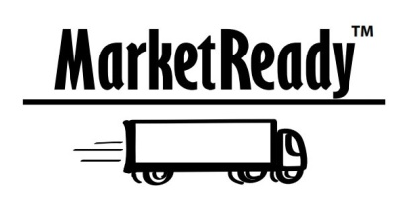
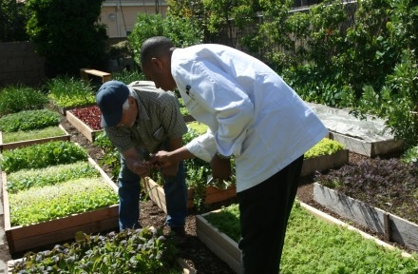
MarketReady Modules
Communication & Relationship Building
Packaging
Labeling
Pricing
Supply
Delivery
Storage
Invoicing
Insurance
Quality Assurance & Temperature Control
Certifications & Audits
Satisfaction Guarantee
Working Cooperatively
Marketing – An ongoing process
Local Products for Local Markets

Slide 11
Communication &
Relationship Building
Interview quotations about communication:
“Give us a phone call, (expletive)!”
“Keep me posted as to what’s happening. I need two weeks notice of any changes.”
“Communicate 2-3 times per week during produce season.”
“I need four days notice to re-supply elsewhere if farmers won’t have the product.”

Slide 12
Communication
The grower must take initiative to communicate with the restaurant
  “Successful growers create a line of communication between them and the chef.”
    David Rand, Chicago City Markets Farm Forager
Clear communication only enhances the farmer-chef relationship—critical to developing the restaurant market and positive changes to a farm’s products
Call ahead…months ahead!

Slide 13
Best Marketing Practices:
Communication & Relationship Building
I understand the importance of advanced notice to the buyer about my products availability and changes in quantity or quality
I have the buyers contact information such as their direct phone numbers, and email; I understand the best way to reach them
I understand wholesale food buyers have many demands on their time, therefore I make appointments in advance in order to meet with the buyer about my products

Slide 14
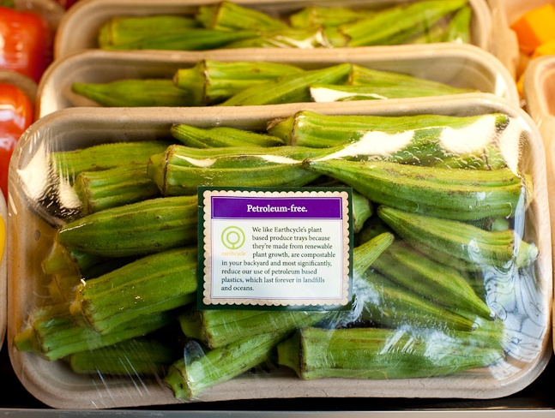
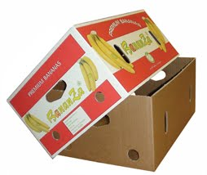
MarketReady Modules
Communication & Relationship Building
Packaging
Labeling
Pricing
Supply
Delivery
Invoicing
Insurance
Quality Assurance, Audits & Certifications
Satisfaction Guarantee
Marketing – An ongoing process
Local Products for Local Markets

Slide 15
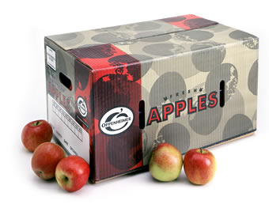
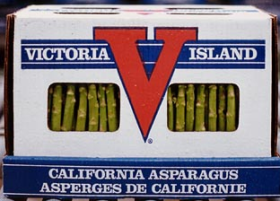
Packaging
Wholesalers and grocers look for “conventional” boxes
Sanitation and durability
Looking for traceability and function for packages down the road
Prefer ‘farm identification’ labels and packaging

Slide 16
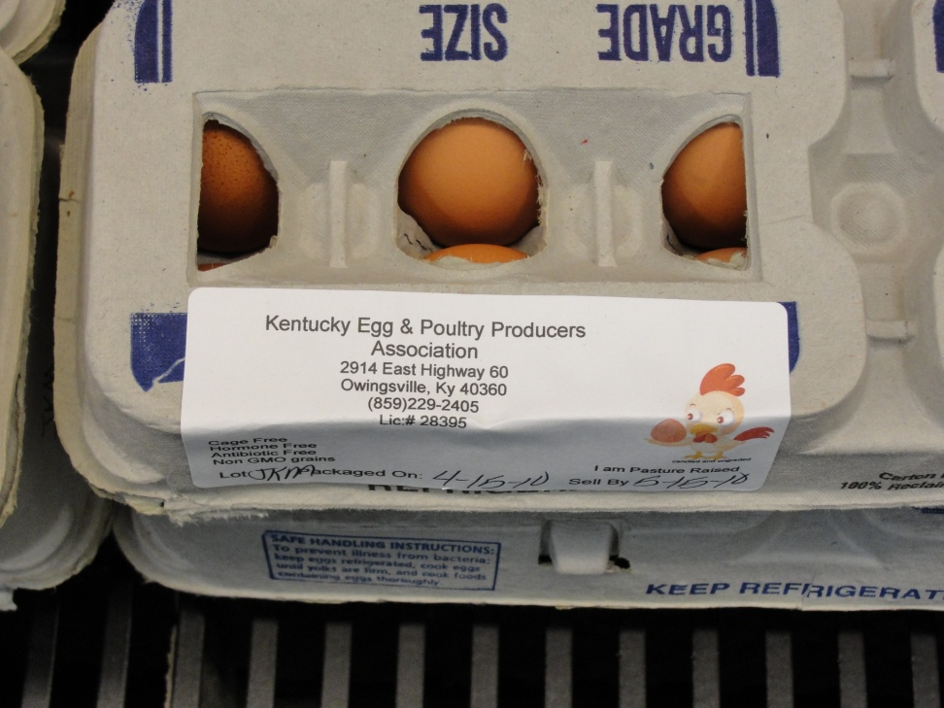
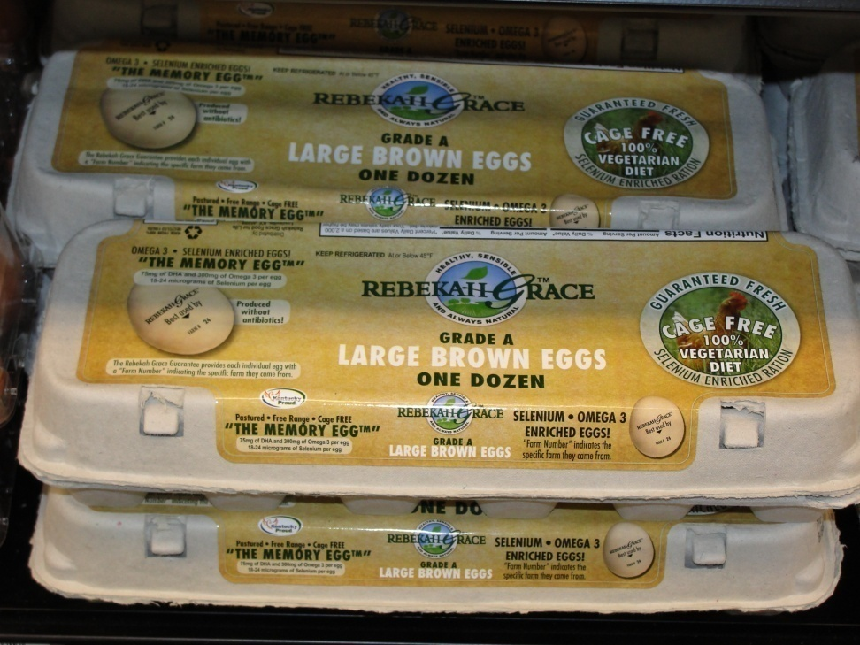
Packaging and Image

Slide 17
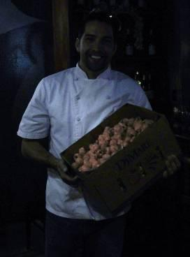
Packaging
It doesn’t matter so much to me if greens and specialties come in a plastic bag…We can deal with that if the quality and consistency is there.”
  Donnie Ferneau, Executive chef, Ferneau’s, Little Rock, AR

Slide 18
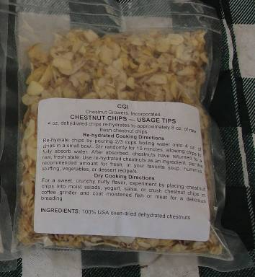
Packaging
“How to use” information may be helpful for specialty products
Labels add professionalism and may be used to indicate delivery date, place of production, and contact information
Use weather-proof materials

Slide 19

Best Marketing Practices: Packaging
I understand industry standard packaging and am prepared to deliver that kind of package
I asked the buyer how they want products packaged
I will package appropriately to protect integrity, temperature and contamination
I will package to allow storage on pallets, in racks

Slide 20
Best Marketing Practices: Packaging
I understand industry standard packaging and am prepared to deliver that kind of package
I asked the buyer how they want products packaged
I will package appropriately to protect integrity, temperature and contamination
I will package to allow storage on pallets, in racks

Slide 21



MarketReady Modules
Communication & Relationship Building
Packaging
Labeling
Pricing
Supply
Delivery
Invoicing
Insurance
Quality Assurance, Audits & Certifications
Satisfaction Guarantee
Marketing – An ongoing process
Local Products for Local Markets

Slide 22

Labeling
Be COOL
  Country of Origin Labeling is required
Do not over-label
PLU or UPC codes
  The Packer Merchandising Guide
Statement of product identity
Indicate appropriate certifications
Get Illinois Fresh labels!

Slide 23
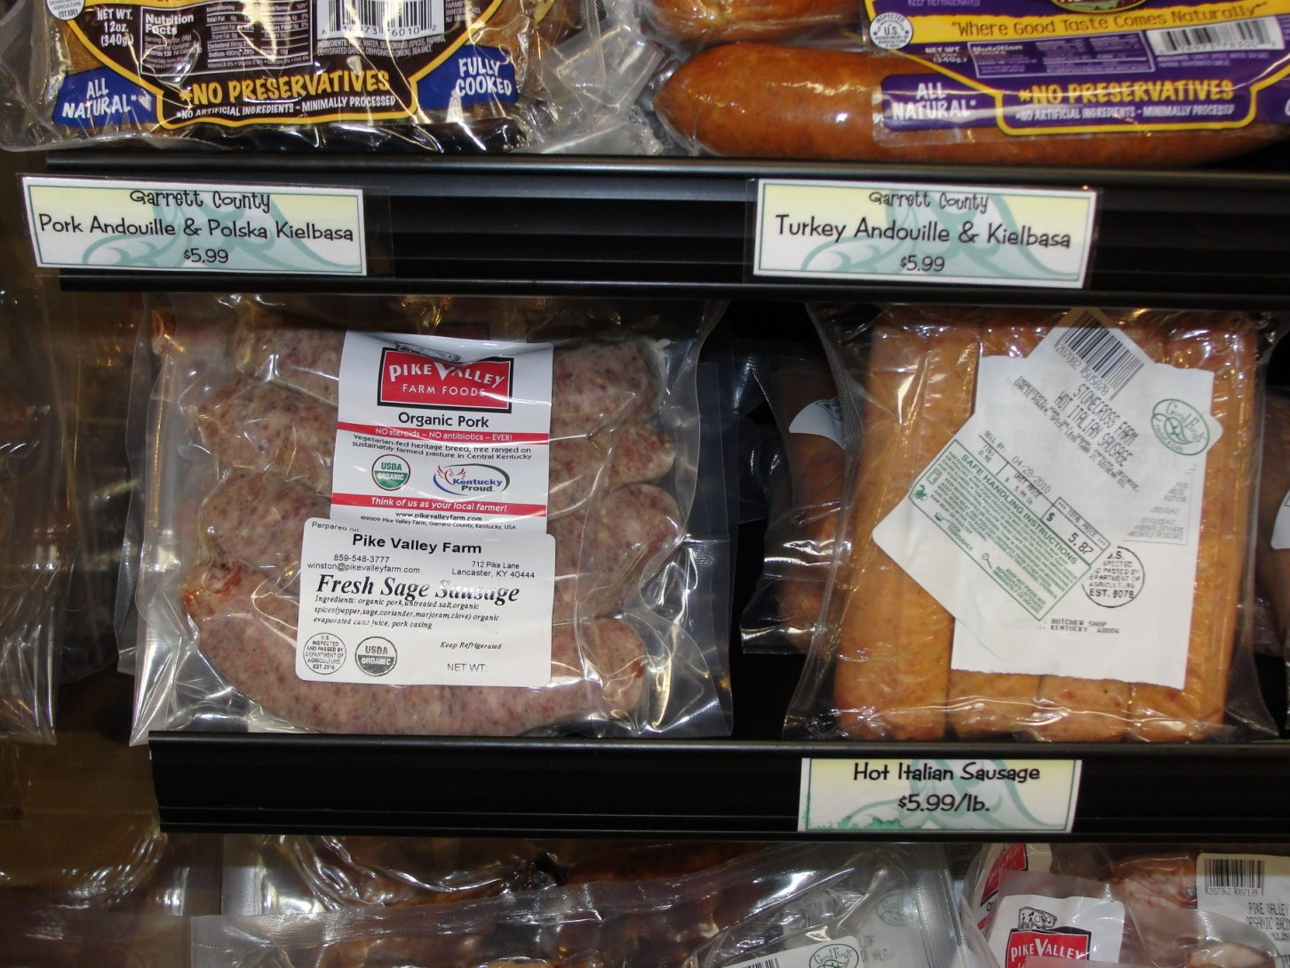

Slide 24
Labeling
Labels communicate a professional product
Labels should be weatherproof and not “get in the way” of the product
Labels should include:
  Farm name, logo, contact information
  Labels may also include
    Field source, harvest date, use information

Slide 25
Best Marketing Practices: Labeling
I understand that labeling can help build my farm’s identity and improve product presentation
I have access to water-resistant labels that link my product with my farm but do not get in the way of product handling
If selling meat, dairy, or processed products, I understand my legal regulations for labeling those products
I have explained to chefs the terms like “certified”, “sustainable”, and other phrases and what they mean when used on my labels or product packaging

Slide 26

MarketReady Modules
Communication & Relationship Building
Packaging
Labeling
Pricing
Supply
Delivery
Storage
Invoicing
Insurance
Quality Assurance & Temperature Control
Satisfaction Guarantee
Working Cooperatively
Marketing – An ongoing process
Local Products for Local Markets

Slide 27

Setting Prices
One of the most important skills you must acquire
Price must balance two objectives
  Establishing market share
  Earning an acceptable return

Slide 28
Key to Good Pricing is Good Information
You’ll never have all the market information you’d like to have, but be as well informed as possible. You should know:
  Break-even price at various given sales volumes
  What your competitors are offering
  Prevailing market prices
  Your product quality relative to others available on the market

Slide 29
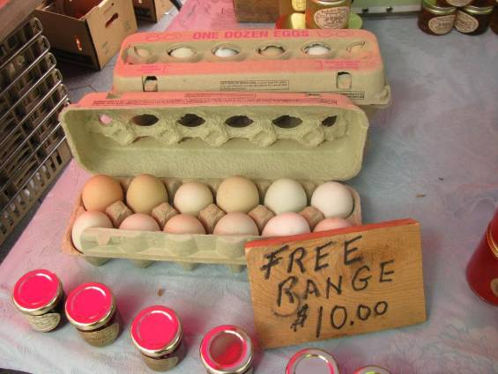
Retail versus Restaurant Pricing

Slide 30
Pricing
The major mistake producers make in pricing to restaurants is to assume retail prices will be competitive with farm markets
Restaurants are a wholesale market—some may pay farmers’ market prices
Most chefs will tell you what they’re looking at for non-local prices

Slide 31
Pricing
Account for the cost of getting your product to the restaurant
“We see what the product is selling for wholesale, figure in fuel costs and our time, and that’s what we stick with.”
--Brian Stout, Dowagiac MI, Green City Market, Chicago, IL

Slide 32
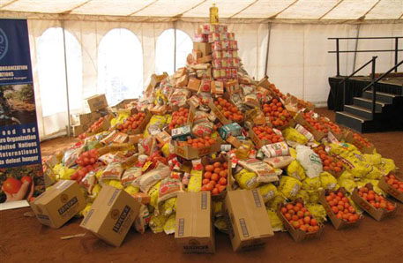
MarketReady Module
Communication & Relationship Building
Packaging
Labeling
Pricing
Supply
Delivery
Invoicing
Insurance
Quality Assurance, Audits & Certifications
Satisfaction Guarantee
Marketing – An ongoing process
Local Products for Local Markets

Slide 33
Supply
Are there minimum volumes needed to do business?
  There are small, medium, and large wholesalers and grocers dealing with a wide range of minimum volumes
  Pre-planning on volume and market season is highly desired
  Discuss target volumes for specific merchandising events

Slide 34
Supply
Take responsibility for the volume committed to supply
  Providing exceptional service in the case of crop failures or other challenges helps strengthen the farmer-wholesale buyer relationship
Regular updates about availability, quality and expected volumes
  Email is often the preferred method to reach out to busy wholesale buyers

Slide 35
Supply
Consistent volume/availability of product is often cited by chefs as a barrier to purchasing locally
  Providing exceptional service in the case of crop failures or other challenges helps strengthen the farmer-chef relationship
Producers should recognize different restaurant markets have different volume needs
  Chains
  Independents
  Caterers
  Institutions

Slide 36
The Changing Wholesale Environment
Increasing demand for Local Foods
  The drivers are many
Traditional supply channels for commercial buyers not Local
  Buyers adapting to consumer demand, etc.
Resulting increased demand for Local Product at HIGH VOLUMES.

Slide 37
Chef Expectations of Supply
Most restaurants are interested in purchasing locally, but have experienced challenges in product consistency or volume
Steady, clear communication regarding changes in product volume or quality are key to managing supply issues
“Volume is our biggest issue.”
“I’m used to being able to go online and select the products I want. If I can do that for local product…all the better.”

Slide 38
Best Marketing Practices: Supply
I have spoken with chef clients before my crop is in to talk about crop availability and their volume needs
I have explained what varieties or types of products I offer, and have invited chefs into conversations about new product possibilities before the season
I have a regular price and availability list available for restaurants
I have identified the best way to reach my chef customers directly
I am exploring season extension and other production options that allow me to increase volume of products supplied

Slide 39

MarketReady Module
Communication & Relationship Building
Packaging
Labeling
Pricing
Supply
Delivery
Invoicing
Insurance
Quality Assurance, Audits & Certifications
Satisfaction Guarantee
Marketing – An ongoing process
Local Products for Local Markets

Slide 40
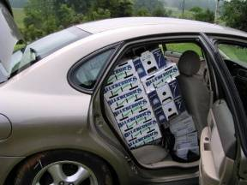
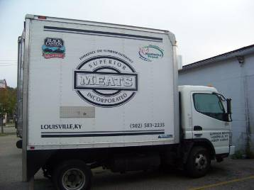
Delivery

Slide 41

MarketReady Module
Communication & Relationship Building
Packaging
Labeling
Pricing
Supply
Delivery
Invoicing
Insurance
Quality Assurance, Audits & Certifications
Satisfaction Guarantee
Marketing – An ongoing process
Local Products for Local Markets

Slide 42
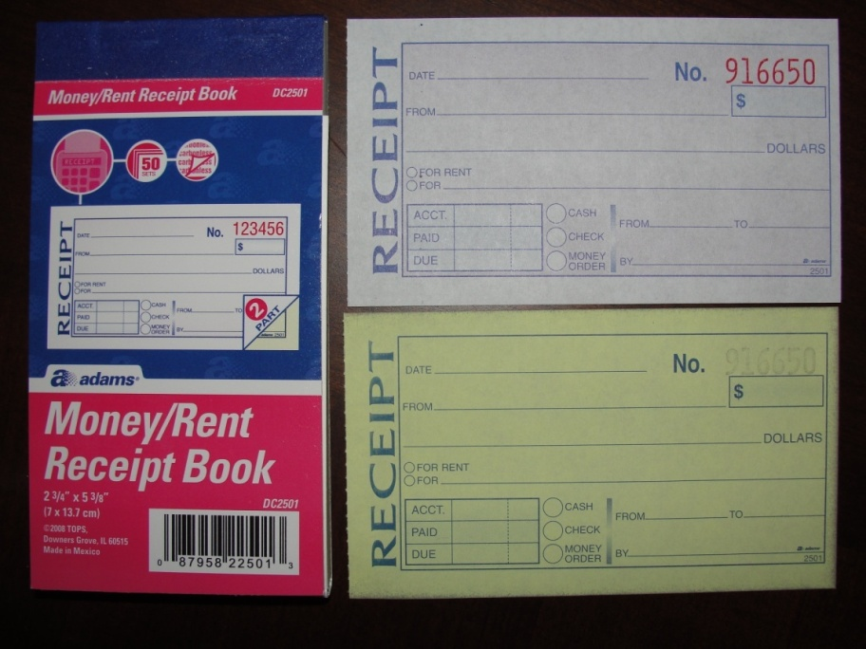
Invoices and Records
Tracking Invoices
Save computerized documents in a word processing or other document file
Use an accounting software package to track all accounts
Use a simple invoice book with duplicate copies
“I keep it simple—just the little invoice book I bought at Walmart.”
David Dedert, Quincy, IL
Sells pork directly to local country club

Slide 43
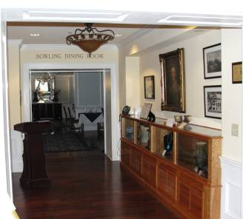
Invoicing
“I want an 8 ½” x 11” piece of paper with the grower’s name, address, phone number, the product, how much it weighed and how much it cost. That’s it.”
--Jeff Newman, Executive Chef, Boone Tavern Inn, Berea, KY

Slide 44
Invoicing and Records
“Inherently, you cannot trust chefs and restaurants to keep track of anything.”
  --Chef Will Gilson, Garden at the Cellar, Cambridge, Massachusetts
Keep duplicates of your invoices so you know how much has been purchased—and how much you are owed
Provide sales receipts for when you get paid

Slide 45
Invoice Example
Farm Logo displayed prominently
Invoice date and number
Space for customer contact information
Payment terms and due date specified
Quantity, Product, Cost and Total
Your Farm’s complete contact information

Slide 46
Bill of Lading

Slide 47
Basic Marketing Practices: Invoicing and Records
I will provide a numbered invoice form with farm name, address, phone number, and other contact information printed on it
The invoice form will have the date, P.O. number, product description, weight or quantity, price per unit and total price
I understand the invoicing procedures and have discussed them with the buyer. I have made sure that my invoice statement or system meets their requirements, including electronic delivery if required

Slide 48
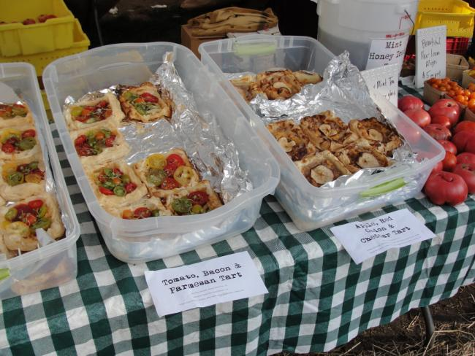
MarketReady Modules
Communication & Relationship Building
Packaging
Labeling
Pricing
Supply
Delivery
Invoicing
Insurance
Quality Assurance, Audits & Certifications
Satisfaction Guarantee
Marketing – An ongoing process
Local Products for Local Markets

Slide 49
Insurance
Smaller grocers and wholesalers tend to have minimal coverage requirements: mostly $1 million umbrella, some $2 million
Larger retailers can require as much as $5 million in coverage
Ask your insurance provider—communicate your business activities

Slide 50
Insurance
Product liability insurance is usually assumed or required in the producer/restaurant relationship
Insurance protects both the producer and the chef
Positive to mention to new clients
Annual premiums vary by region but are often under $500 per year (typically $250) for $1 million coverage
  Larger groups may require more coverage

Slide 51
Chef Expectations of Insurance
Interviewed chefs said they usually assume a producer has product liability insurance or trust the integrity of the local product
“We require our growers to carry $1 million in liability insurance. That costs the grower about $200 per year.”
“I do ask about insurance—but I’m a small restaurant, so it’s not as big a concern.”
“With fresh produce, I can inspect it for freshness and quality….but with meat and other products, I can’t trust myself to be sure.”

Slide 52
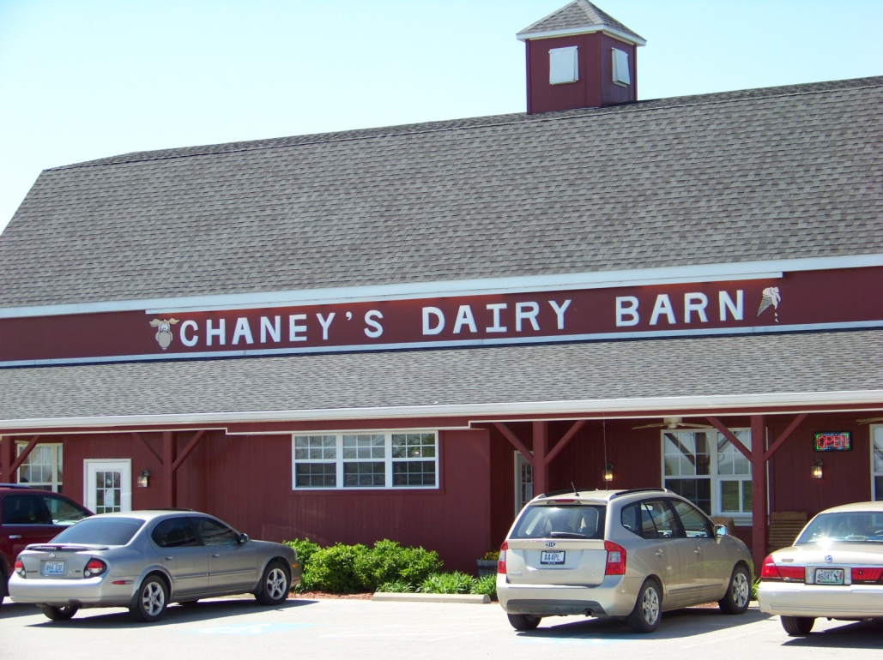
Insurance
“Insurance is simply a cost you have to have to sell to restaurants and other institutions.”
Carl Chaney, Bowling Green, KY
Sells ice cream served at Western Kentucky University, Mammoth Cave National Park, and the National Corvette Museum

Slide 53

MarketReady Modules
Communication & Relationship Building
Packaging
Labeling
Pricing
Supply
Delivery
Storage
Invoicing
Insurance
Quality Assurance & Temperature Control
Satisfaction Guarantee
Working Cooperatively
Marketing – An ongoing process
Local Products for Local Markets

Slide 54

Working Cooperatively
Smaller producers may not find it profitable to deliver to single clients
Restaurants may not be able to source enough product from a single grower
Cooperative delivery, both using informal and formal networks, can help solve this problem
Still check that your products are being delivered as promised

Slide 55


Working Cooperatively
“Having a farm that sells 20 dozen eggs a week doesn’t really help when you might have a thousand possible customers. Plus it’s not worth someone’s time to drive two hours to deliver 20 dozen eggs here to Little Rock. So we’ve set up groups around the state where there are five or six farms with 20 dozen eggs coming together so that we can go and pick up 120, 150 dozen eggs at one time and fill larger orders from chefs.”
-Chef Shane Henderson, Argenta Market & Catering, Little Rock, AR

Slide 56

MarketReady Modules
Communication & Relationship Building
Packaging
Labeling
Pricing
Supply
Delivery
Invoicing
Insurance
Quality Assurance, Audits & Certifications
Satisfaction Guarantee
Marketing – An ongoing process
Local Products for Local Markets

Slide 57
Working Cooperatively
“Having a farm that sells 20 dozen eggs a week doesn’t really help when you might have a thousand possible customers. Plus it’s not worth someone’s time to drive two hours to deliver 20 dozen eggs here to Little Rock. So we’ve set up groups around the state where there are five or six farms with 20 dozen eggs coming together so that we can go and pick up 120, 150 dozen eggs at one time and fill larger orders from chefs.”
-Chef Shane Henderson, Argenta Market & Catering, Little Rock, AR

Slide 58


MarketReady Module
Communication & Relationship Building
Packaging
Labeling
Pricing
Supply
Delivery
Storage
Invoicing
Insurance
Quality Assurance & Temperature Control
Satisfaction Guarantee
Working Cooperatively
Marketing – An ongoing process
Local Products for Local Markets

Slide 59
Get Listed!
http://www.marketmaker.uiuc.edu/
http://www.localharvest.org
http://www.agr.state.il.us/markets/mis/
http://www.ilstewards.org/content/3977
http://www.illinoisfarmdirect.org/
http://search.ams.usda.gov/farmersmarkets/
http://farmersmarketillinois.com/
http://agritourismworld.com/
http://www.orangepippin.com/orchards/united-states/illinois
http://eatlocalgrown.com/illinois
http://localdirt.com

Slide 60
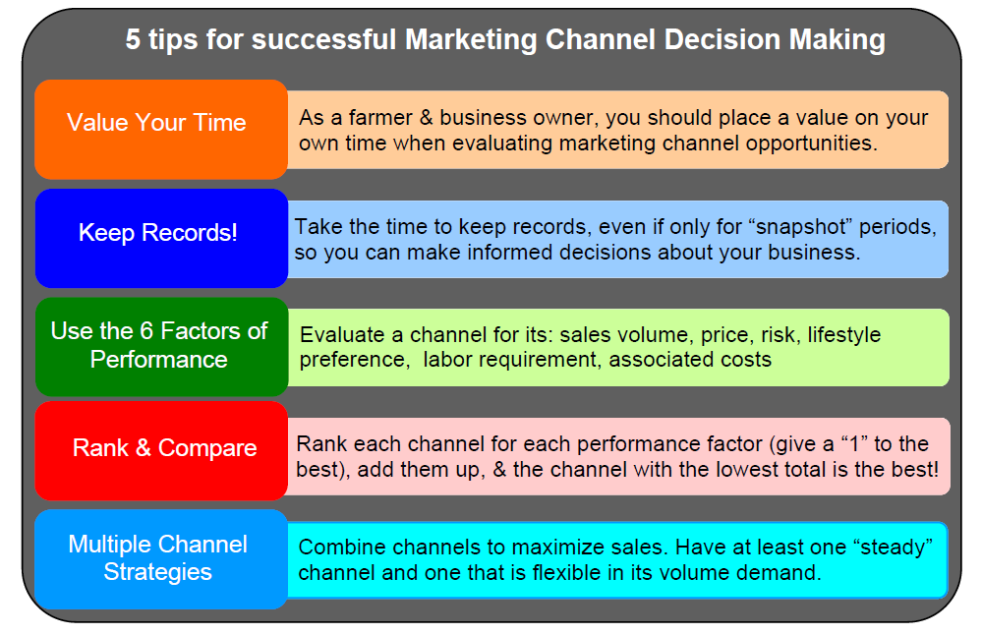
  From: http://files.campus.edublogs.org/blogs.cornell.edu/dist/0/2113/files/2012/04/Market-Channel-Assessment-132dr2l.pdf

Slide 61
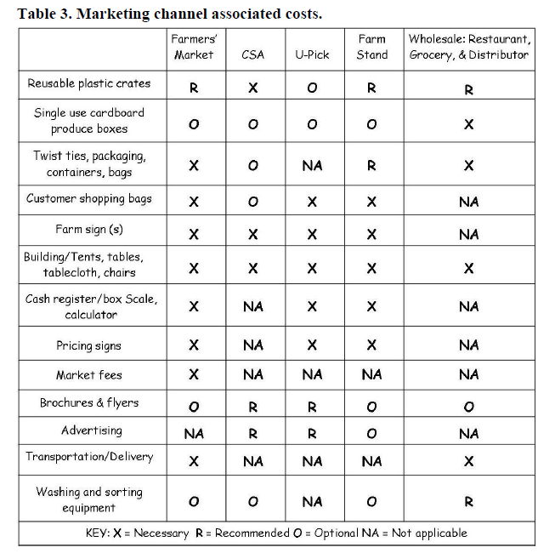

Slide 62
Summary
Effective communication is essential
Understand the best marketing practices that are necessary to sell to restaurants, groceries, wholesale and food service buyers
Its all about the relationship

Slide 63
Resources
Local Harvest: A Multifarm CSA Handbook
  http://www.sare.org/Learning-Center/Books/Local-Harvest
Marketing Strategies for Farmers and Ranchers
  http://www.sare.org/Learning-Center/Bulletins/National-SARE-Bulletins/Marketing-Strategies-for-Farmers-and-Ranchers
Guide to Marketing Channel Selection:
How to Sell Through Wholesale & Direct Marketing Channels
  http://files.campus.edublogs.org/blogs.cornell.edu/dist/0/2113/files/2012/04/Market-Channel-Assessment-132dr2l.pdf
Marketing Alternatives for Fresh Produce
  http://extension.oregonstate.edu/catalog/pdf/pnw/pnw241-e.pdf
Cultivating Success at Farmers Markets
  http://www.sarep.ucdavis.edu/sfs/dm/New%20Farmers%20Guide-v10%20-2.pdf

Slide 64
Resources
Collaborative Marketing for Small Farms
Selling and Working Together for Profitability
  http://smallfarms.cornell.edu/files/2012/05/Collaborative-Marketing-for-Small-Farms-10385vc.pdf
Tips for Selling to: Produce Distributors
  http://www.carolinafarmstewards.org/wp-content/uploads/2012/12/7-ATTRA-Tips-for-Selling-to-Distributors.pdf
Tips for Selling to: Restaurants
  http://www.carolinafarmstewards.org/wp-content/uploads/2012/12/5-ATTRA-Tips-for-Selling-to-Restaurants.pdf
Selling Directly to Wholesale Buyers
  http://directmarketing.osu.edu/content/MarketReadyMaterials/MarketReadyWholesaleOPGMA2012.pdf

Slide 65
Resources
ATTRA's Master Publication List
  https://attra.ncat.org/publication.html
USDA-AMS Market News Reports
  www.ams.usda.gov
Organic Price Report
  http://rodaleinstitute.org/farm/online-tools/organic-price-report/
Pricing for Profit
  www.extension.iastate.edu/agdm/wholefarm/pdf/c1-55.pdf

Slide 66
To reach us
Contacts | Contact information
Deborah Cavanaugh-Grant | cvnghgrn@illinois.edu 217-782-4617
Rick Weinzierl | weinzier@illinois.edu 217-244-2126

Slide 67
If you have questions …
University of Illinois Extension Local Food Systems and Small Farms team
  http://web.extension.illinois.edu/smallfarm/
USDA’s Start2Farm site
  http://www.start2farm.gov/
Notes:
Our beginning farmer training program ended in the fall of 2015. The best way to pursue answers to questions about fruit and vegetable production in Illinois is to contact educators on the University of Illinois Extension Local Food Systems and Small Farms team. Extension programs in other states are operated by the land-grant university in each state. Additionally, USDA’s Start2Farm site provides listings of farmer training programs in specific states and localities.

