Slide 1
Preparing a New Generation of Illinois Fruit and Vegetable Farmers a USDA NIFA Beginning Farmer and Rancher Development Program Project Grant # 2012-49400-19565 http://www.newillinoisfarmers.org
Notes:
The following presentation was part of a beginning farmer course, “Preparing a New Generation of Illinois Fruit and Vegetable Farmers,” offered by the University of Illinois and the Illinois Migrant Council from 2012 through 2015. This course was funded by the United States Department of Agriculture’s National Institute of Food and Agriculture, and specifically by the Beginning Farmer and Rancher Development Program. For more information about the program and for links to presentations and resources on many other topics, see the website newillinoisfarmers.org.

Slide 2
Growing a New Generation of Illinois Fruit and Vegetable Farmers Developing a Strategy for Starting a Small Farm Enterprise
Bill Davison
December , 2014
Notes:
You need to develop a strategy or plan before you start to farm. This presentation will show you how to begin that process.

Slide 3
Today’s Objectives
Demonstrate the importance of understanding
your values and goals
Understand the value of business planning and
what it involves
Provide you with a framework for starting your
own business plan
Be aware of resources that provide business
planning information and support
Encourage you to begin planning your farm business
Notes:
The main goal of this presentation is to demonstrate the importance of business planning and to provide you with a framework for starting your own plan.

Slide 4
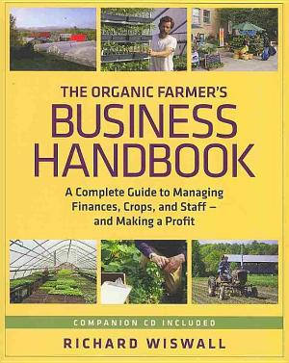
Planning is the easiest and least risky way to make your small farm successful and profitable.
Ron Macher, Making Your Small Farm Profitable
Notes:
New farmers often struggle with how to start a business plan. One way to start is to determine the quality of life that you want.

Slide 5
Plan for Profit
Profit =Income-Expenses
The Organic Farmer’s Business Handbook, Richard Wiswall
Notes:
This is the key take home message! Decide how much income you need your farm to generate and then plan how to achieve that income. It likely will take years to get there, make a long range plan from year one to year 5 and work towards your goal. The Rite in the Rain field notebook is a key component of good record keeping. A 3-ring binder that collects and organizes all the information is another simple yet important tool that allows you to see what is actually happening on your farm. You cannot remember everything that happens! You must write it down.

Slide 6
Quality of Life
Owning and operating a farm offers a unique quality of life, some aspects of which may not be obvious during the early planning stages.
Notes:
Everyone involved in the farm must agree on what quality of life they want.

Slide 7
Quality of Life Questions to Consider
Do you like to mix your personal life and work life or keep them separate? Why?
How valuable is having leisure time with friends and family?
How much do you like working with others, including employees, family members, and business partners? Would you rather work by yourself?
Notes:
Be honest with yourself when determining what is important for your quality of life.

Slide 8
Quality of Life Questions to Consider
What does the phrase "financial security" mean to you?
What are your family members’ goals and interests? How do they align with yours?
What other demands are made on your time? Consider family, health, hobbies, and other time commitments.
Would you prefer to have family members perform all farm labor, or are you interested in hiring outside help?
Notes:
It is important for everyone involved with the farm to agree or at least fully understand the economics of farming and the demands farming will make on your time.

Slide 9
What do you need and want?
Your answer to this question is your
personal goal statement and begins
with
I wish…
I want…
See The Organic Farmer’s Business Handbook pages
7-11 for a personal values worksheet.
Notes:
This provides the guiding principles for your life and helps keep the big picture in focus.
Needs are different from wants. You need a certain amount of profit.

Slide 10
Reasons Why Business Plans are Important
To identify profit centers
To determine how you can be more efficient
To attract key people- whether employees or members of your management team
To help verify financial feasibility
To obtain bank financing
Notes:
Developing a business plan helps you determine where you are making money and where you are losing money. Knowing that helps you focus on profitable crops and stop growing less profitable crops.

Slide 11
A farmer’s perspective…
“Business planning is a critical component to any operation. Even though a ‘seat-of-the-pants’ approach to farming might work… you can waste years doing the wrong thing when you could have been doing the right thing.”
Greg Reynolds, Riverbend Farm
Notes:
You can farm for years thinking you are doing the best you can, but without a detailed business plan you have no way of knowing what the best approach is.

Slide 12
Business Planning is a Process
Identifying Values
Reviewing Current Situation
Clarify Vision and Goals
Evaluate Strategies/Ideas
Implement and Monitor
Notes:
Business planning is a tool that you can use to continually evaluate your farm.

Slide 13
Additional Questions to Ask Before Writing the Business Plan
What skills and experience do I bring to the business?
How will my farm’s business records be maintained?
What insurance coverage will be needed?
What equipment or supplies will I need?
Notes:
Every farm needs a skilled person to manage production, marketing, and employees. It does not have to be one person, but you do need a person to cover all of these aspects of running your business.

Slide 14
Used Equipment = Lower Expenses
Notes:
This used hay rake cost $400. It works well for managing small hayfields 3-4 times a year.

Slide 15
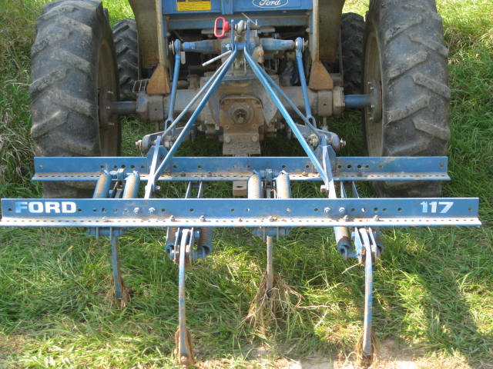
Used chisel plow cut down
to fit 3 foot wide beds.
Notes:
Buying used equipment helps keep your expenses low. A lot of used equipment will be from large scale farms. A little modification can convert a large implement into a small one suitable for use on market farms.

Slide 16
Basket Weeder
Notes:
Basket weeders are hard to find used and cost around $3,000 new, but they are a unique and efficient way to cultivate vegetables. This picture shows a basket weeder belly mounted on a cultivating tractor. That is an ideal set up, because it lets you see the cultivator in action and allows you to get as close as possible to the crop.

Slide 17
Some Business Plan Do’s and Don’ts
Keep the business plan as short as possible without compromising the integrity and content.
Don’t over diversify the venture- creates too many potential complications.
Describe things in terminology that’s understood by someone unfamiliar with the business.
Notes:
Start with the basics and build your plan over time. It can be easy to get overwhelmed with all the details.

Slide 18
Some Business Plan Do’s and Don’ts
Estimate potential sales carefully- can you produce what you need to keep the cash flow coming in.
Substantiate any statements/statistics you are using.
Involve management team in the preparation of the business plan
Share the business plan with others to review to catch mistakes and things that aren’t clear.
Notes:
People often underestimate their expenses. Some farmers expenses end up being twice what they estimated. The Miscellaneous category is often much larger than anticipated.

Slide 19
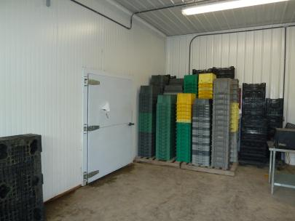
You Must be Efficient to Succeed
Strive for efficiency in every aspect of your operation.
Notes:
A powerful pressure washer makes cleaning crates and other equipment much easier and quicker. A large up front investment can pay for itself quickly with labor savings.
Never underestimate the cumulative impact of small improvements in a variety of practices on your farm. They add up to real improvements.
Harvesting spinach with two hands rather than a knife is one example that helped my crew pick more spinach in less time.
Planning ahead, giving clear instructions to your employees, keeping tools in the optimum location, designing your pack shed for efficient movement of your produce are all examples of ways you can improve efficiency.

Slide 20
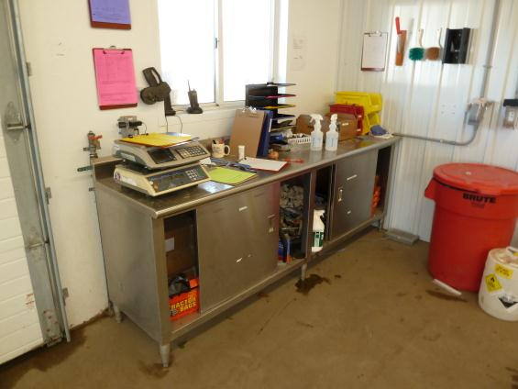
Farm Smarter, Not Harder
“Farming is 80% mental and 20% physical.”
Joel Salatin
Notes:
Color coded clip boards with the days plan of work written up and discussed with all employees at the beginning of the day. A well organized stainless steel workspace in the packing shed helps facilitate an efficient washing and packing operation.
Learn how to make nature work for you by using sunlight, cover crops, compost, beneficial insects, etc. Search for elegant solutions that build resilience into your systems.

Slide 21
What Limits Your Farm?
Production techniques rarely limit a farm’s success; rather it is the lack of dependable profitable returns.
John Peterson, Angelic Organics, Caledonia, IL
The Organic Farmer’s Business Handbook, Richard Wiswall
Notes:
Finding a diversity of marketing outlets that allow you to sell a sufficient volume of produce at reasonable prices is the key to success. The ideal is to have a mix of retail and wholesale channels for you product.

Slide 22
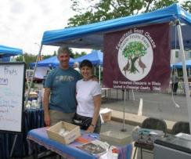
Farm for Profit, not Production
To achieve a net income of $60,000 from a diversified vegetable farm you need to have a gross income of $171,000. With an average gross income of $12,000 per acre that means you need to cultivate 14 acres of vegetables.
Notes:
Gross income per acre varies from $2,000 to $25,000 depending on what you grow, how efficiently you manage your farm and what your marketing outlets are. An average figure of $12,000 per acre for gross income is a reasonable place to start for the purposes of planning. Once you generate your own numbers then you can work with them.
Net income is typically 30-40% of gross.

Slide 23
Marketing Chart
 | Farmers’ Market | Food Co-op | Restaurant | CSA | Other | Total
Beets | 8 weeks x 25lb=200lb=$400 | 12x50lb=600lb=$600 | 0 | 4 wks x 50lb=200lb=$400 | 8 wks x 25lb=200lb=$200 | 1,200lb $1,600
Lettuce | 10 wks x 60heads=600hds=$1,200 | 10 wksx120hds= 1,200hds=$1,200 | 10wksx120hds=1,200=$1,200 | 16wksx50hds=800hds=$1,600 | 10wksx120hds= 1,200hds=$1,200 | 5,000hds $6,400
Total | $1,600 | $1,800 | $1,200 | $2,000 | $1,400 | $8,000
Richard Wiswall. The Organic Farmers Business Handbook
Notes:
This simple chart can be written down on paper or typed into a spreadsheet. Two crops are listed to show examples of volume and pricing. Most farms will have a list of 10-30 different crops included in this chart. The other column represents unplanned outlets like special events, weddings, etc.

Slide 24
Production Plan
Crop | Yield/350ft bed | # of Beds Needed | Proj. Gross Sales | Seeds Needed | Planting Dates | Notes
Beets 1,200lb | 600lb | 2 beds 1 early, 1 late | $1,600 | 16,000 Red Ace 16,000 gold | 5/1 6/1 | 15 seeds/ft
Lettuce 5,000 heads | 830 heads marketable 3 rows x 12” 80% pick | 6 beds 8 plantings 0.75 bed/planting | $6,400 | 2,400 Two Star 1,200 vulcan 2,400 Ermosa | 5/1, 5/15, 6/1,6/15, 7/1,7/15, 8/1,8/15 | 750 plants needed per planting to sell 625 heads
Richard Wiswall. The Organic Farmers Business Handbook
Notes:
This simple production plan helps you organize your crops and efficiently plan out how much of each crop you will grow.

Slide 25
Simple Crop Budgets
Crop budgets record production costs and income derived from each crop. Once completed for each crop, you can determine their relative profitability. This Index of Profitability is an important tool for increasing farm profits.
See page 28 in The Organic Farmer’s Business Handbook for an example of a crop budget
Notes:
Crop budgets allow you to general the all important index of profitability for you farm.

Slide 26
Index of Profitability Richard Wiswall’s Top Ten
Crop | Net Profit Per Acre
Parsley | 47,425
Basil | 35,603
Kale | 24,630
Tomatoes | 18,724
Cilantro | 16,561
Dill | 16,232
Bell Pepper | 15,556
Carrots | 14,046
Parsnips | 13,844
Celeriac | 13,659
Notes:
This slide could also be titled I love herbs and this is why you should too! One thing most of these crops have in common is that they can be mulched and bear over a long season allowing for multiple harvests. This keeps labor costs down and contributes to a higher net profit. The majority of these crops were sold to wholesale markets. His wholesale price for parsley was $.83 cents per bunch. Do not discount the profitability of wholesale accounts!

Slide 27
Doom and Gloom Perspective
The Department of Commerce statistics show that every year over 1 million people in this country start a business of some sort and by the end of the first year at least 40% won’t make it…. Within five years of starting, 80% will have failed- and if you think you are out of the woods after the first five years, think again. Eighty percent of the 20% that made it the first five years will be out of business in the second five years. These are not very hopeful statistics.”
From The E-Myth Revisited by Michael Gerber
Notes:
These statistics highlight why you must be efficient and focus on profitability.

Slide 28
Most Successful Farmers Have These Traits in Common
Passion this is essential, you need to be passionate. (The Latin root of passion is passio- meaning “to suffer”)
Employee management skills
Marketing skills
Production skills
The Sirolli Institute maintains that entrepreneurship has two primary components: Passion and Skill http://www.sirolli.com
Notes:
The Sirolli Institute maintains that entrepreneurship has two primary components: passion and skill. Passion is the “fire in the belly,” that all-consuming dedication essential to the pursuit of any worthwhile activity. Passion, however, is not enough. Without the necessary knowledge and ability to paint, write, sail, inspire social change or run a successful business, passion is only wishful thinking and the mother of all frustrations.
Skill is what makes the dream real and transforms passion into good work.
However, it is impossible for one individual to run a business successfully. Business success requires equal amounts of skill and passion in the areas of production, marketing and finance. Because no one is equally passionate about these three main aspects of running a business, the Sirolli Institute counsels a team approach to business development.

Slide 29
Summary
Starting a small business can be risky, but appropriate planning can reduce the risks.
Remember, your farm enterprise is a small business.
You are an entrepreneur- the visionary looking beyond the day-to-day details of product.
Remember to work ON your business as well as IN your business.
Notes:
Investing time and energy in planning can reduce the risks involved in farming and is a very safe and inexpensive way to increase your chances of succeeding.

Slide 30
Resources
Building a Sustainable Business: A Guide to Developing a Business Plan for Farms and Rural
Business Planning Train-the-Trainer materials on the Center for Farm Financial Management website
The E Myth, Why Most Small Businesses Don’t Work and What to Do About It, Michael E. Gerber
Fearless Farm Finances
Making Your Small Farm Profitable, Ron Macher

Slide 31
Resources
The Organic Farmer’s Business Handbook: A Complete Guide to Managing Finances, Crops, and Staff and Making a Profit, Richard Wiswall
The Sirolli Institute’s “Capturing the Passion and Teaching Skills to a New Generation of Entrepreneurs”
Starting and Running Your Own Small Farm Business, Sarah Beth Aubrey
SWOT Analysis A Tool for Making Better Business Decisions

Slide 32
To reach us
Contacts | Contact information
Bill Davison | wdavison@illinois.edu 309-663-8306
Rick Weinzierl | weinzier@illinois.edu 217-244-2126
Deborah Cavanaugh-Grant | cvnghgrn@illinois.edu 217- 782-4617

Slide 33
If you have questions …
University of Illinois Extension Local Food Systems and Small Farms team
http://web.extension.illinois.edu/smallfarm/
USDA’s Start2Farm site
http://www.start2farm.gov/
Notes:
Our beginning farmer training program ended in the fall of 2015. The best way to pursue answers to questions about fruit and vegetable production in Illinois is to contact educators on the University of Illinois Extension Local Food Systems and Small Farms team. Extension programs in other states are operated by the land-grant university in each state. Additionally, USDA’s Start2Farm site provides listings of farmer training programs in specific states and localities.

